Slide 1
Brain Tumor Detection From 2D MRI Images
Using Machine Learning and Convoluted Neural Network
Group: 8 Imtiaz Ahmed – 1706062 Tamim Ahmed – 1706063 Sadat Tahmeed – 1706064 Md. Mahadi Hasan - 1706065
EEE 312: DSP Laboratory I

Slide 2
Contents
Motivation
Some images of main dataset
Our Approach
Image Preprocessing
Machine Learning Pipeline
Image Augmentation
CNN architecture
Transfer learning
Results
Error in image preprocessing
Challenges faced
conclusion

Slide 3
Motivation

Slide 4
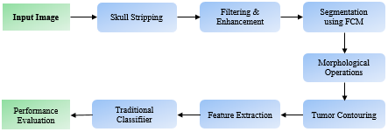
Proposed Method 1: Machine Learning
Image Preprocessing and Traditional Classifier

Slide 5
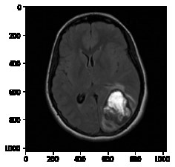
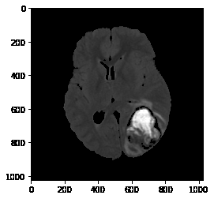
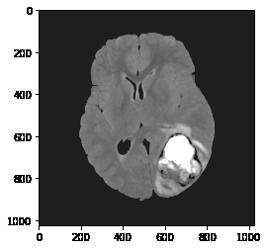
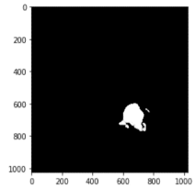
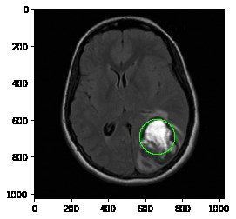
Proposed Method 1: Image Pre-processing
1
Skull Stripping
Thresholding
Connected Component Analysis
2
Input Image Skull Stripping Filtering and Enhancement
Filtering and Enhancement
1
3
Segmentation Using K-means clustering
Tumor contouring
4
Segmentation Contouring

Slide 6
Proposed Method 1: Classification and Evaluation
1
Feature Extraction
Texture-based features: Dissimilarity, Homogeneity, Energy, Correlation, ASM, Entropy
statistical features: Mean, Variance, Standard Deviation, Centroid, Kurtosis, Skewness
2
Traditional Classifiers
Naive Bayes, K-Nearest Neighbour, Support Vector Machine, Multilayer Perceptron, Ensemble trees (Random Forest), Logistic regression
1
3
Evaluation stage
80.39%

Slide 7
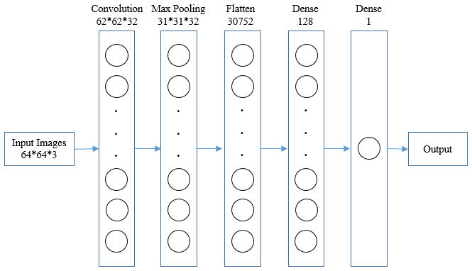
Proposed Method 2: Deep Learning
1
Baseline Model using 5-Layer Convoluted Neural Network (CNN)
Convolutional
Max Pooling
Flatten
Dense (2)
Achieved Accuracy – 94.1%
1

Slide 8
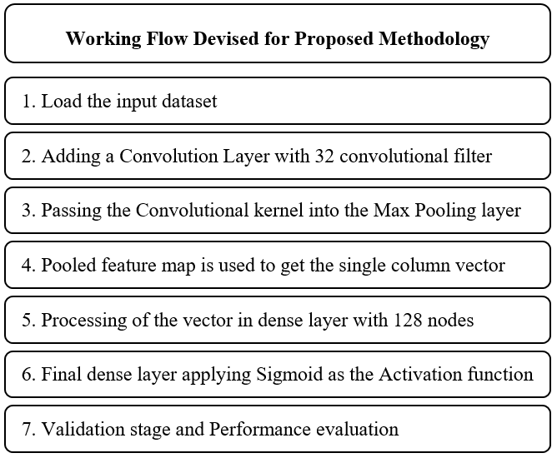
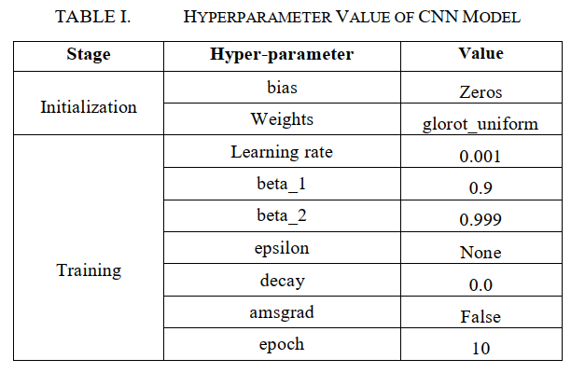
Proposed Method 2: Deep Learning
1
Baseline Model using 5-Layer Convoluted Neural Network (CNN)
1

Slide 9
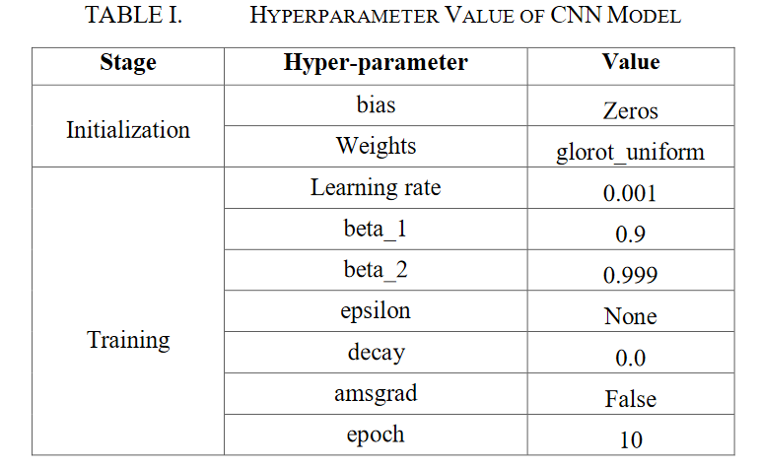
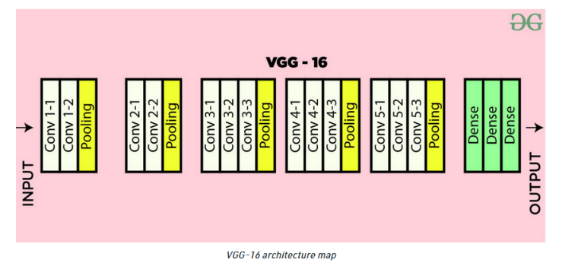
Proposed Method 2: Deep Learning
2
Transfer Learning
Preprocessing layer that scaled the pixel values according to VGG 16 requirement and also used 224*224*3 images as standard values
Achieved Accuracy – 94.12%
1

Slide 10
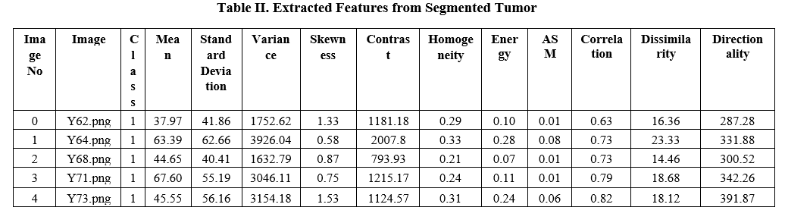
Experimental Results: Machine Learning
1

Slide 11
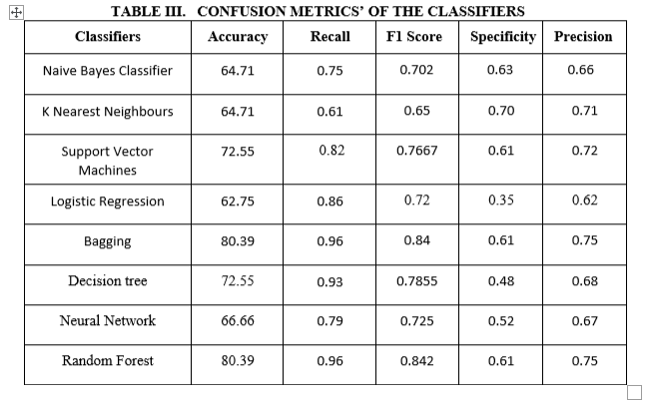
Experimental Results: Machine Learning
1

Slide 12
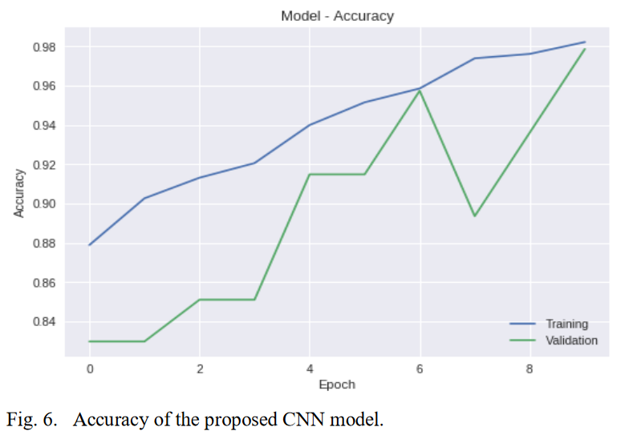
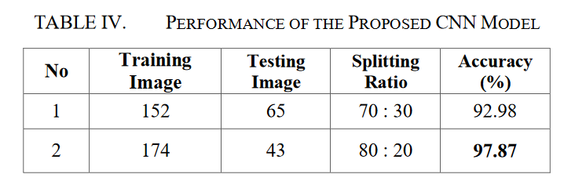
Experimental Results: CNN Model
1

Slide 13
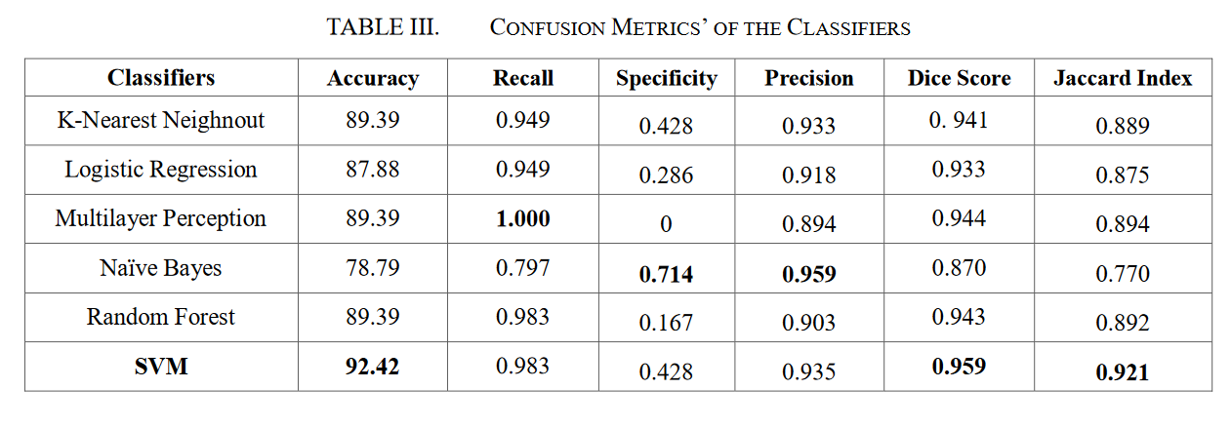
Experimental Results: Transfer Learning
1

Slide 14
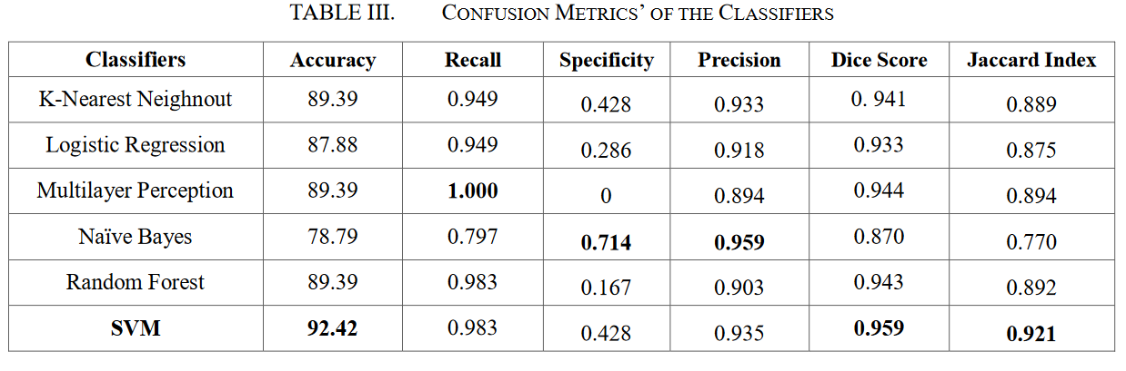
Experimental Results: Model Comparison
1

Slide 16
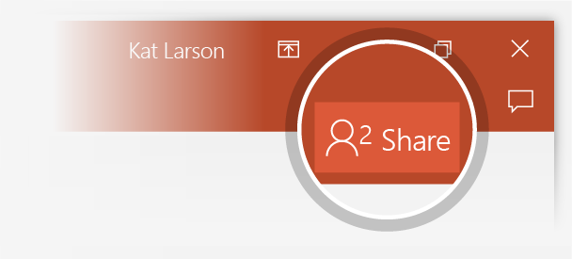
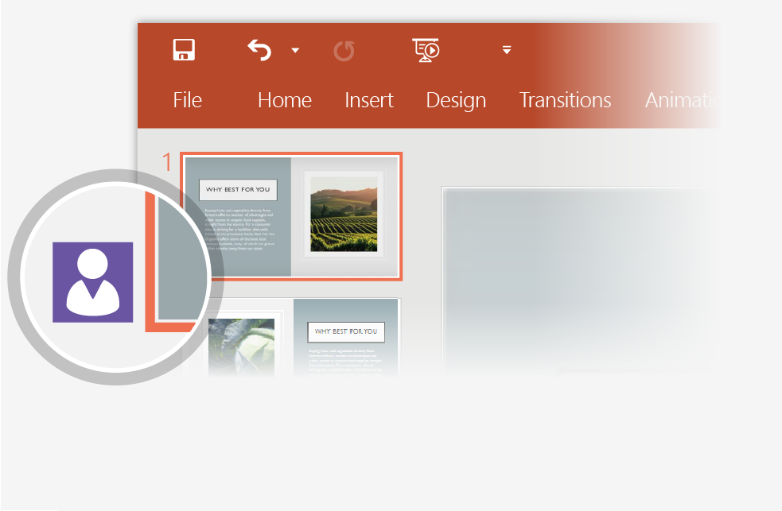
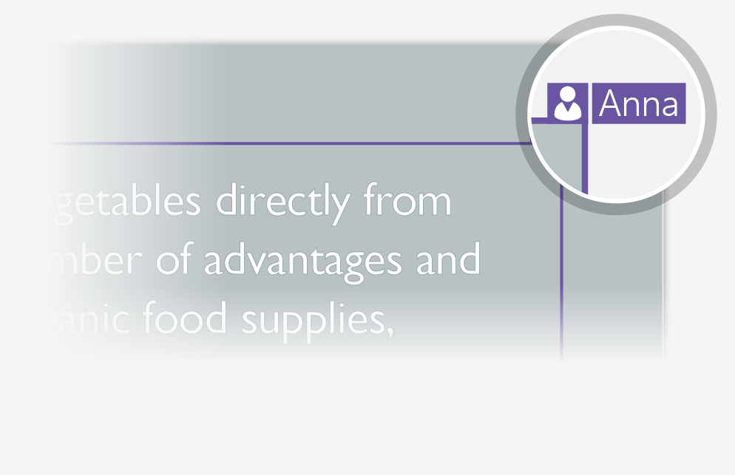
Working together in real time
When you share your presentation with others, you’ll see them working with you at the same time. How it works:
1
Select Share from above the ribbon, or by using short-key Alt-ZS, to invite people to work with you (You can save to the cloud at this point.)
2
When other people are in the presentation, a marker shows who is on which slide…
3
…and the part of the slide they're editing.

Slide 17
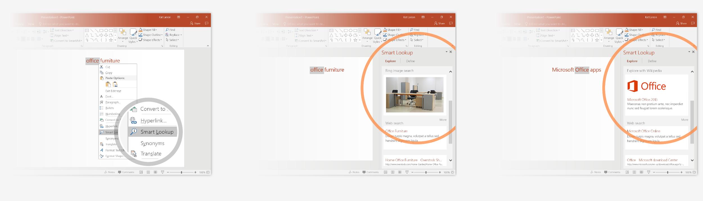
Explore without leaving your slides
Smart Lookup brings research directly in to PowerPoint. Try it:
1
Right-click in the word office in the following phrase: office furniture
2
Choose Smart Lookup, and notice that results are contextual for that phrase, not Microsoft Office apps.
3
Just for fun, try Smart Lookup again by right-clicking in the word Office in Step 2.

Slide 18
Thank You!

