Slide 1
Enable Cuda
Tamim Adnan

Slide 2
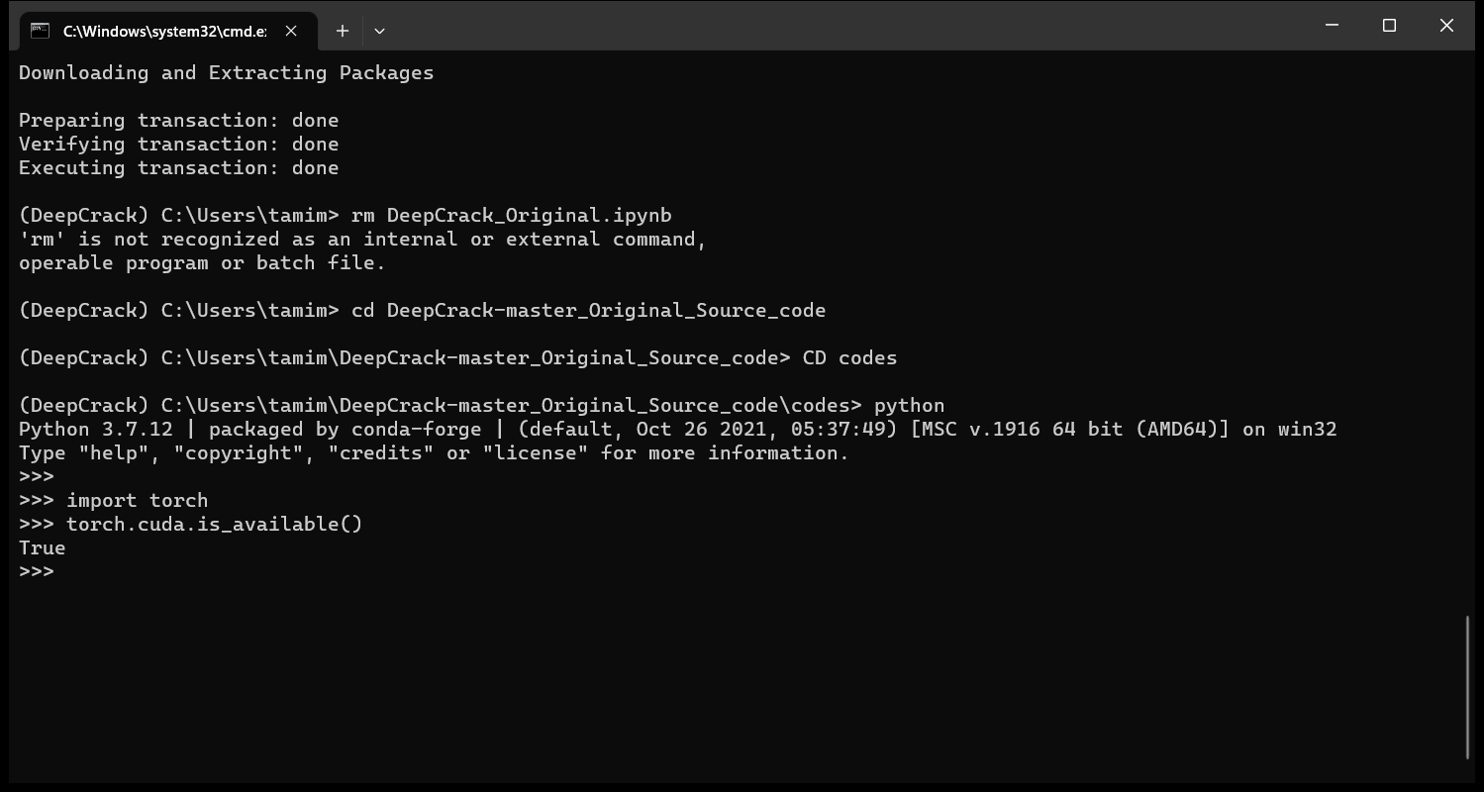
Complete Commands to enable cuda in local machine
Install the code for your local environment (link: https://pytorch.org/get-started/previous-versions/)
Command: conda install pytorch==1.13.1 torchvision==0.14.1 torchaudio==0.13.1 pytorch-cuda=11.7 -c pytorch -c nvidia – this code will install torch, cudatoolkit and everyhting
Link: https://fmorenovr.medium.com/set-up-conda-environment-pytorch-1-7-cuda-11-1-96a8e93014cc
1. Install conda: conda install pytorch==1.13.1 torchvision==0.14.1 torchaudio==0.13.1 pytorch-cuda=11.7 -c pytorch -c nvidia
2. Check version: nvcc --version
3. Check which driver is in mode: nvidia-smi, nvidia-smi –h
Check CUDA is available?
## first activate your environment
Then,
Conda activate (environment)
python
import torch
if torch.cuda.is_available():
print("CUDA is available on this system!")
else:
print("CUDA is not available on this system.")

Slide 3
Detail instruction

Slide 5
Download Nvidia and GeForce software

Slide 6

2. Check compatibility of CUD toolkit, NVidia graphics
Check your GPU specification (display dimension):
Type: ‘control /name Microsoft.DeviceManager’ in run in windows
Then go to Display adapter and double click.
For me, my gpu is NVIDIA GeForce RTX 3050 Li Laptop GPU (check yours)
Use the GPU model to obtain the compute capability of the GPU. NVIDIA provides the list Link: https://developer.nvidia.com/cuda-gpus
From this link https://developer.nvidia.com/cuda-gpus , go to Cuda enabled GeForce and Titan, and click to check the computation power of your gpu. For me, GeForce Notebook Products, capability 8.6.

Slide 7
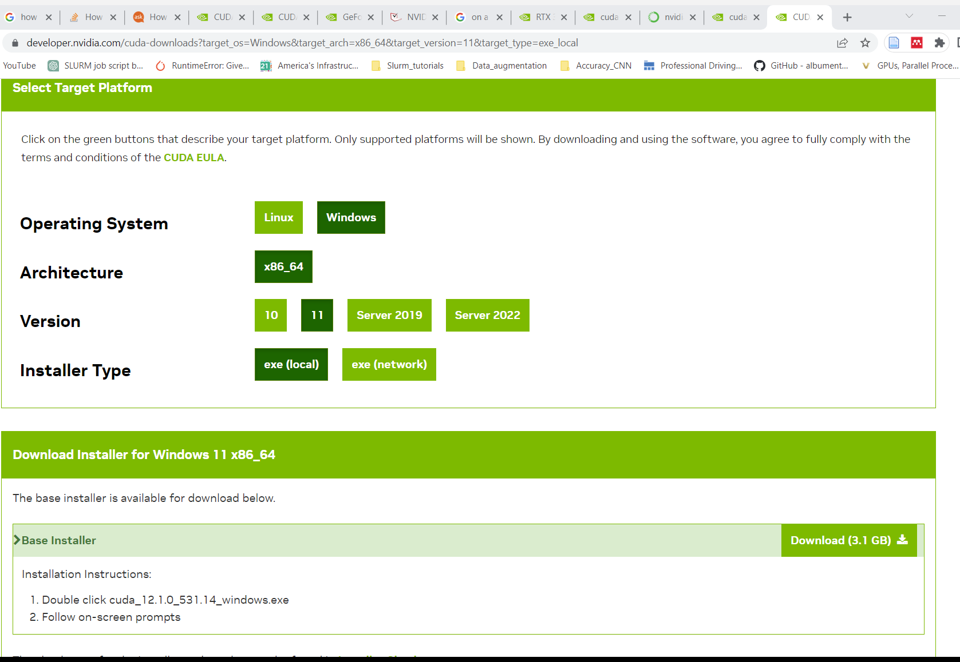
3. Download the Cuda toolkit
1. From here, https://developer.nvidia.com/cuda-downloads. Choose the platform you are using.
2. Then select full installer.
Download the see the instruction to Install the CUDA Software by executing the CUDA installer and following the on-screen prompts.
The CUDA Toolkit installs the CUDA driver and tools needed to create, build and run a CUDA application as well as libraries, header files, and other resources.

Slide 8
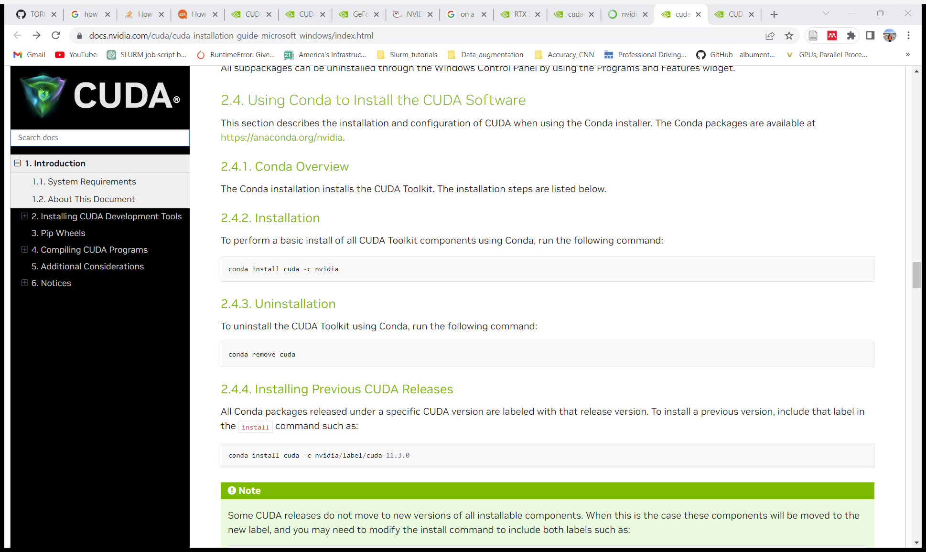
I preferred this although I installed as previous slide
3.1 Same Installation of Cuda toolkit and Cuda software in anaconda
Commands mention the screenshot
1. Activate pytorch: conda activate your environment (DeepCrack)
2. Install cuda, torch alltogether: conda install pytorch==1.13.1 torchvision==0.14.1 torchaudio==0.13.1 pytorch-cuda=11.7 -c pytorch -c nvidia
3. Check version: nvcc --version
4. Check which driver is in mode: nvidia-smi, nvidia-smi -h
5. Remove cuda: conda remove cuda

Slide 9
Check CUDA is available?
## first activate your environment
Then,
python
import torch
if torch.cuda.is_available():
print("CUDA is available on this system!")
else:
print("CUDA is not available on this system.")

Slide 10
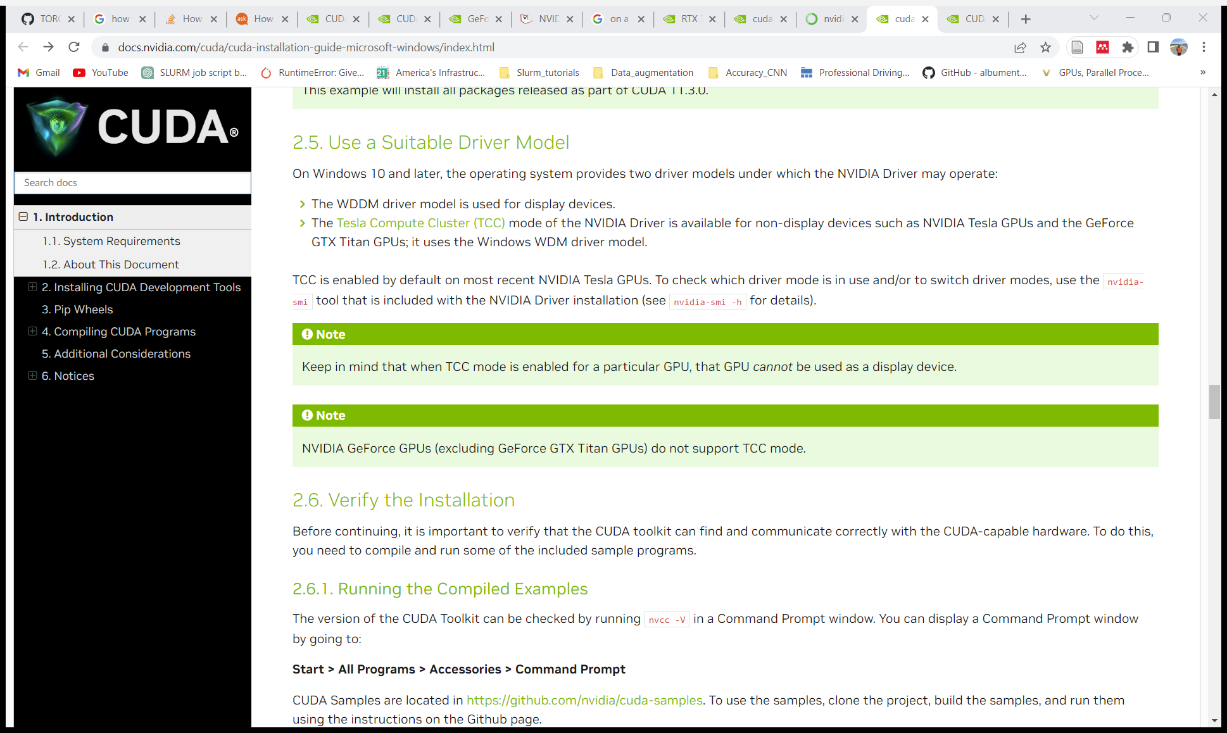
Suitable driver and check work abilities & verify installation
Commands
nvidia-smi
nvidia-smi –h
CUDA Samples are located in https://github.com/nvidia/cuda-samples . To use the samples, clone the project, build the samples, and run them using the instructions on the Github page

Slide 11
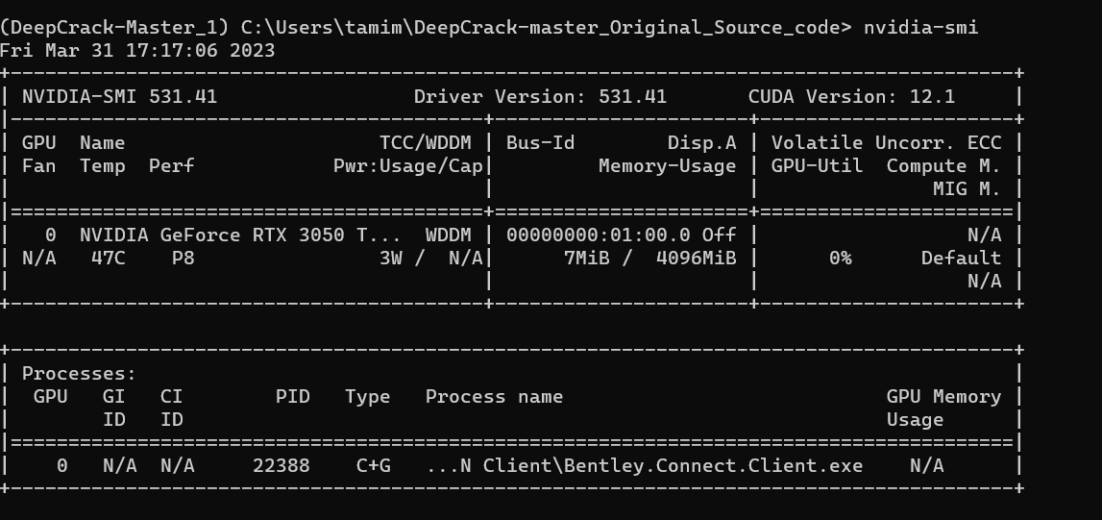

Slide 12
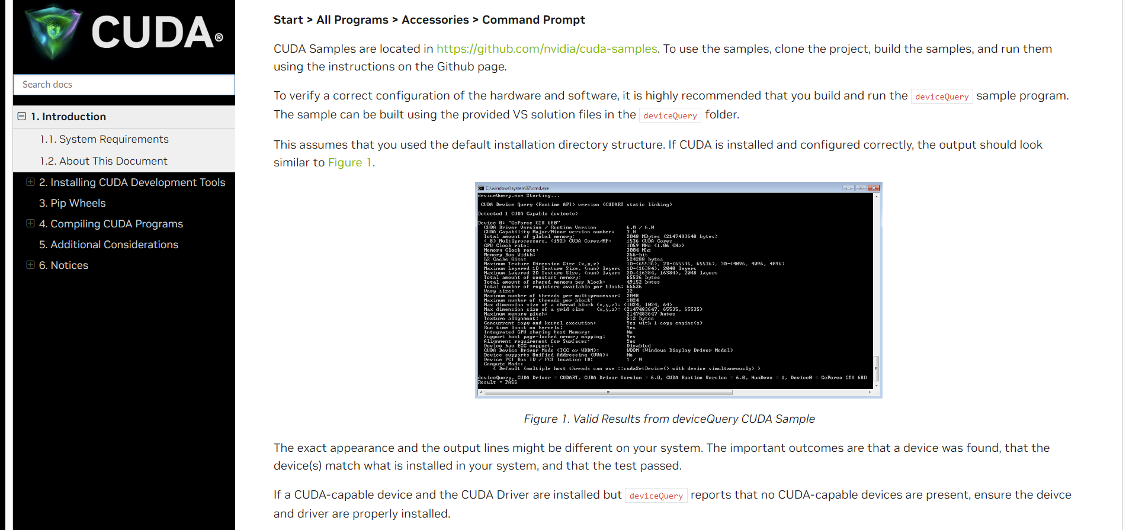
Verify Installation
https://github.com/nvidia/cuda-samples

Slide 13
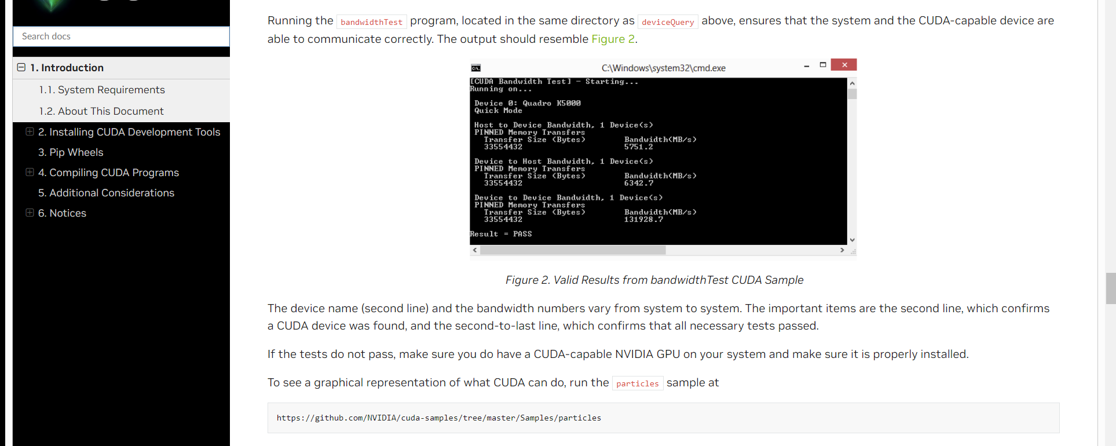
Verify Installation
https://github.com/nvidia/cuda-samples

Slide 14
Follow this https://docs.nvidia.com/cuda/cuda-installation-guide-microsoft-windows/ to enable cuda enabled gpu to your device

Slide 15
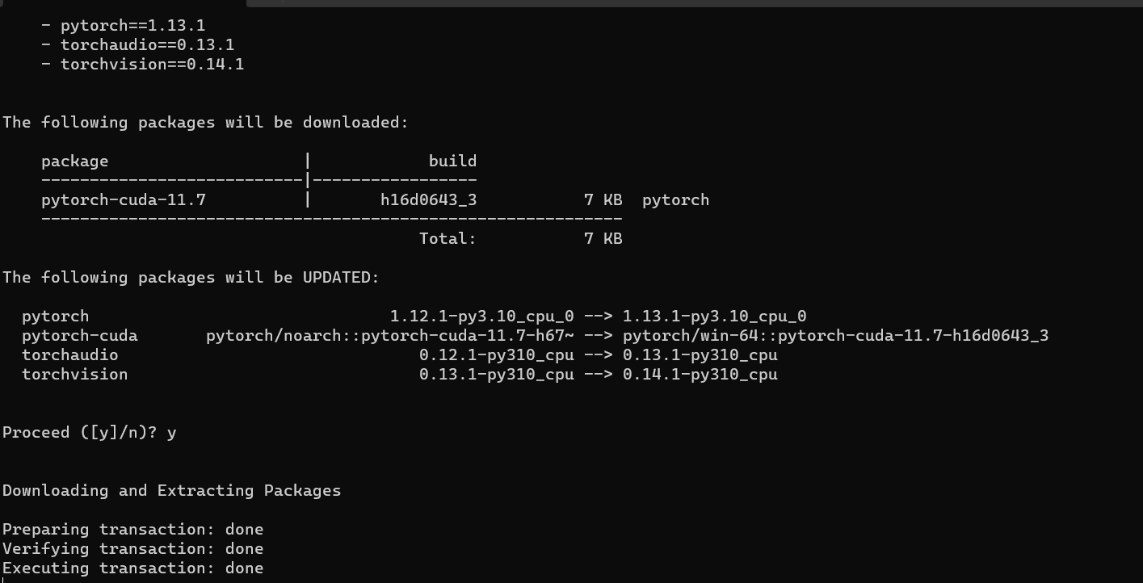
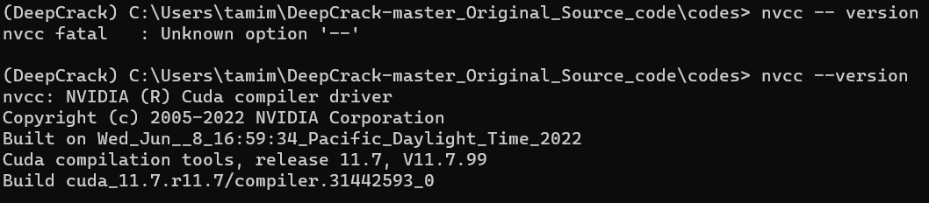
After installing necessary packages for cuda you will see:
Then run ‘nvcc –version’ to check cuda and nvidia version.

Slide 16
Shortcuts codes for specific installations: https://docs.nvidia.com/cuda/cuda-installation-guide-microsoft-windows/index.html
Install the code for your local environment (link: https://pytorch.org/get-started/previous-versions/)
conda install pytorch==1.13.1 torchvision==0.14.1 torchaudio==0.13.1 pytorch-cuda=11.7 -c pytorch -c nvidia – this code will install torch, cudatoolkit and everyhting
You can also give appropriate cuda versions from here pytorch-cuda=11.7

Slide 17
Check your GPU specification (display dimension):
Type: ‘control /name Microsoft.DeviceManager’ in run in windows
Then go to Display adapter and double click.
For me, my gpu is NVIDIA GeForce RTX 3050 Li Laptop GPU (check yours)
Check Capabilities of your GPU From here : https://developer.nvidia.com/cuda-gpus
For me it is 8.6 for NVIDIA Geforce RTX 3050 Ti Laptop GPU

