Slide 1
Optimal Knots to Model Well Logs Using Spline
Naser Tamimi
September 2015

Slide 2
Description
Here is a method for finding the optimal depth for N number of control points/knots.
The method uses an algorithm which calculates the cost of removing a knot from linear spline interpolation and finally find the most optimum depth for control points to keep linear-spline interpolation very similar to the original velocity.
The method finds optimal control points in Z-direction only. Still finding the best lateral location is the user choice/preference.
Also, the method can suggest the best/optimal number of control points based on velocity model complexity.

Slide 3
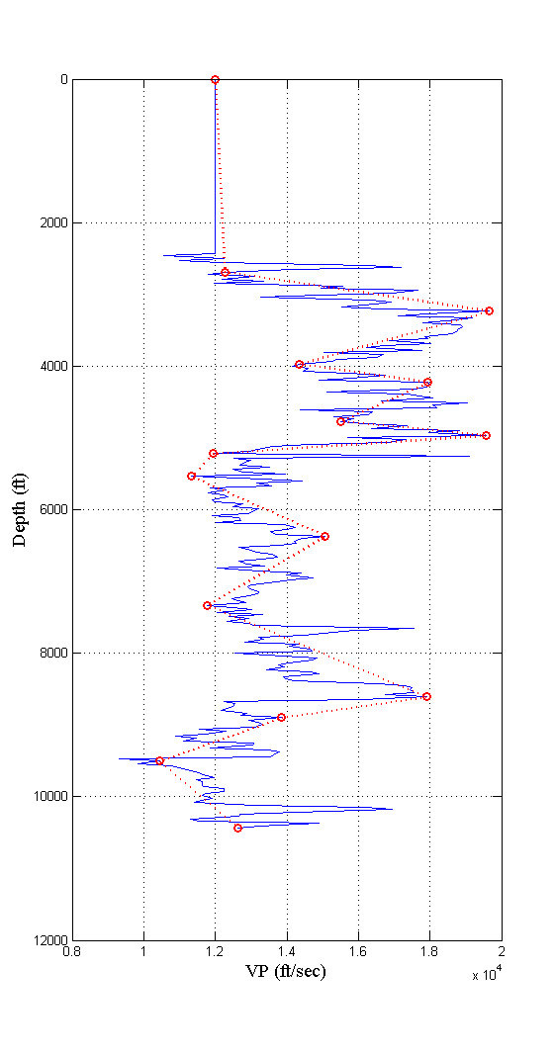
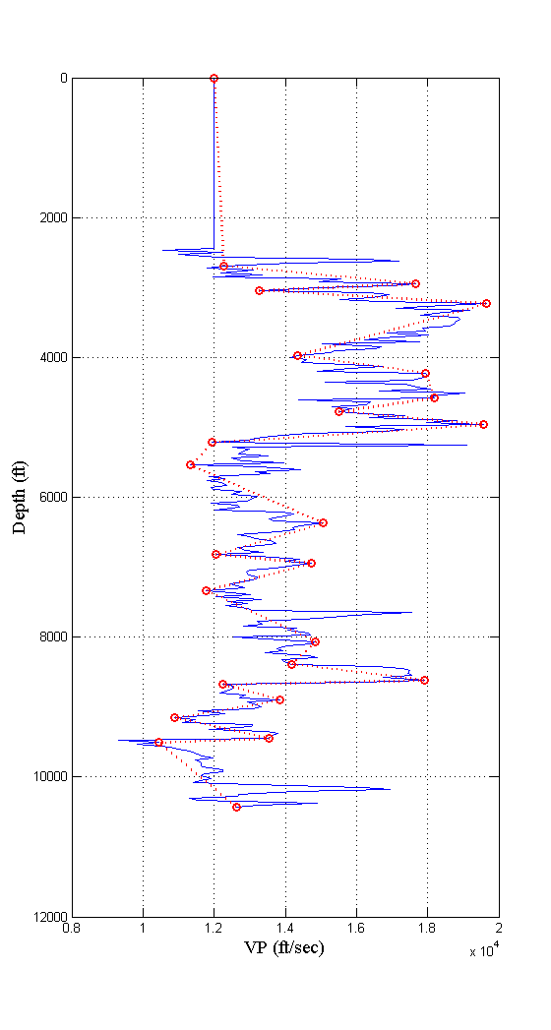
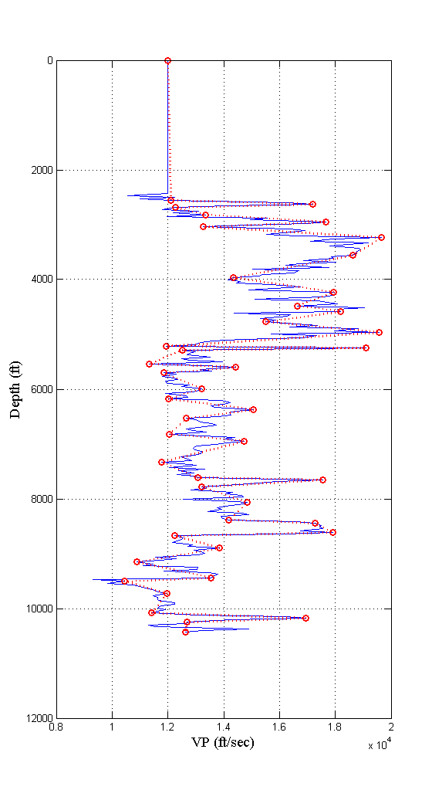
Examples
15 Control Points
25 Control Points
35 Control Points

Slide 4
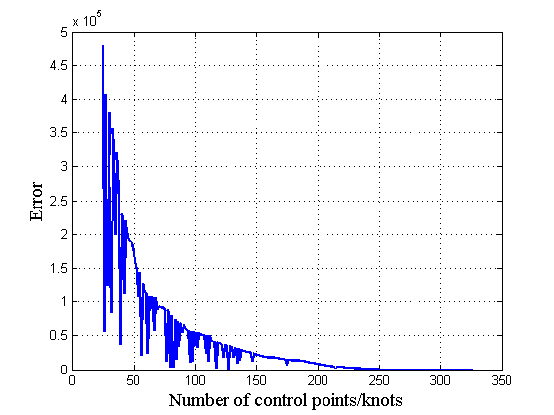
Finding optimal number of control points
Optimum

