Slide 1
2026 SHENZHEN INTERNATIONAL FINTECH COMPETITION
EduWallet AI
International Student Financial
Readiness Simulator
Cross-border & Student Finance Assistant | Topic C
A practical budgeting prototype to help international students explore study costs, funding gaps and financial stress scenarios.
TEAM: EduWallet AI
Competition prototype • Illustrative planning only • No live financial integrations

Slide 2
01 / THE PROBLEM
Studying abroad is a financial decision
Students need to understand the full cost—not just tuition.
01
02
03
Costs add up
Funds can fall short
Plans can change
Tuition, setup costs and monthly living expenses can create a large total budget.
Students may have savings or sponsorship but still face a funding gap.
Unexpected expenses or higher living costs can make a fragile plan harder to sustain.
Opportunity
Give students a simple way to test assumptions before they commit to a study plan.
02

Slide 3
02 / OUR SOLUTION
One dashboard. Clearer financial decisions.
EduWallet AI turns user-entered assumptions into a simple readiness picture.
CORE WORKFLOW
DESIGNED FOR
• Enter tuition, setup costs and monthly living costs
• Set the number of months and available funds
• Review total estimated cost, funding gap and coverage
• Stress-test the plan and download a report
• International students planning study expenses
• Students comparing different budget assumptions
• Users who want to explore shortfalls before making decisions
Not a bank, lender, visa adviser or eligibility checker.
03

Slide 4
03 / PRODUCT FEATURES
Built around practical planning tools
A functional prototype with calculation logic, scenarios and a downloadable report.
01
02
03
Study budget calculator
Funding gap & coverage
Stress test
Estimate total study-period costs from tuition, one-off costs and monthly living expenses.
Compare estimated costs with funds entered by the user.
Explore cost increases, cost shocks and reduced support.
04
05
06
What-If Life Simulator
Survival Mode
Report & currency estimate
Change monthly living costs and add an unexpected expense.
Model higher costs, an emergency expense and funds becoming unavailable.
Download a planning report and use an illustrative, manually entered BDT conversion rate.
04

Slide 5
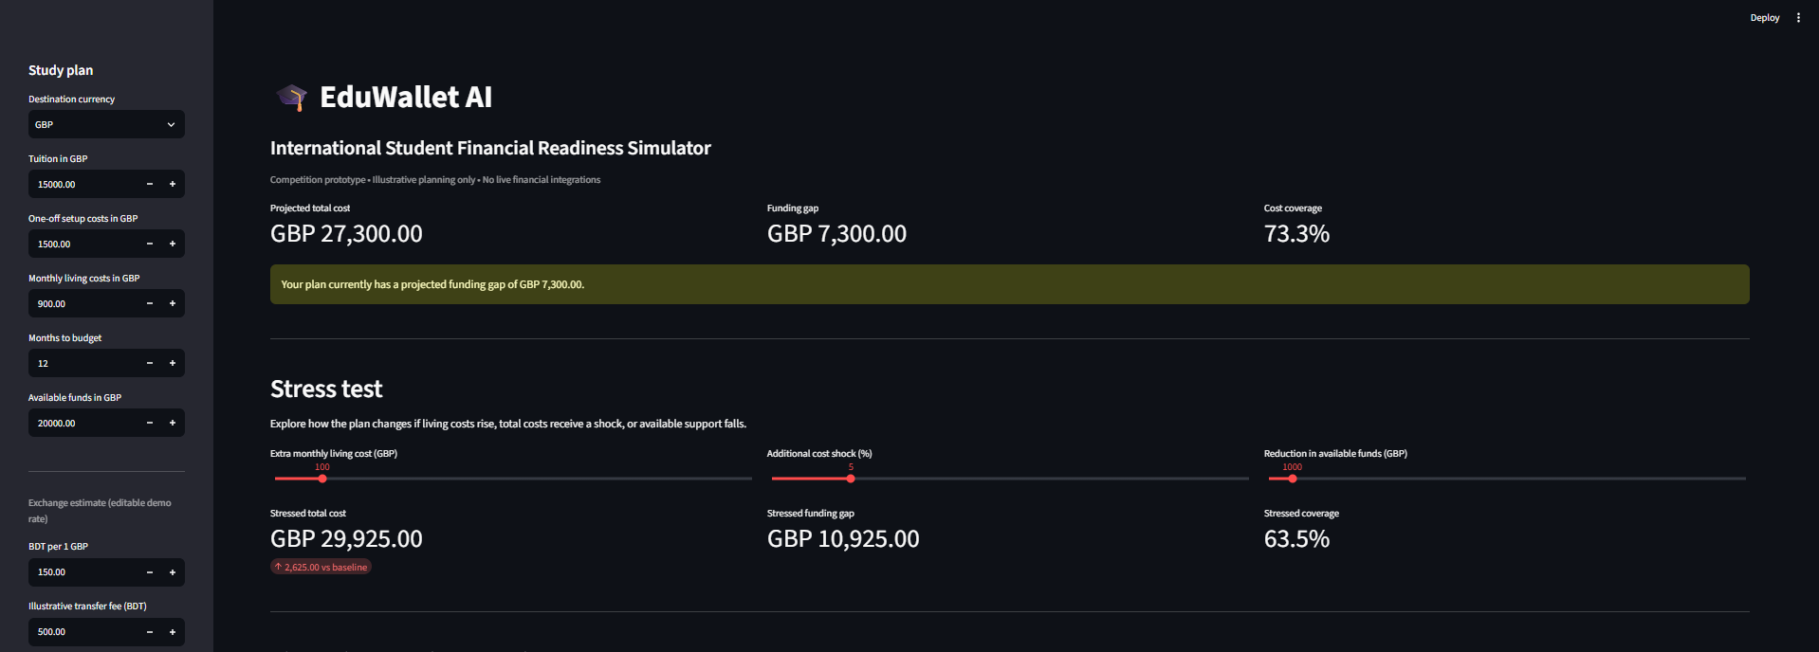
04 / PROTOTYPE EVIDENCE
The main financial dashboard
Example screenshot supplied from the working EduWallet AI prototype.
Example values shown are illustrative and can be changed by the user.
05

Slide 6
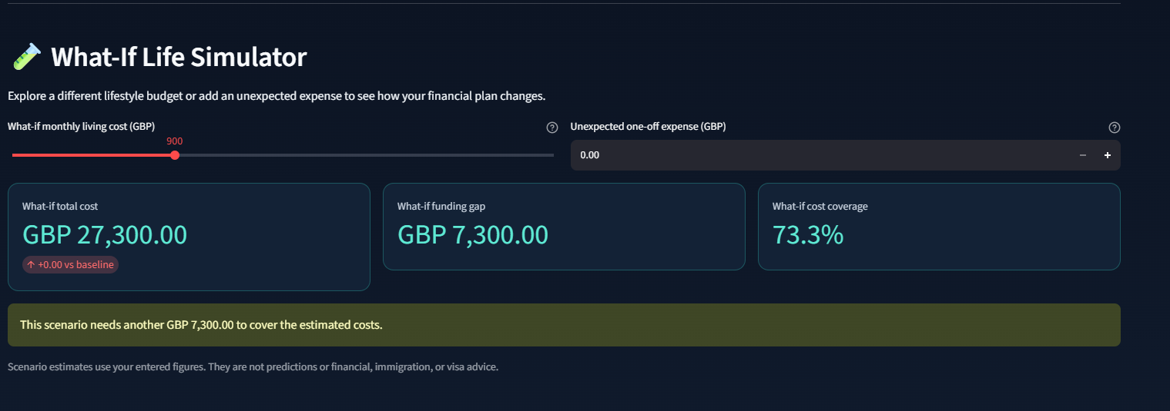
05 / INTERACTIVE SCENARIO
What-If Life Simulator
Show how a different lifestyle budget or an unexpected cost changes the plan.
WHAT THIS SHOWS
• Adjust monthly living costs
• Add an unexpected one-off expense
• Compare total cost with baseline
• Review funding gap and cost coverage
Scenario outputs are estimates, not predictions.
06

Slide 7
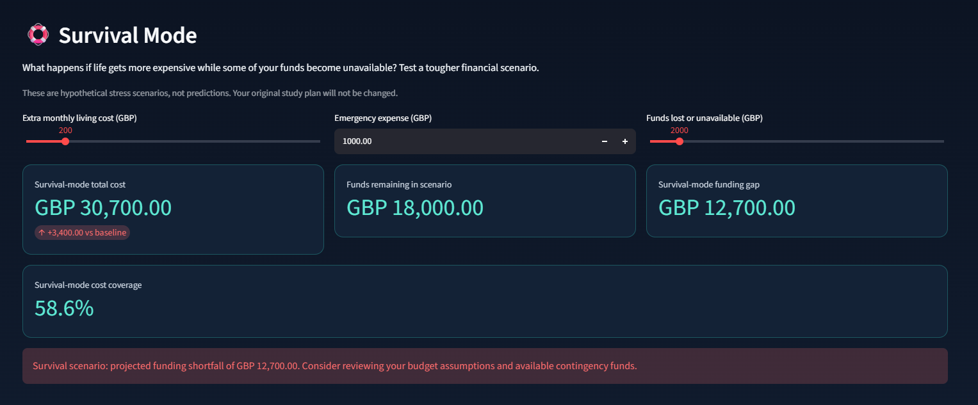
06 / RESILIENCE SCENARIO
Survival Mode
Explore what happens when costs rise and some funds are unavailable.
WHAT THIS SHOWS
• Higher monthly living costs
• A hypothetical emergency expense
• Reduced available funds
• Updated shortfall and coverage
This is a stress scenario, not a forecast.
07

Slide 8
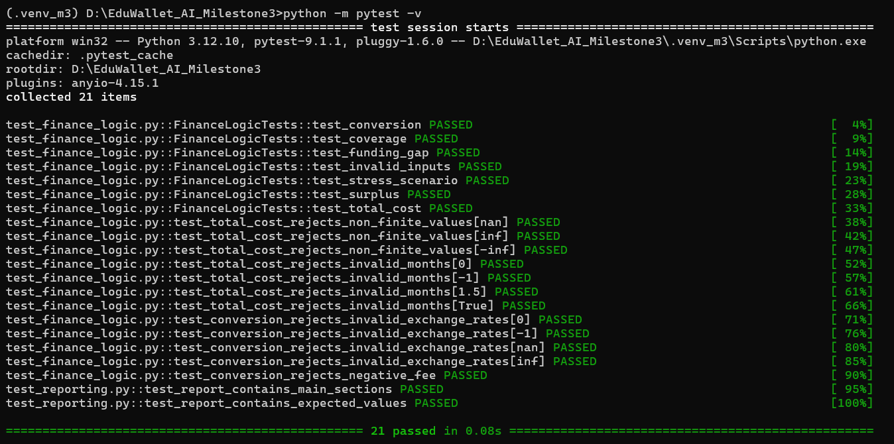
07 / VERIFICATION
Automated tests: 21 passed
Evidence from the Python test suite supplied for this presentation.
21 / 21
0.08 s
2 AREAS
TESTS PASSED
REPORTED RUNTIME
CALCULATIONS + REPORTING
Functional testing is not an independent security audit.
08

Slide 9
08 / IMPLEMENTATION
Simple, testable and transparent
The prototype prioritizes understandable calculations and explicit limitations.
TECH STACK
DESIGN PRINCIPLES
• Python for financial calculation logic
• Streamlit for the interactive web interface
• Pytest for automated tests
• Downloadable text-based financial report
• User-entered assumptions are visible
• Input validation protects calculation functions
• No live bank integrations or payments
• Manual currency rate; not a live exchange feed
09

Slide 10
09 / RESPONSIBLE USE
Clear boundaries build trust
EduWallet AI is an educational planning prototype—not a source of official financial decisions.
• Results depend on the figures and assumptions entered by the user.
• Currency conversion is illustrative and uses a manually entered rate.
• The prototype does not connect to banks, verify balances, or execute payments.
• It does not provide financial, immigration or visa advice.
• The prototype has no user authentication, role-based access or persistent financial profiles.
• Automated tests verify selected functionality; they do not replace an independent security assessment.
Use it to explore scenarios and ask better questions—not as a guarantee of affordability.
10

Slide 11
10 / TEAM
The people behind EduWallet AI
Edit the placeholders below with your official team name and each member’s full name.
TEAM MEMBER 01
TEAM MEMBER 02
TEAM MEMBER 03
[YOUR FULL NAME]
[MEMBER 2 FULL NAME]
[MEMBER 3 FULL NAME]
Technical Developer
Documentation Lead
Presentation Lead
Prototype implementation, financial logic, testing and integration.
Technical documentation, project report and security self-assessment.
Presentation design, competition narrative and demo preparation.
Replace all bracketed placeholders before submitting.
11

Slide 12
EDUWALLET AI
Plan with clarity.
Prepare for uncertainty.
An interactive financial readiness simulator for international students.
THANK YOU
EduWallet AI • Topic C: Cross-border & Student Finance Assistant

