Slide 1
Term Project
Automated detection of deforestation based on multi-spectrum satellite data
Ta Minh Luan
2020.12.22
_

Slide 2
Introduction
Problem statement:
Each year, Vietnam loses more than 2,500 hectares of forest.
caused by: illegal logging, forest fires.
Goal:
Create a system to automated detection of deforestation
based on multi-spectrum satellite data
Detect massive deforestation of wild and protected forest.
Determine the boundaries and changes in commercial logging.
Identify violation of illegal deforestation.
Solution:
This above tasks can be solved using remote sensing images.

Slide 3
Methodology
Using multispectral images: Landsat 7/8, Sentinel 2.
processed images
with same location,
same season,
same or close resolution.
NDVI: Normalized Difference Vegetation Index (NDVI).
The threshold is within 0.2..0.4 and depend on the season.

Slide 4
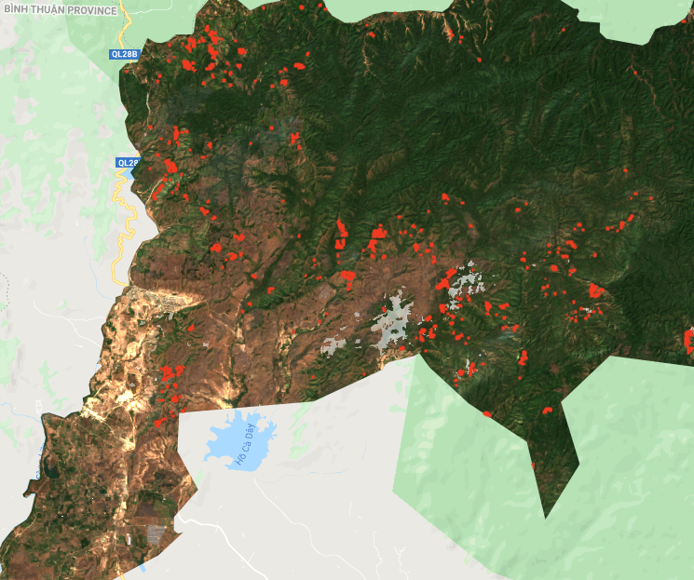
Process
Selection and downloading images
Crop Image
Calculation of NDVI and threshold
Vectorization, determining boundary
Visualization/Exportation
Notes:
Free multispectral images of medium spatial resolution from Landsat-7 (ETM+), Landsat-8 (OLI) ) and Terra (ASTER), as well as remote sensing data obtained from Sentinel-2A / B (MSI) can be used to conduct regular satellite monitoring of deforestation.
selection and downloading of images for a given observation season, taking into account cloudiness;
automatic cropping of images along the borders of a given monitoring site;
automated creation of a cloud mask for a given territory using spectral channels of atmospheric correction (if necessary);
calculation of NDVI index images for selected images in order to detect new logging areas (in automated mode);
threshold binarization of NDVI index images;
morphological filtering of the binary image and sifting;
vectorization of a binary image, determination of boundaries and area of vegetation;
creation of differential images for the selected pairs of images, binarization, vectorization and determination of boundaries and areas of deforestation (an example of detected logging areas is shown in figure 2);
visualization of changes on a digital map, recording the objects attributes (logging areas) in a DBF file and exporting a vector layer to a KML file.

Slide 5
Result
The minimal areas: 0.3 ha.
Good reproducibility.
High stability.
Notes:
slight deviations in the input data or in the settings of the processing procedures should not cause significant deviations in the processing results

Slide 6
Conclusion
Existing problem:
50% of the available images have high percentage of dense cloud cover (from 20% to 80%).
Need high solution satellite data to obtain more accurate.
Future research:
Combining time series data from optical and SAR satellites
Use machine learning model for choosing the threadhold with difference season, special area.

