Slide 1
Term Project Proposal
Automated detection of deforestation based on multi-spectrum satellite data
Attachment: Automated detection of deforestation

Slide 2
Summary
Problem statement:
Each year, Vietnam loses more than 2,500 hectares of forest.
caused by: illegal logging, forest fires.
Goal:
Create a system to automated detection of deforestation
based on multi-spectrum satellite data
Detect massive deforestation of wild and protected forest.
Determine the boundaries and changes in commercial logging.
Identify violation of illegal deforestation.
Solution:
This above tasks can be solved using remote sensing images.

Slide 3
Method
Using multispectral images: Landsat 7/8, Sentinel 2.
processed images with same location, same season, same or close resolution.
NDVI: Normalized Difference Vegetation Index (NDVI).
The threshold is within 0.2..0.4 and depend on the season.

Slide 4
Process
Free multispectral images of medium spatial resolution from Landsat-7 (ETM+), Landsat-8 (OLI) ) and Terra (ASTER), as well as remote sensing data obtained from Sentinel-2A / B (MSI) can be used to conduct regular satellite monitoring of deforestation.
selection and downloading of images for a given observation season, taking into account cloudiness;
automatic cropping of images along the borders of a given monitoring site;
automated creation of a cloud mask for a given territory using spectral channels of atmospheric correction (if necessary);
calculation of NDVI index images for selected images in order to detect new logging areas (in automated mode);
threshold binarization of NDVI index images;
morphological filtering of the binary image and sifting;
vectorization of a binary image, determination of boundaries and area of vegetation;
creation of differential images for the selected pairs of images, binarization, vectorization and determination of boundaries and areas of deforestation (an example of detected logging areas is shown in figure 2);
visualization of changes on a digital map, recording the objects attributes (logging areas) in a DBF file and exporting a vector layer to a KML file.

Slide 5
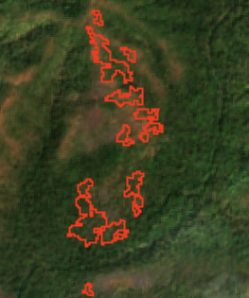
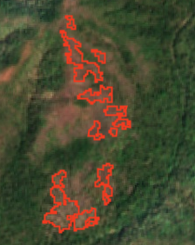
Result
The minimal areas: 0.3 ha.
Error in the determining the coordinates of the boundaries:±10m.
Good reproducibility.
high stability (slight deviations in the input data or in the settings of the processing procedures should not cause significant deviations in the processing results).
Before
After

Slide 6
Method
Existing problem:
50% of the available images have high percentage of dense cloud cover (from 20% to 80%).

