Slide 1
Automated detection of deforestation based on multi-spectrum satellite data

Slide 2
Introduction
Regular monitoring of deforestation is currently an urgent task for many countries.
The availability of relevant and reliable information ensures effective monitoring of compliance with the providing protection and sustainable use of forests
detect massive deforestation of wild and protected forests;
determine the boundaries and dynamics of changes in commercial logging;
identify violations of the existing land allocation regulations for commercial or sanitary logging
control economic activity in the areas being logged;
analyze the consequences of deforestation, monitor the dynamics and nature of changes (soil erosion, restoration of vegetation, change in the species composition of the forest, waterlogging, desertification, etc.).

Slide 3
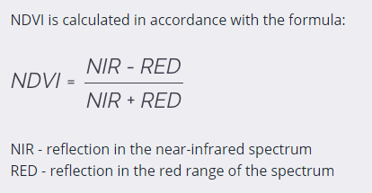
NDVI
NDVI:
Normalized Difference Vegetation Index (NDVI).
From -1.0 to 1.0, basically representing greens,
where negative values ​​are mainly formed from clouds, water and snow. values ​​close to zero are primarily formed from rocks and bare soil. Very small values ​​(0.1 or less) of the NDVI function correspond to empty areas of rocks, sand or snow. Moderate values ​​(from 0.2 to 0.3) represent shrubs and meadows, while large values ​​(from 0.6 to 0.8) indicate temperate and tropical forests. Crop Monitoring successfully utilizes this scale to show farmers which parts of their fields have dense, moderate, or sparse vegetation at any given moment.

Slide 4
Method
Free multispectral images of medium spatial resolution from Landsat-7 (ETM+), Landsat-8 (OLI) ) and Terra (ASTER), as well as remote sensing data obtained from Sentinel-2A / B (MSI) can be used to conduct regular satellite monitoring of deforestation.
selection and downloading of images for a given observation season, taking into account cloudiness;
automatic cropping of images along the borders of a given monitoring site;
automated creation of a cloud mask for a given territory using spectral channels of atmospheric correction (if necessary);
calculation of NDVI index images for selected images in order to detect new logging areas (in automated mode);
threshold binarization of NDVI index images;
morphological filtering of the binary image and sifting;
vectorization of a binary image, determination of boundaries and area of vegetation;
creation of differential images for the selected pairs of images, binarization, vectorization and determination of boundaries and areas of deforestation (an example of detected logging areas is shown in figure 2);
visualization of changes on a digital map, recording the objects attributes (logging areas) in a DBF file and exporting a vector layer to a KML file.

Slide 5
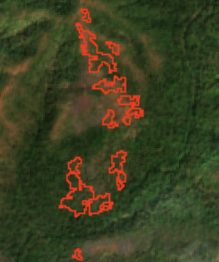
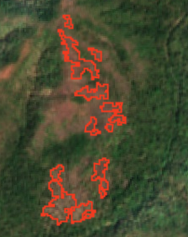
Result
After
Before

