Slide 1
WACV 2027 SUBMISSION · RESULTS TO DATE
Counting Is Not Detecting
Localizing the bottleneck in thermal wildlife video
White-tailed deer detection and counting from vehicle-mounted FLIR thermal transects
32 videos · 521,930 frames · 236 individually tracked animals · 4 sites, southern Illinois

Slide 2
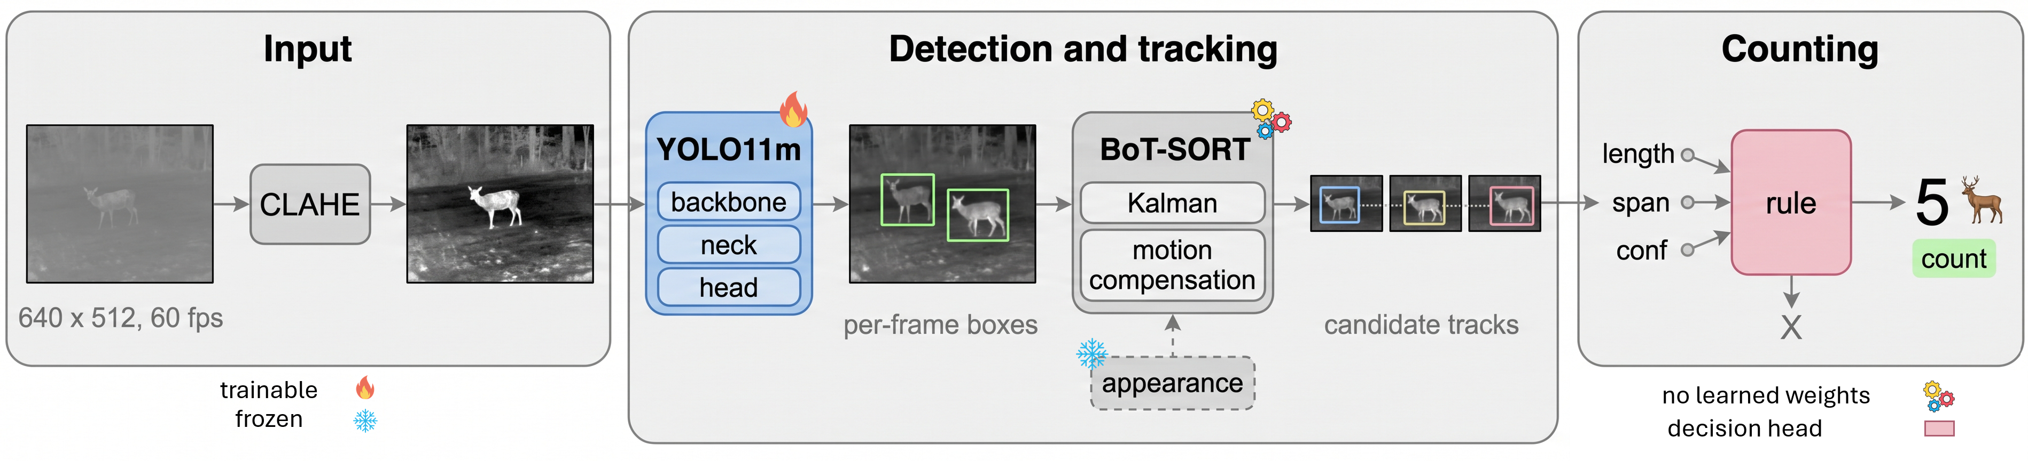
APPROACH
One detector, one tracker, a three-parameter confirmation rule
Detection
Association
Confirmation
YOLO11m @ 640 px, chosen from a 12-architecture benchmark on the criterion that matters downstream, not on mAP.
BoT-SORT with global motion compensation — mandatory, the vehicle travels 25–90 km/h and the whole frame translates.
Accept a track on length, span and top-5 mean confidence. Three parameters, swept on training video and frozen.

Slide 3
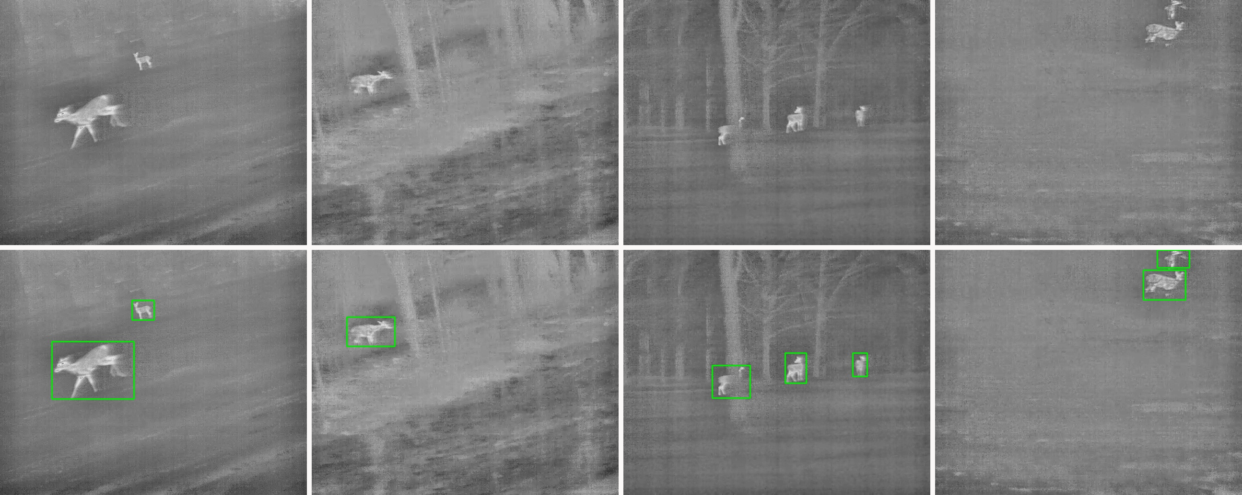
DATASET
32 annotated thermal transects, 236 individually tracked animals
Top: frames as the detector receives them, after CLAHE normalization. Bottom: the same frames with their annotation.
Split
Videos
Frames
With deer
Empty
Boxes
What matters here
Train
19
12,852
5,013
7,839
7,547
11,476 frames are explicit negatives. A survey system must not fire on warm rocks or structures, so background frames are annotated, not discarded.
Splits are by video and site-stratified — no frame from a training video appears in evaluation.
Val
4
2,337
935
1,402
2,564
Test
9
3,725
1,490
2,235
2,792
Total
32
18,914
7,438
11,476
12,903

Slide 4
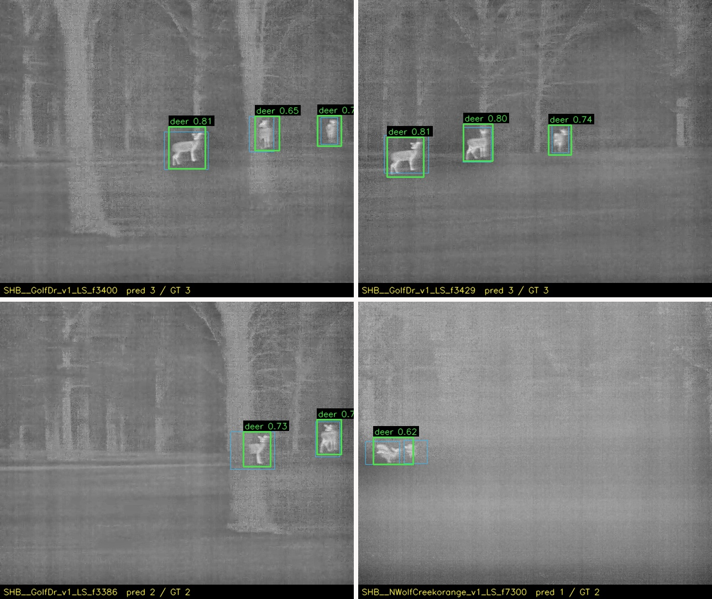
DETECTION
Twelve architectures, and very little separates them
Model
AP50
Precision
Recall
F1
F0.5
YOLOv8m
0.459
0.780
0.572
0.660
0.727
ATSS R50
0.380
0.683
0.635
0.658
0.673
TOOD R50
0.396
0.683
0.621
0.650
0.670
YOLO11m
0.460
0.897
0.503
0.645
0.775
RT-DETR-L
0.434
0.643
0.605
0.623
0.635
YOLO12m
0.508
0.929
0.452
0.608
0.767
YOLOv9m
0.506
0.917
0.450
0.604
0.759
YOLOv10m
0.510
0.874
0.453
0.597
0.737
Why YOLO11m
DINO R50
0.365
0.560
0.572
0.566
0.562
AP50 spans only 0.365–0.510 across designs as different as Faster R-CNN, DINO and YOLO12m — the signature of a data-limited rather than an architecture-limited regime.
The confirmation stage downstream must reject tens of thousands of false candidates against a few hundred true ones, so we select on precision-weighted F0.5, where YOLO11m ranks first at 0.775.
Faster R-CNN
0.418
0.393
0.723
0.509
0.433
RTMDet-m
0.466
0.325
0.779
0.459
0.368

Slide 5
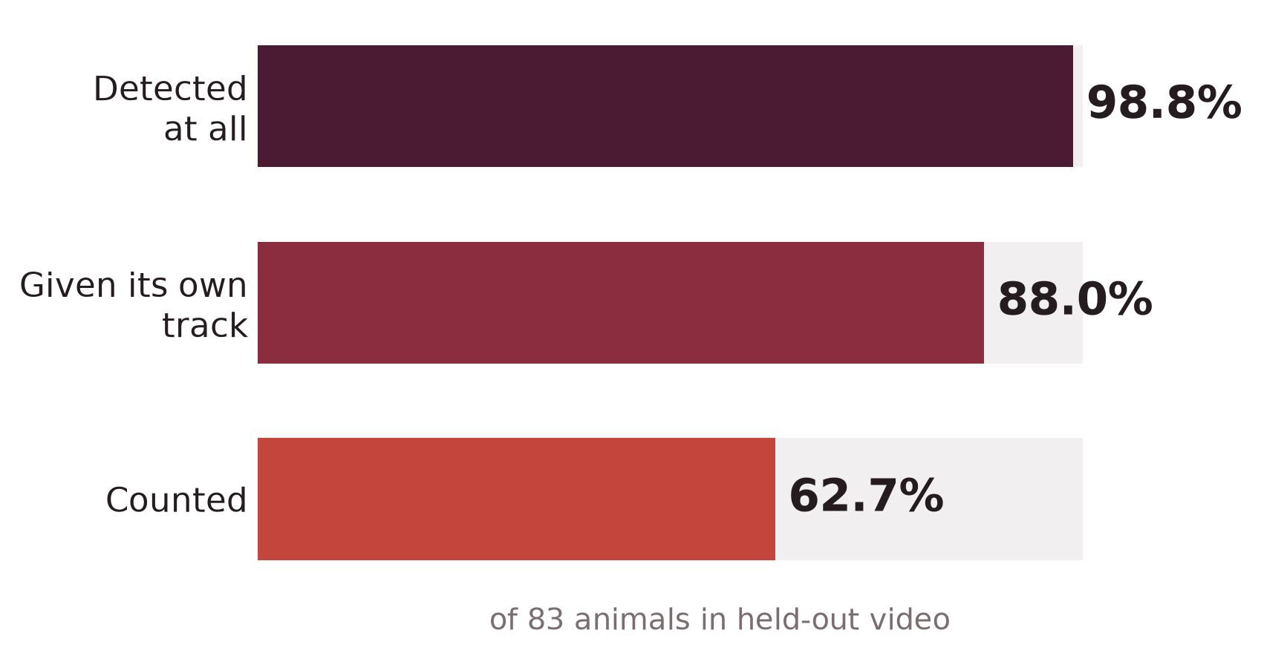
RESULTS
Detection is not the bottleneck
98.8%
88.0%
62.7%
2.38
of held-out animals are detected at all
acquire their own distinct track
survive confirmation and are counted
mean absolute error, animals per video
What this says
Nearly every animal is found. The loss is concentrated after detection — in association, and above all in the decision of which candidate tracks are real.
A better backbone cannot recover the 36 points between detected and counted, because those animals were never missed by the detector in the first place.
Held out: rule swept on 19 training videos, frozen, reported on 13 unseen.

Slide 6
PER-VIDEO BREAKDOWN
Reading a row left to right attributes that video's loss to a stage
Video
Site
Animals
Detected
Own track
Counted
Error
How to read it
NShelbyRd (blue)
SHB
27
22
16
20
−7
Animals is the annotated count. Detected and Own track are the two intermediate stages; Counted is what the system reports.
The error concentrates in dense-group footage. NShelbyRd loses 5 animals to detection and a further 6 to association — the largest tracking failure in the corpus, and the reason group video dominates the total.
Only two videos over-count, and both do so with their detection and association columns complete. Their error is confirmation accepting spurious tracks, not anything upstream.
MAE 2.38 animals per video; the system under-counts and essentially never inflates.
GolfDr
SHB
12
12
10
14
+2
NWolfCreek (orange)
SHB
9
9
9
5
−4
GiantCityRd
TON
8
7
7
3
−5
Robinson
SHW
7
7
7
7
0
Melvin
SHW
5
5
5
1
−4
AquaCultureRd
TON
3
1
1
0
−3
N25thBlue
MAS
3
3
3
3
0
NMarseilles
MAS
3
3
3
1
−2
OikosRd
TON
2
2
2
1
−1
TouchofNature
TON
2
1
1
0
−2
ChipsRd
TON
1
1
1
1
0
SIron
SHW
1
1
1
2
+1
Total
83
74
66
58
−25

Slide 7
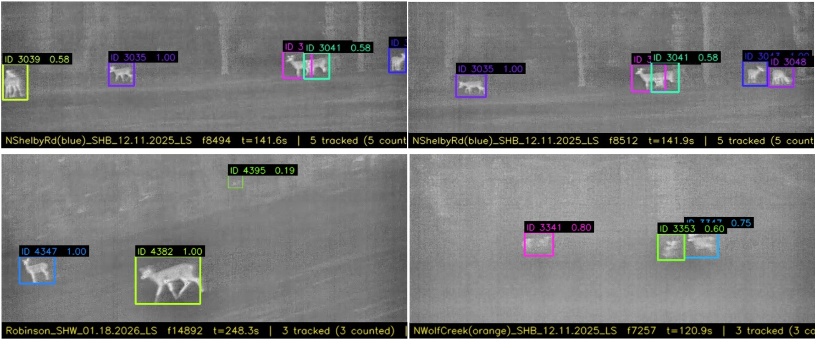
QUALITATIVE RESULTS
Tracking holds through overlap and low contrast
Identities persist
Overlap is resolved
Confidence is honest
Top row is the same scene 0.3 s apart. Tracks keep their identities while the camera translates beneath them.
Animals whose boxes intersect are still carried as separate tracks — the failure that silently merges two deer into one.
The per-track score falls with range, from a near animal at 87 px to a distant one at 22 px in a single frame.

Slide 8
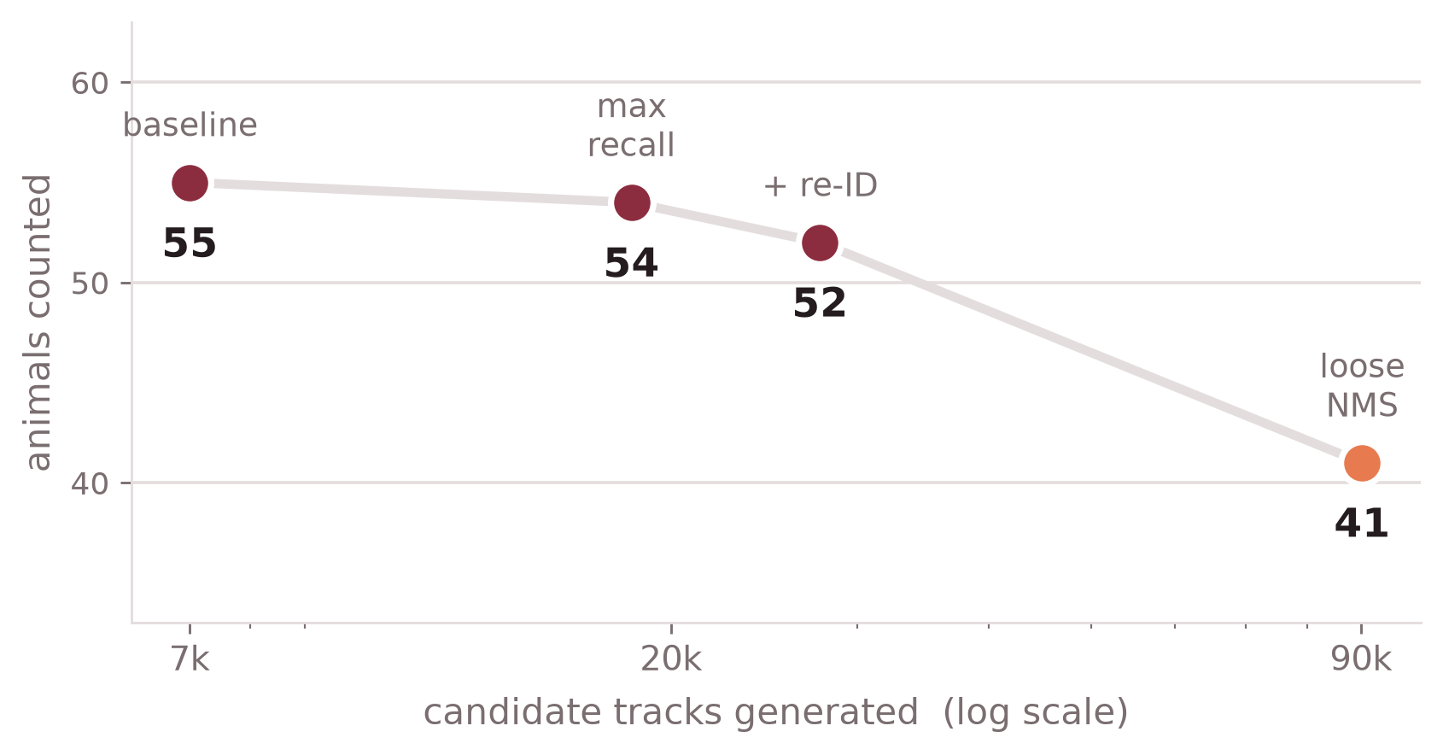
CENTRAL FINDING
Improving candidate generation makes counting worse
Why
Each intervention adds far more false candidates than real ones — the richest pool holds 219 true tracks against 27,460 false. A rule tuned to survive that ratio has to be aggressive enough to reject real animals along with the noise.
And it resists learning
Four independent interventions each enlarged the candidate pool as designed. Every one of them counted fewer animals.
A transformer, gradient boosting and logistic regression all lose to the three-parameter rule under three separate protocols. Error grows with model capacity — the constraint is supervision, not architecture.

Slide 9
SUMMARY
What we can claim today
Corpus
32 fully annotated thermal transects, 236 individually tracked deer, 21,646 boxes. Released with the paper.
Detector
12 architectures benchmarked under four matching criteria. YOLO11m @ 640 px, 0.897 precision, selected on the criterion the counter actually needs.
Preprocessing
CLAHE normalization is worth more than any architectural choice we tested — test mAP50 0.519 with it, 0.299 without.
Counting
98.8% detected, 88.0% distinctly tracked, 62.7% counted on video the detector never saw. MAE 2.38 animals per video, and the system under-counts rather than over-counts.
Auditability
Every counted animal carries a calibrated score and a contact sheet of its own frames; 92.1% score above 0.80.
Manuscript drafted end to end; remaining work is length and final ablations.

Slide 10
WHAT COMES NEXT
Four workstreams
1
Counting paper
In progress
Thermal transect detection and counting. Drafted end to end; remaining work is length and final ablations.
2
Vision–language scene understanding
Proposed
Move from a number to a description: how many, how far, what are they doing, what is occluding them.
3
Edge deployment
Proposed
Run the detector on the camera rather than on a cluster, so a trail camera or drone reports counts in the field.
4
Collaborative grant writing
Proposed
Convert the corpus, the pipeline and the evaluation framework into funded, multi-institution work.

Slide 11
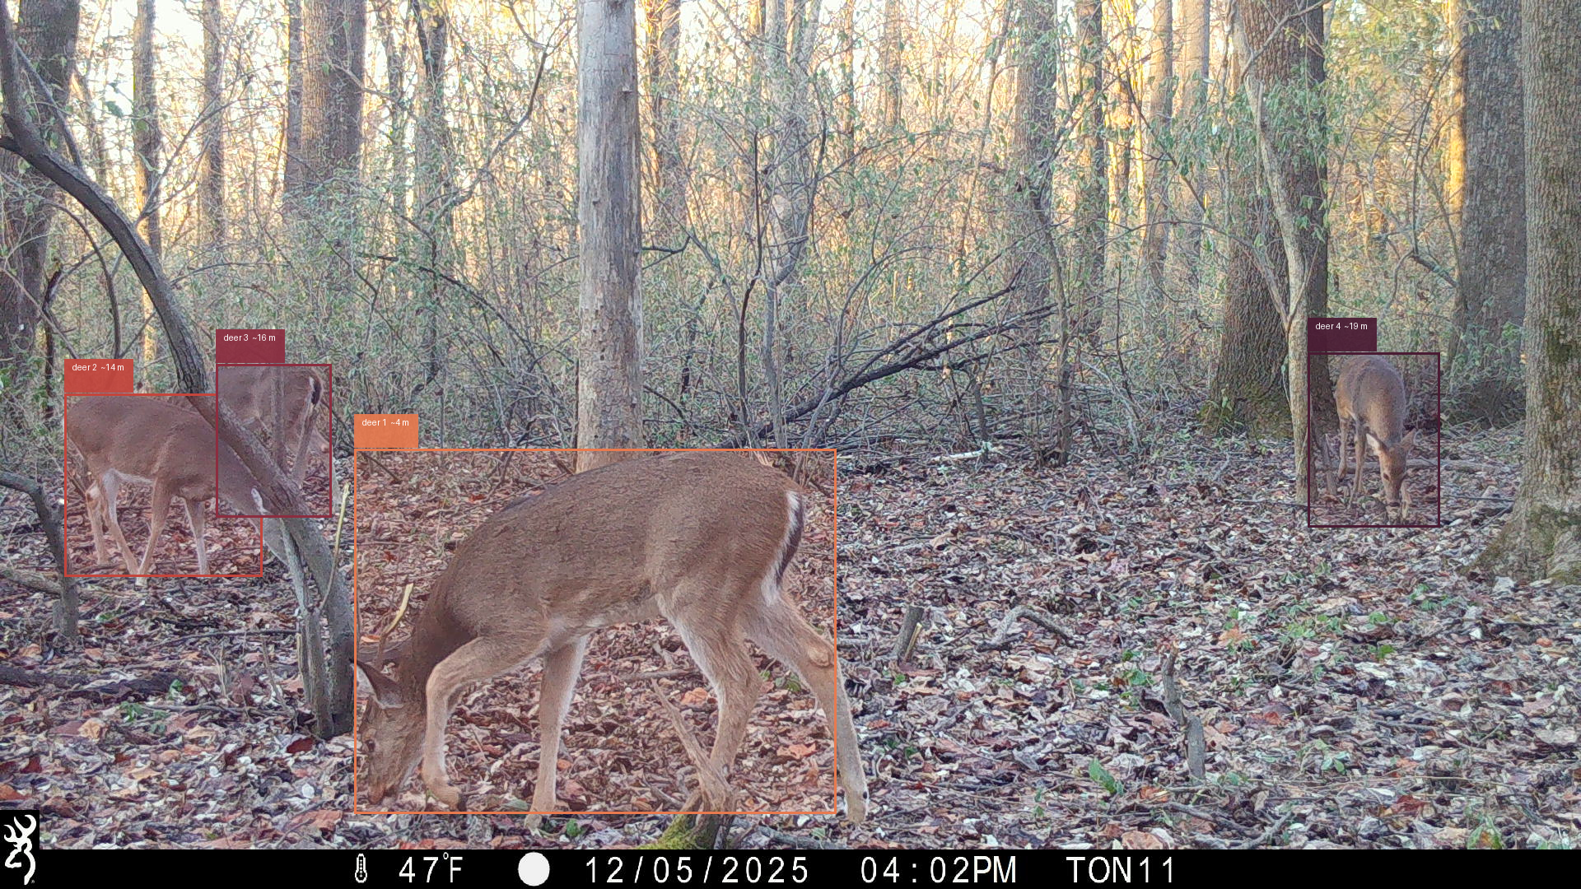
WORKSTREAM 2 · PROPOSED
From a count to an explanation of the scene
Proposed model output
“Four white-tailed deer. One adult foraging in the immediate foreground, two browsing together at mid-range and partly occluded by saplings, one adult at the far right beside a mature oak.
All four are head-down feeding, none alert, no antlers visible. The group is dispersed and stationary rather than travelling.”
Structured fields alongside the prose
count
4
range per animal
~4, 14, 16, 19 m
mask
per-animal segmentation
Trail-camera frame, TON11. The same scene our thermal pipeline would reduce to the single number 4. Boxes and ranges here illustrate the proposed output.
behaviour
foraging, not alert
occlusion
2 of 4 partly hidden
Illustrative — a target capability, not a current result.

Slide 12
WORKSTREAM 3 · PROPOSED
Move the detector onto the camera
Why it is plausible now
Plan
The production detector is a 40 MB checkpoint running at 640 px on a single class. That is a small model by current standards, and the pipeline around it — motion compensation, association, the confirmation rule — carries no learned weights and negligible compute.
Nothing in the design assumes a cluster. The counting run is embarrassingly parallel across videos because each video is independent.
Export
TensorRT / ONNX, INT8 and FP16 variants
Measure
throughput, latency and power on the lab Jetson — no on-device numbers exist yet
Verify
confirm counting accuracy is unchanged after quantization, using the same held-out protocol
What changes for the survey
Field
battery-powered trail-camera unit reporting counts over LTE
A camera that reports a count instead of storing footage removes the retrieval and manual-review step that currently bounds how many sites a survey can cover.
Quantization is the open question: the animals are already at the sensor's resolution limit, so reduced precision may cost recall where it is scarcest.

Slide 13
WORKSTREAM 4 · PROPOSED
What we can bring to a collaborative proposal
A released corpus
32 annotated thermal transects with per-individual tracks — rare enough that the scarcity is itself a contribution.
Funding directions
Candidate targets to scope, not yet selected:
· Federal science agencies supporting AI for environmental monitoring
· Agricultural and natural-resource programmes concerned with deer population management
· State wildlife agencies that already run transect surveys and carry the operational need
· Instrumentation and sensor-development programmes for the edge hardware
An evaluation framework
The reach / own-track / counted decomposition transfers to any survey modality, not just thermal.
A negative result worth citing
Improving candidate generation degrades counting. That shapes how a funded effort should spend its money.
A deployment path
Workstreams 2 and 3 turn a measurement into an instrument ecologists can actually operate.
Natural partners span computer vision, wildlife ecology and state agencies; the corpus is the piece none of them can produce alone.

