Slide 1
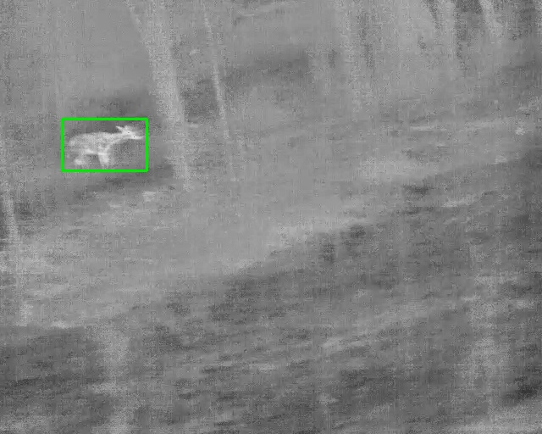
TRACT | Thermal Road-transect Animal Counting and Tracking
Counting White-Tailed Deer in Vehicle-Mounted Thermal Video
Detector benchmarking and a staged error decomposition
Taminul Islam, Toqi Tahamid Sarker, Seth J. Morelock,
Guillaume Bastille-Rousseau, Khaled R. Ahmed
School of Computing and Center for Wildlife Sustainability, Southern Illinois University Carbondale
One annotated frame from the corpus: 640 x 512 px thermal, contrast-normalized
Notes:
Project overview. TRACT is a pipeline that counts distinct deer in thermal video recorded from a vehicle driving road transects at night, together with a way of measuring where the counting error comes from.

Slide 2
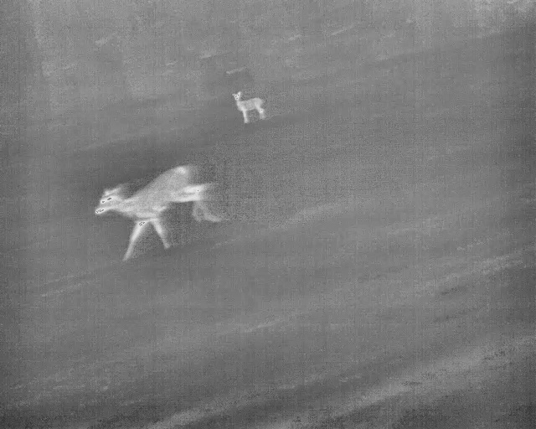
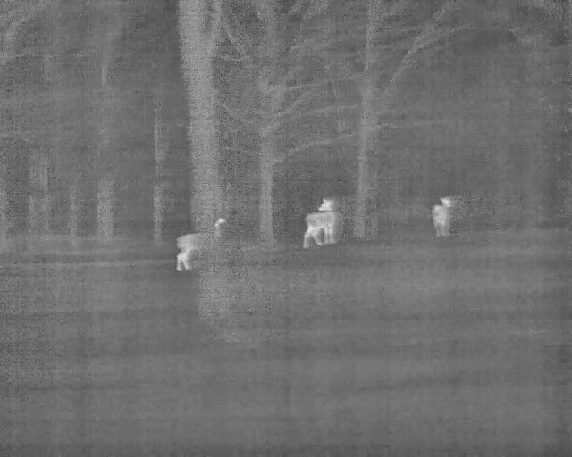
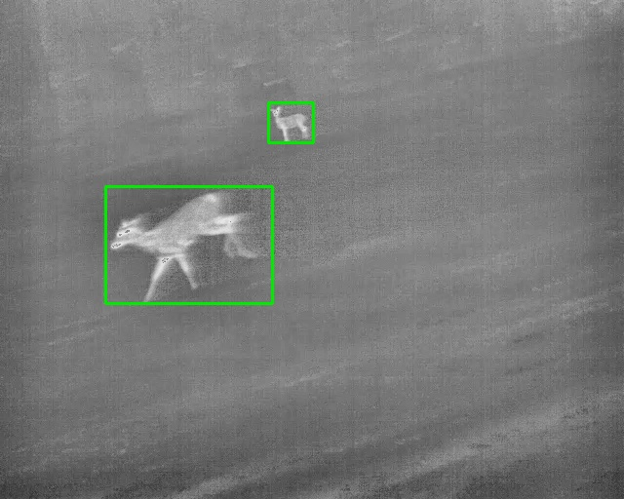
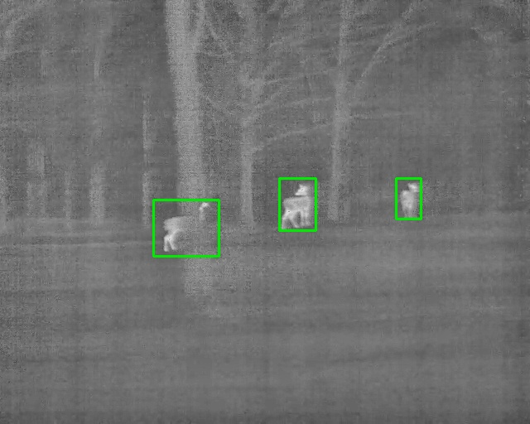
A survey needs animals counted, not boxes placed
Wildlife pipelines are judged as object detectors, by accuracy per frame (mAP).
An abundance survey needs the number of distinct animals, which depends on tracking and on deciding which tracks are new animals.
Our question: does better detection give a better count?
What the detector receives
32
236
thermal road-transect videos, 4 Illinois sites
deer, each annotated as its own track
521,930
29 x 24 px
frames at 60 fps, all annotated
median animal size
Ground truth: one track per animal, in every frame
Notes:
The corpus: 32 nocturnal videos, 8 per site, every deer in every frame annotated in CVAT as an individual track. One track is one animal, so the same annotation gives detection, tracking and count ground truth. 235 of the 236 animals are detectable; one is occluded throughout.

Slide 3
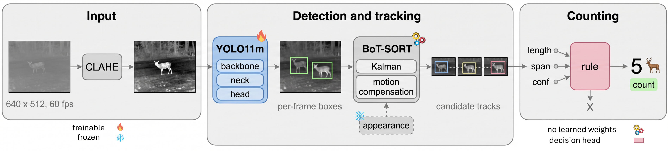
Method: a standard pipeline, measured stage by stage
1
REACHED
2
PRIMARY
3
COUNTED
Held-out protocol
Did any candidate track touch the animal on at least one frame?
Does the animal have a best-covering track of its own?
Did the confirmation rule accept a track on the animal?
The rule is fitted by grid search on the 19 training videos, frozen, and reported on 13 videos the detector never saw (83 deer).
Measures detection and tracking
Measures association
Measures confirmation
Notes:
Every component is standard: CLAHE normalization, YOLO11m at 640 px, BoT-SORT with global motion compensation and its appearance term disabled, orphan recovery, and a confirmation rule with three thresholds (track length of at least 20 frames, mean of the five best confidences of at least 0.65). The system does track association within one video; it does not recognise individual animals. The contribution is the decomposition: for each ground-truth animal we ask three questions, and the gaps between them attribute error to detection, association and confirmation.

Slide 4
Detection is close to solved; the count is lost afterwards
82 to 99.6%
of animals are found in at least one frame by every detector, although AP50 is only 0.37 to 0.51
89 > 80 > 66%
reached, primary and counted on held-out video: most animals are lost at confirmation
MAE 2.38
animals per video; the pipeline under-counts and almost never over-counts
Notes:
Per-box metrics look poor because the animals are 27 pixels: a centre error of nine pixels already fails IoU 0.5. Scored per animal, every architecture finds 82 to 99.6 percent of the 235 detectable deer. End to end on the 13 held-out videos the reported pipeline reaches 89.2 percent of animals, gives 79.5 percent their own track and counts 66.3 percent, with a mean absolute error of 2.38 animals per video. The detector chosen for counting is YOLO11m, selected on precision-weighted F0.5, not the model with the best AP50.

Slide 5
Richer candidate pools count fewer animals
Every richer pool reaches more animals than the baseline and counts fewer: the extra candidates are re-sightings of animals already counted.
Lowering c recovers animals but admits about two duplicates for each; the count is unbiased near c = 0.45 (81 of 83).
Learned confirmers (logistic regression, boosting, transformer) lose to the 3-parameter rule: MAE 2.85 to 3.00 vs. 2.38.
Notes:
The central result. We enriched the candidate pool three ways. The pools are nested, and ordered here by the number of candidate tracks they generate. Reached and primary go up, counted goes down: 55, 54, 52, 41 of 83. With 83 animals a difference of two or three is not significant on its own; the evidence is the consistent direction. The right chart holds the rule fixed and moves only the confidence threshold: the condition acts as a duplicate suppressor, not as a detector threshold. Appearance matching is an ablation only; the reported system does not use it.

Slide 6
Across sites, and what to take away
1
Detection is not the bottleneck
Per animal, detection is near-saturated on this corpus. Confirmation is where animals are lost.
2
Improving the candidate pool did not help
Better detection, association and looser suppression each left the count equal or lower.
3
The limit is supervision, not model capacity
About 200 positive tracks; duplicates sit between true animals and false candidates on every feature.
4
Choose the operating point for the purpose
Minimum error per transect (c = 0.65) or an unbiased total for abundance (c = 0.45); re-fit at a new site.
Detection and association transfer to an unseen site; the count does not. An absolute threshold of 0.65 accepts nothing at MAS, where no track scores above 0.585.
Dataset, annotations and evaluation code will be released with the paper.
Notes:
Leave-one-site-out: train on three sites, count on the fourth, with the confirmation rule unchanged. Pooled over the four folds, reached is 91.1 percent, primary 78.3 percent and counted 51.9 percent. Each site was surveyed on a single night, so site and night conditions are confounded. Limits of the study: one region, one winter, one species, 236 animals, and a ground truth that under-represents distant animals, as any visual survey does.

