Slide 1
Eureka

Slide 2
What is Eureka?
Eureka Server is a service registry that plays a central role in the automatic detection of devices and services on a network. It acts as the heart of your microservices ecosystem, allowing service instances to register themselves and facilitating service discovery. Key aspects of Eureka Server include:
Client Registration: Instances of microservices automatically register themselves with Eureka Server.
Service Discovery: Eureka Server maintains a registry of all client applications running on different ports and IP addresses.

Slide 3
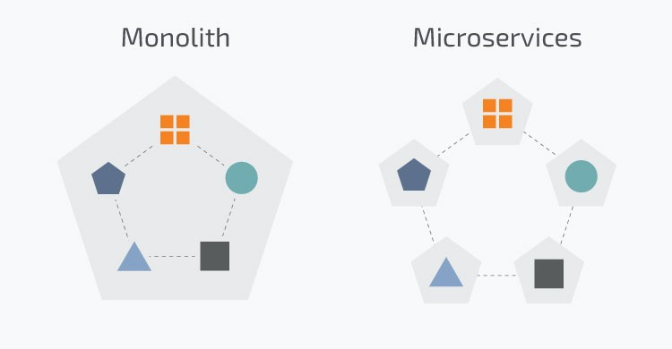
Why switch to Microservices?
Before Eureka, in a traditional monolithic architecture, applications were developed as a single, large unit where all components were tightly integrated.
As the size and complexity of applications grew, maintaining and scaling monolithic systems became challenging.
Additionally, deploying updates or changes to a single component often required redeploying the entire application, leading to downtime and operational inefficiencies.

Slide 4
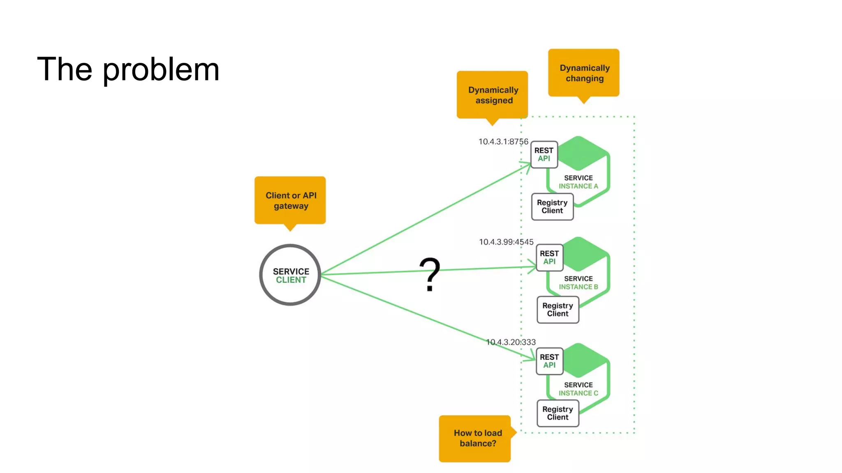
Issues with Microservices
The emergence of microservices architecture addressed some of these challenges. However, with this new architecture, a new set of challenges arose.
Service Discovery: services need hardcoded endpoints in order to communicate with each other. It becomes impractical as the number of services grows.
Load Balancing: multiple instances of a service may be running to handle different loads, efficient load balancing is essential for distributing incoming requests.
Fault Tolerance: services can fail due to various reasons. It’s crucial to handle these failures gracefully to maintain overall system reliability.
Dynamic Scaling: in a dynamic microservices environment, instances may be added or removed based on demand or failures. Traditional approaches struggle to adapt to these changes seamlessly.

Slide 5
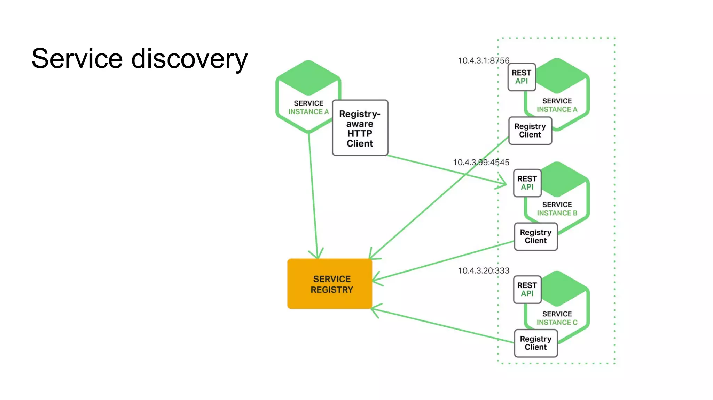
It's a Bird… It's a Plane… It’s Eureka!
So how does Eureka addresses the challenges associated with microservices?
Service Discovery: Eureka provides a dynamic and centralized service registry where microservices can register themselves, and other services can discover available instances.
Load Balancing: Eureka integrates with load balancers, such as Ribbon, to dynamically distribute incoming requests among available service instances.
Fault Tolerance: Eureka employs a self-preservation mechanism that prevents the accidental removal of healthy instances during temporary network issues.
Dynamic Scaling: Eureka enables dynamic scaling by allowing microservices to register and deregister themselves automatically.

Slide 6
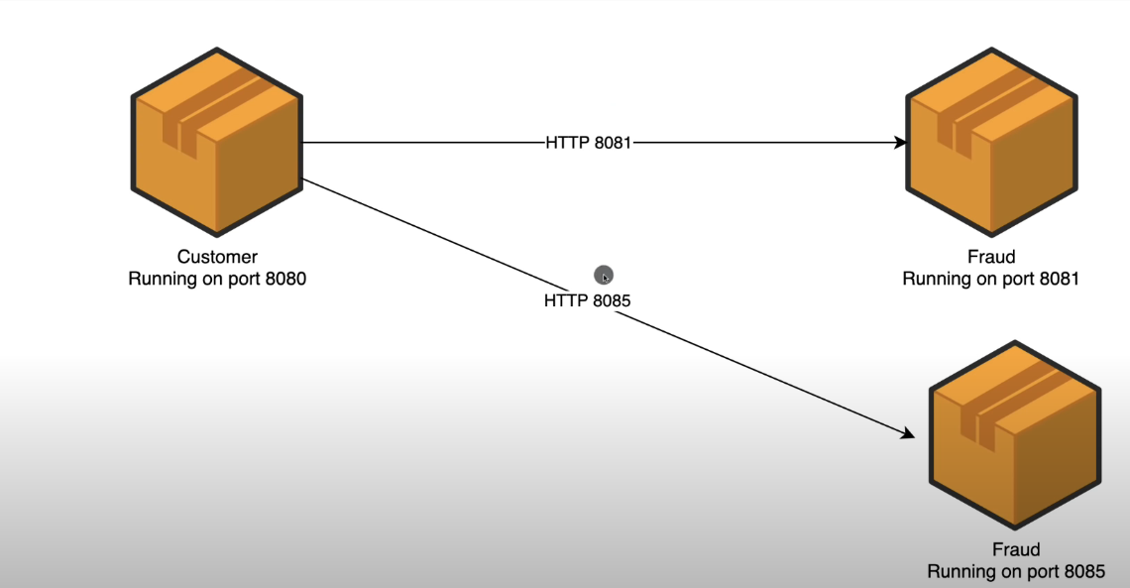
Services Communication before Eureka

Slide 7
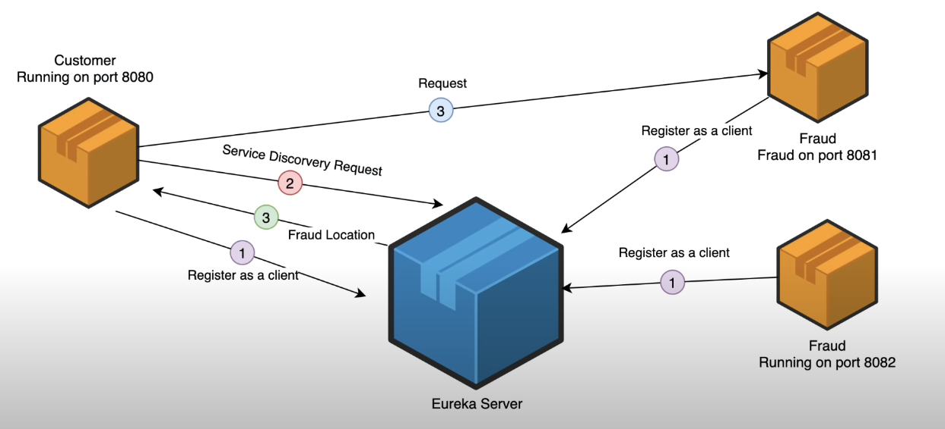
Services Communication with Eureka

