Slide 1

Stock Market Data Base
“Rule No. 1 is never lose money. Rule No. 2 is never forget Rule No. 1.” Warrant Buffet
By Yuval Mastey And Tamir Spilberg

Slide 2
Program Description
Stock Market
With the use of live information the program offers the user a unique opportunity to experiment with stocks and virtual currency in real-time.
Portfolio
The program constantly updates prices, showing stocks behavioral change and user's profit/loss with each update, making sure the user can change his strategy in any given situation in accordance with his balance.

Slide 3
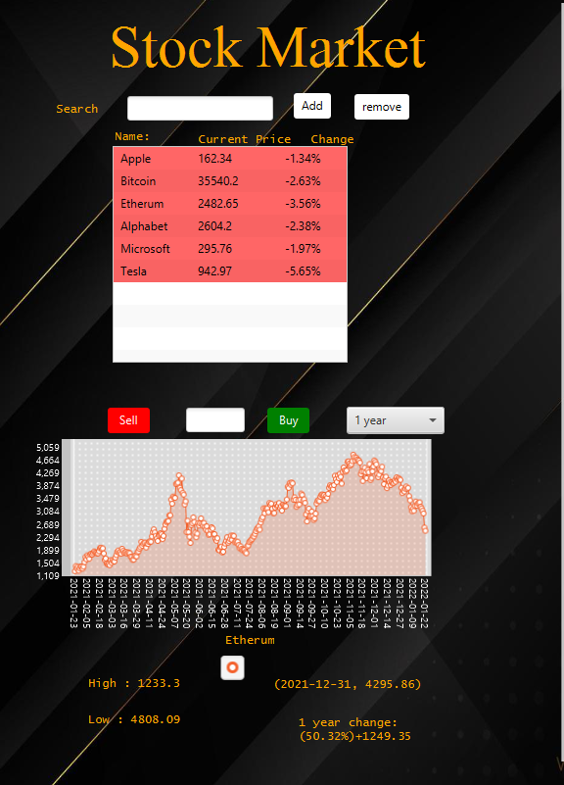
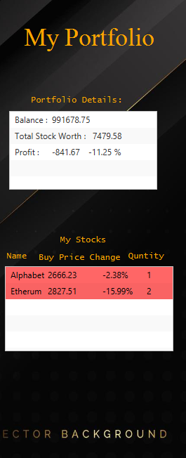
Program Description
Stock Market Features
Live Stock Update
Stock Analysis
View Stock’s Data
Portfolio Features
Buy and sell Stocks
Live Portfolio Update

Slide 4
Design Patterns
Command Pattern (Broker)
Singleton Pattern (Broker , Api)
MVC

Slide 5
Threads
Stocks Real Time Update ( Every 30 Seconds)
Stock Data Update (user Choice)
Main Live Update

Slide 6
Transaction
Buy/Sell Stock
Broker Send Order Command
Update User Stock
Update Data Base (Local SQL server)
Update user Stock’s AVG price(Queue)

Slide 7
Local API concept
Stock Market Data API
Java Program
Local API
Stock Market Data API Cons:
-Expensive for Example NASDAQ API – cost 4000$ per month for unlimited access
-depend on Internet Connection
-Slow (each API call Takes around 700ms)
Local MY SQL Data API Pros:
-Cheap (Local Computer) calls Don’t COST ANY MONEY!
(“Free is Exciting to me” by Amnon Titinsky)
-Fast and Local using
Offer

Slide 8
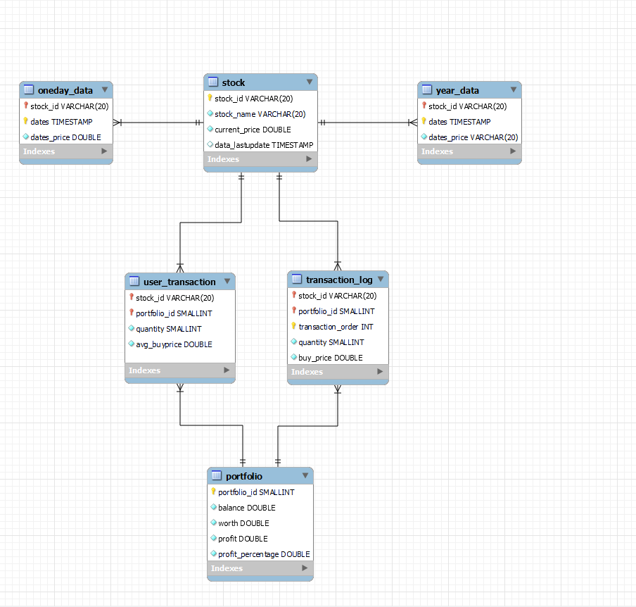
Entity–relationship diagram

