Slide 1
Introduction to Test Automation
Notes:
להתחיל מלשאול את המשתתפים מה זה אוטומציה? בדיקות תוכנה ממוכנות הן בדיקות תוכנה המבוצעות בדרך אוטומטית על ידי שימוש בתוכנה ייעודית (נפרדת מהתכנה הנבדקת) לשליטה על ביצוע בדיקות והשוואת פלט הבדיקה הרצוי לפלט בפועל. אוטומציה יכולה להריץ בצורה אוטומטית בדיקות קיימות כחלק מתהליך הבדיקות הפורמלי או להוסיף בדיקות נוספות שקשה לבצען ידנית.
למה צריך אוטומציה והאם זה מחליף בדיקות ידניות
מתי נשתמש בבדיקות אוטומטיות : רגרסיה , continues integration, sanety

Slide 2
Types of automated tests
Functional
NFT
Sanity
System
Performance
Load
API
Regression
Integration
Unit

Slide 3
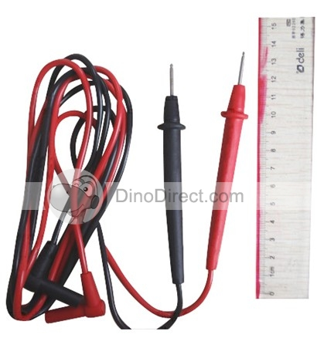

Test Scope: End to End
UI
View Model
Client Logic
Server Proxy
Service Layer
Business Logic
DAL
ORM
DB

Slide 4
Test Scope – Server only (+DB)
UI
View Model
Client Logic
Server Proxy
Service Layer
Business Logic
DAL
ORM
DB

Slide 5
Test Scope – unit tests
UI
View Model
Client Logic
Server Proxy
Service Layer
Business Logic
DAL
ORM
DB
Notes:
שקף הבא : מה היתרונות?
מהירות
חוסך זמן בדיקה
מפנה את הבודקים למשימות חשובות ומעניות יותר שדורשות מחשבה
ניתן לבדוק דברים שלא ניתן לבדוק מהGUI למשל
מה החסרונות
זמן פיתוח
תחזוקה

Slide 6
Benefits of (functional) test automation
Saves manpower
(is it really?)
Runs much faster
Accurate - doesn’t cut corners…
Can simulate cases that are difficult manually
Not applicable for Ranorex without code
Fast feedback!
Notes:
הערה למרצה: עדיף לא להציג, אלא לקיים כדיון
* Manpower is saved because less people are needed to run regression testing. However, automation requires more manpower to maintain the tests and to investigate failures.
The most important benefit of test automation is that it provides fast feedback! It’s much cheaper to fix (regression) bugs as close to when they are introduced rather than later. But this also requires a change in business processes! In order to get this benefit, the test automation must be kept reliable, and every bug that it founds must be fixed ASAP (even if it’s not a critical bug!)
שקף הבא מגבלות
לא מחפש באגים
לא יודעים איך נראה העמוד(יש אפשרות כיום מאוד יקרה אמפליטוד)
שבירה שינויים תשתיתים יכולים לגרום לאוטומציה להפסיק לעבוד

Slide 7
Limitation of Test Automation
Verification vs. Validation
Doesn’t look for bugs
Doesn’t test “look & feel”
Don’t use common sense!
Must be accurately defined
Fragile – Building trust is challenging!
Maintenance
Notes:
הערה למרצה: עדיף לא להציג, אלא לקיים כדיון
validation = did we built the right thing, i.e., is the customer happy, whereas verification = did we built the thing right, i.e., does it work according to specs
Doesn’t look for bugs = only verifies what it’s been programmed. Doesn’t “look around”
Manual tests are not always accurately defined. Automated tests must be, and that can be very challenging!
Explain why test automation is fragile: Test automation relies on many very fine detailed that may change from one machine to another, from one run to another, when data changes, and most important: when the code changes between builds. All of these lead to the need for maintainance.
ולידציה = מתן תוקף (ווידוא) (validation) = ווידוא ע"י בחינה ועדויות תוצאתיות שהדרישות לשימוש מסוים או יישום מסוים אכן מולאו.
ולידציה מתבצעת כחלק מהבדיקות הדינמיות כלומר ניתן לבצע ולידציה רק ע"י הרצת הבדיקות.
וריפיקציה =אימות (verification) = אימות ע"י בחינה ועדויות תוצאתיות שדרישות ספציפיות אכן מולאו.
וריפיקציה מתבצעת כחלק מהבדיקות הסטטיות כלומר האימות מבוצע כנגד מסמכים (אפיון, דרישות וכדומה) ואין צורך בהרצת בדיקות.

Slide 8

Manual vs. Automated tests
Notes:
בודק

Slide 9




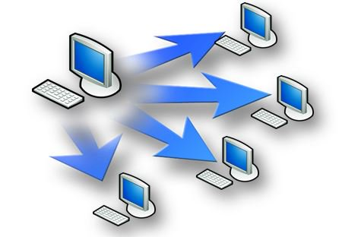

Development process (CICD)
Source Control
Build
Deploy

Slide 10
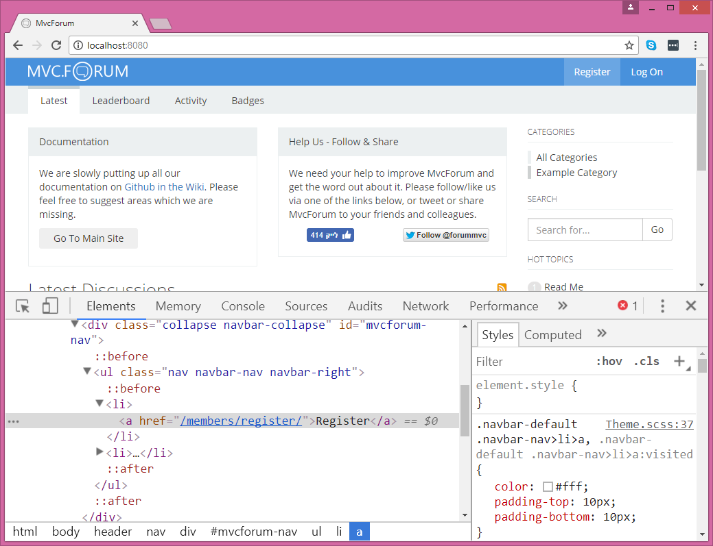
Selenium

Slide 11
Selenium
Open-Source
Mainly for Browsers
Supports all browsers known to man
Tests are written by code – all popular languages are supported!
Very popular – large community
Selenium IDE
Status
Record & Playback
Can export C# or Java code

Slide 12
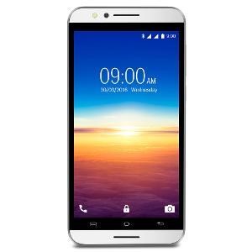
Appium
Selenium Extension for Mobile
Supports both Android and iOS
Requires Mac to run iOS tests

Slide 13
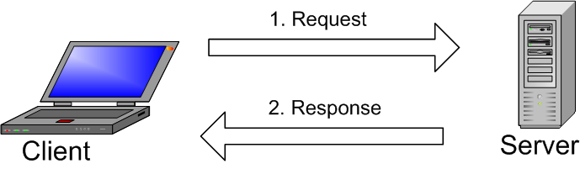
API automation
SOAP UI
Free version
Full version
RestAssured
Hand-coded…

Slide 14

Selenium Overview

Slide 15
Selenium Overview
Open Source
Most Popular Test Automation tool
W3C recommendation
Supported by all known browse vendors
Runs on Windows, Mac and Linux
Supports many programming languages
Extensible architecture
Appium
Selenium Grid

Slide 16






Supported Browsers
Chrome
Firefox
Edge
Internet Explorer
Safari
Opera

Slide 17
Supported Languages
C#
Java
Python
JavaScript
Ruby
Objective-C
PHP
Haskell
R

Slide 18
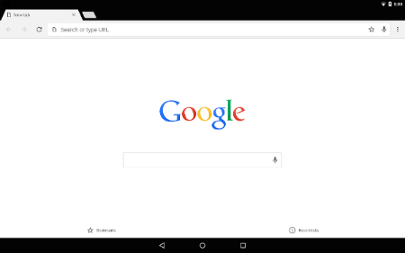
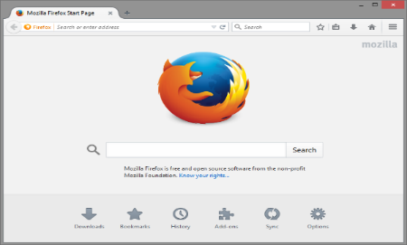
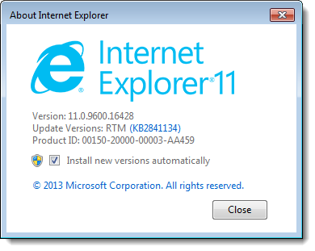
Architecture of Selenium
Your test process (C#)
JSON Wire Protocol
Chrome Driver
WebDriver.dll (.Net binding)
Intenet
JSON Wire Proto-col
Test process (Java)
WebDriver.jar(Java binding)
FireFox Driver
Intenet
Test process (Ruby)
WebDriver.gem (Ruby binding)
IE Driver
Intenet
Test process (Python)
WebDriver.py (Python binding)

Slide 19
Notes!
Selenium is not a testing framework!
Selenium is not limited to testing…

Slide 20
First Selenium Demo
Notes:
Most details will be clear later
Create a console project and add WebDriver and ChormeDriver nuget packages
Navigate to “https://www.seleniumhq.org”, and click Projects ( By.Id(“menu_projects”) – show in F12)
Find all elements matching “#mainContent h3” and print their text.

Slide 21

Unit Testing Framework Basics

Slide 22
MSTest – Microsoft Visual Studio Unit Testing Project

Slide 23
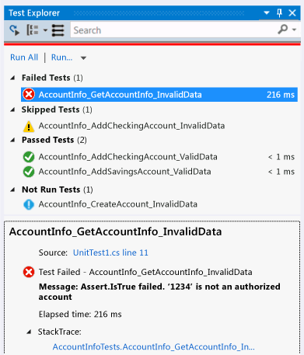
MSTest – Basics
Classes containing tests must have [TestClass] attribute
Class must be public
Each Test method must be have a [TestMethod] attribute
Method must be public void
Test → Windows → Test Explorer

Slide 24
Asserts
Assert.AreEqual(expected, actual [, message])
Assert.IsTrue(Boolean-expression [, message])
Assert.IsFalse
Assert.IsNull
Assert.IsNotNull
StringAssert.Contains
StringAssert.StartsWith
StringAssert.EndsWith
StringAssert.Matches(string, regex,…)
StringAssert.DoesNotMatch(string, regex,…)
CollectionAssert.AreEqual
CollectionAssert.AreEquivallent
CollectionAssert.Contains
And more…

Slide 25
Initialization and Cleanup lifecycle
Attribute | When executed
TestInitialize | Before each test in the same class
TestCleanup | After each test in the same class
ClassInitialize | Before the first test in the class
ClassCleanup | After the last test in the class
AssemblyInitialize | Before the first test in the project
AssemblyCleanup | After the last test in the project

Slide 26
Typical Test Structure - AAA
Arrange
Act
Assert

Slide 27
Selenium WebDriver

Slide 28
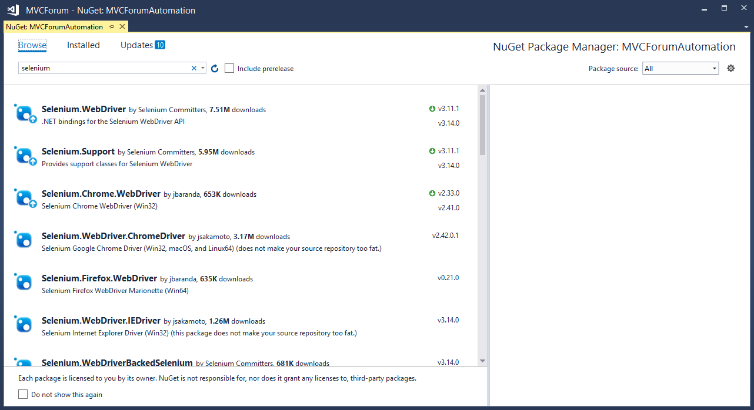
Adding WebDriver to the project

Slide 29

Opening and navigating to a page
Open the browser:
IWebDriver driver = new ChromeDriver();
Maximize the browser:
driver.Manage().Window.Maximize();
Navigate to a page:
driver.Url = "https://www.seleniumhq.org";
Closing the browser:
driver.Quit();

Slide 30
IWebDriver
Represents a browser
Implemented by: ChromeDriver, FirefoxDriver, etc.
All derive from RemoteWebDriver
Makes cross-browser testing easy
The entry point to all Selenium’s API
It’s possible to create multiple instances (!)
Main uses:
Navigation
Locating elements

Slide 31
Navigation
webDriver.Url = "http://www.mywebsite.com"
webDriver.Navigate().Back();
webDriver.Navigate().Forward();
webDriver.Navigate().Refresh();

Slide 32
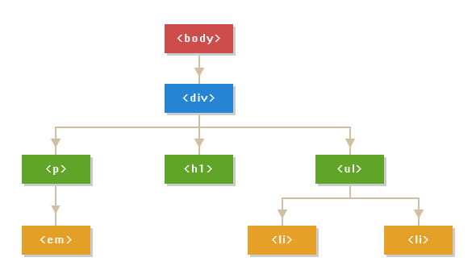
DOM – Document Object Model
<body>
<div class="container">
<h1>Hello World</h1>
<p>This is a <em>simple paragraph</em>.</p>
<ul>
<li>Item One</li>
<li>Item Two</li>
</ul>
</div>
</body>

Slide 33
Find element
Driver
Element Id= id1
Id= id3 class=“xx rr tt”
Id=id2 class=xx
Id=id3 class=xx
Id=id4 class=zz
Id= id3
Id= id3
Id= id3
Id = id5
Id = id5
Id = id 5
Id = id7
Id = id7
Id = id7
Id = id6
Id = id6
$50.99
Dress 2

Slide 34
DOM vs. HTML
HTML | DOM
Static representation of a web page | Dynamic (runtime) representation of the page
Received from the server | Based on the HTML, but can be manipulated using JavaScript
Both represent the hierarchy of elements
Each element can contain other elements and attributes
JavaScript code can:
Add new elements
Remove elements
Change attributes and content of elements

Slide 35
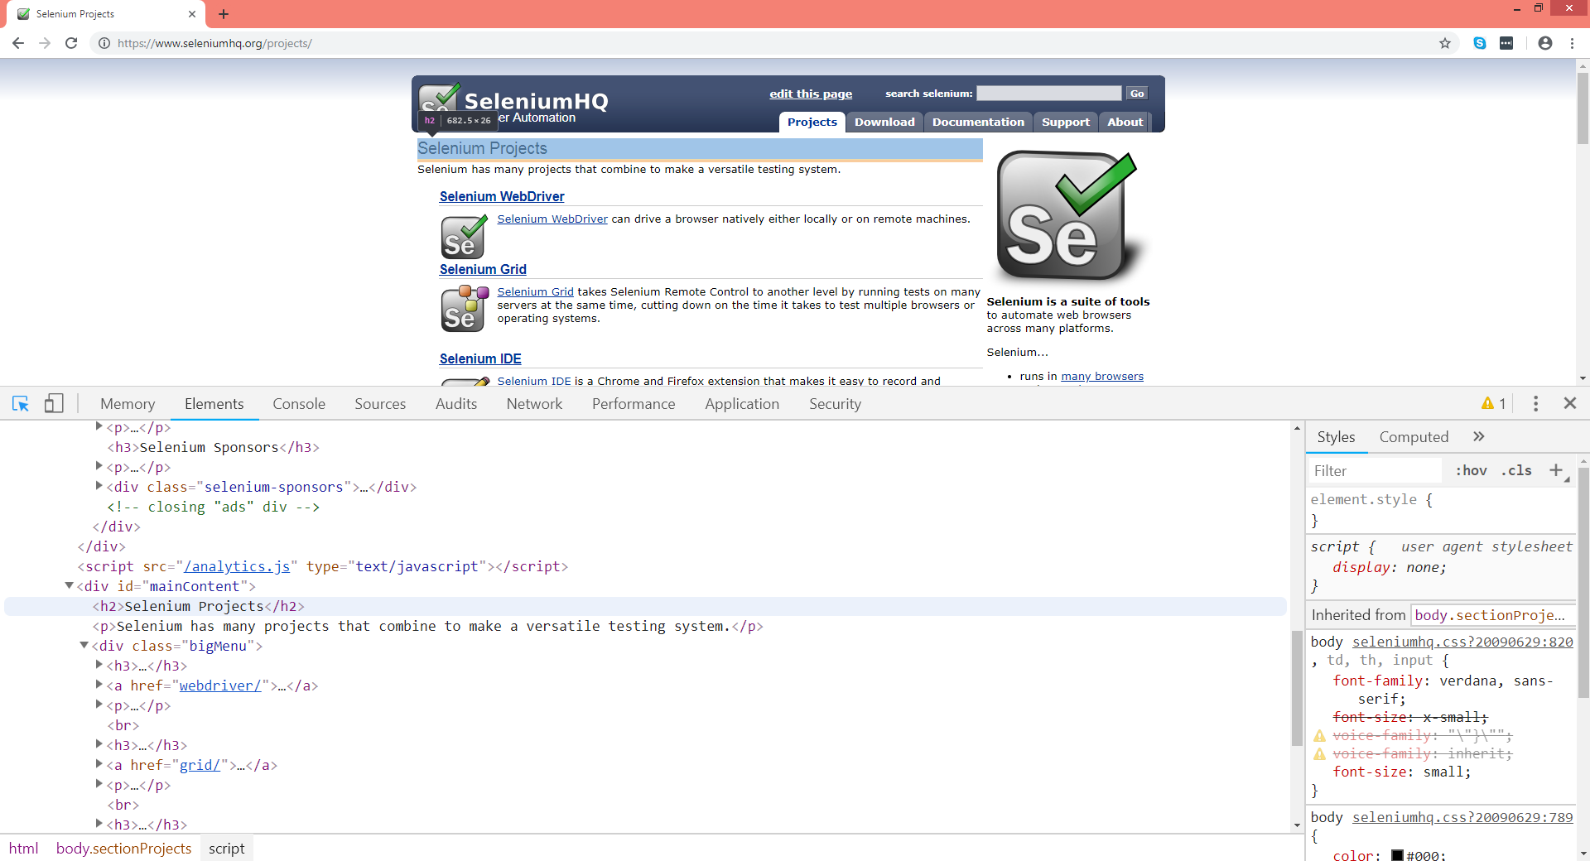
Chrome Dev Tools (F12)

Slide 36
Finding elements using IWebDriver
Syntax:
IWebElement projectsMenu = webDriver.FindElement(By.Id("menu_projects"));
A new object that represents the found element
The IWebDriver object we created previously
The locator which specifies how to find the element

Slide 37
Finding Multiple elements using IWebDriver
Syntax:
ReadOnlyCollection<IWebElement> results = webDriver.FindElements(By.CssSelector(“#mainContent h3"));
foreach(IWebElement result in results)
…
A new object that represents the list of found elements
Note the trailing “s”…
The locator which specifies how to find the elements
Loop over the results

Slide 38
Locators (By)
Id
Name
TagName
LinkText
PartialLinkText
ClassName
CssSelector
XPath

Slide 39
By.Id
Finds the element whose id attribute matches the specified value. Example:
<li id="menu_projects">Projects</li>
IWebElement element = webDriver.FindElement(By.Id("menu_projects"));
Notes:
The Id attribute is supposed to be unique across all elements in a page
However, the browsers don’t enforce that
Recommended for FindElement but not for FindElements…

Slide 40
By.Name
Finds the element whose name attribute matches the specified value. Example:
<form method="get">
Phone number: <input name="phoneNumber"/>
</form>
IWebElement element = webDriver.FindElement(By.Name("phoneNumber"));
Notes:
The name attribute is typically used in elements that belong to a form
The name attribute should be unique within the form they belong to

Slide 41
By.TagName
Finds the element whose tag matches the specified value. Example:
<button>Log in</button>
IWebElement element = webDriver.FindElement(By.TagName("button"));

Slide 42
By.LinkText
Finds the element whose inner text matches the specified value. Example:
<button>Log in</button>
IWebElement element = webDriver.FindElement(By.LinkText("Log in"));
Notes:
It works for all elements, not only links
The value must exactly match the inner text
Not recommended for multilingual websites

Slide 43
By.PartialLinkText
Finds the element whose inner text contains the specified value. Example:
<button>Click here to log in, please</button>
IWebElement element = webDriver.FindElement(By.PartialLinkText("log in"));
Notes:
It works for all elements, not only links
Not recommended for multilingual websites

Slide 44
By.ClassName
Finds the element whose class attribute contains the specified value. Example:
<input class="margin-bottom default-button right-aligned">Log in</input>
IWebElement element = webDriver.FindElement(By.ClassName(“default-button"));
Notes:
The class attribute is a special attribute that can contain multiple names of CSS classes separated by spaces
The By.ClassName locator can take only one class name and finds the element(s) who has this class
By.ClassName does not perform a simple “contains” operator. E.g., By.ClassName("button") won’t match the element in the example
Often useful in FindElements

Slide 45
By.ClassName
Finds the element whose class attribute contains the specified value. Example:
<input class="margin-bottom default-button right-aligned">Log in</input>
IWebElement element = webDriver.FindElement(By.ClassName(“default-button"));
Notes:
The class attribute is a special attribute that can contain multiple names of CSS classes separated by spaces
The By.ClassName locator can take only one class name and finds the element(s) who has this class
By.ClassName does not perform a simple “contains” operator. E.g., By.ClassName("button") won’t match the element in the example
Often useful in FindElements

Slide 46
By.CssSelector
Finds the element that matches the specified CSS selector. Example:
<div class="right-aligned">Some text</div>
<input class="right-aligned" />
<input class="left-aligned" >
IWebElement element = webDriver.FindElement(By.CssSelector("input.right-aligned"));
Notes:
CSS Selector is a compound locator
Syntax of CSS Selectors can be found at https://www.w3schools.com/cssref/css_selectors.asp

Slide 47
CSS
ID - <HTML tag><#><Value of ID attribute>
<input id=“Email” class=“some class name” ….>
css=input#Email
CLASS - <HTML tag><.><Value of Class attribute>
<header id="masthead" class="site-header" …>
css= header.site-header
Attribute-<HTML tag><[attribute=Value of attribute]>
<input class=“className" type="text" id="searc…>
css=input[type=’text’]
Sub-string -<HTML tag><[attribute^=prefix of the string]>
<input class=“className" type=“Password" id="Passwd”…>
css= input#Passwd[type ^=’Pass’]
Inner Text - <HTML tag><:><contains><(text)>
<button id=“Email” text=“Log in to …” ….>
css=button:contains("Log In")
https://www.softwaretestinghelp.com/css-selector-selenium-locator-selenium-tutorial-6/

Slide 48
CSS
Parent
<div id=“Email” ….> <p class="tab-content” ….>
Css = div#Email>p.tab-content
https://www.softwaretestinghelp.com/css-selector-selenium-locator-selenium-tutorial-6/

Slide 49
By.XPath
Finds the element that matches the specified XPath. Example:
<input type="button">Sign-up</input>
<div id="login-pane" class="container">
Username: <input type="text"/>
Password: <input type="password" />
<input type="button">Log in</input>
</div>
IWebElement loginButton = webDriver.FindElement(By.XPath("//div/input[@type='button']"));
Notes:
XPath is a compound locator
Syntax of XPath can be found athttps://www.w3schools.com/xml/xpath_syntax.asp

Slide 50
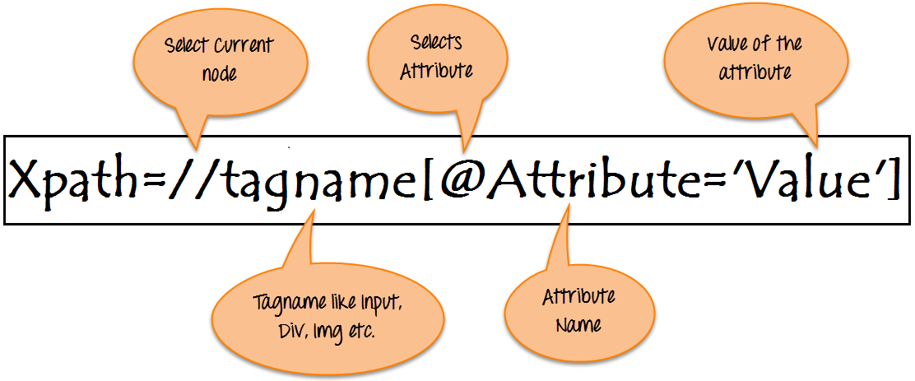
Xpath https://www.guru99.com/xpath-selenium.html

Slide 51
Xpath examples
Xpath=//*[contains(@type,'sub')]
Xpath=//*[@type='submit' OR @name='btnReset']
Xpath=//input[@type='submit' and @name='btnLogin']
Xpath=//label[starts-with(@id,'message')]
Not a good Xpath
//*[@id="g-mainbar"]/div[1]/div/div/div/div/div/div[2]/p[57]

Slide 52
IWebElement interface
Represents a single element
Though can be a parent of other elements
Returned from IWebDriver.FindElement and IWebDriver.FindElements
Also returned from IWebElement.FindElement and IWebElement.FindElements
Provides information and performs actions on the element

Slide 53
Important IWebElement members
Member | Description | Example
Click (method) | Clicks on the element | IWebElement loginButton = driver.FindElement(…); loginButton.Click();
SendKeys (method) | Types text in an input element | IWebElement username = driver.FindElement(…); username.SendKeys("arnonax");
Clear (method) | Clears the text in an input element (sometimes necessary to clear default value) | IWebElement username = driver.FindElement(…); username.Clear(); username.SendKeys("arnonax");
FindElement FindElements (methods) | Finds child element(s) of the current element | IWebElement loginPanel = driver.FindElement(By.Id("login-panel"); IWebElement loginButton = loginPanel.FindElement(By.TagName("button")); loginButton.Click();
Text (get property) | Returned the inner text of the element | IWebElement popupMessage = driver.FindElement(…); Assert.AreEqual("File not found", popupMessage.Text);
Enabled (get property) | Indicates whether the element is enabled | IWebElement loginButton = driver.FindElement(…); Assert.IsTrue(loginButton.Enabled);

Slide 54
Locators
http://automationpractice.com
User: test1234@sela.com
Password: 12345
Test 1 search “summer” select one item add it to cart
Test 2 search “evening” and buy the first Item
Test 3*
Log in
Go back to main window
Click on women button
Select the “Blouse”
Open the page add it to cart
Complete your purchase

Slide 55
How to choose a locator
The 4 rules for maintainable locators:
The locator must match the correct element
The locator must not match any other element
Avoid depending on information that is likely to change
Depend on the minimal necessary information
Order matters!

Slide 56
Locators – more tips
Collaborate with the developers!
Use FindElement within other elements
To remove duplication
For better modularity
Used for the Page-object pattern (discussed later)
Sometimes its easier to find a parent or a child
Verify your locator in the Dev Tools pane

Slide 57
IFRAME https://www.guru99.com/handling-iframes-selenium.html
IFrame is a web page which is embedded in another web page or an HTML document embedded inside another HTML document.
Name and ID
driver.switchTo().frame("a077aa5e");
driver.switchTo().frame(driver.findElement(By.Classname(“class")));
Switch out
driver.switchTo().defaultContent();
driver.SwitchTo().ParentFrame();

Slide 58
driver = new ChromeDriver();
<iframe id=“11111" name=“iframe-name" class="iframe class“…..
/>
button
button

Slide 59
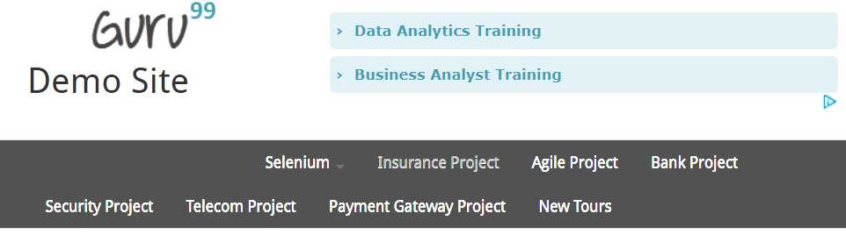
IFRAME
LAB - http://demo.guru99.com/test/guru99home/
Get the text from
Click on the

Slide 60
The SelectElement class https://www.guru99.com/select-option-dropdown-selenium-webdriver.html
Helper for working with drop-down (Select) elements
Example:
<select id="country">
<option value="IL">Israel</option>
<option value="US“>United States</option>
<option value="GB“>Great Britain</option>
</select>
IWebElement element = webDriver.FindElement(By.Id(“country"));
SelectElement select = new SelectElement(element);
select.SelectByValue("US");

Slide 61
The SelectElement Class
Member | Description
SelectByIndex (method) | Select the option by the index, as determined by the "index" attribute of the element
SelectByValue (method) | Select an option by the value
SelectByText (method) | Select all options by the text displayed
Options (get property) | Gets the list of options for the select element
SelectedOption (get property) | Gets the selected item within the select element

Slide 62
The Action class https://www.edureka.co/blog/keyboard-mouse-events-actions-class https://www.guru99.com/drag-drop-selenium.html (http://demo.guru99.com/test/drag_drop.html)
Helper for performing mouse and keyboard action
Example:
Actions action = new Actions(driver);
action.moveToElement(element).click().perform();
action.dragAndDropBy(element,135, 40).build().perform();
action.dragAndDrop(element, element1).build().perform();

Slide 63
The SelectElement Class
Member | Description
click(): | Clicks on the element.
doubleClick (): | Double clicks on the element.
contextClick() | Performs a context-click (right-click) on the element.
clickAndHold(): | Clicks at the present mouse location without releasing.
dragAndDrop(source, target): | Clicks at the source location and moves to the location of the target element before releasing the mouse. source (element to grab, target – element to release).
dragAndDropBy(source, xOffset, yOffset): | ): Performs click-and-hold at the source location, shifts by a given offset value, then frees the mouse. (X offset – to shift horizontally, Y Offset – to shift vertically).
Notes:
click(): Clicks on the element.
doubleClick (): Double clicks on the element.
contextClick() : Performs a context-click (right-click) on the element.
clickAndHold(): Clicks at the present mouse location without releasing.
dragAndDrop(source, target): Clicks at the source location and moves to the location of the target element before releasing the mouse. source (element to grab, target – element to release).
dragAndDropBy(source, xOffset, yOffset): Performs click-and-hold at the source location, shifts by a given offset value, then frees the mouse. (X offset – to shift horizontally, Y Offset – to shift vertically).
moveByOffset(x-offset, y-offset): Shifts the mouse from its current position (or 0,0) by the given offset. x-offset – Sets the horizontal offset (negative value – shifting the mouse to the left), y-offset – Sets the vertical offset (negative value – shifting the mouse to the up).
moveToElement(toElement): It shifts the mouse to the center of the element.
release(): Releases the pressed left mouse button at the existing mouse location.

Slide 64
The Action KeyBoard Class
Member | Description
sendKeys(keysToSend) | Sends a series of keystrokes onto the element.
keyDown(theKey) | Sends a key press without release it. Subsequent actions may assume it as pressed.
keyUp(theKey) | Performs a key release.
Notes:
click(): Clicks on the element.
doubleClick (): Double clicks on the element.
contextClick() : Performs a context-click (right-click) on the element.
clickAndHold(): Clicks at the present mouse location without releasing.
dragAndDrop(source, target): Clicks at the source location and moves to the location of the target element before releasing the mouse. source (element to grab, target – element to release).
dragAndDropBy(source, xOffset, yOffset): Performs click-and-hold at the source location, shifts by a given offset value, then frees the mouse. (X offset – to shift horizontally, Y Offset – to shift vertically).
moveByOffset(x-offset, y-offset): Shifts the mouse from its current position (or 0,0) by the given offset. x-offset – Sets the horizontal offset (negative value – shifting the mouse to the left), y-offset – Sets the vertical offset (negative value – shifting the mouse to the up).
moveToElement(toElement): It shifts the mouse to the center of the element.
release(): Releases the pressed left mouse button at the existing mouse location.

Slide 65
Select Element
http://demo.guru99.com/test/newtours/register.php
Open the site
Fill the form and send it

Slide 66
Waits
Thread.Sleep – waits a constant time (not recommended!)
Implicit Wait – automatically waits until FindElement finds the specified element
Throws NoSuchElementException if not found after timeout
Explicit Wait – Waits for a specific condition to be true
Throws WebDriverTimeoutException if condition is not met after timeout

Slide 67
Thread.Sleep
Median
Avarage
99%
Time wasted!

Slide 68
Implicit Wait
Syntax:
driver.Manage().Timeouts().ImplicitWait = TimeSpan.FromSeconds(20);
Affects all FindElement operations
Affects only FindElement operations
For FindElements – waits until at least one element is found

Slide 69
Explicit Wait
Syntax:
WebDriverWait wait = new WebDriverWait(driver, TimeSpan.FromSeconds(10));
Wait.Until(condition);
Can be used to wait for any condition
Condition is a delegate to a method or lambda that accepts IWebDriver argument and either an object or a Boolean
The delegate is called continuously until it returns true or an object (not null)
The ExpectedConditions class has many built-in conditions

Slide 70
ExpectedCondition class – important conditions
Condition (static method) | Description
ElementExists | Waits until the element is present on the DOM. This does not necessarily mean that the element is visible
ElementIsVisible | Waits until the element is present on the DOM and is visible
ElementToBeClickable | Waits until the element is visib
TextToBePresentInElement | Waits until the given text is present in the specified element
TextToBePresentInElementValue | Waits until the given text is present in the value of the element (for Input elements)
TitleIs | Waits until the title of the page matches the given text
TitleContains | Waits until the title of the page contains the given text
AlertIsPresent | Waits until an alert message is present

Slide 71
WebDriverWait wait = new WebDriverWait(driver, TimeSpan.FromSeconds(10));
wait.Until(drv => drv.FindElement(by));

Slide 72
Wait example
Syntax:
public static IWebElement FindElement(IWebDriver driver, By by, int timeoutInSeconds) {
if (timeoutInSeconds > 0) {
var wait = new WebDriverWait(driver, TimeSpan.FromSeconds(timeoutInSeconds));
return wait.Until(drv => drv.FindElement(by));
}
return driver.FindElement(by);
}
public static ReadOnlyCollection<IWebElement> FindElements( IWebDriver driver, By by, int timeoutInSeconds) {
if (timeoutInSeconds > 0){
var wait = new WebDriverWait(driver, TimeSpan.FromSeconds(timeoutInSeconds));
return wait.Until(drv => (drv.FindElements(by).Count > 0) ? drv.FindElements(by) : null); }
return driver.FindElements(by); }

Slide 73
Implicit and Explicit Waits
Notes:
Show relevant demos from https://github.com/arnonax/SeleniumInDepth

Slide 74
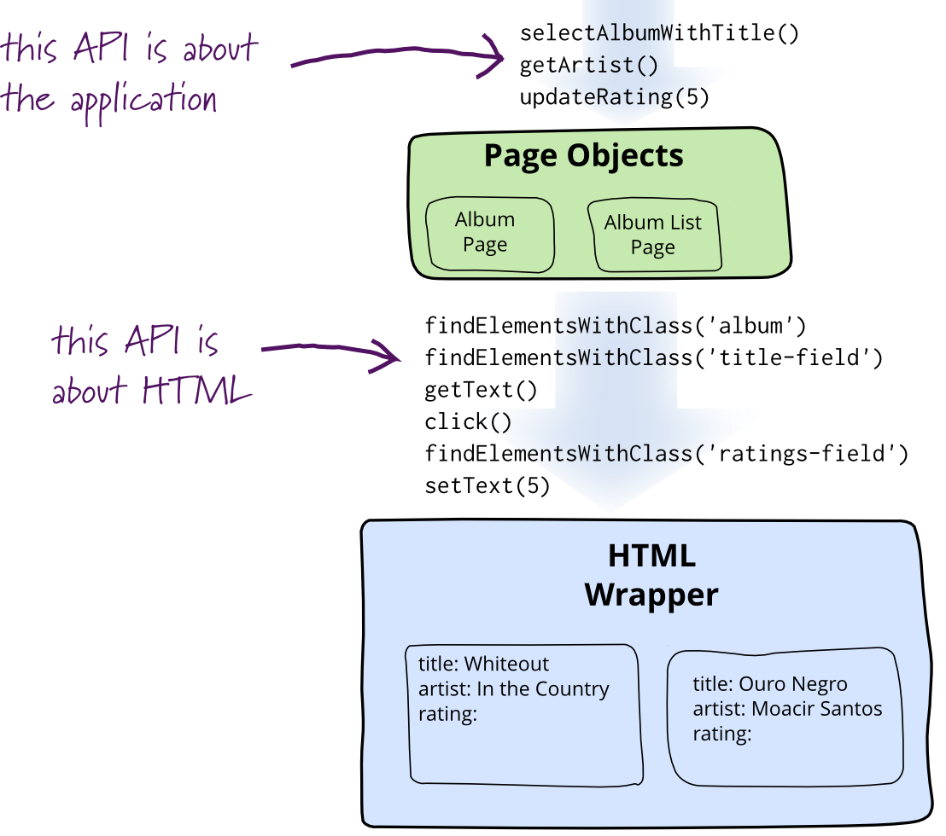
The Page Object Model pattern
Image source: https://martinfowler.com/bliki/PageObject.html

Slide 75
The POM pattern
A class for each page or part of a page
Elements are encapsulated (private or local variables)
Exposes business-oriented public methods, used by the tests
Benefits:
Remove duplication
Readable tests
Modularity
Maintainability

Slide 76

Page Object Pattern

Slide 77

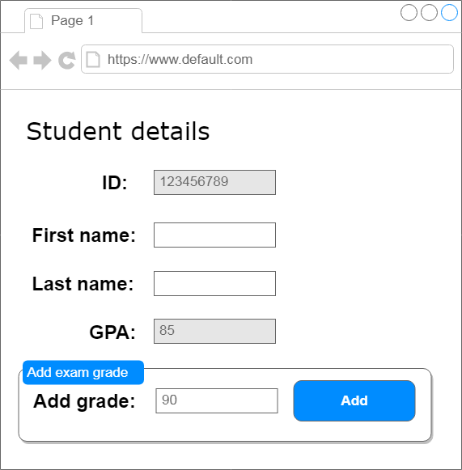
Don’t expose the underlying elements
public class StudentPage
{
public IWebElement ID { get { ... } }
public IWebElement FirstName { get { ... } }
public IWebElement LastName { get { ... } }
public IWebElement GPA { get { ... } }
public IWebElement ExamGradeToAdd { get { ... } }
public IWebElement AddExamGradeButton { get { ... } }
}
public class StudentPage
{
public string ID { get { ... } }
public string FirstName { get { ... } set { ... } }
public string LastName { get { ... } set { ... } }
public decimal GPA { get { ... } }
public void AddExamGrade(decimal grade) { ... }
}

Slide 78

Don’t use static fields
public class StudentPage
{
private static IWebDriver _driver = SeleniumUtils.Driver;
…
}
public class StudentPage
{
private IWebDriver _driver;
public StudentsPage(IWebDriver driver)
{
_driver = driver;
}
…
}

Slide 79
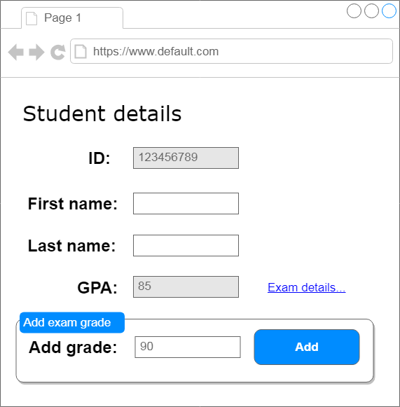
Return other page objects on navigation
public class StudentPage
{
.
.
.
public ExamDetailsPage OpenExamDetails()
{
...
}
}

Slide 80
Nested Page Objects
Main Page
Toolbar
Folders Tree
Headers List
Preview Pane
Message Header
class MainPage
{
public Toolbar ToolBar { get { ... } }
public FoldersTree FoldersTree { get { ... } }
public HeadersList HeadersList { get { ... } }
public PreviewPane PreviewPane { get { ... } }
}
Message Body

Slide 81
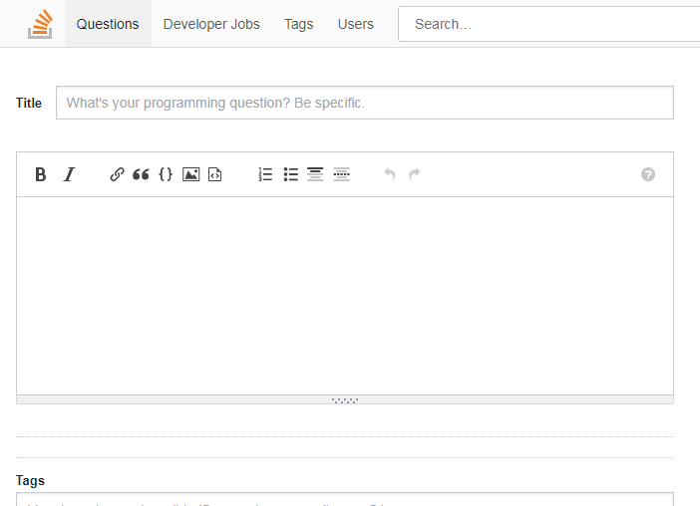
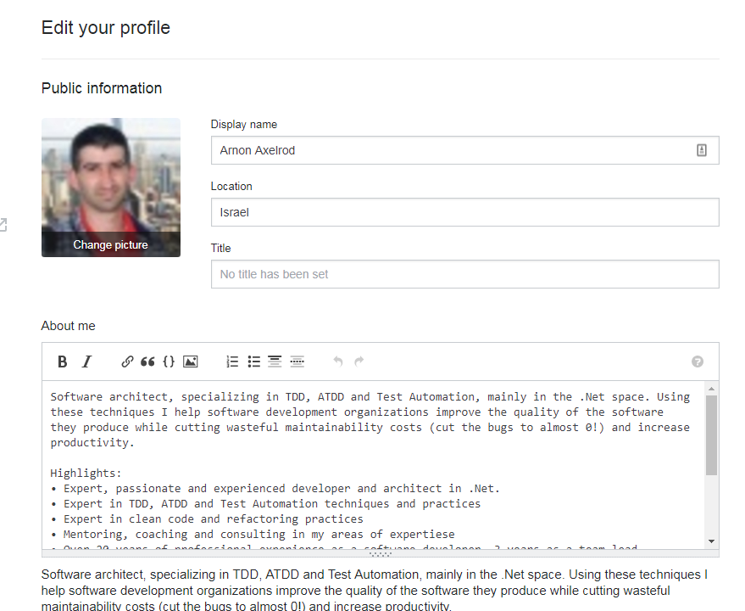
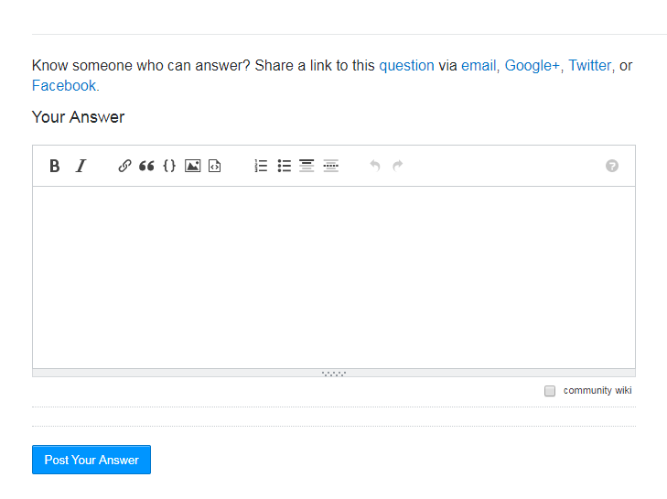
Reusable Page Objects

Slide 82
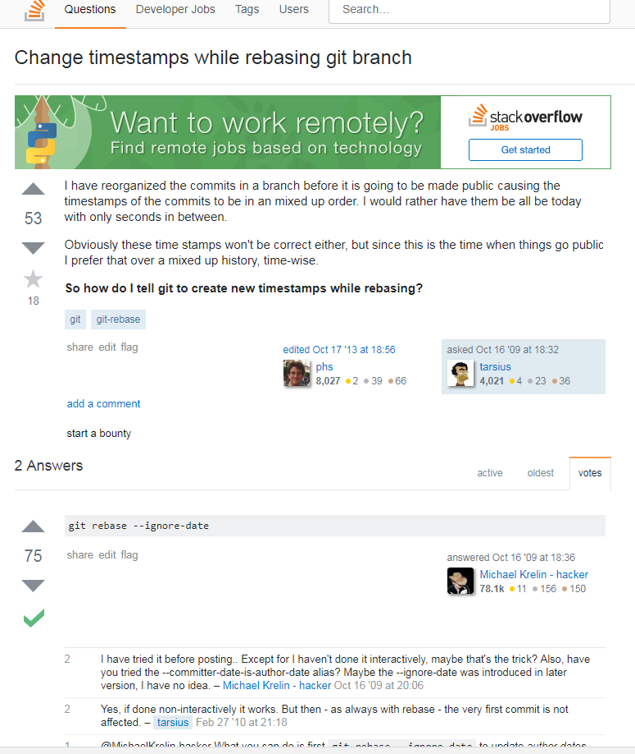
Page Object & Inheritance
A StackOverflow question and answer look very similar
But there are differences:
Only questions have tags
Only questions can have bounty
Only questions have favorite star
Only Answer can be marked as accepted
Notes:
אתם יכולים לראות עוד reusable object? (האווטר של המשתמשים)

Slide 83
Page Object & Inheritance
class StackOverflowQuestion
{
public QuestionMessage Question { get {... }}
public IReadOnlyList<AnswerMessage> Answers { get {... } }
}
abstract class Message
{
public string Text { get { ... } }
public int Votes { get { ... } }
public IReadOnlyList<Comment> Comments { get { ... } }
public void IncreaseVotes();
public void DecreaseVotes();
}
public class QuestionMessage : Message
{
public IReadOnlyList<Tag> Tags { get { ... } }
public bool Favorite { get { ...} set { ...} }
public void Bounty() { ... }
}
public class AnswerMessage : Message
{
public bool Accepted { get { ... } }
}
Notes:
אתם יכולים לראות עוד reusable object? (האווטר של המשתמשים)

Slide 84
Limitations of Page Objects
Business Processes may cross several pages
Causing duplication
Not always the best abstraction
Models the UI and not the Business Logic

Slide 85
Page Objects

