Slide 1
Mobile price Prediction with Spark & kafka
Tamir Shoresh
Liora Cohen
Dan Goren

Slide 2
AGENDA
Mobile Price Dataset
Prediction Task
Hypotheses
Method
Results & Conclusions

Slide 3
Mobile price dataset
Taken from Kaggle: https://www.kaggle.com/datasets/gauravduttakiit/mobile-price-classification?select=train.csv
2000 samples
20 features
Target variable – mobile price in range 0-3 0 – very cheap 1 – cheap 2 – expensive 3 – very expensive

Slide 4
Prediction task
In this study we will predict the mobile price with supervised and unsupervised learning and comparing accuracy and computation time.
Unsupervised – K-means VS. Bisecting K-means
Supervised – Decision Tree VS. Random Forest

Slide 5
Hypotheses
we expect the classification models to be more accurate than the clustering models
we expect the K-means algorithm to outperform the Bisecting K-means algorithm, while still having a longer computation time.
we expect the decision tree to have a lower accuracy then the Random Forest, while still having a faster computation time

Slide 6
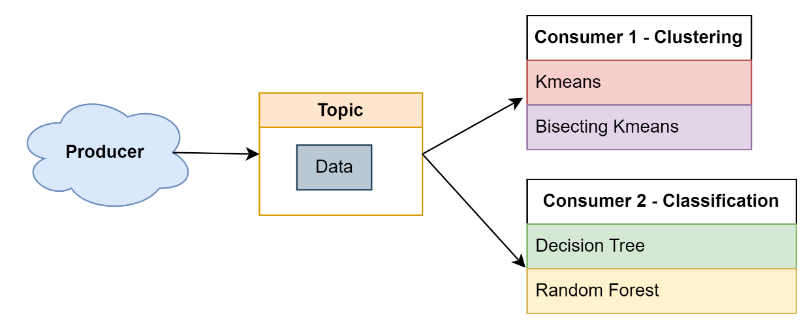
Method
We create a Kafka producer which publishes 100 samples every 5 seconds to a topic named “Data”.
We create 2 consumers that read from “Data” and put the data into a Spark data frame.
Using Spark ML library, we fit all models and calculate accuracy and computation time at each iteration.

Slide 7
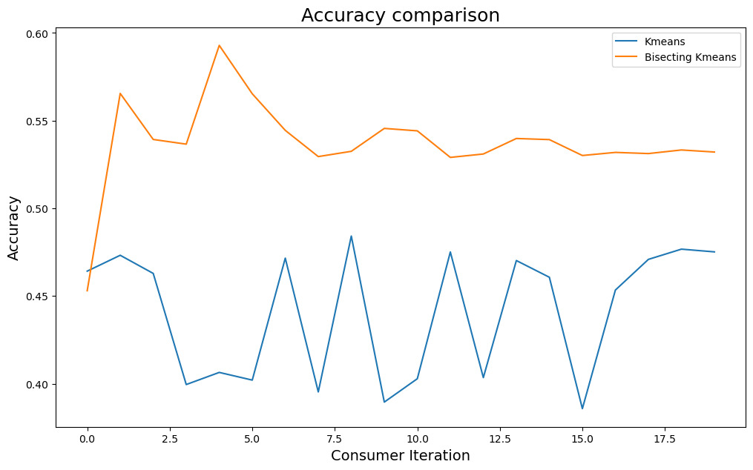
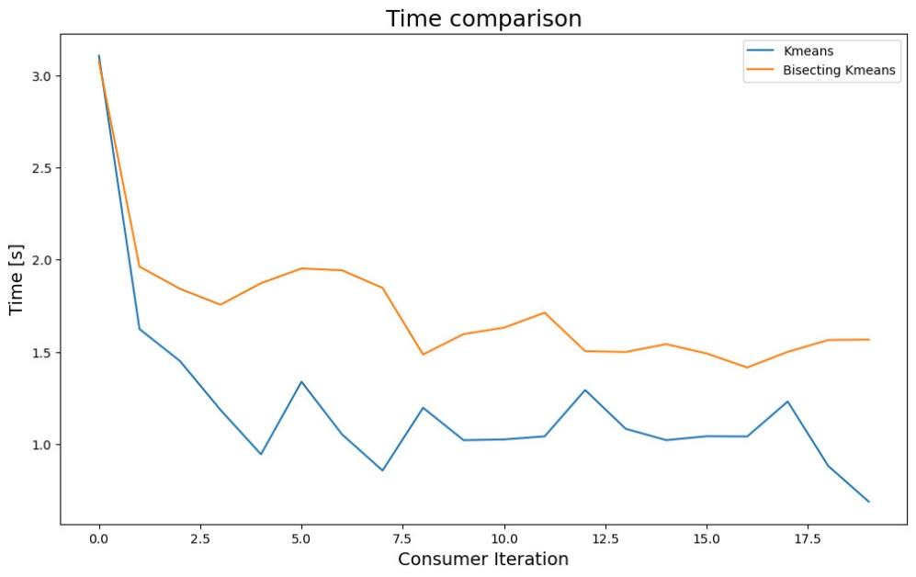
Clustering Results

Slide 8
Clustering conclusions
Hypothesis 2 rejected!
K-means is sensitive to the initialization of the centroids, and if the initial centroids are not chosen well, it can lead to poor convergence and lower accuracy.
Bisecting K-means overcomes this limitation by iteratively dividing the data into smaller and smaller clusters, thus reducing the impact of poor initial centroids.
Also, bisecting K-means iteratively fits the K-means algorithm therefor takes more computation time.

Slide 9
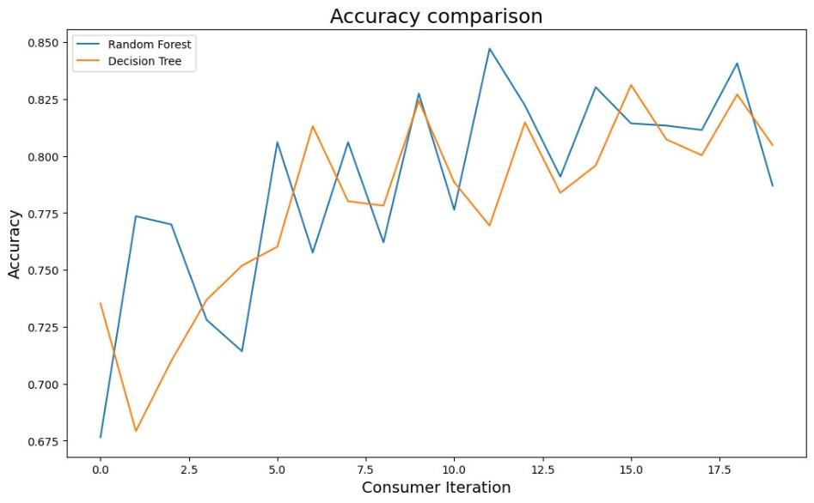
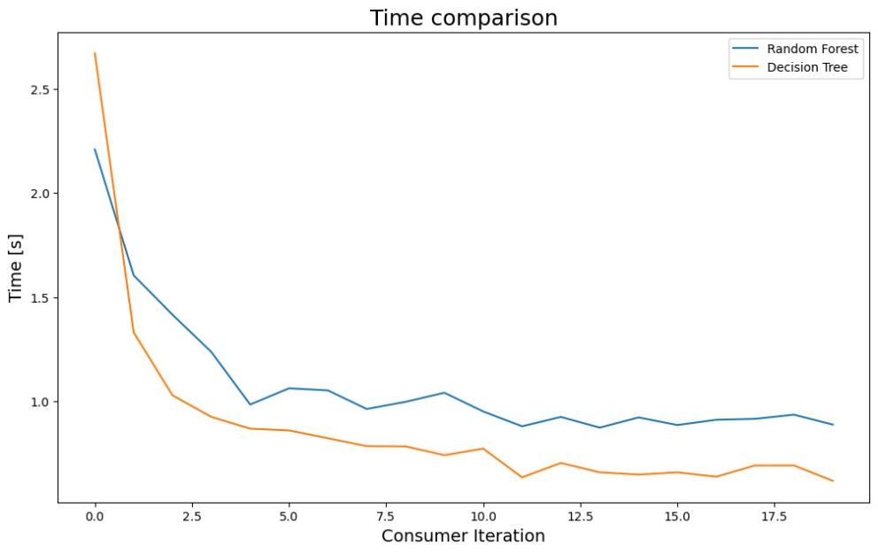
Classification Results

Slide 10
Classification conclusions
Hypothesis 3 proven partly right!
As expected, fitting a decision tree takes less time, although we do get similar accuracies – probably because of the low complexity of the data.
Hypothesis 1 proven right!
As expected, supervised learning outperformed unsupervised learning due to the access supervised learning has to the target variable.

Slide 11
Demonstration

