Slide 1




1
STUDENT NAME:P.Tamilselvan
REGISTER NO AND NMID: 40EC870098120C7BEBC47639EBD28E94 DEPARTMENT: Computer science
COLLEGE: Puratchi thalaiviamma arts and science college, palladam

Slide 2




• modernpro oliowebsite with a clean,responsive,anduser riendly design
• itincludes darkmodefeature andsmoth animations
• sections:
• Aboutme
• skils
• project
• cert cate
• contact
2

Slide 3

1.Problem Statement
2.Project Overview
3.End Users
4.Tools and Technologies
5.Portfolio design and Layout 6.Features and Functionality 7.Results and Screenshots
8.Conclusion
9.Github Link
3/21/2024
3

Slide 4

• Intodays' competitive enviroment,showcashing technical skils,projects,and
Achievements is esentialfor carer growth.Traditionalresumesarelimited In presentinginteractive and visualconten There is a nedfora Modren,responsive,and personalized protfolio website thathighlights my Skils,projects,and certicates ina profesional way.
4

Slide 5
The Digital Portfolio website is a personalwebsite built to highlight academic Background, technical skils, projects, cert cates,and contact details. ItProvides recruiters and peers with a professional, interactive, And modern Waytoview
achievements.
5

Slide 6
• Recruiters/HR Managers
• Colege Facultyfor Evaluation
• Felow Developers&Colaborators
• Internship/Job Providers
6

Slide 7
• Frontend:HTML5, CSS3, JavaScript
• Icons:FontAwesome
• Animation&Efects:Typingefec Dark modetogle, Smothscroling
• Hosting:GitHub Pages
• Tols:Trebedite
7

Slide 8
• Clean, modern single-page layout
• Sections:Home, AboutMe, Skils, Projects, Cert cates, Contact
• Responsive design with dark modesuport
• Smoth navigation and UI riendly interactions
8

Slide 9
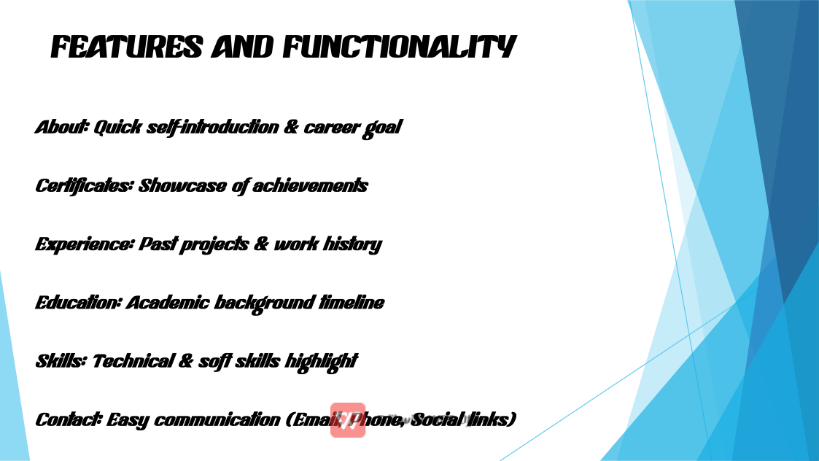

Slide 10
• Workingpor olio website hostedonline
• Sucessfulydisplayspersonaldetails, projects, andcert cates
• Easy navigation anduser riendlyUI
• Atracts recruiters by showcasingboth skils andcreativity
3/21/2024
10

Slide 11




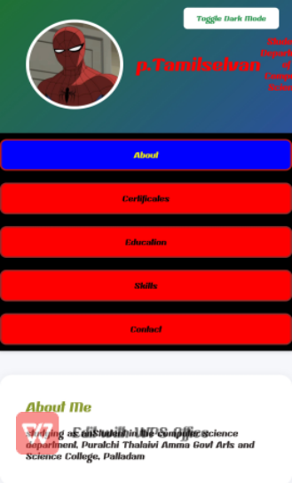
11

Slide 12
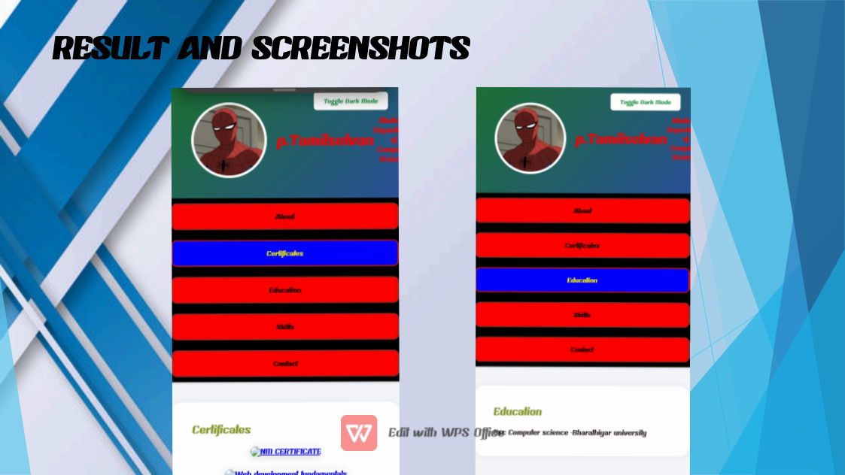

Slide 13
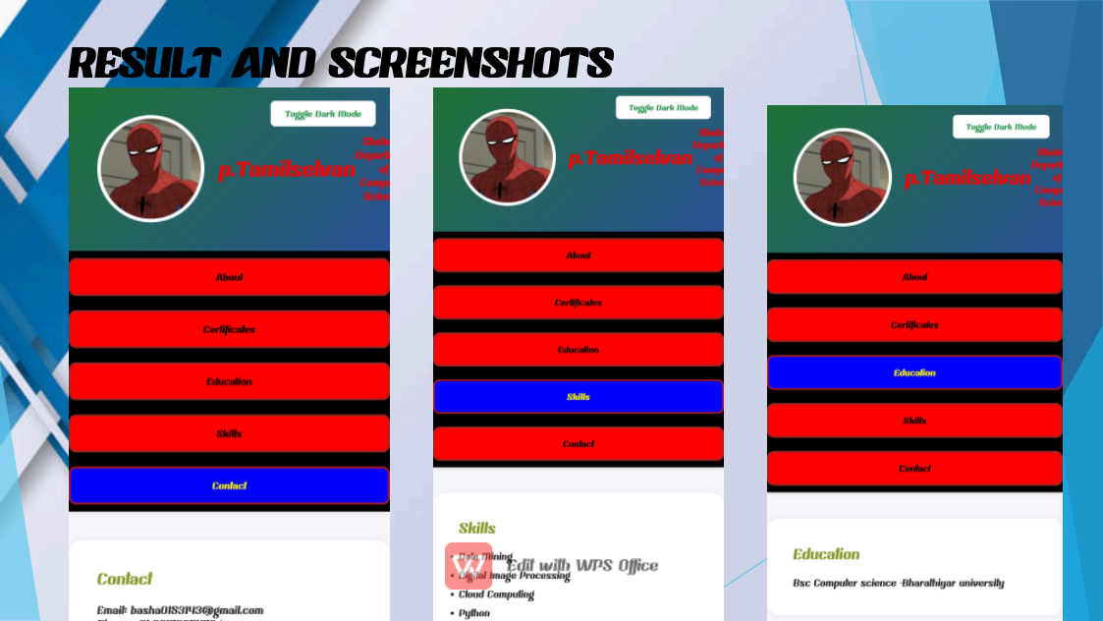

Slide 14

• The digital portfolioactsasa modernresume, improvingonlinevisibility, Profesionalism, andoportunitiesfor internships andjobs. ItDemonstrates both
technicalskils andpersonalbranding.

