Slide 1
Bias-Free Resume Screening System
done by: TAMIZHANBAN NITISH P
PRASAHNTH R
PENIEL LAWRENCE J
MYTHREYAN P

Slide 2
Business Problem
Unconscious bias in resume screening processes leads to unfair hiring practices and reduced workplace diversity.
Skewed selection of candidates
Decreased workforce diversity
Legal and reputational risks
Inefficiencies in talent acquisition

Slide 3
Current Challenges
Human bias during resume reviews
Lack of consistent screening criteria
AI models trained on biased data
Resistance to new hiring practices
Privacy issues in anonymizing resumes
High cost and integration challenges of fairness tools

Slide 4
Current Solution
Extract features from resumes using skillsets
Simulate sensitive attributes (e.g., gender)
Train Random Forest model for classification
Evaluate fairness using Fairlearn’s MetricFrame
Goal: Detect bias in selection rates across demographic groups

Slide 5
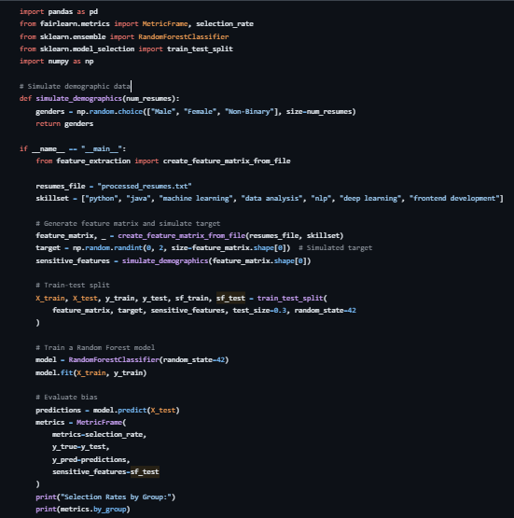
CODE : PROCESS RESUME

Slide 6
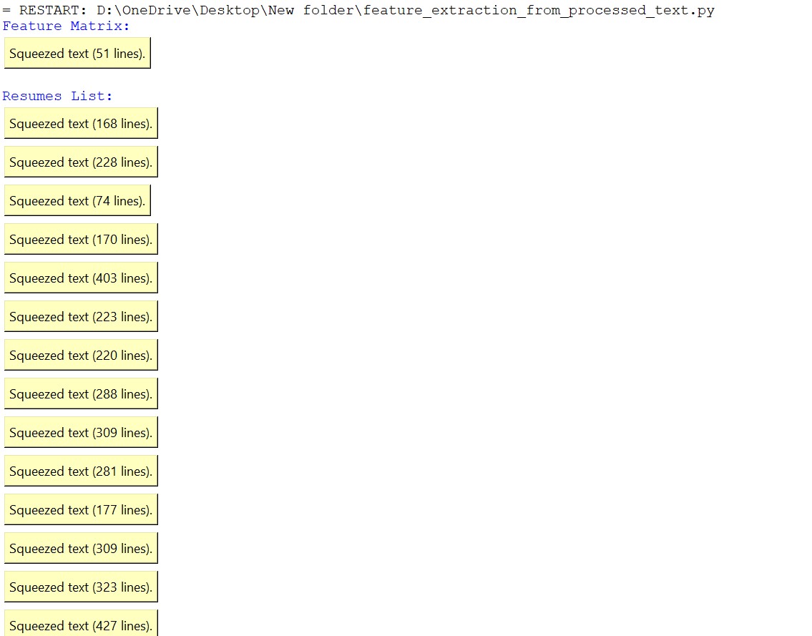
OUTPUT 1

Slide 7
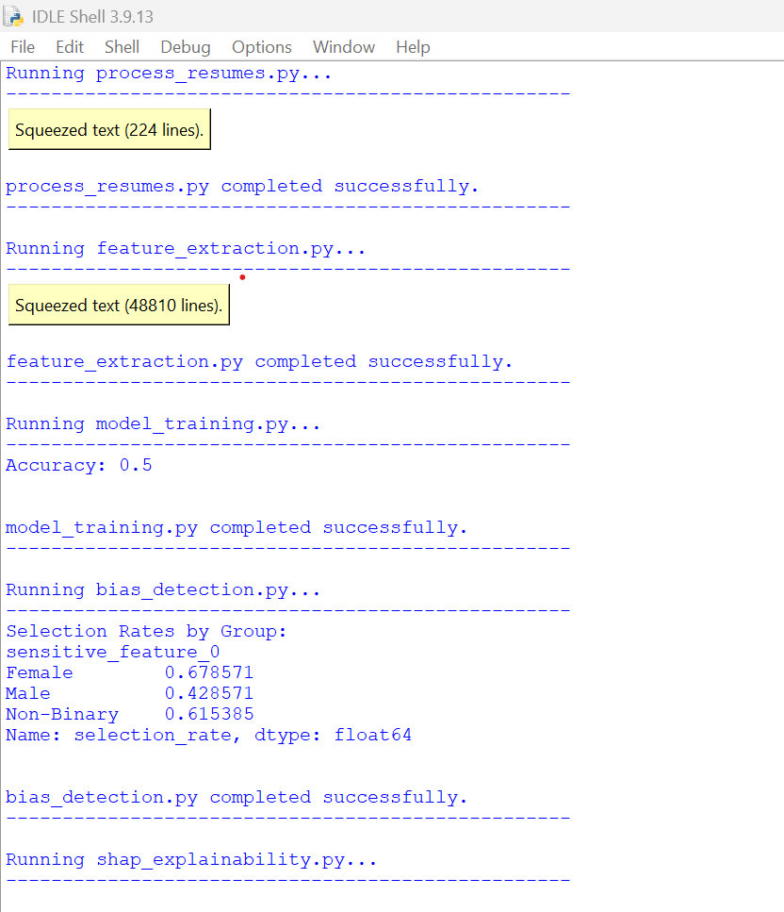
OUTPUT 2

Slide 8
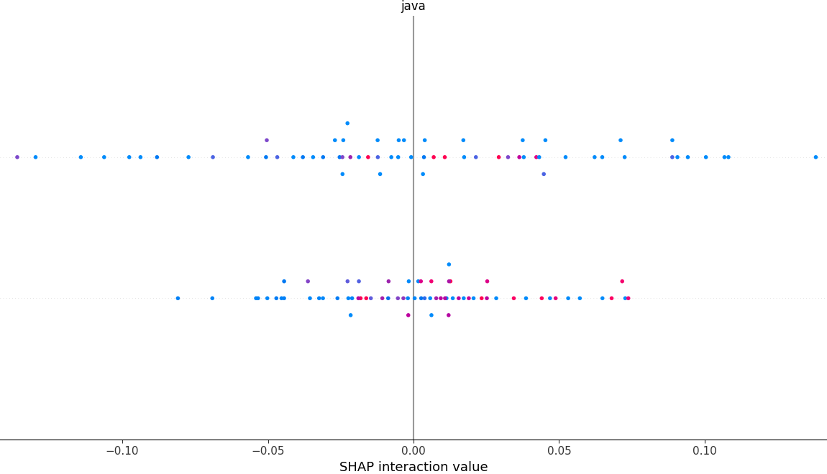
OUTPUT 3

Slide 9
Limitations
Demographics are simulated, not real data
Only selection rate is measured — no deeper bias insights
No mitigation strategies applied (only evaluation)
Opaque model (Random Forest lacks explainability)
Resume anonymization not implemented
Scalability and deployment not addressed

Slide 10
Algorithm Used: Random Forest
Robust ensemble of decision trees reduces overfitting
Handles high-dimensional skill-based resume data well
Captures non-linear patterns in candidate qualifications
Provides feature importance for interpretability
Efficient for moderate-sized datasets

Slide 11
Alternative Algorithms
1. Logistic Regression: Simple and interpretable, but limited in complexity
2. SVM: Effective in high-dimensional spaces, but not scalable
3. XGBoost: High performance with more control, but resource-heavy
4. Neural Networks: Deep pattern learning, but data-intensive and less explainable

Slide 12
THANK YOU

