Slide 1
Institution Training – Minor Project Comprehensive Examination – Viva-Voce
COMPARATIVE ANALYSIS OF NETWORK ROUTING PROTOCOLS USING NS2
Presented By
Tamizharasan G C
III M.Sc Software Systems
PSG College of Arts & Science
Coimbatore
Under the Guidance of
Dr. G. S. Karthick M.Sc., PhD., NET., DST Fellow.,
Assistant Professor
Department of Software Systems
PSG College of Arts & Science
Coimbatore

Slide 2

ABSTRACT
1. Focus Protocols: The study examines three major routing protocols in wireless networks AODV, DSR, and DSDV.
2. Performance Metrics: Key metrics include average delay, throughput, and packet delivery ratio (PDR) for evaluating data transmission.
3. Protocol Analysis:
AODV: Adapts effectively to high mobility scenarios.
DSR: Performs well in static or low mobility networks.
DSDV: Offers stable performance but has higher overhead in large networks.
4. Data Visualization: Uses tools like matplotlib and seaborn for comparing and visualizing protocol performance.
5. Significance: The findings provide valuable insights into the adaptability and limitations of these protocols in dynamic wireless environments.

Slide 3
INTRODUCTION
1. Wireless networks have transformed communication, business, and information access, driven by mobile devices and IoT applications.
2. Routing protocols are crucial for efficiently transmitting data packets across wireless networks.
3. Key performance metrics like average delay, throughput, and packet delivery ratio (PDR) are used to assess routing efficiency.
4. Analyzing these metrics helps understand the behavior of routing protocols under different network conditions.
5. The project focuses on analyzing the behavior of AODV, DSR, and DSDV routing protocols.
6. AODV establishes routes on demand, DSR dynamically discovers and maintains routes, and DSDV maintains up-to-date routing information with increased overhead.

Slide 4
SYSTEM SPECIFICATION
Hardware Requirements
Processor Dual Core (Intel i5 or equivalent) for efficient performance
RAM Minimum of 4 GB (8 GB recommended for smoother operation)
Storage At least 250 GB HDD/SSD for data and software storage
Network Interface Ethernet or wireless network adapter for connectivity
Software Requirements
Operating System Linux (preferably Ubuntu) or Windows
Network Simulator NS2 (Network Simulator 2) for network simulations
Scripting Languages TCL (for running simulations), AWK (for processing simulation data)
Graph Generation Python (with libraries like Matplotlib and Pandas for data visualization

Slide 5
MODULES
Project Module Overview
Project Focus:
Analyze the behavior of AODV, DSR, and DSDV routing protocols in wireless networks.
Objectives:
Evaluate performance metrics: Average Delay, Throughput, and Packet Delivery Ratio (PDR).
Identify areas for improvement and propose optimizations for efficiency and reliability.
Core Components:
Simulation Setup:
Utilize NS2 for varied network scenarios (node density, mobility, traffic loads).
Data Extraction:
Employ Tcl/AWK scripts for detailed performance metrics.

Slide 6
Performance Analysis and Tools
Performance Analysis:
End to End Delay: AODV shows lower and more stable delay.
Throughput: AODV consistently higher; DSDV improves; DSR declines.
Packet Delivery Ratio (PDR): AODV highest, followed by DSR and DSDV.
Strategies:
Explore techniques to enhance performance and improve data packet delivery.
Tools and Technologies:
NS2: Simulates routing protocols.
Tcl/AWK: Automates data extraction.
Python: Data visualization with libraries like matplotlib and seaborn.

Slide 7
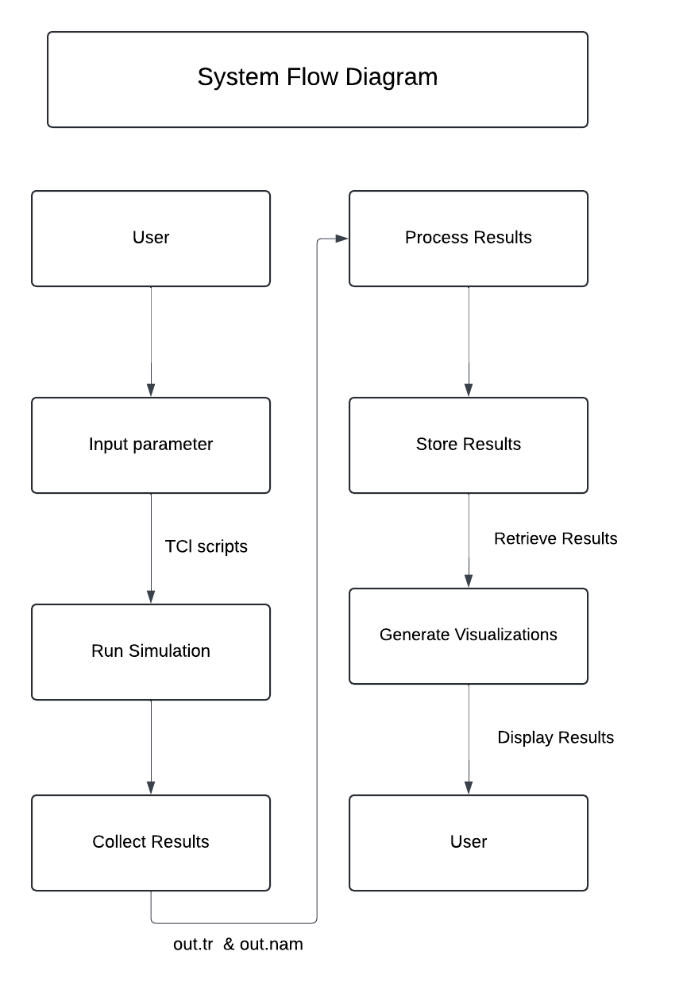
System design
System Flow Diagram

Slide 8
Methodology
Ad hoc On-Demand Distance Vector (AODV)
Overview
Combines on demand route discovery of DSR
Incorporates sequence numbers and periodic beaconing from DSDV
Routing Mechanism
Minimizes broadcasts by creating routes on demand
Supports symmetric links
Consists of two main phases:
Route Discovery
Route Maintenance
Route Discovery Process
Source mobile host broadcasts RREQ when lacking a valid route
Neighbors forward RREQ until destination or valid route is found

Slide 9
Sequence Numbers
Each node maintains a sequence number and broadcast ID
Incremented with each RREQ initiated
Intermediate nodes record first neighbor address for reverse path
Discard duplicate RREQs
Unicast RREP sent back to originating neighbor
Routing Constraints
Supports only unicast routing
Only one route to a destination can exist at a time
No multipath routing support

Slide 10
Dynamic Source Routing (DSR)
Overview
Reactive routing protocol for Mobile Ad Hoc Networks (MANETs)
Relies on source routes stored in data packets
Route Caching
Mobile hosts maintain route caches
Caches updated as new routes are discovered
Protocol Phases Route Discovery
If no valid route exists, broadcast Route Request (RREQ)
Nodes check their cache and forward RREQ, adding their address if needed
Generate Route Reply (RREP) when destination or valid route is found
Route Maintenance
Uses Route Error (RERR) packets for maintenance
Removes erroneous hops from route cache
Supports multipath routing

Slide 11
DESTINATION-SEQUENCED DISTANCE VECTOR (DSDV)
Overview
Proactive routing protocol for mobile ad-hoc networks
Maintains consistent, loop-free routes using sequence numbers
Frequent broadcasts can lead to higher overhead in dynamic/large networks
Routing Table Management
Each node maintains a routing table
Stores next hop, distance (number of hops), and sequence number for each destination
Sequence number helps avoid routing loops

Slide 12
Sequence Number
Assigned by destination nodes
Indicates freshness of the route
Higher sequence number = more up-to-date route
Route Updates
Periodic updates triggered by network topology changes
Types of Updates
Full Updates: Transmit entire routing table
Incremental Updates: Transmit only changes, reducing overhead

Slide 13
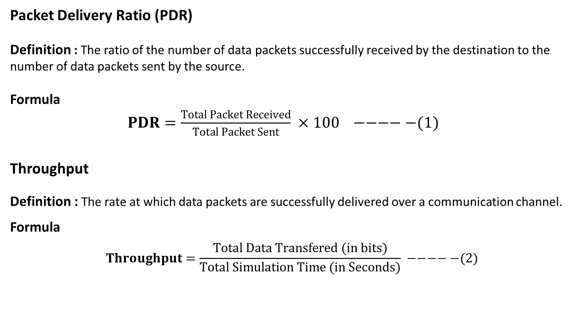
Performance Evaluation Metrics
Packet Delivery Ratio (PDR)
Definition : The ratio of the number of data packets successfully received by the destination to the number of data packets sent by the source.
Formula
$PDR=\frac{Total Packet Received​}{Total Packet Sent} ×100 −−−−−(1)$
Throughput
Definition : The rate at which data packets are successfully delivered over a communication channel.
Formula
$$Throughput=\frac{Total Data Transfered (in bits)​}{Total Simulation Time (in Seconds)} −−−−−(2)$$

Slide 14
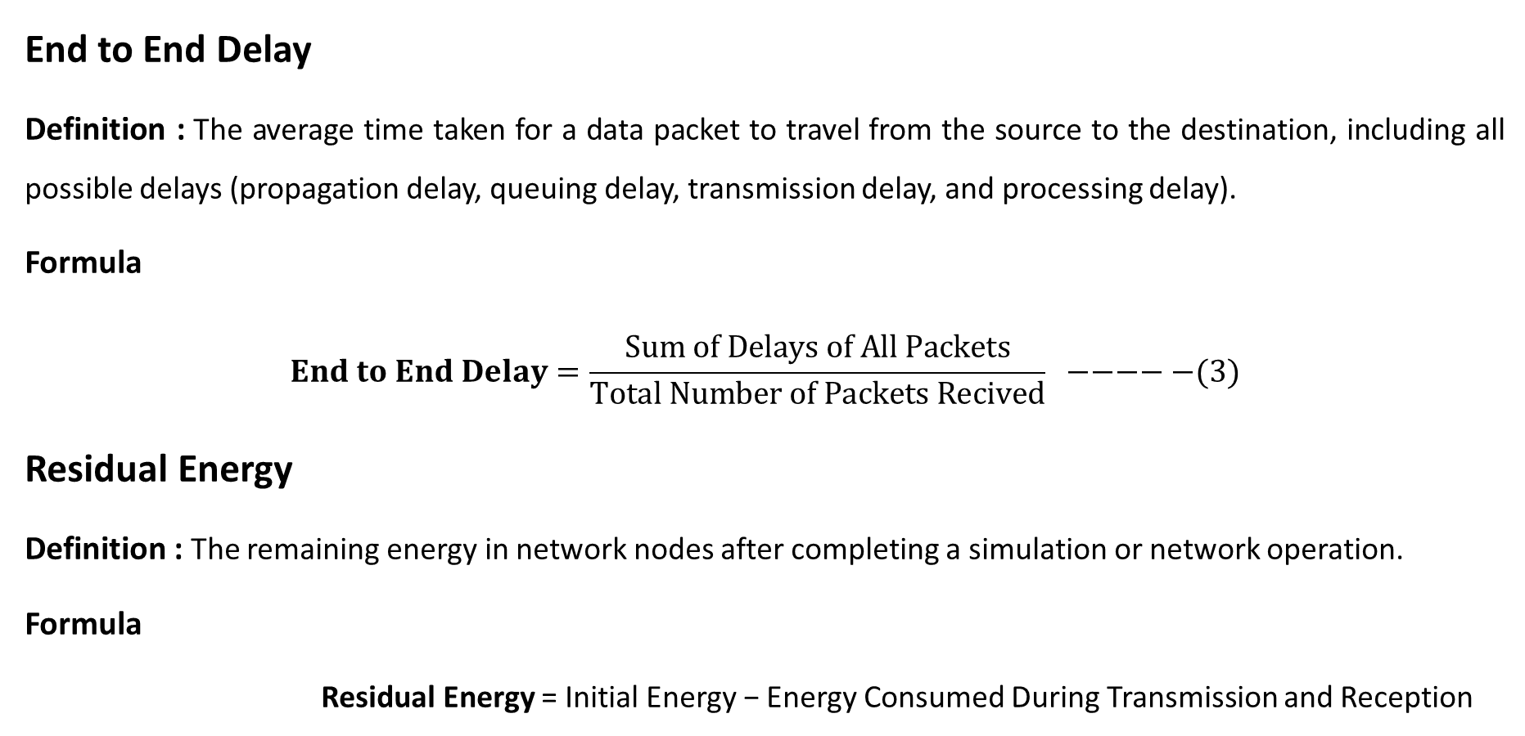
End to End Delay
Definition : The average time taken for a data packet to travel from the source to the destination, including all possible delays (propagation delay, queuing delay, transmission delay, and processing delay).
Formula
$$End to End Delay=\frac{Sum of Delays of All Packets​}{Total Number of Packets Recived} −−−−−(3)$$
Residual Energy
Definition : The remaining energy in network nodes after completing a simulation or network operation.
Formula
Residual Energy = Initial Energy − Energy Consumed During Transmission and Reception

Slide 15
RESULTS AND DISCUSSION
AODV SIMULATION DATA
TABLE I: Performance Evaluation of AODV Simulation
Simulation Time | Packet Sent | Packet Received | PDR | Packet Forwarded
25 | 12208 | 713 | 1712.20 | 3506
50 | 24416 | 1431 | 1706.22 | 7007
75 | 36622 | 2156 | 1698.61 | 10501
100 | 48830 | 2889 | 1690.20 | 13990
125 | 61036 | 3618 | 1687.01 | 17473
150 | 73244 | 4363 | 1678.75 | 20948
175 | 85450 | 5108 | 1672.85 | 24427

Slide 16
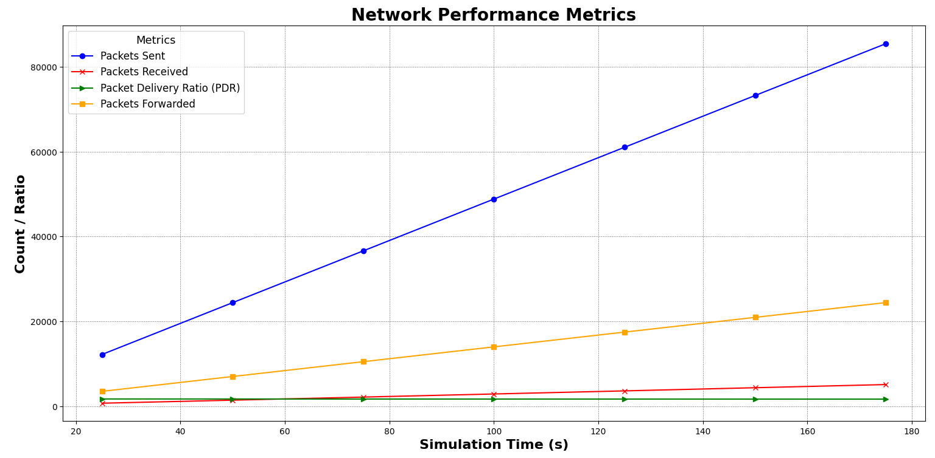

Slide 17
DSR SIMULATION DATA
TABLE II: Performance Evaluation of DSR Simulation
Simulation Time | Packet Sent | Packet Received | PDR | Packet Forwarded
25 | 12208 | 976 | 1250.82 | 3233
50 | 24416 | 1916 | 1274.32 | 6497
75 | 36622 | 2835 | 1291.78 | 9783
100 | 48830 | 3765 | 1296.95 | 13059
125 | 61036 | 4693 | 1300.58 | 16336
150 | 73244 | 5618 | 1303.74 | 19621
175 | 85450 | 6550 | 1304.58 | 22898

Slide 18
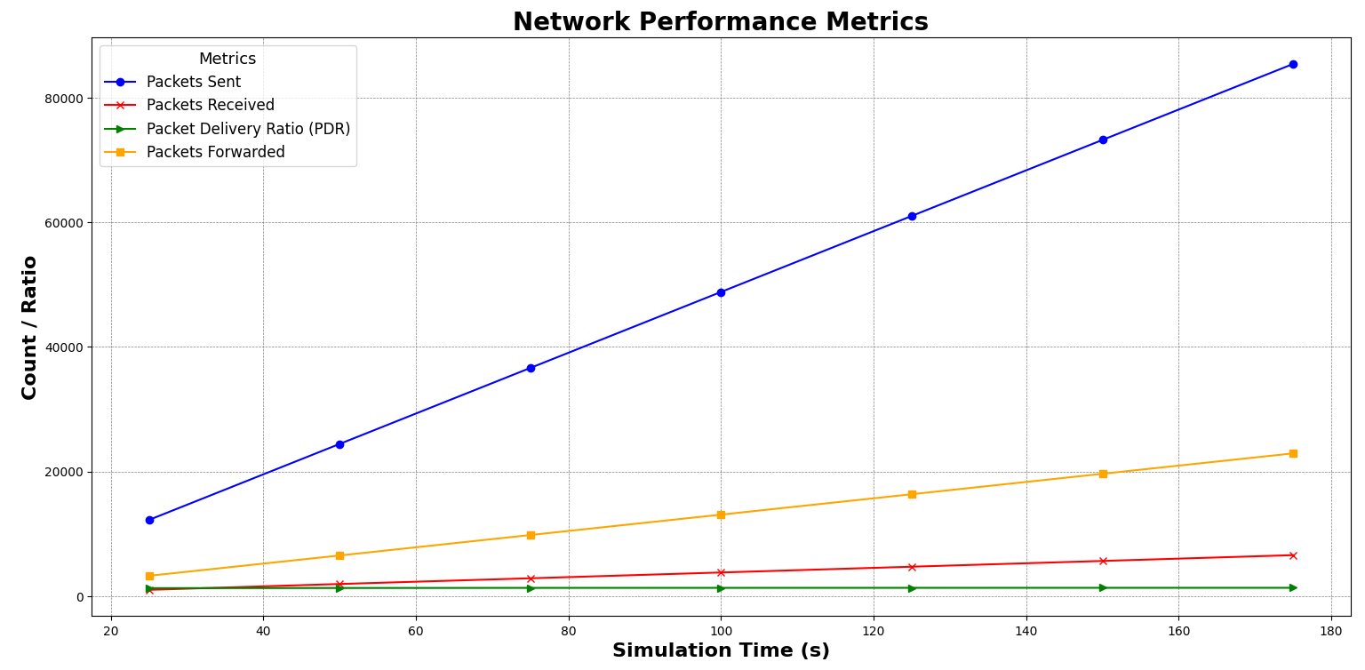

Slide 19
DSDV SIMULATION DATA
TABLE III: Performance Evaluation of DSDV Simulation
Simulation Time | Packet Sent | Packet Received | PDR | Packet Forwarded
25 | 12208 | 125 | 7154 | 872
50 | 24416 | 397 | 6150.13 | 1779
75 | 36622 | 768 | 4768.49 | 5585
100 | 48830 | 1536 | 3179.04 | 9004
125 | 61036 | 2501 | 2440.46 | 12241
150 | 73244 | 3485 | 2101.69 | 15439
175 | 85450 | 4520 | 1890.49 | 18606

Slide 20
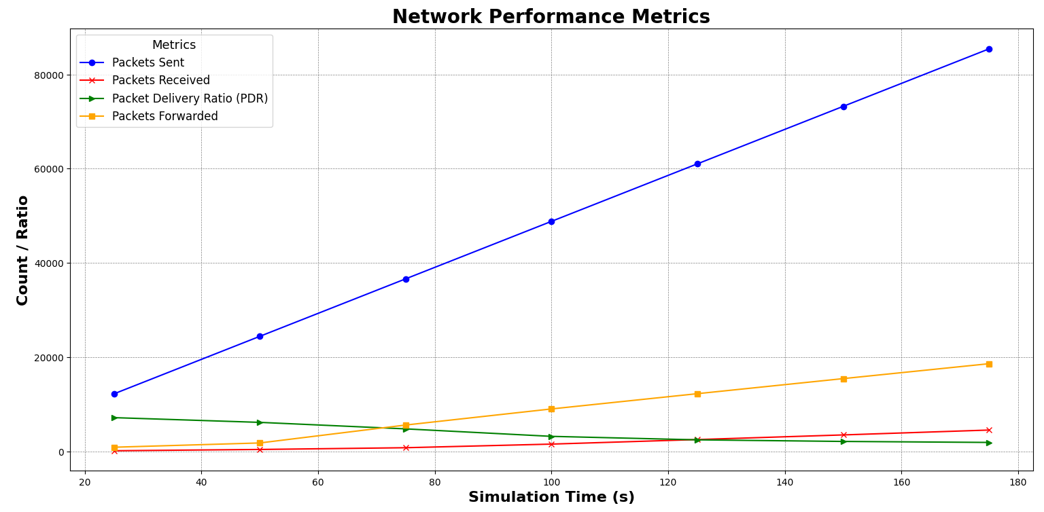

Slide 21
AVERAGE THROUGHPUT (KBPS)
TABLE IV: Average Throughput Analysis
Simulation Time | AODV | DSR | DSDV
25 | 114.11 | 156.45 | 25.67
50 | 114.49 | 153.31 | 31.82
75 | 114.99 | 151.25 | 41.29
100 | 115.58 | 150.65 | 61.45
125 | 115.78 | 150.21 | 80.03
150 | 116.35 | 149.83 | 92.94
175 | 116.77 | 149.73 | 103.32

Slide 22
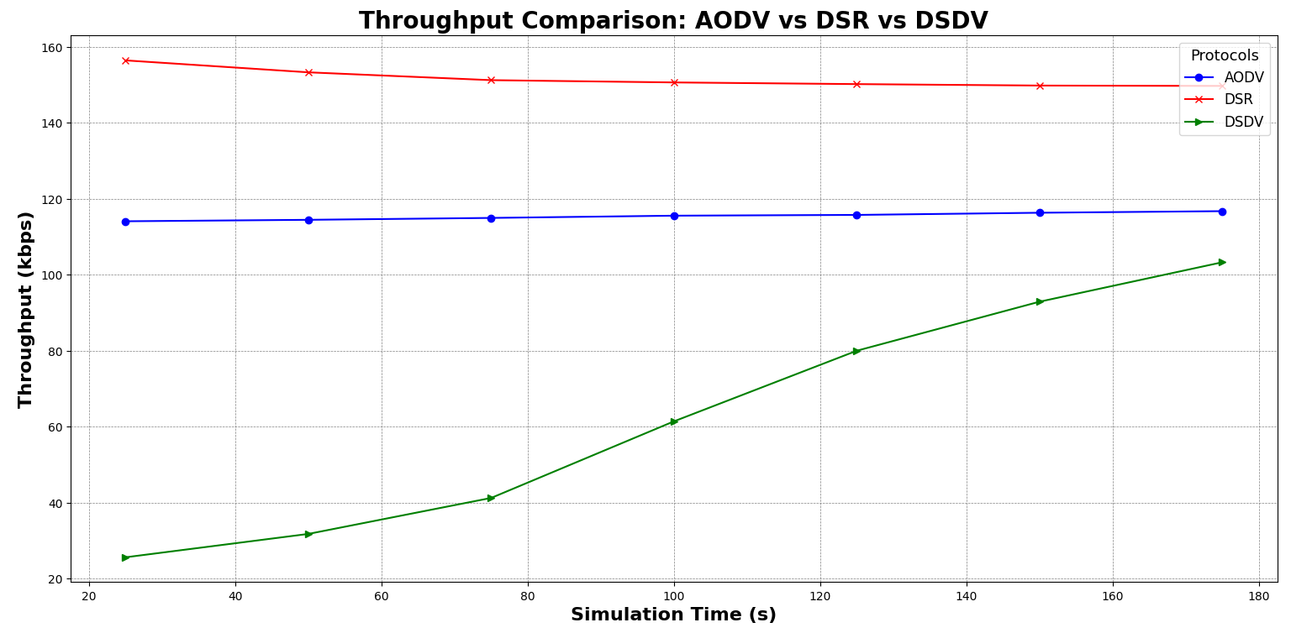

Slide 23
NORMALIZED ROUTING LOAD
TABLE V: Normalized Routing Load Evaluation
Simulation Time | AODV | DSR | DSDV
25 | 0.034 | 0.047 | 0.21
50 | 0.017 | 0.024 | 0.191
75 | 0.011 | 0.016 | 0.121
100 | 0.008 | 0.012 | 0.070
125 | 0.007 | 0.010 | 0.051
150 | 0.006 | 0.008 | 0.041
175 | 0.005 | 0.007 | 0.036

Slide 24
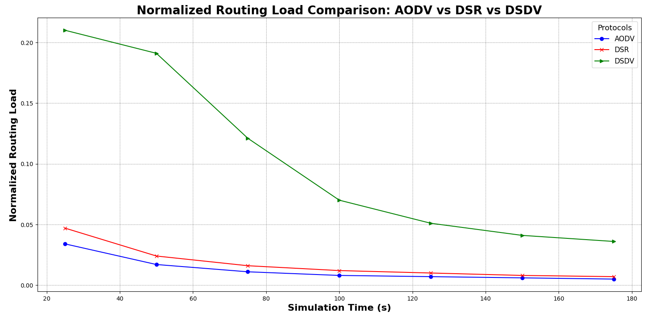

Slide 25
END TO END DELAY (MS)
TABLE VI: End to End Delay Analysis
Simulation Time | AODV | DSR | DSDV
25 | 2323.83 | 2442.25 | 1981.74
50 | 2387.25 | 2829.09 | 1981.74
75 | 2423.63 | 2961.97 | 2210.73
100 | 2435.29 | 3025.91 | 2543.01
125 | 2454.6 | 3064.43 | 2811.11
150 | 2458.72 | 3087.23 | 2882.68
175 | 2454.67 | 3133.38 | 3014.98

Slide 26
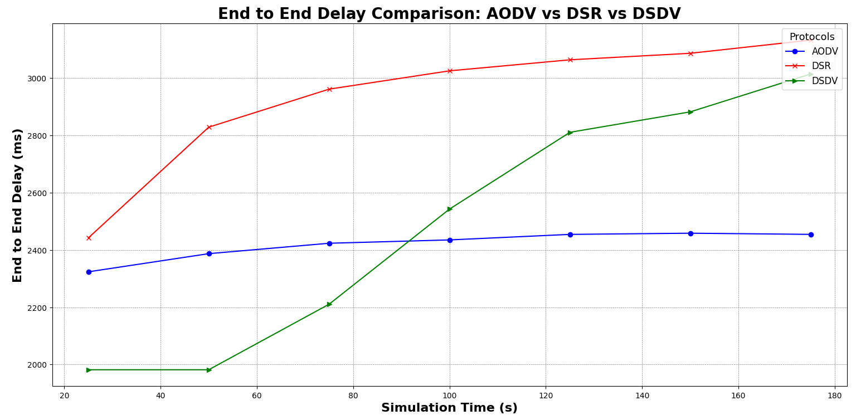

Slide 27
RESIDUAL ENERGY
TABLE VII: Residual Energy Analysis
Node | AODV Residual Energy | DSR Residual Energy | DSDV Residual Energy
0 | 40.15601 | 39.15162 | 35.13445
1 | 39.43013 | 34.9608 | 35.13436
2 | 39.42488 | 34.27775 | 35.13419
3 | 38.8238 | 34.29631 | 35.13461
4 | 39.426 | 35.10218 | 35.13505
5 | 38.74524 | 34.95225 | 35.06932
6 | 39.42495 | 35.10029 | 35.06937

Slide 28
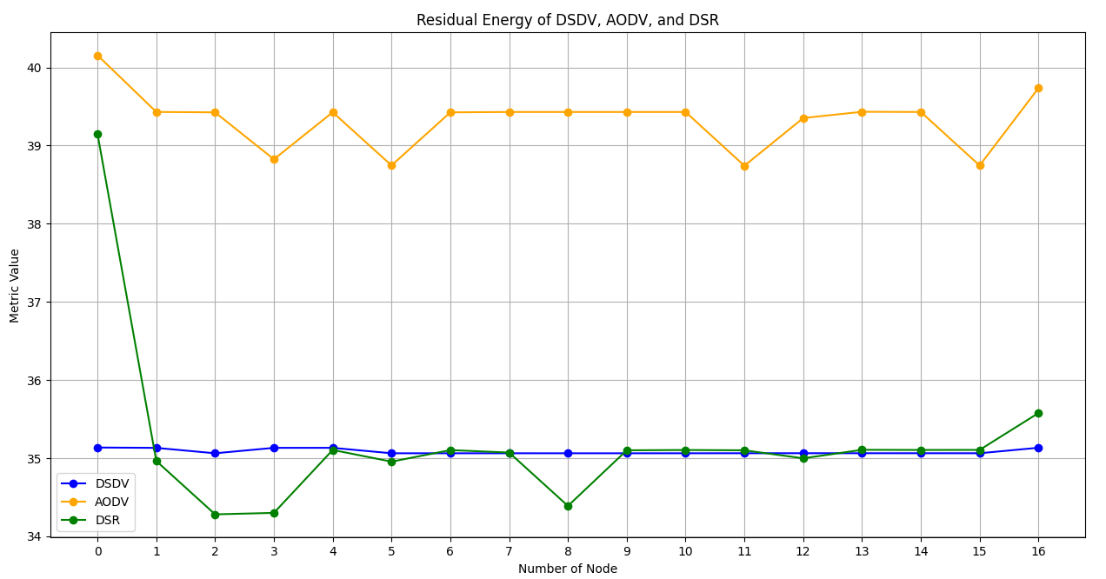

Slide 29
CONCLUSION
1. Performance analysis of AODV, DSR, and DSDV routing protocols using NS2 and Python visualization revealed their operational efficiencies and limitations across different network scenarios.
2. Each protocol exhibited unique characteristics: AODV showed strong scalability and adaptability, DSR excelled in dynamic environments, and DSDV proved beneficial in low mobility scenarios despite inefficiencies in larger networks.
3. The findings emphasize the importance of selecting the right routing protocol tailored to specific network requirements and conditions.
4. There is significant potential for future enhancements through the integration of advanced protocols, machine learning for optimization, and a focus on energy efficiency.
5. Continued research and optimization of these routing protocols are crucial to address the evolving demands of modern communication systems.

Slide 30
THANK YOU

