Slide 1

Department of Computer Science and Engineering
Organizes
CS23533-FOUNDATIONS OF ARTIFICIAL INTELLIGENCE
STUDYVERSE AI – AN INTELLIGENT GAMIFIED ADAPTIVE LEARNING PLATFORM
College Name: RAJALAKSHMI ENGINEERING COLLEGE
Presented By: MADHUMITHA P (240701297)
TAMIZHARASI S(240701552)

Slide 2
List of Content
Abstract
Introduction
Literature Survey
Problem Statement
Proposed work
System Architecture
Methodology
Results and Discussions
Conclusion
References

Slide 3
Abstract
StudyVerse AI is an intelligent, gamified learning platform designed to make education more interactive, engaging, and adaptive. It provides educational quizzes across five subjects: Mathematics, Science, English, Computer Science, and General Knowledge. The system evaluates student performance based on accuracy, recent answers, response time, and learning progress to adjust question difficulty using predefined rules. It incorporates classical Artificial Intelligence techniques, including heuristic evaluation, Minimax, and Alpha-Beta Pruning, to support performance assessment and decision-making in an optional AI Battle mode. Gamification features such as experience points (XP), levels, learning streaks, and achievement badges encourage consistent participation. A personalized dashboard enables students to monitor their progress and performance. StudyVerse AI combines adaptive learning, educational gaming, and classical AI algorithms to create an engaging learning environment without relying on trained machine learning models.

Slide 4
Introduction
STUDYVERSE AI – AN INTELLIGENT GAMIFIED ADAPTIVE LEARNING PLATFORM is a web-based educational platform designed to improve the learning experience through interactive quizzes and personalized learning activities. Traditional learning methods may lack engagement, immediate performance feedback, and the ability to adapt to individual student progress. The proposed system provides quizzes across five subjects: Mathematics, Science, English, Computer Science, and General Knowledge, with multiple difficulty levels. A rule-based adaptive mechanism evaluates students’ recent answers and adjusts question difficulty accordingly. Gamification features such as experience points (XP), levels, learning streaks, and achievement badges motivate students to participate consistently. A personalized dashboard enables students to monitor their progress and quiz performance. Classical Artificial Intelligence techniques, including heuristic evaluation, Minimax, and Alpha-Beta Pruning, support performance assessment and the optional AI Battle mode. This system aims to make learning more engaging, encourage continuous practice, and provide a personalized educational experience.

Slide 5
Literature Survey
Traditional Learning Systems: Primarily rely on fixed learning materials and assessments, which may not adapt to individual student performance.
Digital Learning Platforms: Provide online educational content and quizzes but may offer limited personalization and gamified learning experiences.
Gamified Learning Systems: Use points, levels, badges, and rewards to improve student engagement and encourage consistent learning.
Adaptive Learning Systems: Adjust question difficulty based on student performance using predefined rules and evaluation techniques.
AI-Based Learning Systems: Apply heuristic evaluation and decision-making algorithms to assess performance and support interactive learning activities.
Research Gap: An integrated educational platform combining rule-based adaptive difficulty, gamification, personalized progress tracking, and classical AI algorithms is needed to provide a more engaging and personalized learning experience.

Slide 6
Problem Statement
Traditional learning methods often face challenges such as limited personalization, lack of student engagement, and difficulty adapting to individual learning progress. Students may find it difficult to identify their strengths and weaknesses due to limited performance feedback and fixed question difficulty levels. Conventional quiz systems may also lack interactive features that encourage consistent learning and practice. Therefore, there is a need for an intelligent and engaging learning platform that evaluates student performance, adjusts question difficulty, and tracks learning progress. StudyVerse AI – An Intelligent Gamified Adaptive Learning Platform aims to address these challenges by combining rule-based adaptive learning, interactive quizzes, gamification features, and classical Artificial Intelligence techniques to improve student engagement and provide a more personalized learning experience.

Slide 7
Proposed Work
Develop a web-based adaptive learning platform.
Provide secure student and admin login.
Offer quizzes across five subjects with multiple difficulty levels.
Adjust difficulty using rule-based adaptation.
Include XP, levels, streaks, and badges.
Track student performance through a personalized dashboard.
Integrate heuristic evaluation and AI Battle algorithms.

Slide 8
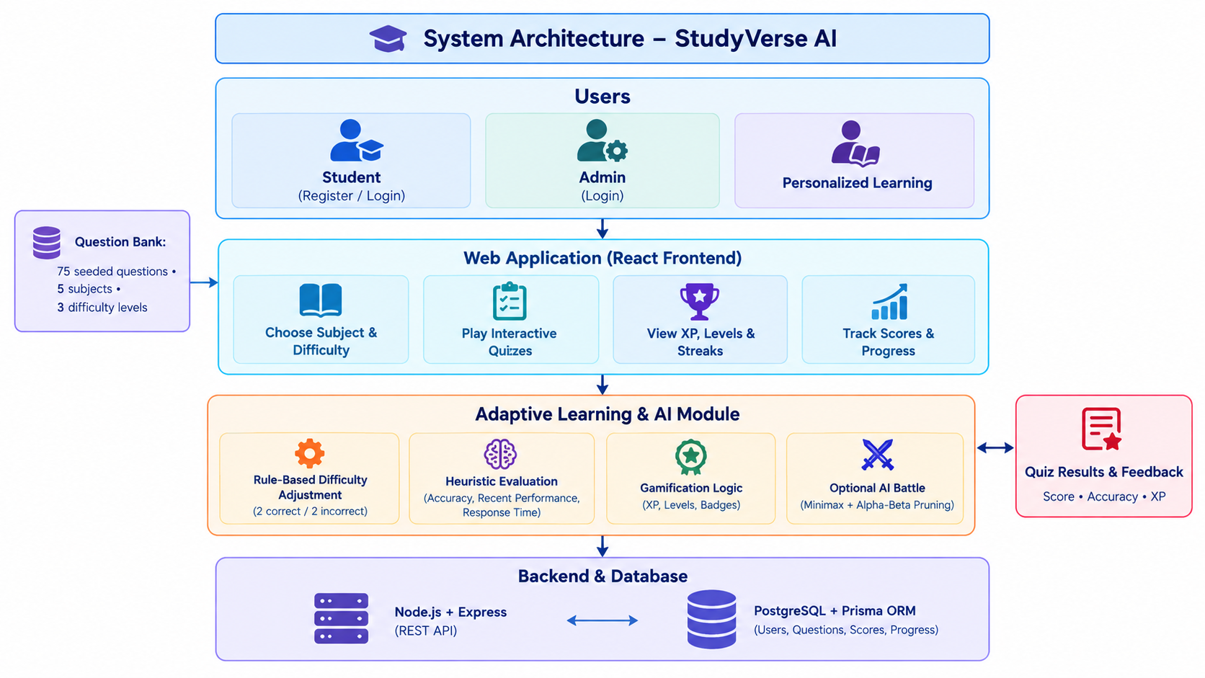
System Architecture

Slide 9
Methodology
User Authentication: Students register and log in securely.
Subject Selection: Students choose a subject and difficulty level.
Quiz Execution: The system presents interactive questions with a timer.
Adaptive Difficulty: Difficulty adjusts based on consecutive correct or incorrect answers.
Performance Evaluation: Heuristic evaluation considers accuracy, recent performance, and response time.
Gamification: XP, levels, streaks, and badges motivate students.
Progress Tracking: The dashboard displays scores, accuracy, and learning progress.
AI Battle: Minimax and Alpha-Beta Pruning support the optional AI Battle mode.

Slide 10
Results and Discussions
Interactive Learning: Provides quizzes across five subjects.
Adaptive Difficulty: Adjusts question difficulty based on student performance.
Performance Monitoring: Tracks scores, accuracy, and quiz completion.
Gamified Experience: Rewards students with XP, levels, streaks, and badges.
AI-Based Evaluation: Uses heuristic evaluation and optional AI Battle algorithms.
Personalized Dashboard: Enables students to monitor their learning progress.
Expected Outcome: Improved student engagement, consistent practice, and a more personalized learning experience.

Slide 11
Conclusion
StudyVerse AI provides an engaging approach to learning by integrating interactive quizzes, rule-based adaptive difficulty, gamification, and performance tracking. By incorporating classical AI techniques and a personalized dashboard, the system aims to improve student engagement, encourage consistent practice, and support personalized learning. It helps students monitor their progress and learn at a suitable difficulty level. Future enhancements may include more advanced personalization, expanded question banks, and additional AI-powered learning features.

Slide 12
References
Russell, S. and Norvig, P., Artificial Intelligence: A Modern Approach, 4th Edition, Pearson, 2021.
Erlang, A. K., “The Theory of Probabilities and Telephone Conversations,” Nyt Tidsskrift for Matematik B, 1909.
React Documentation: https://react.dev/
Node.js Documentation: https://nodejs.org/docs/
MongoDB Documentation: https://www.mongodb.com/docs/
Research articles on AI-based queue management and customer service optimization.

