Slide 1

Ministry/Organization Name/Student Innovation: Education / Ministry of Housing and Urban Affairs/ Student Innovation
PS Code : DH1040
Problem Statement Title :. Employment tracking and traceability system - Organized sector
Team Name : e-TECHIES
Team Leader Name : GOKULAKRISHNAN M
Institute Code (AISHE): C-49142
Institute Name: Government College of Engineering Srirangam, Tiruchirappalli. 620 012. Tamil Nadu.
Theme Name: Smart Automation

Slide 2
SOFTWARE REQUIREMENTS:
HTML
CSS
JAVASCRIPT
BOOTSTRAP
SQLITE
PYTHON(DJANGO FRAMEWORK)

Slide 3
FEATURES :
Government can able to identify the unemployment rates/uneducated rates in a particular region.
It is easy to track an individuals educational employment status easily
No details of the employees are hidden from the government since it has been store in government server.
This data can be linked to the third party job service like naukri, quikr jobs so that the individual can easily find the job

Slide 4
WORKING:
INDIVIDUAL LEVEL
INSTITUTION/ORGANISATION LEVEL
Individual with the QR code/12 digit code can only view his/her resume.
Individual cannot update his/her resume by themself.
The updation of this card is strictly done by the course providing institution after completion of the course (or) the job providing company but anyone can view his/her activities using QR or 12 digit code.
When comes to occupation, employers should update employee’s card at the time of joining and also at the time of resigning.
Each record is updated with a digital certificate.
These data are stored on the NCS servers.

Slide 5
FLOW CHART :
NCS SERVER
INSTITUTION / ORGANISATION
INDIVIDUAL
VIEW RESUME
ENTER 16 DIGIT CODE OR SCAN THE QR CODE TO VIEW RESUME
LOGIN PORTAL?
ACCESS DENIED
NO
YES
REGISTER
ADD COURSE
ADD WORK
ADD RESIGN
VIEW RESUME
ONLY FOR INSTITUTION

Slide 6
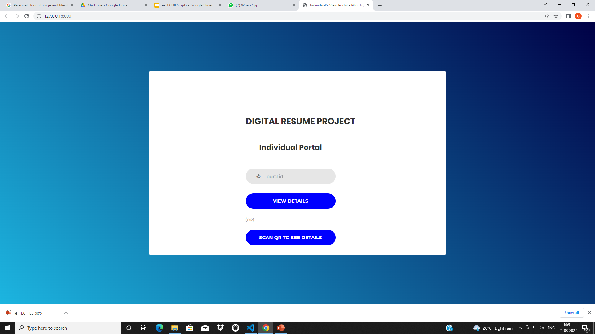
Individual’s Portal :

Slide 7
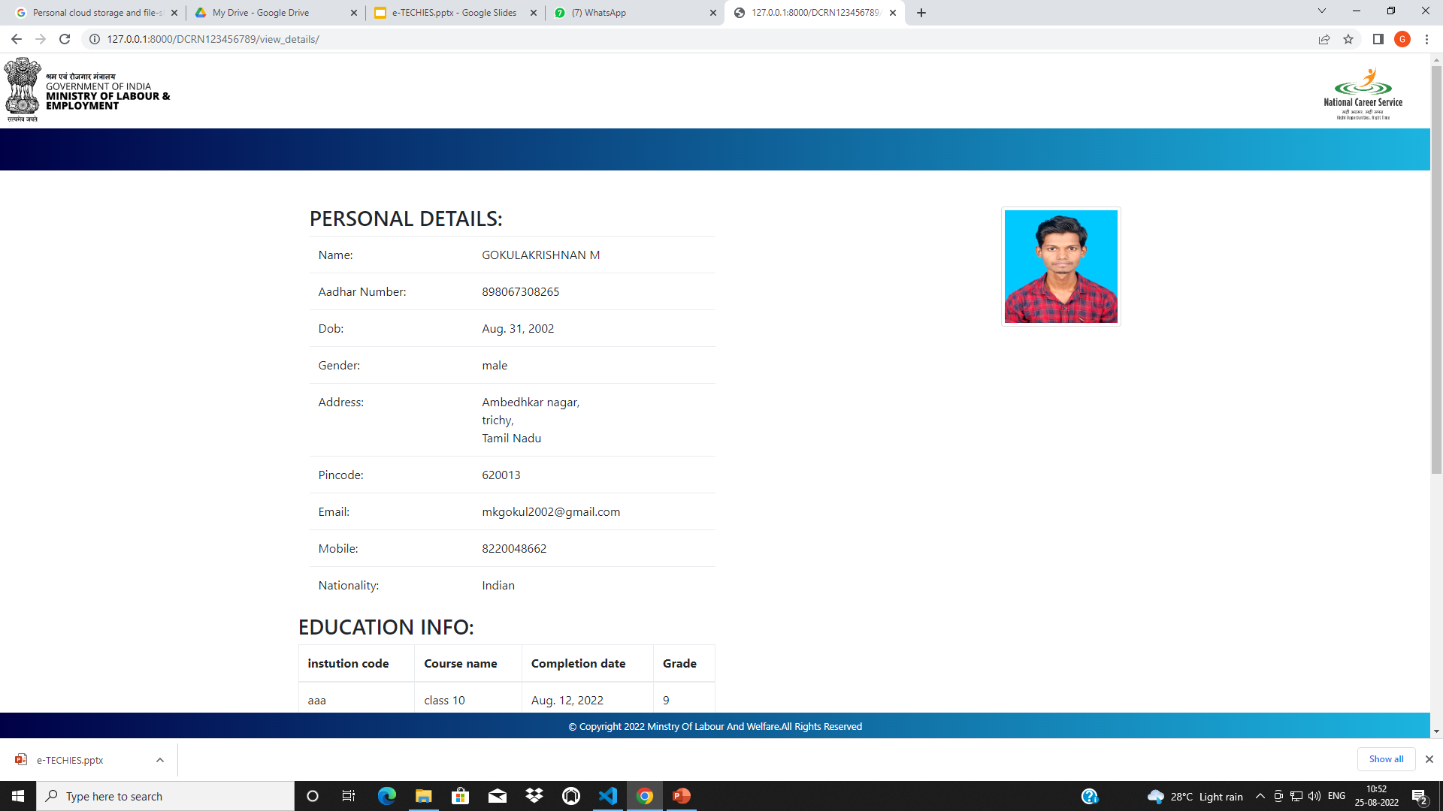

Slide 8
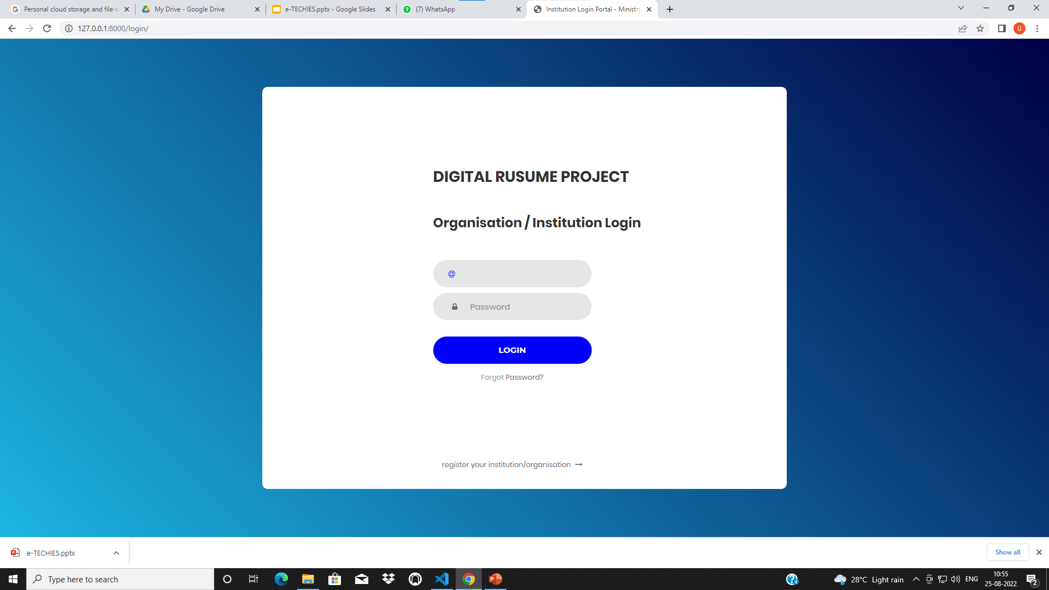
Institution/ Organisation login :

Slide 9
