Slide 1
Consolidated Segmentation and Churn Analysis of Bank Clients
By: Tamjid Ahsan
Date: July 22, 2021, 05:00 PM [DST]

Slide 2

OVERVIEW
Customer churn has direct impact on profit.
Cost of maintaining existing customers is significantly less than the cost of obtaining a new one.
The financial crisis of 2008 changed the banking sector's strategy.
Previously focused on acquiring more and more clients.
Technology and laws making things easier than ever to transfer assets and money between institutions. Which introduced new competitors in market
open banking
neo-banks
fin-tech businesses (Banking as a Service (BaaS))
Banks can use existing data to tackle client turnover challenge.
Notes:
Customer churn is a big issue that occurs when consumers abandon your products and go to another provider. Because of the direct impact on profit margins, firms are now focusing on identifying consumers who are at danger of churning and keeping them through tailored promotional offers. Customer churn analysis and customer turnover rates are frequently used as essential business indicators by banks, insurance firms, streaming service providers, and telecommunications service providers since the cost of maintaining existing customers is significantly less than the cost of obtaining a new one.
When it comes to customers, the financial crisis of 2008 changed the banking sector's strategy. Prior to the financial crisis, banks were mostly focused on acquiring more and more clients. However, once the market crashed after the market imploded, banks realized rapidly that the expense of attracting new clients is multiple times higher than holding existing ones, which means losing clients can be monetarily unfavorable. Fast forward to today, and the global banking sector has a market capitalization of $7.6 trillion, with technology and laws making things easier than ever to transfer assets and money between institutions. Furthermore, it has given rise to new forms of competition for banks, such as open banking, neo-banks, and fin-tech businesses (Banking as a Service (BaaS))^{[1]}. Overall, today's consumers have more options than ever before, making it easier than ever to transfer or quit banks altogether. According to studies, repeat customers seem to be more likely to spend 67 percent more on a bank's products and services, emphasizing the necessity of knowing why clients churn and how it varies across different characteristics. Banking is one of those conventional sectors that has undergone continuous development throughout the years. Nonetheless, many banks today with a sizable client base expecting to gain a competitive advantage have not tapped into the huge amounts of data they have, particularly in tackling one of the most well-known challenges, customer turnover.

Slide 3

BUSINESS PROBLEM
Importance of existing customer management is well recognized.
Hard to anticipate
Feedback from customers is hard to obtain.
XYZ Bank (read: fictional) is a mature financial institution based in North America.
New competitors in market.
Have existing data of their clients.
Based on the data available, the bank wants to predict risk of churning.
Notes:
While everyone recognizes the importance of maintaining existing customers and therefore improving their lifetime value, there is very little banks can do about customer churn when they don't anticipate it coming in the first place. Predicting attrition becomes critical in this situation, especially when unambiguous consumer feedback is lacking. Precise prediction enables advertisers and client experience groups to be imaginative and proactive in their offering to the client.
XYZ Bank (read: fictional) is a mature financial institution based in Eastern North America. Recent advance in technology and rise in BaaS is a real threat for them as they can lure away the existing clientele. The bank has existing data of their clients. Based on the data available, the bank wants to know whom of them are in risk of churning.
This analysis focuses on the behavior of bank clients who are more likely to leave the bank (i.e. close their bank account, churn).

Slide 4
METHODOLOGY
This analysis is combining churn prediction and customer segmentation.
- Using clusters from segmentation model as input for prediction model.
Customer data of the bank is used for this analysis.
- 10127 unique client information.
- 18 features.
Customer segmentation: ‘K-means’ clustering.
- Divided into five clusters.
Churn prediction: Using the predictions from the customer segmentation model, a ‘XGBClassifier’ model is used
- 0.97 model accuracy
- 0.90 precision for churn class.
Notes:
Reference dashboard, put slide before recommendation

Slide 5

CHURN PREDICTION
What factors alienates clients

Slide 6
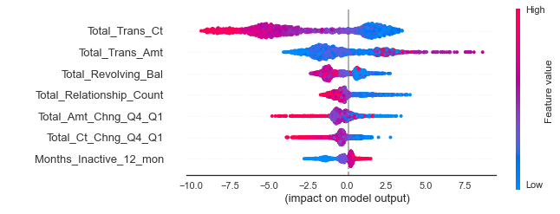
Impact of feature values
Feature | Observation
Total_Trans_Ct | Low value means higher risk of churning
Total_Trans_Amt | Above average value means higher risk of churning
Total_Revolving_Bal | Low value means higher risk of churning
Total_Relationship_Count | More relationship indicates higher chance of churning
Total_Amt_Chng_Q4_Q1 | Low value means higher risk of churning
Total_Ct_Chng_Q4_Q1 | Low value means higher risk of churning
Months_Inactive_12_mon | Higher value means higher risk of churning
Contacts_Count_12_mon | Higher value means higher risk of churning
Notes:
Each dot is an observation. Red represents churning.
distribution of the impacts each feature has. The color represents the feature value:
red indicating high
blue indicating low.

Slide 7

CLUSTERS
Peeking into clusters

Slide 8
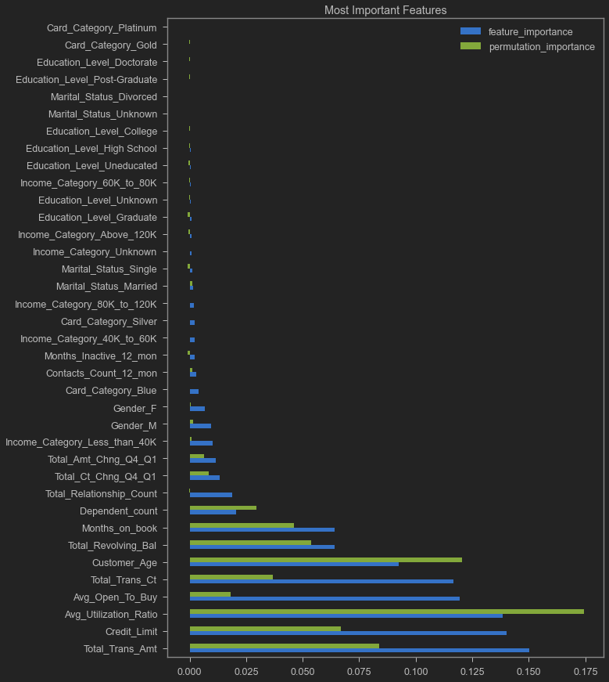
Features that isolates client segmentation
With insights from model, these are the topmost important features.
Total Transaction Amount
Credit Limit
Avg Utilization Ratio
Avg Open To Buy
Total Transaction Count
Customer Age
Total Revolving Balance
Months on book
Dependent count
Total Relationship Count

Slide 9
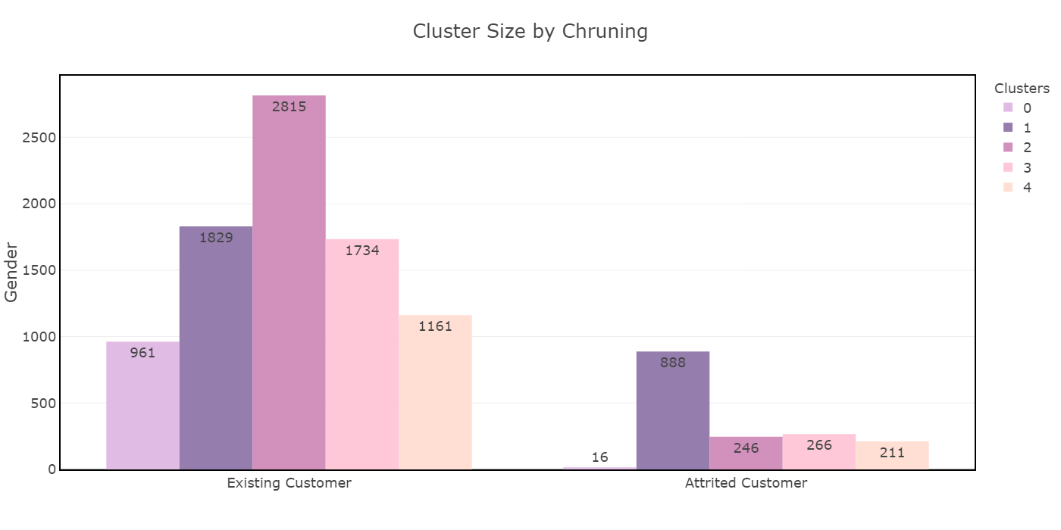
Clusters & Churn
Cluster 0 has low churn rate.
Cluster 2, labeled as High Risk, has large number of churned clients.

Slide 10
Identifying Clusters
CLUSTER | LABEL
Cluster 0 | Low value frequent users of services
Cluster 1 | High risk clients
Cluster 2 | Regular clients
Cluster 3 | Most loyal clients. (mostly consists of older clients)
Cluster 4 | High value clients

Slide 11
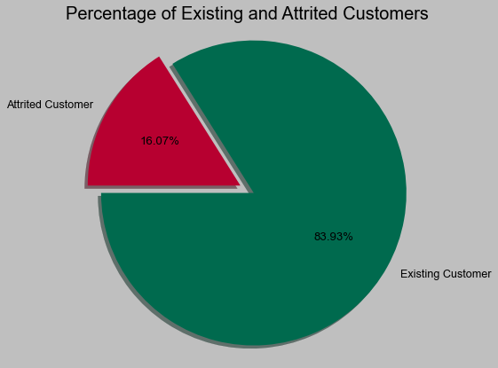
Cluster size
16% of customers terminated their relationship with the bank.
Female clients dominates cluster 1 and 2.
They can be targeted with tailored offer.

Slide 12
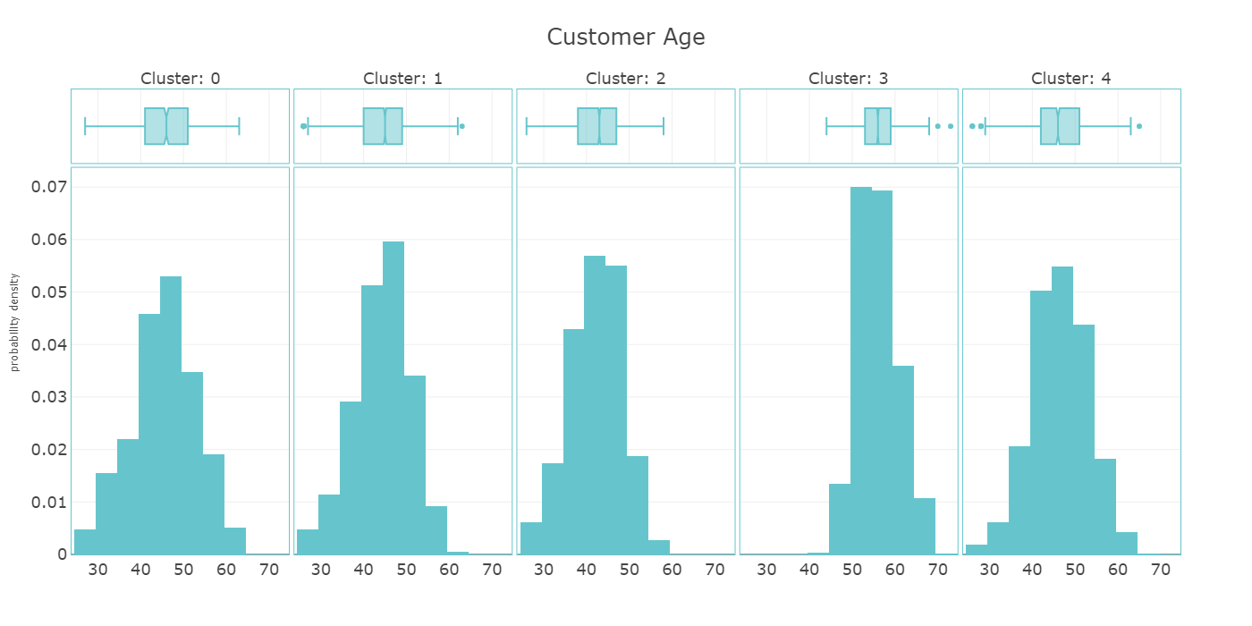
Customer Age
Cluster 1 and 4 has similar distribution.
Cluster 0 is slightly younger.
Cluster 3 is distinct as it is mostly comprised of older clients.
Others have similar distribution.

Slide 13
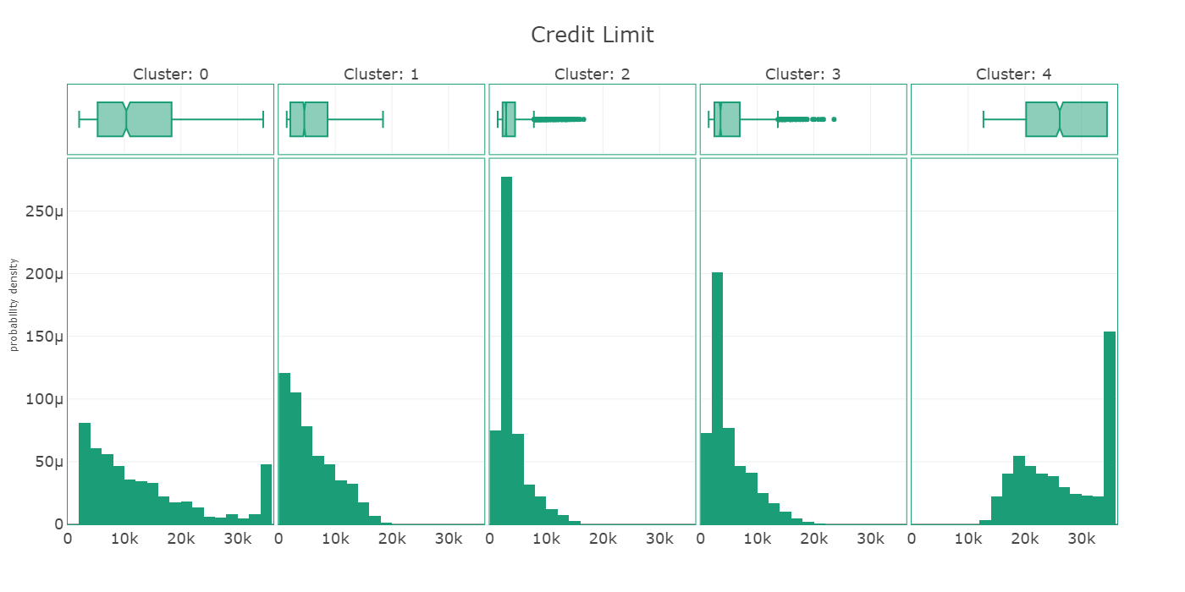
Credit Limit
Cluster 1 has mostly lower credit limit clients.
Cluster 0 has a well-balanced distribution; it does not have lower credit limit clients.
Cluster 2 and 3 has mostly same characteristics.
Cluster 4 has the clients with mostly high credit limit.

Slide 14
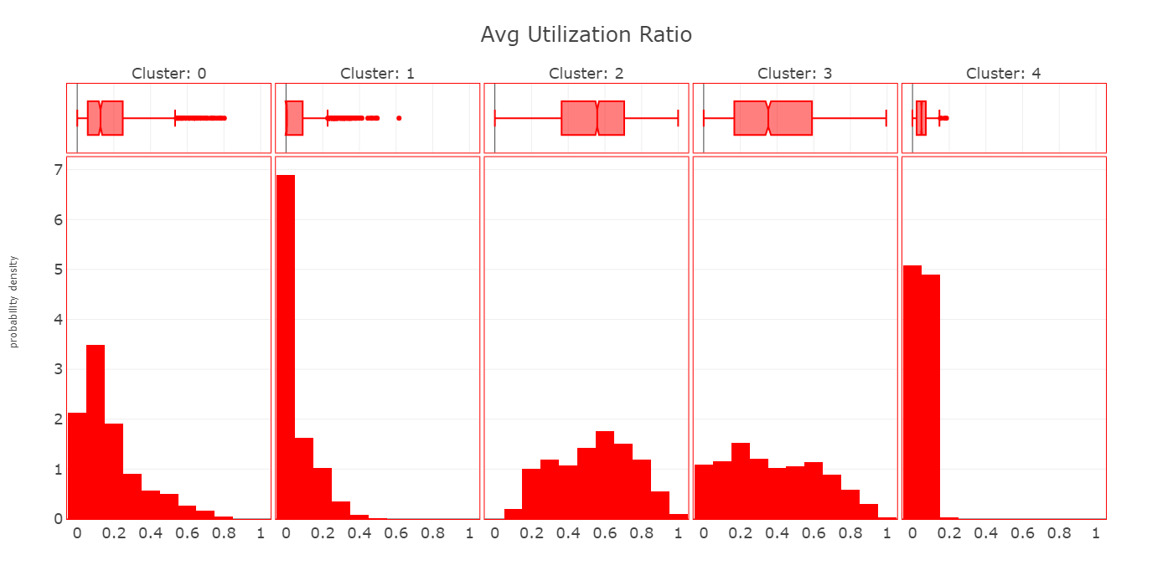
Average Utilization Ratio
Cluster 1 has mostly less utilization ratio.
Cluster 0 shows good utilization ratio, with some 0.
Cluster 2 and 3 has similar utilization. Cluster 2 does not have many 0’s.
Cluster 4 has low utilization of credit.

Slide 15
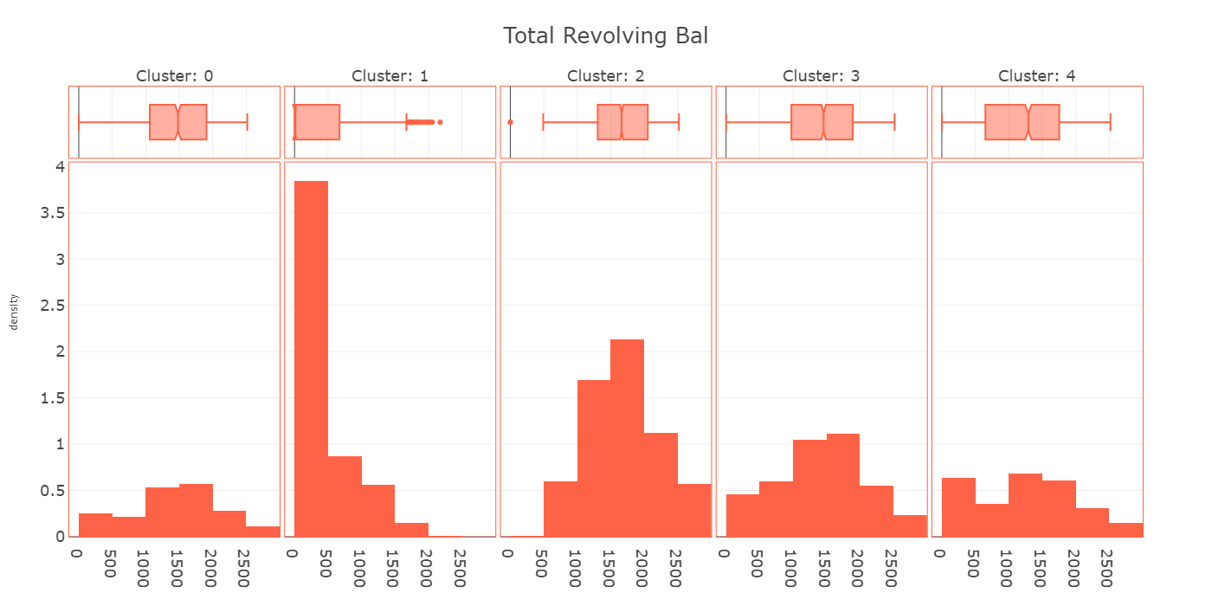
Total Revolving Balance
Cluster 1 has mostly low revolving balance.
Cluster 0 has even distribution.
Cluster 2 does not include low revolving balance clients.
Cluster 3 and 4 has similar distribution.

Slide 16
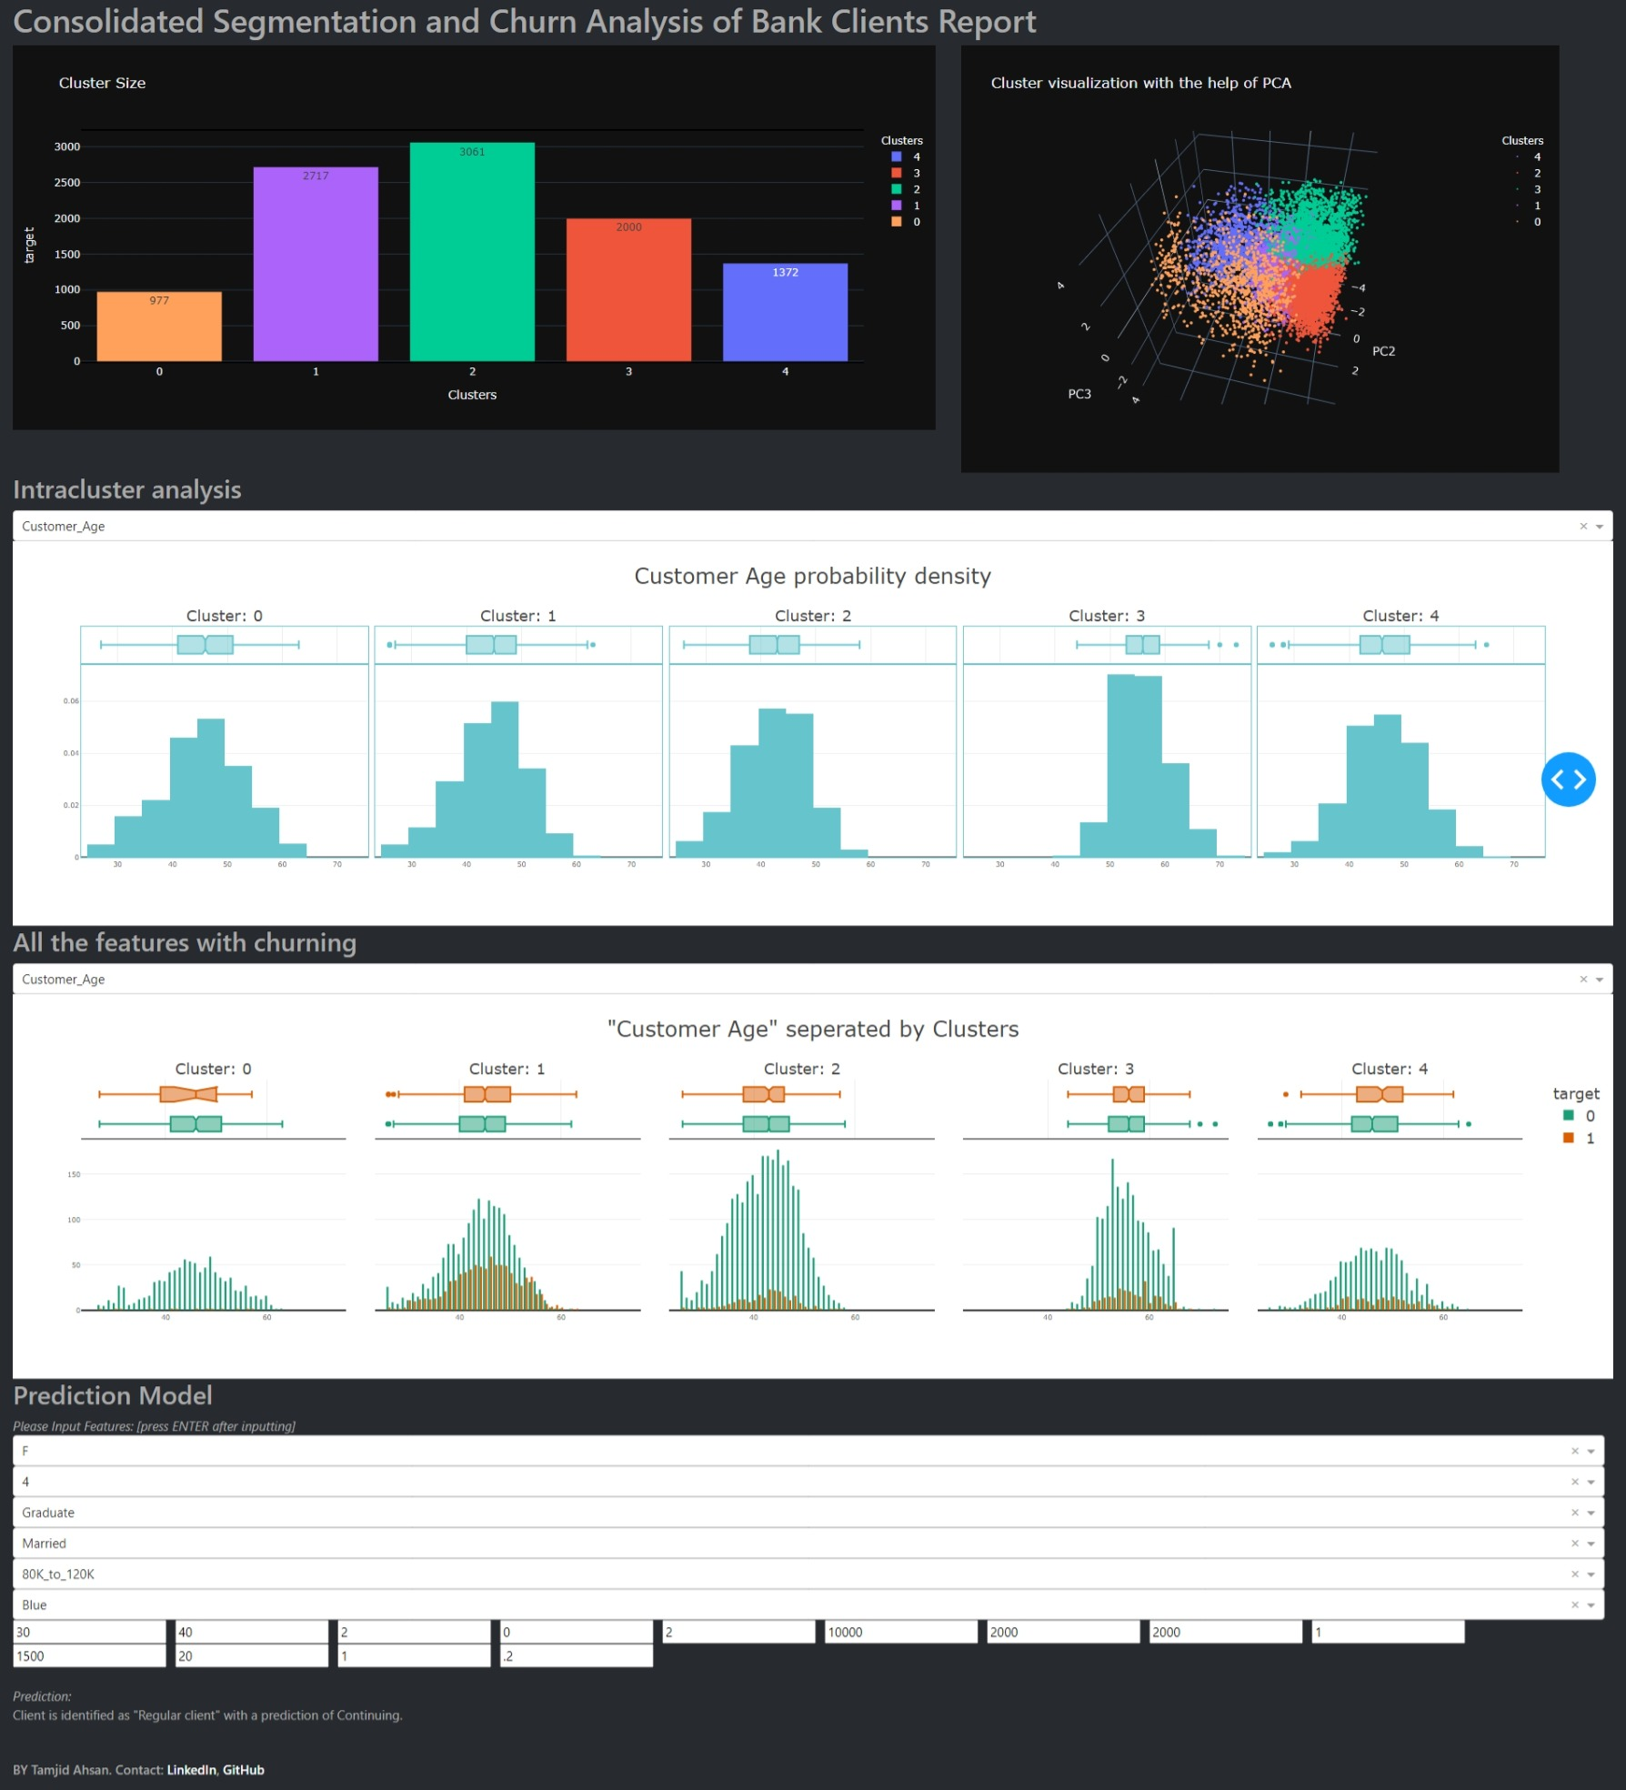
Dashboard
Additional insights
Predict new clients churn and cluster group.

Slide 17

RECOMMENDATIONS
Cluster 1 is the riskiest client segmentation.
Their utilization ratio is low.
offering incentives like cash back.
Their credit limits are low. Based on their credit habit, they can be offered a larger credit limit.
As a rule of thumb:
Marketers should target female clients with specific package.
Frequent smaller amount of transaction can be perceived as a red flag. When spotted, customer relationship team must act on it.
Large expenditure can be a signal for cross selling opportunity, and it is also a sign of churn.
Notes:
Cluster 1 is the riskiest client segmentation.
Their utilization ratio is low.
offering incentives like cash back.
Their credit limits are low. Based on their credit habit, they can be offered a larger credit limit.
As a rule of thumb:
Most loyal and at-risk clients are female. Marketers should target them with specific package.
frequent smaller amount of transaction can be perceived as a red flag. When spotted, customer relationship team must act on it.
large expenditure can be a signal for cross selling products, and it is also a sign of churn.

Slide 18
THANK YOU
GitHub: @tamjid-ahsan
LinkedIn: linkedin.com/in/tamjidahsan/
Project repo: https://github.com/tamjid-ahsan/capstone_customer_churn

Slide 19
APPENDIX

Slide 20
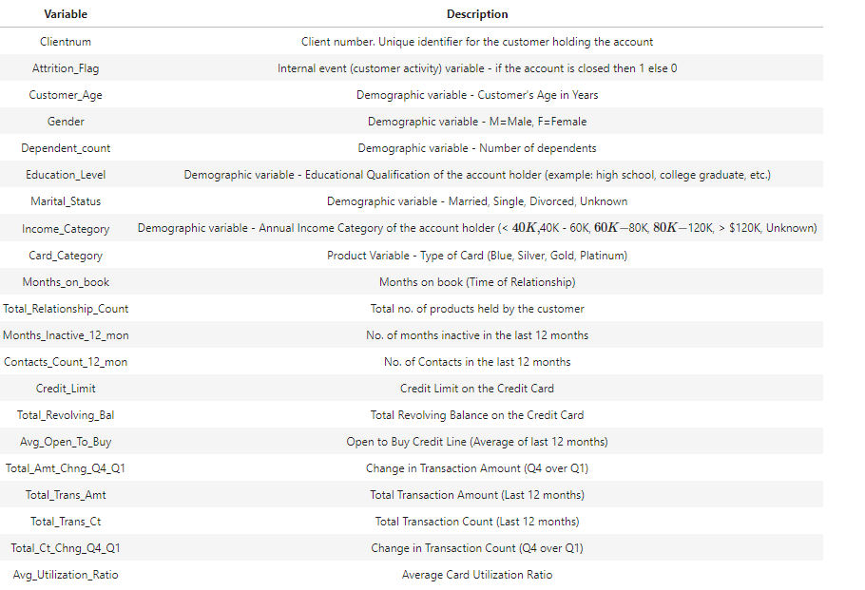
Features of the dataset

Slide 21
Summary of exploring
Variable | Cluster 0 | Cluster 1 | Cluster 2 | Cluster 3 | Cluster 4 | Churn | Comment
Avg_Open_To_Buy | spread | low | low | low | high value | 1 | Majority values are low
Avg_Utilization_Ratio | low utilization | minimal low utilization | no low utilization ratio | med utilization | low utilization | 1 | Majority values are low
Card_Category |  |  |  |  |  | 1 | High class imbalance to comment
Credit_Limit | all clients from2k | mostly low limit | 2k to 4k, no high limit |  | high limit, above 14k | 1
Customer_Age | similar | similar | similar | older | similar | 3
Dependent_count | spread | spread | spread | low | spread | 1 | count 3 and 4 is risky
Education_Level | Graduate | Graduate | College | College | Uneducated | 1 | Graduates >HS >= Unknown>=Uneducated, PG and PhD is less likely to churn
Gender | M | F | F | F | M | 1 | Females is risky
Income_Category | Less_than_40K | 40K_to_60K | 40K_to_60K | Less_than_40K | Unknown | 1 | Less than 40K
Marital_Status | Unknown | Single | Married | Married | Unknown | 1 | Majority values is Married
Months_on_book | good | similar | similar | loyal customer | similar | 3
Total_Relationship_Count | low | high | high | high | high | 1 | 2 and 3 are most frequent
Total_Revolving_Bal | spread | low | mod | spread | spread | 1 | Majority values are low
Total_Trans_Amt | High transaction amount | low | mid amount till 5k high feq transaction | mid amount till 5k high feq transaction | mid amount till 5k med freq transaction | 1 | low amounts
Total_Trans_Ct | heavy user | moderate user | moderate user | moderate user | moderate user | 1 | Majority values are between 30 to 50

Slide 22
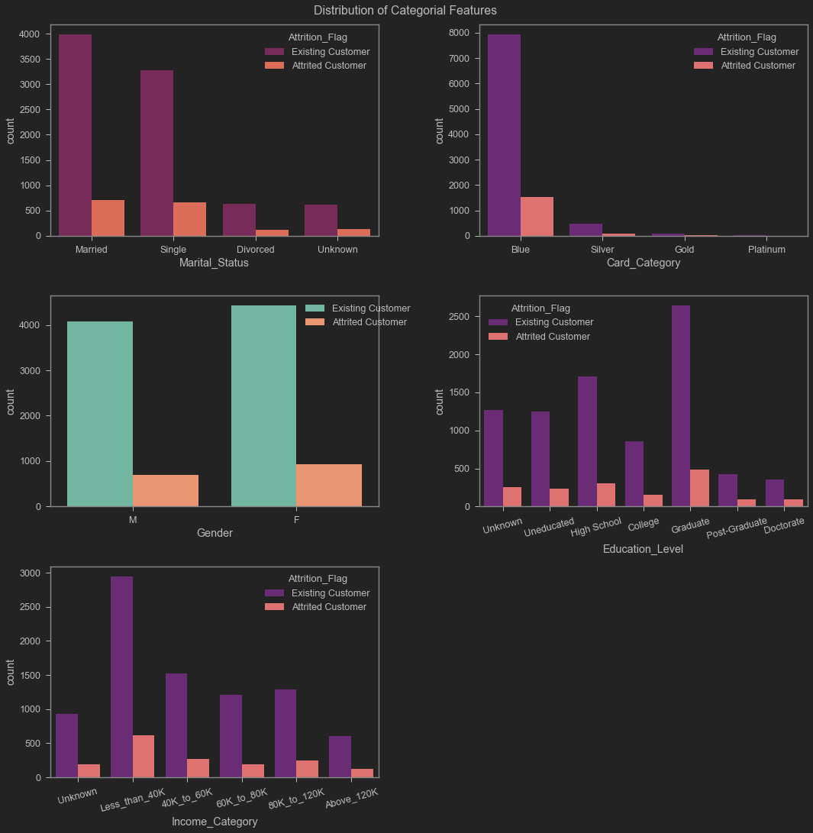
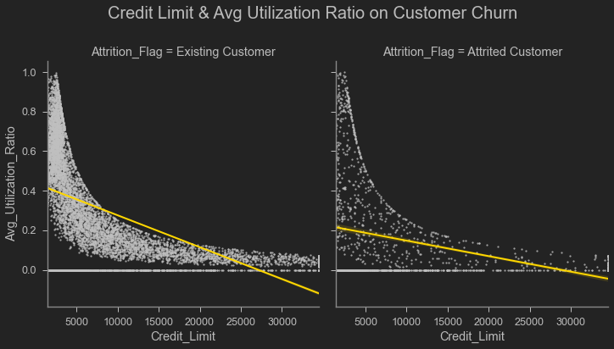
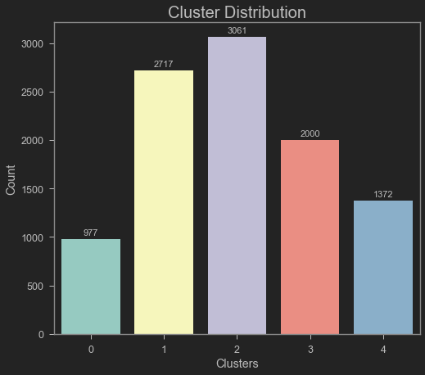
Exploration

