Slide 1
MACHINE LEARNING AND ARTIFICIAL INTELLIGENCE APPROACHES USING DATA TO IMPROVE HEALTH
PANELISTS
Ram Samudrala
Md Tamjidul Hoque
Rammohan Shukla
Elizabeth Chen
PANEL STRUCTURE
Introductory presentations (25 minutes total)
Moderator questions x 2 (20 minutes total)
Audience Q&A

Slide 2
RAM SAMUDRALA

Slide 3
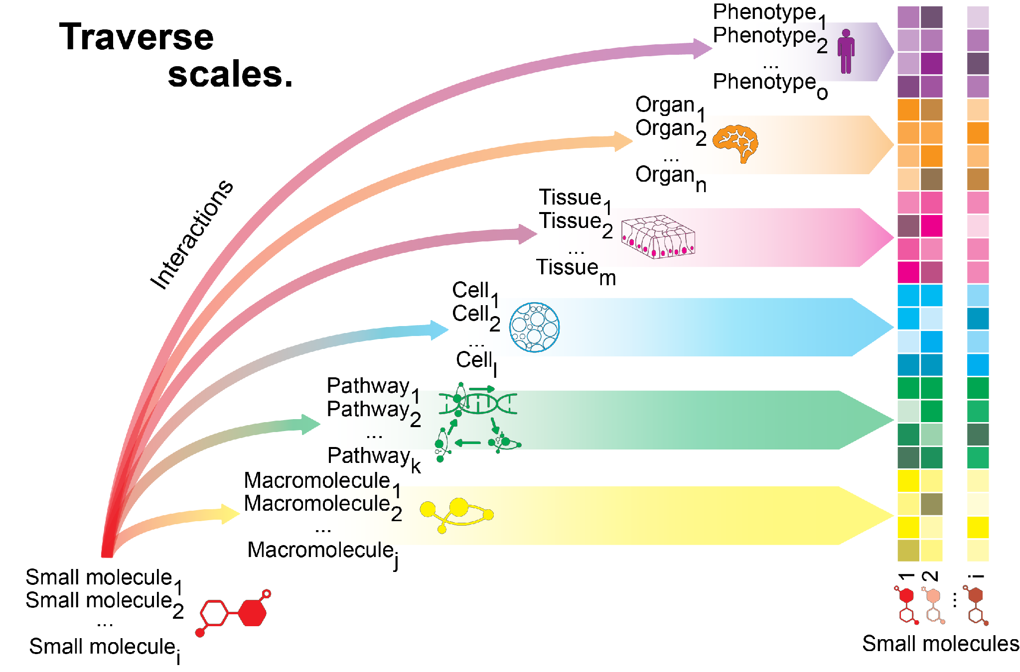
MULTISCALE AI-DRIVEN DRUG DISCOVERY USING CANDO

Slide 4
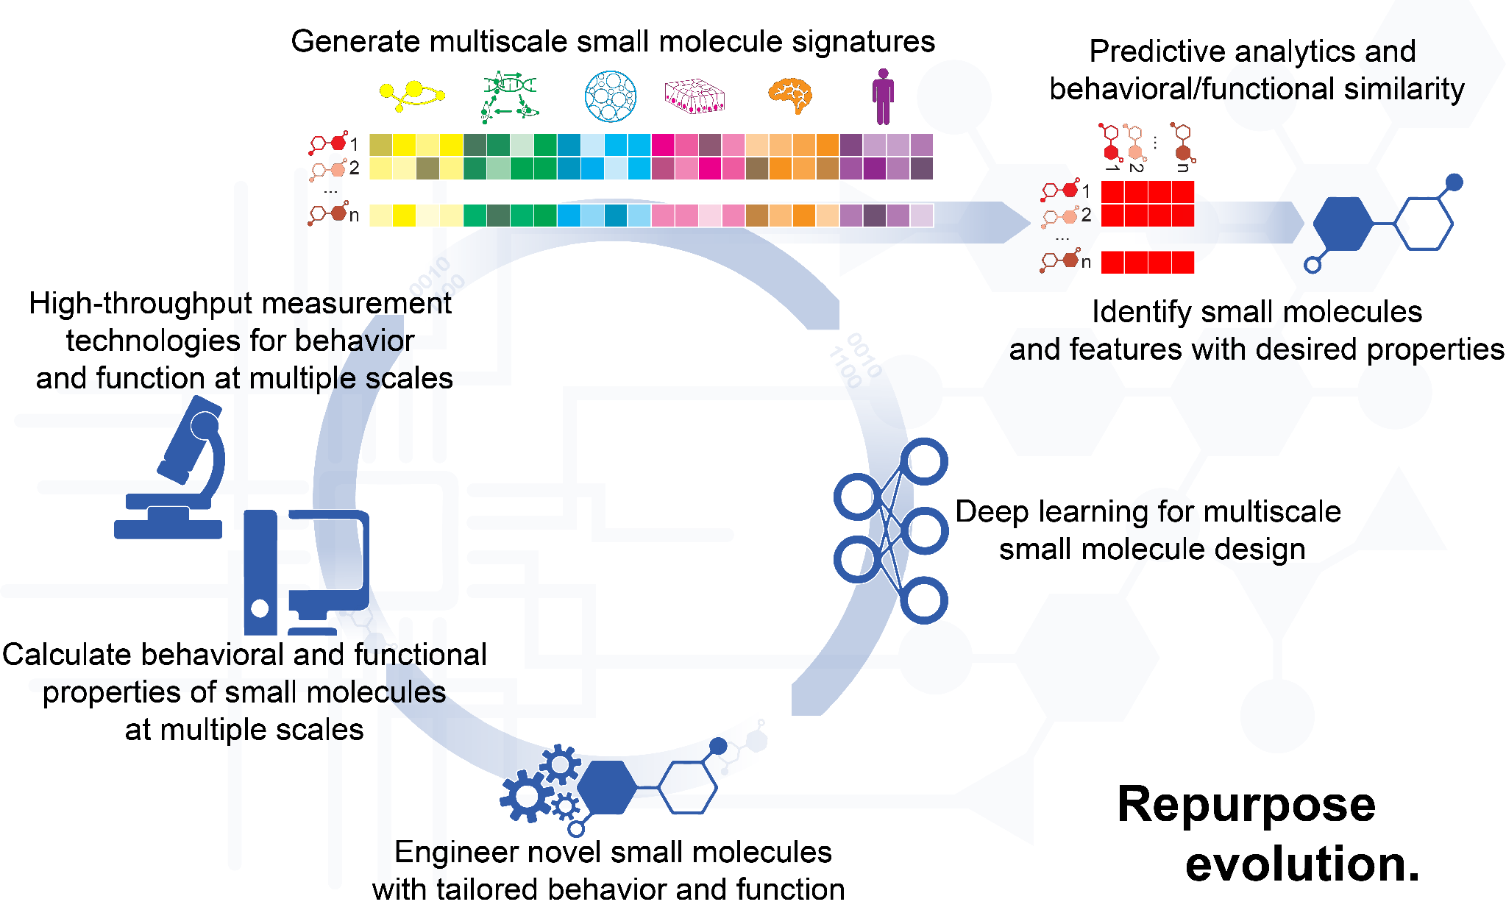
MULTISCALE AI-DRIVEN DRUG DISCOVERY USING CANDO

Slide 5
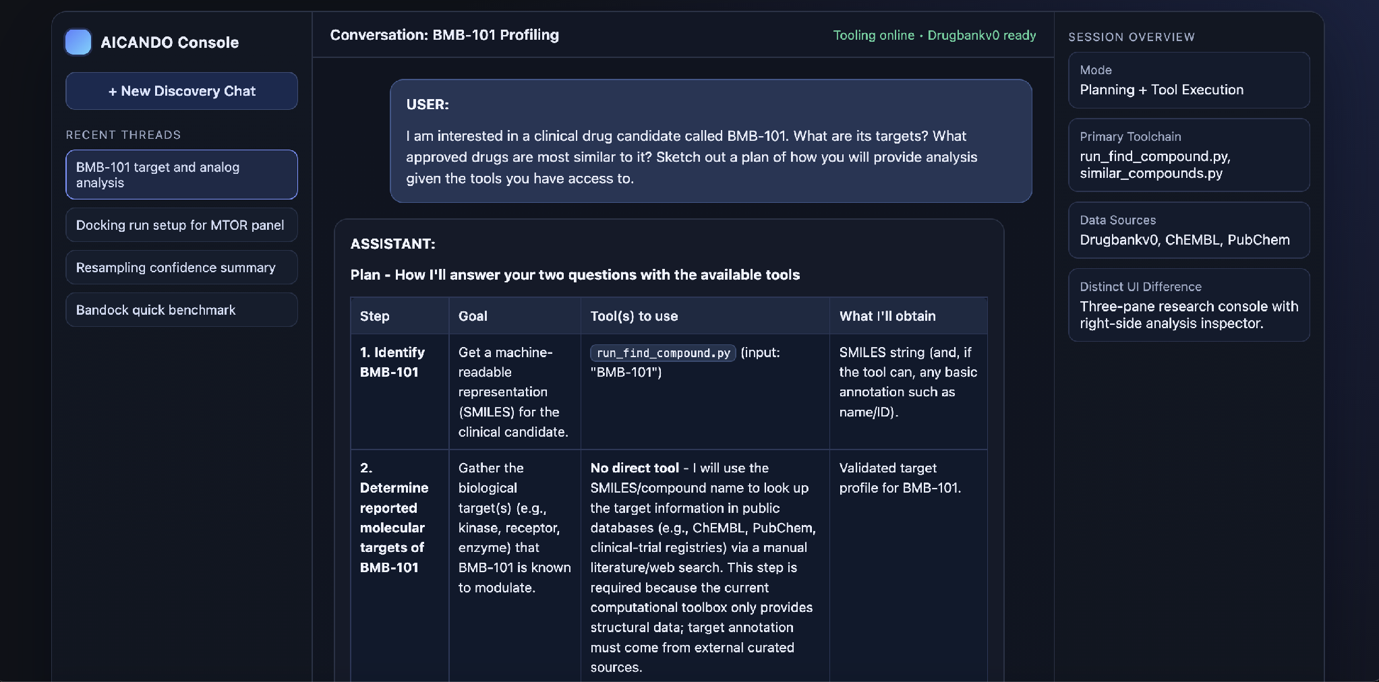
AI-CANDO
Plans the experiment
AICANDO
Executes plan with built-in CANDO tools
Capable of improvising

Slide 6
TRAINING, INFRASTRUCTURE, IMPACT
Provide informatics support for local, national, and international researchers – including genomics, proteomics, ontology, data analytics, and bio, clinical, and translational informatics.
Enable multiscale computational drug discovery using the CANDO platform, integrating proteomic-scale interaction signatures for systematic drug repurposing and design.
Deliver actionable therapeutic candidates: NSCLC and OUD leads identified and validated, including compounds with improved efficacy/toxicity profiles and reduced fentanyl self-administration in vivo.
Advance AI-driven drug discovery (AI-CANDO): an agentic system that plans, executes, and adapts computational experiments, enabling rapid, reproducible, and scalable analysis.
Translate data to impact by combining AI/ML, ontology-based standards, and interoperable data frameworks, accelerating discovery, validation, and clinical relevance.
Advance ontology-driven translational applications in pain, aging, vaccine science, and general medical science, facilitating cross-study analyses and collaborative research.
Create and implement ontology-based Common Data Elements (CDEs) to support consistent representation, integration, and reuse of clinical and experimental data.
Provide training and workforce development through BMI Bootcamp, CTSI programs, and the online MS in Applied Ontology, expanding adoption of standards-based informatics.

Slide 7
MD TAMJIDUL HOQUE

Slide 8
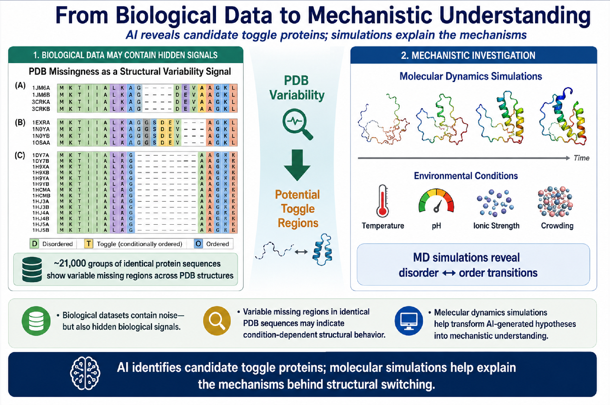
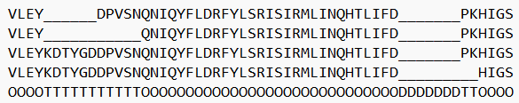
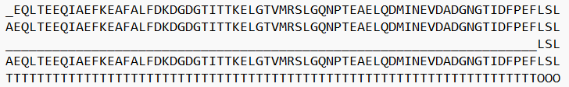
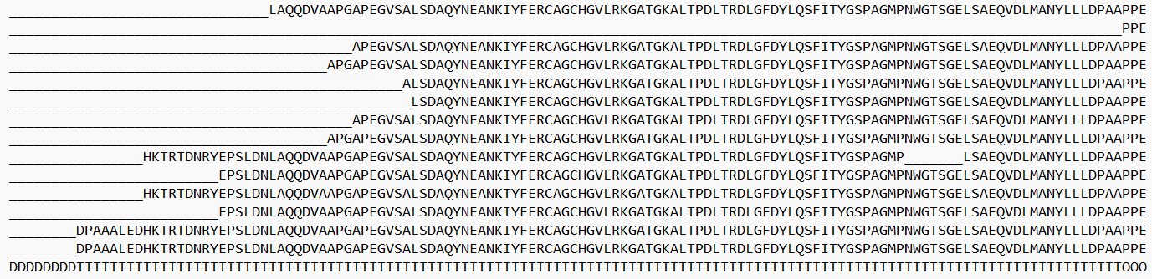
AI as a Bridge from Data to Discovery
Md Tamjidul Hoque, Professor of Computer Science, University of New Orleans

Slide 9
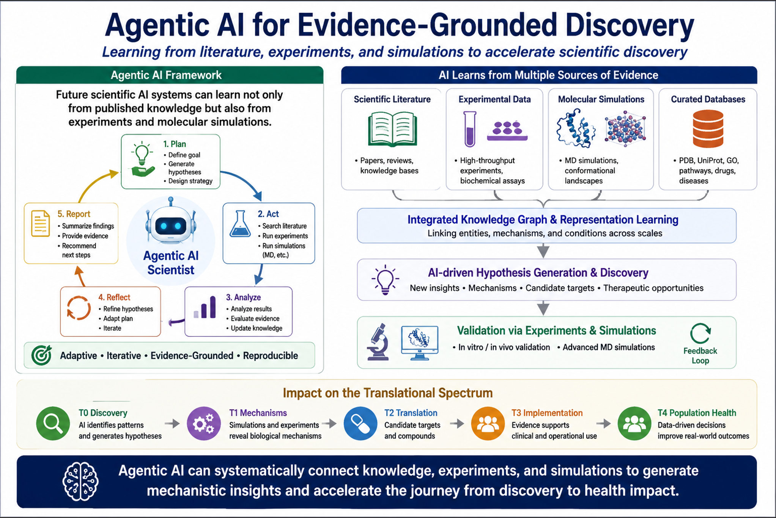

Slide 10
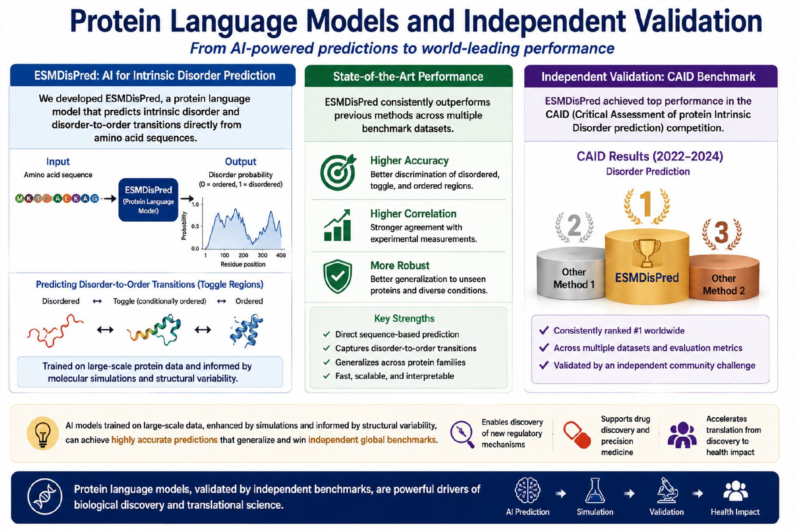

Slide 11
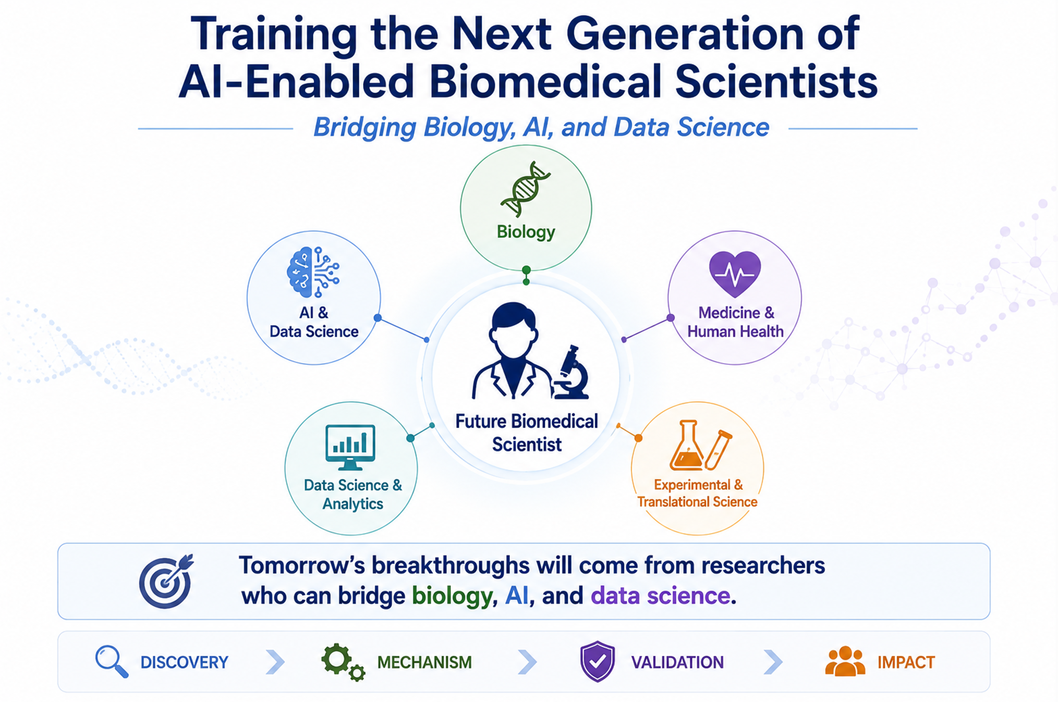

Slide 12
RAMMOHAN SHUKLA

Slide 13
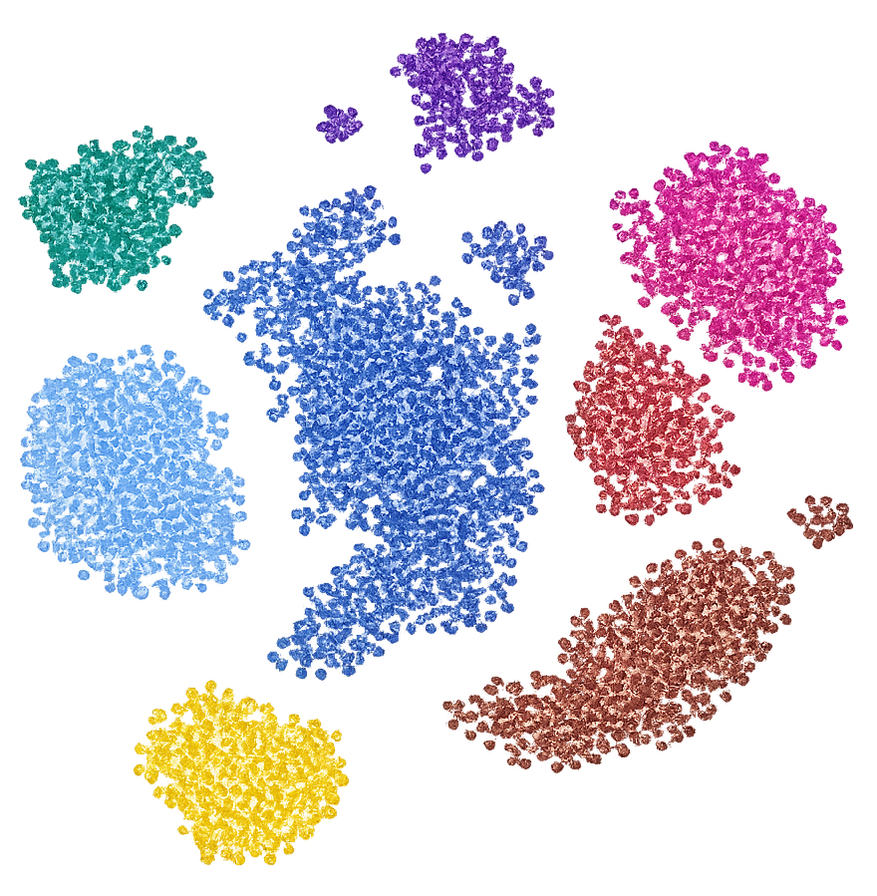
Can We Predict Neural Computation using Single-Cell Transcriptomics?
Neuronal Characterization
Cell types
Cell states
Gene regulation
Cell-cell interactions
Circuit composition
Vulnerability
Neural Computation
Excitability
E/I balance
Oscillations
Functional connectivity
Information processing
Memory
Circuit resilience
Emergent phenotypes

Slide 14
Can We Predict Neural Computation using Single-Cell Transcriptomics?
Annotations

Slide 15
Can We Predict Neural Computation using Single-Cell Transcriptomics?
Connectivity
Annotations

Slide 16
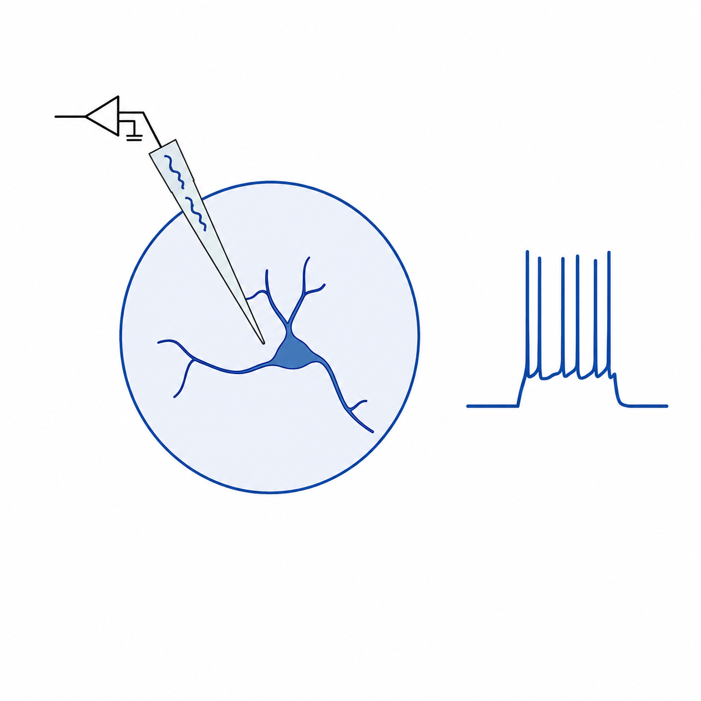
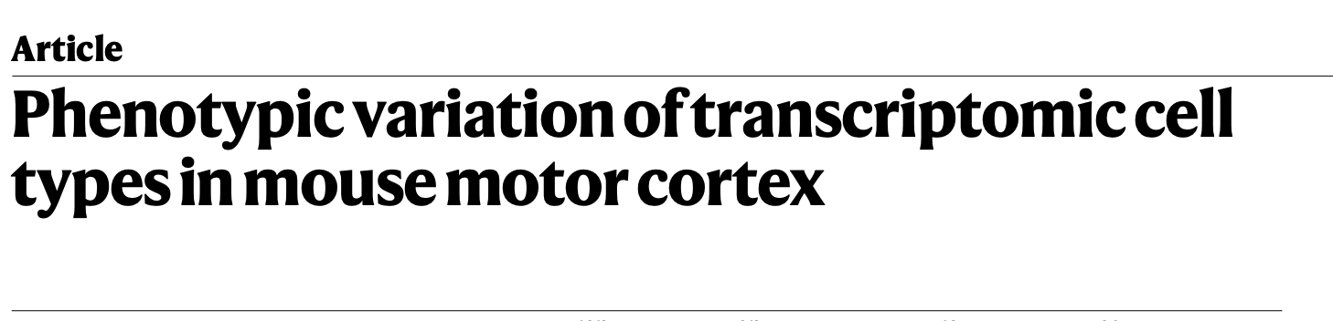
Can We Predict Neural Computation using Single-Cell Transcriptomics?
Connectivity
Annotations
Parameters
Simple-Adex

Slide 17
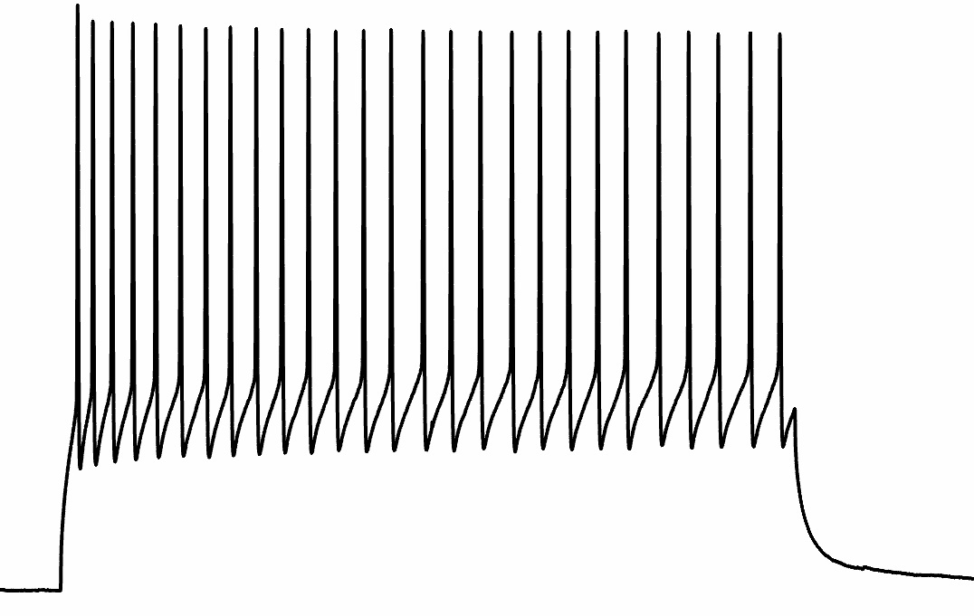
Can We Predict Neural Computation using Single-Cell Transcriptomics?
Connectivity
Annotations
Parameters
Simple-Adex

Slide 18
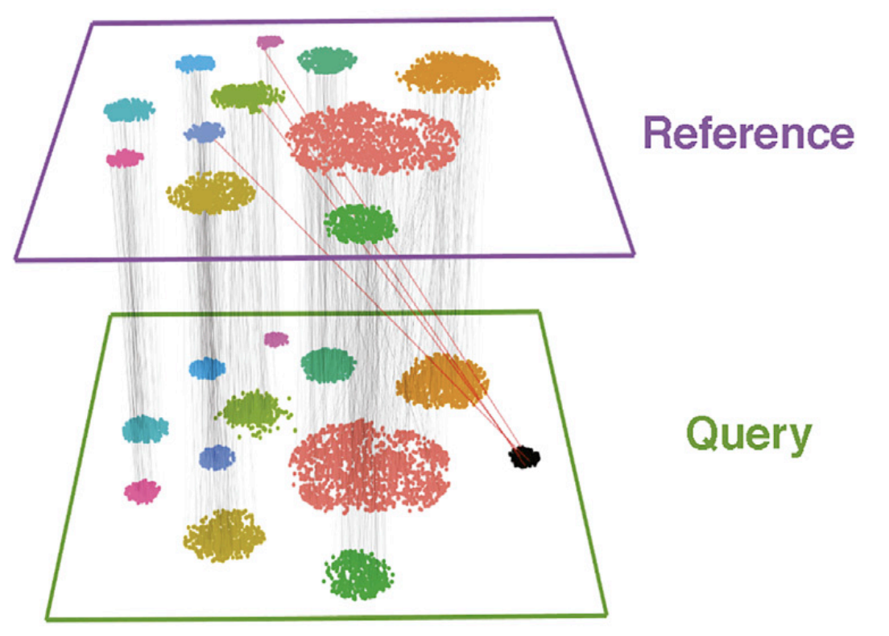
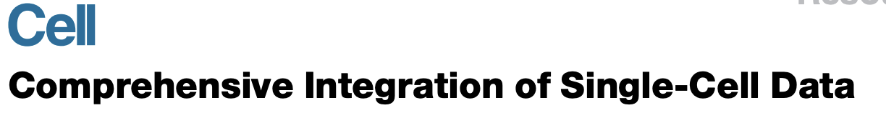
Can We Predict Neural Computation using Single-Cell Transcriptomics?
Connectivity
Annotations
Parameters
Simple-Adex

Slide 19
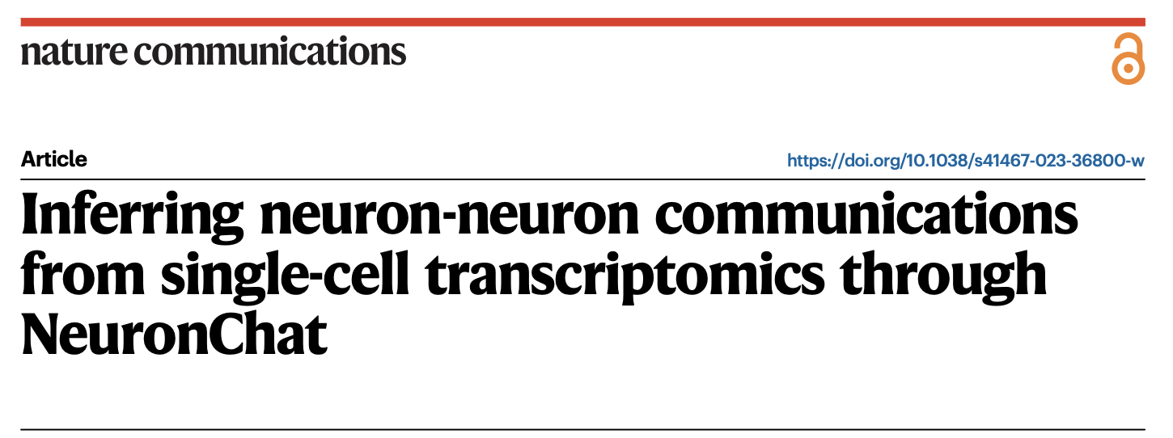
Can We Predict Neural Computation using Single-Cell Transcriptomics?
Neuron-chat
Connectivity
Annotations
Parameters
Simple-Adex

Slide 20
Can We Predict Neural Computation using Single-Cell Transcriptomics?
What can we use this model for
Enables multi-scale neuroscience
Genes
Cells
Circuits
Behavior
Provides a causal framework
All models are wrong, but some are useful.
Not a perfect brain model — a useful predictive model
A transcriptomically informed
microcircuit model

Slide 21
ELIZABETH S. CHEN

Slide 22
Machine Learning and Artificial Intelligence Approaches Using Data to Improve Health: EHRs and AI for Learning Health Systems
Elizabeth S. Chen, PhD, FACMI
Associate Professor of Medical Science
Associate Professor of Health Services, Policy, and Practice
Interim Director of the Center for Biomedical Informatics
Lead of the Advance RI-CTR Biomedical Informatics, Bioinformatics, and Cyberinfrastructure Enhancement Core
Brown University, Providence, RI
NISBRE 2026 | Rockville, MD | June 17, 2026

Slide 23
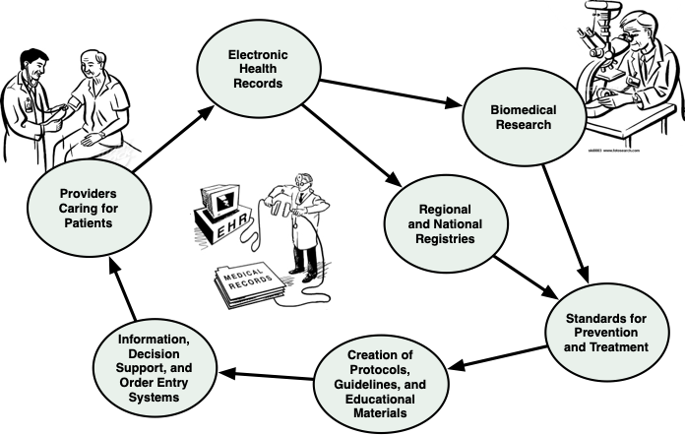
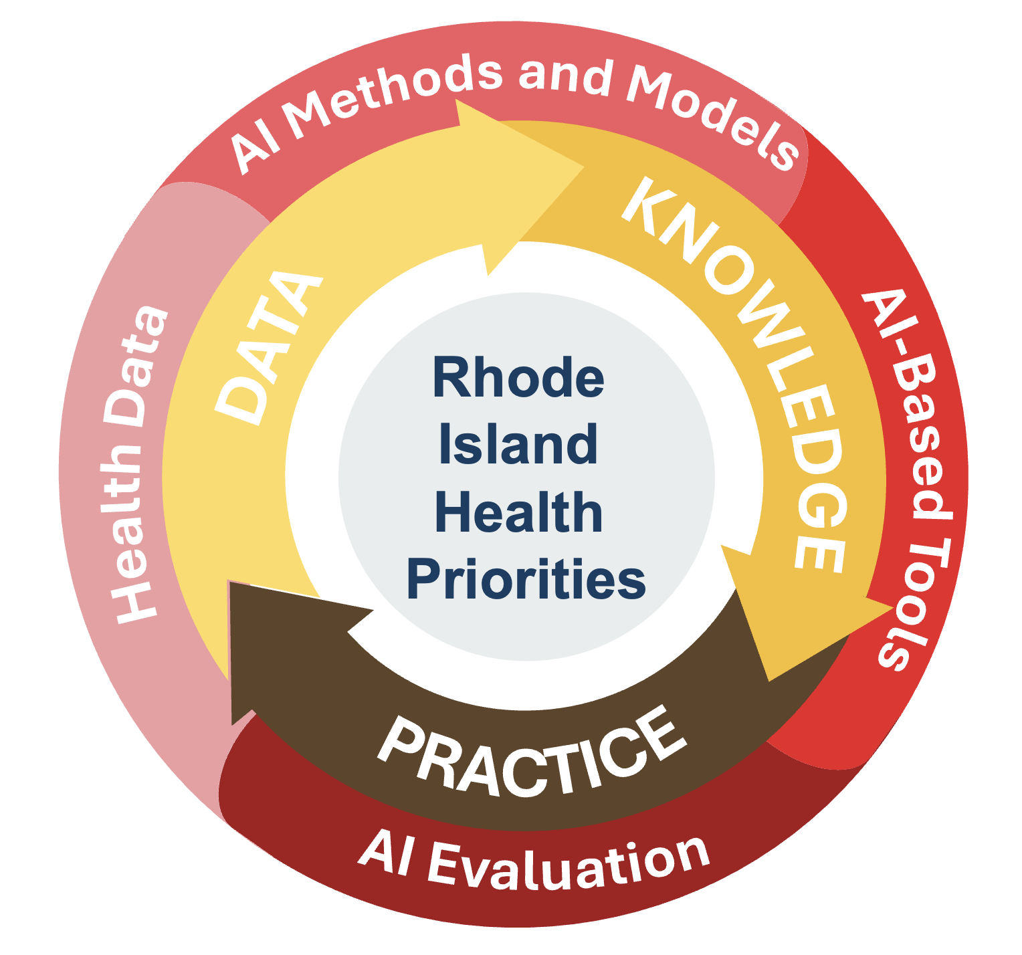
EHRs and AI for LHS
A “Learning Health System”
Artificial Intelligence for Learning Health Systems
Discovery
Transforming EHR Data to Knowledge
Implementation
Putting Clinical Decision Support (CDS) Tools into Practice
Data to Knowledge
Practice to Data
Impact
Studying the outcomes of CDS Tools in the EHR
Knowledge to Practice
Adapted from: Shortliffe EH, Chiang MF. Biomedical Informatics: The Science and the Pragmatics. In: Shortliffe EH, Cimino JJ, Chiang MF, editors. Biomedical informatics: computer applications in health care and biomedicine. 5th ed. New York: Springer; 2021.
Friedman CP. What is unique about learning health systems? Learn Health Syst. 2022 Jul 15;6(3):e10328. doi: 10.1002/lrh2.10328. PMID: 35860320; PMCID: PMC9284922.

Slide 24
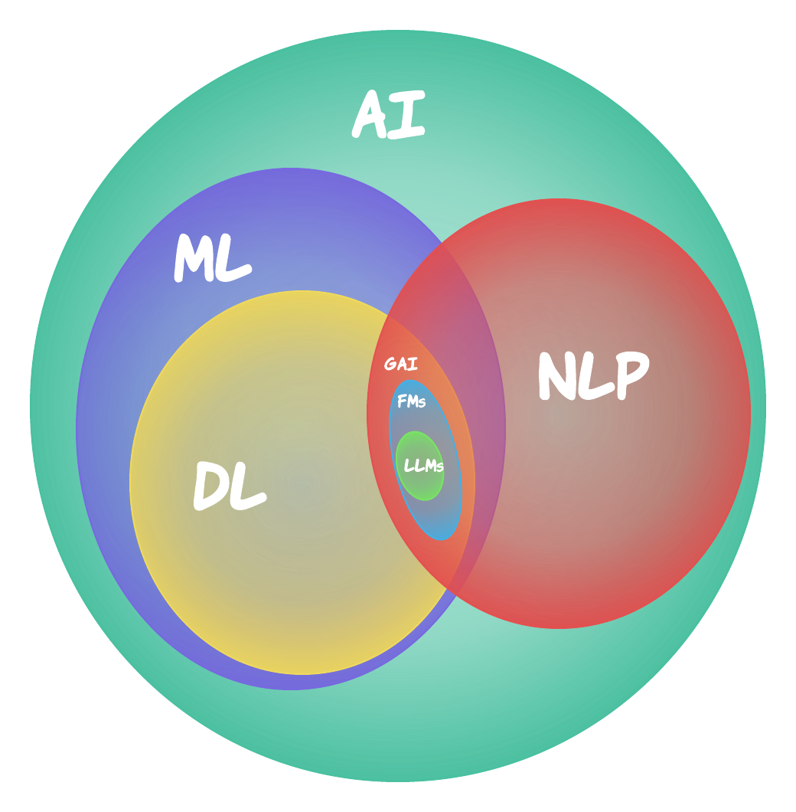
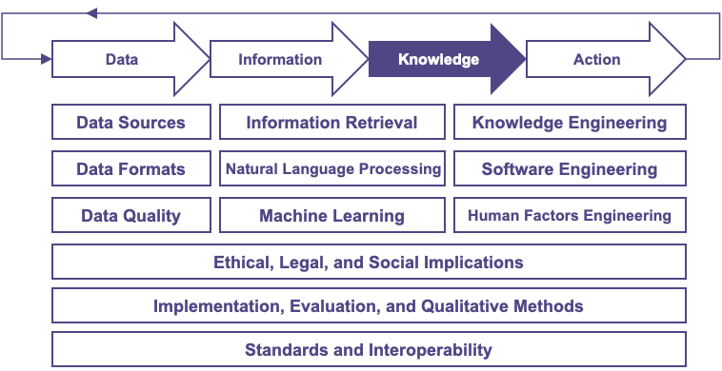
Transforming EHR Data to Knowledge
Methods, Techniques, and Technologies
AI = Artificial Intelligence | ML = Machine Learning | DL = Deep Learning | NLP = Natural Language Processing | GAI = Generative AI | FM = Foundation Models | LLM = Large Language Models
https://www.techtimes.com/articles/297641/20231017/deepening-our-understanding-of-artificial-intelligence-from-machine-learning-to-generative-ai-large-language-models-and-beyond.htm

Slide 25
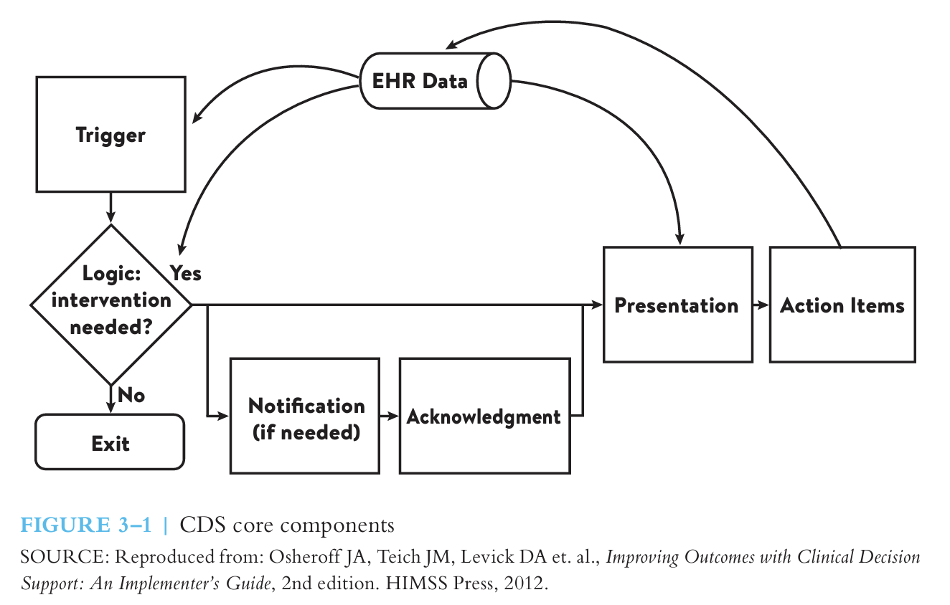
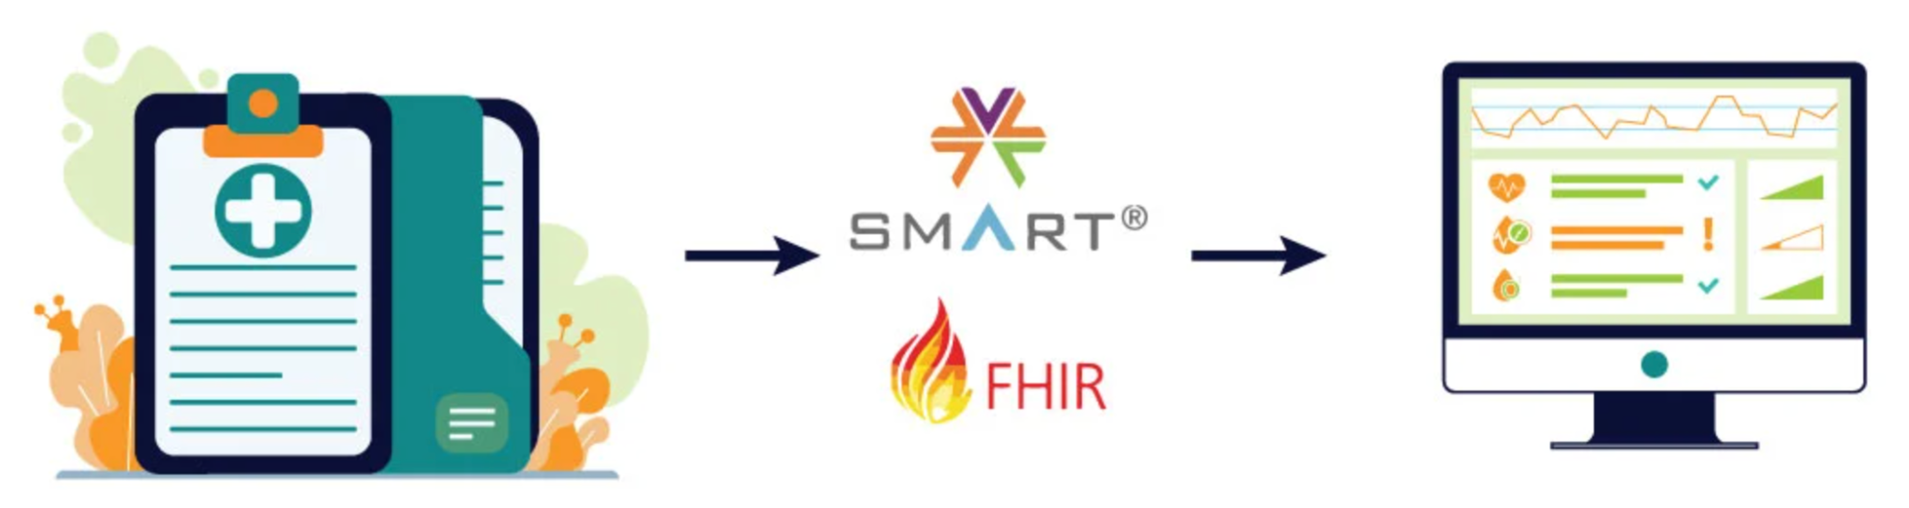
Putting EHR Knowledge into Practice
Clinical Decision Support (CDS) Tools
The right information (what)
To the right person (who)
In the right intervention format (how)
Through the right channel (where)
At the right time in workflow (when)
https://www.mindbowser.com/decoding-smart-on-fhir-for-healthcare-interoperability/

Slide 26





HEALTH INFORMATICS, DATA SCIENCE, AND AI TRAINING IN RHODE ISLAND
Pragmatic Acceleration of Community-Engaged Education for Data-Driven Health Sciences (PACE-DHS)
U54GM115677
5x5 Short Course:
Observational Research with EHR Data
5x5 Short Course:
Artificial Intelligence for Health (AI4H)
5x5 Short Course:
Health AI
for All (HAI4All)
5x5 Short Course:
EHR FHIR App Development
EHR Data & Standards | Concept Sets & Cohorts
Statistics
Introduction to
Health Data
HL7 Standards & Software Engineering
EHR Data Analysis with OHDSI ATLAS
Machine Learning
Understanding
Health Statistics
Web Programming & FHIR APIs
EHR Data Analysis with UNIX & SQL
Deep Learning
Navigating
Health Information
FHIR App Dev with Python & HTML
EHR Data Analysis with Julia
Natural Language Processing
AI in Healthcare
User Interfaces & Javascript
EHR Data Analysis with Python
Large Language Models
Shared Decision Making
Implementation & Evaluation
https://docs.bcbi.brown.edu/codiac-for-health

