Slide 1
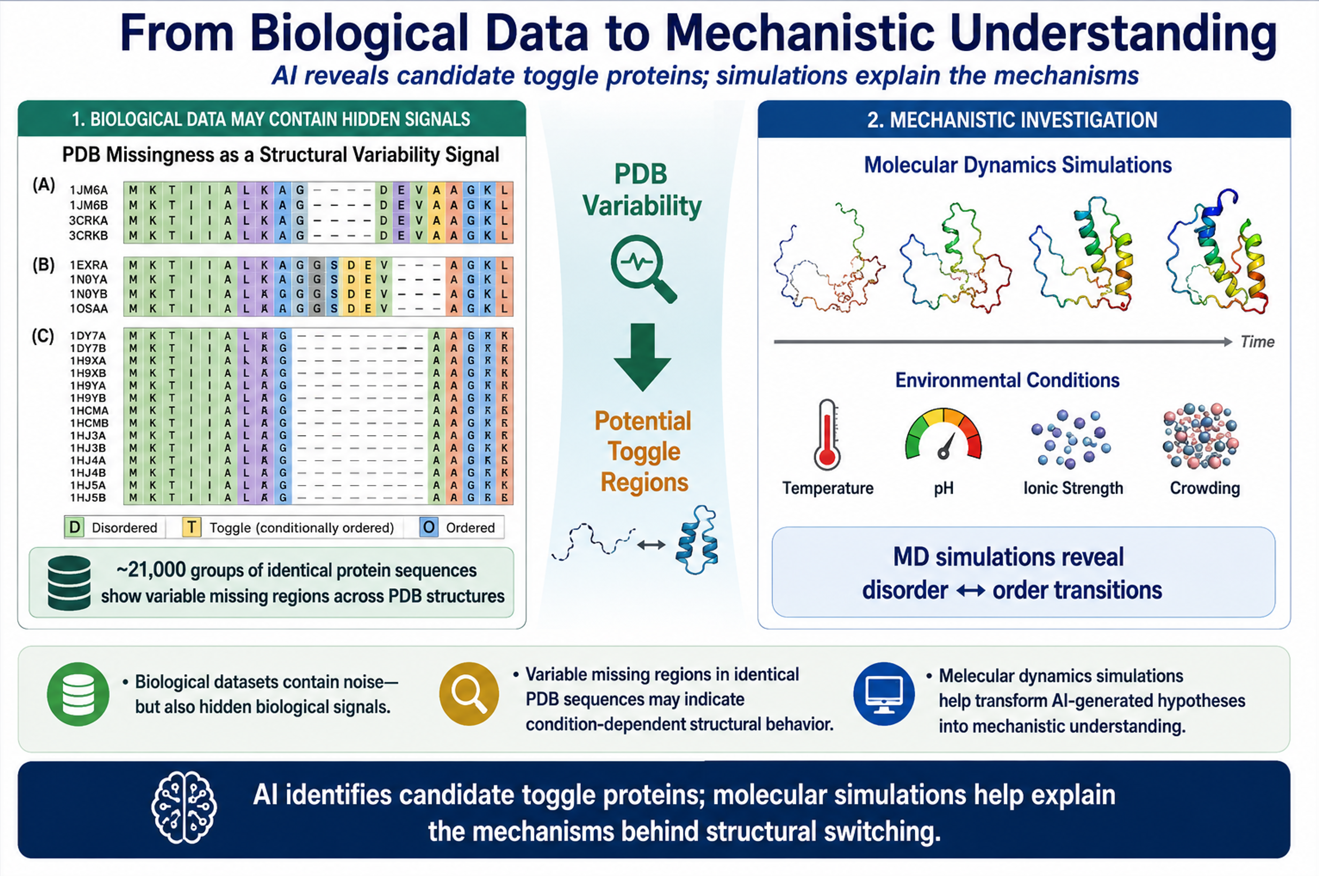
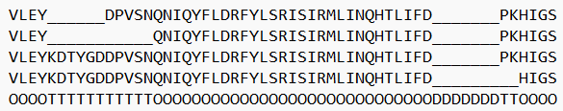
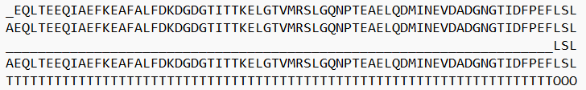
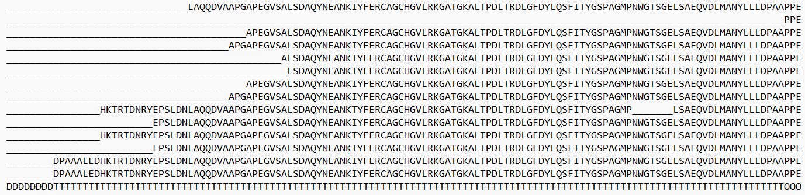
AI as a Bridge from Data to Discovery
Md Tamjidul Hoque, Professor of Computer Science, University of New Orleans
Email: thoque@uno.edu

Slide 2
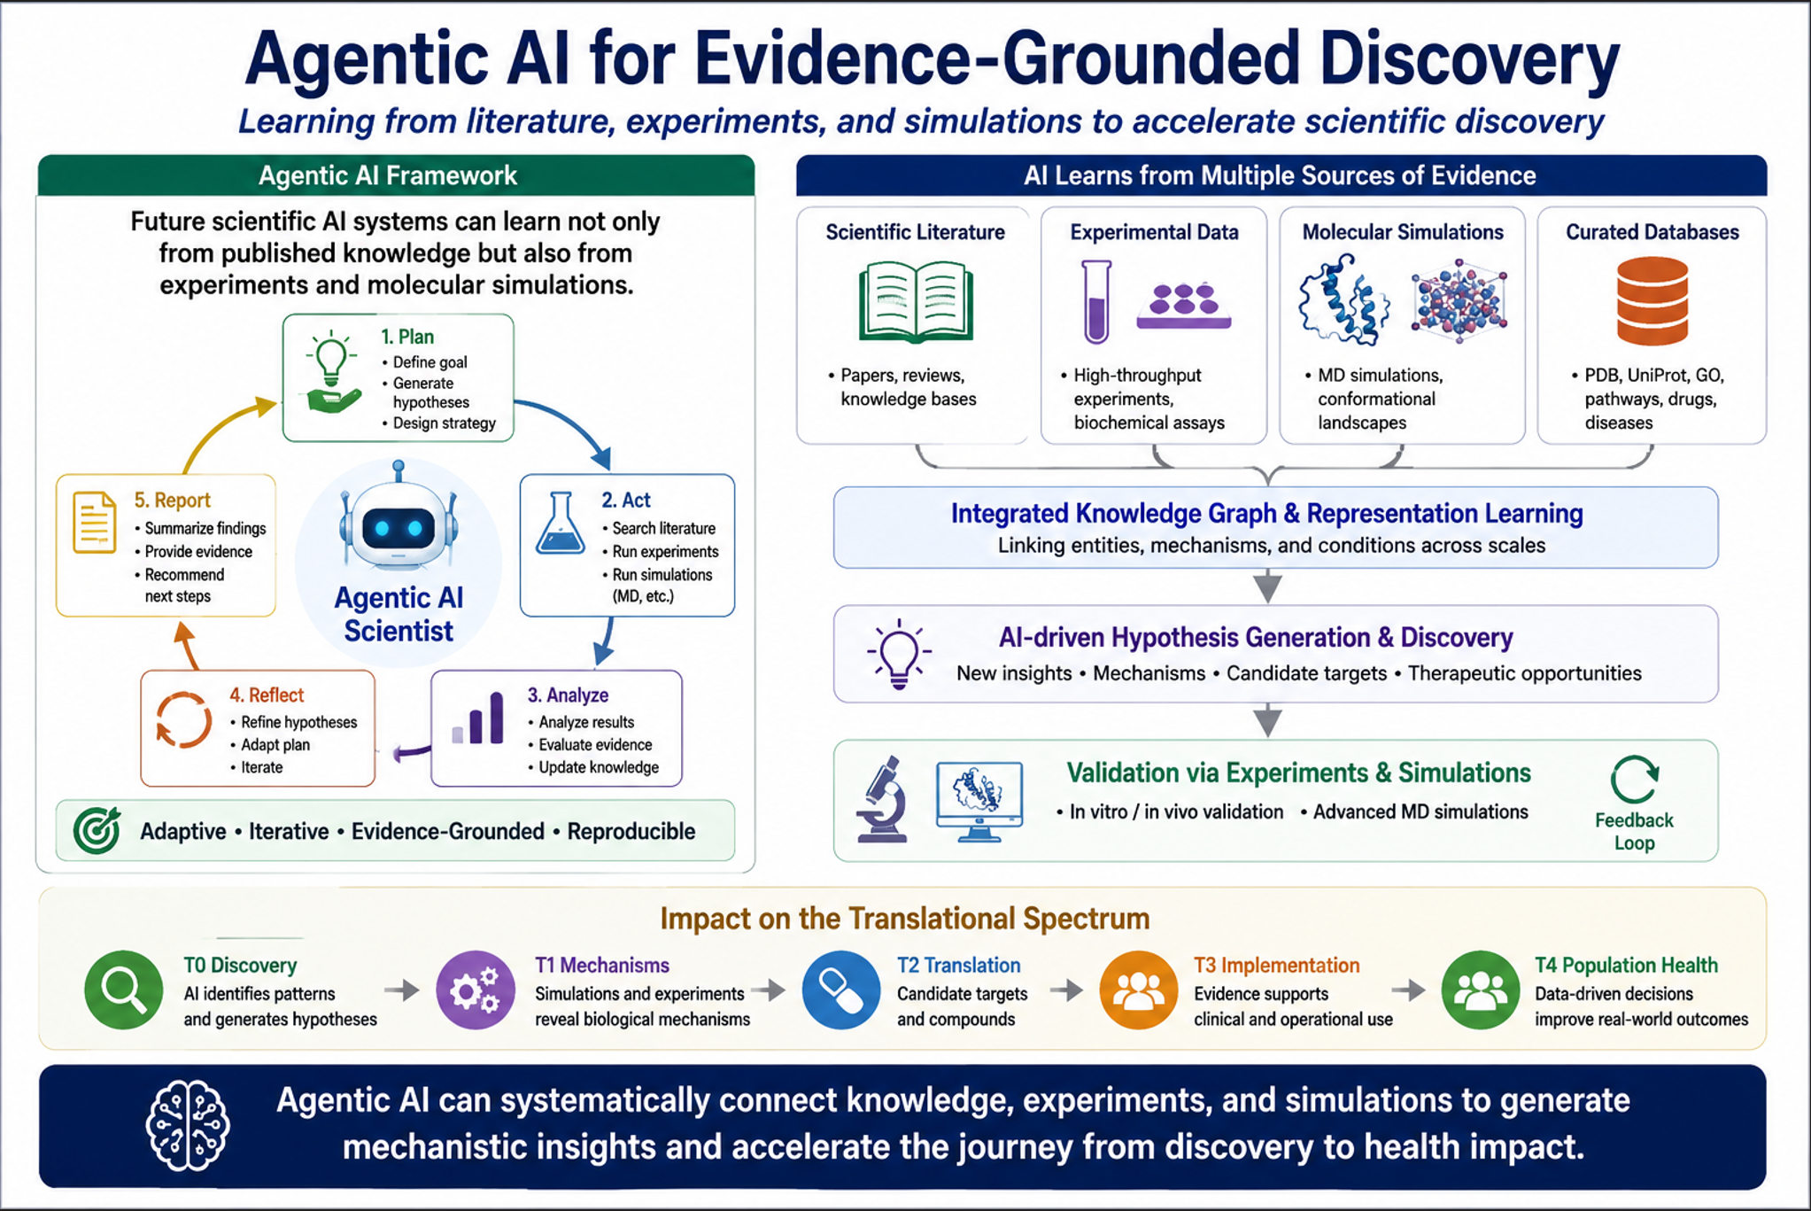

Slide 3
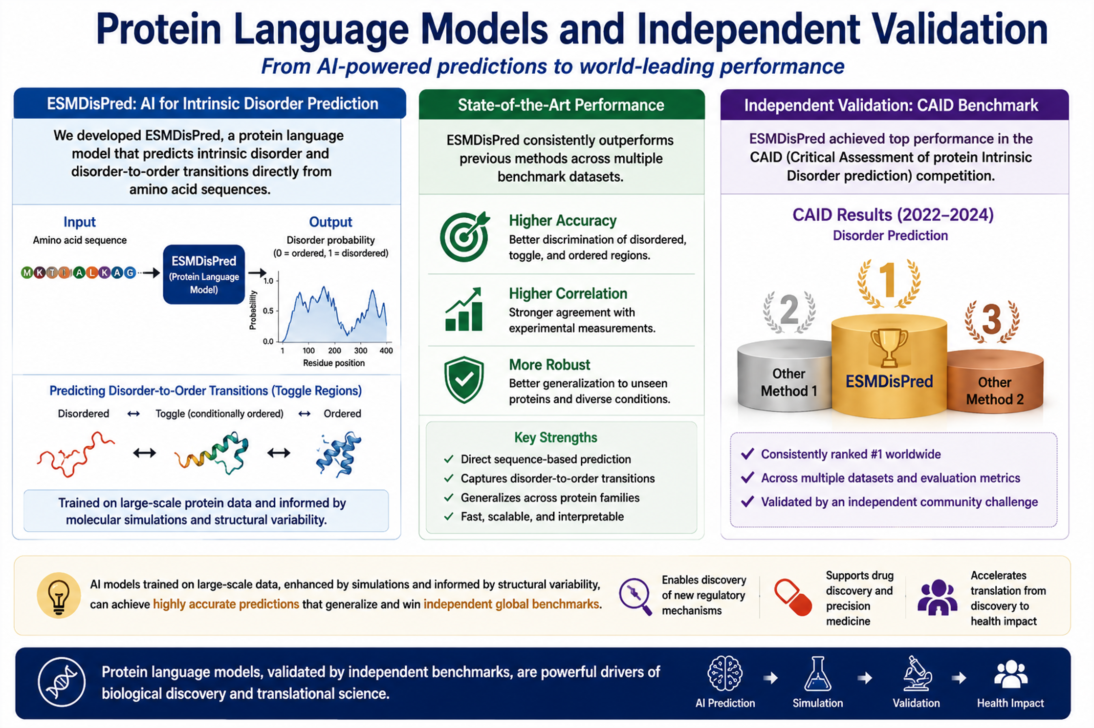

Slide 4
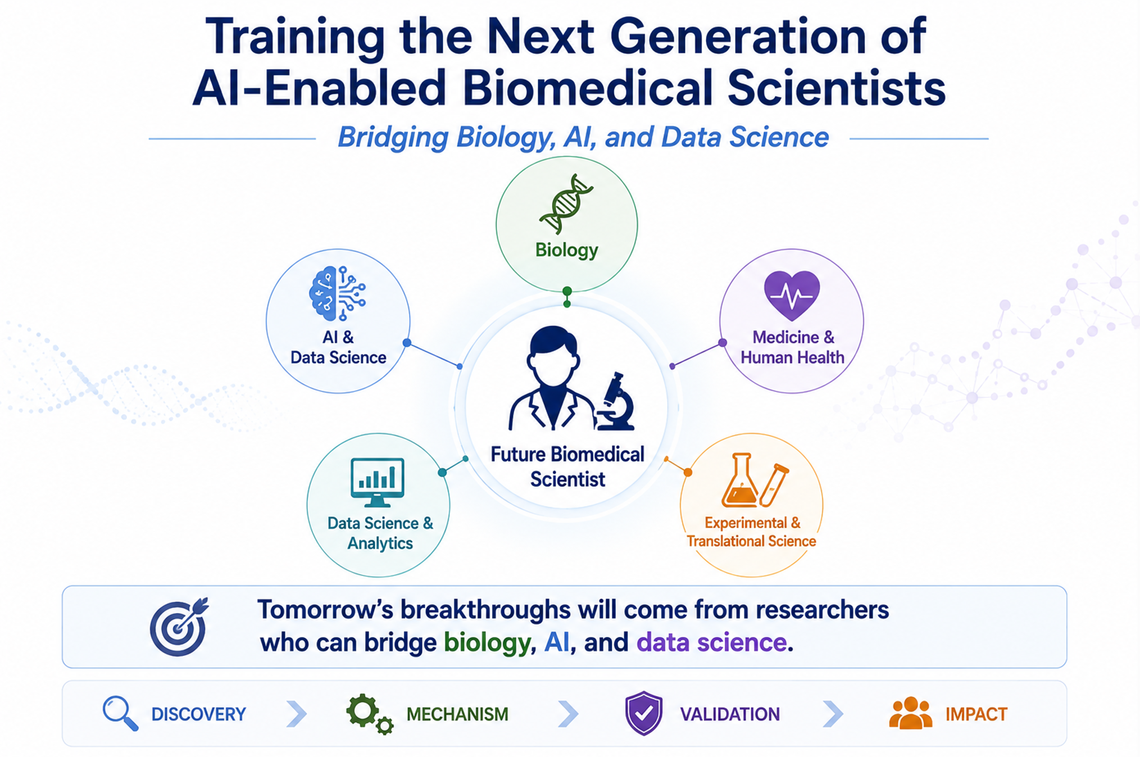
Md Tamjidul Hoque, Professor of Computer Science, University of New Orleans
Email: thoque@uno.edu

