Slide 1
Computing Algorithms – 2801ICT
Week 9&10 – Graph algorithms

Slide 2
Problem 1
Solve the following instances of the single-source shortest-paths problem with vertex a as the source for the graph given in problem 1(B).
Give a counterexample that shows that Dijkstra’s algorithm may not work for a weighted connected graph with negative weights.
Prove the correctness of Dijkstra’s algorithm for graphs with positive weights.

Slide 3
Solution 1
Give a counterexample that shows that Dijkstra’s algorithm may not work for a weighted connected graph with negative weights.
A
Selects the unvisited node with the lowest distance, which is node A with a distance of 0.
Node A has two neighbours, B and D. The distance to B is updated to 1(0+1) and the distance to D is updated to 10(0+10).
B: next unvisited node with the lowest distance. The distance to C is updated to 3(1+2) and the distance to E is updated to 0(1-1).
E, C, D: next unvisited node with the lowest distance. No neighbouring nodes need updating.
(1)
(10)
B
D
(-1)
(0)
E
(2)
C

Slide 4
Solution 1
Give a counterexample that shows that Dijkstra’s algorithm may not work for a weighted connected graph with negative weights.
A
(1)
(10)
Dijkstra's algorithm yields the following shortest distances from node A:
A: 0
B: 1
C: 3
D: 10
E: 0
B
D
(-1)
(0)
E
(2)
C

Slide 5
Solution 1
Give a counterexample that shows that Dijkstra’s algorithm may not work for a weighted connected graph with negative weights.
A
(1)
(10)
However, the correct shortest path from A to D should be A->B->E->D, with a total cost of 0 (1-1+10+0)
B
D
(-1)
(0)
E
(2)
C

Slide 6
Solution 1
Prove the correctness of Dijkstra’s algorithm for graphs with positive weights. (OPTIONAL)
We'll show that the algorithm maintains the invariant property that at each iteration, it correctly identifies the shortest path from the source node to the current node.
Invariant Property: At each iteration, Dijkstra's algorithm computes the correct shortest path distance from the source node s to the currently selected node v.
Base Case: The algorithm starts by selecting the source node s. The shortest distance from s to itself is 0, which is trivially true.
Inductive Hypothesis: Assume that for all nodes u, the algorithm correctly computes the shortest path distance from the source node s to node u. We will show that this property holds for the next unvisited node v with the minimum distance value.

Slide 7
Solution 1
Inductive Step:
1. When the algorithm selects the next unvisited node v with the minimum distance value, it means that all other unvisited nodes have distance values greater than or equal to the distance value of v.
2. If there was a shorter path from the source node s to node v, that path would pass through an intermediate unvisited node w.
3. By the inductive hypothesis, we have already found the shortest path distance from s to w.
4. Since all edge weights are positive, the path from s to v through w would have a distance greater than the current distance value of v. This contradicts our assumption that there was a shorter path from s to v through w.
5. Therefore, the algorithm has found the correct shortest path distance from s to v.

Slide 8
Problem 2
Explain what adjustments if any need to be made in Dijkstra’s algorithm and/or in an underlying graph to solve the following problems.
Solve the single-source shortest-paths problem for directed weighted graphs.
Find a shortest path between two given vertices of a weighted graph or digraph.
Find the shortest paths to a given vertex from each other vertex of a weighted graph or digraph.

Slide 9
Solution 2
Solve the single-source shortest-paths problem for directed weighted graphs.
Dijkstra's algorithm is already designed to solve the single-source shortest-paths problem for directed weighted graphs with non-negative edge weights.

Slide 10
Solution 2
Find a shortest path between two given vertices of a weighted graph or digraph.
Make a minor adjustment to the algorithm to stop the search once the target vertex has been visited.
All steps in Dijkstra’s algorithms are the same except that we don’t need to visit all unvisited nodes.

Slide 11
Solution 2
Find the shortest paths to a given vertex from each other vertex of a weighted graph or digraph.
Use a reverse version of Dijkstra's algorithm. First, reverse the direction of all edges in the graph, then run Dijkstra's algorithm with the target vertex as the source node.

Slide 12
Problem 3
Consider the following graph.
f
b
c
g
d
a
e

Slide 13
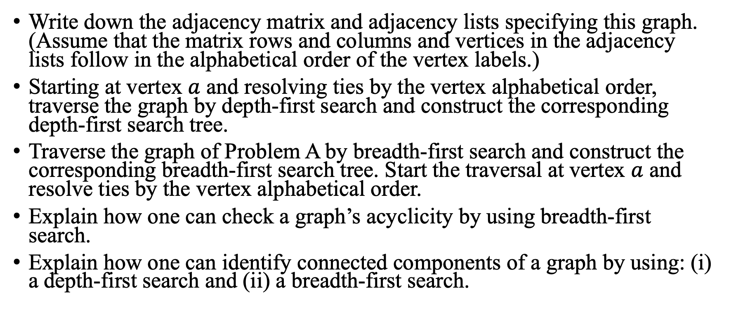
Problem 3
Write down the adjacency matrix and adjacency lists specifying this graph. (Assume that the matrix rows and columns and vertices in the adjacency lists follow in the alphabetical order of the vertex labels.)
Starting at vertex $a$ and resolving ties by the vertex alphabetical order, traverse the graph by depth-first search and construct the corresponding depth-first search tree.
Traverse the graph of Problem A by breadth-first search and construct the corresponding breadth-first search tree. Start the traversal at vertex $a$ and resolve ties by the vertex alphabetical order.
Explain how one can check a graph’s acyclicity by using breadth-first search.
Explain how one can identify connected components of a graph by using: (i) a depth-first search and (ii) a breadth-first search.

Slide 14
Solution 3
Write down the adjacency matrix and adjacency lists specifying this graph. (Assume that the matrix rows and columns and vertices in the adjacency lists follow in the alphabetical order of the vertex labels.)
 | A | B | C | D | E | F | G
A | 0 | 1 | 1 | 1 | 1 | 0 | 0
B | 1 | 0 | 0 | 1 | 0 | 1 | 0
C | 1 | 0 | 0 | 0 | 0 | 0 | 1
D | 1 | 1 | 0 | 0 | 0 | 1 | 0
E | 1 | 0 | 0 | 0 | 0 | 0 | 1
F | 0 | 1 | 0 | 1 | 0 | 0 | 0
G | 0 | 0 | 1 | 0 | 1 | 0 | 0
Adjacency matrix

Slide 15
Solution 3
Write down the adjacency matrix and adjacency lists specifying this graph. (Assume that the matrix rows and columns and vertices in the adjacency lists follow in the alphabetical order of the vertex labels.)
A: [B, C, D, E]
B: [A, D, F]
C: [A, G]
D: [A, B, F]
E: [A, G]
F: [B, D]
G: [C, E]
Adjacency list

Slide 16
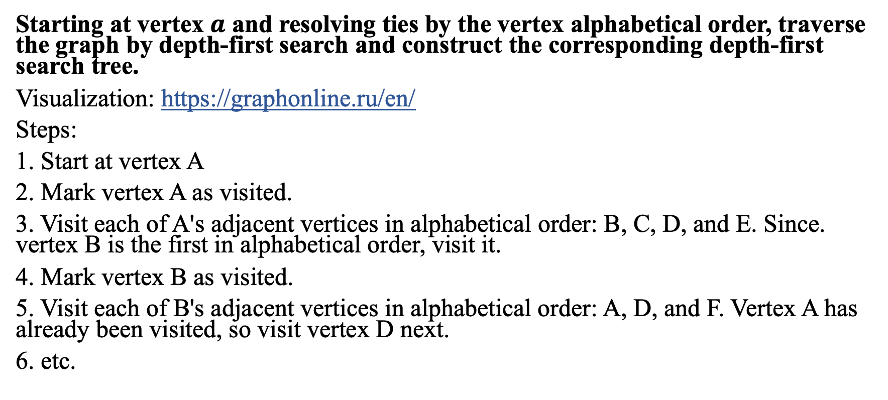
Solution 3
Starting at vertex $a$ and resolving ties by the vertex alphabetical order, traverse the graph by depth-first search and construct the corresponding depth-first search tree.
Visualization: https://graphonline.ru/en/
Steps:
1. Start at vertex A
2. Mark vertex A as visited.
3. Visit each of A's adjacent vertices in alphabetical order: B, C, D, and E. Since. vertex B is the first in alphabetical order, visit it.
4. Mark vertex B as visited.
5. Visit each of B's adjacent vertices in alphabetical order: A, D, and F. Vertex A has already been visited, so visit vertex D next.
6. etc.

Slide 17
Solution 3
The DFS traversal order is: A, B, D, F, C, G, E
A
B
C
E
D
G
F

Slide 18
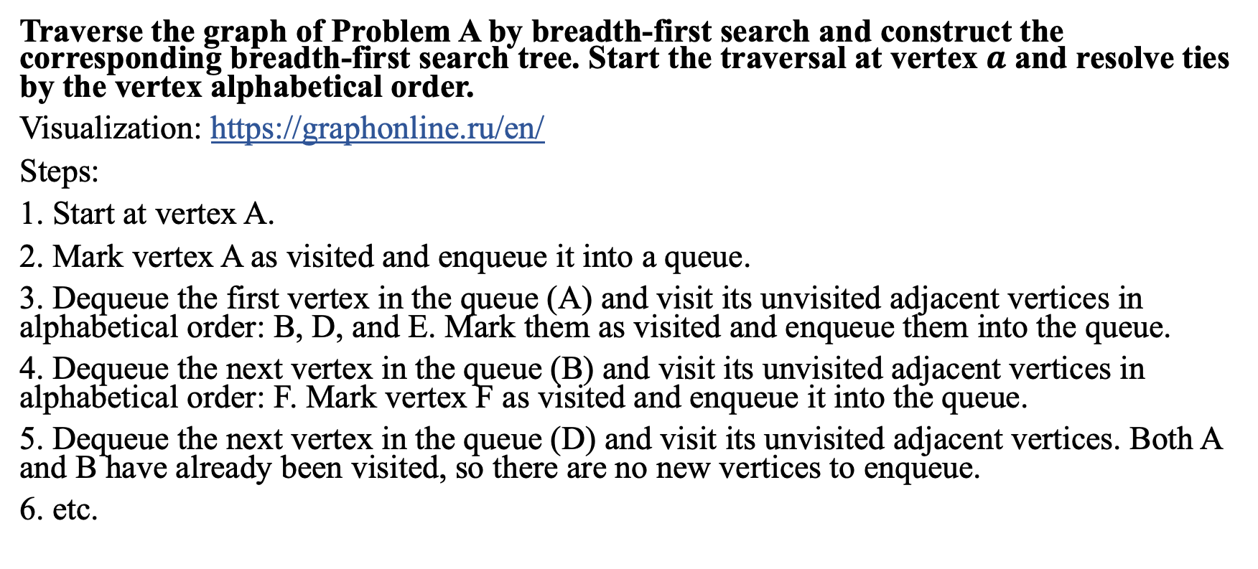
Solution 3
Traverse the graph of Problem A by breadth-first search and construct the corresponding breadth-first search tree. Start the traversal at vertex $a$ and resolve ties by the vertex alphabetical order.
Visualization: https://graphonline.ru/en/
Steps:
1. Start at vertex A.
2. Mark vertex A as visited and enqueue it into a queue.
3. Dequeue the first vertex in the queue (A) and visit its unvisited adjacent vertices in alphabetical order: B, D, and E. Mark them as visited and enqueue them into the queue.
4. Dequeue the next vertex in the queue (B) and visit its unvisited adjacent vertices in alphabetical order: F. Mark vertex F as visited and enqueue it into the queue.
5. Dequeue the next vertex in the queue (D) and visit its unvisited adjacent vertices. Both A and B have already been visited, so there are no new vertices to enqueue.
6. etc.

Slide 19
Solution 3
The BFS traversal order is: A, B, D, E, F, G, C
A
B
D
E
F
G
C

Slide 20
Solution 3
Explain how one can check a graph’s acyclicity by using breadth-first search.
Modify the BFS algorithm slightly to track the number of nodes visited, and simultaneously check for back edges. If a back edge is found during the BFS traversal, it means the graph contains a cycle. Otherwise, it's acyclic.

Slide 21
Problem 4
For the directed graph below, give a topological ordering of the vertices.
State a concise sufficient and necessary condition for when two vertices in a DAG can be in either order in a topological sort. (In other words, either one of them can be first in a valid topological sort of that DAG).
A
B
C
D
E
F
G

Slide 22
Solution 4
For the directed graph below, give a topological ordering of the vertices.
To find a topological ordering of the vertices, you can use a modified depth-first search (DFS) called Topological Sort
A
B
C
D
E
F
G

Slide 23
Solution 4
1. Perform a DFS from vertex A, and mark A as visited.
2. Visit B, C, and D in alphabetical order, marking them as visited.
3. Visit G from C, marking it as visited.
4. Backtrack to A, as all vertices reachable from A have been visited.
A
B
C
D
E
F
G

Slide 24
Solution 4
5. Perform a DFS from vertex E (which is not visited yet), and mark E as visited.
6. Visit B, D, and F in alphabetical order, marking them as visited.
7. Visit C and G from F, both of which have already been visited.
8. Backtrack to E, as all vertices reachable from E have been visited.
Reverse the order in which we completed visiting all vertices, we get a valid topological ordering: A, E, F, C, G, D, B
A
B
C
D
E
F
G

Slide 25
Solution 4
State a concise sufficient and necessary condition for when two vertices in a DAG can be in either order in a topological sort. (In other words, either one of them can be first in a valid topological sort of that DAG).
Two vertices u and v in a DAG can be in either order in a topological sort if and only if there is no directed path between them, meaning that u does not reach v and v does not reach u
making it possible to order them in any way without violating the topological sort condition.

