Slide 1
Computing Algorithms – 2801ICT
Geometric and Data Compression Algorithms

Slide 2
Problem 1
Consider the version of the divide-and-conquer two-dimensional closest-pair algorithm in which, instead of presorting input set P, we simply sort each of the two sets P_{r} and P_{l} in nondecreasing order of their y coordinates on each recursive call. Assuming that sorting is done by mergesort, set up a recurrence relation for the running time in the worst case and solve it for n = 2^{k}.

Slide 3
Solution 1
The master theorem: Suppose the runtime of an algorithm can be expressed as:
T(n) = aT(n/b) +f(n)
Where:
- n is the size of the problem
- a is the number of subproblems in the recursion
- n/b is the size of the subproblem
- f(n) is the cost of work done outside the recursive calls

Slide 4
Solution 1
The advance master theorem: Suppose the runtime of an algorithm can be expressed as:
T(n) = aT(n/b) +O(n^{k}log^{p}n)
Where:
- n is the size of the problem
- a is the number of subproblems in the recursion
- n/b is the size of the subproblem
- b > 1, k > 0 and p is a real number

Slide 5
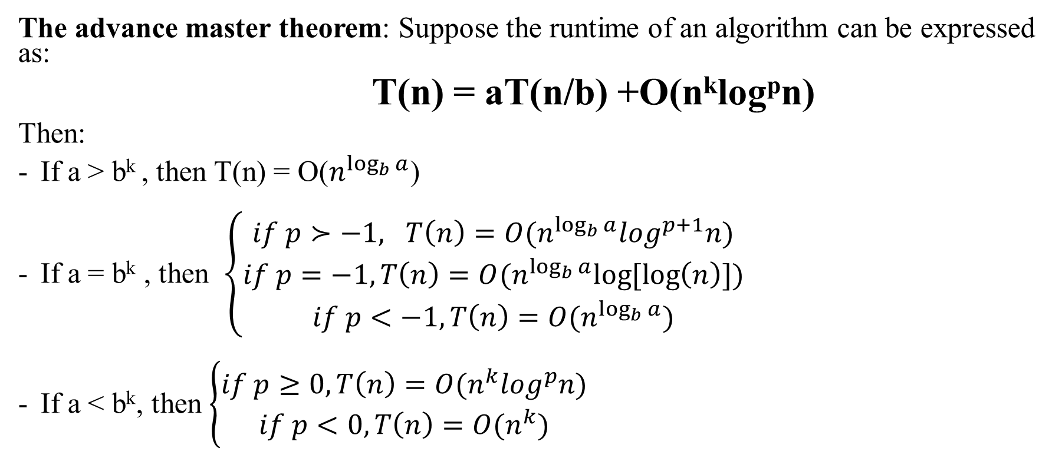
Solution 1
The advance master theorem: Suppose the runtime of an algorithm can be expressed as:
T(n) = aT(n/b) +O(n^{k}log^{p}n)
Then:
If a > b^{k} , then T(n) = O($n^{\log_{b}{a}}$)
If a = b^{k} , then $\left\{\begin{aligned}if p≻−1, T\left(n\right)=O(n^{\log_{b}{a}}\log^{p+1}n) \\ if p=−1,T\left(n\right)=O(n^{\log_{b}{a}}log⁡[\log\left(n\right)]) \\ if p<−1,T\left(n\right)=O(n^{\log_{b}{a}})\end{aligned}\right.$
If a < b^{k}, then $\left\{\begin{aligned}if p≥0,T\left(n\right)=O(n^{k}\log^{p}n) \\ if p<0, T\left(n\right)=O(n^{k})\end{aligned}\right.$

Slide 6
Solution 1
At each recursive call:
Divide the subproblem into smaller problems of size n/2.
Find the strip in O(n) time.
Sort P_{r} and P_{l} take O(nlogn) time for each set using merge sort.
- Finds the closest points in strip in O(n) time
The recurrence relation for the running time T(n) is: T(n) = 2*T(n/2) + O(n)+ O(nlogn) + O(n)
⬄ T(n) = 2*T(n/2) + O(nlogn)

Slide 7
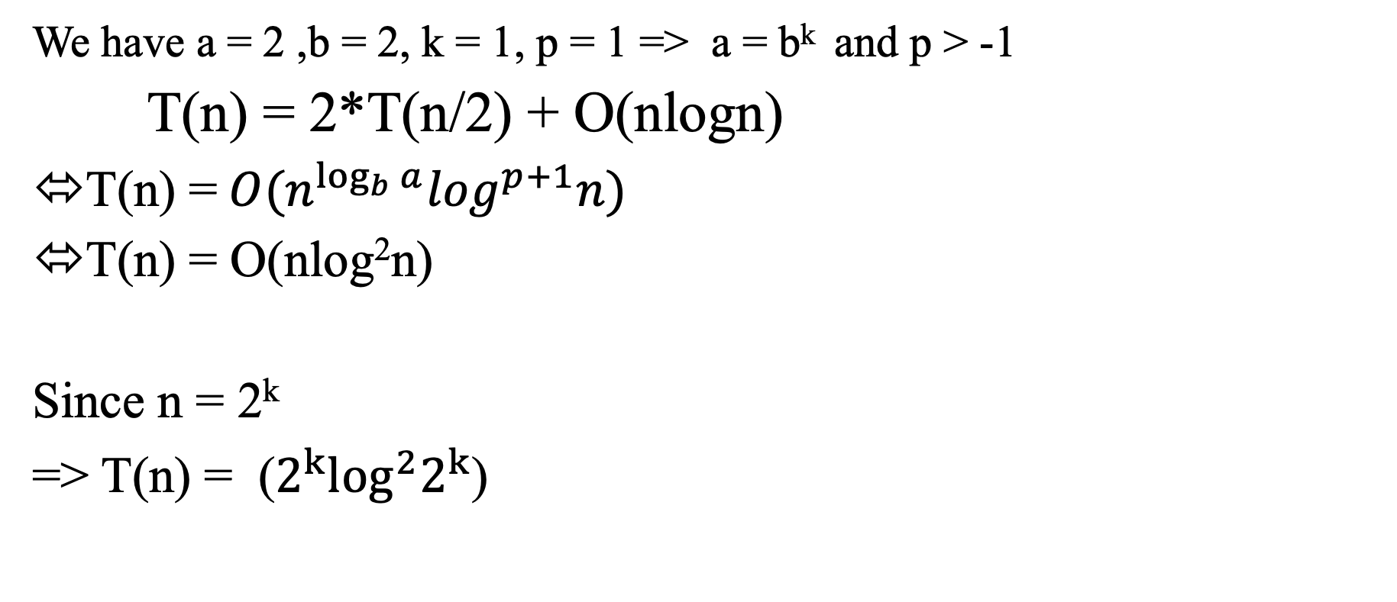
Solution 1
We have a = 2 ,b = 2, k = 1, p = 1 => a = b^{k} and p > -1
T(n) = 2*T(n/2) + O(nlogn)
T(n) =$O(n^{\log_{b}{a}}\log^{p+1}n)$
T(n) = O(nlog²n)
Since n = 2^{k}
=> T(n) = ($2^{k}\log^{2}2^{k}$)

Slide 8
Problem 2-A
Explain how one can find point p_{max} in the quick hull algorithm analytically.

Slide 9
Solution 2-A
One of the key steps in the QuickHull algorithm is to find the point p_max, which is the farthest point from the line segment formed by two initial hull points, often the leftmost and rightmost points of the dataset.

Slide 10
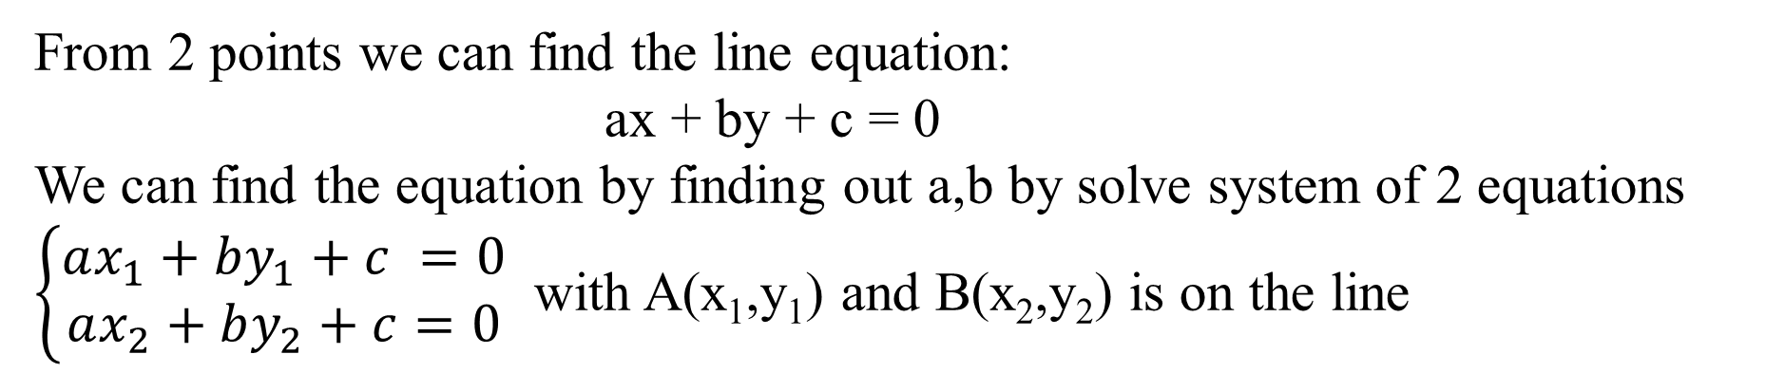
Solution 2-A
From 2 points we can find the line equation:
ax + by + c = 0
We can find the equation by finding out a,b by solve system of 2 equations
$\left\{\begin{aligned}ax_{1}+by_{1}+c =0 \\ ax_{2}+by_{2}+c=0\end{aligned}\right.$ with A(x₁,y₁) and B(x₂,y₂) is on the line

Slide 11
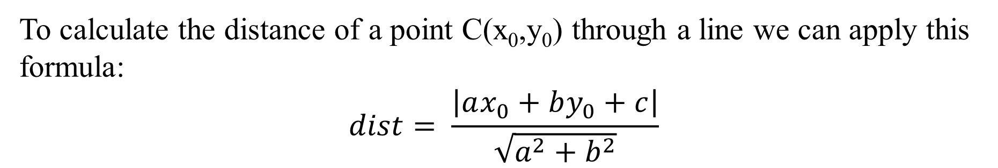
Solution 2-A
To calculate the distance of a point C(x₀,y₀) through a line we can apply this formula:
$$dist= \frac{\left|ax_{0}+by_{0}+c\right|}{\sqrt{a^{2}+b^{2}}}$$

Slide 12
Problem 2-B
What is the best-case efficiency of quickhull?

Slide 13
Solution 2-B
The best case of quick hull happened when:
- Each segmentation divides the nodes evenly
- The number of vertices on the convex hull is smaller compared to the vertices in the convex hull.
The best-case time complexity is O(nlogn)

Slide 14
Example 2-B

Slide 15
Problem 2-C
Give an example of solving quick hull in quadratic time?

Slide 16
Solution 2-C
The worst-case time complexity of quick hull is quadratic (O(n²)) when all points are a part of the convex set.

Slide 17
Example 2-C

Slide 18
Problem 3-A
Construct a Huffman code for the following data
Symbols | A | B | C | D | _
Frequency | 0.4 | 0.1 | 0.2 | 0.15 | 0.15

Slide 19
Solution 3-A
Step 1: sorted the table by frequency
Symbols | A | B | C | D | _
Frequency | 0.4 | 0.1 | 0.2 | 0.15 | 0.15
Symbols | B | D | _ | C | A
Frequency | 0.1 | 0.15 | 0.15 | 0.2 | 0.4

Slide 20
Solution 3-A
Step 2: Construct the tree by the bottom-up manner
Character | Frequency
B | 0.1
D | 0.15
_ | 0.15
C | 0.2
A | 0.4
Node 1: 0.25
B
D

Slide 21
Solution 3-A
Step 2: Construct the tree by the bottom-up manner
Character | Frequency
_ | 0.15
C | 0.2
Node 1 | 0.25
A | 0.4
Node 2: 0.35
Node 1: 0.25
_
C
B
D

Slide 22
Solution 3-A
Step 2: Construct the tree by the bottom-up manner
Node 3:
0.6
Character | Frequency
Node 1 | 0.25
Node 2 | 0.35
A | 0.4
Node 2: 0.35
Node 1: 0.25
_
C
B
D

Slide 23
Solution 3-A
Step 2: Construct the tree by the bottom-up manner
Node 4:
1
Character | Frequency
A | 0.4
Node 3 | 0.6
A
Node 3:
0.6
Node 2: 0.35
Node 1: 0.25
_
C
B
D

Slide 24
Solution 3-A
Step 3: Traverse the tree formed starting from the root
If moved to the left child: add 0 to the array
If moved to the right child: add 1 to the array

Slide 25
Solution 3-A
Node 4:
1
0
1
A
Node 3:
0.6
1
0
Node 2: 0.35
Node 1: 0.25
0
1
0
1
_
C
B
D

Slide 26
Solution 3-A
So the Huffman code of the data is:
Symbols | A | B | C | D | _
code | 0 | 110 | 101 | 111 | 100

Slide 27
Problem 3-B
Encode ABACABAD using the code of question (A).

Slide 28
Solution 3-B
The Huffman code of ABACABAD is 0110010101100111
Symbols | A | B | A | C | A | B | A | D
code | 0 | 110 | 0 | 101 | 0 | 110 | 0 | 111

Slide 29
Problem 3-C
Decode 100010111001010 using the code of question (A)

Slide 30
Solution 3-C
We can decode the Huffman code by:
We start from the root and do the following until a leaf is found.
If the current bit is 0, we move to the left node of the tree.
If the bit is 1, we move to the right node of the tree.
If during the traversal, we encounter a leaf node, we print the character of that particular leaf node and then again continue the iteration of the encoded data starting from step 1.

Slide 31
Solution 3-C
`
1 | 0 | 0 | 0 | 1 | 0 | 1 | 1 | 1 | 0 | 0 | 1 | 0 | 1 | 0
Output
Node 4:
1
A
Node 3:
0.6
Node 2: 0.35
Node 1: 0.25
_
C
B
D

Slide 32
Solution 3-C
`
1 | 0 | 0 | 0 | 1 | 0 | 1 | 1 | 1 | 0 | 0 | 1 | 0 | 1 | 0
Output
Node 4:
1
A
Node 3:
0.6
Node 2: 0.35
Node 1: 0.25
_
C
B
D

Slide 33
Solution 3-C
`
1 | 0 | 0 | 0 | 1 | 0 | 1 | 1 | 1 | 0 | 0 | 1 | 0 | 1 | 0
Output
Node 4:
1
A
Node 3:
0.6
Node 2: 0.35
Node 1: 0.25
_
C
B
D

Slide 34
Solution 3-C
`
1 | 0 | 0 | 0 | 1 | 0 | 1 | 1 | 1 | 0 | 0 | 1 | 0 | 1 | 0
Output: _
Node 4:
1
A
Node 3:
0.6
Node 2: 0.35
Node 1: 0.25
_
C
B
D

Slide 35
Solution 3-C
`
1 | 0 | 0 | 0 | 1 | 0 | 1 | 1 | 1 | 0 | 0 | 1 | 0 | 1 | 0
Output: _
Node 4:
1
A
Node 3:
0.6
Node 2: 0.35
Node 1: 0.25
_
C
B
D

Slide 36
Solution 3-C
`
1 | 0 | 0 | 0 | 1 | 0 | 1 | 1 | 1 | 0 | 0 | 1 | 0 | 1 | 0
Output: _A
Node 4:
1
A
Node 3:
0.6
Node 2: 0.35
Node 1: 0.25
_
C
B
D

Slide 37
Solution 3-C
`
1 | 0 | 0 | 0 | 1 | 0 | 1 | 1 | 1 | 0 | 0 | 1 | 0 | 1 | 0
Output: _A
Node 4:
1
A
Node 3:
0.6
Node 2: 0.35
Node 1: 0.25
_
C
B
D

Slide 38
Solution 3-C
`
1 | 0 | 0 | 0 | 1 | 0 | 1 | 1 | 1 | 0 | 0 | 1 | 0 | 1 | 0
Output: _A
Node 4:
1
A
Node 3:
0.6
Node 2: 0.35
Node 1: 0.25
_
C
B
D

Slide 39
Solution 3-C
`
1 | 0 | 0 | 0 | 1 | 0 | 1 | 1 | 1 | 0 | 0 | 1 | 0 | 1 | 0
Output: _A
Node 4:
1
A
Node 3:
0.6
Node 2: 0.35
Node 1: 0.25
_
C
B
D

Slide 40
Solution 3-C
`
1 | 0 | 0 | 0 | 1 | 0 | 1 | 1 | 1 | 0 | 0 | 1 | 0 | 1 | 0
Output: _AC
Node 4:
1
A
Node 3:
0.6
Node 2: 0.35
Node 1: 0.25
_
C
B
D

Slide 41
Solution 3-C
`
1 | 0 | 0 | 0 | 1 | 0 | 1 | 1 | 1 | 0 | 0 | 1 | 0 | 1 | 0
Output: _AC
Node 4:
1
A
Node 3:
0.6
Node 2: 0.35
Node 1: 0.25
_
C
B
D

Slide 42
Solution 3-C
`
1 | 0 | 0 | 0 | 1 | 0 | 1 | 1 | 1 | 0 | 0 | 1 | 0 | 1 | 0
Output: _AC
Node 4:
1
A
Node 3:
0.6
Node 2: 0.35
Node 1: 0.25
_
C
B
D

Slide 43
Solution 3-C
`
1 | 0 | 0 | 0 | 1 | 0 | 1 | 1 | 1 | 0 | 0 | 1 | 0 | 1 | 0
Output: _AC
Node 4:
1
A
Node 3:
0.6
Node 2: 0.35
Node 1: 0.25
_
C
B
D

Slide 44
Solution 3-C
`
1 | 0 | 0 | 0 | 1 | 0 | 1 | 1 | 1 | 0 | 0 | 1 | 0 | 1 | 0
Output: _ACB
Node 4:
1
A
Node 3:
0.6
Node 2: 0.35
Node 1: 0.25
_
C
B
D

Slide 45
Solution 3-C
`
1 | 0 | 0 | 0 | 1 | 0 | 1 | 1 | 1 | 0 | 0 | 1 | 0 | 1 | 0
Output: _ACB
Node 4:
1
A
Node 3:
0.6
Node 2: 0.35
Node 1: 0.25
_
C
B
D

Slide 46
Solution 3-C
`
1 | 0 | 0 | 0 | 1 | 0 | 1 | 1 | 1 | 0 | 0 | 1 | 0 | 1 | 0
Output: _ACBA
Node 4:
1
A
Node 3:
0.6
Node 2: 0.35
Node 1: 0.25
_
C
B
D

Slide 47
Solution 3-C
`
1 | 0 | 0 | 0 | 1 | 0 | 1 | 1 | 1 | 0 | 0 | 1 | 0 | 1 | 0
Output: _ACBA
Node 4:
1
A
Node 3:
0.6
Node 2: 0.35
Node 1: 0.25
_
C
B
D

Slide 48
Solution 3-C
`
1 | 0 | 0 | 0 | 1 | 0 | 1 | 1 | 1 | 0 | 0 | 1 | 0 | 1 | 0
Output: _ACBA
Node 4:
1
A
Node 3:
0.6
Node 2: 0.35
Node 1: 0.25
_
C
B
D

Slide 49
Solution 3-C
`
1 | 0 | 0 | 0 | 1 | 0 | 1 | 1 | 1 | 0 | 0 | 1 | 0 | 1 | 0
Output: _ACBA
Node 4:
1
A
Node 3:
0.6
Node 2: 0.35
Node 1: 0.25
_
C
B
D

Slide 50
Solution 3-C
`
1 | 0 | 0 | 0 | 1 | 0 | 1 | 1 | 1 | 0 | 0 | 1 | 0 | 1 | 0
Output: _ACBAC
Node 4:
1
A
Node 3:
0.6
Node 2: 0.35
Node 1: 0.25
_
C
B
D

Slide 51
Solution 3-C
`
1 | 0 | 0 | 0 | 1 | 0 | 1 | 1 | 1 | 0 | 0 | 1 | 0 | 1 | 0
Output: _ACBAC
Node 4:
1
A
Node 3:
0.6
Node 2: 0.35
Node 1: 0.25
_
C
B
D

Slide 52
Solution 3-C
`
1 | 0 | 0 | 0 | 1 | 0 | 1 | 1 | 1 | 0 | 0 | 1 | 0 | 1 | 0
Output: _ACBACA
Node 4:
1
A
Node 3:
0.6
Node 2: 0.35
Node 1: 0.25
_
C
B
D

Slide 53
Problem 3-D
Indicate whether each of the following properties is true for every Huffman code.
i. The codewords of the two least frequent symbols have the same length.
ii. The codeword’s length of a more frequent symbol is always smaller than or equal to the codeword’s length of a less frequent one.

Slide 54
Solution 3-D
i. The codewords of the two least frequent symbols have the same length.
True
The Huffman code tree was built in a bottom-up manner, the two least frequent symbols always have the same parent node so they have the same height in the code tree. Therefore, they have the same length

Slide 55
Solution 3-D
ii. The codeword’s length of a more frequent symbol is always smaller than or equal to the codeword’s length of a less frequent one.
True
The Huffman code tree was built in a bottom-up manner, the most frequent symbol always has a depth smaller or equal to the less frequent one in the tree code. Therefore, the codeword’s length of more frequent symbol is always smaller than or equal to which of less frequent one

Slide 56
Problem 3-E
What is the maximal length of a codeword possible in a Huffman encoding of an alphabet of n symbols?

Slide 57
Solution 3-E
The maximal length of codeword possible in a Huffman encoding is n-1 bits
This happens when the n-2 characters have a frequency of a power of 2

Slide 58
Solution 3-E
Characters | A | B | C | D
Frequency | 1 | 2 | 4 | 8
Example
Node 3
It takes 3 bits to encode 4 characters
D
Node 2
Node 1
C
A
B

Slide 59
Problem 3-F
Write pseudo-code of the Huffman-tree construction algorithm. What is the time efficiency class of the algorithm for constructing a Huffman tree as a function of the alphabet size?

Slide 60
Solution 3-F
Pseudo-code:
function huffman_tree(alphabet, frequencies):
1. Create an empty priority queue Q
2. For each symbol s in alphabet:
a. Create a new node N with the frequency f(s)
b. Insert N into Q
3. While the size of Q > 1:
a. Remove the two nodes with the lowest frequencies from Q, let's call them A and B
b. Create a new node C with the combined frequency of A and B
c. Set A as the left child and B as the right child of node C
d. Insert node C back into Q
4. Return the root node of the tree (the only remaining node in Q)

Slide 61
Solution 3-F
Time complexity:
Initialize the priority queue: O(n)
Perform n -1 loop in step 3, remove and insert operation in priority queue take O(logn). So the time complexity is O(nlogn)
Return output take O(1)
=> The time complexity is O(nlogn)

Slide 62
Problem 3-G
Given a Huffman coding tree, which algorithm would you use to get the codewords for all the symbols?
What is its time-efficiency class as a function of the alphabet size?

Slide 63
Solution 3-G
Given a Huffman coding tree, which algorithm would you use to get the codewords for all the symbols?
We can use DFS to get the code words for all symbols
def dfs_traversal(node, codeword, codeword_dict):
if node.symbol is not None:
codeword_dict[node.symbol] = codeword
else:
dfs_traversal(node.left, codeword + '0', codeword_dict)
dfs_traversal(node.right, codeword + '1', codeword_dict)

Slide 64
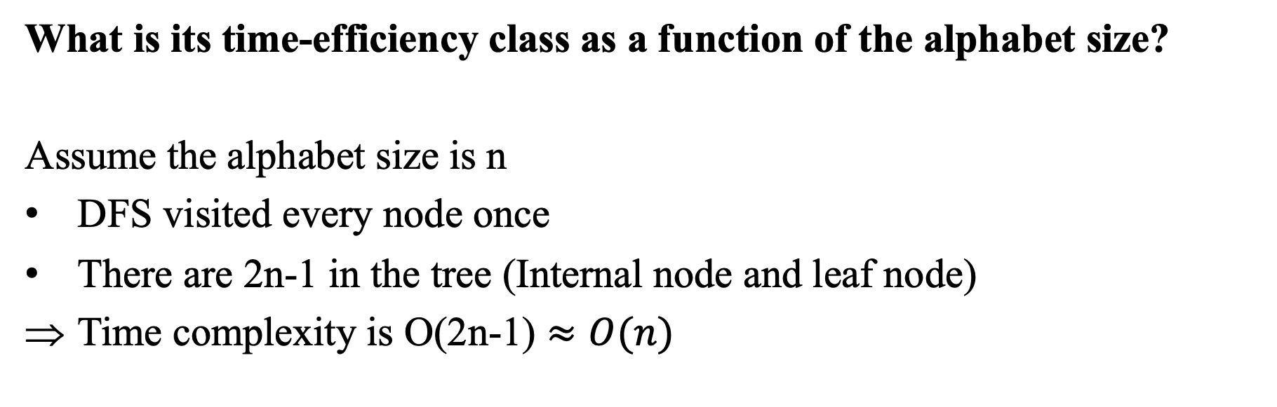
Solution 3-G
What is its time-efficiency class as a function of the alphabet size?
Assume the alphabet size is n
DFS visited every node once
There are 2n-1 in the tree (Internal node and leaf node)
Time complexity is O(2n-1) $≈O(n)$

