Slide 1
Computing Algorithms – 2801ICT
Workshop 2 – Data Structure

Slide 2
Problem 1
If you have to solve the searching problem for a list of n numbers, how can you take advantage of the fact that the list is known to be sorted? Give separate answers for
lists represented as arrays.
lists represented as linked lists.

Slide 3
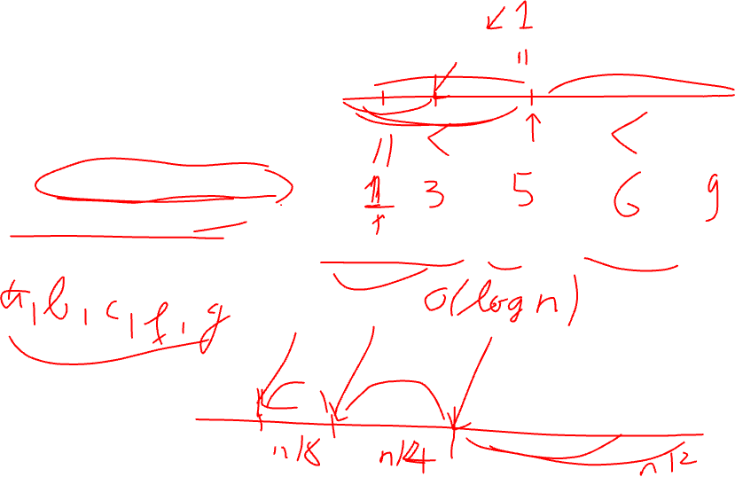
Solution 1
Lists represented as arrays.
Binary search
Time complexity: O(log n)
Interpolation Search
Time complexity: O(log log n) in the best case and O(n) in the worst case.
Notes:
Binary search:
The most commonly used algorithm for searching a sorted list.
The basic idea of binary search is to divide the sorted list into halves and eliminate one half of the list based on the comparison of the middle element with the target element.
The search continues on the remaining half until the target element is found or until the remaining list is empty.
Interpolation search:
An improved version of binary search, which works better when the elements in the array are uniformly distributed.
The basic idea of interpolation search is to predict the position of the target element based on the value of the target and the distribution of the elements in the array.

Slide 4
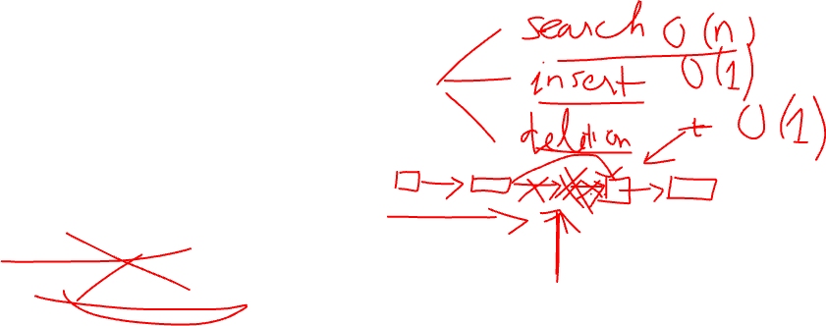
Solution 1
Lists represented as linked list.
Linear search
Time complexity: O(n)
Skip list search
Time complexity: O(log n)
Notes:
Linear search:
The simplest approach for searching a sorted linked list is a linear search.
We traverse the linked list from the beginning to end until we find the target element or reach the end of the list.
As the linked list is sorted, we can stop searching as soon as we reach an element greater than the target element.
Binary search:
Unlike the array, we cannot access a random element in the linked list in O(1) time.
Therefore, we need to traverse the linked list to find the middle element.
The basic idea of binary search in a linked list is similar to binary search in an array.
We first find the middle element of the linked list and compare it with the target element.
If the middle element is equal to the target, we return it. If the middle element is less than the target, we search for the target in the right half of the linked list.
Otherwise, we search for the target in the left half of the linked list.

Slide 5
Problem 2 (a)
Let A be the adjacency matrix of an undirected graph. Explain what property of the matrix indicates that
the graph is complete.
the graph has a loop, i.e., an edge connecting a vertex to itself.
the graph has an isolated vertex, i.e., a vertex with no edges incident to it.

Slide 6
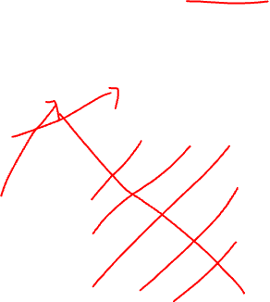
Solution 2 (a)
Adjacency matrix representation of an undirected graph: A[i,j] = 1 if there is an edge between vertex i and vertex j, and A[i,j] = 0 otherwise.
V1 | V2 | V3 | V4
V1
V2
V3
V4
0 | 1 | 0 | 1
1 | 0 | 0 | 1
0 | 0 | 0 | 1
1 | 1 | 1 | 0

Slide 7
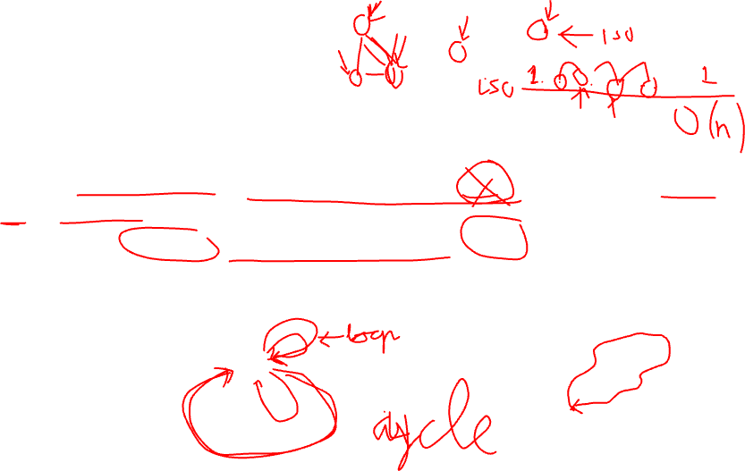
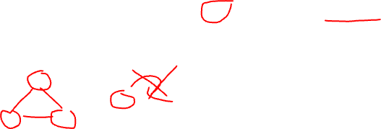
Solution 2 (a)
Adjacency matrix representation of an undirected graph: A[i,j] = 1 if there is an edge between i and j, and A[i,j] = 0 otherwise.
The graph is complete: For all i and j such that i ≠ j, A[i,j] = 1, and for all i, A[i, i] = 0.
The graph has a loop: there exists an i such that A[i,i] = 1.
The graph has an isolated vertex: there exists an i such that for all j, A[i,j] = 0, and there exists a j such that for all i, A[i,j] = 0, except possibly for A[j,j].
Notes:
In the adjacency matrix representation of an undirected graph, the entry A[i,j] in the ith row and jth column indicates whether there is an edge between vertex i and vertex j. Specifically, A[i,j] = 1 if there is an edge between i and j, and A[i,j] = 0 otherwise.
a. If the graph is complete, then every vertex is connected to every other vertex. This means that every entry in the adjacency matrix is equal to 1, except for the diagonal entries, which are all 0. In other words, for all i and j such that i ≠ j, A[i,j] = 1, and for all i, A[i,i] = 0.
b. If the graph has a loop, then there exists an edge that connects a vertex to itself. This means that there exists an entry in the diagonal of the adjacency matrix that is equal to 1. In other words, there exists an i such that A[i,i] = 1.
c. If the graph has an isolated vertex, then there exists a vertex that has no edges incident to it. This means that there is a row and a column in the adjacency matrix that are all 0, except for the diagonal entry, which may be either 0 or 1. In other words, there exists an i such that for all j, A[i,j] = 0, and there exists a j such that for all i, A[i,j] = 0, except possibly for A[j,j].

Slide 8
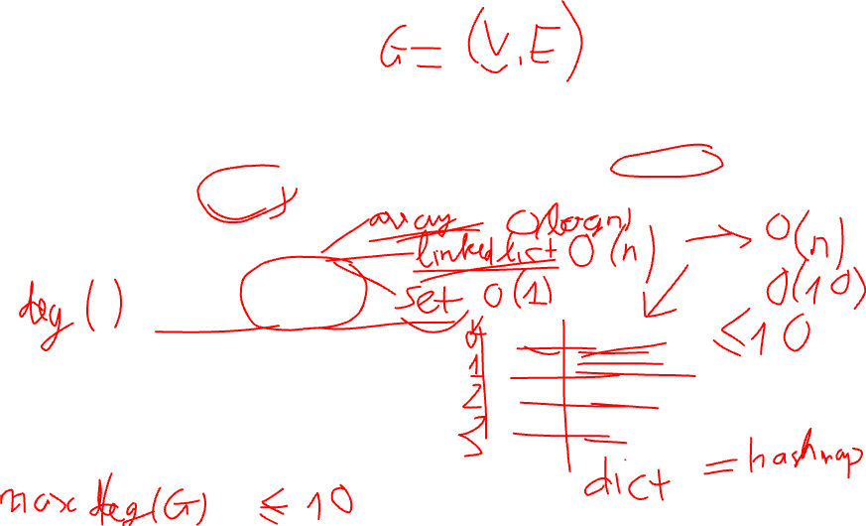
Problem 2 (b)
Answer the same questions for the adjacency list representation.
Adjacency list representation of an undirected graph G = (V, E) : stores a list of vertices v ∈ V and their adjacent vertices adj(v) = { u ∈ V : {u, v} ∈ E }.
A
B
C
D
B | C
graph = {
'A': ['B', 'C'],
'B': ['A', 'C', 'D'],
'C': ['A', 'B'],
'D': ['B'],
}
A | C | D
A | B
B
Notes:
In the adjacency matrix representation of an undirected graph, the entry A[i,j] in the ith row and jth column indicates whether there is an edge between vertex i and vertex j. Specifically, A[i,j] = 1 if there is an edge between i and j, and A[i,j] = 0 otherwise.
a. If the graph is complete, then every vertex is connected to every other vertex. This means that every entry in the adjacency matrix is equal to 1, except for the diagonal entries, which are all 0. In other words, for all i and j such that i ≠ j, A[i,j] = 1, and for all i, A[i,i] = 0.
b. If the graph has a loop, then there exists an edge that connects a vertex to itself. This means that there exists an entry in the diagonal of the adjacency matrix that is equal to 1. In other words, there exists an i such that A[i,i] = 1.
c. If the graph has an isolated vertex, then there exists a vertex that has no edges incident to it. This means that there is a row and a column in the adjacency matrix that are all 0, except for the diagonal entry, which may be either 0 or 1. In other words, there exists an i such that for all j, A[i,j] = 0, and there exists a j such that for all i, A[i,j] = 0, except possibly for A[j,j].

Slide 9
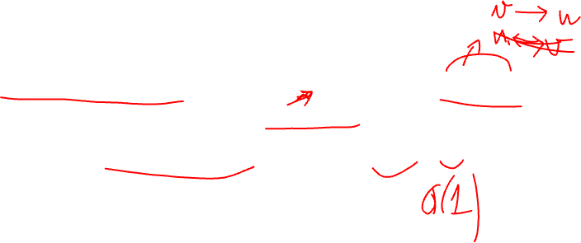
Solution 2 (b)
The graph is complete: ∀v ∈ V: ∀u ∈ V, u ≠ v ⇒ u ∈ adj(v)
The graph has a loop: ∃v ∈ V: v ∈ adj(v)
The graph has an isolated vertex: ∃v ∈ V: adj(v) = {}
Notes:
- The graph is complete if and only if every vertex in the graph has an adjacency list containing every other vertex in the graph, and no vertex appears in its own adjacency list. In other words, every vertex in the graph is connected to every other vertex, and there are no self-loops. This can be expressed as: ∀v ∈ V: ∀u ∈ V, u ≠ v ⇒ u ∈ adj(v)
- The graph has a loop: there exists at least one vertex that appears in its own adjacency list. This indicates that there is at least one vertex that is connected to itself. This can be expressed as: ∃v ∈ V: v ∈ adj(v)
- The graph has an isolated vertex if and only if there exists at least one vertex that has an empty adjacency list. This indicates that there is at least one vertex in the graph that is not connected to any other vertex, except possibly itself if there is a self-loop. This can be expressed as: ∃v ∈ V: adj(v) = {}

Slide 10
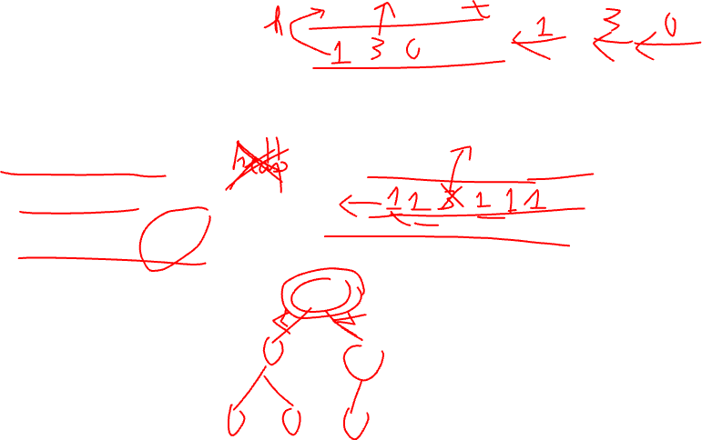
Problem 3
Indicate how the ADT priority queue can be implemented as
An (unsorted) array
A sorted array
A binary search tree
Notes:
ADT priority queue can be implemented using the following ways:
Unsorted array: In an unsorted array implementation of priority queue, we add elements to the end of the array and remove the element with the highest priority by performing a linear search through the array to find the highest priority element. The time complexity of inserting an element is O(1) while removing the highest priority element takes O(n) time.
Sorted array: In a sorted array implementation of priority queue, elements are added to the array in a sorted order. The highest priority element is at the end of the array and can be easily accessed and removed in constant time. The time complexity of inserting an element is O(n) as we need to find the right position to insert the element in a sorted order.
Binary search tree: In a binary search tree implementation of priority queue, elements are added to the tree based on their priority values. The highest priority element is the root of the tree and can be easily accessed and removed in constant time. The time complexity of inserting an element is O(log n) while removing the highest priority element takes O(log n) time.
Overall, the binary search tree implementation is the most efficient among the three options as it has a better time complexity for both inserting and removing elements.

Slide 11
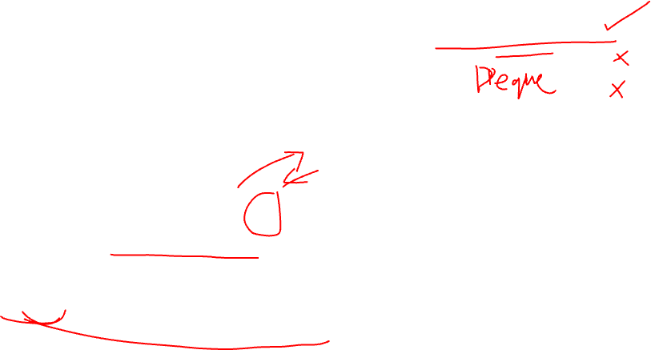
Solution 3
Time complexity:
Insert: O(1)
Remove: O(n)
An (unsorted) array
Add elements to the end of the array
Remove the element with the highest priority by performing a linear search through the array to find the highest priority element
-3 | 4 | 10 | -6
20
Queue
Add
1 | 3 | 4 | 2
Search and Remove highest priority element
Priority
Notes:
Unsorted array: In an unsorted array implementation of priority queue, we add elements to the end of the array and remove the element with the highest priority by performing a linear search through the array to find the highest priority element. The time complexity of inserting an element is O(1) while removing the highest priority element takes O(n) time.

Slide 12
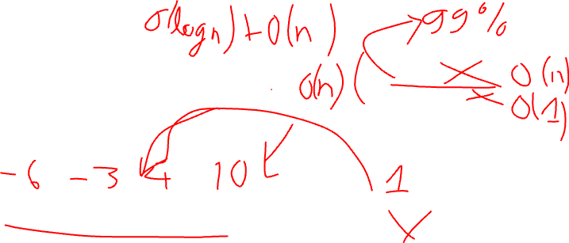
Solution 3
Time complexity:
Insert: O(1)
Remove: O(n)
A sorted array
The highest priority element is at the end of the array and can be easily accessed and removed in constant time
-3 | 4 | 10 | -6
20
Queue
Add
1 | 2 | 3 | 4
Remove latest (highest) priority element
Priority
Notes:
Sorted array: In a sorted array implementation of priority queue, elements are added to the array in a sorted order. The highest priority element is at the end of the array and can be easily accessed and removed in constant time. The time complexity of inserting an element is O(n) as we need to find the right position to insert the element in a sorted order.

Slide 13
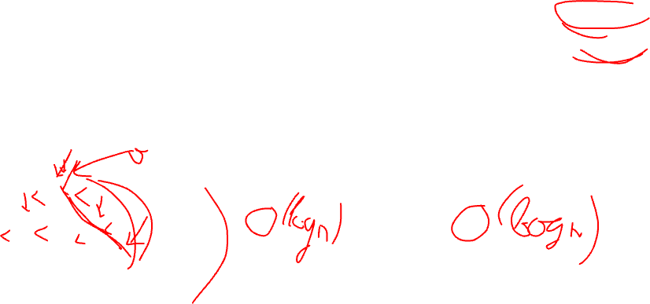
Solution 3
Time complexity:
Insert: O(log n)
Remove: O(log n)
A binary search tree
To add an element to the priority queue, traverse the tree starting from the root node, and find the appropriate place to insert the new node.
To remove an element from the priority queue, traverse the tree starting from the root node, and find the node with the highest priority.
Node with highest priority
Node with lowest priority
Notes:
Create a binary search tree with the following fields for each node:
Key: a numeric value representing the priority of the element.
Value: the data element that is being stored.
Left child: a reference to the left child node.
Right child: a reference to the right child node.
To add an element to the priority queue, traverse the tree starting from the root node, and find the appropriate place to insert the new node. This is done by comparing the priority of the new element with the priority of the current node. If the priority of the new element is higher, traverse to the right subtree; otherwise, traverse to the left subtree. Continue until a leaf node is reached, and insert the new node as a child of that node.
To remove an element from the priority queue, traverse the tree starting from the root node, and find the node with the highest priority. This is done by always traversing to the right subtree, since the highest priority node will be the node with the largest key. Once the highest priority node is found, remove it from the tree and return its value.
To access the element with the highest priority without removing it, simply traverse the tree to find the node with the highest priority, as in step 3, but do not remove it from the tree.

Slide 14
Problem 4
For each of the following applications, indicate the most appropriate data structure: a. answering telephone calls in the order of their known priorities b. sending backlog orders to customers in the order they have been received c. implementing a calculator for computing simple arithmetical expressions
Notes:
a. For answering telephone calls in the order of their known priorities, a priority queue would be the most appropriate data structure. A priority queue stores elements with associated priorities, and allows for efficient removal of the highest priority element. In this case, the priorities would be based on the urgency or importance of the call, and the highest priority calls would be answered first.
b. For sending backlog orders to customers in the order they have been received, a queue would be the most appropriate data structure. A queue stores elements in a First-In-First-Out (FIFO) order, which means that the first order received would be the first to be sent out. As new orders come in, they are added to the end of the queue, and orders are sent out from the front of the queue.
c. For implementing a calculator for computing simple arithmetical expressions, a stack would be the most appropriate data structure. A stack allows for efficient Last-In-First-Out (LIFO) operations, which is useful for evaluating arithmetic expressions in postfix or reverse Polish notation. In postfix notation, the operators come after the operands, and each operator is applied to the top two operands on the stack.

Slide 15
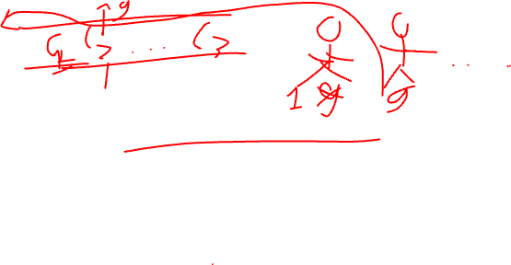
Solution 4
Answering telephone calls in the order of their known priorities:
A priority queue would be the most appropriate data structure.
A priority queue stores elements with associated priorities and allows for efficient removal of the highest priority element. In this case, the priorities would be based on the urgency or importance of the call, and the highest priority calls would be answered first.
Notes:
For answering telephone calls in the order of their known priorities, a priority queue would be the most appropriate data structure. A priority queue stores elements with associated priorities, and allows for efficient removal of the highest priority element. In this case, the priorities would be based on the urgency or importance of the call, and the highest priority calls would be answered first.

Slide 16
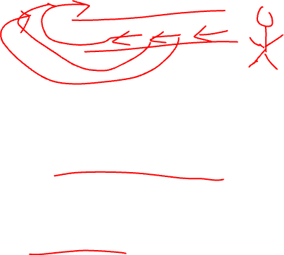
Solution 4
Sending backlog orders to customers in the order they have been received:
A queue would be the most appropriate data structure.
A queue stores elements in a First-In-First-Out (FIFO) order, which means that the first order received would be the first to be sent out. As new orders come in, they are added to the end of the queue, and orders are sent out from the front of the queue.
Notes:
For sending backlog orders to customers in the order they have been received, a queue would be the most appropriate data structure. A queue stores elements in a First-In-First-Out (FIFO) order, which means that the first order received would be the first to be sent out. As new orders come in, they are added to the end of the queue, and orders are sent out from the front of the queue.

Slide 17
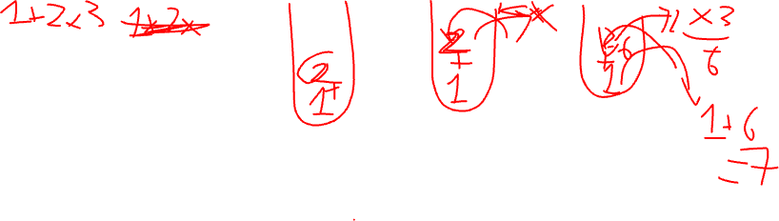
Solution 4
Implementing a calculator for computing simple arithmetical expressions:
A stack would be the most appropriate data structure.
A stack allows for efficient Last-In-First-Out (LIFO) operations, which is useful for evaluating arithmetic expressions in postfix or reverse Polish notation. In postfix notation, the operators come after the operands, and each operator is applied to the top two operands on the stack.
Notes:
For implementing a calculator for computing simple arithmetical expressions, a stack would be the most appropriate data structure. A stack allows for efficient Last-In-First-Out (LIFO) operations, which is useful for evaluating arithmetic expressions in postfix or reverse Polish notation. In postfix notation, the operators come after the operands, and each operator is applied to the top two operands on the stack.

Slide 18
Problem 5
(Anagram checking) Design an algorithm for checking whether two given words are anagrams, i.e., whether one word can be obtained by permuting the letters of the other. For example, the words tea and eat are anagrams.

Slide 19
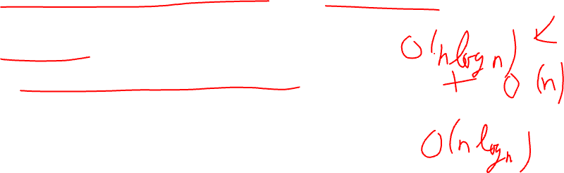
Solution 5
Convert both words to lowercase (assuming case-insensitivity).
Remove any non-letter characters (e.g. spaces, punctuation marks).
Sort the letters of each word in alphabetical order.
Compare the sorted letter sequences of the two words.
If the sorted sequences are equal, the words are anagrams. Otherwise, they are not.

Slide 20
Problem 6
Reverse the order of elements on stack S
Using two additional stacks
Using one additional queue
Using one additional stack and some additional non-array variables

Slide 21
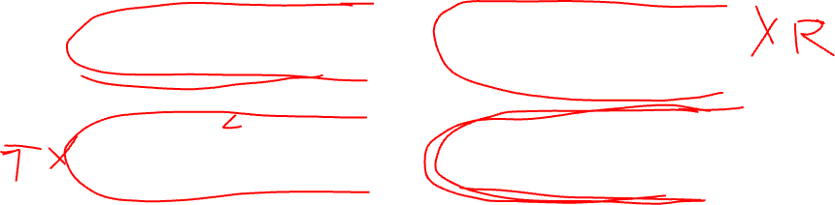
Solution 6
Using two additional stacks
Create two empty stacks, let's call them R and T.
While S is not empty, pop the top element of S and push it onto stack R.
While R is not empty, pop the top element of R and push it onto stack T.
While T is not empty, pop the top element of T and push it onto stack S.
S
1 | 2 | 3 | 4
4 | 3 | 2 | 1
Q
R
1 | 2 | 3 | 4
4 | 3 | 2 | 1
S

Slide 22
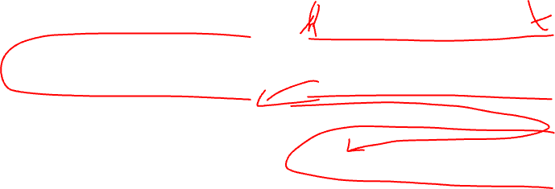
Solution 6
Using one additional queue
Create an empty queue, let's call it Q.
While S is not empty, pop the top element of S and enqueue it onto Q
While Q is not empty, dequeue the front element of Q and push it onto stack S.
S
1 | 2 | 3 | 4
4 | 3 | 2 | 1
Q
4 | 3 | 2 | 1
S

Slide 23
Solution 6
Using one additional stack and some additional non-array variables
Create an empty stack, let's call it T.
While S is not empty, pop the top element of S and save it to a variable, let's call it x.
While T is not empty and the top element of T is greater than x, pop the top element of T and push it onto stack S.
Push x onto stack T.
=> Repeat steps 2-4 until S is empty.
The elements of stack T are now in reverse order of stack S. While T is not empty, pop the top element of T and push it onto stack S.

Slide 24
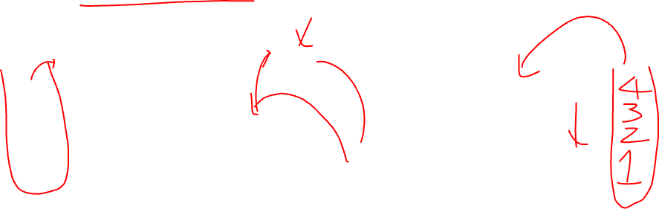
Solution 6
Using one additional stack and some additional non-array variables
x
x
4
3
3
4
2
2
2
1
4
1
4
1
3
S
T
S
T
S
T

Slide 25
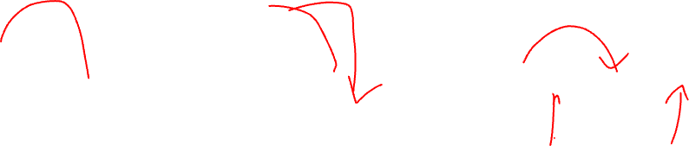
Solution 6
Using one additional stack and some additional non-array variables
x
4
4
2
2
2
4
1
3
1
3
1
3
S
T
S
T
S
T

Slide 26
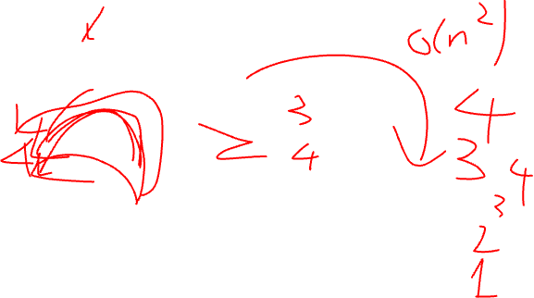

Solution 6
Using one additional stack and some additional non-array variables
x
2
4
2
4
4
3
1
3
1
3
1
2
S
T
S
T
S
T

Slide 27
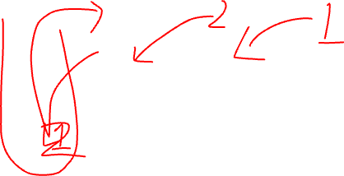
Problem 7
Put the elements on the stack S in ascending order using one additional stack and some additional non-array variables.

Slide 28
Solution 7
Hint:
Same solution as 6.c
As 6.c is descending order, we need to change the condition when compare with “x”.

Slide 29
Problem 8
Define a queue in terms of a stack.

Slide 30
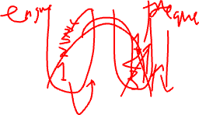
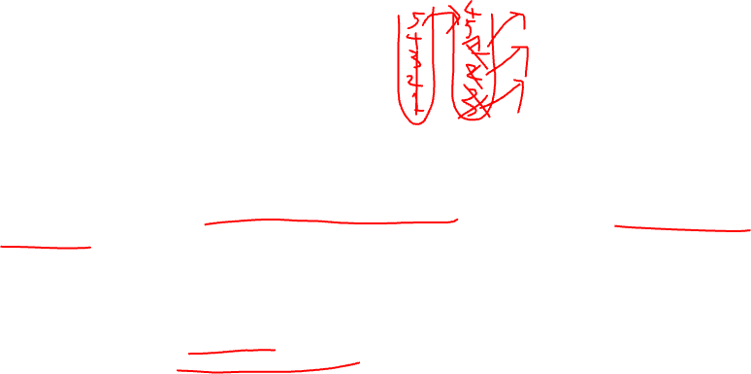
Solution 8
A queue can be defined in terms of a stack by using two stacks: stack1 and stack2.
Basic idea: use one stack to enqueue elements and the other to dequeue elements.
Enqueue operation: push the element onto stack1.
Dequeue operation:
First check if stack2 is empty.
If it is empty, pop all the elements from stack1 and push them onto stack2,
Then pop the top element from stack2 and return it as the dequeued element.
Notes:
A queue can be defined in terms of a stack by using two stacks. Let's call them stack1 and stack2. The basic idea is to use one stack to enqueue elements and the other to dequeue elements.
Here's how we can define a queue in terms of a stack:
Enqueue operation: To enqueue an element into the queue, push the element onto stack1.
Dequeue operation: To dequeue an element from the queue, first check if stack2 is empty. If it is empty, pop all the elements from stack1 and push them onto stack2, reversing the order of the elements. Then pop the top element from stack2 and return it as the dequeued element.

Slide 31

Problem 9
Using additional non-array variables, order all elements on a queue using also
two additional queues
one additional queue

Slide 32

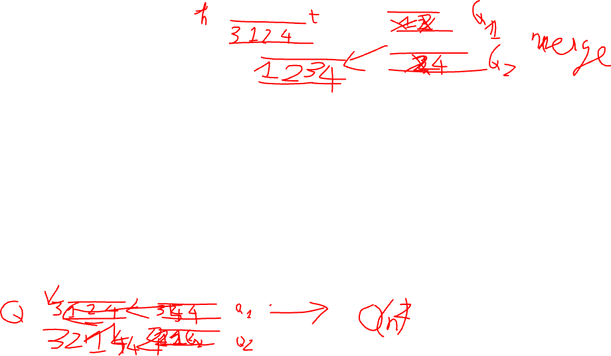
Solution 9
Two additional queues
Create two additional queues, Q1 and Q2.
Dequeue the first element from the original queue and store it in a variable called current_min.
Loop through the original queue while it is not empty:
Dequeue an element from the original queue and compare it to current_min
If the dequeued element is less than current_min, enqueue current_min into Q1 and assign the dequeued element to current_min
If the dequeued element is greater than or equal to current_min, enqueue the dequeued element into Q1.
Enqueue current_min into Q1.
While Q1 is not empty:
Dequeue an element from Q1 and enqueue it into Q2.
Compare the dequeued element to the next element in Q1. If the dequeued element is greater than the next element, swap them.
Continue this process until Q1 is empty.
Dequeue all elements from Q2 and enqueue them back into the original queue.
Notes:
Create two additional queues, Q1 and Q2.
Dequeue the first element from the original queue and store it in a variable called current_min.
Loop through the original queue while it is not empty: a. Dequeue an element from the original queue and compare it to current_min. b. If the dequeued element is less than current_min, enqueue current_min into Q1 and assign the dequeued element to current_min. c. If the dequeued element is greater than or equal to current_min, enqueue the dequeued element into Q1.
Enqueue current_min into Q1.
While Q1 is not empty: a. Dequeue an element from Q1 and enqueue it into Q2. b. Compare the dequeued element to the next element in Q1. If the dequeued element is greater than the next element, swap them. c. Continue this process until Q1 is empty.
Dequeue all elements from Q2 and enqueue them back into the original queue.

Slide 33
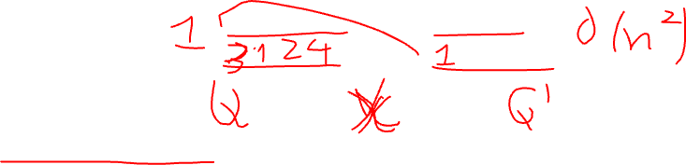
Solution 9
One additional queue
Create one additional queue, called sorted_queue.
While the original queue is not empty, dequeue an element from the original queue and call it current_element.
While sorted_queue is not empty and the front element of the queue is greater than current_element, dequeue that element and enqueue it back onto the original queue.
Enqueue current_element onto sorted_queue.
Repeat steps 2-4 until the original queue is empty.
Dequeue all elements from sorted_queue and enqueue them back onto the original queue.
Notes:
Create one additional queue, called sorted_queue.
While the original queue is not empty, dequeue an element from the original queue and call it current_element.
While sorted_queue is not empty and the front element of the queue is greater than current_element, dequeue that element and enqueue it back onto the original queue.
Enqueue current_element onto sorted_queue.
Repeat steps 2-4 until the original queue is empty.
Dequeue all elements from sorted_queue and enqueue them back onto the original queue.

Slide 34
Problem 10
Tower of Hanoi consists of three pegs or towers with n disks placed one over the other. The objective of the puzzle is to move the stack to another peg following these simple rules.
a. Only one disk can be moved at a time.
b. No disk can be placed on top of the smaller disk.
Write an algorithm to solve the Tower of Hanoi problem for n disks.

Slide 35
Solution 10
The number of disks (n), the source peg (src), the destination peg (dest), and the auxiliary peg (aux).
Create an empty stack called stk.
Push the initial parameters (n, src, dest, aux) onto the stack.
While the stack is not empty:
Pop the top parameters (n, src, dest, aux) from the stack.
If n == 1, move the disk from src to dest and continue to the next iteration of the loop.
Push the parameters (n-1, aux, dest, src) onto the stack.
Push the parameters (1, src, dest, aux) onto the stack.
Push the parameters (n-1, src, aux, dest) onto the stack.
Notes:
Define a function called tower_of_hanoi_iterative that takes three arguments: the number of disks (n), the source peg (src), the destination peg (dest), and the auxiliary peg (aux).
Create an empty stack called stk.
Push the initial parameters (n, src, dest, aux) onto the stack.
While the stack is not empty: a. Pop the top parameters (n, src, dest, aux) from the stack. b. If n == 1, move the disk from src to dest and continue to the next iteration of the loop. c. Push the parameters (n-1, aux, dest, src) onto the stack. d. Push the parameters (1, src, dest, aux) onto the stack. e. Push the parameters (n-1, src, aux, dest) onto the stack.

Slide 36
Problem 11
The stock span problem is a financial problem where we have a series of n daily price quotes for a stock and we need to calculate span of stock’s price for all n days. The span Si of the stock’s price on a given day i is defined as the maximum number of consecutive days just before the given day, for which the price of the stock on the current day is less than or equal to its price on the given day. For example, if an array of 7 days prices is given as {100, 80, 60, 70, 60, 75, 85}, then the span values for corresponding 7 days are {1, 1, 1, 2, 1, 4, 6}.
Write an algorithm to solve the stock span problem using stack.
Notes:
Define a function called stock_span that takes an array of daily stock prices as an argument.
Create an empty stack called stk and an empty list called span.
Loop through the daily stock prices: a. Initialize the span value for the current day to 1. b. While the stack is not empty and the price at the top of the stack is less than or equal to the current day's price: i. Pop the top of the stack and subtract its span value from the current day's span value. c. Append the current day's span value to span. d. Push the current day's price and span value onto the stack.
Return the span list.

Slide 37
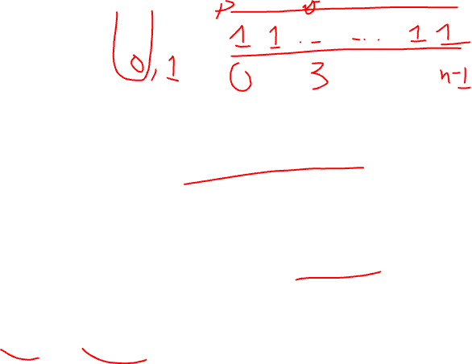
Solution 11
Define a function called stock_span that takes an array of daily stock prices as an argument.
Create an empty stack called stk and an empty list called span.
Loop through the daily stock prices:
Initialize the span value for the current day to 1.
While the stack is not empty and the price at the top of the stack is less than or equal to the current day's price: i. Pop the top of the stack and subtract its span value from the current day's span value.
Append the current day's span value to span.
Push the current day's price and span value onto the stack.
Return the span list.
Notes:
Define a function called stock_span that takes an array of daily stock prices as an argument.
Create an empty stack called stk and an empty list called span.
Loop through the daily stock prices: a. Initialize the span value for the current day to 1. b. While the stack is not empty and the price at the top of the stack is less than or equal to the current day's price: i. Pop the top of the stack and subtract its span value from the current day's span value. c. Append the current day's span value to span. d. Push the current day's price and span value onto the stack.
Return the span list.

