Slide 1
Computing Algorithms – 2801ICT
Workshop 5 – Sorting

Slide 2
Problem 1
Consider the algorithm for the sorting problem that sorts an array by counting, for each of its elements, the number of smaller elements and then uses this information to put the element in its appropriate position in the sorted array.
Apply this algorithm to sorting the list 60, 35, 81, 98, 14, 47
Is this algorithm stable?
Is it in place?
for i ← 0 to n − 1 do Count[i] ← 0 for i ← 0 to n − 2 do for j ← i + 1 to n − 1 do if A[i] < A[j]: Count[j] ← Count[j] + 1 else: Count[i] ← Count[i] + 1 for i ← 0 to n − 1 do S[Count[i]] ← A[i]

Slide 3
Solution 1
Apply this algorithm to sorting the list 60, 35, 81, 98, 14, 47
Step 1
Step 3
1 | 0 | 0 | 0 | 0 | 0
1 | 0 | 1 | 1 | 0 | 0
60 | 35 | 81 | 98 | 14 | 47
60 | 35 | 81 | 98 | 14 | 47
i=0
j=1
i=0
j=3
Keep doing these steps…
Step 2
Step 4
1 | 0 | 1 | 0 | 0 | 0
2 | 0 | 1 | 1 | 0 | 0
60 | 35 | 81 | 98 | 14 | 47
60 | 35 | 81 | 98 | 14 | 47
i=0
j=2
i=0
j=4
Notes:
Ring Topology: In a ring topology, each device is connected to exactly two other devices, forming a closed loop. To check if the given matrix represents a ring topology, we can check if each row and column has exactly two non-zero entries, and if the non-zero entries form a cyclic pattern.
Check if the given matrix represents a ring topology:
For each row i:
Count the number of non-zero entries.
If the count is not equal to 2, return false.
If the non-zero entries do not form a cyclic pattern, return false.
For each column j:
Count the number of non-zero entries.
If the count is not equal to 2, return false.
If the non-zero entries do not form a cyclic pattern, return false.
If all rows and columns pass the above checks, return true for ring topology.

Slide 4
Solution 1
Is this algorithm stable?
No
If the algorithm encounters A[i] before A[j] during the iteration, it will increment Count[j] for each element in A that is greater than A[j], including A[i]
For example:
Count
3 | 4 | 5 | 1 | 0 | 2
3 | 4 | 5 | 1 | 2 | 3
3 | 4 | 5 | 1 | 2 | 3
1 | 2 | 3 | 3 | 4 | 5
Notes:
Ring Topology: In a ring topology, each device is connected to exactly two other devices, forming a closed loop. To check if the given matrix represents a ring topology, we can check if each row and column has exactly two non-zero entries, and if the non-zero entries form a cyclic pattern.
Check if the given matrix represents a ring topology:
For each row i:
Count the number of non-zero entries.
If the count is not equal to 2, return false.
If the non-zero entries do not form a cyclic pattern, return false.
For each column j:
Count the number of non-zero entries.
If the count is not equal to 2, return false.
If the non-zero entries do not form a cyclic pattern, return false.
If all rows and columns pass the above checks, return true for ring topology.

Slide 5
Solution 1
Is it in place?
No
This algorithm uses additional memory for the Count and S arrays, so it is not an in-place algorithm
Notes:
Ring Topology: In a ring topology, each device is connected to exactly two other devices, forming a closed loop. To check if the given matrix represents a ring topology, we can check if each row and column has exactly two non-zero entries, and if the non-zero entries form a cyclic pattern.
Check if the given matrix represents a ring topology:
For each row i:
Count the number of non-zero entries.
If the count is not equal to 2, return false.
If the non-zero entries do not form a cyclic pattern, return false.
For each column j:
Count the number of non-zero entries.
If the count is not equal to 2, return false.
If the non-zero entries do not form a cyclic pattern, return false.
If all rows and columns pass the above checks, return true for ring topology.

Slide 6
Problem 2
Insertion sort goes sequentially through the array when making comparisons to find a proper place for an element currently processed. Consider using binary search instead and give a complexity of the resulting insertion sort.

Slide 7
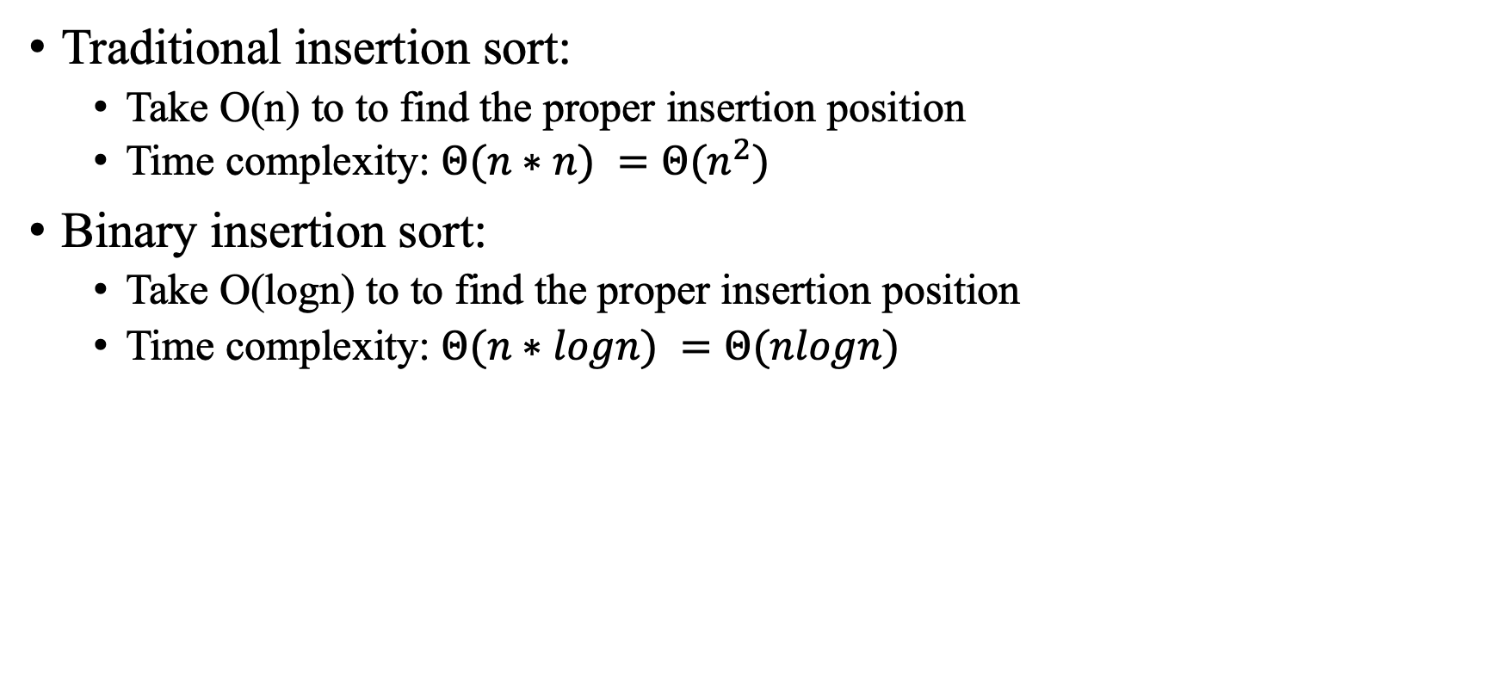
Solution 2
Traditional insertion sort:
Take O(n) to to find the proper insertion position
Time complexity: $Θ(n∗n) =Θ(n^{2})$
Binary insertion sort:
Take O(logn) to to find the proper insertion position
Time complexity: $Θ(n∗logn) =Θ(nlogn)$
100 | 1 | 2 | 3 | 4 | 5 | 6
Index to insert
100
Traditional insert sort.
Take O(n) to insert
Binary insertion sort.
Take O(logn) to insert

Slide 8
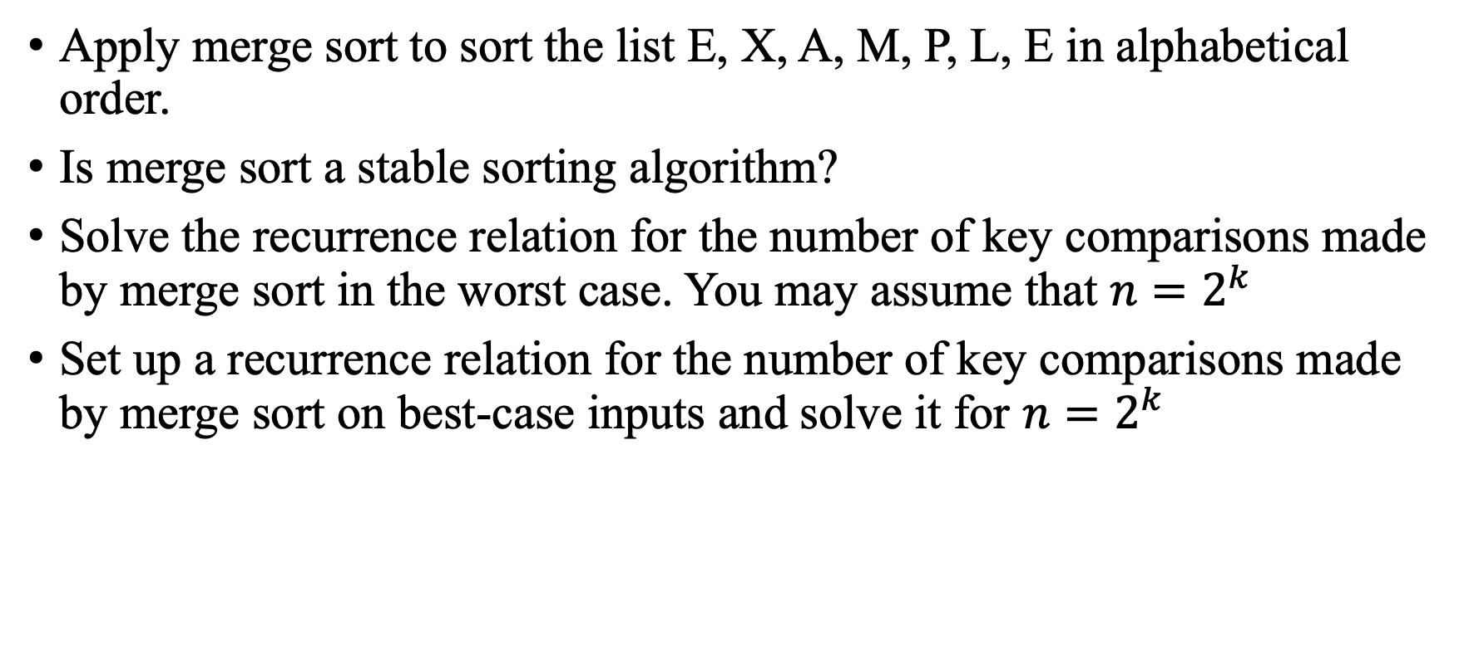
Problem 3
Apply merge sort to sort the list E, X, A, M, P, L, E in alphabetical order.
Is merge sort a stable sorting algorithm?
Solve the recurrence relation for the number of key comparisons made by merge sort in the worst case. You may assume that $n=2^{k}$
Set up a recurrence relation for the number of key comparisons made by merge sort on best-case inputs and solve it for $n=2^{k}$

Slide 9
Solution 3
E | X | A | M | P | L | E
E | X | A | M
P | L | E
E | X
A | M
P | L
E
E
X
A
M
P
L
E | X
A | M
L | P
A | E | M | X
E | L | P
A | E | E | L | M | P | X

Slide 10
Solution 3
Is merge sort a stable sorting algorithm?
Yes
During the merge operation, when elements from two different sub-sequences are compared, the algorithm always takes the element from the left sub-sequence first if both elements are equal
def mergeSort(arr):
mid = len(arr)//2
L = arr[:mid]
R = arr[mid:]
mergeSort(L)
mergeSort(R)
i = j = k = 0
# Copy data to temp arrays L[] and R[]
while i < len(L) and j < len(R):
if L[i] <= R[j]:
arr[k] = L[i]
i += 1
else:
arr[k] = R[j]
j += 1
k += 1
…

Slide 11
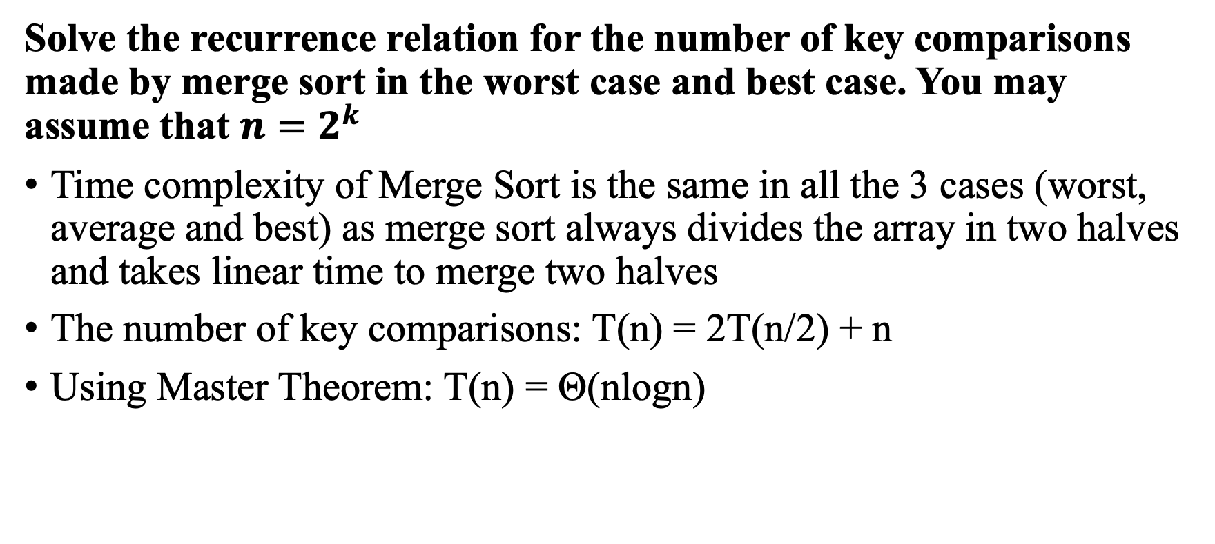
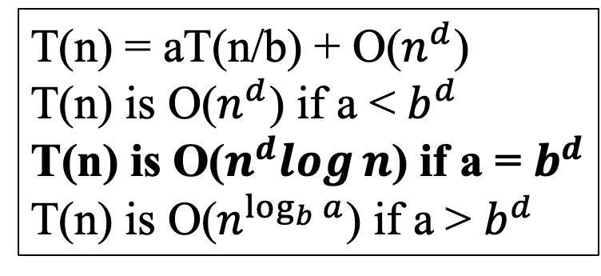
Solution 3
Solve the recurrence relation for the number of key comparisons made by merge sort in the worst case and best case. You may assume that $n=2^{k}$
Time complexity of Merge Sort is the same in all the 3 cases (worst, average and best) as merge sort always divides the array in two halves and takes linear time to merge two halves
The number of key comparisons: T(n) = 2T(n/2) + n
Using Master Theorem: T(n) = Θ(nlogn)
T(n) = aT(n/b) + O($n^{d}$)
T(n) is O($n^{d}$) if a < $b^{d}$
T(n) is O($n^{d}log⁡n$) if a = $b^{d}$
T(n) is O($n^{\log_{b}{a}}$) if a > $b^{d}$

Slide 12

Problem 4
Show that for mergesort the number of comparisons $C\left(n\right)= nlogn – 2^{\log{n}} + 1$

Slide 13
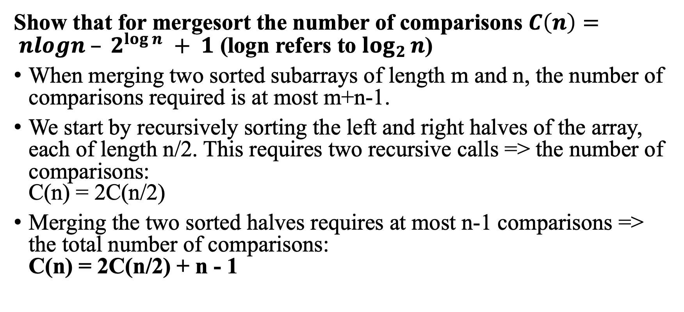
Solution 4
Show that for mergesort the number of comparisons $C\left(n\right)= nlogn – 2^{\log{n}} + 1$ (logn refers to $\log_{2}{n}$)
When merging two sorted subarrays of length m and n, the number of comparisons required is at most m+n-1.
We start by recursively sorting the left and right halves of the array, each of length n/2. This requires two recursive calls => the number of comparisons: C(n) = 2C(n/2)
Merging the two sorted halves requires at most n-1 comparisons => the total number of comparisons: C(n) = 2C(n/2) + n - 1

Slide 14
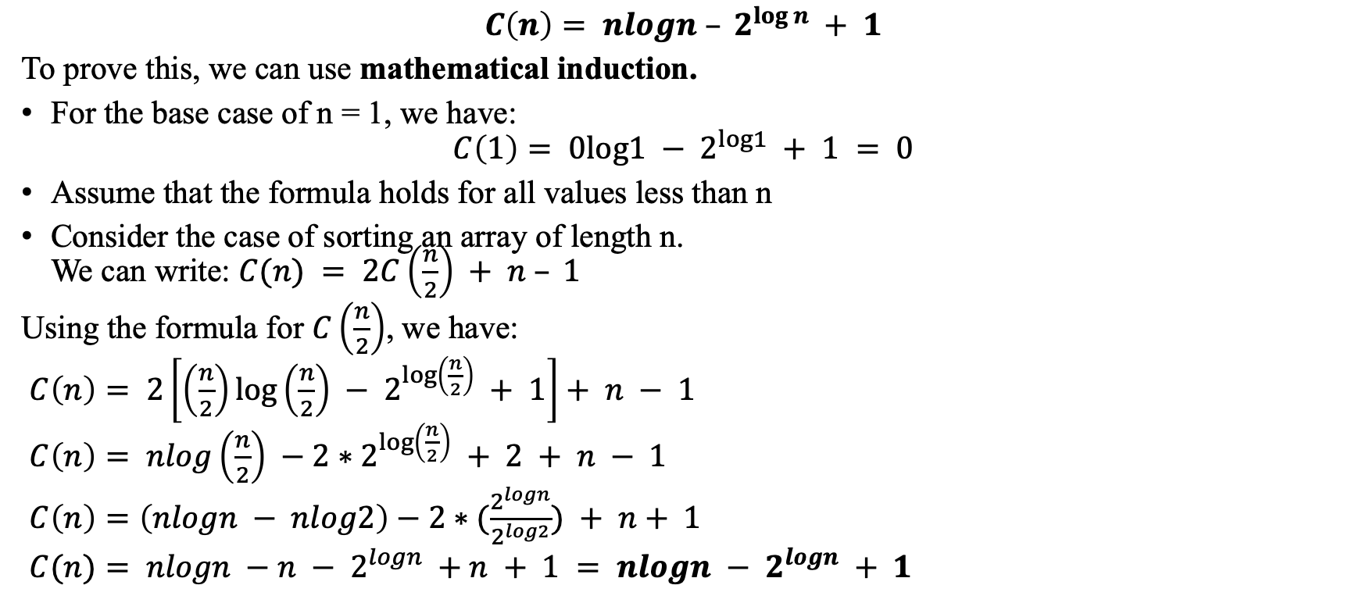
Solution 4
$$C\left(n\right)= nlogn – 2^{\log{n}} + 1$$
To prove this, we can use mathematical induction.
For the base case of n = 1, we have:
$$C\left(1\right)= 0log1 − 2^{log1} + 1 = 0$$
Assume that the formula holds for all values less than n
Consider the case of sorting an array of length n. We can write: $C(n) = 2C\left(\frac{n}{2}\right) + n – 1$
Using the formula for $C\left(\frac{n}{2}\right)$, we have:
$C\left(n\right)= 2\left[\left(\frac{n}{2}\right)\log\left(\frac{n}{2}\right) − 2^{\log\left(\frac{n}{2}\right)} + 1\right]+ n − 1$
$C\left(n\right)= nlog\left(\frac{n}{2}\right) −2∗2^{\log\left(\frac{n}{2}\right)} + 2 + n − 1$
$C\left(n\right)=\left(nlogn − nlog2\right)−2∗(\frac{2^{logn}}{2^{log2}}) + n+ 1$
$C(n)= nlogn −n − 2^{logn} +n + 1 = nlogn − 2^{logn} + 1$

Slide 15
Problem 5
To avoid doubling the workspace needed when arrays are sorted with mergesort, it may be better to use a linked list of data instead of an array. In what situations is this approach better?

Slide 16
Solution 5
To avoid doubling the workspace needed when arrays are sorted with mergesort, it may be better to use a linked list of data instead of an array. In what situations is this approach better?
The size of the data set is very large
When the output needs to be a linked list
When the data set is dynamic: If the data set is dynamic, meaning that elements are frequently added or removed, a linked list can be a more efficient approach because it can easily add or remove elements without the need to shift elements around, which can be expensive with an array-based approach.

Slide 17
Problem 6
Apply quicksort to sort the list 48, 67, 41, 10, 19, 23. Draw the tree of the recursive calls made.
Give an example showing that quicksort is not a stable sorting algorithm.

Slide 18
Solution 6
Apply quicksort to sort the list 48, 67, 41, 10, 19, 23. Draw the tree of the recursive calls made.
Visualization:
https://www.hackerearth.com/practice/algorithms/sorting/quick-sort/visualize/
48 | 67 | 41 | 10 | 19 | 23
Select the last element as the pivot
10 | 19
48 | 67 | 41
10
48
67

Slide 19
Solution 6
Give an example showing that quicksort is not a stable sorting algorithm.
# find the partition position
def partition(array, low, high):
pivot = array[high]
i = low - 1
for j in range(low, high):
if array[j] <= pivot:
i = i + 1
(array[i], array[j]) = (array[j], array[i])
(array[i + 1], array[high]) = (array[high], array[i + 1])
return i + 1
5
48 | 67 | 48 | 10 | 19 | 23
1
10 | 23 | 19 | 48
6
67
3
23 | 19 | 48
If we use the first element as the pivot and apply quicksort, the partition step will place all elements less than or equal to ‘pivot’ to the left of it, and all elements greater than ‘pivot’ to the right of it
2
19
4
48

Slide 20
Problem 7
For quicksort:
Are arrays made up of all equal elements the worst-case input, the best-case input, or neither? Why?
Are strictly decreasing arrays the worst-case input, the best-case input, or neither? Why?

Slide 21
Solution 7
For both questions:
Worst case: If the pivot is always chosen as the first or last element => highly unbalanced partitions: one with no elements and the other with n-1 elements
Best case: if the pivot is always chosen as the median element => balanced partitions => O(nlogn), regardless of the input.
N partitioning levels
log(N) partitioning levels

Slide 22

Problem 8
Find the smallest and the largest number of keys that a heap of height h can contain.
Prove that the height of a heap with n nodes is equal to [$\log_{2}{n}$].
Outline an algorithm for checking whether an array H[1..n] is a heap and determine its time efficiency.

Slide 23
Solution 8
Find the smallest number of keys that a heap of height h can contain.
Smallest: The heap have a structure where each level has the minimum possible number of nodes
One node at each level.
Smallest number of keys = 1 (root) + 1 (first level) + 1 (second level) + ... + 1 (h-th level) = 1 + 1 + ... + 1 (h+1 times) = h + 1

Slide 24
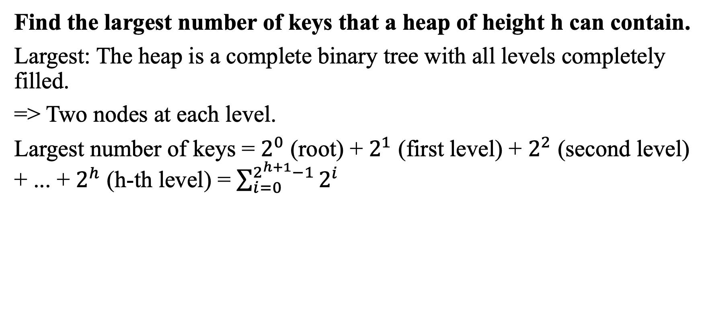
Solution 8
Find the largest number of keys that a heap of height h can contain.
Largest: The heap is a complete binary tree with all levels completely filled.
=> Two nodes at each level.
Largest number of keys = $2^{0}$ (root) + $2^{1}$ (first level) + $2^{2}$ (second level) + ... + $2^{h}$ (h-th level) = $\sum_{i=0}^{2^{h+1}−1}{2^{i}}$

Slide 25
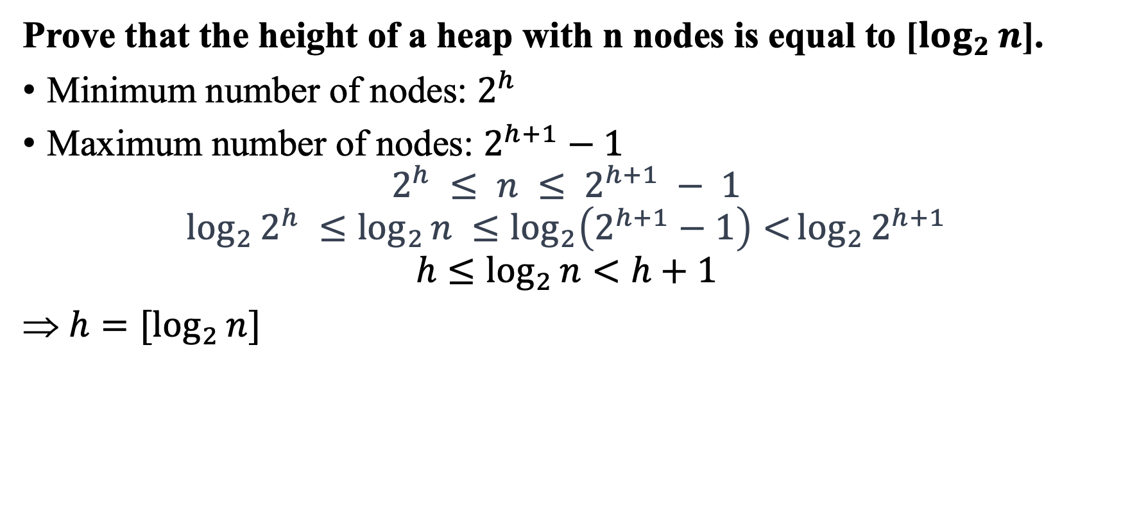
Solution 8
Prove that the height of a heap with n nodes is equal to [$\log_{2}{n}$].
Minimum number of nodes: $2^{h}$
Maximum number of nodes: $2^{h+1}−1$
$$2^{h} ≤ n ≤ 2^{h+1} − 1$$
$$\log_{2}{2^{h}} ≤\log_{2}{n} ≤\log_{2}\left(2^{h+1}−1\right)<\log_{2}{2^{h+1}}$$
$$h≤\log_{2}{n}<h+1$$
$h=[\log_{2}{n}]$

Slide 26
Solution 8
def is_max_heap(H):
n = len(H) - 1 # The number of nodes in the heap (excluding the first element, H[0])
# Iterate through the parent nodes
for i in range(1, n//2 + 1):
left_child = 2 * i
right_child = 2 * i + 1
# Check if the parent node follows the max-heap property with respect to its child nodes
if left_child <= n and H[i] < H[left_child]:
return False
if right_child <= n and H[i] < H[right_child]:
return False
# If all parent nodes follow the max-heap property, the array is a max-heap
return True
Outline an algorithm for checking whether an array H[1..n] is a heap and determine its time efficiency.

Slide 27
Problem 9
Sort the following lists by heapsort by using the array representation of heaps.
1, 2, 3, 4, 5 (in increasing order)
5, 4, 3, 2, 1 (in increasing order)
S, O, R, T, I, N, G (in alphabetical order)
Is heapsort a stable sorting algorithm?

Slide 28
Problem 9
Sort the following lists by heapsort by using the array representation of heaps.
1, 2, 3, 4, 5 (in increasing order)
5, 4, 3, 2, 1 (in increasing order)
S, O, R, T, I, N, G (in alphabetical order)
https://www.cs.usfca.edu/~galles/visualization/HeapSort.html

Slide 29
Problem 9
Is heapsort a stable sorting algorithm?
No
Example:
Consider array 21 20a 20b 12 11 8 7 (already in max-heap format)
Heapsort first 21 is removed and placed in the last index
20a is removed and placed in last but one index
20b in the last but two index so after heap sort the array looks like
Final sequence: 7 8 11 12 20b 20a 21.

Slide 30
Problem 10
What exactly are the smallest and largest numbers of movements and comparisons to sort four elements using heapsort(), quicksort(), and mergesort()?

Slide 31
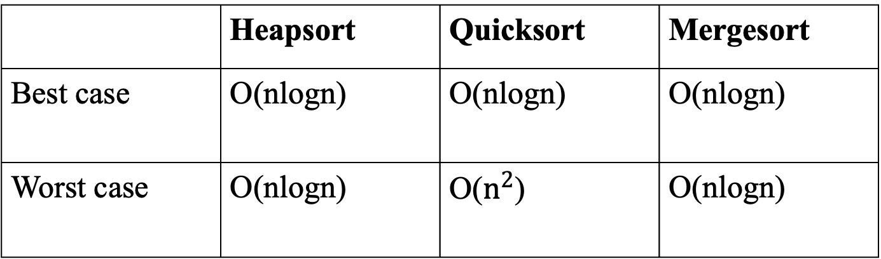
Solution 10
According to solutions above
 | Heapsort | Quicksort | Mergesort
Best case | O(nlogn) | O(nlogn) | O(nlogn)
Worst case | O(nlogn) | O($n^{2}$) | O(nlogn)

Slide 32
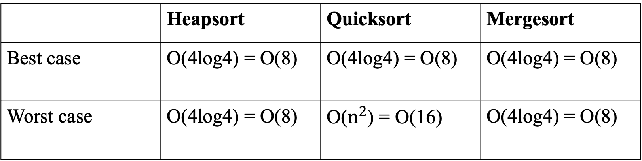
Solution 10
Apply to sort four elements
 | Heapsort | Quicksort | Mergesort
Best case | O(4log4) = O(8) | O(4log4) = O(8) | O(4log4) = O(8)
Worst case | O(4log4) = O(8) | O($n^{2}$) = O(16) | O(4log4) = O(8)

