Slide 1
Computing Algorithms – 2801ICT
Workshop 6 – Master Theorem

Slide 2
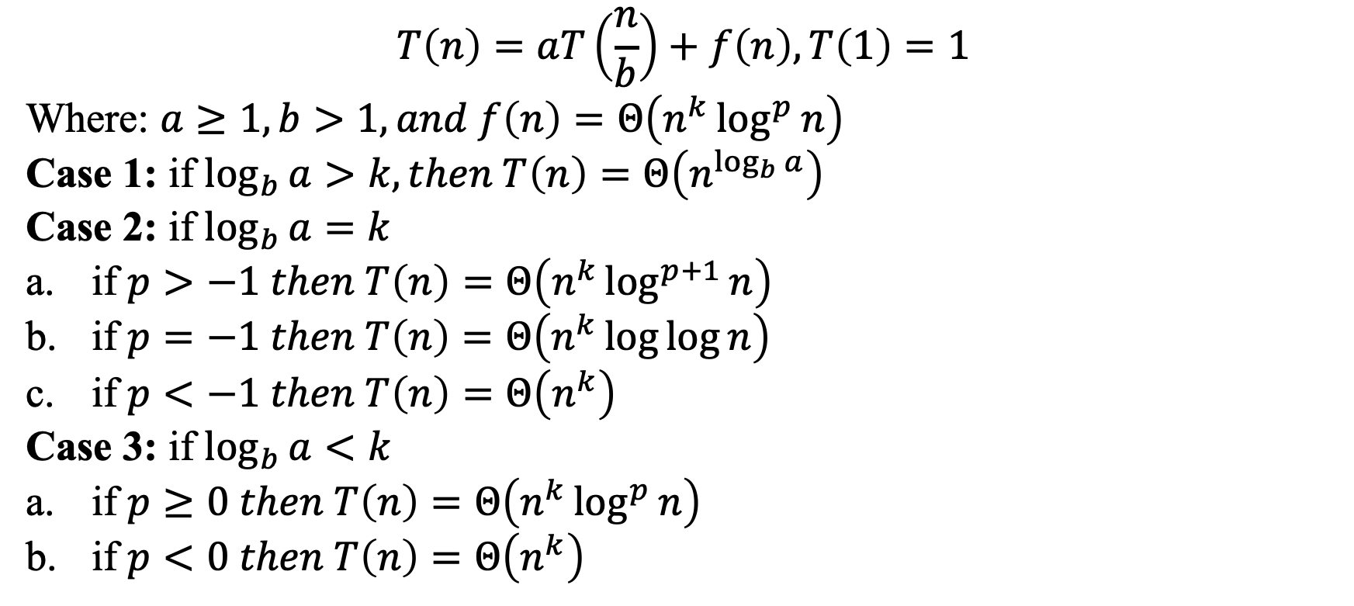
Master Theorom
$$T\left(n\right)=aT\left(\frac{n}{b}\right)+f\left(n\right), T\left(1\right)=1$$
Where: $a≥1, b>1, and f\left(n\right)=Θ\left(n^{k}\log^{p}{n}\right)$
Case 1: if $\log_{b}{a}>k, then T\left(n\right)=Θ\left(n^{\log_{b}{a}}\right)$
Case 2: if $\log_{b}{a}=k$
if $p>−1 then T\left(n\right)=Θ\left(n^{k}\log^{p+1}{n}\right)$
if $p=−1 then T\left(n\right)=Θ\left(n^{k}\log{\log{n}}\right)$
if $p<−1 then T\left(n\right)=Θ\left(n^{k}\right)$
Case 3: if $\log_{b}{a}<k$
if $p≥0 then T\left(n\right)=Θ\left(n^{k}\log^{p}{n}\right)$
if $p<0 then T\left(n\right)=Θ\left(n^{k}\right)$

Slide 3
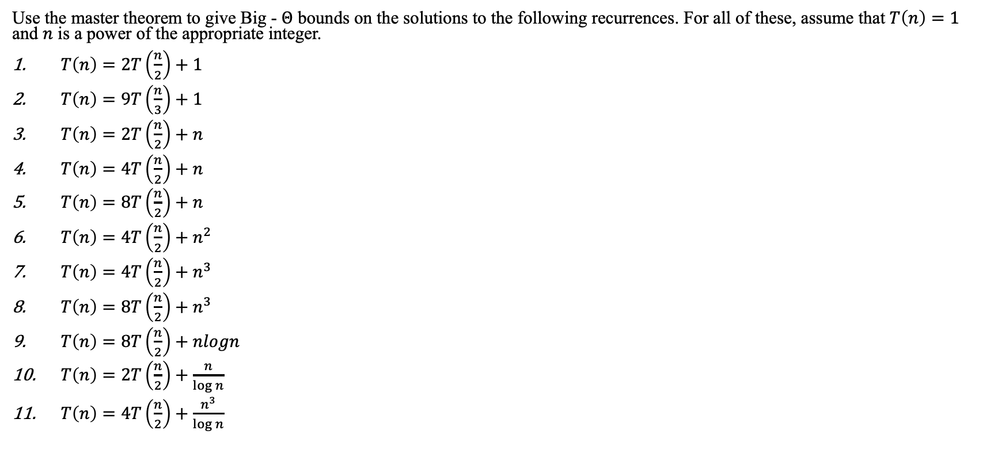
Master Theorom
Use the master theorem to give Big - $Θ$ bounds on the solutions to the following recurrences. For all of these, assume that $T\left(n\right)=1$ and $n$ is a power of the appropriate integer.
$T\left(n\right)=2T\left(\frac{n}{2}\right)+1$
$T\left(n\right)=9T\left(\frac{n}{3}\right)+1$
$T\left(n\right)=2T\left(\frac{n}{2}\right)+n$
$T\left(n\right)=4T\left(\frac{n}{2}\right)+n$
$T\left(n\right)=8T\left(\frac{n}{2}\right)+n$
$T\left(n\right)=4T\left(\frac{n}{2}\right)+n^{2}$
$T\left(n\right)=4T\left(\frac{n}{2}\right)+n^{3}$
$T\left(n\right)=8T\left(\frac{n}{2}\right)+n^{3}$
$T\left(n\right)=8T\left(\frac{n}{2}\right)+nlogn$
$T\left(n\right)=2T\left(\frac{n}{2}\right)+\frac{n}{\log{n}}$
$T\left(n\right)=4T\left(\frac{n}{2}\right)+\frac{n^{3}}{\log{n}}$

