Slide 1
Computing Algorithms – 2801ICT
Workshop 4 – Analysis of Algorithms Efficiency

Slide 2
Problem 1
Analyze the time complexity for the recursive Fibonacci algorithm.

Slide 3
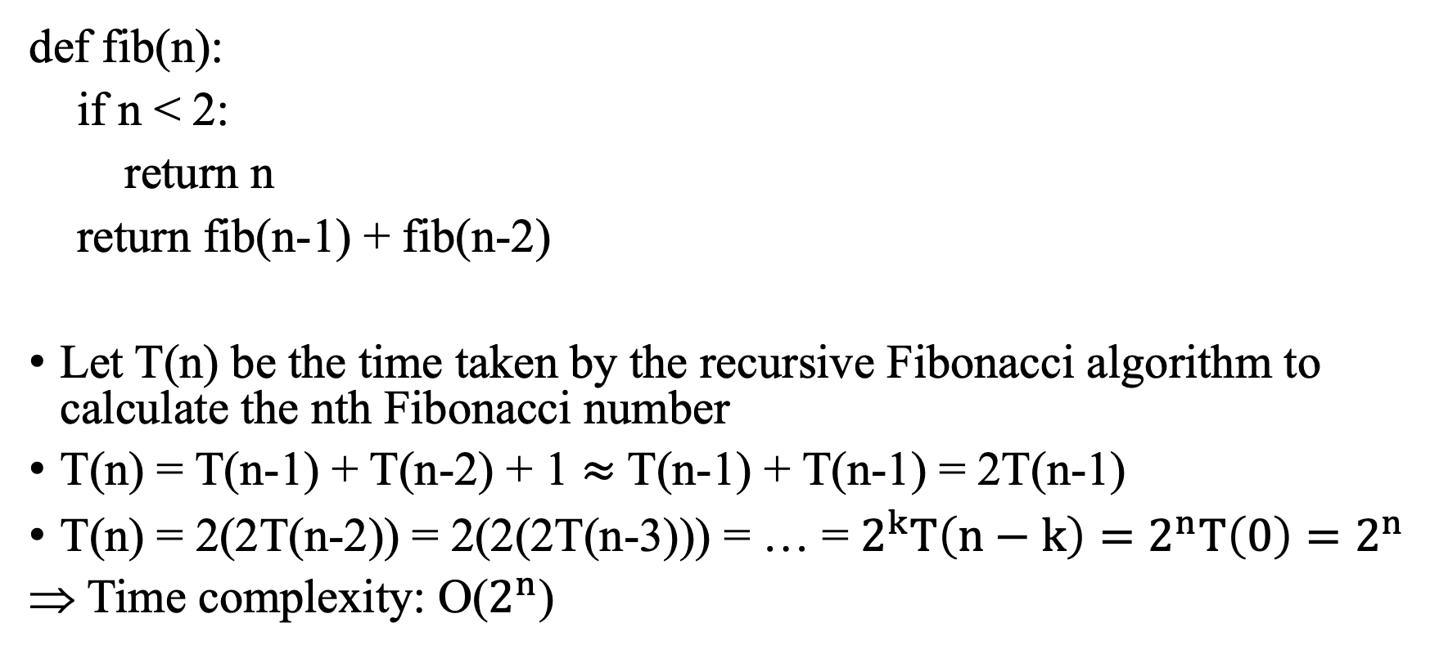
Solution 1
def fib(n):
if n < 2:
return n
return fib(n-1) + fib(n-2)
Let T(n) be the time taken by the recursive Fibonacci algorithm to calculate the nth Fibonacci number
T(n) = T(n-1) + T(n-2) + 1 $≈$ T(n-1) + T(n-1) = 2T(n-1)
T(n) = 2(2T(n-2)) = 2(2(2T(n-3))) = … = $2^{k}T\left(n−k\right)=2^{n}T\left(0\right)=2^{n}$
Time complexity: O($2^{n}$)
1
T(n-1) + T(n-2)
Notes:
Ring Topology: In a ring topology, each device is connected to exactly two other devices, forming a closed loop. To check if the given matrix represents a ring topology, we can check if each row and column has exactly two non-zero entries, and if the non-zero entries form a cyclic pattern.
Check if the given matrix represents a ring topology:
For each row i:
Count the number of non-zero entries.
If the count is not equal to 2, return false.
If the non-zero entries do not form a cyclic pattern, return false.
For each column j:
Count the number of non-zero entries.
If the count is not equal to 2, return false.
If the non-zero entries do not form a cyclic pattern, return false.
If all rows and columns pass the above checks, return true for ring topology.

Slide 4






Solution 1
Another method (Tree method)
Fib(n)
$$2^{0}$$
Fib(n-1)
Fib(n-2)
$$2^{1}$$
Fib(n-2)
Fib(n-3)
Fib(n-3)
Fib(n-4)
$$2^{2}$$
Fib(n-3)
Fib(n-4)
Fib(n-4)
Fib(n-5)
Fib(n-4)
Fib(n-5)
Fib(n-5)
Fib(n-6)
$$2^{4}$$
$$…$$
$$2^{n}$$
Notes:
Ring Topology: In a ring topology, each device is connected to exactly two other devices, forming a closed loop. To check if the given matrix represents a ring topology, we can check if each row and column has exactly two non-zero entries, and if the non-zero entries form a cyclic pattern.
Check if the given matrix represents a ring topology:
For each row i:
Count the number of non-zero entries.
If the count is not equal to 2, return false.
If the non-zero entries do not form a cyclic pattern, return false.
For each column j:
Count the number of non-zero entries.
If the count is not equal to 2, return false.
If the non-zero entries do not form a cyclic pattern, return false.
If all rows and columns pass the above checks, return true for ring topology.

Slide 5
Problem 2
Write pseudocode for a divide-and-conquer algorithm for finding values of both the largest and smallest elements in an array of n numbers.
Set up and solve (for n = 2k) a recurrence relation for the number of key comparisons made by your algorithm.
How does this algorithm compare with the brute-force algorithm for this problem?

Slide 6
Solution 2
Write pseudocode for a divide-and-conquer algorithm for finding values of both the largest and smallest elements in an array of n numbers.
Idea: Divide the array into two halves and recursively find the largest and smallest element in each half.
Min value
4 | 3 | 5 | 8 | 6 | 10
Max value
 | 3 | 5
8 | 6 | 10
4 | 3
5
8 | 6
10
4
3
8
6

Slide 7
Solution 2
def find_min_max(arr, low, high):
if low == high:
return (arr[low], arr[low])
elif high == low + 1:
return (min(arr[low], arr[high]), max(arr[low], arr[high]))
else:
mid = (low + high) // 2
(min1, max1) = find_min_max(arr, low, mid)
(min2, max2) = find_min_max(arr, mid+1, high)
return (min(min1, min2), max(max1, max2))

Slide 8
Solution 2
Set up and solve (for n = 2k) a recurrence relation for the number of key comparisons made by your algorithm.
T(n): the time required for the algorithm
T(n) includes:
Time complexity of finding min and max value
Time complexity of dividing the array
T(n)
4 | 3 | 5 | 8 | 6 | 10
4 | 3 | 5
8 | 6 | 10
T(n/2)
T(n/2)

Slide 9
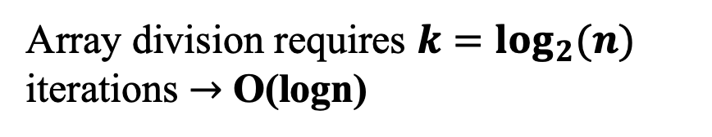
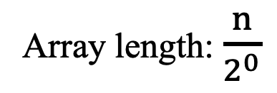
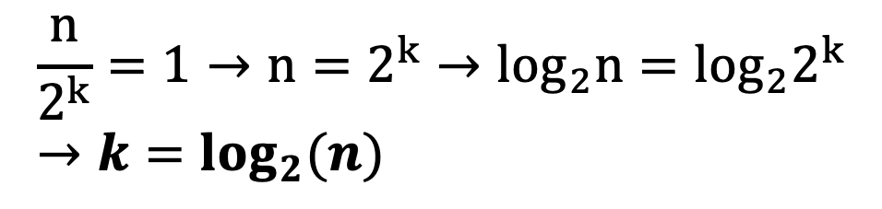
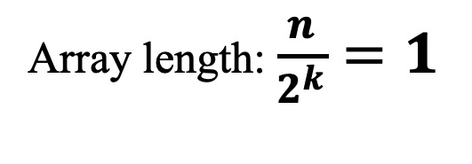
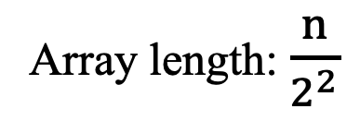
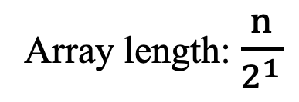
Solution 2
4 | 3 | 5 | 8 | 6 | 10
Array length: $\frac{n}{2^{0}}$
4 | 3 | 5
8 | 6 | 10
Array length: $\frac{n}{2^{1}}$
4 | 3
5
8 | 6
10
Array length: $\frac{n}{2^{2}}$
…
4
3
8
6
Array length: $\frac{n}{2^{k}}=1$
$$\frac{n}{2^{k}}=1→n=2^{k}→\log_{2}n=\log_{2}2^{k}→k=\log_{2}(n)$$
Array division requires $k=\log_{2}(n)$ iterations $→$ O(logn)

Slide 10

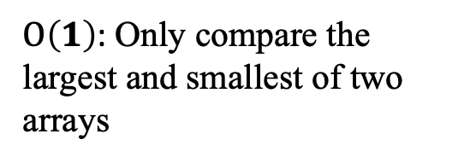









Solution 2
$O\left(1\right)$: Only compare the largest and smallest of two arrays
$$O(1)$$
4 | 3 | 5 | 8 | 6 | 10
$$O(1)$$
$$O(1)$$
4 | 3 | 5
8 | 6 | 10
$$O(1)$$
$$O(1)$$
$$O(1)$$
$$O(1)$$
Time complexity of the algorithm: O(logn)
4 | 3
5
8 | 6
10
$$O(1)$$
$$O(1)$$
$$O(1)$$
$$O(1)$$
4
3
8
6

Slide 11
Solution 2
How does this algorithm compare with the brute-force algorithm for this problem?
Brute-force: requires O(n)
Divide and conquer: requires O(logn)
=> Divide and conquer is faster than brute-force

Slide 12
Problem 3
Analyse the time complexity for computing F(n)=F(n-1) + F(n-2) for a given number n using the dynamic programming approach.

Slide 13
Solution 3
Analyse the time complexity for computing F(n)=F(n-1) + F(n-2) for a given number n using the dynamic programming approach.
for i=1 to n: dict[i] = -1
function F(n)
if (n < 3) return 1
else
if (dict[n] == -1)
dict[n] = F(n-1) + F(n-2)
return dict[n]
F(1) = 1
F(2) = 1
F(3) = F(2) + F(1) = 1 + 1 = 2
F(4) = F(3) + F(2) = 2 + 1 = 3
F(5) = F(4) + F(3) = 3 + 2 = 5
…
F(n) = F(n-1) + F(n-2)
Calculate n Fibo numbers requires n iterations
O(n)
Store solutions of sub-problems
Call sub-problems once

Slide 14
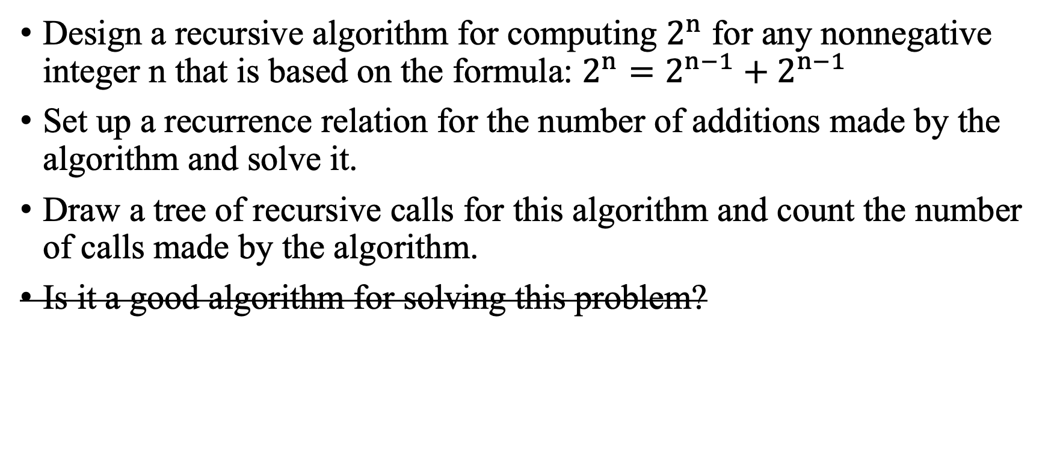
Problem 4
Design a recursive algorithm for computing $2^{n}$ for any nonnegative integer n that is based on the formula: $2^{n}=2^{n−1}+2^{n−1}$
Set up a recurrence relation for the number of additions made by the algorithm and solve it.
Draw a tree of recursive calls for this algorithm and count the number of calls made by the algorithm.
Is it a good algorithm for solving this problem?

Slide 15
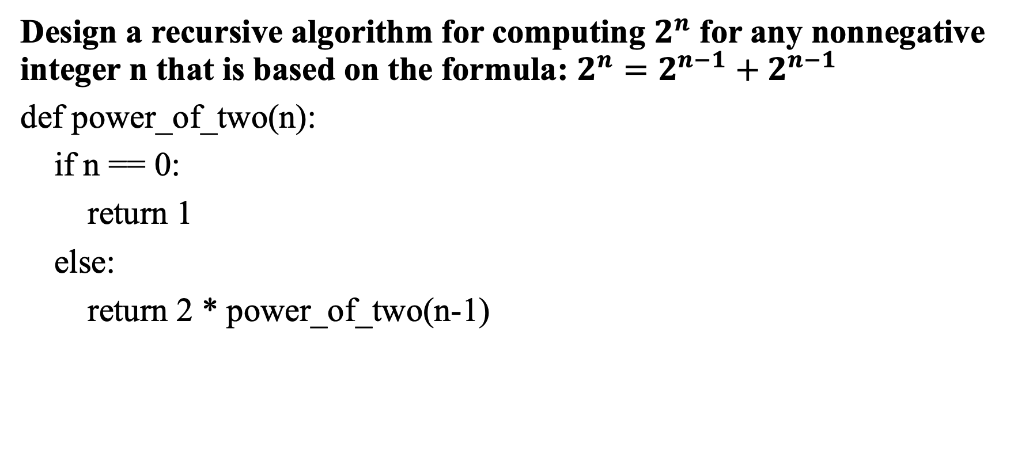
Solution 4
Design a recursive algorithm for computing $2^{n}$ for any nonnegative integer n that is based on the formula: $2^{n}=2^{n−1}+2^{n−1}$
def power_of_two(n):
if n == 0:
return 1
else:
return 2 * power_of_two(n-1)

Slide 16
Solution 4
Set up a recurrence relation for the number of additions made by the algorithm and solve it
T(n) be the number of additions made by the recursive algorithm
T(n) = T(n-1) + 1
= (T(n-2) + 1) + 1
= (T(n-3) + 1) + 2
= …
= T(n-(n-1)) + 1 + n-2
= T(0) + 1 + n-1 = n
Time complexity: O(n)

Slide 17
Solution 4
Draw a tree of recursive calls for this algorithm and count the number of calls made by the algorithm.
F(n)
#1 call
F(n-1)
#2 call
Number of calls: n
F(n-2)
#3 call
…
…
F(1)
#n call

Slide 18
Problem 5
Find the complexity of the function used to find the kth smallest integer in an unordered array of integers
int selectkth(int a[], int k, int n) {
int i, j, mini, tmp;
for (i = 0; i < k; i++) {
mini = i;
for (j = i+1; j < n; j++)
if (a[j] < a[mini]) mini = j;
tmp = a[i];
a[i] = a[mini];
a[mini] = tmp;
}
return a[k-1];
}

Slide 19
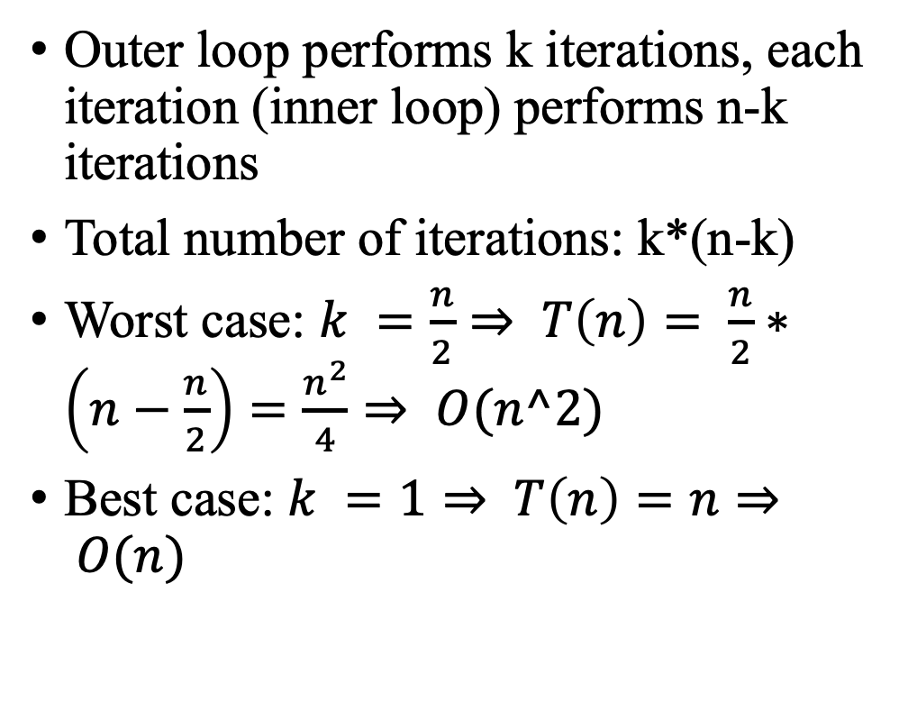
Solution 5
Outer loop performs k iterations, each iteration (inner loop) performs n-k iterations
Total number of iterations: k*(n-k)
Worst case: $k =\frac{n}{2}⇒ T\left(n\right)= \frac{n}{2}∗\left(n−\frac{n}{2}\right)=\frac{n^{2}}{4}⇒ O(n^2)$
Best case: $k =1⇒ T\left(n\right)=n⇒ O(n)$
int selectkth(int a[], int k, int n) {
int i, j, mini, tmp;
for (i = 0; i < k; i++) {
mini = i;
for (j = i+1; j < n; j++)
if (a[j] < a[mini]) mini = j;
tmp = a[i];
a[i] = a[mini];
a[mini] = tmp;
}
return a[k-1];
}

Slide 20

Problem 6
Find the order of growth for solutions of the following recurrences.
$T (n) = 4T(n/2) + n, T (1) = 1$
$T (n) = 4T(n/2) + n^{2}, T (1) = 1$
$T (n) = 4T(n/2) + n^{3}, T (1) = 1$

Slide 21
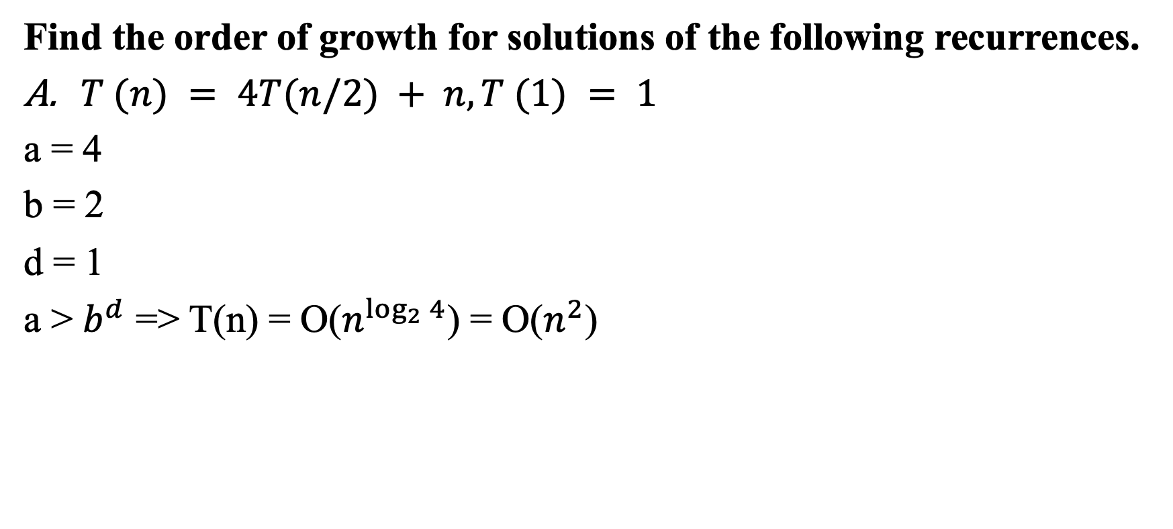
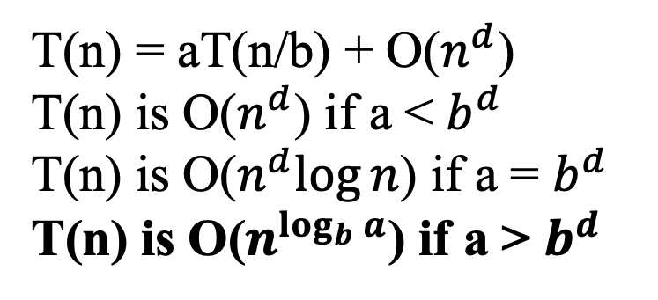
Solution 6
Find the order of growth for solutions of the following recurrences.
$T (n) = 4T(n/2) + n, T (1) = 1$
a = 4
b = 2
d = 1
a > $b^{d}$ => T(n) = O($n^{\log_{2}{4}}$) = O($n^{2}$)
T(n) = aT(n/b) + O($n^{d}$)
T(n) is O($n^{d}$) if a < $b^{d}$
T(n) is O($n^{d}log⁡n$) if a = $b^{d}$
T(n) is O($n^{\log_{b}{a}}$) if a > $b^{d}$

Slide 22
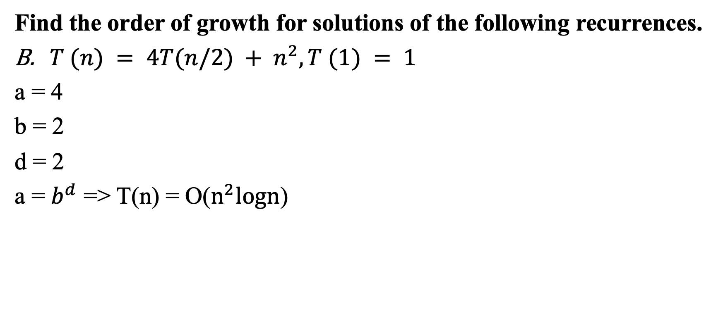
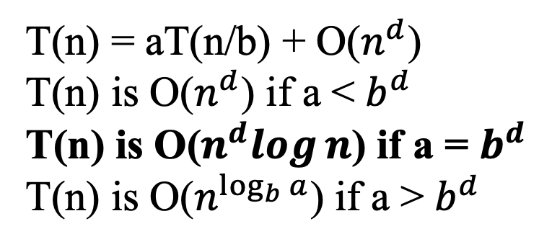
Solution 6
Find the order of growth for solutions of the following recurrences.
$T (n) = 4T(n/2) + n^{2}, T (1) = 1$
a = 4
b = 2
d = 2
a = $b^{d}$ => T(n) = O($n^{2}logn$)
T(n) = aT(n/b) + O($n^{d}$)
T(n) is O($n^{d}$) if a < $b^{d}$
T(n) is O($n^{d}log⁡n$) if a = $b^{d}$
T(n) is O($n^{\log_{b}{a}}$) if a > $b^{d}$

Slide 23
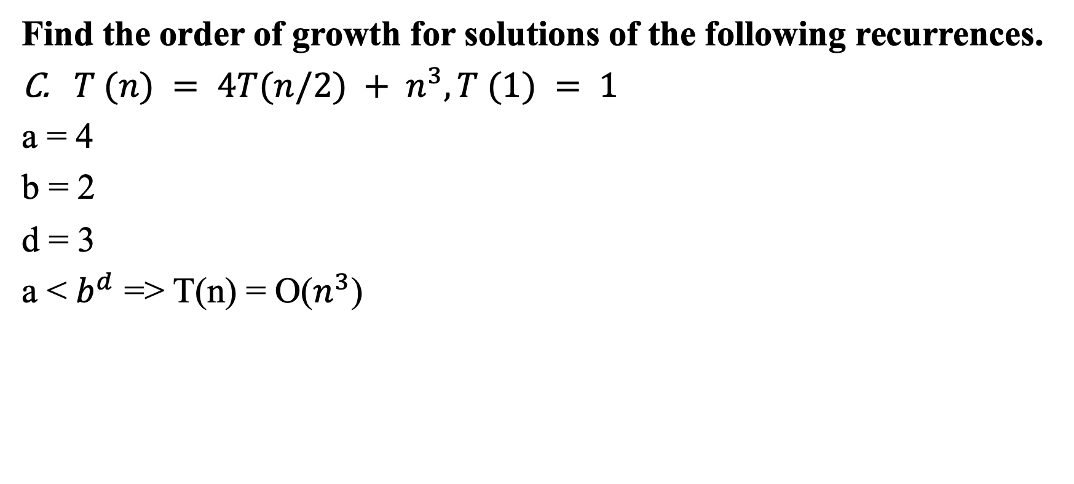
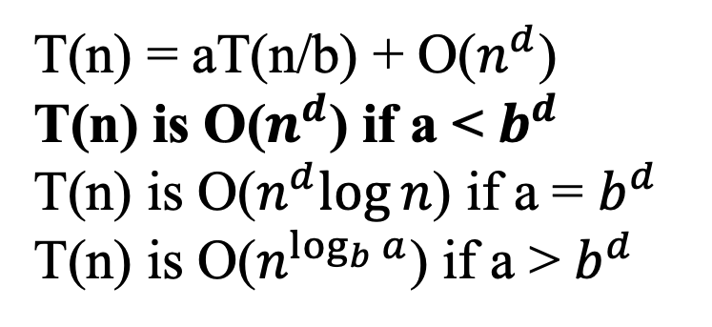
Solution 6
Find the order of growth for solutions of the following recurrences.
$T (n) = 4T(n/2) + n^{3}, T (1) = 1$
a = 4
b = 2
d = 3
a < $b^{d}$ => T(n) = O($n^{3}$)
T(n) = aT(n/b) + O($n^{d}$)
T(n) is O($n^{d}$) if a < $b^{d}$
T(n) is O($n^{d}log⁡n$) if a = $b^{d}$
T(n) is O($n^{\log_{b}{a}}$) if a > $b^{d}$

Slide 24
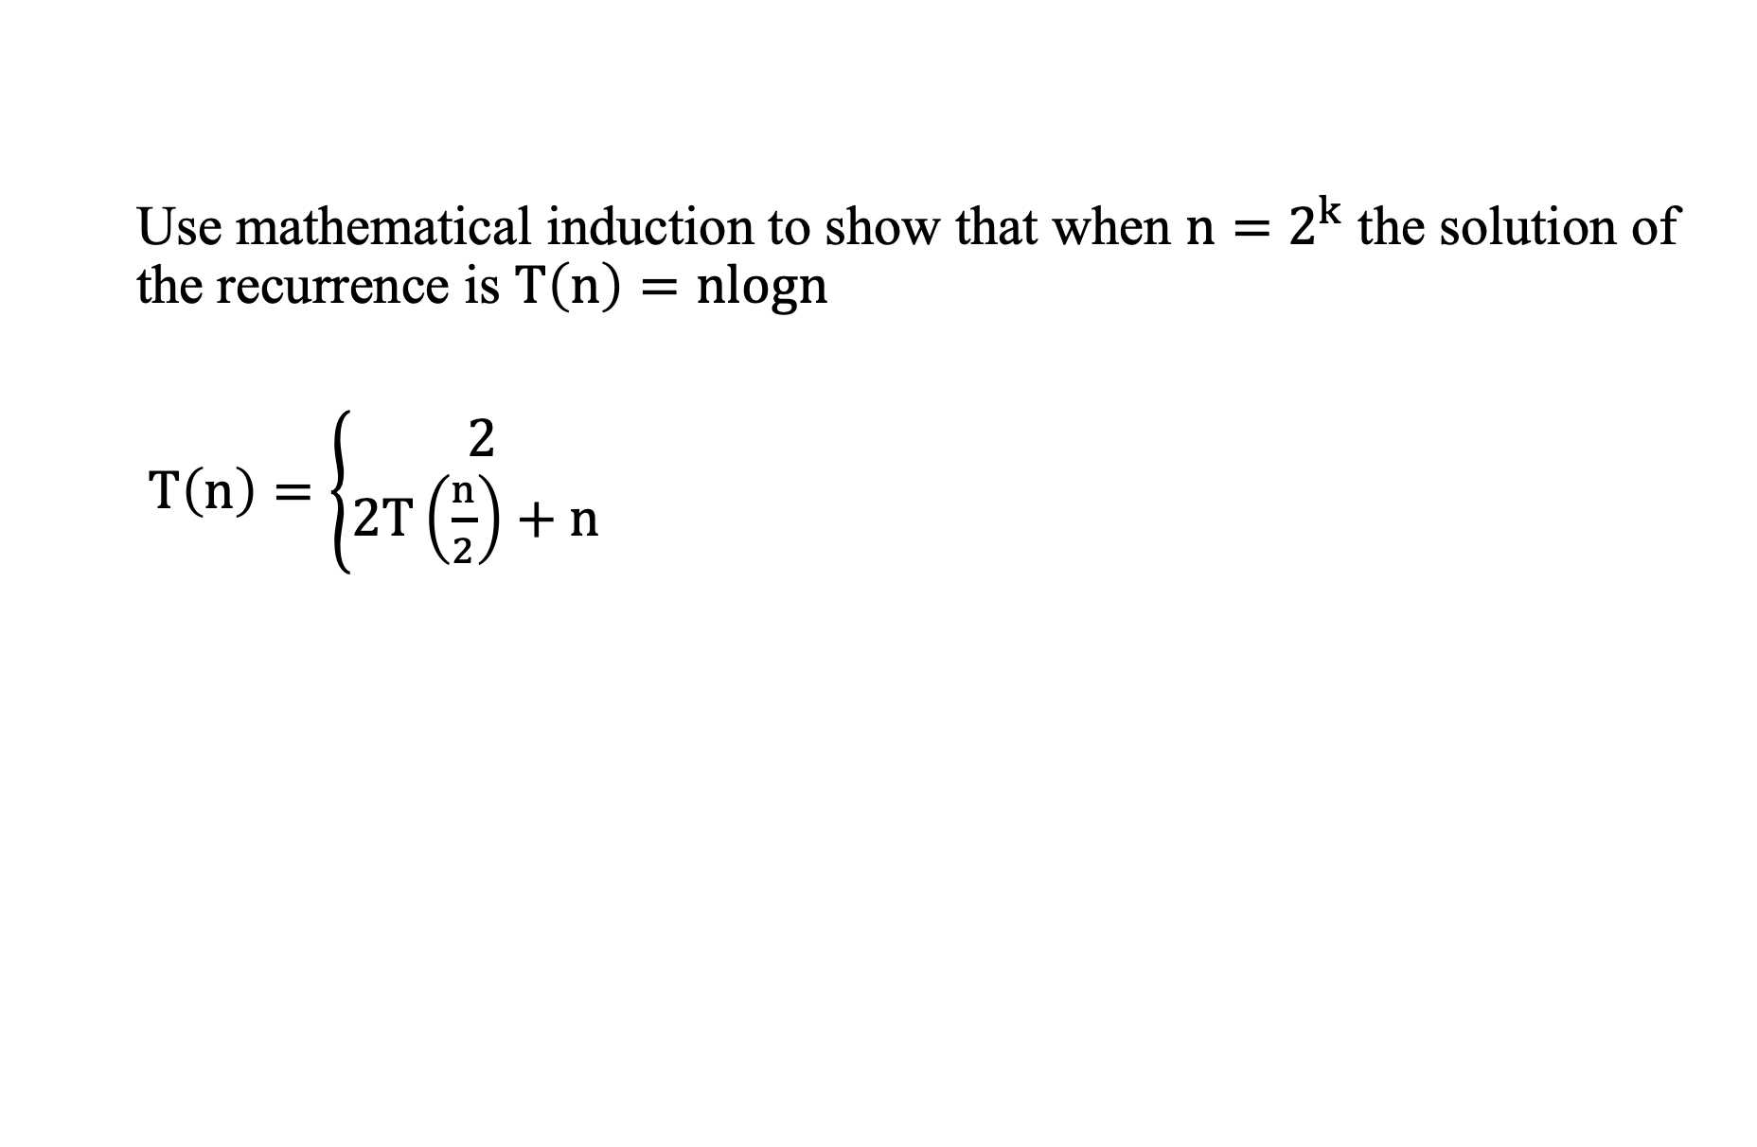
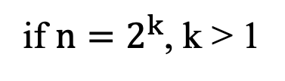
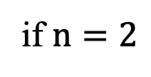
Problem 7
Use mathematical induction to show that when $n=2^{k}$ the solution of the recurrence is $T\left(n\right)=nlogn$
$T\left(n\right)=\left\{\begin{aligned}2 \\ 2T\left(\frac{n}{2}\right)+n \end{aligned}\right.$
if $n=2$
if $n=2^{k}$, k > 1

Slide 25
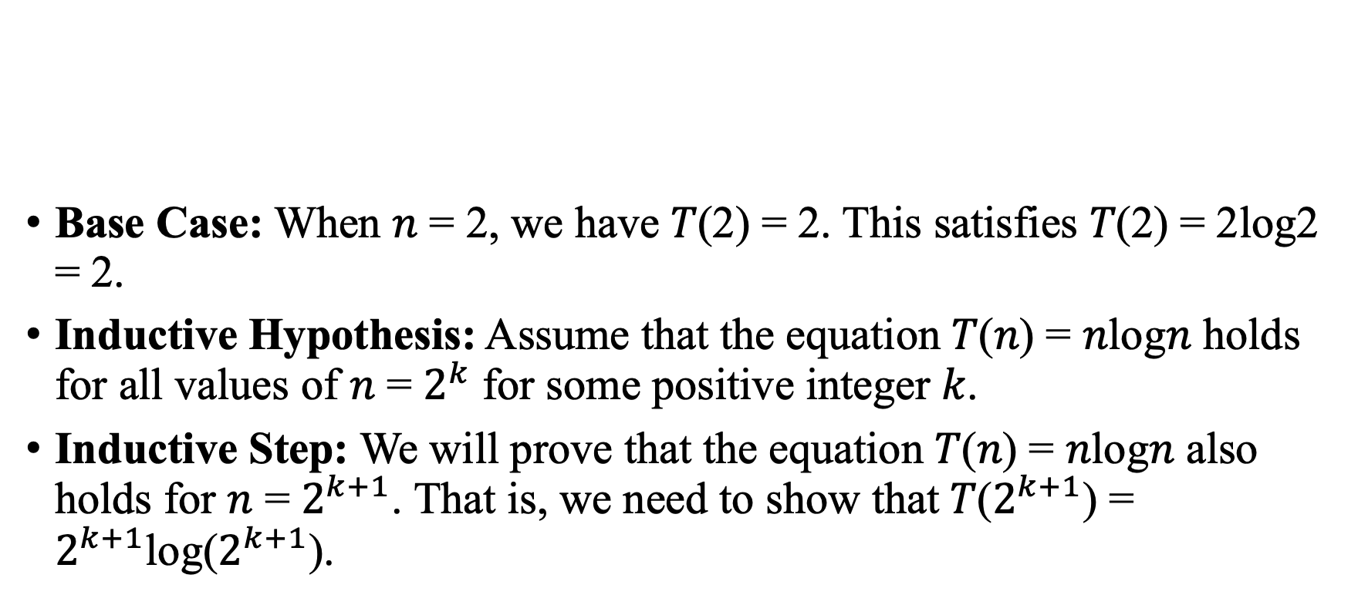
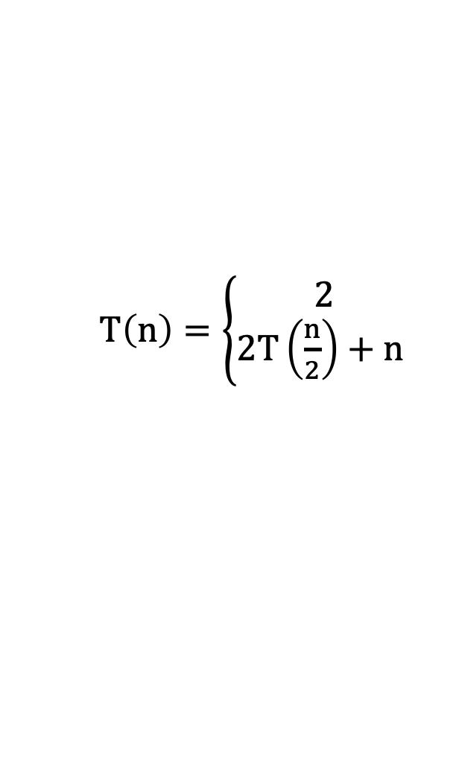
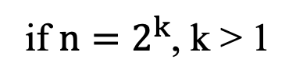
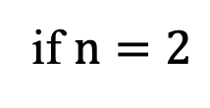
Solution 7
if $n=2$
Base Case: When 𝑛 = 2, we have 𝑇(2) = 2. This satisfies 𝑇(2) = 2log2 = 2.
Inductive Hypothesis: Assume that the equation 𝑇(𝑛) = 𝑛log𝑛 holds for all values of 𝑛 = $2^{k}$ for some positive integer 𝑘.
Inductive Step: We will prove that the equation 𝑇(𝑛) = 𝑛log𝑛 also holds for 𝑛 = $2^{k+1}$. That is, we need to show that 𝑇($2^{k+1}$) = $2^{k+1}$log($2^{k+1}$).
$T\left(n\right)=\left\{\begin{aligned}2 \\ 2T\left(\frac{n}{2}\right)+n \end{aligned}\right.$
if $n=2^{k}$, k > 1

Slide 26
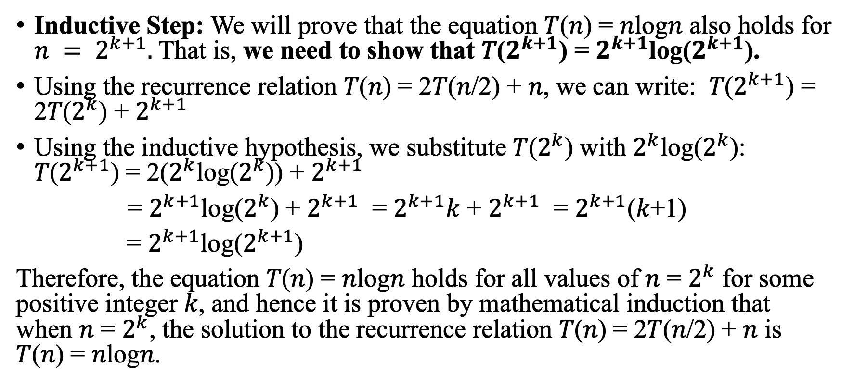
Solution 7
Inductive Step: We will prove that the equation 𝑇(𝑛) = 𝑛log𝑛 also holds for $n = 2^{k+1}.$That is, we need to show that 𝑇($2^{k+1}$) = $2^{k+1}$log($2^{k+1}$).
Using the recurrence relation 𝑇(𝑛) = 2𝑇(𝑛/2) + 𝑛, we can write: 𝑇($2^{k+1}$) = 2𝑇($2^{k}$) + $2^{k+1}$
Using the inductive hypothesis, we substitute 𝑇($2^{k}$) with $2^{k}$log($2^{k}$): 𝑇($2^{k+1}$) = 2($2^{k}$log($2^{k}$)) + $2^{k+1}$
= $2^{k+1}$log($2^{k}$) + $2^{k+1}$ = $2^{k+1}$𝑘 + $2^{k+1}$ = $2^{k+1}$(𝑘+1)
= $2^{k+1}$log($2^{k+1}$)
Therefore, the equation 𝑇(𝑛) = 𝑛log𝑛 holds for all values of 𝑛 = $2^{k}$ for some positive integer 𝑘, and hence it is proven by mathematical induction that when 𝑛 = $2^{k}$, the solution to the recurrence relation 𝑇(𝑛) = 2𝑇(𝑛/2) + 𝑛 is 𝑇(𝑛) = 𝑛log𝑛.

Slide 27
Problem 8
Consider the following algorithm.
ALGORITHM Mystery(n)
//Input: A nonnegative integer n
S ←0
for i ←1 to n do
S ←S + i ∗ i
return S
What does this algorithm compute?
What are its basic operations?
How many times are the basic operations executed?
What is the efficiency class of this algorithm?
Suggest an improvement, or a better algorithm altogether, and indicate its efficiency class.

Slide 28

Solution 8
What does this algorithm compute?
The algorithm computes the sum of the squares of the first n non-negative integers.
S = S+$i^{2}$
//Input: A nonnegative integer n
S ←0
for i ←1 to n do
S ←S + i ∗ i
return S

Slide 29
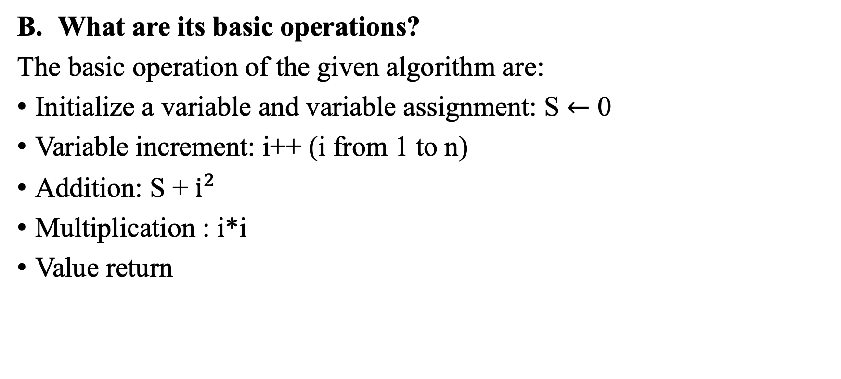
Solution 8
What are its basic operations?
The basic operation of the given algorithm are:
Initialize a variable and variable assignment: S $←$ 0
Variable increment: i++ (i from 1 to n)
Addition: S + $i^{2}$
Multiplication : i*i
Value return
//Input: A nonnegative integer n
S ←0
for i ←1 to n do
S ←S + i ∗ i
return S

Slide 30
Solution 8
How many times are the basic operations executed?
Initialize a variable and variable assignment: once
Variable increment: n times
Addition: n times
Multiplication : n times
Value return: once
//Input: A nonnegative integer n
S ←0
for i ←1 to n do
S ←S + i ∗ i
return S

Slide 31
Solution 8
What is the efficiency class of this algorithm?
The algorithm consists of a single loop that iterates n times.
Within each iteration, a constant number of arithmetic operations (one addition and one multiplication) are performed.
The efficiency class of this algorithm is linear with respect to the input size n (O(n))
//Input: A nonnegative integer n
S ←0
for i ←1 to n do
S ←S + i ∗ i
return S

Slide 32
Solution 8
Suggest an improvement, or a better algorithm altogether, and indicate its efficiency class.
Improvement: use the closed-form formula for the sum of squares of the first n integers: S=n(n+1)(2n+1)/6
Compute the sum of squares in constant time, regardless of the value of n (O(1))
//Input: A nonnegative integer n
S ← n*(n+1)(2n+1)/6
return S

Slide 33
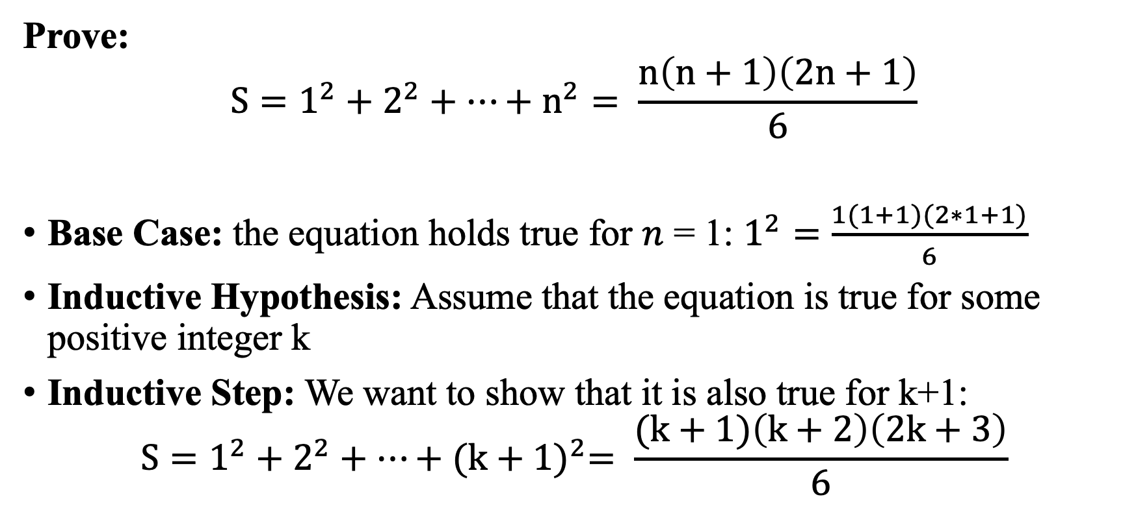
Solution 8
Prove:
$$S=1^{2}+2^{2}+…+n^{2}= \frac{n\left(n+1\right)\left(2n+1\right)}{6}$$
Base Case: the equation holds true for 𝑛 = 1: $1^{2}=\frac{1(1+1)(2∗1+1)}{6}$
Inductive Hypothesis: Assume that the equation is true for some positive integer k
Inductive Step: We want to show that it is also true for k+1:
$$S=1^{2}+2^{2}+…+{(k+1)}^{2}= \frac{(k+1)\left(k+2\right)\left(2k+3\right)}{6}$$

Slide 34
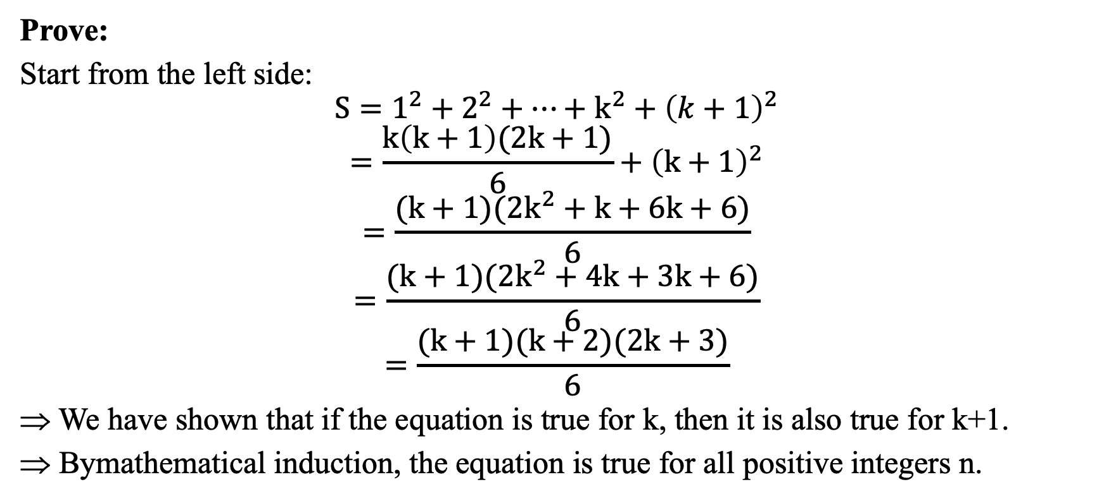
Solution 8
Prove:
Start from the left side:
$$S=1^{2}+2^{2}+…+k^{2}+{\left(k+1\right)}^{2}$$
$$=\frac{k\left(k+1\right)(2k+1)}{6}+{\left(k+1\right)}^{2}$$
$$=\frac{(k+1)(2k^{2}+k+6k+6)}{6}$$
$$=\frac{(k+1)(2k^{2}+4k+3k+6)}{6}$$
$$=\frac{(k+1)(k+2)(2k+3)}{6}$$
We have shown that if the equation is true for k, then it is also true for k+1.
Bymathematical induction, the equation is true for all positive integers n.

Slide 35
Problem 9
Consider the following algorithm.
ALGORITHM Enigma(A[0..n − 1, 0..n − 1])
//Input: A matrix A[0..n − 1, 0..n − 1] of real numbers
for i ←0 to n − 2 do
for j ←i + 1 to n − 1 do
if A[i, j ] ≠ A[j, i]
return false
return true
What does this algorithm compute?
What are its basic operations?
How many times are the basic operations executed?
What is the efficiency class of this algorithm?
Suggest an improvement, or a better algorithm altogether, and indicate its efficiency class.

Slide 36
Solution 9
What does this algorithm compute?
The Enigma algorithm checks whether a given square matrix A[0..n-1, 0..n-1] of real numbers is symmetric, that is, whether A[i,j] = A[j,i] for all i and j in the range 0 to n-1.
Consider the following algorithm.
ALGORITHM Enigma(A[0..n − 1, 0..n − 1])
//Input: A matrix A[0..n − 1, 0..n − 1] of real numbers
for i ←0 to n − 2 do
for j ←i + 1 to n − 1 do
if A[i, j ] ≠ A[j, i]
return false
return true

Slide 37
Solution 9
What are its basic operations?
The basic operation of the given algorithm are:
Initialize an array
Variable increment: i++ (from 1 to n) and j++ (from i+1 to n-1)
Comparison: if A[i, j ] ≠ A[j, i]
Value returns
Consider the following algorithm.
ALGORITHM Enigma(A[0..n − 1, 0..n − 1])
//Input: A matrix A[0..n − 1, 0..n − 1] of real numbers
for i ←0 to n − 2 do
for j ←i + 1 to n − 1 do
if A[i, j ] ≠ A[j, i]
return false
return true

Slide 38
Solution 9
How many times are the basic operations executed?
Initialize an array: once
Variable increment: (n-1) + (n-2) + ... + 1 = n*(n-1)/2 times
Comparison: (n-1) + (n-2) + ... + 1 = n*(n-1)/2 times
Value returns: once
Consider the following algorithm.
ALGORITHM Enigma(A[0..n − 1, 0..n − 1])
//Input: A matrix A[0..n − 1, 0..n − 1] of real numbers
for i ←0 to n − 2 do
for j ←i + 1 to n − 1 do
if A[i, j ] ≠ A[j, i]
return false
return true

Slide 39
Solution 9
What is the efficiency class of this algorithm?
Therefore, the total number of iterations in both loops is: n*(n-1)/2
The time complexity of the algorithm is O(n^2)
The Enigma algorithm belongs to the efficiency class O(n^2), which is the class of quadratic-time algorithms.
Consider the following algorithm.
ALGORITHM Enigma(A[0..n − 1, 0..n − 1])
//Input: A matrix A[0..n − 1, 0..n − 1] of real numbers
for i ←0 to n − 2 do
for j ←i + 1 to n − 1 do
if A[i, j ] ≠ A[j, i]
return false
return true

Slide 40
Solution 9
Suggest an improvement, or a better algorithm altogether, and indicate its efficiency class.
Consider the following algorithm.
ALGORITHM Enigma(A[0..n − 1, 0..n − 1])
//Input: A matrix A[0..n − 1, 0..n − 1] of real numbers
for i ←0 to n − 2 do
for j ←i + 1 to n − 1 do
if A[i, j ] ≠ A[j, i]
return false
return true

