Slide 1
Computing Algorithms – 2801ICT
Workshop 3 – Algorithmic Strategies

Slide 2
Problem 1
A network topology specifies how computers, printers, and other devices are connected over a network. The figure below illustrates three common topologies of networks: the ring, the star, and the fully connected mesh.
You are given a boolean matrix A[0..n − 1, 0..n − 1], where n > 3, which is supposed to be the adjacency matrix of a graph modeling a network with one of these topologies. Your task is to determine which of these three topologies, if any, the matrix represents. Design a brute-force algorithm for this task and indicate its time efficiency class.

Slide 3
Solution 1
Ring Topology:
Each node should have exactly two neighbors
The matrix should be symmetric i.e., A[i,j] = A[j,i] for all i,j
V1 | V2 | V3 | V4
V1
V2
V3
V4
0 | 1 | 0 | 1
1 | 0 | 1 | 0
0 | 1 | 0 | 1
1 | 0 | 1 | 0
Ring Topology
Notes:
Ring Topology: In a ring topology, each device is connected to exactly two other devices, forming a closed loop. To check if the given matrix represents a ring topology, we can check if each row and column has exactly two non-zero entries, and if the non-zero entries form a cyclic pattern.
Check if the given matrix represents a ring topology:
For each row i:
Count the number of non-zero entries.
If the count is not equal to 2, return false.
If the non-zero entries do not form a cyclic pattern, return false.
For each column j:
Count the number of non-zero entries.
If the count is not equal to 2, return false.
If the non-zero entries do not form a cyclic pattern, return false.
If all rows and columns pass the above checks, return true for ring topology.

Slide 4
Solution 1
Star Topology:
One node should be connected to all other nodes
That node should have n-1 edges
V1 | V2 | V3 | V4
V1
V2
V3
V4
0 | 1 | 1 | 1
1 | 0 | 0 | 0
1 | 0 | 0 | 0
1 | 0 | 0 | 0
Star Topology
Notes:
Ring Topology: In a ring topology, each device is connected to exactly two other devices, forming a closed loop. To check if the given matrix represents a ring topology, we can check if each row and column has exactly two non-zero entries, and if the non-zero entries form a cyclic pattern.
Check if the given matrix represents a ring topology:
For each row i:
Count the number of non-zero entries.
If the count is not equal to 2, return false.
If the non-zero entries do not form a cyclic pattern, return false.
For each column j:
Count the number of non-zero entries.
If the count is not equal to 2, return false.
If the non-zero entries do not form a cyclic pattern, return false.
If all rows and columns pass the above checks, return true for ring topology.

Slide 5
Solution 1
Fully Connected Mesh:
Each node should be connected to every other node i.e., A[i,j] = A[j,i] = 1 for all i,j
V1 | V2 | V3 | V4
V1
V2
V3
V4
0 | 1 | 1 | 1
1 | 0 | 1 | 1
1 | 1 | 0 | 1
1 | 1 | 1 | 0
Fully Connected Mesh
Notes:
Ring Topology: In a ring topology, each device is connected to exactly two other devices, forming a closed loop. To check if the given matrix represents a ring topology, we can check if each row and column has exactly two non-zero entries, and if the non-zero entries form a cyclic pattern.
Check if the given matrix represents a ring topology:
For each row i:
Count the number of non-zero entries.
If the count is not equal to 2, return false.
If the non-zero entries do not form a cyclic pattern, return false.
For each column j:
Count the number of non-zero entries.
If the count is not equal to 2, return false.
If the non-zero entries do not form a cyclic pattern, return false.
If all rows and columns pass the above checks, return true for ring topology.

Slide 6
Problem 2
Illustrate the action of the Selection Sort algorithm on the list 89, 45, 68, 90, 29, 34, 17.
Is selection sort stable? Why?
Is it possible to implement selection sort for linked lists with the same Θ(n^2) efficiency as the array version?

Slide 7
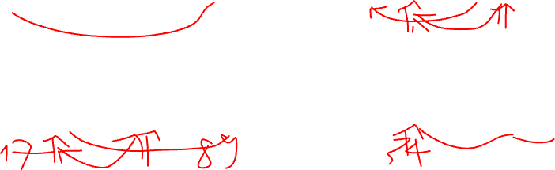
Solution 2
Illustrate the action of the Selection Sort algorithm on the list 89, 45, 68, 90, 29, 34, 17.
Step 3: swap with second element (45) Find minimum (34)
Step 1: Find minimum (17)
89 | 45 | 68 | 90 | 29 | 34 | 17
17 | 29 | 68 | 90 | 45 | 34 | 89
Step 2: swap with first element (89) Find minimum (29)
Step 4: swap with third element (68) Find minimum (45) => … keep doing this
17 | 45 | 68 | 90 | 29 | 34 | 89
17 | 29 | 34 | 90 | 45 | 68 | 89
Notes:
Starting with the first element, find the smallest element in the list.
In this case, the smallest element is 17.
Swap the smallest element with the first element in the list.
The list now becomes: 17, 45, 68, 90, 29, 34, 89.
Move to the second element in the list and repeat steps 1 and 2 for the remaining unsorted elements.
The smallest element in the remaining unsorted elements (45, 68, 90, 29, 34, 89) is 29.
Swap 29 with the second element in the list.
The list now becomes: 17, 29, 68, 90, 45, 34, 89.
Repeat step 3 for the remaining unsorted elements.
The smallest element in the remaining unsorted elements (68, 90, 45, 34, 89) is 34.
Swap 34 with the third element in the list.
The list now becomes: 17, 29, 34, 90, 45, 68, 89.
Repeat step 3 for the remaining unsorted elements.
The smallest element in the remaining unsorted elements (90, 45, 68, 89) is 45.
Swap 45 with the fourth element in the list.
The list now becomes: 17, 29, 34, 45, 90, 68, 89.
Repeat step 3 for the remaining unsorted elements.
The smallest element in the remaining unsorted elements (90, 68, 89) is 68.
Swap 68 with the fifth element in the list.
The list now becomes: 17, 29, 34, 45, 68, 90, 89.
Repeat step 3 for the remaining unsorted elements.
The smallest element in the remaining unsorted elements (90, 89) is 89.
Swap 89 with the sixth element in the list.
The list now becomes: 17, 29, 34, 45, 68, 89, 90.
The list is now sorted.
So the final sorted list is: 17, 29, 34, 45, 68, 89, 90.

Slide 8
Solution 2
Is selection sort stable? Why?
Yes, stable (depends on the comparison)
For example: [2, 1, 3, 2] => [1, 2, 3, 2] => Not stable
A sorting algorithm is said to be stable if it maintains the relative order of equal elements in the input array after sorting
Notes:
No, Selection Sort is not stable.
A sorting algorithm is said to be stable if it maintains the relative order of equal elements in the input array after sorting. That is, if two elements have the same value, their order in the original array should be preserved in the sorted array.
In the Selection Sort algorithm, we find the minimum element and swap it with the first element. In doing so, the relative order of equal elements can be changed. For example, consider the array [2, 1, 3, 2]. After the first iteration of Selection Sort, the array becomes [1, 2, 3, 2]. The two 2s have swapped positions, changing their relative order.
Therefore, Selection Sort is not stable because it does not guarantee to maintain the relative order of equal elements.

Slide 9
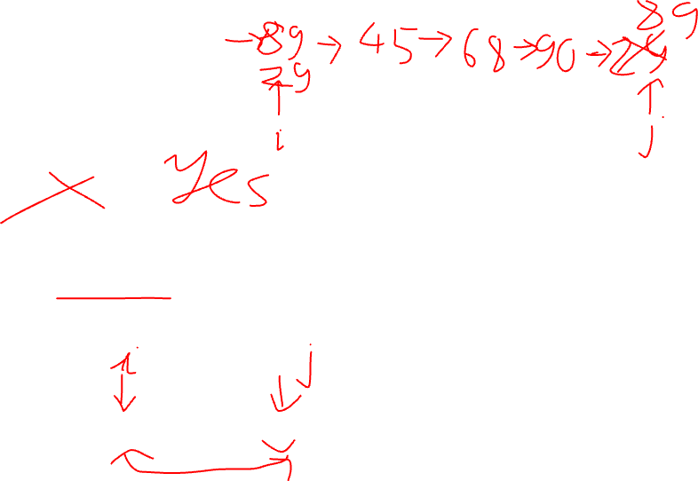
Solution 2
Is it possible to implement selection sort for linked lists with the same Θ(n^2) efficiency as the array version?
No
Selection Sort algorithm requires swapping of elements, which is a constant time operation in an array, but not in a linked list
Swapping two nodes in a linked list requires updating the pointers of the preceding and succeeding nodes, which can take linear time
Swap in O (1)
Swap in O (n): requires update pointers
89 | 45 | 68 | 90 | 29
89
45
68
90
29
Array
Linked list
Notes:
No, it is not possible to implement Selection Sort for linked lists with the same Θ(n^2) efficiency as the array version.
The reason is that Selection Sort algorithm requires swapping of elements, which is a constant time operation in an array, but not in a linked list. Swapping two nodes in a linked list requires updating the pointers of the preceding and succeeding nodes, which can take linear time. Therefore, the time complexity of Selection Sort algorithm for linked lists would be higher than Θ(n^2).
One possible approach to sort a linked list using a Θ(n^2) algorithm is to use the Insertion Sort algorithm. Insertion Sort works by iterating over the list and inserting each element into its correct position in the sorted sublist. This can be done efficiently in a linked list by inserting a node between two existing nodes without the need to move any other nodes around.
Another option is to use a sorting algorithm that is designed for linked lists, such as Merge Sort or Quick Sort. These algorithms have better time complexity than Θ(n^2) and can be implemented efficiently on linked lists.

Slide 10
Problem 3
Alternating disks You have a row of 2n disks of two colours, n dark and n light. They alternate: dark, light, dark, light, and so on. You want to get all the dark disks to the right-hand end, and all the light disks to the left-hand end. The only moves you are allowed to make are those that interchange the positions of two neighbouring disks.
Design an algorithm for solving this puzzle and determine the time complexity.

Slide 11
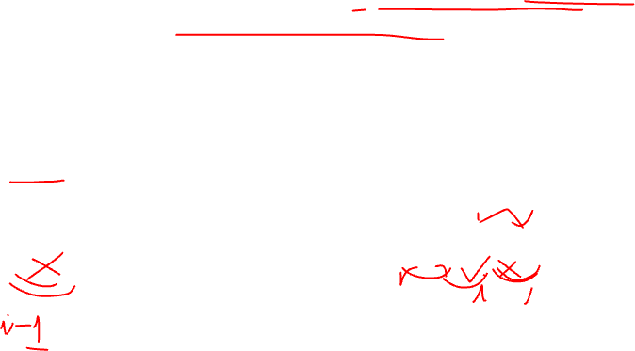
Solution 3
Starting from the left end of the row, scan each pair of adjacent disks and swap them if they are in the wrong order (‘light’ is not on the left of ‘dark’)
Repeat step 1 until no more swaps can be made.
Do nothing
i=0
Swap
i=1
Notes:
Starting from the left end of the row, scan each pair of adjacent disks and swap them if they are in the wrong order (i.e., a light disk is on the left of a dark disk).
Repeat step 1 until no more swaps can be made.
The row is now sorted with all the light disks on the left and all the dark disks on the right.

Slide 12
Solution 3
Starting from the left end of the row, scan each pair of adjacent disks and swap them if they are in the wrong order (‘light’ is not on the left of ‘dark’)
Repeat step 1 until no more swaps can be made.
Do nothing
i=2
i=3
Swap
Notes:
Starting from the left end of the row, scan each pair of adjacent disks and swap them if they are in the wrong order (i.e., a light disk is on the left of a dark disk).
Repeat step 1 until no more swaps can be made.
The row is now sorted with all the light disks on the left and all the dark disks on the right.

Slide 13

Solution 3
Starting from the left end of the row, scan each pair of adjacent disks and swap them if they are in the wrong order (‘light’ is not on the left of ‘dark’)
Repeat step 1 until no more swaps can be made.
Original
After #1 iteration:
After #2 iteration:
After #3 iteration:
Notes:
Starting from the left end of the row, scan each pair of adjacent disks and swap them if they are in the wrong order (i.e., a light disk is on the left of a dark disk).
Repeat step 1 until no more swaps can be made.
The row is now sorted with all the light disks on the left and all the dark disks on the right.

Slide 14
Problem 4
Prove that if bubble sort makes no exchanges on its pass through a list, the list is sorted and the algorithm can be stopped.
Write pseudocode of the method that incorporates this improvement.
Prove that the worst-case efficiency of the improved version is quadratic.
Is bubble sort stable?

Slide 15
Solution 4
Prove that if bubble sort makes no exchanges on its pass through a list, the list is sorted and the algorithm can be stopped.
Assume that the list is not sorted: exist two adjacent elements that are out of order.
Since bubble sort compares adjacent elements: it would have detected this pair of out of order elements and swapped them to put them in the correct order.
Made no exchanges on its pass through the list means: The out of order pair of elements does not exist
The list is sorted and the algorithm can be stopped.
1 | 2 | 4 | 3 | 5

Slide 16
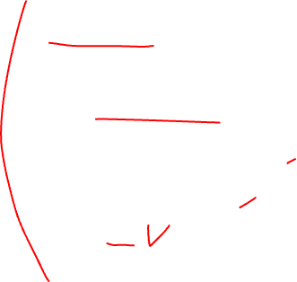
Solution 4
Write pseudocode of the method that incorporates this improvement.
for i ← 0 to n - 2 do
isSorted ← true
for j ← 0 to n - 2 - i do
if A[j + 1] < A[j]
swap A[j] and A[j + 1]
isSorted ← false
if isSorted = true
break

Slide 17




Solution 4
Prove that the worst-case efficiency of the improved version is quadratic.
In the best case (already sorted): can terminate early, O(n).
In the worst case (reverse order): have the same time complexity as the original Bubble Sort, O(n^2).
for i = 0 to n-1: for j = i to n-1: swap()
S = (n-1) + (n-2) + … + 1 = (n - 1) * n / 2 => O(n^2)
$$i=0$$
$$i=1$$
$$i=n−1$$

Slide 18
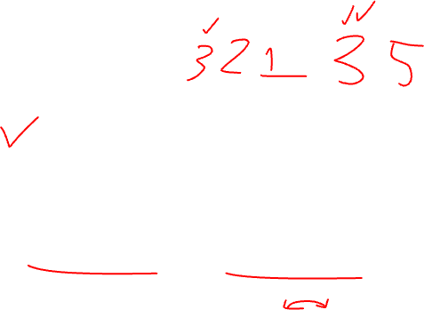
Solution 4
Is bubble sort stable?
Yes
Because it only swaps adjacent elements if they are out of order. If two elements in the input list have the same value, then they will not be swapped
Their relative order will be preserved
1 | 2 | 3 | 3 | 5
Stay the same because not out of order

Slide 19
Problem 5
Write pseudocode for a divide-and-conquer algorithm for finding the position of the largest element in an array of n numbers.
What will be your algorithm’s output for arrays with several elements of the largest value?

Slide 20
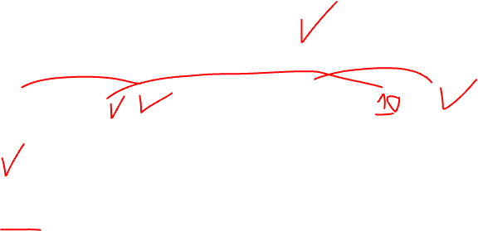
Solution 5
Write pseudocode for a divide-and-conquer algorithm for finding the position of the largest element in an array of n numbers.
Idea: Divide the array into two halves and recursively find the position of the largest element in each half.
4 | 3 | 5 | 8 | 6 | 10
4 | 3 | 5
8 | 6 | 10
4 | 3
5
8 | 6
10
4
3
8
6

Slide 21

Solution 5
Write pseudocode for a divide-and-conquer algorithm for finding the position of the largest element in an array of n numbers.
function find_largest_position(arr, left, right):
if left == right:
return left
else:
mid = (left + right) // 2
left_max_position = find_largest_position(arr, left, mid)
right_max_position = find_largest_position(arr, mid + 1, right)
if arr[left_max_position] >= arr[right_max_position]:
return left_max_position
else:
return right_max_position

Slide 22
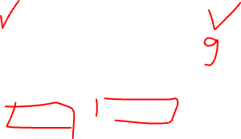
Solution 5
What will be your algorithm’s output for arrays with several elements of the largest value?
Return the position of the first occurrence of the largest element that it encounters during the recursive calls.
9 | 3 | 4 | 9 | 5 | 1
First occurrent

Slide 23
Solution 5
Write pseudocode for a divide-and-conquer algorithm for finding the position of the largest element in an array of n numbers.
function find_largest_position(arr, left, right):
if left == right:
return left
else:
mid = (left + right) // 2
left_max_position = find_largest_position(arr, left, mid)
right_max_position = find_largest_position(arr, mid + 1, right)
if arr[left_max_position] >= arr[right_max_position]:
return left_max_position
else:
return right_max_position

Slide 24
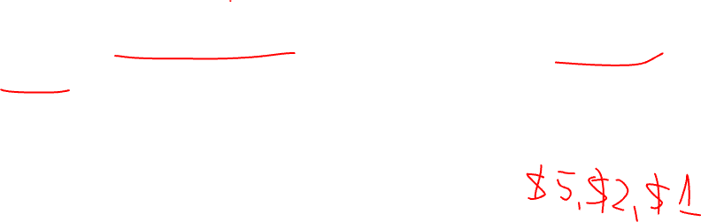
Problem 6
What does dynamic programming have in common with divide-and-conquer? What is a principal difference between them?
Coin change. Given an integer array of coins[] of size N representing different types of currency and an integer sum. The task is to find the number of ways to make sum by using different combinations from coins[]. Compare dynamic programming and recursive algorithm.

Slide 25
Solution 6
What does dynamic programming have in common with divide-and-conquer? What is a principal difference between them?
Common: breaking problems down into smaller subproblems
Difference:
Dynamic programming | Divide and conquer
Solves the sub-problems only once and then stores it in the table. | May solve sub-problems multiple times.
Sub-problems are not independent. | Sub-problems are independent of each other.

Slide 26
Solution 6
Dynamic Programming
Divide and Conquer
for i=1 to n: dict[i] = -1
function F(n)
if (n < 3) return 1
else
if (dict[n] == -1)
dict[n] = F(n-1) + F(n-2)
return dict[n]
function F(n):
if (n < 3) return 1
else
return F(n-1) + F(n-2) }
Sub-problems are independent => Call sub-problems multiple times.
Store solutions of sub-problems, sub-problems are dependent.
Call sub-problems once
F(4): 1 time
F(3): 2 times
F(2): 3 times
F(1): 2 times
F(1) = 1
F(2) = 1
F(3) = F(2) + F(1) = 1 + 1 = 2
F(4) = F(3) + F(2) = 2 + 1 = 3
F(5) = F(4) + F(3) = 3 + 2 = 5
F(5) = F(4) + F(3)
= {F(3)+F(2)} + {F(2)+F(1)}
= {[F(2)+F(1)]+1} + {1+1}
= 1+1+1+1+1 = 5

Slide 27
Solution 6
Coin change. Given an integer array of coins[] of size N representing different types of currency and an integer sum. The task is to find the number of ways to make sum by using different combinations from coins[]. Compare dynamic programming and recursive algorithm.

Slide 28
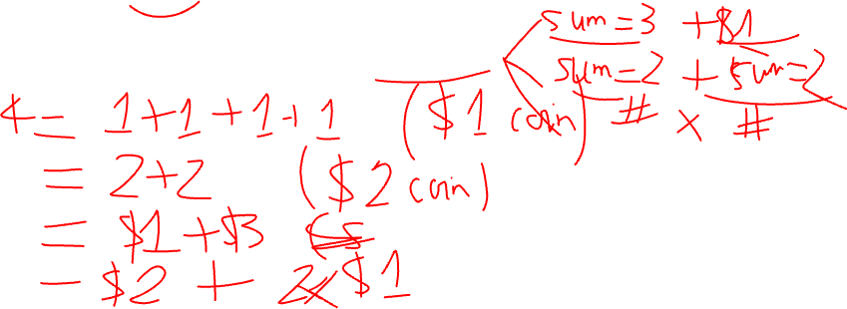
Solution 6
Recursive algorithm
Idea:
Number of ways = number of solutions include coins[i] and exclude coins[i]
For examples: 3 coins [1, 2, 3], sum = 4

Slide 29

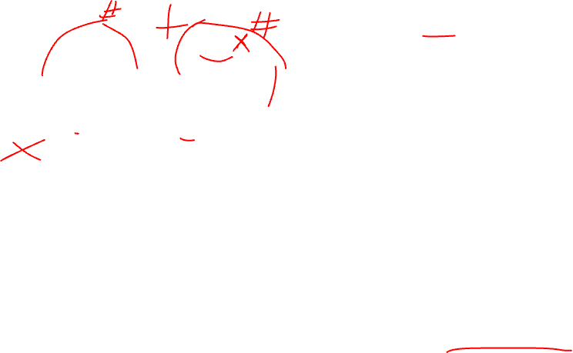
({1, 2, 3}, 4)
Number of ways to make 4 using {1, 2, 3}
= number of ways to make 4 choosing 3 and not choosing 3
Choose 3,
sum remains 1
Not choose 3,
sum remains 4
({1, 2, 3}, 1)
({1, 2, 3}, 4)
Choose 3,
sum remains 1
Not choose 3,
sum remains 1
Number of ways to make 1 using {1, 2, 3}
= number of ways to make 1 choosing 3 and not choosing 3
({1, 2, 3}, -2)
({1, 2}, 1)
Choose 2,
sum remains -1
Not choose 2,
sum remains 1
Number of ways to make 1 using {1, 2}
= number of ways to make 1 choosing 2 and not choosing 2
({1, 2}, -1)
({1}, 1)
Choose 1,
sum remains 0
Not choose 1,
sum remains 1
Number of ways to make 1 using {1}
= number of ways to make 1 choosing 1 and not choosing 1
Sum=0 => Count = 1
({1, 2}, 0)
({}, 1)
No coins
Time complexity: O($2^{n}$)

Slide 30
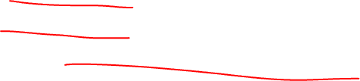
Solution 6
Recursive algorithm
def count(coins, n, total):
if total == 0:
return 1
if total < 0 or n <= 0:
return 0
without_current_coin = count(coins, n - 1, total)
with_current_coin = count(coins, n, total - coins[n-1])
return without_current_coin + with_current_coin

Slide 31
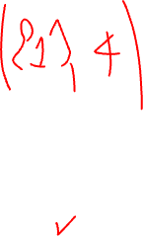
Solution 6
Dynamic programming
sum
Ideas:
Use a table to store solutions
Number of ways = number of solutions include coins[i] and exclude coins[i]
 | 0 | 1 | 2 | 3 | 4
1
2
3
coin

Slide 32
Solution 6
Dynamic programming
sum
Fill in the table number of ways when use coins {1, 2, 3}
 | 0 | 1 | 2 | 3 | 4
1
2
3
coin

Slide 33
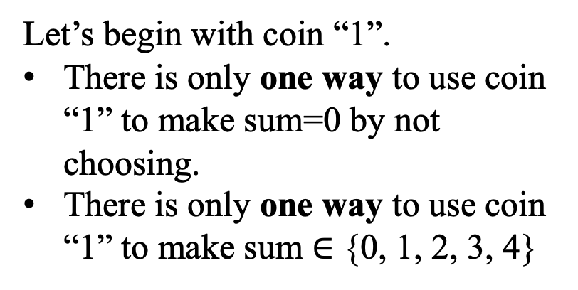
Solution 6
Dynamic programming
sum
Let’s begin with coin “1”.
There is only one way to use coin “1” to make sum=0 by not choosing.
There is only one way to use coin “1” to make sum $∈$ {0, 1, 2, 3, 4}
 | 0 | 1 | 2 | 3 | 4
1 | 1 | 1 | 1 | 1 | 1
coin

Slide 34

Solution 6
Dynamic programming
sum
Introduce coin ‘2’.
There is only one way to use coin “2” and “1” to make sum=0 by not choosing coin “2” and “1”.
 | 0 | 1 | 2 | 3 | 4
1 | 1 | 1 | 1 | 1 | 1
2 | 1
coin

Slide 35

Solution 6
Dynamic programming
sum
There is only one way to use coin “2” and “1” to make sum=1 by choosing one coin “1”.
 | 0 | 1 | 2 | 3 | 4
1 | 1 | 1 | 1 | 1 | 1
2 | 1 | 1
coin

Slide 36
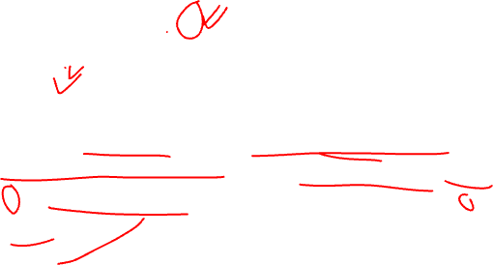
Solution 6
There are two ways to use coin “2” and “1” to make sum=2 by:
Choosing two coins “1”
Choose one coin “2”
The equation is:
Number of ways = number of ways exclude “2” and number of ways include “2”
Dynamic programming
sum
 | 0 | 1 | 2 | 3 | 4
1 | 1 | 1 | 1 | 1 | 1
2 | 1 | 1 | 2
coin
= num_ways exclude 2 + num_ways include 2
= 1 (choose 2 coins “1”) + num_ways make sum (2 - 2)
= 1 + num_ways make sum 0
= 1 + 1
As we include the coin, the ”sum” decreases by the value of coin

Slide 37
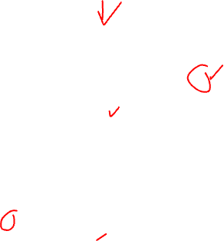
Solution 6
Dynamic programming
There are two ways to use coin “2” and “1” to make sum=3 by:
Choosing three coins “1”
Choose one coin “2” and one coin “1”
sum
 | 0 | 1 | 2 | 3 | 4
1 | 1 | 1 | 1 | 1 | 1
2 | 1 | 1 | 2 | 2
coin
= num_ways exclude 2 + num_ways include 2
= 1 (choose 3 coins “1”) + num_ways make sum (3 - 2)
= 1 + num_ways make sum 1
= 1 + 1
As we include the coin, the ”sum” decreases by the value of coin

Slide 38
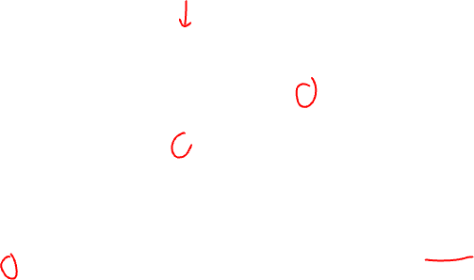
Solution 6
Dynamic programming
There are three ways to use coin “2” and “1” to make sum=4 by:
Choosing four coins “1”
Choose one coin “2” and two coins “1”
Choose two coins “2”
sum
 | 0 | 1 | 2 | 3 | 4
1 | 1 | 1 | 1 | 1 | 1
2 | 1 | 1 | 2 | 2 | 3
coin
= num_ways exclude 2 + num_ways include 2
= 1 (choose 4 coins “1”) + num_ways make sum (4 - 2)
= 1 + num_ways make sum 2
= 1 + 2
As we include the coin, the ”sum” decreases by the value of coin

Slide 39
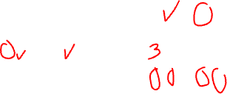
Solution 6
Dynamic programming
sum
 | 0 | 1 | 2 | 3 | 4
1 | 1 | 1 | 1 | 1 | 1
2 | 1 | 1 | 2 | 2 | 3
3 | 1 | 1 | 2 | 3 | 4
Introduce coin “3”
Number of ways make sum=4 using coins {1, 2, 3} is 4
coin
= 2+1
= 3+1

Slide 40
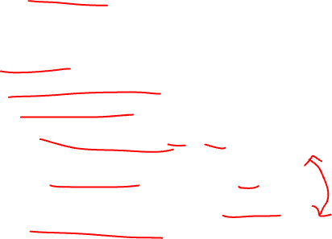
Solution 6
def count_dynamic_programming(coins, n, sum):
table = np.zeros((n, sum+1), dtype=int)
table[:, 0] = 1
for i in range(n):
for j in range(1, sum+1):
if coins[i] > j:
table[i][j] = table[i-1][j]
else:
ways_exclude = table[i-1][j]
ways_include = table[i][j-coins[i]]
table[i][j] = x + y
return table[-1][-1]
Dynamic programming
sum
 | 0 | 1 | 2 | 3 | 4
1 | 1 | 1 | 1 | 1 | 1
2 | 1 | 1 | 2 | 2 | 3
3 | 1 | 1 | 2 | 3 | 4
coin
= 2+1
= 3+1

Slide 41
Problem 7
Write pseudocode of the greedy algorithm for the change-making problem, with an amount n and coin denominations d1>d2 >…>dm as its input. What is the time efficiency class of your algorithm?

Slide 42

Solution 7
Write pseudocode of the greedy algorithm for the change-making problem, with an amount n and coin denominations d1>d2>…>dm as its input. What is the time efficiency class of your algorithm?
The change-making problem addresses the question of finding the minimum number of coins (of certain denominations) that add up to a given amount of money.
For example:
Denominations: [9, 3, 2] (d1>d2>…>dm)
Amount: n = 11
Idea: To minimize the number of coins
Choose the denomination having largest value
If total values > n, choose the next denomination having smaller value
Choose 9 first => solution {9:1, 2:1}
Choose 3 first => solution {3:3, 2:1}

Slide 43
Solution 7
def greedy_change_with_denominations(n, denominations):
num_coins = 0
denominations_used = {}
for denomination in denominations:
while n >= denomination:
n = n - denomination
num_coins += 1
if denomination not in denominations_used: denominations_used[denomination] = 1 else:
denominations_used[denomination] += 1
return denominations_used

Slide 44
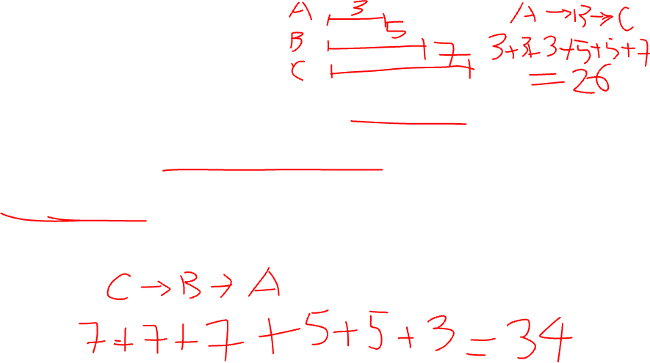
Problem 8
Job scheduling. Consider the problem of scheduling n jobs of known durations t1, t2, . . . , tn for execution by a single processor. The jobs can be executed in any order, one job at a time. You want to find a schedule that minimizes the total time spent by all the jobs in the system. (The time spent by one job in the system is the sum of the time spent by this job in waiting plus the time spent on its execution.)
Design a greedy algorithm for this problem. Does the greedy algorithm always yield an optimal solution?

Slide 45

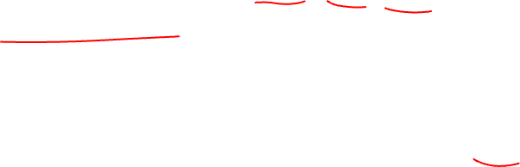



Solution 8
Design a greedy algorithm for this problem.
Example: Three jobs $A,B,C$ with $t_{A}=1,t_{B}=6,t_{C}=10$
If choose C (longest job) first
A done.
If choose C first
Total time = (10+6+1) + (10+6) + (10)
= 43
B done. A wait 6 sec
$$A$$
1
$$B$$
6
$$C$$
C done. A and B wait 10
10

Slide 46


Solution 8
Idea:
Scheduling shorter jobs first to minimize the waiting time.
The shortest job is scheduled first, followed by the second shortest job, and so on.
A done. B and C wait 1 sec
If choose A (shortest job) first
Total time = (1) + (1+6) + (1+6+10)
= 25
$$A$$
1
B done. C wait 6 sec
$$B$$
6
$$C$$
C done.
10

Slide 47
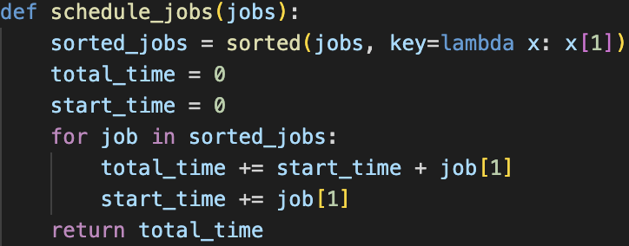
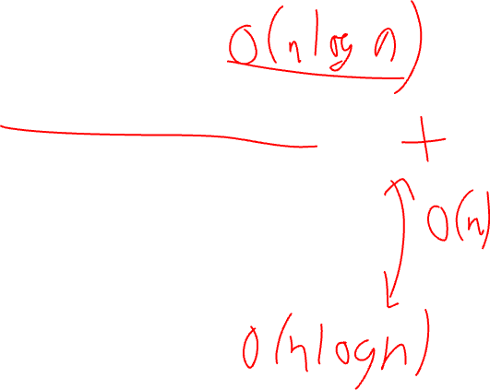
Solution 8
Design a greedy algorithm for this problem.

Slide 48
Solution 8
Does the greedy algorithm always yield an optimal solution?
No, a Greedy algorithm takes optimal solution in each step and it doesn't care about the overall result.

Slide 49
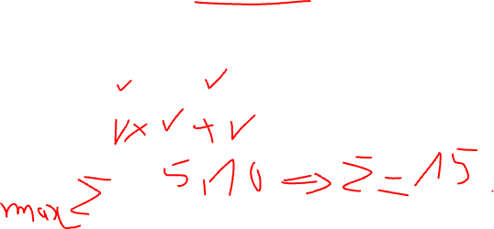
Problem 9
Coin-row problem There is a row of n coins whose values are some positive integers c1, c2, . . . , cn, not necessarily distinct. The goal is to pick up the maximum amount of money subject to the constraint that no two coins adjacent in the initial row can be picked up.
Solve the instance 5, 1, 2, 10, 6 of the coin-row problem.

Slide 50
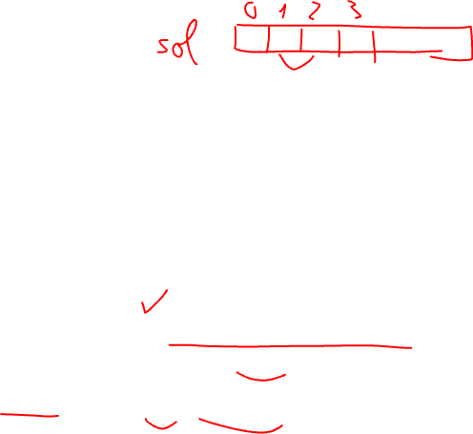
Solution 9
Solve the instance 5, 1, 2, 10, 6 of the coin-row problem.
Idea:
tm[i]: maximum amount of money obtained by picking up coins up to the i-th position
To calculate tm[i]:
Do not pick up the i-th coin: the maximum amount of money that can be obtained is tm[i-1].
Pick up the i-th coin: cannot pick up the i-1-th coin, so the maximum amount of money that can be obtained is c_i + tm[i-2].
tm[i] = max(tm[i-1], c_i + tm[i-2])
See an example…

Slide 51


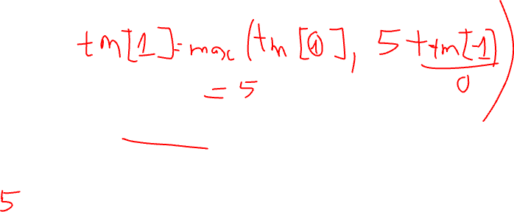

Solution 9
Initialization:
$$tm\left[0\right]=0,tm\left[1\right]=5$$
$$i=0$$
0 | 5 | 1 | 2 | 10 | 6
$$i=1$$

Slide 52
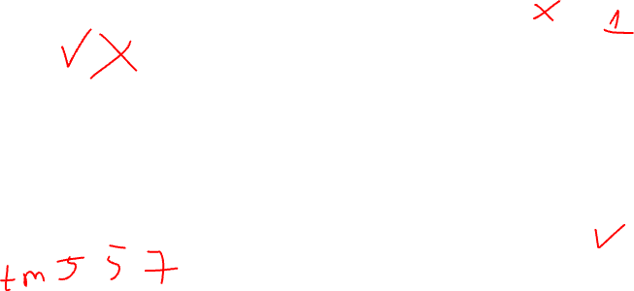
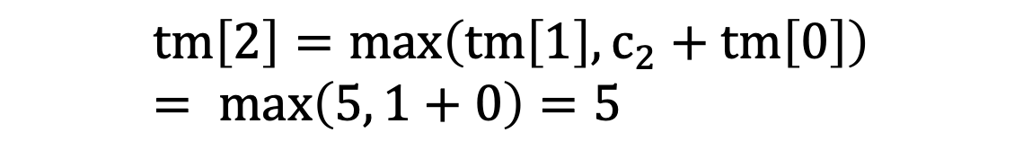


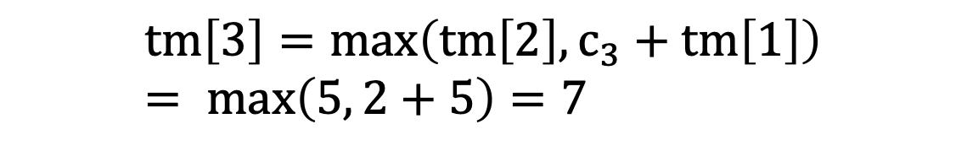

Solution 9
$$tm\left[0\right]=0,tm\left[1\right]=5$$
$$i=2$$
$$tm\left[2\right]=max\left(tm\left[1\right], c_{2}+tm\left[0\right]\right)= max\left(5, 1+0\right)=5$$
5 | 1 | 2 | 10 | 6
$$i=3$$
$$tm\left[3\right]=max\left(tm\left[2\right], c_{3}+tm\left[1\right]\right)= max\left(5, 2+5\right)=7$$
5 | 1 | 2 | 10 | 6

Slide 53
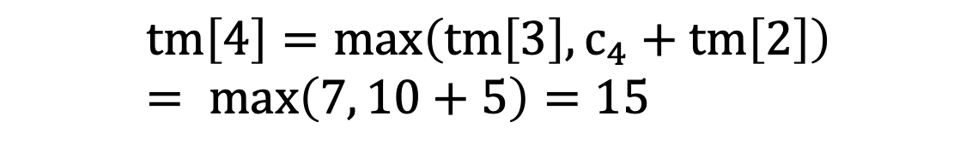
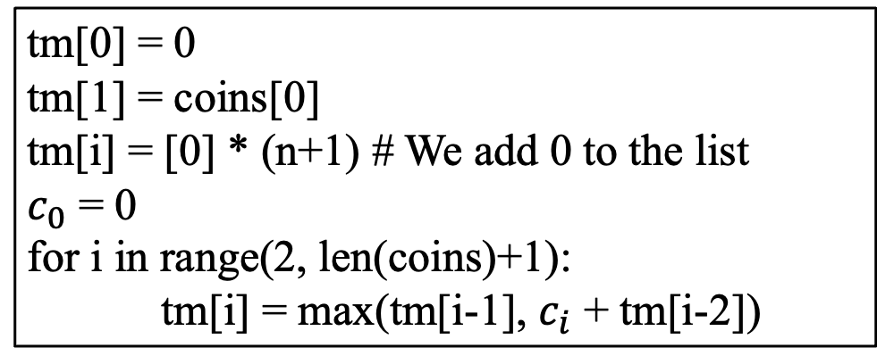

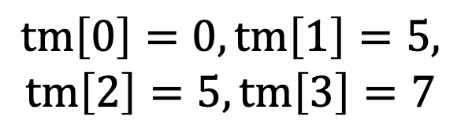
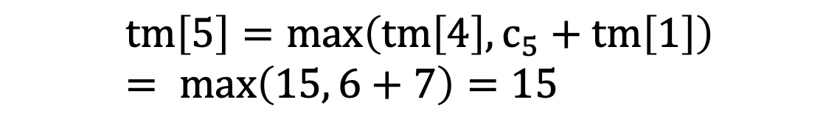

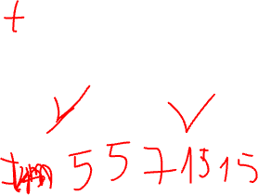
Solution 9
$$tm\left[0\right]=0,tm\left[1\right]=5,$$
$$tm\left[2\right]=5,tm\left[3\right]=7$$
$$i=4$$
$$tm\left[4\right]=max\left(tm\left[3\right], c_{4}+tm\left[2\right]\right)= max\left(7, 10+5\right)=15$$
5 | 1 | 2 | 10 | 6
$$i=5$$
$$tm\left[5\right]=max\left(tm\left[4\right], c_{5}+tm\left[1\right]\right)= max\left(15, 6+7\right)=15$$
5 | 1 | 2 | 10 | 6
tm[0] = 0
tm[1] = coins[0]
tm[i] = [0] * (n+1) # We add 0 to the list
$c_{0}$ = 0
for i in range(2, len(coins)+1):
tm[i] = max(tm[i-1], $c_{i}$ + tm[i-2])
Maximum amount of money: 15

