Slide 1
Computing Algorithms – 2801ICT
Week 9&10 – Graph algorithms

Slide 2
Problem 1
Apply Prim’s algorithm to the following graph. Include in the priority queue all the vertices not already in the tree.
5
a
b
2
3
7
e
6
4
5
c
d
4

Slide 3
Problem 1
Apply Prim’s algorithm to the following graph. Include in the priority queue only the fringe vertices (the vertices not in the current tree which are adjacent to at least one tree vertex).
3
a
b
6
5
4
3
2
1
2
c
d
e
f
4
5
4
5
3
6
3
g
h
i
j
7
5
6
9
k
l
8

Slide 4
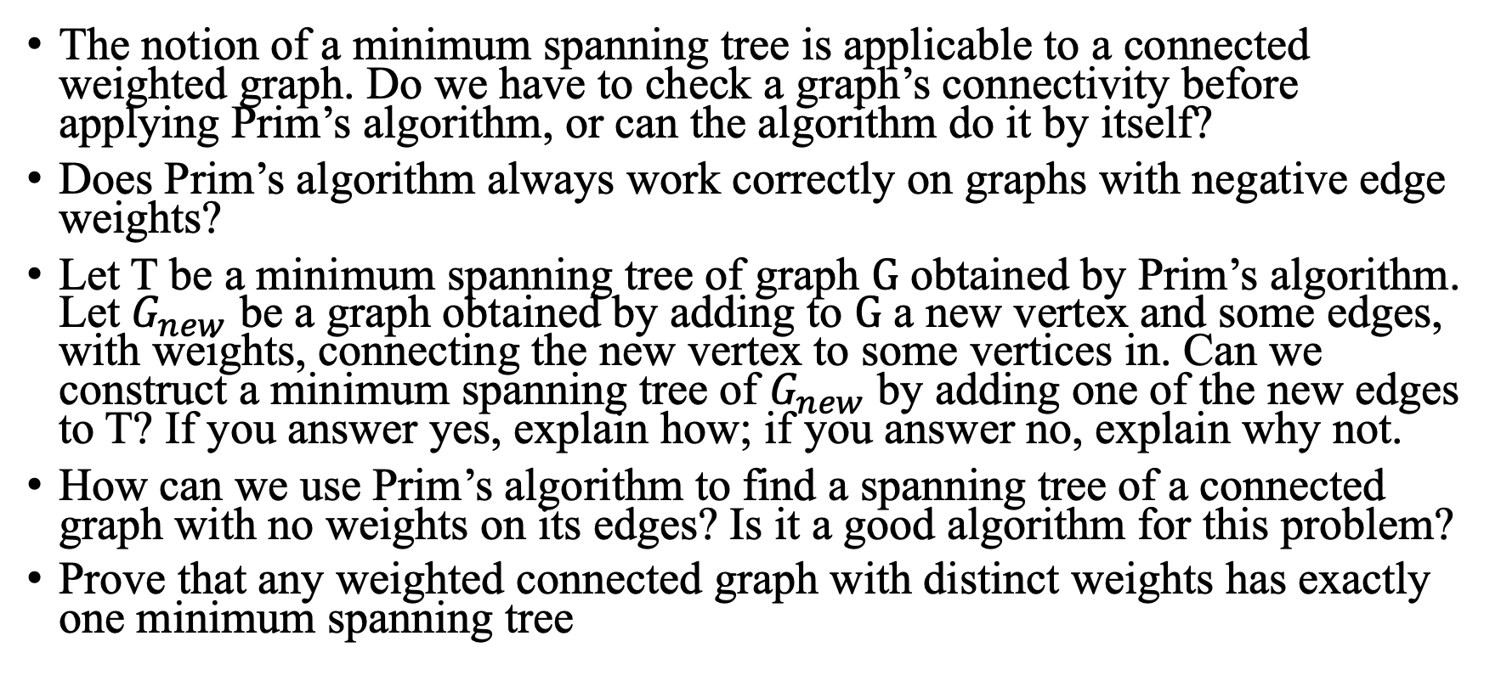
Problem 1
The notion of a minimum spanning tree is applicable to a connected weighted graph. Do we have to check a graph’s connectivity before applying Prim’s algorithm, or can the algorithm do it by itself?
Does Prim’s algorithm always work correctly on graphs with negative edge weights?
Let T be a minimum spanning tree of graph $G$ obtained by Prim’s algorithm. Let $G_{new}$ be a graph obtained by adding to $G$ a new vertex and some edges, with weights, connecting the new vertex to some vertices in. Can we construct a minimum spanning tree of $G_{new}$ by adding one of the new edges to T? If you answer yes, explain how; if you answer no, explain why not.
How can we use Prim’s algorithm to find a spanning tree of a connected graph with no weights on its edges? Is it a good algorithm for this problem?
Prove that any weighted connected graph with distinct weights has exactly one minimum spanning tree

Slide 5
Solution 1
The notion of a minimum spanning tree is applicable to a connected weighted graph. Do we have to check a graph’s connectivity before applying Prim’s algorithm, or can the algorithm do it by itself?
The algorithm does not explicitly check for connectivity But we can infer the connectivity status from the result:
If the number of vertices in the resulting MST = total number of vertices in the original graph => connected.
If the number is smaller, the graph has multiple connected components.
To ensure the connectivity of the graph before applying Prim's algorithm
Use a graph traversal algorithm: Depth-First Search (DFS) or Breadth-First Search (BFS) to check if all vertices are reachable from a starting point.
If all vertices can be visited, the graph is connected. If not, the graph is not connected and applying Prim's algorithm will only generate an MST for the connected subgraph.

Slide 6
Solution 1
Does Prim’s algorithm always work correctly on graphs with negative edge weights?
Yes
The algorithm doesn't depend on the positivity of edge weights; it only requires the graph to be connected and undirected.
The goal of the algorithm is to find the minimum spanning tree, which is the tree that connects all the vertices in the graph with the smallest total edge weight. Negative edge weights do not affect the correctness of the algorithm.

Slide 7
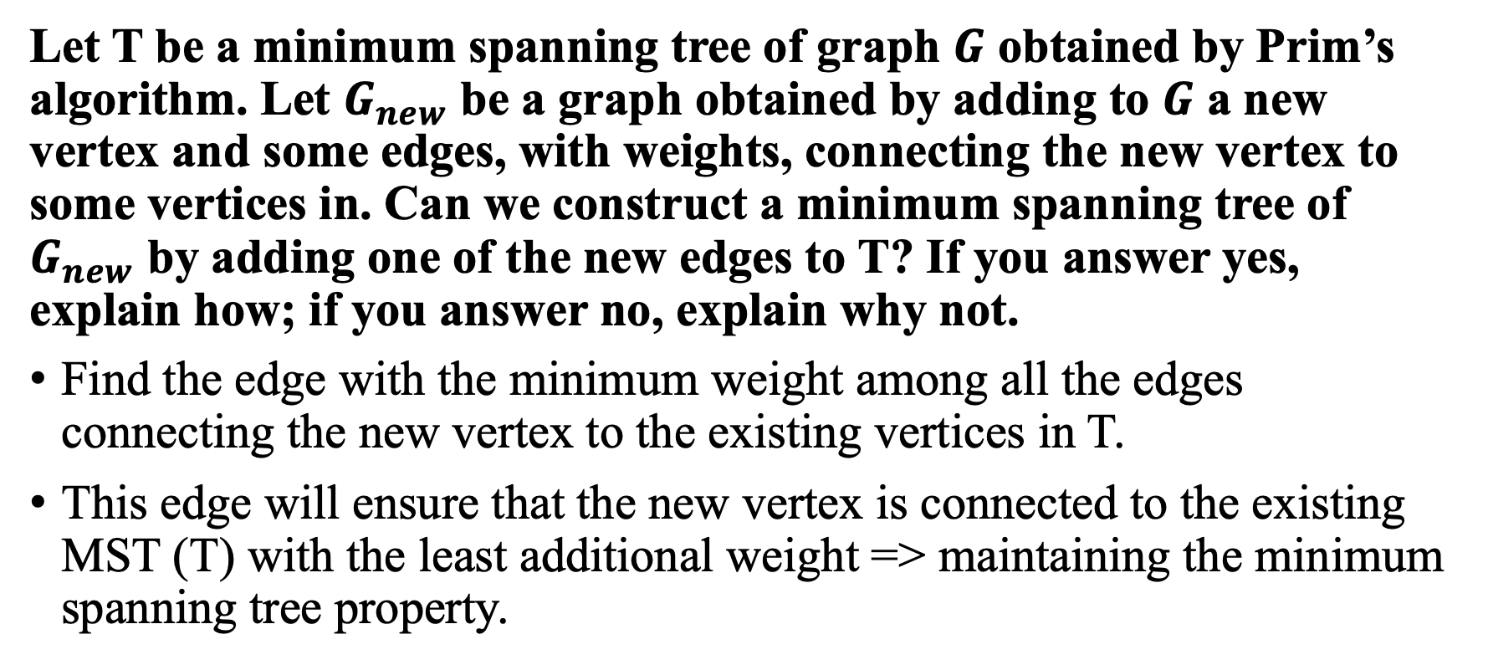
Solution 1
Let T be a minimum spanning tree of graph $G$ obtained by Prim’s algorithm. Let $G_{new}$ be a graph obtained by adding to $G$ a new vertex and some edges, with weights, connecting the new vertex to some vertices in. Can we construct a minimum spanning tree of $G_{new}$ by adding one of the new edges to T? If you answer yes, explain how; if you answer no, explain why not.
Find the edge with the minimum weight among all the edges connecting the new vertex to the existing vertices in T.
This edge will ensure that the new vertex is connected to the existing MST (T) with the least additional weight => maintaining the minimum spanning tree property.

Slide 8
Solution 1
How can we use Prim’s algorithm to find a spanning tree of a connected graph with no weights on its edges? Is it a good algorithm for this problem?
Treat all the edges as if they have the same weight (e.g., assign all edges a weight of 1 or any constant). Since all edges have equal weight, the algorithm will still be able to find a spanning tree.
It may not be the most efficient algorithm for this problem. Both Depth-First Search (DFS) and Breadth-First Search (BFS) can find a spanning tree in linear time O(|V|+|E|) ( |V|: vertices, |E|: edges)
For an unweighted graph, it's generally more efficient to use DFS or BFS to find a spanning tree.

Slide 9
Solution 1
Prove that any weighted connected graph with distinct weights has exactly one minimum spanning tree
Use a proof by contradiction.
Let's assume that there are two different minimum spanning trees, T1 and T2, for the graph G.

Slide 10
Solution 1
x
u
y
T1
v
T2
Let (u, v) be the edge with the smallest weight that is present in T1 but not in T2.
Let (x, y) be the edge with the smallest weight that is present in T2 but not in T1.

Slide 11
Solution 1
x
y
u
T2
v
Let's consider adding edge (u, v) to T2
Without loss of generality: The weight of (u, v) must be smaller than the weight of (x, y).

Slide 12
Solution 1
u
T3
v
Weight of (u, v) < weight of (x, y) => the total weight of T3 is smaller than the total weight of T2.
This contradicts the assumption that T2 is a minimum spanning tree, as we found a spanning tree with a smaller weight.

Slide 13
Problem 2
Apply Kruskal’s algorithm to find a minimum spanning tree of the graph given in problem 1(B).
Indicate whether the following statements are true or false:
If e is a minimum-weight edge in a connected weighted graph, it must be among edges of at least one minimum spanning tree of the graph.
If e is a minimum-weight edge in a connected weighted graph, it must be among edges of each minimum spanning tree of the graph.
If edge weights of a connected weighted graph are all distinct, the graph must have exactly one minimum spanning tree.
If edge weights of a connected weighted graph are not all distinct, the graph must have more than one minimum spanning tree
Does Kruskal’s algorithm work correctly on graphs that have negative edge weights?
Design an algorithm for finding a maximum spanning tree—a spanning tree with the largest possible edge weight—of a weighted connected graph.
Prove the correctness of Kruskal’s algorithm

Slide 14
Solution 2
Indicate whether the following statements are true or false
If e is a minimum-weight edge in a connected weighted graph, it must be among edges of at least one minimum spanning tree of the graph.
True. This is because adding the minimum-weight edge to the tree would not create a cycle, and it would contribute the least possible additional weight to the MST.

Slide 15
Solution 2
Indicate whether the following statements are true or false
If e is a minimum-weight edge in a connected weighted graph, it must be among edges of each minimum spanning tree of the graph.
False. While it is true that e would be in at least one MST, there could be other MSTs in the graph that don't include e but still have the same total weight.

Slide 16
Solution 2
Indicate whether the following statements are true or false
If edge weights of a connected weighted graph are all distinct, the graph must have exactly one minimum spanning tree.
True. This can be proved by contradiction, as shown in the Solution 1.

Slide 17
Solution 2
Indicate whether the following statements are true or false
If edge weights of a connected weighted graph are not all distinct, the graph must have more than one minimum spanning tree.
True. If edge weights of a connected weighted graph are not all distinct, meaning there are multiple edges with the same weight, the graph may have more than one minimum spanning tree.

Slide 18
Solution 2
Does Kruskal’s algorithm work correctly on graphs that have negative edge weights?
Yes
The algorithm does not rely on the edge weights being positive; it only requires sorting the edges by their weights and iteratively adding the next smallest edge to the growing forest if it doesn't create a cycle.

Slide 19
Solution 2
Design an algorithm for finding a maximum spanning tree—a spanning tree with the largest possible edge weight—of a weighted connected graph.
To find the maximum spanning tree (MST) of a weighted connected graph => adapt the existing Kruskal's algorithm or Prim's algorithm by making a simple modification.
Kruskal’s: Instead of sorting the edges in increasing order by their weights, sort them in decreasing order (i.e., largest to smallest). The rest of the algorithm remains the same.

Slide 20
Solution 2
Prove the correctness of Kruskal’s algorithm
we need to show that the algorithm always returns a minimum spanning tree (MST) for a connected, undirected, weighted graph => use two properties of MSTs to prove this:
Cut property: For any cut (a partition of vertices into two disjoint sets) in the graph, the lightest edge crossing the cut (connecting the two sets) is in the MST, assuming no two edges have the same weight.
Cycle property: For any cycle in the graph, the heaviest edge in the cycle is not part of the MST.
Kruskal's algorithm works by iteratively selecting the next lightest edge that does not form a cycle with the edges already in the MST.

Slide 21
Solution 2
Base case: When the algorithm starts, no edges have been selected, and the MST is an empty set. This is a valid MST for a graph with no vertices.
Inductive step: Assume that the algorithm has constructed an MST up to step k, which we will denote as T. We will prove that the algorithm constructs a valid MST at step k+1.
Let T' be the partial tree after the k+1 step, and let e be the edge added in the k+1 step. We will show that T' is also an MST.

Slide 22
Solution 2
T' is connected and acyclic: Since e was chosen such that it does not form a cycle with the edges in T, T' remains acyclic. As the algorithm selects the next lightest edge that connects two previously disconnected components of T, T' remains connected.
T' has the correct number of edges: After the k+1 step, T' has k+1 edges, one more than T.

Slide 23
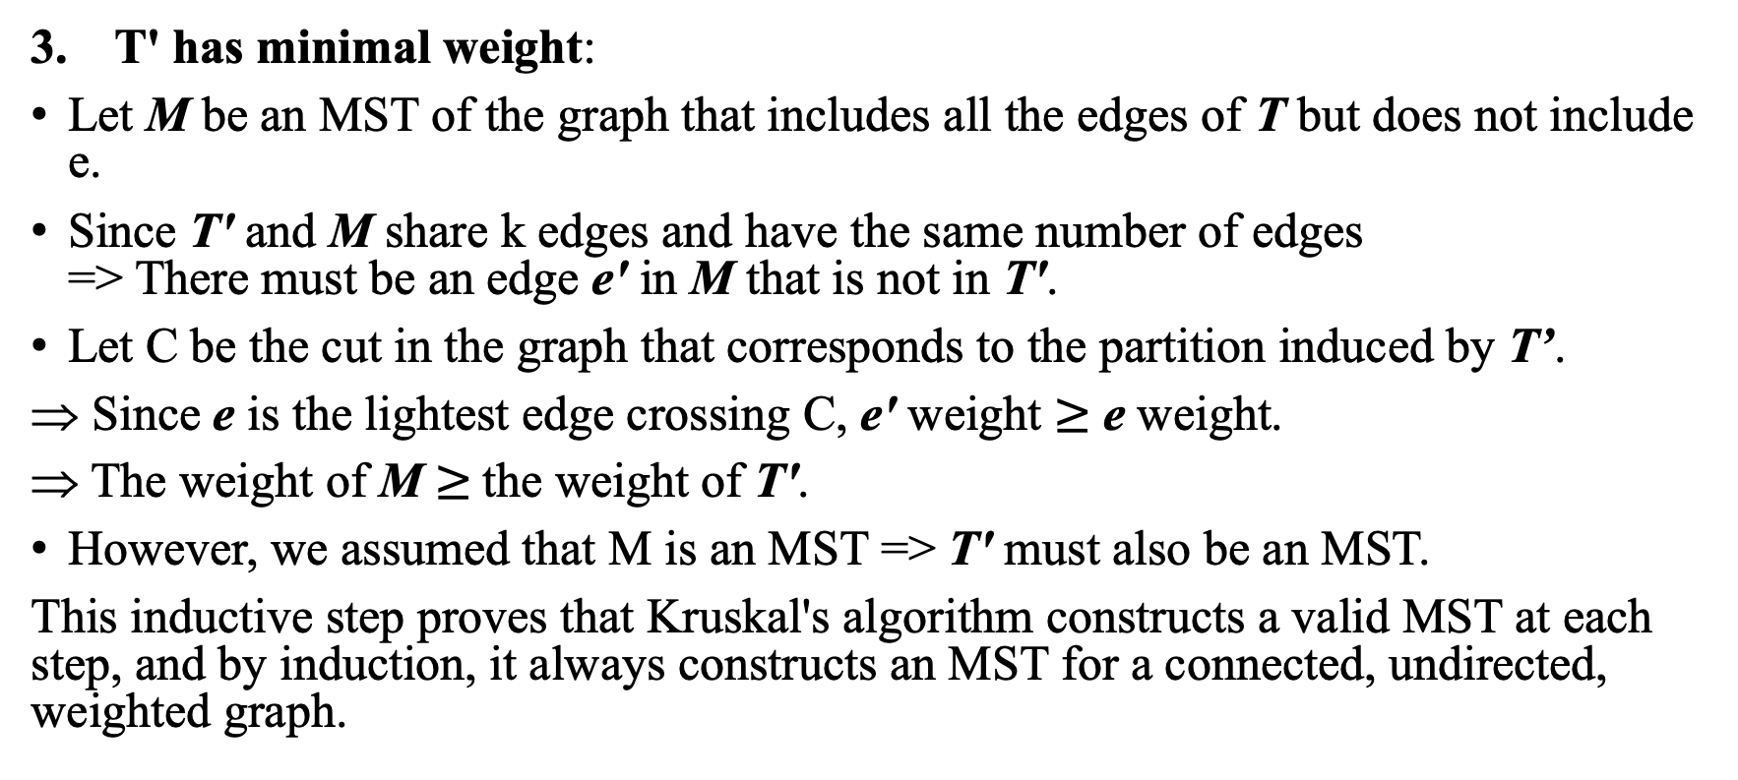
Solution 2
T' has minimal weight:
Let M be an MST of the graph that includes all the edges of T but does not include e.
Since T' and M share k edges and have the same number of edges => There must be an edge e' in M that is not in T'.
Let C be the cut in the graph that corresponds to the partition induced by T’.
Since e is the lightest edge crossing C, e' weight $≥$ e weight.
The weight of M $≥$the weight of T'.
However, we assumed that M is an MST => T' must also be an MST.
This inductive step proves that Kruskal's algorithm constructs a valid MST at each step, and by induction, it always constructs an MST for a connected, undirected, weighted graph.

Slide 24
Problem 3
Solve the following instances of the single-source shortest-paths problem with vertex a as the source for the graph given in problem 1(B).
Give a counterexample that shows that Dijkstra’s algorithm may not work for a weighted connected graph with negative weights.
Prove the correctness of Dijkstra’s algorithm for graphs with positive weights.

Slide 25
Solution 3
Give a counterexample that shows that Dijkstra’s algorithm may not work for a weighted connected graph with negative weights.
A
Selects the unvisited node with the lowest distance, which is node A with a distance of 0.
Node A has two neighbours, B and D. The distance to B is updated to 1(0+1) and the distance to D is updated to 10(0+10).
B: next unvisited node with the lowest distance. The distance to C is updated to 3(1+2) and the distance to E is updated to 0(1-1).
E, C, D: next unvisited node with the lowest distance. No neighbouring nodes need updating.
(1)
(10)
B
D
(-1)
(0)
E
(2)
C

Slide 26
Solution 3
Give a counterexample that shows that Dijkstra’s algorithm may not work for a weighted connected graph with negative weights.
A
(1)
(10)
Dijkstra's algorithm yields the following shortest distances from node A:
A: 0
B: 1
C: 3
D: 10
E: 0
B
D
(-1)
(0)
E
(2)
C

Slide 27
Solution 3
Give a counterexample that shows that Dijkstra’s algorithm may not work for a weighted connected graph with negative weights.
A
(1)
(10)
However, the correct shortest path from A to D should be A->B->E->D, with a total cost of 0 (1-1+10+0)
B
D
(-1)
(0)
E
(2)
C

Slide 28
Solution 3
Prove the correctness of Dijkstra’s algorithm for graphs with positive weights.
We'll show that the algorithm maintains the invariant property that at each iteration, it correctly identifies the shortest path from the source node to the current node.
Invariant Property: At each iteration, Dijkstra's algorithm computes the correct shortest path distance from the source node s to the currently selected node v.
Base Case: The algorithm starts by selecting the source node s. The shortest distance from s to itself is 0, which is trivially true.
Inductive Hypothesis: Assume that for all nodes u, the algorithm correctly computes the shortest path distance from the source node s to node u. We will show that this property holds for the next unvisited node v with the minimum distance value.

Slide 29
Solution 3
Inductive Step:
1. When the algorithm selects the next unvisited node v with the minimum distance value, it means that all other unvisited nodes have distance values greater than or equal to the distance value of v.
2. If there was a shorter path from the source node s to node v, that path would pass through an intermediate unvisited node w.
3. By the inductive hypothesis, we have already found the shortest path distance from s to w.
4. Since all edge weights are positive, the path from s to v through w would have a distance greater than the current distance value of v. This contradicts our assumption that there was a shorter path from s to v through w.
5. Therefore, the algorithm has found the correct shortest path distance from s to v.

Slide 30
Problem 4
Explain what adjustments if any need to be made in Dijkstra’s algorithm and/or in an underlying graph to solve the following problems.
Solve the single-source shortest-paths problem for directed weighted graphs.
Find a shortest path between two given vertices of a weighted graph or digraph.
Find the shortest paths to a given vertex from each other vertex of a weighted graph or digraph.

Slide 31
Solution 4
Solve the single-source shortest-paths problem for directed weighted graphs.
Dijkstra's algorithm is already designed to solve the single-source shortest-paths problem for directed weighted graphs with non-negative edge weights.

Slide 32
Solution 4
Find a shortest path between two given vertices of a weighted graph or digraph.
Make a minor adjustment to the algorithm to stop the search once the target vertex has been visited.
All steps in Dijkstra’s algorithms are the same except that we don’t need to visit all unvisited nodes.

Slide 33
Solution 4
Find the shortest paths to a given vertex from each other vertex of a weighted graph or digraph.
Use a reverse version of Dijkstra's algorithm. First, reverse the direction of all edges in the graph, then run Dijkstra's algorithm with the target vertex as the source node.

Slide 34
Problem 5
Consider the following graph.
f
b
c
g
d
a
e

Slide 35
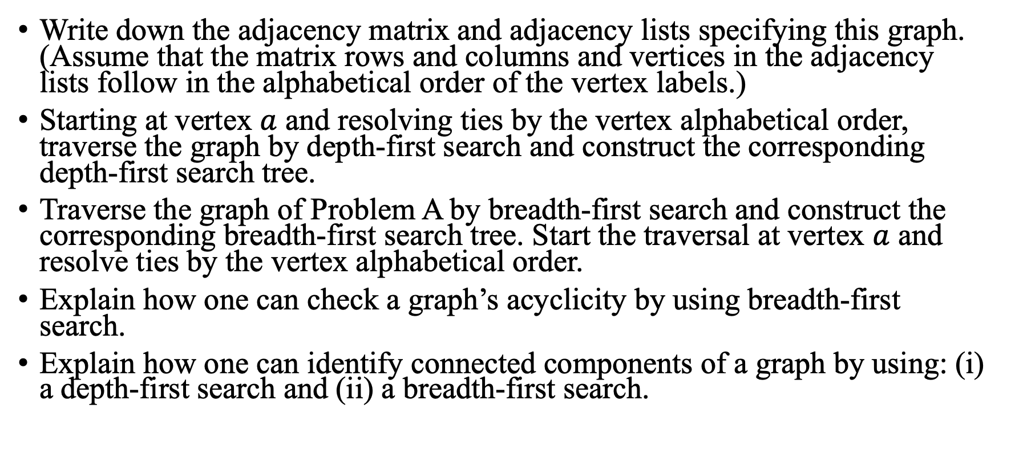
Problem 5
Write down the adjacency matrix and adjacency lists specifying this graph. (Assume that the matrix rows and columns and vertices in the adjacency lists follow in the alphabetical order of the vertex labels.)
Starting at vertex $a$ and resolving ties by the vertex alphabetical order, traverse the graph by depth-first search and construct the corresponding depth-first search tree.
Traverse the graph of Problem A by breadth-first search and construct the corresponding breadth-first search tree. Start the traversal at vertex $a$ and resolve ties by the vertex alphabetical order.
Explain how one can check a graph’s acyclicity by using breadth-first search.
Explain how one can identify connected components of a graph by using: (i) a depth-first search and (ii) a breadth-first search.

Slide 36
Solution 5
Write down the adjacency matrix and adjacency lists specifying this graph. (Assume that the matrix rows and columns and vertices in the adjacency lists follow in the alphabetical order of the vertex labels.)
 | A | B | C | D | E | F | G
A | 0 | 1 | 1 | 1 | 1 | 0 | 0
B | 1 | 0 | 0 | 1 | 0 | 1 | 0
C | 1 | 0 | 0 | 0 | 0 | 0 | 1
D | 1 | 1 | 0 | 0 | 0 | 1 | 0
E | 1 | 0 | 0 | 0 | 0 | 0 | 1
F | 0 | 1 | 0 | 1 | 0 | 0 | 0
G | 0 | 0 | 1 | 0 | 1 | 0 | 0
Adjacency matrix

Slide 37
Solution 5
Write down the adjacency matrix and adjacency lists specifying this graph. (Assume that the matrix rows and columns and vertices in the adjacency lists follow in the alphabetical order of the vertex labels.)
A: [B, C, D, E]
B: [A, D, F]
C: [A, G]
D: [A, B, F]
E: [A, G]
F: [B, D]
G: [C, E]
Adjacency list

Slide 38
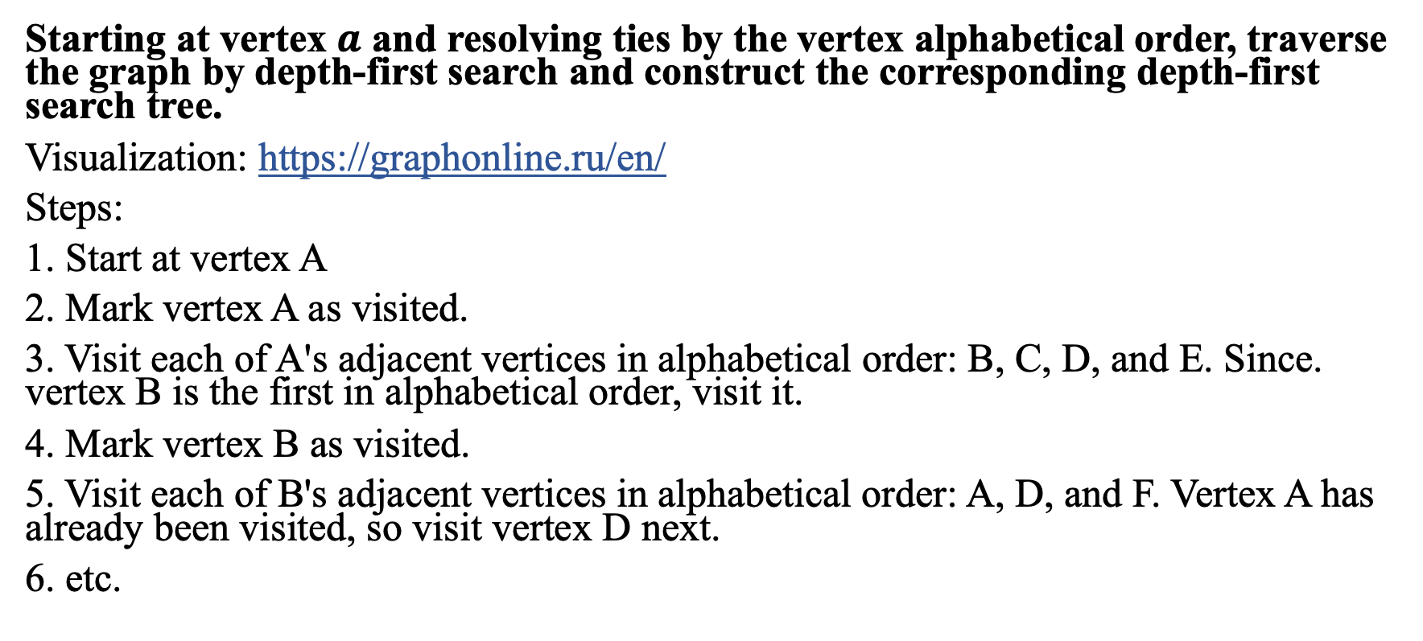
Solution 5
Starting at vertex $a$ and resolving ties by the vertex alphabetical order, traverse the graph by depth-first search and construct the corresponding depth-first search tree.
Visualization: https://graphonline.ru/en/
Steps:
1. Start at vertex A
2. Mark vertex A as visited.
3. Visit each of A's adjacent vertices in alphabetical order: B, C, D, and E. Since. vertex B is the first in alphabetical order, visit it.
4. Mark vertex B as visited.
5. Visit each of B's adjacent vertices in alphabetical order: A, D, and F. Vertex A has already been visited, so visit vertex D next.
6. etc.

Slide 39
Solution 5
The DFS traversal order is: A, B, D, F, C, G, E
A
B
C
E
D
G
F

Slide 40
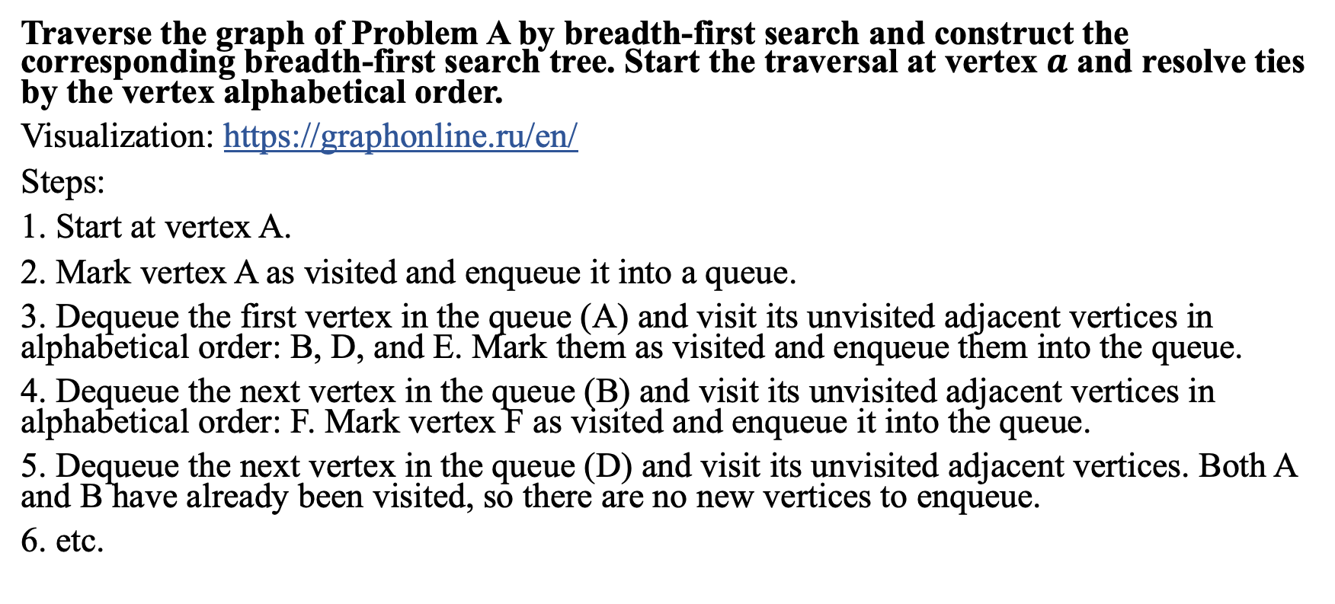
Solution 5
Traverse the graph of Problem A by breadth-first search and construct the corresponding breadth-first search tree. Start the traversal at vertex $a$ and resolve ties by the vertex alphabetical order.
Visualization: https://graphonline.ru/en/
Steps:
1. Start at vertex A.
2. Mark vertex A as visited and enqueue it into a queue.
3. Dequeue the first vertex in the queue (A) and visit its unvisited adjacent vertices in alphabetical order: B, D, and E. Mark them as visited and enqueue them into the queue.
4. Dequeue the next vertex in the queue (B) and visit its unvisited adjacent vertices in alphabetical order: F. Mark vertex F as visited and enqueue it into the queue.
5. Dequeue the next vertex in the queue (D) and visit its unvisited adjacent vertices. Both A and B have already been visited, so there are no new vertices to enqueue.
6. etc.

Slide 41
Solution 5
The BFS traversal order is: A, B, D, E, F, G, C
A
B
D
E
F
G
C

Slide 42
Solution 5
Explain how one can check a graph’s acyclicity by using breadth-first search.
Modify the BFS algorithm slightly to track the number of nodes visited, and simultaneously check for back edges. If a back edge is found during the BFS traversal, it means the graph contains a cycle. Otherwise, it's acyclic.

Slide 43








Problem 6
Run the Bellman-Ford shortest path algorithm on the following graph, starting from vertex $s$.
e
-8
$$∞$$
2
d
f
1
$$∞$$
$$∞$$
0
b
5
-3
$$∞$$
-3
8
-1
$$∞$$
4
$$∞$$
a
3
c
6
$$∞$$
s

Slide 44
Problem 6
Suppose you are given a directed graph that has negative values on some of the edges. The Bellman Ford algorithm will give the correct solution for shortest paths from some starting vertex s, if there are no negative cycles. But suppose you don’t know if the given graph has negative cycles. One way to check for negative cycles is to run Bellman Ford for n iterations, instead of n-1. Explain.

Slide 45
Solution 6
Suppose you are given a directed graph that has negative values on some of the edges. The Bellman Ford algorithm will give the correct solution for shortest paths from some starting vertex s, if there are no negative cycles. But suppose you don’t know if the given graph has negative cycles. One way to check for negative cycles is to run Bellman Ford for n iterations, instead of n-1. Explain.

Slide 46
Solution 6
After (n-1) iterations, where n is the number of vertices, all shortest paths from the starting vertex s to all other vertices should have been found (as the longest acyclic path can have at most (n-1) edges)
By running the Bellman-Ford algorithm for n iterations, one extra iteration compared to the usual (n-1), we can check for negative cycles. If after the nth iteration, any of the shortest path estimates still improve (i.e., the distance to any vertex is updated), this implies that a negative cycle is reachable from the starting vertex s.
This is because the extra iteration should not be able to further improve any path estimates unless a cycle with a negative total weight is traversed.

Slide 47
Problem 7
For the directed graph below, give a topological ordering of the vertices.
State a concise sufficient and necessary condition for when two vertices in a DAG can be in either order in a topological sort. (In other words, either one of them can be first in a valid topological sort of that DAG).
A
B
C
D
E
F
G

Slide 48
Solution 7
For the directed graph below, give a topological ordering of the vertices.
To find a topological ordering of the vertices, you can use a modified depth-first search (DFS) called Topological Sort
A
B
C
D
E
F
G

Slide 49
Solution 7
1. Perform a DFS from vertex A, and mark A as visited.
2. Visit B, C, and D in alphabetical order, marking them as visited.
3. Visit G from C, marking it as visited.
4. Backtrack to A, as all vertices reachable from A have been visited.
A
B
C
D
E
F
G

Slide 50
Solution 7
5. Perform a DFS from vertex E (which is not visited yet), and mark E as visited.
6. Visit B, D, and F in alphabetical order, marking them as visited.
7. Visit C and G from F, both of which have already been visited.
8. Backtrack to E, as all vertices reachable from E have been visited.
Reverse the order in which we completed visiting all vertices, we get a valid topological ordering: A, E, F, C, G, D, B
A
B
C
D
E
F
G

Slide 51
Solution 7
State a concise sufficient and necessary condition for when two vertices in a DAG can be in either order in a topological sort. (In other words, either one of them can be first in a valid topological sort of that DAG).
Two vertices u and v in a DAG can be in either order in a topological sort if and only if there is no directed path between them, meaning that u does not reach v and v does not reach u
making it possible to order them in any way without violating the topological sort condition.

