Slide 1
Computing Algorithms – 2801ICT
Week 7&8 – Searching algorithms

Slide 2
Problem 1
What is the largest number of key comparisons made by binary search in searching for a key in the following array? 3 14 27 31 39 42 55 70 74 81 85 93 98
List all the keys of this array that will require the largest number of key comparisons when searched for by binary search.
Find the average number of key comparisons made by binary search in a successful search in this array. Assume that each key is searched for with the same probability.

Slide 3
Solution 1
What is the largest number of key comparisons made by binary search in searching for a key in the following array? 3 14 27 31 39 42 55 70 74 81 85 93 98
Binary search works by dividing the array in half repeatedly until the desired key is found or the search space is reduced to zero.
Steps:
Initial array size: 13 elements
First division: 6 elements (either left or right half)
Second division: 3 elements
Third division: 1 element
The largest number of key comparisons: 4
Notes:
Ring Topology: In a ring topology, each device is connected to exactly two other devices, forming a closed loop. To check if the given matrix represents a ring topology, we can check if each row and column has exactly two non-zero entries, and if the non-zero entries form a cyclic pattern.
Check if the given matrix represents a ring topology:
For each row i:
Count the number of non-zero entries.
If the count is not equal to 2, return false.
If the non-zero entries do not form a cyclic pattern, return false.
For each column j:
Count the number of non-zero entries.
If the count is not equal to 2, return false.
If the non-zero entries do not form a cyclic pattern, return false.
If all rows and columns pass the above checks, return true for ring topology.

Slide 4
Solution 1
List all the keys of this array that will require the largest number of key comparisons when searched for by binary search.
https://binary-search-visualization.netlify.app
Copy this to the link above: 3,14,27,31,39,42,55,70,74,81,85,93,98
Notes:
Ring Topology: In a ring topology, each device is connected to exactly two other devices, forming a closed loop. To check if the given matrix represents a ring topology, we can check if each row and column has exactly two non-zero entries, and if the non-zero entries form a cyclic pattern.
Check if the given matrix represents a ring topology:
For each row i:
Count the number of non-zero entries.
If the count is not equal to 2, return false.
If the non-zero entries do not form a cyclic pattern, return false.
For each column j:
Count the number of non-zero entries.
If the count is not equal to 2, return false.
If the non-zero entries do not form a cyclic pattern, return false.
If all rows and columns pass the above checks, return true for ring topology.

Slide 5
Solution 1
Find the average number of key comparisons made by binary search in a successful search in this array. Assume that each key is searched for with the same probability.
Notes:
Ring Topology: In a ring topology, each device is connected to exactly two other devices, forming a closed loop. To check if the given matrix represents a ring topology, we can check if each row and column has exactly two non-zero entries, and if the non-zero entries form a cyclic pattern.
Check if the given matrix represents a ring topology:
For each row i:
Count the number of non-zero entries.
If the count is not equal to 2, return false.
If the non-zero entries do not form a cyclic pattern, return false.
For each column j:
Count the number of non-zero entries.
If the count is not equal to 2, return false.
If the non-zero entries do not form a cyclic pattern, return false.
If all rows and columns pass the above checks, return true for ring topology.

Slide 6
Solution 1
Consider 14 intervals:
(-∞, 3)
(3, 14)
(14, 27)
(27, 31)
(31, 39)
(39, 42)
(42, 55)
(55, 70)
(70, 74)
(74, 81)
(81, 85)
(85, 93)
(93, 98)
(98, ∞)
Notes:
Ring Topology: In a ring topology, each device is connected to exactly two other devices, forming a closed loop. To check if the given matrix represents a ring topology, we can check if each row and column has exactly two non-zero entries, and if the non-zero entries form a cyclic pattern.
Check if the given matrix represents a ring topology:
For each row i:
Count the number of non-zero entries.
If the count is not equal to 2, return false.
If the non-zero entries do not form a cyclic pattern, return false.
For each column j:
Count the number of non-zero entries.
If the count is not equal to 2, return false.
If the non-zero entries do not form a cyclic pattern, return false.
If all rows and columns pass the above checks, return true for ring topology.

Slide 7
Solution 1
Now, consider a binary search on this array. The search sequence would go as follows:
First comparison: 55 (middle of the array) - divides into 2 groups: Group 1 (from -∞ to 55) and Group 2 (from 55 to ∞)
Second comparison (if in Group 1): 27 - divides Group 1 into 2 subgroups: Subgroup 1.1 (from -∞ to 27) and Subgroup 1.2 (from 27 to 55)
Second comparison (if in Group 2): 81 - divides Group 2 into 2 subgroups: Subgroup 2.1 (from 55 to 81) and Subgroup 2.2 (from 81 to ∞)
And so on...
Notes:
Ring Topology: In a ring topology, each device is connected to exactly two other devices, forming a closed loop. To check if the given matrix represents a ring topology, we can check if each row and column has exactly two non-zero entries, and if the non-zero entries form a cyclic pattern.
Check if the given matrix represents a ring topology:
For each row i:
Count the number of non-zero entries.
If the count is not equal to 2, return false.
If the non-zero entries do not form a cyclic pattern, return false.
For each column j:
Count the number of non-zero entries.
If the count is not equal to 2, return false.
If the non-zero entries do not form a cyclic pattern, return false.
If all rows and columns pass the above checks, return true for ring topology.

Slide 8
Solution 1
If we calculate the average number of comparisons:
For 1st, 8th, and 14th intervals, you only need 1 comparison (55).
For 2nd, 3rd, 7th, 9th, 10th, and 13th intervals, you need 2 comparisons.
For 4th, 5th, 6th, 11th, and 12th intervals, you need 3 comparisons.
Notes:
Ring Topology: In a ring topology, each device is connected to exactly two other devices, forming a closed loop. To check if the given matrix represents a ring topology, we can check if each row and column has exactly two non-zero entries, and if the non-zero entries form a cyclic pattern.
Check if the given matrix represents a ring topology:
For each row i:
Count the number of non-zero entries.
If the count is not equal to 2, return false.
If the non-zero entries do not form a cyclic pattern, return false.
For each column j:
Count the number of non-zero entries.
If the count is not equal to 2, return false.
If the non-zero entries do not form a cyclic pattern, return false.
If all rows and columns pass the above checks, return true for ring topology.

Slide 9
Solution 1
So, the average number of comparisons for an unsuccessful search is:
(1*3 + 2*6 + 3*5) / 14 = 2.21
Therefore, the average number of comparisons made by binary search in an unsuccessful search in this array, assuming that searches for keys in each of the 14 intervals formed by the array’s elements are equally likely, is approximately 2.21 comparisons.
Notes:
Ring Topology: In a ring topology, each device is connected to exactly two other devices, forming a closed loop. To check if the given matrix represents a ring topology, we can check if each row and column has exactly two non-zero entries, and if the non-zero entries form a cyclic pattern.
Check if the given matrix represents a ring topology:
For each row i:
Count the number of non-zero entries.
If the count is not equal to 2, return false.
If the non-zero entries do not form a cyclic pattern, return false.
For each column j:
Count the number of non-zero entries.
If the count is not equal to 2, return false.
If the non-zero entries do not form a cyclic pattern, return false.
If all rows and columns pass the above checks, return true for ring topology.

Slide 10
Problem 2
The time efficiency of sequential search does not depend on whether a list is implemented as an array or as a linked list. Is it also true for searching a sorted list by binary search?
Design a version of binary search that uses only two-way comparisons such as ≤ and =. Analyse the time efficiency of the two-way comparison version designed in part A.
Develop a recurrence relation for Binary Search in a sorted array.
Prove that the complexity of binary search in a sorted array is Ο(logn).

Slide 11
Solution 2
The time efficiency of sequential search does not depend on whether a list is implemented as an array or as a linked list. Is it also true for searching a sorted list by binary search?
No. It is not true.
Array: allows random access to elements in constant time O(1). This means that we can directly access the middle element of the list in each step.
Binary search can find an element in O(log n) time
Linked List: In a linked list, elements are not stored in contiguous memory locations. To find the middle element, we must traverse the list from the head to the middle element O(n)

Slide 12
Solution 2
def two_way_comparison_binary_search(arr, target):
left, right = 0, len(arr) - 1
while left <= right:
mid = (left + right) // 2
# Check if the middle element is equal to the target value
if arr[mid] == target:
return mid
# Check if the middle element is less than or equal to the target value
if arr[mid] <= target:
left = mid + 1
else:
right = mid - 1
# If the loop finishes without finding the target, return -1
return -1
Design a version of binary search that uses only two-way comparisons such as ≤ and = . Analyse the time efficiency.
Time efficiency: Still O(logn)
However, the modified algorithm may perform an additional comparison (using ≤) at each iteration compared to the classic binary search algorithm.

Slide 13
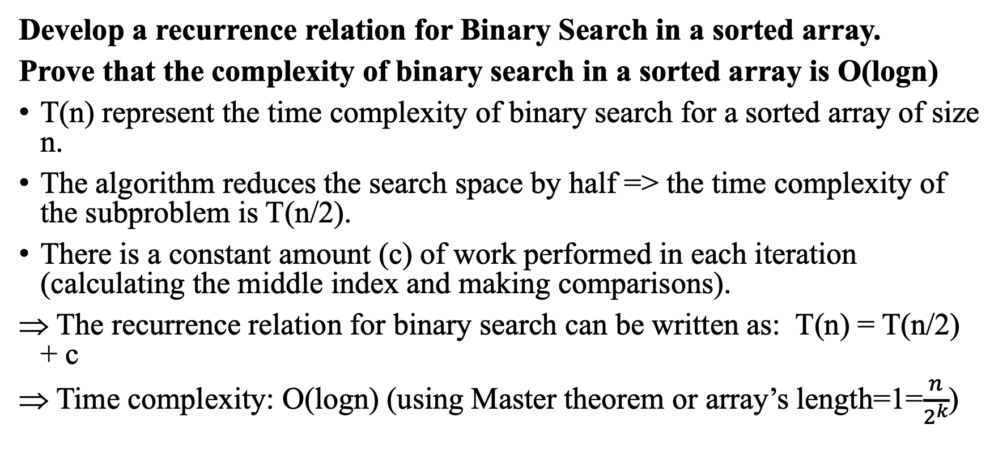
Solution 2
Develop a recurrence relation for Binary Search in a sorted array.
Prove that the complexity of binary search in a sorted array is Ο(logn)
T(n) represent the time complexity of binary search for a sorted array of size n.
The algorithm reduces the search space by half => the time complexity of the subproblem is T(n/2).
There is a constant amount (c) of work performed in each iteration (calculating the middle index and making comparisons).
The recurrence relation for binary search can be written as: T(n) = T(n/2) + c
Time complexity: O(logn) (using Master theorem or array’s length=1=$\frac{n}{2^{k}}$)

Slide 14
Problem 3
Show that a tree with n vertices has n – 1 edges.
Write functions
i. to count the number of nodes in a binary tree.
ii. to count the number of leaves.
iii. to count the number of right children.
iv. to find the height of the tree.
v. to delete all leaves from a binary tree.
Design an algorithm to test whether a binary tree is a binary search tree.
Prove by induction that there is a unique path between any pair of vertices in a tree.
Given pre-order and in-order traversals of a binary tree, is it possible to reconstruct the tree? If so, sketch an algorithm to do it. If not, give a counterexample. Repeat the problem if you are given the pre-order and post-order traversals.

Slide 15
Solution 3
Show that a tree with n vertices has n – 1 edges.
A tree is a connected, undirected graph with no cycles.
1 vertex has 0 edge
2 vertices has 1 edge
3 vertices has 2 edges
…
n vertices has n-1 edges
(Can use math induction to prove this)

Slide 16
Solution 3
Write functions
i. to count the number of nodes in a binary tree.
class TreeNode:
def __init__(self, value):
self.value = value
self.left = None
self.right = None
def count_nodes(node):
if not node:
return 0
return 1 + count_nodes(node.left) + count_nodes(node.right)

Slide 17
Solution 3
Write functions
ii. to count the number of leaves.
class TreeNode:
def __init__(self, value):
self.value = value
self.left = None
self.right = None
def count_leaves(node):
if not node:
return 0
if not node.left and not node.right:
return 1
return count_leaves(node.left) + count_leaves(node.right)

Slide 18
Solution 3
Write functions
iii. to count the number of right children.
class TreeNode:
def __init__(self, value):
self.value = value
self.left = None
self.right = None
def count_right_children(node):
if not node:
return 0
right_count = count_right_children(node.right)
left_count = count_right_children(node.left)
return 1 + right_count + left_count if node.right else right_count + left_count

Slide 19
Solution 3
Write functions
iv. to find the height of the tree.
class TreeNode:
def __init__(self, value):
self.value = value
self.left = None
self.right = None
def tree_height(node):
if not node:
return 0
return 1 + max(tree_height(node.left), tree_height(node.right))

Slide 20
Solution 3
class TreeNode:
def __init__(self, value):
self.value = value
self.left = None
self.right = None
def delete_leaves(node):
if not node:
return None
if not node.left and not node.right:
return None
node.left = delete_leaves(node.left)
node.right = delete_leaves(node.right)
return node
Write functions
v. to delete all leaves from a binary tree.

Slide 21
Solution 3
def is_bst(node, prev=None):
if not node:
return True
# Traverse the left subtree
if not is_bst(node.left, prev):
return False
# Check if the current node's value is greater than the previous node's value
if prev and prev.value >= node.value:
return False
# Update the previous node's value
prev = node
# Traverse the right subtree
return is_bst(node.right, prev)
Design an algorithm to test whether a binary tree is a binary search tree.

Slide 22
Solution 3
Prove by induction that there is a unique path between any pair of vertices in a tree.
Induction Hypothesis (IH): For any tree T with n vertices, there is a unique path between any pair of vertices.
Base Case (n = 2): When there are only two vertices (u and v) in the tree T, there is a single edge connecting them. This edge forms the unique path between u and v. So, the induction hypothesis holds for the base case.

Slide 23
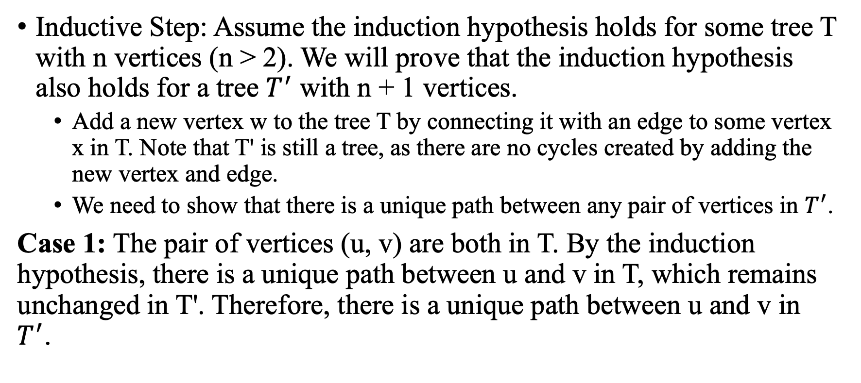
Solution 3
Inductive Step: Assume the induction hypothesis holds for some tree T with n vertices (n > 2). We will prove that the induction hypothesis also holds for a tree $T^{′}$ with n + 1 vertices.
Add a new vertex w to the tree T by connecting it with an edge to some vertex x in T. Note that T' is still a tree, as there are no cycles created by adding the new vertex and edge.
We need to show that there is a unique path between any pair of vertices in $T^{′}$.
Case 1: The pair of vertices (u, v) are both in T. By the induction hypothesis, there is a unique path between u and v in T, which remains unchanged in T'. Therefore, there is a unique path between u and v in $T^{′}$.

Slide 24
Solution 3
Case 2: One of the vertices in the pair (u, v) is the new vertex w. Without loss of generality, let u = w. There is a unique path between w and x (the edge we added), and there is a unique path between x and v in T (by the induction hypothesis).
There is a unique path between w and v in T', which is the combination of the unique paths between w and x, and x and v.
v
x
w

Slide 25
Solution 3
Given pre-order and in-order traversals of a binary tree, is it possible to reconstruct the tree? If so, sketch an algorithm to do it. If not, give a counterexample. Repeat the problem if you are given the pre-order and post-order traversals.

Slide 26
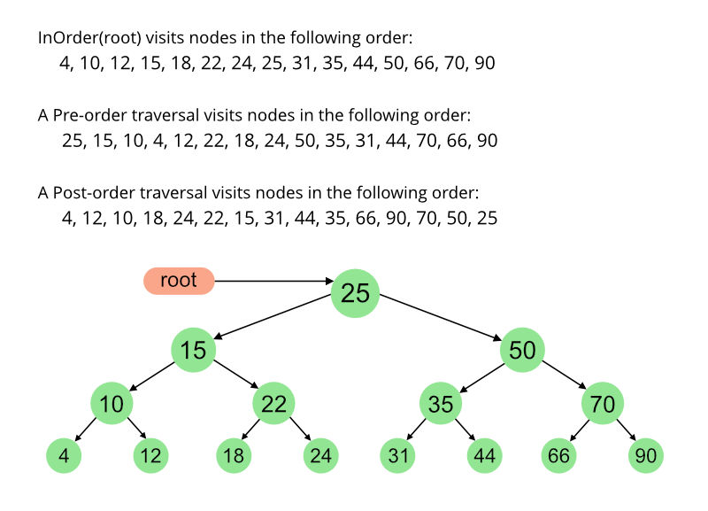
Solution 3

Slide 27
Solution 3
Is it possible to reconstruct the tree given pre-order and in-order traversals of a binary tree.
The key idea:
Pre-order traversal visits the root before its children
In-order traversal visits the left child, root, and right child in that order.
We can identify the root from the pre-order traversal and then find its index in the in-order traversal, which helps us to split the left and right subtrees.

Slide 28
Solution 3
def build_tree(pre_order, in_order):
if not in_order:
return None
root_value = pre_order.pop(0)
root = TreeNode(root_value)
root_index = in_order.index(root_value)
root.left = build_tree(pre_order, in_order[:root_index])
root.right = build_tree(pre_order, in_order[root_index + 1:])
return root

Slide 29
Solution 3
Repeat the problem if you are given the pre-order and post-order traversals.
It is not possible to uniquely reconstruct the binary tree in general, unless additional constraints are given (e.g., the tree is a full binary tree).
Tree A: Tree B:
1 1
/ / \
2 2 3
/
3
Both trees have the same pre-order traversal (1, 2, 3) and post-order traversal (3, 2, 1), but they are not the same.

Slide 30
Problem 4
Write an algorithm pseudocode to divide a binary search tree into two trees, one tree with key < K and the other tree with keys ≥ K, where K is any key in the tree.
Write an algorithm pseudocode to merge two binary search trees into one without inserting one node at a time from one tree into another.
A concatenate operation takes two sets S1 and S2, where every key in S1 is smaller than any key in S2, and merges them together. Give an algorithm to concatenate two binary search trees into one binary search tree. The worst-case running time should be O(ℎ), where ℎ is the maximal height of the two trees.
Give a recurrence for the number of possible binary search trees with n keys. You may assume the keys are {1,2, ..., n}. [Hint: the root of the binary search tree can be any one of the n keys. You need to consider each of these n possibilities.]

Slide 31
Solution 4
Write an algorithm pseudocode to divide a binary search tree into two trees, one tree with key < K and the other tree with keys ≥ K, where K is any key in the tree.
50
Idea:
Current root's value < K => the root belongs to the left tree (no need to search in left tree) => continue the process with the right subtree.
Current root's value >= K => the root belongs to the right tree (no need to search in right tree) => continue the process with the left subtree.
30
70
20
40
54
80

Slide 32
Solution 4
Write an algorithm pseudocode to divide a binary search tree into two trees, one tree with key < K and the other tree with keys ≥ K, where K is any key in the tree.
50
Step 1: Root = 50 < 55 (key)
Step 2: Go to right tree (left tree with root=50 <55). Root=70 > 55
Step 3: Go to left tree (right tree with root=70 > 55) Root = 54 < 55
Step 4: Insert 54 to the left tree with root=50
30
70
20
40
54
80

Slide 33
Solution 4
def split_tree(root, K):
if root is None:
return None, None
if root.val < K:
left_tree, right_tree = split_tree(root.right, K)
root.right = left_tree
return root, right_tree
else:
left_tree, right_tree = split_tree(root.left, K)
root.left = right_tree
return left_tree, root
50
30
70
20
40
54
80

Slide 34
Solution 4
Starting at the root (50), compare the value with K (55). Since 50 < 55, we will move to the right subtree.
Now we are at node 70. Compare its value with K (55). Since 70 > 55, we will move to the left subtree.
Now we are at node 54. Compare its value with K (55). Since 54 < 55, we will move to the right subtree. However, there is no right subtree, so we have reached the end of our search.
From node 54, we will return (None, None) since there are no left or right subtrees.
1
50
2
30
70
4
20
40
54
80
3

Slide 35
Solution 4
Moving up to node 70, we set its left child to be the second element of the returned tuple (None), resulting in the right tree:
Moving up to node 50, we set its right child to be the first element of the returned tuple (70), resulting in the left tree:
70
5
80
50
6
30
54
20
40

Slide 36
Solution 4
Write an algorithm pseudocode to merge two binary search trees into one without inserting one node at a time from one tree into another.
Algorithm Pseudocode:
Perform in-order traversal on both trees to obtain two sorted arrays.
Merge the two sorted arrays into a single sorted array.
Construct a balanced binary search tree from the merged sorted array.
function merge_trees(tree1, tree2):
array1 = in_order_traversal(tree1)
array2 = in_order_traversal(tree2)
merged_array = merge_sorted_arrays(array1, array2)
merged_tree = build_balanced_bst(merged_array)
return merged_tree

Slide 37
Solution 4
A concatenate operation takes two sets S1 and S2, where every key in S1 is smaller than any key in S2, and merges them together. Give an algorithm to concatenate two binary search trees into one binary search tree. The worst-case running time should be O(ℎ), where ℎ is the maximal height of the two trees.
Algorithm Pseudocode:
Find the largest node in the first tree (rightmost node)
Find the smallest node in the second tree (leftmost node)
Connect the largest node of the first tree to the smallest node of the second tree

Slide 38
Solution 4
20
Find the largest node in Tree 1:
Largest node: 30
10
30
Algorithm Pseudocode:
Find the largest node in the first tree (rightmost node)
Find the smallest node in the second tree (leftmost node)
Connect the largest node of the first tree to the smallest node of the second tree
Find the smallest node in Tree 2:
Smallest node: 40
50
40
60
20
Connect the largest node of Tree 1 (30) to the smallest node of Tree 2 (40)
10
30
40
50
60

Slide 39
Solution 4
Give a recurrence for the number of possible binary search trees with n keys. You may assume the keys are {1,2, ..., n}. [Hint: the root of the binary search tree can be any one of the n keys. You need to consider each of these n possibilities.
If we choose the i-th key as the root (1 ≤ i ≤ n), it will divide the remaining n-1 keys into two groups:
The left subtree containing the keys smaller than the root (i-1 keys)
The right subtree containing the keys larger than the root (n-i keys)
The left and right subtrees can be independently constructed using the remaining keys.
The total number of possible binary search trees can be calculated by multiplying the number of possible binary search trees for the left and right subtrees:
T(i) = T(i-1) * T(n-i) for i from 1 to n
T(0) = T(1) = 1

Slide 40
Problem 5
For the input 30, 20, 56, 75, 31, 19 and hash function ℎ(K) = K mod 11
Construct the open hash table.
Find the largest number of key comparisons in a successful search in this table.
Find the average number of key comparisons in a successful search in this table.

Slide 41
Solution 5
For the input 30, 20, 56, 75, 31, 19 and hash function ℎ(K) = K mod 11. Construct the open hash table.
0 -> None
1 -> 56
2 -> None
3 -> None
4 -> None
5 -> None
6 -> None
7 -> None
8 -> 30 -> 75 -> 19
9 -> 20 -> 31
10 -> None
Key: 30, Hash: 30 mod 11 = 8
Key: 20, Hash: 20 mod 11 = 9
Key: 56, Hash: 56 mod 11 = 1
Key: 75, Hash: 75 mod 11 = 8 => behind key 30
Key: 31, Hash: 31 mod 11 = 9 => behind key 20
Key: 19, Hash: 19 mod 11 = 8 => behind key 75
If more than one key results in the same slot, we'll add the new key to the end of the linked list at that slot.

Slide 42
Solution 5
For the input 30, 20, 56, 75, 31, 19 and hash function ℎ(K) = K mod 11.
Find the largest number of key comparisons in a successful search in this table.
Find the average number of key comparisons in a successful search in this table.
Largest number of key comparisons in a successful search: This occurs at slot 8, which has 3 keys (30, 75, 19). Therefore, the largest number of key comparisons is 3.
Average number of key comparisons in a successful search: To calculate this, we need to find the average number of keys in the non-empty slots. There are total of 6 keys across 3 non-empty slots, which gives an average of 6/3 = 2 comparisons per successful search.

Slide 43
Problem 6
For the input 30, 20, 56, 75, 31, 19 and hash function ℎ(K) = K mod 11
Construct the closed hash table.
Find the largest number of key comparisons in a successful search in this table.
Find the average number of key comparisons in a successful search in this table.

Slide 44
Solution 6
For the input 30, 20, 56, 75, 31, 19 and hash function ℎ(K) = K mod 11. Construct the closed hash table.
Use linear probing => if a collision occurs at index i => try the next index (i+1) until we find an empty slot.
h(30) = 30 mod 11 = 8 -> Place 30 at index 8
h(20) = 20 mod 11 = 9 -> Place 20 at index 9
h(56) = 56 mod 11 = 1 -> Place 56 at index 1
h(75) = 75 mod 11 = 9 -> collision, next available slot
h(31) = 31 mod 11 = 9 -> collision, next available slot
h(19) = 19 mod 11 = 8 -> collision, next available slot
Index | Key
--------------
0 | 31
1 | 56
2 | 19
3 |
4 |
5 |
6 |
7 |
8 | 30
9 | 20
10 | 75

Slide 45
Solution 6
For the input 30, 20, 56, 75, 31, 19 and hash function ℎ(K) = K mod 11
Find the largest number of key comparisons in a successful search in this table.
Find the average number of key comparisons in a successful search in this table.
Largest number of key comparisons in a successful search:
This would be for key 31, which is the third key in its probe sequence (20, 75, 31). So it would require 3 comparisons.
Average number of key comparisons in a successful search:
For key 30: 1 comparison
For key 20: 1 comparison
For key 56: 1 comparison
For key 75: 2 comparisons (collision with 20)
For key 31: 3 comparisons (collisions with 20 and 75)
For key 19: 2 comparisons (collision with 30)
So the total number of comparisons would be 1 + 1 + 1 + 2 + 3 + 2 = 10. Since there are 6 keys, the average number of key comparisons for a successful search would be 10 / 6 ≈ 1.67.

Slide 46
Problem 7
Why is it not a good idea for a hash function to depend on just one letter (say, the first one) of a natural-language word?
Find the probability of all n keys being hashed to the same cell of a hash table of size m if the hash function distributes keys evenly among all the cells of the table

Slide 47
Solution 7
Why is it not a good idea for a hash function to depend on just one letter (say, the first one) of a natural-language word?
Loss of information: ignores the rest of the characters
Increased collisions/Poor performance: encounter more collisions because many words share the same first letter => Higher time complexity for search, insertion, and deletion operations, which defeats the purpose of using a hash table for efficient access to data.

Slide 48
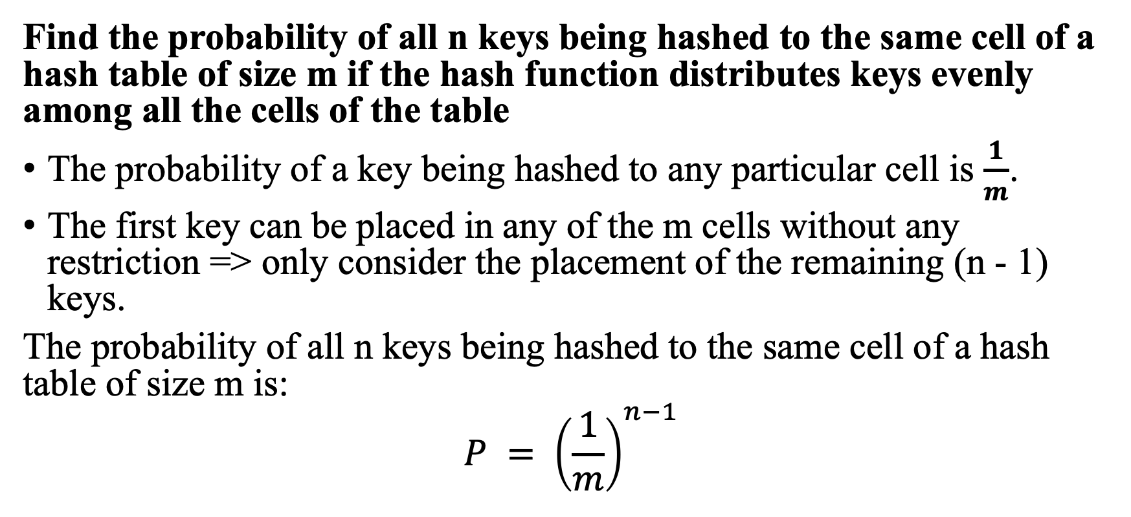
Solution 7
Find the probability of all n keys being hashed to the same cell of a hash table of size m if the hash function distributes keys evenly among all the cells of the table
The probability of a key being hashed to any particular cell is $\frac{1}{m}$.
The first key can be placed in any of the m cells without any restriction => only consider the placement of the remaining (n - 1) keys.
The probability of all n keys being hashed to the same cell of a hash table of size m is:
$$P = {\left(\frac{1}{m}\right)}^{n−1}$$

Slide 49
Problem 8
Answer the following questions for the separate-chaining version of hashing.
Where would you insert keys if you knew that all the keys in the dictionary are distinct? Which dictionary operations, if any, would benefit from this modification?
We could keep keys of the same linked list sorted. Which of the dictionary operations would benefit from this modification? How could we take advantage of this if all the keys stored in the entire table need to be sorted?

Slide 50
Solution 8
Where would you insert keys if you knew that all the keys in the dictionary are distinct? Which dictionary operations, if any, would benefit from this modification?
Simply insert new keys at the beginning of the linked list for each hash table index. This approach is efficient because you don't need to search for the key's position within the list or check for duplicates.
The primary dictionary operations that would benefit from this modification are
Insert: Inserting a new key would require constant time complexity O(1), as you only need to add the key at the beginning of the linked list without checking for duplicates.
Search: Searching for a key would remain with the same average time complexity O(n/m) (n: number of keys, m: size of the hash table), but the worst-case time complexity remains O(n) in the case of an imbalanced hash table.

Slide 51
Solution 8
We could keep keys of the same linked list sorted. Which of the dictionary operations would benefit from this modification?
Keeping keys of the same linked list sorted within each hash table index can benefit the search and delete operations:
Search: When the keys within the linked list are sorted, searching for a key can be more efficient, as you can stop the search as soon as you find a key greater than the target key. This can result in faster search times in some cases, although the average case time complexity remains the same.
Delete: Deleting a key can also be more efficient, as the search for the key to delete will benefit from the sorted list in the same way as the search operation.

Slide 52
Solution 8
How could we take advantage of this if all the keys stored in the entire table need to be sorted?
Iterate through the hash table indices and traverse each linked list in order.
For each index, retrieve the sorted keys from the linked list and merge them into the final sorted list.
This can be done efficiently by using a merge-like algorithm similar to the one used in merge sort, resulting in a time complexity of O(n) for merging all sorted linked lists from the hash table.

Slide 53
Problem 9
Explain how to use hashing to check whether all elements of a list are distinct. What is the time efficiency of this application? Compare its efficiency with that of the brute-force algorithm and of the presorting-based algorithm.

Slide 54
Solution 9
Algorithm:
Create a hash table where each entry is a linked list.
Iterate through the elements of the list, compute their hash values
If an element is found in the linked list (bucket) => not distinct
If it's not => add the element to the bucket and continue.
If reach the end of the list => all elements are distinct.
Time efficiency:
Average case: when the hash table is well-distributed, the time complexity is O(n)
Worst case: where all values share the same hash value and are placed into the same bucket, the time complexity is O(n^2).

Slide 55
Solution 9
Brute-force algorithm: The brute-force approach involves comparing each element with every other element in the list, which takes O(n^2) time.
Presorting-based algorithm: By sorting the list first (O(nlogn)) and then checking for adjacent equal elements (O(n)), you can determine if all elements are distinct. The overall time complexity of this approach is O(nlogn).
Our algorithm:
Best case/Average case: O(n)
Worst case: O(n^2)

Slide 56
Problem 10
Draw an AVL tree of height 3 that has the minimum number of nodes.
Draw an AVL tree of height 4 that has the minimum number of nodes.
Minimum number of nodes in a tree with height ℎ can be represented as: N(ℎ) = N(ℎ − 1) + N(ℎ − 2) + 1 for n > 2 where N(0) = 1 and N(1) = 2. [Hint: First, check out the solution for the previous questions D and E. Let ℎ be the height and let N(ℎ) be this minimum number of nodes. Then N(0) = 1, i.e., a tree with just a root, N(1) = 2, i.e., a root node and one child.]
If there are n nodes in AVL tree, minimum height of AVL tree is [logn].

Slide 57
Solution 10
Draw an AVL tree of height 3 that has the minimum number of nodes.

Slide 58
Solution 10
Draw an AVL tree of height 4 that has the minimum number of nodes.

Slide 59
Problem 10
Prove that minimum number of nodes in a tree with height ℎ can be represented as: N(ℎ) = N(ℎ − 1) + N(ℎ − 2) + 1 for n > 2 where N(0) = 1 and N(1) = 2.

Slide 60
Solution 10
Prove that minimum number of nodes in a tree with height ℎ can be represented as: N(ℎ) = N(ℎ − 1) + N(ℎ − 2) + 1 for n > 2 where N(0) = 1 and N(1) = 2.
Induction Hypothesis: For an AVL tree T with height h, the minimum number of nodes N(h) is given by the formula N(h) = N(h-1) + N(h-2) + 1. We are given the base cases: N(0) = 1 and N(1) = 2.
Base cases:
h = 0: N(0) = 1. The formula holds, as there is only one node in the tree (the root), and no children.
h = 1: N(1) = 2. The formula holds, as there is a root node and a single child (left or right), making a total of 2 nodes in the tree.

Slide 61
Solution 10
Inductive Step: Assume the induction hypothesis holds for some heights h-1 and h-2, where h > 1. We will prove that the induction hypothesis also holds for height h.
For an AVL tree T with height h, the root has a left subtree L of height h-1 and a right subtree R of height h-2. By the induction hypothesis, the minimum number of nodes in subtree L (N(h-1)) and subtree R (N(h-2)) are given by:
N(h-1) = N(h-2) + N(h-3) + 1
N(h-2) = N(h-3) + N(h-4) + 1

Slide 62
Solution 10
Now we calculate the minimum number of nodes in the tree T of height h by adding the nodes from the left subtree L, right subtree R, and the root:
N(h) = N(h-1) + N(h-2) + 1
We have shown that it holds for height h given that it holds for heights h-1 and h-2.

Slide 63
Solution 10
If there are n nodes in AVL tree, minimum height of AVL tree is [logn].
The minimum height occurs when each level is as full as possible, which means that at each level, the number of nodes is doubled.
If the height of the AVL tree is h_min, then the maximum number of nodes in the tree is: n_max = 1 + 2 + 2^2 + 2^3 + ... + 2^(h_min) = 2^(h_min+1) – 1
Need to find the smallest h_min that satisfies the inequality: n <= n_max, or n <= 2^(h_min+1) – 1 log2(n + 1) <= h_min + 1 h_min >= log2(n + 1) - 1
h_min = [logn]

Slide 64

Problem 11
If height of AVL tree is ℎ, maximum number of nodes can be $2^{h+1}$ - 1.
If there are n nodes in AVL tree, maximum height can’t exceed 1.44 ∗ [logn].
The complexity of searching, inserting and deletion in AVL tree is Ο(logn).

Slide 65
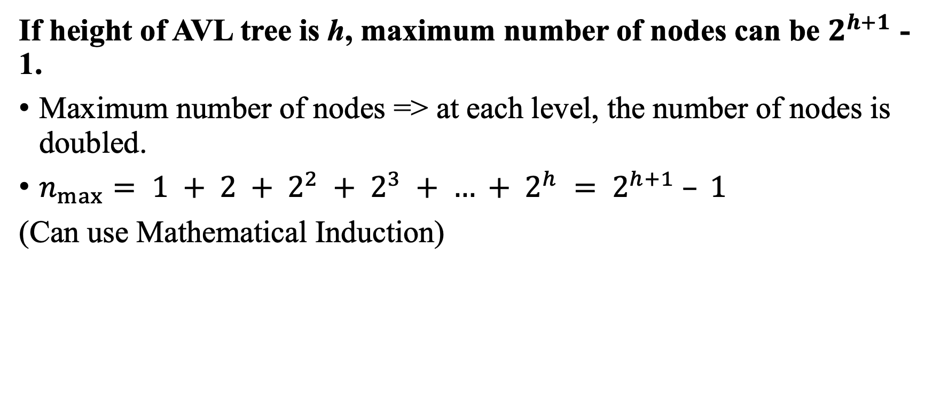
Solution 11
If height of AVL tree is ℎ, maximum number of nodes can be $2^{h+1}$ - 1.
Maximum number of nodes => at each level, the number of nodes is doubled.
$n_{max}⁡= 1 + 2 + 2^{2} + 2^{3} + … + 2^{h} = 2^{h+1} – 1$
(Can use Mathematical Induction)

Slide 66
Solution 11
If there are n nodes in AVL tree, maximum height can’t exceed 1.44 ∗ [logn].
From our previous discussion, we know the minimum number of nodes in an AVL tree of height h can be represented by the formula:
N(h) = N(h-1) + N(h-2) + 1
Using the base cases N(0) = 1 and N(1) = 2, we can find the minimum number of nodes required for different heights:
N(0) = 1
N(1) = 2
N(2) = 1 + 2 + 1 = 4
N(3) = 2 + 4 + 1 = 7
N(4) = 4 + 7 + 1 = 12

Slide 67
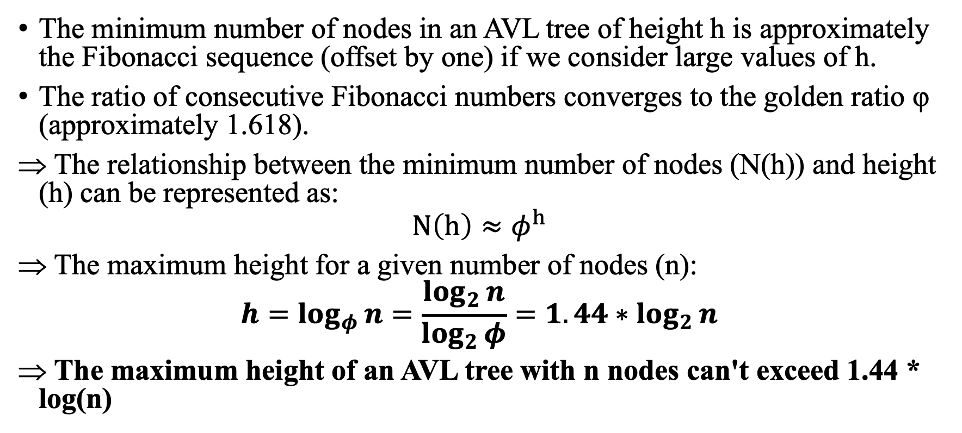
Solution 11
The minimum number of nodes in an AVL tree of height h is approximately the Fibonacci sequence (offset by one) if we consider large values of h.
The ratio of consecutive Fibonacci numbers converges to the golden ratio φ (approximately 1.618).
The relationship between the minimum number of nodes (N(h)) and height (h) can be represented as:
$$N\left(h\right)≈φ^{h}$$
The maximum height for a given number of nodes (n):
$$h=\log_{φ}{n}=\frac{\log_{2}{n}}{\log_{2}{φ}}=1.44∗\log_{2}{n}$$
The maximum height of an AVL tree with n nodes can't exceed 1.44 * log(n)

Slide 68
Solution 11
The complexity of searching, inserting and deletion in AVL tree is Ο(logn)
Let's first consider the time complexity of searching in an AVL tree. Since an AVL tree is a binary search tree, searching in an AVL tree requires comparing the target value with the value of the current node, and then continuing the search in the left or right subtree depending on the result of the comparison. Since the height of an AVL tree is O(log n), where n is the number of nodes in the tree, the number of comparisons required to search in an AVL tree is O(log n).
Now let's consider the time complexity of inserting a new node into an AVL tree. The insertion operation first performs a search to find the correct position for the new node. As we just saw, the search operation takes O(log n) time. Once the correct position has been found, the new node is inserted and the height balance of the tree is checked and corrected if necessary. This rebalancing operation involves at most O(log n) rotations and updates to the balance factors of the nodes on the path from the root to the newly inserted node. Since each rotation or update takes constant time, the total time complexity of the insertion operation is O(log n).
Finally, let's consider the time complexity of deleting a node from an AVL tree. The deletion operation first performs a search to find the node to be deleted. As we just saw, the search operation takes O(log n) time. Once the node has been found, it is deleted and the height balance of the tree is checked and corrected if necessary. This rebalancing operation involves at most O(log n) rotations and updates to the balance factors of the nodes on the path from the root to the deleted node. Again, since each rotation or update takes constant time, the total time complexity of the deletion operation is O(log n).
Therefore, we have shown that the time complexity of searching, inserting, and deleting in an AVL tree is O(log n). This completes the proof.

Slide 69
Problem 12
Starting with an empty tree, construct an AVL tree by inserting the following keys in the order given: 2, 3, 5, 6, 9, 8, 7, 4, 1. If an insertion causes the tree to become unbalanced, then perform the necessary rotations to maintain the balance. State where the rotations were done.
Given the following AVL Tree, draw the resulting AVL Tree after 5 is removed after showing all internal steps of the algorithm that deletes a key from an AVL Tree.

Slide 70
Solution 12
Starting with an empty tree, construct an AVL tree by inserting the following keys in the order given: 2, 3, 5, 6, 9, 8, 7, 4, 1. If an insertion causes the tree to become unbalanced, then perform the necessary rotations to maintain the balance. State where the rotations were done.
https://www.cs.usfca.edu/~galles/visualization/AVLtree.html
Input number (or text) and then click Insert
Decrease/Increase animation speed to visualize better

Slide 71
Solution 12
Given the following AVL Tree, draw the resulting AVL Tree after 5 is removed after showing all internal steps of the algorithm that deletes a key from an AVL Tree.
https://www.cs.usfca.edu/~galles/visualization/AVLtree.html
Insert these input first then delete 5
5, 3, 10, 2, 4, 7, 11, 1, 6, 9, 12, 8
Increase Animation speed to add numbers quicker

Slide 72
Problem 13
When a heap is represented in an array, why is it important that the tree being represented in complete? What happens if this condition is not satisfied?
If you interpret a sorted array as a heap, is it guaranteed to have the heap order property?
Where is the smallest value found in a heap? Assume min heap here.
Find the smallest and the largest number of keys that a heap of height h can contain.
Outline an algorithm for checking whether an array H[1..n] is a heap and determine its time efficiency.
Show that unless other information is maintained, finding the maximum value in a heap must be an O(n)operation. Assume min heap here. [Hint: How many elements in the heap could potentially be the maximum?].
Why is a priority queue not a true queue

Slide 73
Solution 13
When a heap is represented in an array, why is it important that the tree being represented in complete? What happens if this condition is not satisfied?
When a heap is represented in an array, it is important for the tree to be complete (i.e., every level except possibly the last is completely filled, and all nodes in the last level are as far left as possible) because it ensures efficient use of space and simplifies index calculations for parent-child relationships. This complete binary tree property is crucial for the efficient implementation of heap data structures, such as binary heaps, which are often used in priority queues, heap sort, and other algorithms.
Efficient use of space: A complete binary tree stored in an array does not waste any space, as the array will be fully utilized. If the tree is not complete, there would be unused gaps in the array, leading to inefficient memory usage.
Simplified index calculations: When the binary tree is complete, parent-child index relationships can be easily calculated using the following formulas:
For a node at index i:
Its parent node is at index floor((i-1)/2)
Its left child is at index 2i + 1
Its right child is at index 2i + 2
These calculations assume a zero-based array indexing. If the tree is not complete, these formulas would no longer hold, and more complex calculations or data structures would be needed to determine parent-child relationships, which would increase the complexity and decrease the efficiency of heap operations.
If the condition of a complete binary tree is not satisfied:
The array representation becomes inefficient in terms of space utilization, as there would be unused gaps.
The simple parent-child index calculations would not be valid, which would complicate the algorithms and data structures needed to maintain the heap.
The time complexity of basic heap operations, such as insertion and deletion, may be affected, making the heap less efficient as a data structure for priority queues or sorting algorithms.

Slide 74
Solution 13
If you interpret a sorted array as a heap, is it guaranteed to have the heap order property?
Yes
Min-Heap: The parent nodes have a value less than or equal to their children. If you have a sorted array in ascending order, interpreting it as a heap will result in a min-heap. For each parent node, its children will have values greater than or equal to the parent => satisfy.
Max-Heap: The parent nodes have a value greater than or equal to their children. If you have a sorted array in descending order, interpreting it as a heap will result in a max-heap. For each parent node, its children will have values less than or equal to the parent => satisfy.

Slide 75
Solution 13
Where is the smallest value found in a heap? Assume min heap here.
In a min-heap, the smallest value is always found at the root node. Since the min-heap order property dictates that every parent node must have a value less than or equal to its children, the root node will always have the smallest value in the entire heap. In an array representation of the heap, the root node is at index 0.

Slide 76
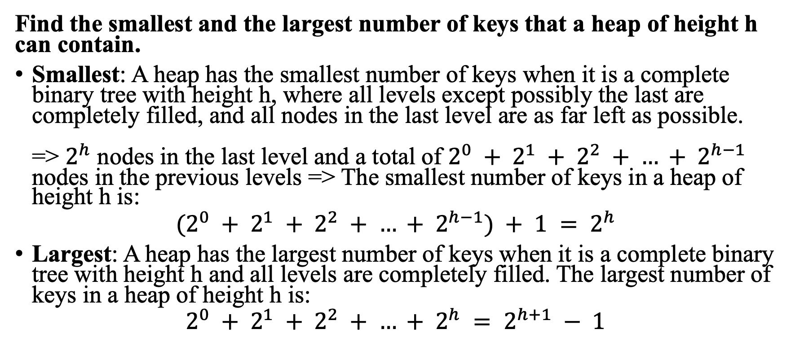
Solution 13
Find the smallest and the largest number of keys that a heap of height h can contain.
Smallest: A heap has the smallest number of keys when it is a complete binary tree with height h, where all levels except possibly the last are completely filled, and all nodes in the last level are as far left as possible. => $2^{h}$ nodes in the last level and a total of $2^{0} + 2^{1} + 2^{2} + … + 2^{h−1}$ nodes in the previous levels => The smallest number of keys in a heap of height h is:
$$(2^{0} + 2^{1} + 2^{2} + … + 2^{h−1}) + 1 = 2^{h}$$
Largest: A heap has the largest number of keys when it is a complete binary tree with height h and all levels are completely filled. The largest number of keys in a heap of height h is:
$$2^{0} + 2^{1} + 2^{2} + … + 2^{h} = 2^{h+1} − 1$$

Slide 77
Solution 13
Outline an algorithm for checking whether an array H[1..n] is a heap and determine its time efficiency.
H is a min-heap: if parent node > child node => False
H is a max-heap: if parent node < child node => False
def is_min_heap(H):
n = len(H)
is_heap = True
for i in range(1, (n-1) // 2 + 1):
left_child = 2 * i
right_child = 2 * i + 1
if H[i-1] > H[left_child-1] or (right_child <= n and H[i-1] > H[right_child-1]):
is_heap = False
break
return is_heap
def is_max_heap(H):
n = len(H)
is_heap = True
for i in range(1, (n-1) // 2 + 1):
left_child = 2 * i
right_child = 2 * i + 1
if H[i-1] < H[left_child-1] or (right_child <= n and H[i-1] < H[right_child-1]):
is_heap = False
break
return is_heap

Slide 78

Solution 13
Show that unless other information is maintained, finding the maximum value in a heap must be an O(n) operation. Assume min heap here.
The maximum value can be present in any of the leaf nodes, as the min-heap property only guarantees that every parent node has a value less than or equal to its children.
In a complete binary tree of height h, the number of leaf nodes can be at most $2^{h}$. Since the height h of the binary tree can be roughly log(n) for n elements (base 2)
The number of leaf nodes can be at most $2^{\log\left(n\right)}$= n.
Finding the maximum value in a min-heap requires O(n), unless other information is maintained.
…
…
…
…
n nodes

Slide 79
Solution 13
Why is a priority queue not a true queue?
A priority queue is not considered a true queue because it does not follow the First-In-First-Out (FIFO) order:
In a true queue, elements are dequeued in a linear order, maintaining the FIFO order.
In a priority queue, elements are dequeued based on their priorities, which may not correspond to the order in which they were inserted.

Slide 80
Problem 14
You are given the task of reading n numbers and then printing them out in sorted order. Suppose you have access to a balanced dictionary data structure, which supports the operations search, insert, delete, minimum, maximum, successor, and predecessor each in O(logn) time.
How can you sort in O(nlogn) time using only insert and in-order traversal?
How can you sort in O(nlogn) time using only minimum, successor, and insert?
How can you sort in O(nlogn) time using only minimum, insert, delete, search?

Slide 81
Solution 14
How can you sort in O(nlogn) time using only insert and in-order traversal?
Read each of the n numbers and insert them into the balanced dictionary. Since the insertion operation takes O(logn) time, this step takes O(nlogn) time.
Perform an in-order traversal of the balanced dictionary. This will visit the nodes in ascending order, thus printing the numbers in sorted order. In-order traversal takes O(n) time.
The total time complexity of this method is O(nlogn) + O(n) = O(nlogn).

Slide 82
Solution 14
How can you sort in O(nlogn) time using only minimum, successor, and insert?
Read each of the n numbers and insert them into the balanced dictionary. Since the insertion operation takes O(logn) time, this step takes O(nlogn) time
Find and print the minimum element in the balanced dictionary. The minimum operation takes O(logn) time
Repeatedly find and print the successor of the previously printed element until there are no more successors. The successor operation takes O(logn) time. Since there are n elements in the balanced dictionary, this step takes O(nlogn) time
The total time complexity of this method is O(nlogn) + O(logn) + O(nlogn) = O(nlogn)

Slide 83
Solution 14
How can you sort in O(nlogn) time using only minimum, insert, delete, search?
Read each of the n numbers and insert them into the balanced dictionary. Since the insertion operation takes O(logn) time, this step takes O(nlogn) time.
Repeatedly perform the following steps until the balanced dictionary is empty:
Find and print the minimum element in the balanced dictionary. The minimum operation takes O(logn) time.
Delete the minimum element from the balanced dictionary. The delete operation takes O(logn) time.
The total time complexity of this method is O(nlogn) + O(nlogn) = O(nlogn)

