Slide 1
3805ICT Advanced Algorithms
Workshop – Approximation Algorithms

Slide 2
Task 1
In Python/C++ implement the 2-approximation algorithm for vertex cover.
Definitions:
Vertex Cover problem: find the minimum number of vertices such that every edge in the graph is incident to at least one vertex in this set
A 2-approximation algorithm doesn't guarantee finding the minimum vertex cover but ensures that the number of vertices in the cover is at most twice the optimal number.

Slide 3
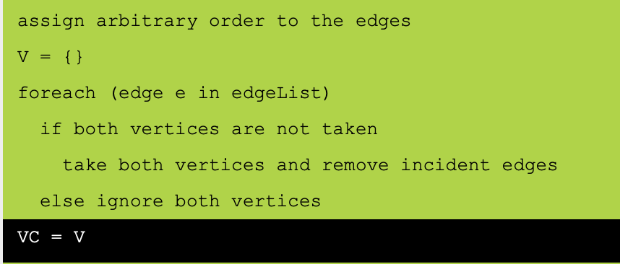
Task 1
Idea:
By including both u and v for each selected edge, the algorithm potentially doubles the count of vertices in the worst case, hence ensuring the size of the vertex cover found by the algorithm is at most twice the size of the optimal vertex cover.
Pseudo code (https://visualgo.net/en/mvc):

Slide 4
Task 2
In Python/C++ implement the 2-approximation algorithm for the TSP.
Definitions:
TSP: Given a list of cities and the distances between each pair of cities, the problem is to find the shortest possible route that visits each city exactly once and returns to the origin city.

Slide 5
Task 2
Idea:
A well-known 2-approximation algorithm for TSP in metric spaces (where the triangle inequality holds) is based on constructing a MST, performing a preorder traversal of the MST to visit the vertices, and then returning to the start to complete the tour. This method is often referred to in relation to Christofides' algorithm, which offers a 1.5-approximation but is a bit more complex due to involving a matching step on odd-degree vertices.
Pseudo code (https://visualgo.net/en/tsp):
- Construct a Minimum Spanning Tree (MST) for the graph.
- Perform a Preorder Traversal of the MST to get the order of visits.
- Create the TSP path by following the preorder traversal and return to the start.

Slide 6
Task 3
In Python/ C++ implement the greedy algorithm for set cover.
Definitions:
Given a universe of elements and a collection of sets containing these elements, find the smallest subset of sets such that every element in the universe is included in at least one of the selected sets.

Slide 7
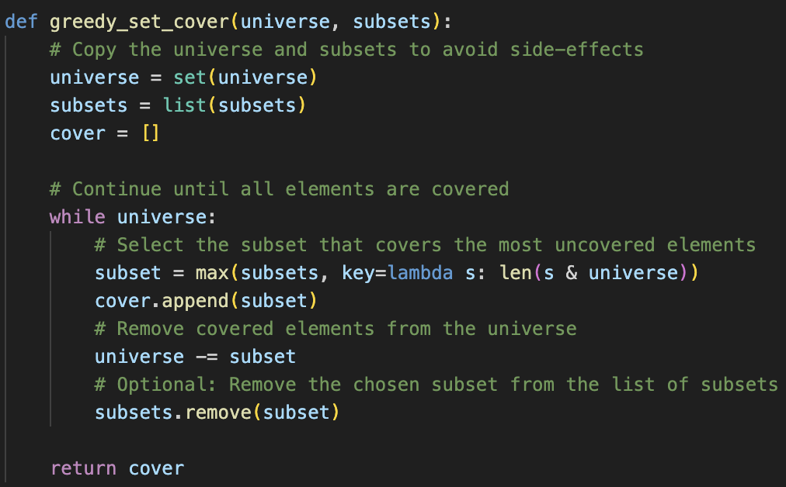
Task 3
Ideas:
Start with all your items (the universe) and all the boxes (the subsets) available.
Find the box that contains the most items that are not yet covered by boxes already chosen.
Add this box to your list of chosen boxes (the cover).
Remove the items in this box from your list of items that still need to be covered.
Repeat this process until all items are covered.
Pseudo code:

Slide 8
Task 4
In Python/ C++ implement the first and best fit algorithms for bin packing.
Definitions:
Given several objects of different sizes and a set of bins, each with the same capacity, our task is to pack all the objects into the bins so that we use as few bins as possible without exceeding the capacity of any bin.

Slide 9
Task 4
def first_fit(objects, bin_capacity):
bins = []
for obj in objects:
placed = False
for bin in bins:
if sum(bin) + obj <= bin_capacity:
bin.append(obj)
placed = True
break
if not placed:
bins.append([obj])
return bins
Ideas:
The First Fit algorithm places each object into the first bin that has enough space for it. If no bin can accommodate the object, a new bin is added => less computation, more space.
The Best Fit algorithm places each object into the bin that will have the least remaining space after the object is placed. If no bin can accommodate the object, a new bin is added => more computation, less space.
def best_fit(objects, bin_capacity):
bins = []
for obj in objects:
best_bin = None
min_space_left = bin_capacity + 1 # Initialize with a value greater than bin capacity
for bin in bins:
space_left = bin_capacity - sum(bin)
if space_left >= obj and space_left < min_space_left:
best_bin = bin
min_space_left = space_left
if best_bin is not None:
best_bin.append(obj)
else:
bins.append([obj])
return bins

