Slide 1
Workshop 6 – Dynamic Programming

Slide 2
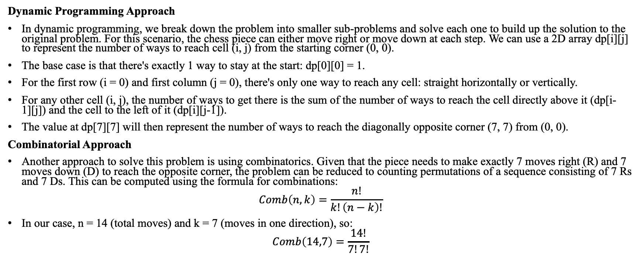
Question 1
Dynamic Programming Approach
In dynamic programming, we break down the problem into smaller sub-problems and solve each one to build up the solution to the original problem. For this scenario, the chess piece can either move right or move down at each step. We can use a 2D array dp[i][j] to represent the number of ways to reach cell (i, j) from the starting corner (0, 0).
The base case is that there's exactly 1 way to stay at the start: dp[0][0] = 1.
For the first row (i = 0) and first column (j = 0), there's only one way to reach any cell: straight horizontally or vertically.
For any other cell (i, j), the number of ways to get there is the sum of the number of ways to reach the cell directly above it (dp[i-1][j]) and the cell to the left of it (dp[i][j-1]).
The value at dp[7][7] will then represent the number of ways to reach the diagonally opposite corner (7, 7) from (0, 0).
Combinatorial Approach
Another approach to solve this problem is using combinatorics. Given that the piece needs to make exactly 7 moves right (R) and 7 moves down (D) to reach the opposite corner, the problem can be reduced to counting permutations of a sequence consisting of 7 Rs and 7 Ds. This can be computed using the formula for combinations:
$$Comb\left(n,k\right)=\frac{n!}{k!\left(n−k\right)!}$$
In our case, n = 14 (total moves) and k = 7 (moves in one direction), so:
$$Comb\left(14,7\right)=\frac{14!}{7!7!}$$

Slide 3
Question 2
https://www.geeksforgeeks.org/longest-common-subsequence-dp-4/
https://www.cs.usfca.edu/~galles/visualization/DPLCS.html

Slide 4
Question 3
https://dhruvilkotecha.medium.com/optimal-binary-search-tree-b91665db450c

Slide 5
Question 4 (optional)
https://pages.cs.wisc.edu/~bsettles/ibs08/lectures/02-alignment.pdf
https://www.youtube.com/watch?v=vqxc2EfPWdk

Slide 6
Question 5
https://www.geeksforgeeks.org/find-if-a-string-is-interleaved-of-two-other-strings-dp-33/
Initialization: We first initialize a 2D table dp of size (len(A)+1) x (len(B)+1) where dp[i][j] will be True if the first i characters of A and the first j characters of B can form an interleaving that matches the first i+j characters of C.
Base Cases:
dp[0][0]: Trivially True because an empty A and an empty B can form an empty C.
dp[0][j]: True if the first j characters of B match the first j characters of C.
dp[i][0]: True if the first i characters of A match the first i characters of C.
Filling the Table: The entry dp[i][j] is True if either:
The character from A that would be added to form the interleaving matches the current character in C and dp[i-1][j] was True.
The character from B that would be added matches the current character in C and dp[i][j-1] was True.

