Slide 1
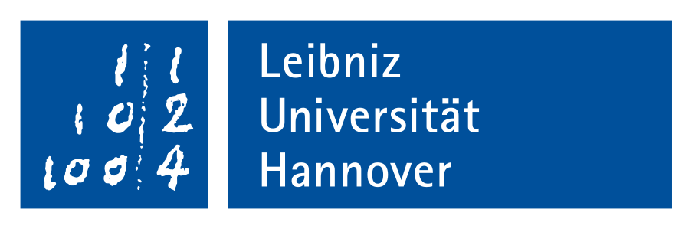
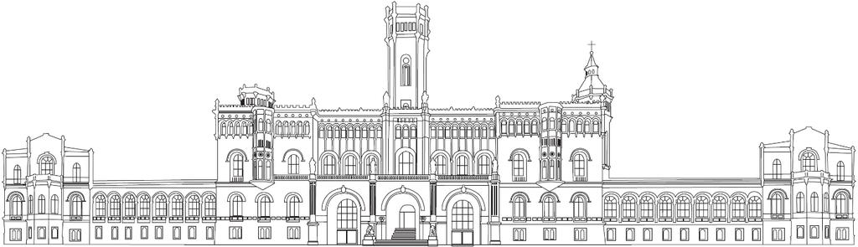
Debunking Medical Misinformation - Rootcauses, Benchmarks, and Explanations
präsentation der Bachelorarbeit von
Baraa Ragab Tbab
betreuer von
Prof. Dr. Wolfgang Nejdl
Prof. Niloy Ganguly
Dr. Thanh Tam Nguyen
12.04.2022

Slide 2
Contents
Introduction and Motivation
Methodology and Implementation
Experiments and Evaluation
Summary
Baraa Ragab Tbab
2

Slide 3

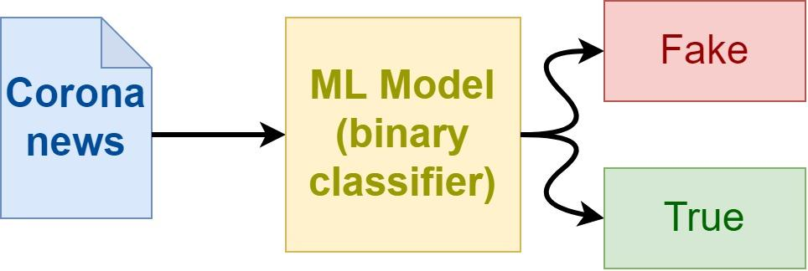
Introduction and Motivation
https://www.laeuft.eu/umgang-mit-fake-news-coronainsights/
Baraa Ragab Tbab
3

Slide 4
Contents
Introduction and Motivation
Methodology and Implementation
Experiments and Evaluation
Summary
Baraa Ragab Tbab
4

Slide 5
Methodology and Implementation
Creating and Preprocessing The Data
tweets with preprocessing
DS1
preprocessing
tweets without preprocessing
DS1
tweets
Internet
DS1
articles and tweets with preprocessing
preprocessing
DS1
articles and tweets without preprocessing
articles and tweets
Baraa Ragab Tbab
5

Slide 6
Methodology and Implementation
Preprocessing The Data
Remove the web links ("https:\\")
Remove Mention (@)
Remove Hashtag (#)
Remove tab (\t) and newline (\n) characters
Multiple posts shared repeatedly on Facebook and Twitter claim COVID-19 \n \t means \u0153see a sheep surrender in Latin. @test #test https://test.com
Remove the digits
multiple posts shared repeatedly facebook twitter claim covid means see sheep surrender latin
Remove stop words
Remove the duplicate whitespaces
Convert all letters to lowercase
Remove the punctuation marks
Remove every character, that is not in the ascii table
Baraa Ragab Tbab
6

Slide 7
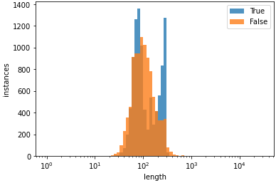
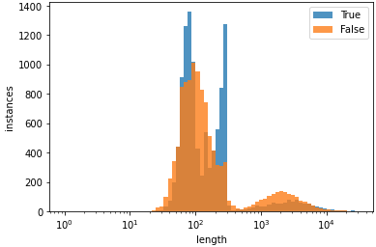
Methodology and Implementation
tweets
article and tweets
Baraa Ragab Tbab
7

Slide 8
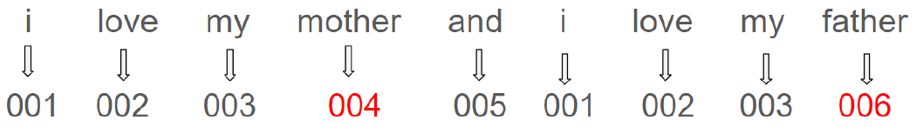
Methodology and Implementation
Create the Tokenizer
Tensorflow Tokenizer.
BERT ‘paraphrase- MiniLM-L6-v2’ encoder (Sentence Transformer).
Baraa Ragab Tbab
8

Slide 9
Methodology and Implementation
Models Implementation
Keras Sequential Model
k-Nearest Neighbors Model (KNN)
Naive-Bayes Model (NB)
Support Vector Machine Model(SVM)
Ensemble Model
Baraa Ragab Tbab
9

Slide 10
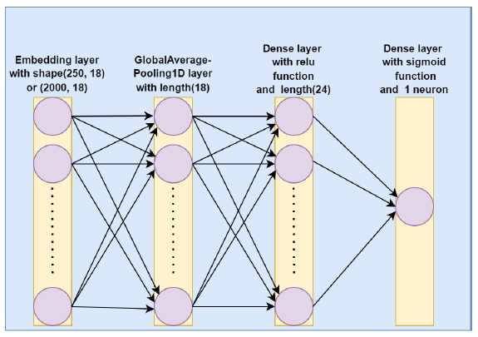
Methodology and Implementation
Models Implementation
The structure of the Keras model used in this thesis.
Keras Sequential Model
k-Nearest Neighbors Model (KNN)
Naive-Bayes Model (NB)
Support Vector Machine Model(SVM)
Ensemble Model
Baraa Ragab Tbab
10

Slide 11
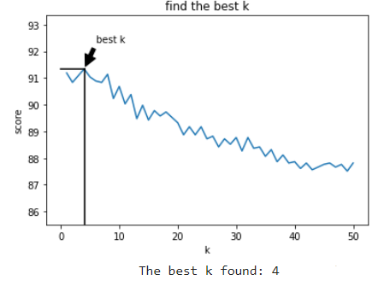
Methodology and Implementation
Models Implementation
Keras Sequential Model
k-Nearest Neighbors Model (KNN)
Naive-Bayes Model (NB)
Support Vector Machine Model(SVM)
Ensemble Model
Baraa Ragab Tbab
11

Slide 12
Methodology and Implementation
Models Implementation
SVM
with
probability
uses 5-fold cross-validation internally
5 times slower
usable with LIME
Keras Sequential Model
k-Nearest Neighbors Model (KNN)
SVM
Naive-Bayes Model (NB)
SVM
without
probability
Support Vector Machine Model(SVM)
Ensemble Model
Baraa Ragab Tbab
12

Slide 13
Methodology and Implementation
Models Implementation
The structure of the Ensemble Model used in this thesis
Keras Sequential Model
keras
Fake
k-Nearest Neighbors Model (KNN)
x
Naive-Bayes Model (NB)
Corona news
NB
Support Vector Machine Model(SVM)
Y
Ensemble Model
True
SVM
z
Baraa Ragab Tbab
13

Slide 14
Contents
Introduction and Motivation
Methodology and Implementation
Experiments and Evaluation
Summary
Baraa Ragab Tbab
14

Slide 15
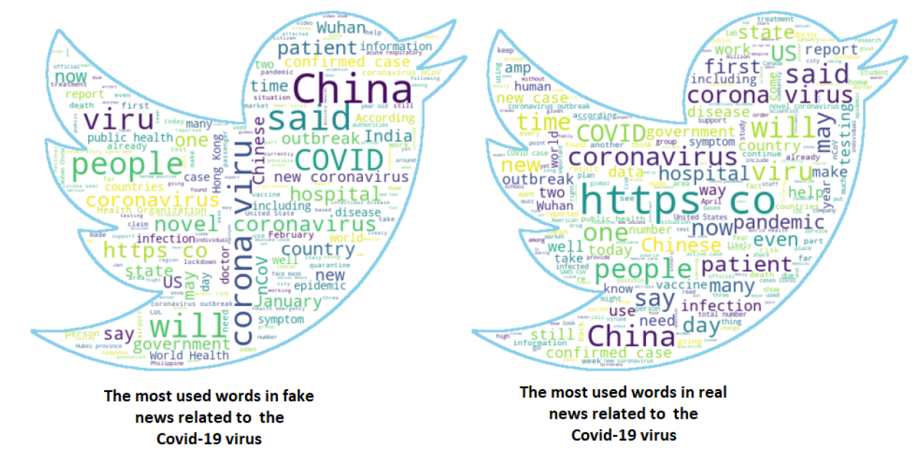
Experiments and Evaluation
Experiments
dataset type | preprocessed | number of instances
Tweets | yes | 19850
Tweets | no | 19852
Articles and Tweets | yes | 21940
Articles and Tweets | no | 21944
The dataset used in this figure is Articles and Tweets without preprocessing
Baraa Ragab Tbab
15

Slide 16
Experiments and Evaluation
Experiments
experiments | used model | running time
1 | keras sequential | 60 minutes
2 | KNN | 90 minutes
3 | Naive-Bayes | 48 seconds
4 | SVM | 9.5 hours
Baraa Ragab Tbab
16

Slide 17
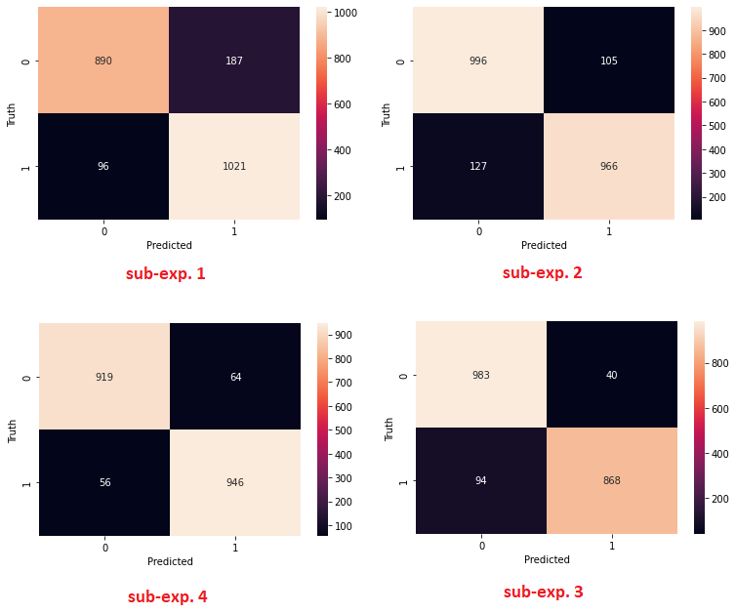
Experiments and Evaluation
The first experiment (Keras Sequential Model)
sub-exp. | dataset | preprocessed | accuracy | f1-score
1 | Articles and Tweets | yes | 0.86 | 0.86
2 | Articles and Tweets | no | 0.88 | 0.87
3 | Tweets | yes | 0.91 | 0.91
4 | Tweets | no | 0.93 | 0.93
average |  |  | 0.89 | 0.89
Baraa Ragab Tbab
17

Slide 18
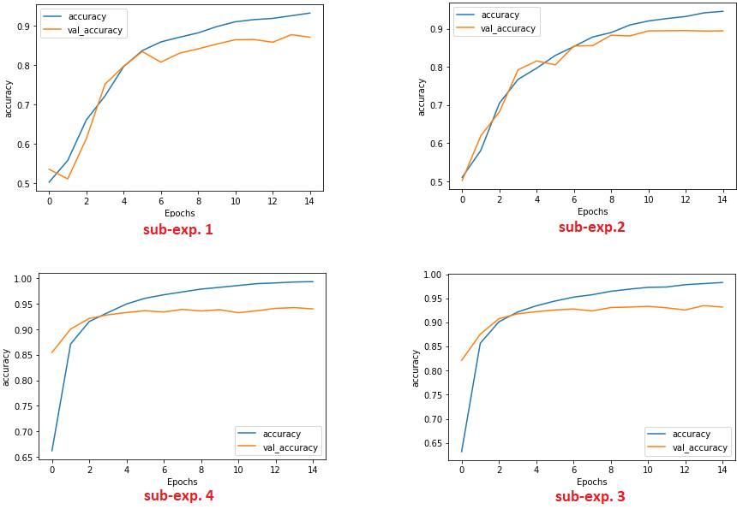
Experiments and Evaluation
The first experiment (Keras Sequential Model)
sub-exp. | dataset | preprocessed | accuracy | f1-score
1 | Articles and Tweets | yes | 0.86 | 0.86
2 | Articles and Tweets | no | 0.88 | 0.87
3 | Tweets | yes | 0.91 | 0.91
4 | Tweets | no | 0.93 | 0.93
average |  |  | 0.89 | 0.89
Baraa Ragab Tbab
18

Slide 19
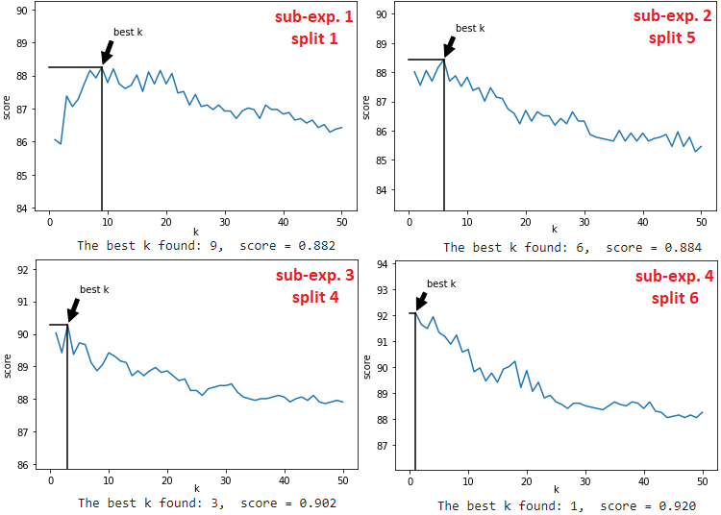
Experiments and Evaluation
The second experiment (KNN Model)
sub-exp. | dataset | preprocessed | accuracy | f1-score
1 | Articles and Tweets | yes | 0.88 | 0.87
2 | Articles and Tweets | no | 0.88 | 0.88
3 | Tweets | yes | 0.90 | 0.90
4 | Tweets | no | 0.91 | 0.91
average |  |  | 0.89 | 0.89
Baraa Ragab Tbab
19

Slide 20
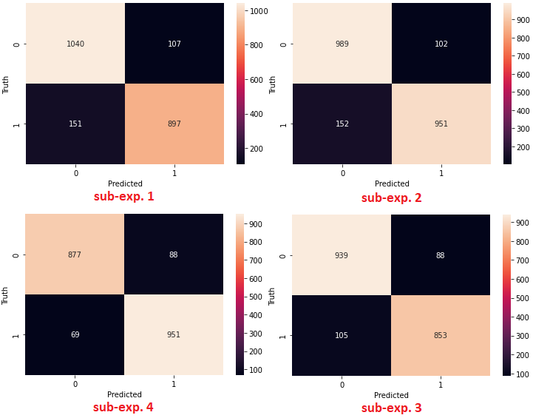
Experiments and Evaluation
The second experiment (KNN Model)
sub-exp. | dataset | preprocessed | accuracy | f1-score
1 | Articles and Tweets | yes | 0.88 | 0.87
2 | Articles and Tweets | no | 0.88 | 0.88
3 | Tweets | yes | 0.90 | 0.90
4 | Tweets | no | 0.91 | 0.91
average |  |  | 0.89 | 0.89
Baraa Ragab Tbab
20

Slide 21
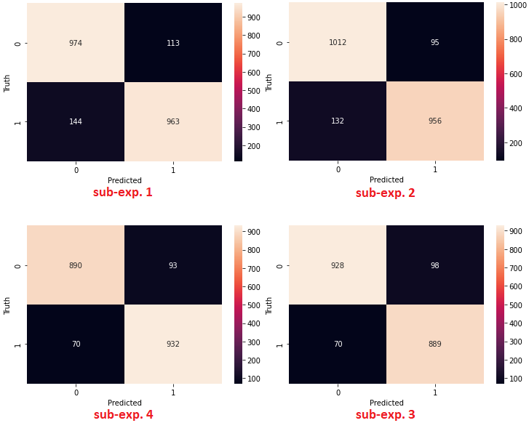
Experiments and Evaluation
The third experiment (Naive-Bayes Model)
sub-exp. | dataset | preprocessed | accuracy | f1-score
1 | Articles and Tweets | yes | 0.88 | 0.88
2 | Articles and Tweets | no | 0.88 | 0.88
3 | Tweets | yes | 0.91 | 0.91
4 | Tweets | no | 0.92 | 0.92
average |  |  | 0.90 | 0.90
Baraa Ragab Tbab
21

Slide 22
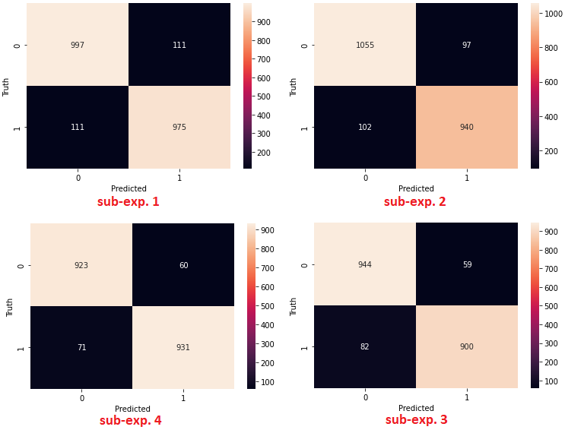
Experiments and Evaluation
The fourth experiment (SVM Model)
sub-exp. | dataset | preprocessed | accuracy | f1-score
1 | Articles and Tweets | yes | 0.90 | 0.90
2 | Articles and Tweets | no | 0.91 | 0.91
3 | Tweets | yes | 0.93 | 0.93
4 | Tweets | no | 0.93 | 0.93
average |  |  | 0.92 | 0.92
Baraa Ragab Tbab
22

Slide 23
Experiments and Evaluation
Comparison of the results of the four experiments:
experiment | used model | tokenizer/encoder | running time | accuracy
1 | Keras (sequential) | Tensorflow tokenizer | 60 minutes | 0.89
2 | KNN | BERT encoder | 90 minutes | 0.89
3 | Naive-Bayes | - | 48 seconds | 0.90
4 | SVM | - | 9.5 hours | 0.92
average |  |  |  | 0.90
Baraa Ragab Tbab
23

Slide 24
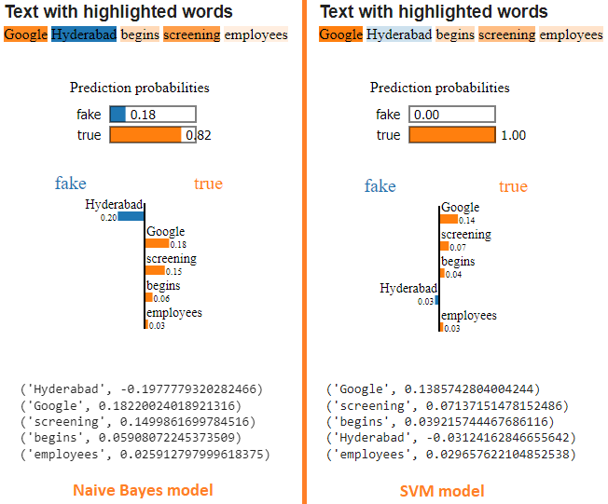
Experiments and Evaluation
Using LIME Explainer to Explain the Models results:
Baraa Ragab Tbab
24

Slide 25
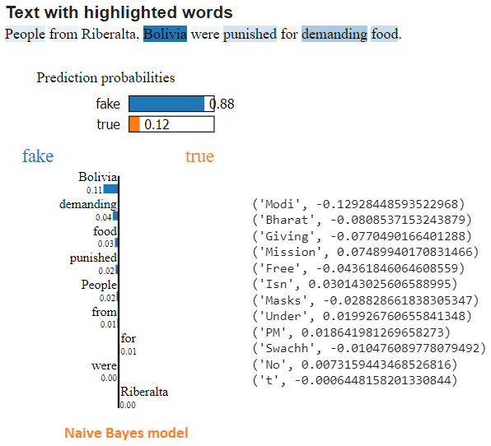
Experiments and Evaluation
Using LIME Explainer to Explain the Models results:
Baraa Ragab Tbab
25

Slide 26
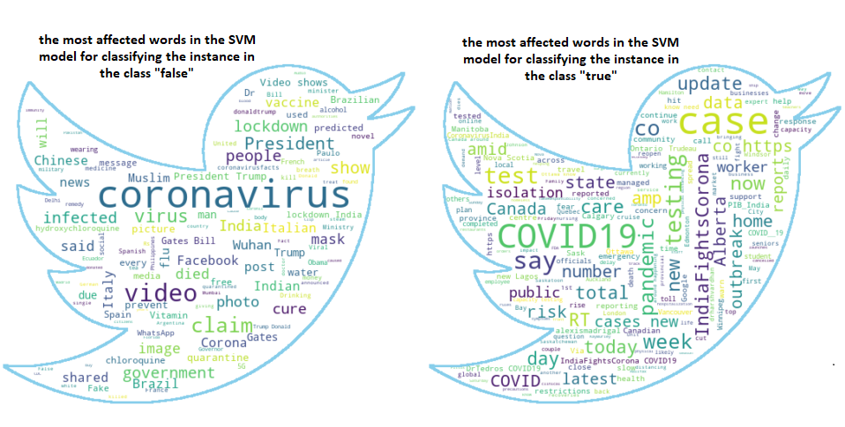
Experiments and Evaluation
Word Cloud
The dataset used in this figure is Articles and Tweets without preprocessing
Baraa Ragab Tbab
26

Slide 27
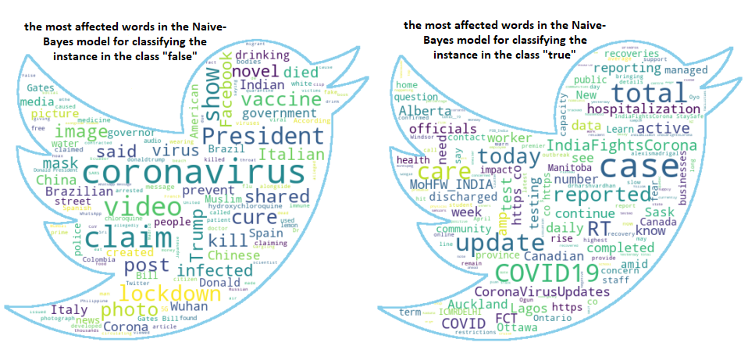
Experiments and Evaluation
Word Cloud
The dataset used in this figure is Articles and Tweets without preprocessing
Baraa Ragab Tbab
27

Slide 28
Experiments and Evaluation
Ensemble Model
used model | used dataset | accuracy
Keras (sequential) | Tweets without preprocessing | 0.93
KNN | Tweets without preprocessing | 0.91
Naive-Bayes | Tweets without preprocessing | 0.92
SVM | Tweets without preprocessing | 0.93
ensemble mode | Tweets without preprocessing | 0.94
Baraa Ragab Tbab
28

Slide 29
Contents
Introduction and Motivation
Methodology and Implementation
Experiments and Evaluation
Summary
Baraa Ragab Tbab
29

Slide 30
Summary
In the context of these experiments it was found:
No significant differences in the performance of the models used in this experiment.
There are significant differences between the models in terms of the time needed to create, train and test the model.
Data preprocessing does not necessarily improve the performance of the machine learning model.
The performance of the model, and its decisions can be explained (LIME, word cloud).
the performance of the Ensemble model is better than the performance of each model separately.
Baraa Ragab Tbab
30

Slide 31
Baraa Ragab Tbab
31

