Slide 1
Robust Locomotion Under Dynamics Shift
PPO vs. SAC with Domain Randomization in Hopper-v5
Suresh Tammana · Reinforcement Learning Project, Part 2 · October 2026
12
3,000
25
trained agents
robustness episodes
dynamics conditions
Notes:
Hello, I'm Suresh Tammana. My project asks whether a reinforcement-learning locomotion policy that works well in its training simulator keeps working when the physics changes. I compare PPO and SAC, each trained with fixed physics and with domain randomization, on the MuJoCo Hopper: 12 agents, tested in 3,000 episodes across 25 combinations of mass and friction.

Slide 2
Problem and motivation
A controller that only works in its training simulator is not a reliable controller
Research question from Part 1
How do algorithm choice and domain randomization affect the trade-off between peak performance and robustness to dynamics shift in learned locomotion?
TRAIN
PPO or SAC, nominal or randomized physics
1
TEST
25 mass × friction conditions, 10 episodes each
2
Why it matters
Simulators never match real robots exactly; payload, wear and surfaces change mass and friction.
Deep RL policies can fail under modest parameter changes (Rajeswaran et al., 2017).
So I separate training performance from robustness testing.
MEASURE
Return, success, in- vs. out-of-distribution
3
Notes:
Real robots never match their simulator exactly, so a controller that only works in its training physics is not reliable. In Part 1 I asked how algorithm choice and domain randomization affect the trade-off between peak performance and robustness. To answer it, I train each policy, then test it on a controlled grid of physics changes and measure return, success, and the gap between conditions inside and outside the training range. This matters because payload, wear and surfaces all change these parameters on a real robot.

Slide 3
Background
Two families of continuous-control algorithms, plus one robustness technique
P
PPO
S
SAC
D
Domain randomization
On-policy policy gradient. A clipped surrogate objective keeps each update small and stable. Discards data after each update.
Off-policy actor–critic. Learns from a replay buffer and maximizes return plus policy entropy, which aids exploration and sample efficiency.
Resample physics during training so the policy must work across a range of dynamics. The policy never observes the sampled values.
Schulman et al., 2017
Haarnoja et al., 2018
Tobin et al., 2017; Peng et al., 2018
Closest prior work: EPOpt trained Hopper on an ensemble of perturbed models and stayed robust to torso-mass changes where nominal policies failed (Rajeswaran et al., 2017). Evaluation caution: MuJoCo results vary widely across random seeds, so few-seed comparisons can mislead (Henderson et al., 2018).
Notes:
PPO is on-policy and stabilizes learning by clipping each policy update. SAC is off-policy: it reuses experience from a replay buffer and adds an entropy bonus, which usually makes it more sample-efficient. Domain randomization resamples the physics every episode, and the policy never sees the values, so it must learn behavior that works across them. EPOpt showed robustness gains on this same Hopper task, and Henderson and colleagues warned that MuJoCo results vary a lot between seeds. That warning turns out to be central to my results.

Slide 4
Hypotheses from Part 1
Each prediction had a pre-specified test
Sample efficiency
Under nominal training, SAC learns faster than PPO.
Test
Larger learning-curve area; reaches return 1,500 in fewer steps
H1
Brittleness
Nominally trained policies are brittle out of distribution.
Test
Robustness ratio (OOD return ÷ nominal return) below 0.70
H2
Randomization
Domain randomization improves robustness at a small cost.
Test
Higher robustness ratio and OOD success; under 10% nominal-return loss
H3
Notes:
Part 1 set three hypotheses with fixed tests. H1: SAC learns faster than PPO under nominal training. H2: nominally trained policies keep less than 70 percent of their return out of distribution. H3: randomization raises robustness while costing less than 10 percent of nominal return. I'll return to each with a verdict. Each one has a numeric test, so the verdicts don't depend on my interpretation.

Slide 5
Experimental design
A 2 × 2 design, trained on equal budgets and tested on a shared 5 × 5 physics grid
PPO
Nominal
PPO
Randomized
1.4
1.2
SAC
Nominal
SAC
Randomized
Mass scale
1.0
0.8
Gymnasium Hopper-v5 (MuJoCo), Stable-Baselines3
500,000 environment steps per run; 3 seeds per condition = 12 agents
Randomized training: mass × U[0.8, 1.2], friction × U[0.7, 1.3], resampled each episode
Validation every 25,000 steps: 10 deterministic nominal episodes
Test: final policy, 10 deterministic episodes per grid cell
0.6
0.5
0.75
1.0
1.25
1.5
Friction scale
Nominal
In-distribution (9)
Out-of-distribution (16)
Notes:
Two algorithms times two training regimes gives four conditions, each trained with three seeds for 500,000 steps: 12 agents. Randomized training scales mass between 0.8 and 1.2 and friction between 0.7 and 1.3. Every agent is then tested on this five-by-five grid, ten episodes per cell. The dark center is nominal, the nine teal cells are inside the training range, and the sixteen grey cells are out-of-distribution. All agents get identical starting conditions in each cell. Validation runs every 25,000 steps on nominal physics.

Slide 6
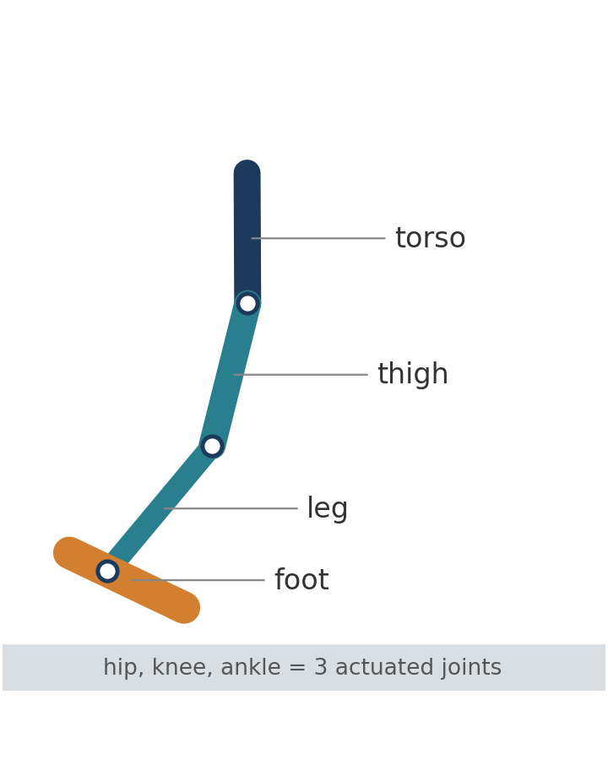
Environment: state, action, reward
Dynamics shift changes the physics, not what the policy observes
State
11 values: torso height and angle, 3 joint angles, 6 velocities. Mass and friction are not observed.
Action
3 continuous joint torques in [−1, 1] (hip, knee, ankle).
Reward
Forward velocity + 1 per step alive − small control cost on squared torques. Built-in reward, no shaping.
Episode end
Robot becomes unhealthy (torso too low or tilted) or 1,000 steps (8 s) elapse.
Success
Survive all 1,000 steps and move the torso at least 3 m forward.
Notes:
The Hopper is a one-legged planar robot with three actuated joints. It observes eleven values, such as torso height and joint angles and velocities, and outputs three torques. I used the built-in reward: forward velocity, plus a bonus for staying upright, minus a small torque cost. An episode counts as a success only if the robot survives all 1,000 steps and moves at least three meters. Importantly, mass and friction are never observed. That way, a robot that just balances in place doesn't count as a success.

Slide 7
Implementation
Stable-Baselines3 for both algorithms, so code base and network size don't confound the comparison
Setting | PPO | SAC
Networks (actor, critic) | 2 × 256, tanh | 2 × 256, ReLU
Learning rate; discount γ | 3e-4; 0.99 | 3e-4; 0.99
Data per update | 2,048-step rollouts, 10 epochs, batch 64 | 1M replay buffer, batch 256, 1 step per env step
Algorithm-specific | Clip 0.2, GAE λ 0.95, entropy coef. 0 | τ 0.005, automatic entropy, 10K random start steps
Hardware | Colab CPU | Colab NVIDIA L4 GPU
Dynamics wrapper
Scales all body masses and all contact friction relative to stored nominal MuJoCo values, so changes never accumulate. Resamples each training episode.
Evaluation
Deterministic actions; evaluation seeds separate from training seeds; the final policy is tested, not the best checkpoint. Checkpoints every 100K steps for recovery.
Tools: Python, Gymnasium + MuJoCo, Stable-Baselines3 / PyTorch, NumPy, pandas, Matplotlib, Google Colab + Drive.
Notes:
Both algorithms use Stable-Baselines3 with two layers of 256 units and standard, untuned MuJoCo settings, so implementation differences don't confound the comparison. A custom wrapper scales mass and friction relative to the stored nominal values, so changes never accumulate between episodes. Evaluation uses deterministic actions, separate seeds, and the final policy rather than the best checkpoint, which avoids overstating performance. PPO trained on CPU, but SAC needed a GPU to finish in time, so I don't compare wall-clock time.

Slide 8
Changes from the Part 1 plan
Every deviation is disclosed, with its reason
Item | Part 1 plan | What I did | Why
Seeds | 5 per condition | 3 per condition | Runtime; Part 1's fallback rule
Hardware | Colab CPU for all | SAC on L4 GPU | SAC runtime; wall-clock not compared
PPO normalization | Observation and reward normalization | Not used; raw observations for both | Omitted in the final implementation
Budget | 500,000 steps | PPO ran 501,760 steps | PPO collects whole 2,048-step rollouts
Statistics | IQM with bootstrap CIs | IQM plus every seed shown | CIs are not meaningful with n = 3
Validation curves | Complete for all runs | Two SAC runs lack 25K–300K | Session crash; logs held in memory
Demo | MuJoCo camera video | Video drawn from MuJoCo state | Colab OpenGL renderer crashed
Notes:
Several things changed from Part 1, and I want to be transparent. I used three seeds instead of five because of runtime, as Part 1's fallback allowed. PPO ran without input normalization and actually trained 501,760 steps because it collects whole rollouts. With three seeds I report the interquartile mean and show every seed instead of confidence intervals. Two SAC runs lost early validation history in a Colab crash, and the demo is drawn from simulation state because the renderer crashed.

Slide 9
Learning curves (H1)
SAC learned faster on its complete seeds; PPO was unstable late in training
Learning-curve area
(mean validation return)
SAC 2,293
PPO 1,871
Steps to return 1,500
SAC 75K, 125K
PPO 75K, 175K, 225K
* SAC seed 0's first 300K steps of validation were lost and are not reconstructed, so SAC metrics use seeds 1 and 2. Each line is one seed (10 deterministic nominal episodes per point).
Notes:
These are the nominal-training validation curves, one line per seed. On its two complete seeds, SAC has a larger learning-curve area, 2,293 versus 1,871 for PPO, and reached a return of 1,500 by 75 to 125 thousand steps. So H1 is directionally supported, but two seeds can't confirm it. Notice PPO's instability: seed 0 reached about 2,900 at 425 thousand steps, then collapsed to about 1,200 by the end. Because Part 1 committed to testing the final policy rather than the best checkpoint, that late collapse is why PPO seed 0 counts as a failure.

Slide 10
Training challenges
Two engineering issues shaped how the results must be read
1
Interrupted SAC runs
2
PPO's last update
Colab crashed during SAC Nominal seed 0 and SAC Randomized seed 2.
Both resumed from 300K-step checkpoints: model weights, optimizer state and replay buffer, with the step counter continued.
Validation points 25K–300K were held in memory and lost. I did not reconstruct or interpolate them.
Fix for future work: write each validation row to disk immediately.
PPO trains in 2,048-step rollouts, so it stopped at 501,760 steps.
The "500K" validation ran inside the last rollout, before PPO's final update.
For two unstable PPO Randomized seeds, that one update changed nominal return sharply:
Seed 0
1,056
3,074
Seed 2
3,284
1,193
validation at 500K → final model
Notes:
Two engineering issues matter. First, two SAC runs crashed; I resumed both from 300-thousand-step checkpoints, including the replay buffer, but the early validation points were lost, and I left those gaps rather than inventing data. Second, PPO's 500-thousand-step validation happens just before its final update. For two unstable randomized seeds, that one update swung nominal return between about 1,000 and over 3,000, which shows how fragile these policies were. The lesson for me was to write every log entry to disk immediately.

Slide 11
Result 1: nominal performance
SAC Nominal was the most reliable learner: all 3 seeds succeeded
SAC Nominal
3 of 3 seeds succeed · IQM 3,281
100% nominal success
PPO Nominal
2 of 3 seeds succeed · IQM 2,979
Seed 0 collapsed late in training
Randomized training
One failed seed per algorithm (1,193 and 1,621)
Notes:
At nominal physics, the successful policies all score between about 3,000 and 3,400, so peak performance is similar. The real difference is reliability. SAC Nominal succeeded on all three seeds, with 100 percent success. PPO Nominal succeeded on two of three; seed 0 is the late collapse from the learning curves. Each randomized configuration also had one failed seed. So SAC Nominal is best described as the most reliable learner, with an interquartile mean of 3,281, versus 2,979 for PPO Nominal.

Slide 12
Result 2: robustness across 25 conditions
One PPO Randomized seed was exceptional; the configuration as a whole was not
PPO Randomized, seed 1
51% grid success: more than twice any other agent. Its other two seeds: 3% and 8%.
Grid return | Mean | IQM
PPO Nominal | 993 | 969
PPO Randomized | 1,326 | 1,193
SAC Nominal | 1,012 | 1,032
SAC Randomized | 1,108 | 1,061
The mean is pulled up by one seed; the IQM is the Part 1 metric.
Notes:
Across all 25 conditions, success is low for everyone. The standout is PPO Randomized seed 1, with 51 percent grid success, more than twice any other agent, but its other two seeds reached only 3 and 8 percent. That one seed is why PPO Randomized has the highest mean grid return, 1,326. Using the interquartile mean that Part 1 specified, it is still highest, but the gap shrinks to about 130 points. So randomization produced a very robust policy on only one of three seeds, exactly the seed variance Henderson warned about.

Slide 13
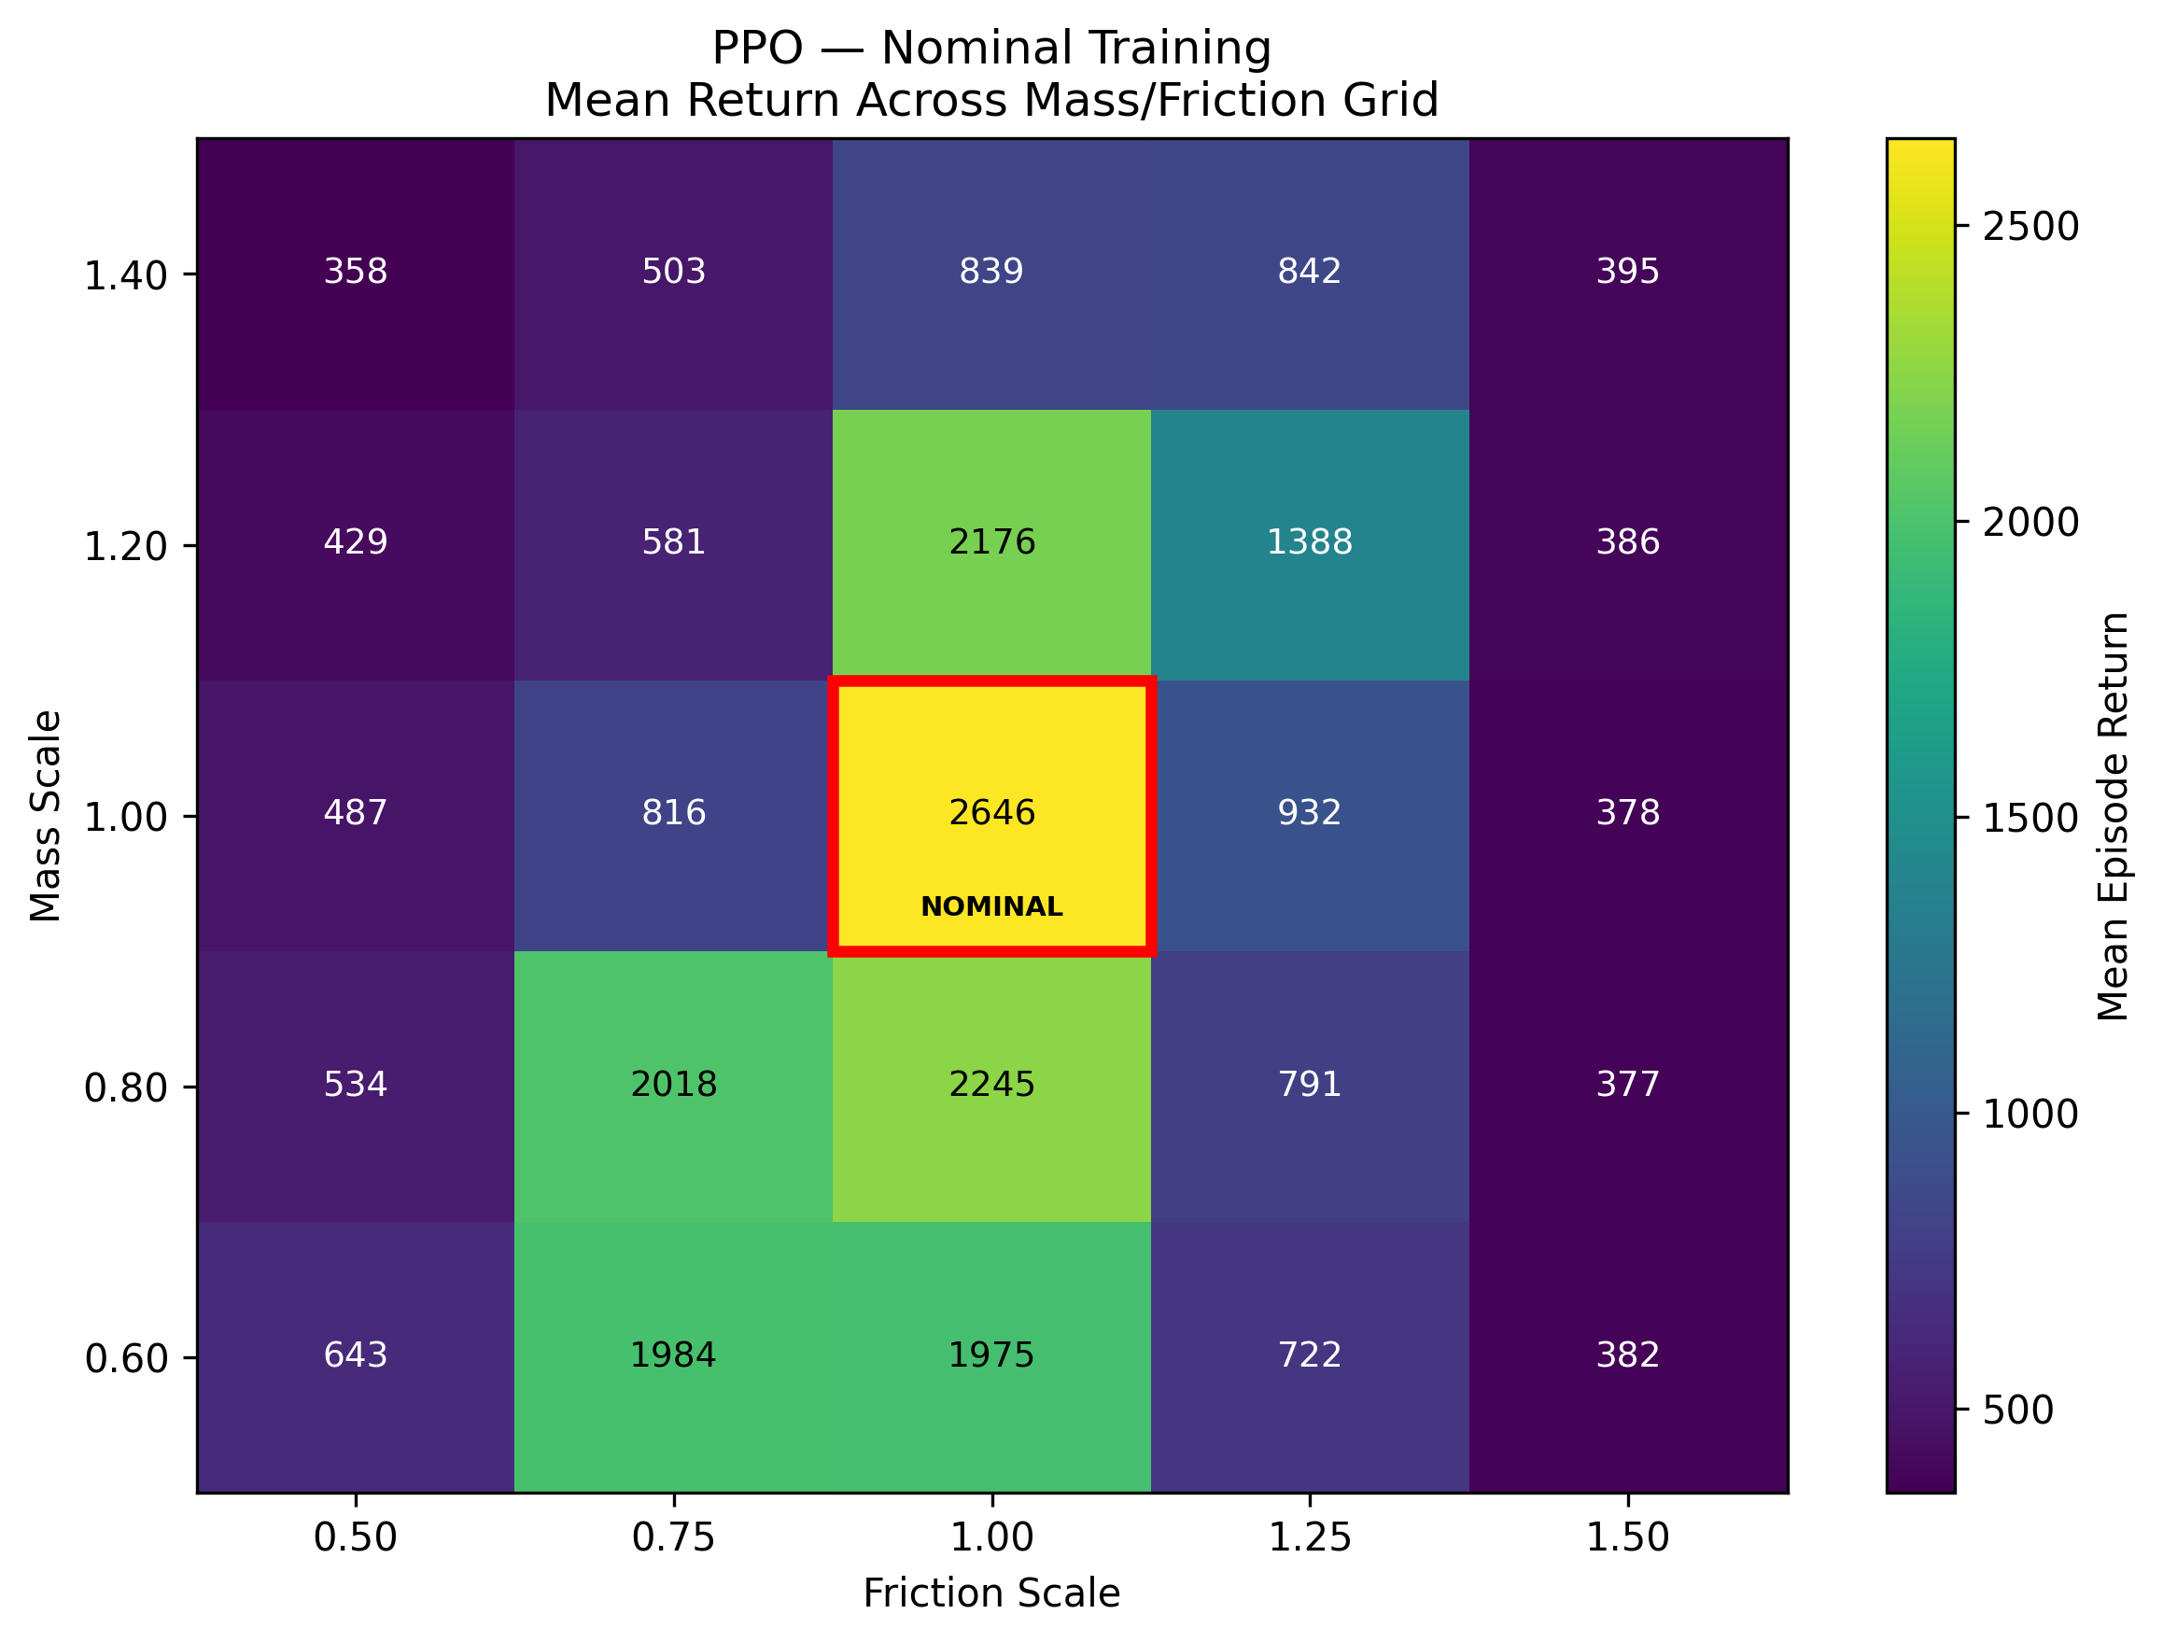
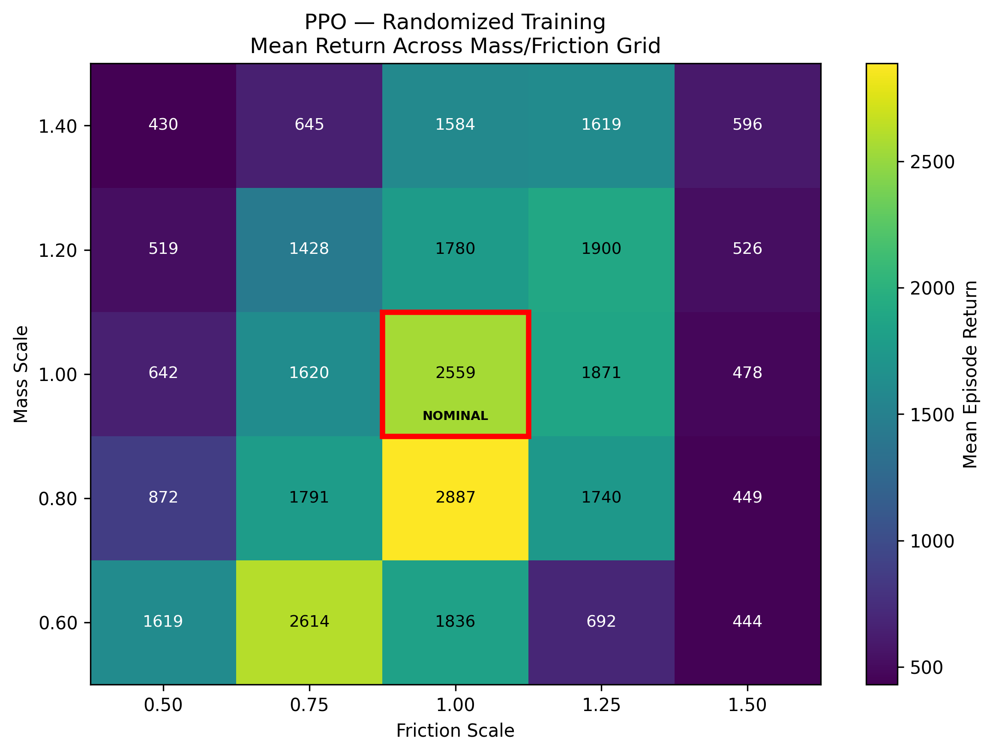
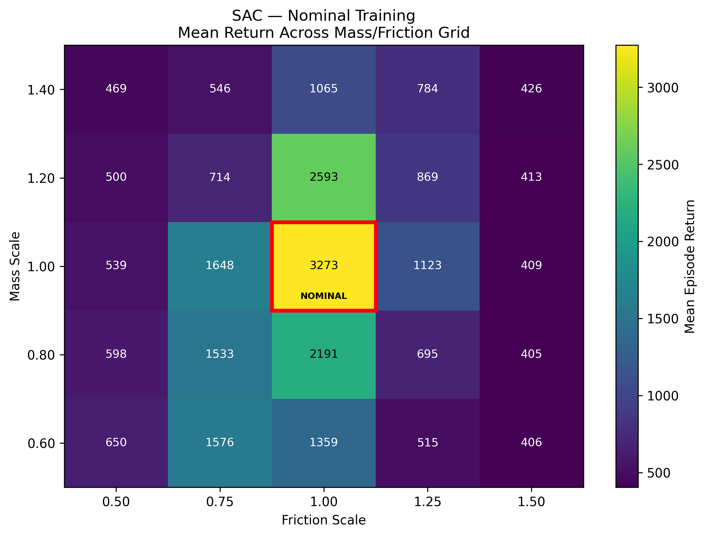
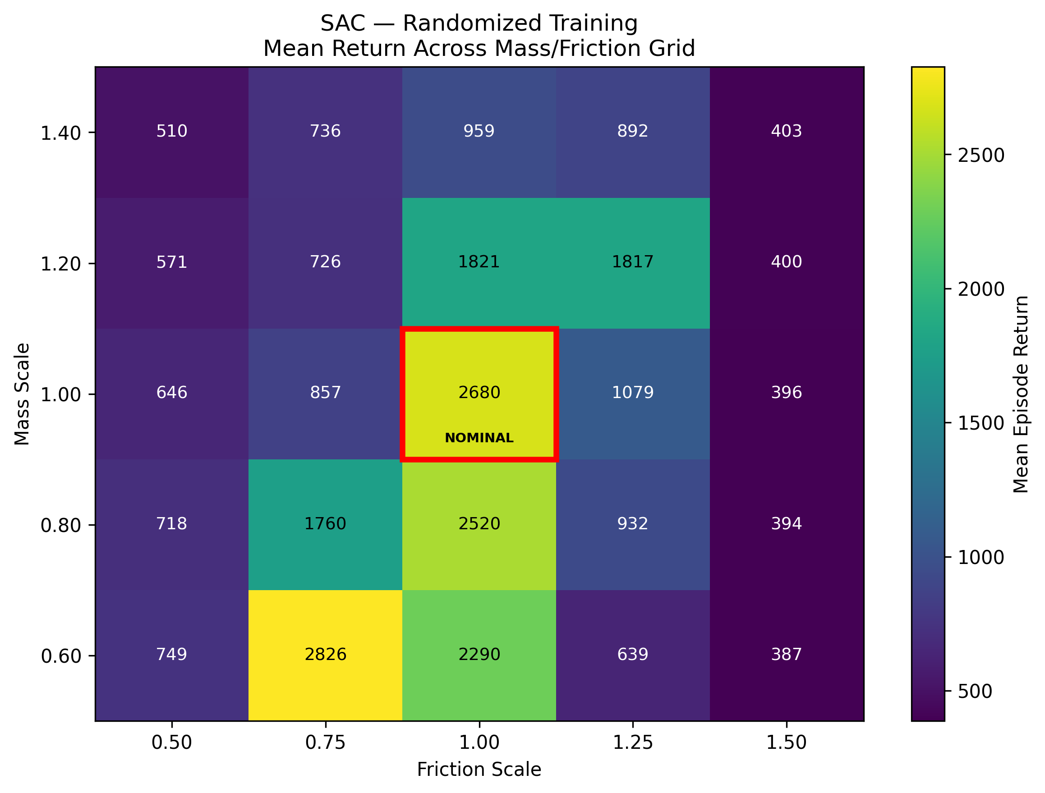
Where policies break
High friction defeats every policy; randomized PPO has the widest working region
What the maps show
High friction (1.5×) breaks every policy: every cell in that column scores below 600.
Nominal training gives a narrow peak: SAC Nominal scores 3,273 at the center but only 1,123–1,648 one step away in friction.
PPO Randomized keeps every in-distribution cell at 1,428 or above, the widest working region (helped most by seed 1).
Rows: mass 0.6–1.4. Columns: friction 0.5–1.5. Red box: nominal.
Notes:
These heatmaps show mean return in every grid cell, averaged over three seeds; the red box marks nominal physics. Three patterns stand out. First, high friction was the hardest shift: at 1.5 times friction, every configuration scores below 600. Second, nominal training gives a narrow peak: SAC Nominal scores 3,273 at the center but drops to between about 1,100 and 1,650 just one step away in friction. Third, PPO Randomized has the widest working region, with every in-distribution cell above 1,400, partly thanks to its exceptional seed 1.

Slide 14
Result 3: what domain randomization changed
Randomization raised out-of-distribution return, most consistently for SAC
SAC
Every randomized seed (803–923) beats every nominal seed (479–770).
PPO
IQM 956 vs. 700, but the seed ranges overlap.
Not solved
Best OOD success IQM: only 9%.
Notes:
Looking only at the out-of-distribution cells, randomization helped. For SAC, every randomized seed beats every nominal seed, the cleanest result in the study. For PPO, the interquartile mean rises from 700 to 956, but the seed ranges overlap, so the evidence is weaker. Still, the best out-of-distribution success rate is only about 9 percent: randomization made failure more graceful, but it didn't solve robustness.

Slide 15
Hypothesis scorecard
Brittleness is confirmed; the benefits of SAC and randomization hold only partly
 | Prediction | Evidence (IQM across seeds) | Verdict
H1 | SAC learns faster than PPO | Curve area 2,293 vs. 1,871; return 1,500 by 75–125K vs. 75–225K (SAC: 2 complete seeds) | Directional
H2 | Nominal policies keep < 70% of return OOD | Robustness ratio PPO 0.28, SAC 0.22; OOD success 2% | Supported
H3 | Randomization raises robustness at < 10% nominal cost | Ratio 0.28→0.42 (PPO), 0.22→0.32 (SAC); OOD success 2→9%, 2→7%; nominal loss 5.5% (PPO), 10.7% (SAC) | Partly
Goal | IQM nominal return ≥ 1,500 and success ≥ 80% | PPO 2,979 and 83%; SAC 3,281 and 100%; all 4 conditions × 3 seeds tested | Met
Ratios include failed seeds as computed in the pre-specified analysis, which inflates them; among seeds that learned to hop, every ratio is ≤ 0.37.
Notes:
Against the Part 1 tests: H1 is directionally supported, but two seeds are too few to confirm it. H2 is clearly supported: nominal policies kept only about a quarter of their return out of distribution, far below the 0.70 threshold. For example, the robustness ratio was 0.28 for PPO and 0.22 for SAC. H3 is partly supported: randomization raised robustness for both algorithms, and PPO's nominal cost was within the 10 percent limit, but SAC's, at 10.7 percent, was just over. The Part 1 success criterion was met. Both nominally trained algorithms exceeded a return of 1,500 with at least 80 percent success.

Slide 16
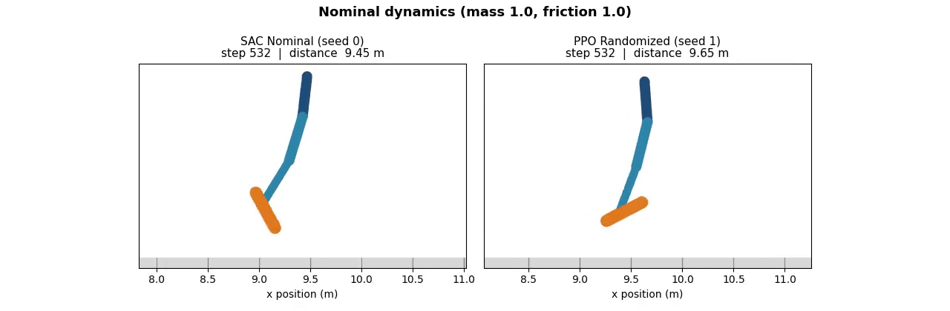
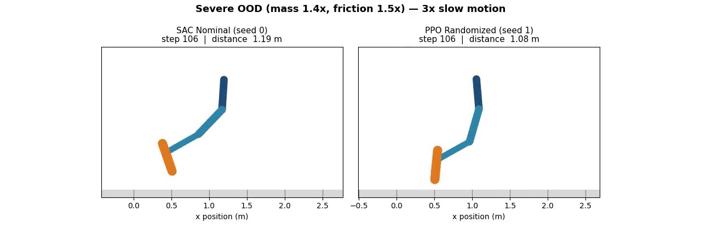
Demonstration: trained policies in Hopper-v5
Both walk at nominal physics; at 1.4× mass and 1.5× friction both fail, PPO Randomized later
Nominal dynamics · real time
SAC Nominal: 1,000 steps · 18.64 m · return 3,330
PPO Randomized: 1,000 steps · 19.24 m · return 3,404
Severe OOD: mass 1.4×, friction 1.5× · 3× slow motion
SAC Nominal: falls at step 153 · 2.04 m
PPO Randomized: falls at step 223 · 4.05 m
Actual deterministic rollouts of the trained policies, drawn from MuJoCo simulation state. Best seed of each configuration; conclusions rest on the full 3,000-episode grid.
Notes:
Here are real rollouts of the trained policies, drawn from the MuJoCo simulation state. [Play the top video.] At nominal physics, both SAC Nominal and PPO Randomized hop the full 1,000 steps, about 19 meters. [Play the bottom video.] Now with 40 percent more mass and 50 percent more friction, at one-third speed. Watch the knee buckle on landing. SAC Nominal fails at step 153; PPO Randomized lasts about 70 steps longer, then fails the same way. These are best seeds, so this illustrates the pattern rather than proving it. PPO Randomized saw heavier bodies during training, which may explain why it holds on longer. Notice that both robots fall the same way, so randomization delayed the failure rather than preventing it.

Slide 17
Ethical and practical considerations
Simulation robustness is evidence, not a safety guarantee
S
Safety
R
Reliability and accountability
A policy that fails at 1.4× mass in simulation could damage hardware or injure people on a real robot. Deployment would need safety constraints, staged testing and human oversight.
Only 1 of 3 randomized PPO seeds was robust. Certifying a controller from its best seed would be misleading, so all seeds must be reported and tested.
H
Honest reporting
D
Dual use and cost
Missing validation data was disclosed, not reconstructed. The demo shows labeled best seeds; aggregate claims use the full grid.
Robust legged locomotion has beneficial and military or surveillance uses. GPU training also carries energy and access costs.
Notes:
A policy that collapses at 1.4 times mass in simulation could damage a real robot or hurt someone, so deployment would need safety constraints, staged testing, and human oversight. Since only one of three randomized PPO seeds was robust, judging a controller by its best seed would be misleading, so I report every seed and disclosed my missing data. Robust locomotion is also dual-use, and GPU training has energy costs. I also labeled the demo clearly as best seeds.

Slide 18
Limitations and lessons learned
What constrains these conclusions, and what I would do differently
Limitations
Three seeds per condition: results hinge on single seeds and confidence intervals are not meaningful.
Mass scaling does not scale rotational inertia; friction scaling changes all three MuJoCo friction coefficients.
Return and the 3 m success rule are simplified proxies for real robot objectives.
Only one task (Hopper) and two physics parameters were tested.
What I learned
High nominal return and robustness are different properties and must be measured separately.
Seed variance can dominate an RL comparison: always show every seed and use robust statistics.
Log incrementally and checkpoint everything; long Colab runs will be interrupted.
Small implementation details (when PPO updates relative to evaluation) can change conclusions.
Notes:
The main limitation is three seeds: several conclusions hinge on one seed. Mass scaling also doesn't scale inertia, and I tested only one task. What I learned: nominal return and robustness are different properties, seed variance can dominate an RL comparison, long cloud runs must log and checkpoint incrementally, and small implementation details can change what the numbers seem to say. That's why every seed is on my slides.

Slide 19
Conclusion and future work
1
Brittleness is real
Every nominal policy kept at most 37% of its return out of distribution (H2).
Future work
5+ seeds with bootstrap confidence intervals
Scale inertia with mass; wider and continuous shifts
Adaptive randomization or recurrent policies
System identification before any hardware test
2
SAC was the reliable specialist
All 3 SAC Nominal seeds learned to hop; it was the strongest nominal configuration.
3
Randomization helps, unreliably
OOD return rose (every SAC seed), but strong robustness appeared in only 1 of 3 PPO seeds.
Takeaway: a policy that scores well in its training simulator is not automatically robust. Test under controlled shift, and report every seed.
Notes:
To conclude, three findings. First, brittleness is real: every nominally trained policy lost most of its return out of distribution. Second, SAC was the most reliable nominal learner, succeeding on all three seeds. Third, randomization helps but unreliably: it raised out-of-distribution return on every SAC seed, but strong robustness appeared in only one of three PPO seeds. For future work, I'd run at least five seeds with confidence intervals, scale inertia along with mass, and test wider shifts and adaptive randomization. The takeaway: a high benchmark score is not robustness. Test under controlled shift, and report every seed.

Slide 20
References
Agarwal, R., et al. (2021). Deep reinforcement learning at the edge of the statistical precipice. NeurIPS, 34, 29304–29320.
Haarnoja, T., Zhou, A., Abbeel, P., & Levine, S. (2018). Soft actor-critic. Proceedings of ICML, PMLR 80, 1861–1870.
Henderson, P., et al. (2018). Deep reinforcement learning that matters. Proceedings of AAAI, 32(1), 3207–3214.
Peng, X. B., Andrychowicz, M., Zaremba, W., & Abbeel, P. (2018). Sim-to-real transfer of robotic control with dynamics randomization. ICRA, 3803–3810.
Raffin, A., et al. (2021). Stable-Baselines3: Reliable reinforcement learning implementations. JMLR, 22(268), 1–8.
Rajeswaran, A., Ghotra, S., Ravindran, B., & Levine, S. (2017). EPOpt: Learning robust neural network policies using model ensembles. ICLR.
Schulman, J., Wolski, F., Dhariwal, P., Radford, A., & Klimov, O. (2017). Proximal policy optimization algorithms. arXiv:1707.06347.
Tobin, J., et al. (2017). Domain randomization for transferring deep neural networks from simulation to the real world. IROS, 23–30.
Todorov, E., Erez, T., & Tassa, Y. (2012). MuJoCo: A physics engine for model-based control. IROS, 5026–5033.
Notes:
These are my main references.

Slide 21
AI disclosure
How I used an AI assistant in Part 2
I used Claude (Anthropic) to:
Review my slides, notebooks and result files against the assignment rubric
Recompute per-seed statistics and IQMs from my own CSV outputs
Diagnose the Colab rendering crash and write the demo-video notebook
Draft this slide deck and the speaker notes
My responsibility
I designed the study in Part 1, ran all training and evaluation, checked every number in this deck against my result files, and take responsibility for the content and conclusions.
Notes:
Finally, I used Claude to review my work against the rubric, recompute per-seed statistics from my results, fix the demo rendering, and draft these slides and notes. I designed the study, ran the experiments, checked the numbers, and take responsibility for the conclusions. Thank you.

