Slide 1
Department of MCA
QR Code College Canteen Management System Under the Guidance of :- Dr MNV KIRAN BABU sir
By :- Tamma Rohith Reddy
Roll No :- 2401600139
Dept. of MCA. KL University.

Slide 2
Admin login
Login: Admins can securely log in using authorized credentials to access system features.
Canteen Staff Management: Admins can add, view, update, or remove canteen staff from the system.
Dashboard Management: A graphical dashboard displays real-time statistics including:
Report Generation: Admins can download revenue and user data in Excel format for analysis and record-keeping.
Feedback Management: Admins can view feedback submitted by students for service improvement.
Logout: Allows the administrator to safely exit the session.
Canteen login:
Login: Canteen staff can log in securely to manage daily operations.
Order Management: Staff can view pending and confirmed orders on a dashboard and update order status after delivery.
QR Code / Order ID Confirmation: Orders can be retrieved and confirmed quickly using QR code scanning or by entering the Order ID.
Food Item Management: Staff can add, delete, or update available food items on the menu.
Inventory Management: Staff can track stock levels and update item quantities in real time.
Logout: Allows staff to log out securely after completing tasks.
Student login:
Login: Students can securely log in to place orders and manage their accounts.
Menu Browsing: Students can view the list of available food items with prices and descriptions.
Order Placement: Students can add items to a cart, make payments, and receive an Order ID and a QR Code for order pickup.
Order History: Students can track previous orders and payment statuses.
Feedback Submission: Students can submit feedback to improve services.
Profile Management: Students can manage their personal and contact information.
Logout: Students can log out safely after using the system.

Slide 3
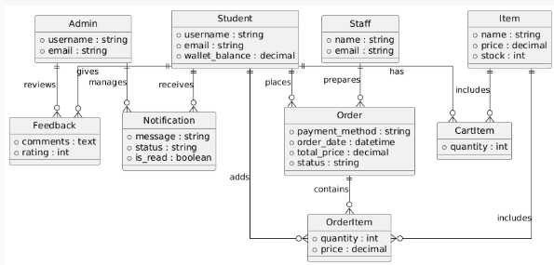

Slide 4
HARDWARE REQUIREMENTS:
Processor - I3/Intel Processor
RAM - 4GB (min)
Hard Disk - 160GB
SOFTWARE SYSTEM CONFIGURATION:
Operating System : Windows 7/8/10
Front-end : HTML, CSS, JavaScript
Backend : Django
IDE/Workbench : VS Code
Database : SQLLITE

Slide 5
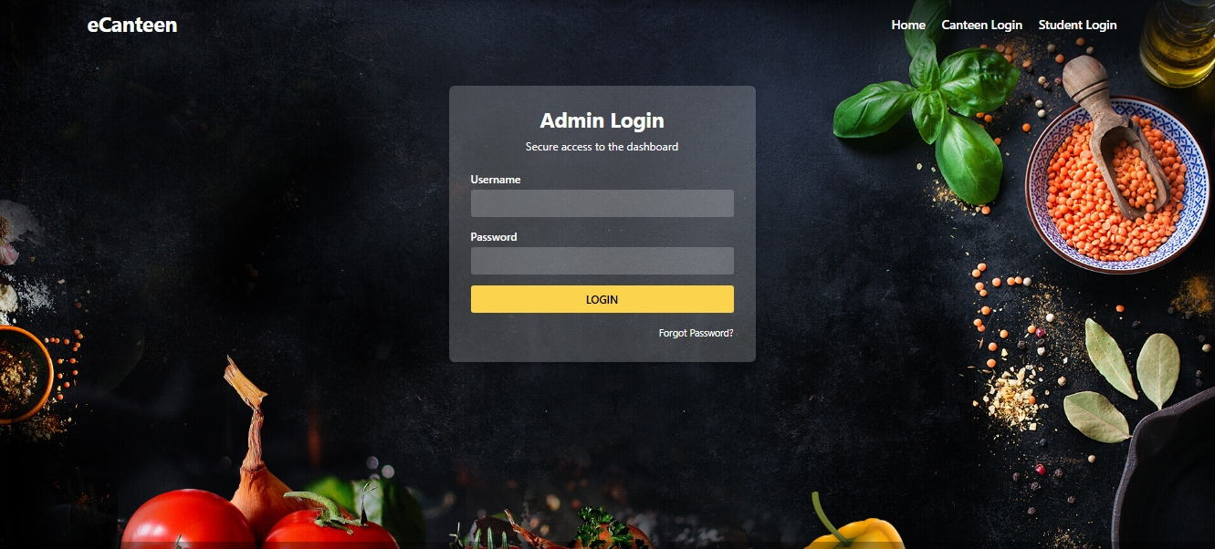

Slide 6
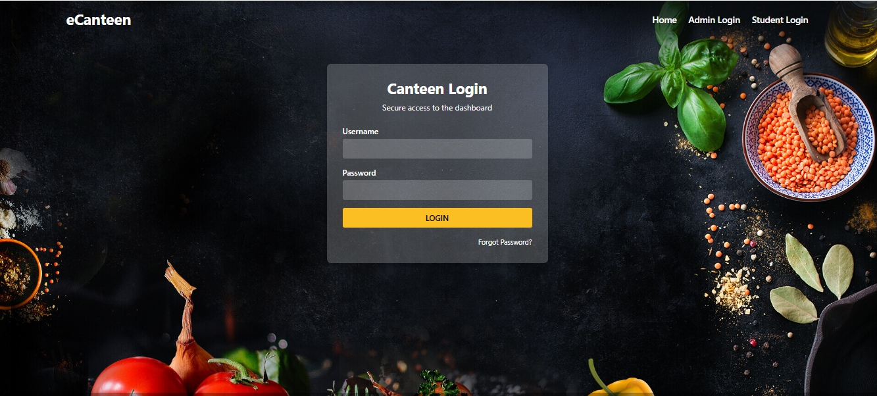

Slide 7
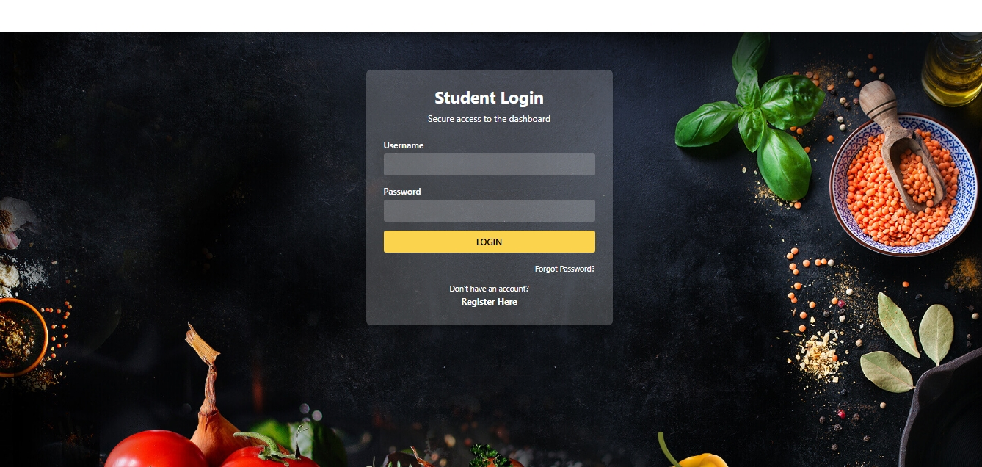

Slide 8
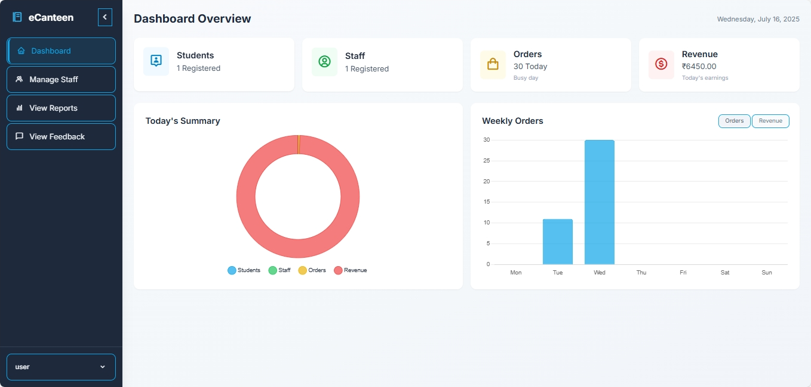
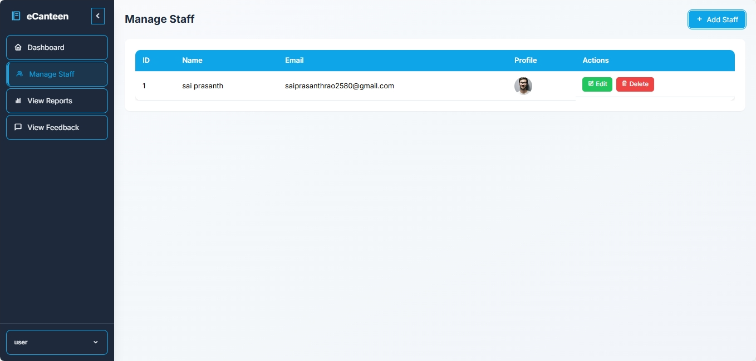
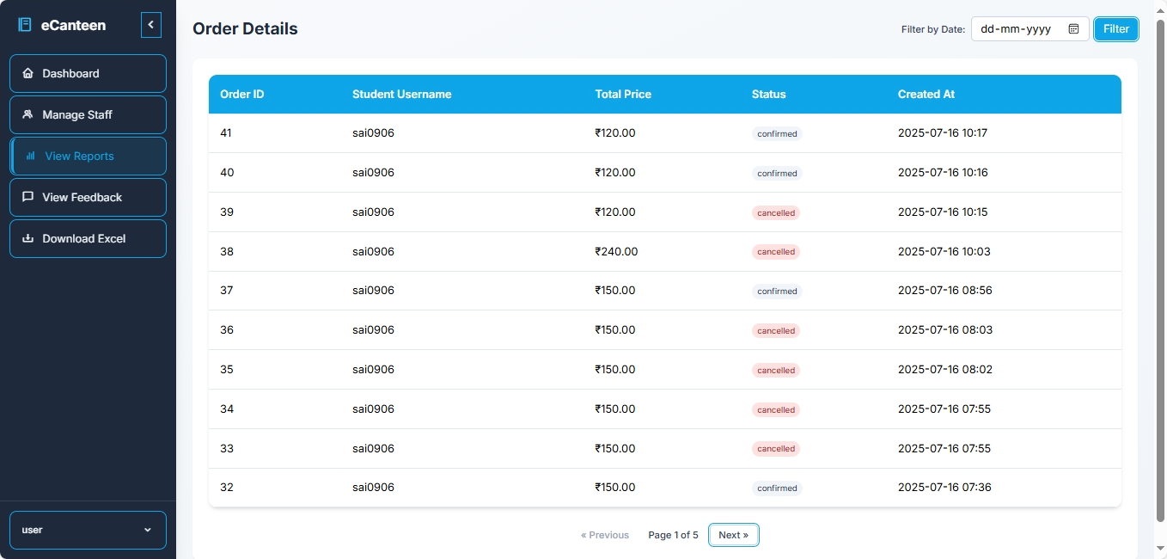
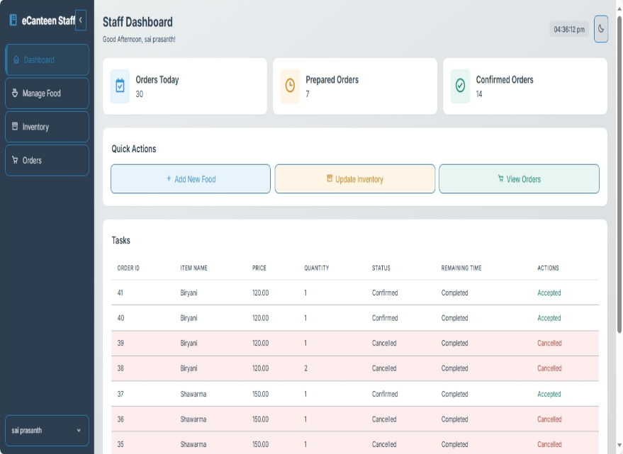

Slide 9
challenges
1. Enables fast and contactless order placement using QR codes and Order IDs.
2. Reduces waiting time and crowding in the canteen.
3. Provides real-time order tracking and confirmation for canteen staff.
4. Simplifies inventory management with instant stock updates.
5. Offers a centralized admin dashboard for monitoring students, staff, orders, and revenue.

Slide 10
FUTURE ENHANCEMETS
In the future, the QR-Based College Canteen Web Application can be enhanced with several advanced features to improve user experience and operational efficiency. Integrating a secure online payment gateway such as UPI or Razorpay would enable students to make instant, cashless payments. Developing a dedicated mobile application for Android and iOS can offer convenient access, real-time notifications, and on-the-go ordering. Incorporating AI-based food recommendations based on order history and preferences can personalize the user experience. Expanding support for multiple canteens or campuses through a centralized admin system will make the platform scalable. A feedback analytics dashboard can help the admin analyze user satisfaction and improve services over time. Lastly, enabling offline QR scanning with sync support can ensure uninterrupted operations even during network issues.

Slide 11
CONCLUSION
In conclusion, the QR-Based College Canteen Web Application provides an innovative, efficient, and contactless solution to streamline food ordering and management within educational institutions. By integrating modules for students, canteen staff, and administrators, the system ensures transparency, real-time updates, and ease of use across all user levels. The use of technologies like QR code scanning, Django backend, and a responsive frontend enhances the overall experience, reduces manual errors, and supports a digital-first approach. With the potential for future enhancements such as mobile apps, AI-driven recommendations, and payment gateway integration, this platform can evolve into a comprehensive smart canteen ecosystem that meets the growing demands of modern campus life.

Slide 12
THANK YOU

