Slide 1
Department of MCA
PROJECT TITLE :- QR-Based College Canteen Management System Under the Guidance of Dr MNV KIRAN BABU
By :
Student Name ROHITH
Roll No. 2401600139
Dept. of MCA. KL University.

Slide 2
ProblemStatement
Manual canteen ordering causes long queues, order mistakes, and payment delays, leading to poor user experience and inefficient management.
Clearly define the problem
College canteens face long queues, manual order taking, and payment delays, which waste time and reduce service efficiency for students and staff.
Existing issues / limitations
The current manual system leads to order errors, slow processing, poor record maintenance, and difficulty in managing peak-hour crowding.
Why this problem needs a solution
A digital QR-code based system speeds up ordering and payment, reduces errors, improves customer experience, and enables efficient canteen management.

Slide 3
Scope of the Project
The project focuses on digitizing the college canteen ordering and billing process using a QR-code based system for faster and efficient service.
What the system covers
The system covers QR code scanning, digital menu display, online order placement, order management, and basic payment tracking.
What is not included
The system does not include third-party delivery services, advanced analytics, or integration with external payment gateways beyond basic functionality.
Target users
The target users are college students, faculty members, canteen staff, and administrators managing daily canteen operations.

Slide 4
Proposed Solution
Overview of your solution → how it solves the problem
The proposed system uses QR codes to allow users to scan, view the menu, place orders, and make payments digitally, reducing waiting time and manual effort.
Key features
QR-based menu access, online order placement, digital billing, real-time order tracking, and an admin panel for managing orders and menu items.
Innovation / uniqueness (if any)
The use of QR codes eliminates the need for physical menus and counters, enabling a contactless, fast, and user-friendly canteen management solution.

Slide 5
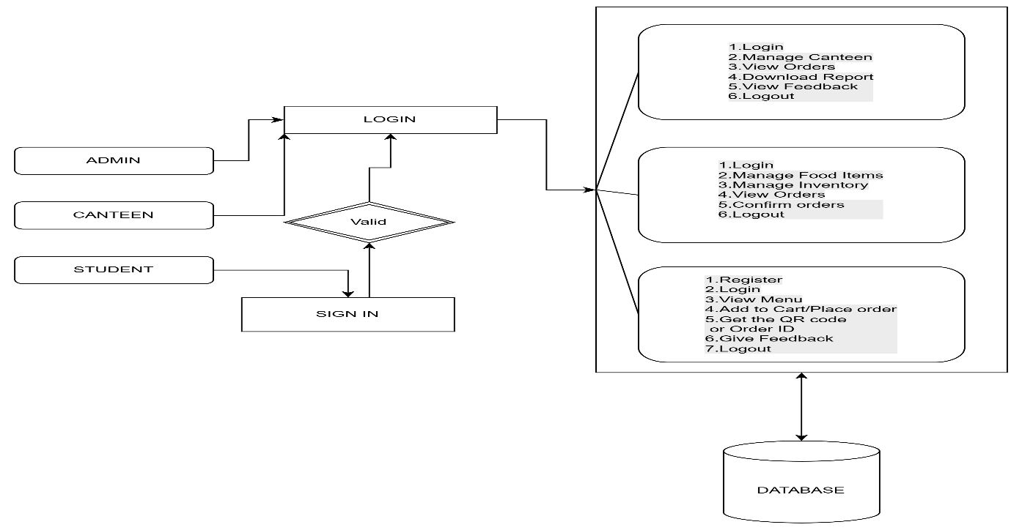
System Architecture
Components Explanation
The main components include the user interface (QR scan & menu), backend server for order processing, database for storing user and order details, and admin panel for management.
Data Flow Overview
User scans the QR code and places an order, which is sent to the server and stored in the database; the admin receives the order and updates the order status in real time.

Slide 6
Frontend
Technologies Used
HTML, CSS, and JavaScript
Backend
Django
Database
SQLLITE
Tools & Libraries
Tools such as VS Code, XAMPP, phpMyAdmin, and QR code libraries are used for development, testing, and database management.

Slide 7
Modules:
Admin Module:
Login: Admins can securely log in using authorized credentials to access system features.
Canteen Staff Management: Admins can add, view, update, or remove canteen staff from the system.
Dashboard Management: A graphical dashboard displays real-time statistics including:
Report Generation: Admins can download revenue and user data in Excel format for analysis and record-keeping.
Feedback Management: Admins can view feedback submitted by students for service improvement.
Logout: Allows the administrator to safely exit the session.
Canteen Module:
Login: Canteen staff can log in securely to manage daily operations.
Order Management: Staff can view pending and confirmed orders on a dashboard and update order status after delivery.
QR Code / Order ID Confirmation: Orders can be retrieved and confirmed quickly using QR code scanning or by entering the Order ID.
Food Item Management: Staff can add, delete, or update available food items on the menu.
Inventory Management: Staff can track stock levels and update item quantities in real time.
Logout: Allows staff to log out securely after completing tasks.
Student Module:
Login: Students can securely log in to place orders and manage their accounts.
Menu Browsing: Students can view the list of available food items with prices and descriptions.
Order Placement: Students can add items to a cart, make payments, and receive an Order ID and a QR Code for order pickup.
Order History: Students can track previous orders and payment statuses.
Feedback Submission: Students can submit feedback to improve services.
Profile Management: Students can manage their personal and contact information.
Logout: Students can log out safely after using the system.

Slide 8
Conclusion
Project summary
The QR-Code College Canteen Management System digitizes the ordering and billing process, reducing queues and improving efficiency through a fast, contactless solution.
Achievements
The project successfully minimizes manual work, reduces order errors, and provides a user-friendly platform for both customers and canteen administrators.

