Slide 1

Designing Decoders
From Logic Gates to System Architecture
DIGITAL LOGIC DESIGN
COMBINATIONAL CIRCUITS
Team members:
Harish - 2620080071
Neeraj - 2620080074
Sneha - 2620080080
Santhoshi - 2620080081
Tanush - 2620080120

Slide 2

The Decoder: A Fundamental Building Block
What Is a Decoder?
A combinational circuit that converts an n-bit binary input into a maximum of 2ⁿ discrete outputs. Each unique input combination activates exactly one corresponding output line.
How It Works
Think of it as a translator: the decoder reads a binary address and "selects" one output wire, leaving all others inactive. This one-hot output behaviour is the cornerstone of address decoding in digital systems.

Slide 3
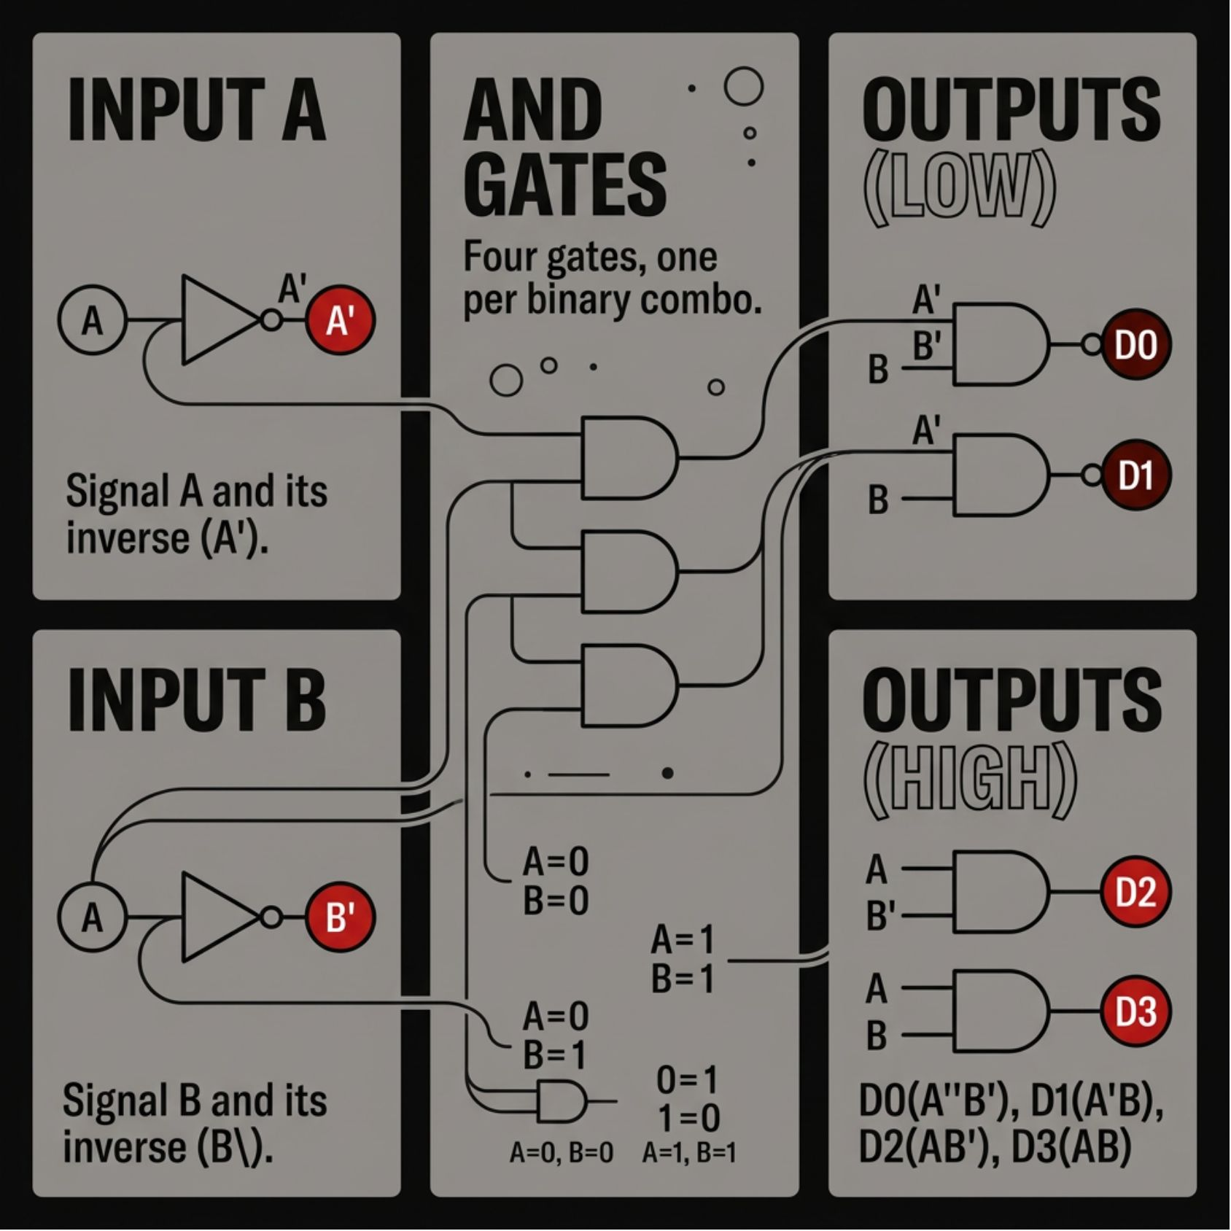
Anatomy of a 2 to 4 Decoder
Structure & Logic
Uses 2 input lines to select one of 4 unique output lines. Implementation requires NOT gates to invert inputs and AND gates to detect each binary combination.
Inputs
Outputs
Example
A, B (2 bits)
D0–D3 (4 lines)
Input 10 → D2 active

Slide 4
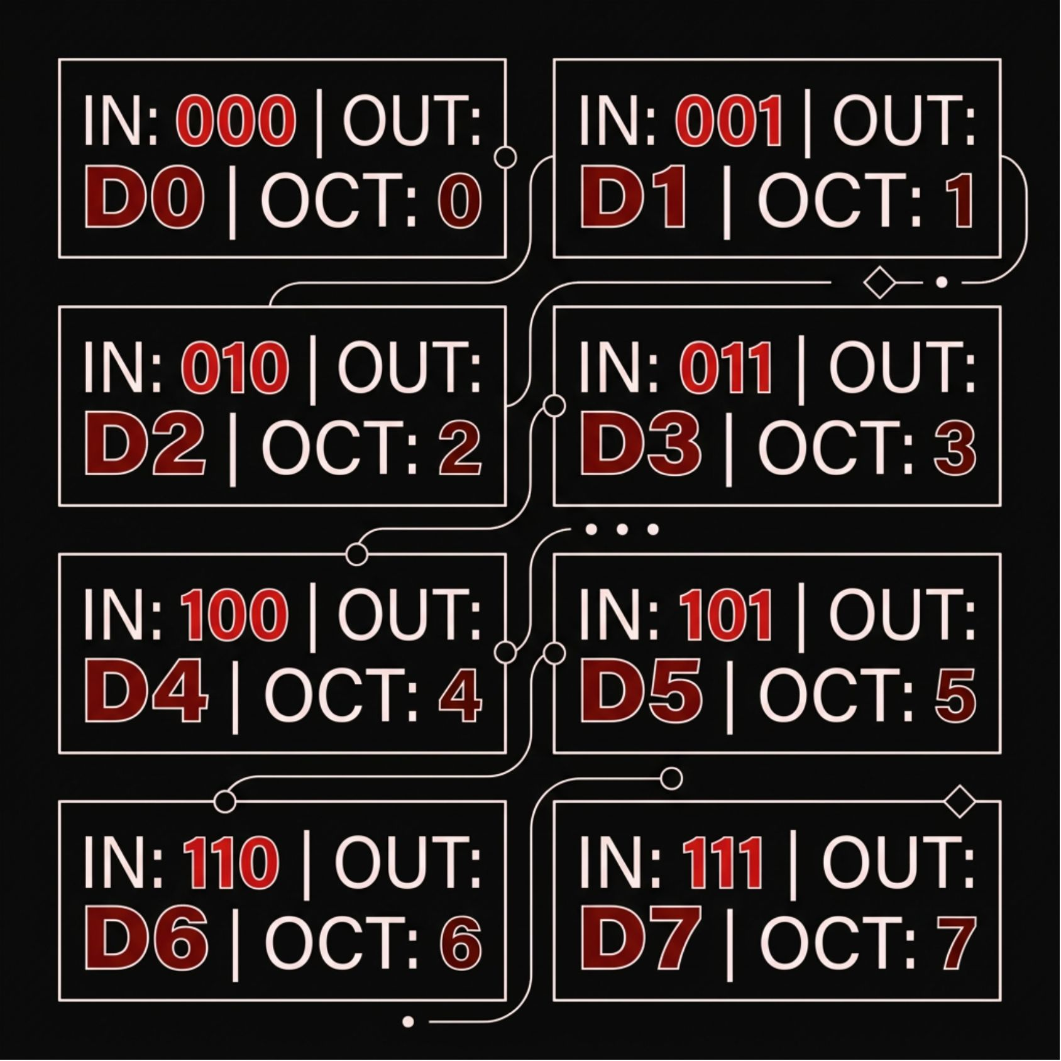
Scaling Up: The 3-to-8 Decoder
Binary-to-Octal Conversion
Expands the concept to 3 inputs and 8 outputs, acting as a binary-to-octal converter. Each output represents one octal equivalent of the binary input.
3 input lines (A, B, C) encode 8 possible states
Requires 3-input AND gates for each output
NOT gates generate all input complements

Slide 5

The Power of the Enable Signal
Without Enable
With Enable (E)
A standard decoder is always active — it continuously decodes inputs regardless of system state, which can be inefficient and cause bus conflicts.
Adding an Enable pin allows the circuit to be toggled. When E = 0, all outputs are forced inactive. When E = 1, normal decoding resumes.
Why It Matters
Enable signals provide essential control in complex systems, allowing decoders to be chained, disabled during idle cycles, or used in hierarchical designs.

Slide 6
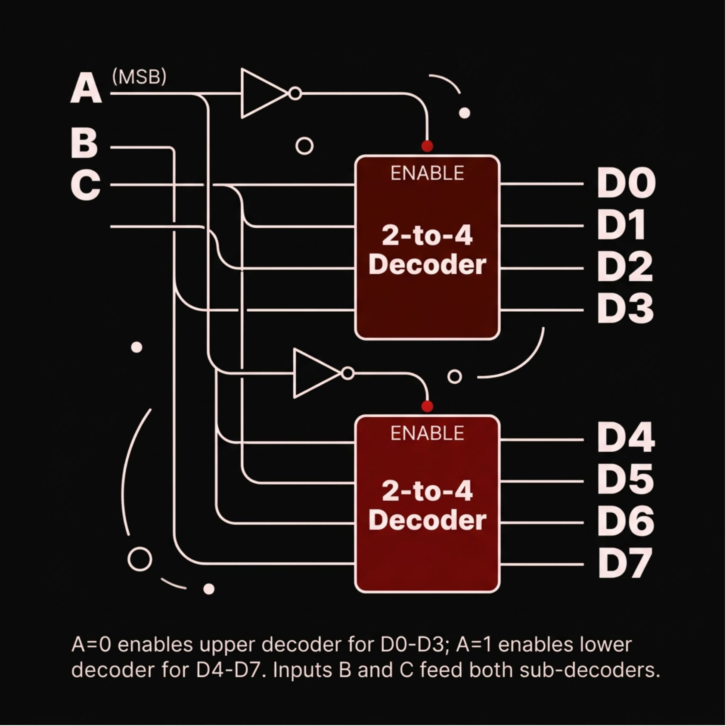

Hierarchical Design: Building Larger Decoders
Tree-Based Construction
Complex systems use a modular, tree-based approach to build large decoders from smaller, reusable blocks — reducing design complexity and improving scalability.
Key Example:
Two 2-to-4 decoders combine to form a 3-to-8 decoder. The MSB toggles the Enable pins of each sub-unit, selecting which half of the outputs is active.

Slide 7

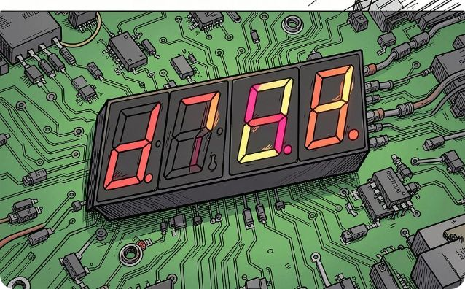

Real-World Applications
Memory Addressing
Data Routing & Displays
Processor Control Units
RAM and ROM use decoders to select specific memory locations based on a binary address, enabling precise read / write operations across millions of cells.
Decoders drive multiplexers to select data paths and convert BCD codes into readable digits on 7-segment displays used in calculators and clocks.
Inside every CPU, decoders interpret instruction opcodes and activate the correct execution unit — a critical role in instruction decoding pipelines.

Slide 8
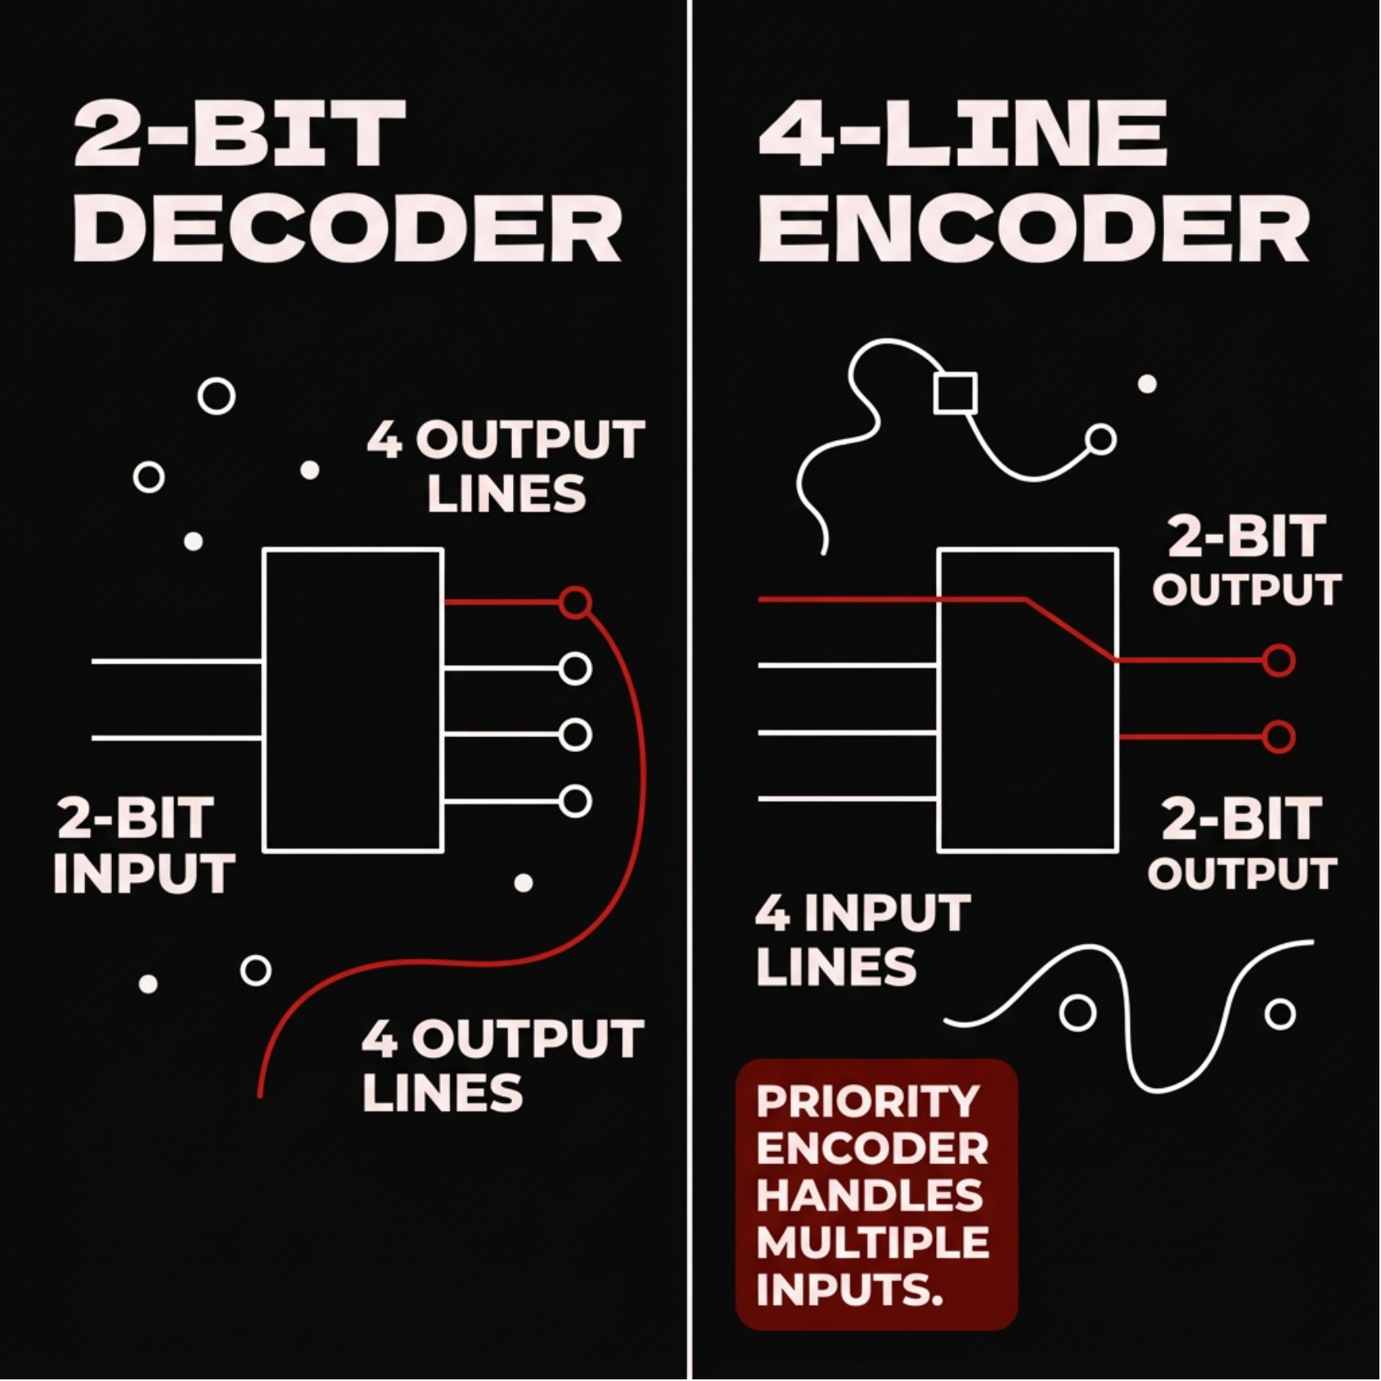
Encoders: The Inverse Operation
From Outputs Back to Binary
Where a decoder expands n inputs → 2ⁿ outputs, an encoder performs the reverse: it compresses multiple active input lines into a smaller binary code.
Standard Encoder
Priority Encoder
Assumes only one input is active at a time; outputs the binary
position of that input.
Handles multiple simultaneous inputs by assigning priority to the
highest-value active signal, resolving ambiguity.

Slide 9

Conclusion:
The Foundation of Digital Logic
Essential Role
Scalable Design
Decoders underpin sequencing, memory selection, and code conversion in every modern processor and digital system.
Through hierarchical construction and Enable signals, simple 2-to-4 blocks scale into complex, production-grade architectures.
Engineering Mastery
By mastering these building blocks, engineers construct the hierarchical systems that power today's computing era.

Slide 10
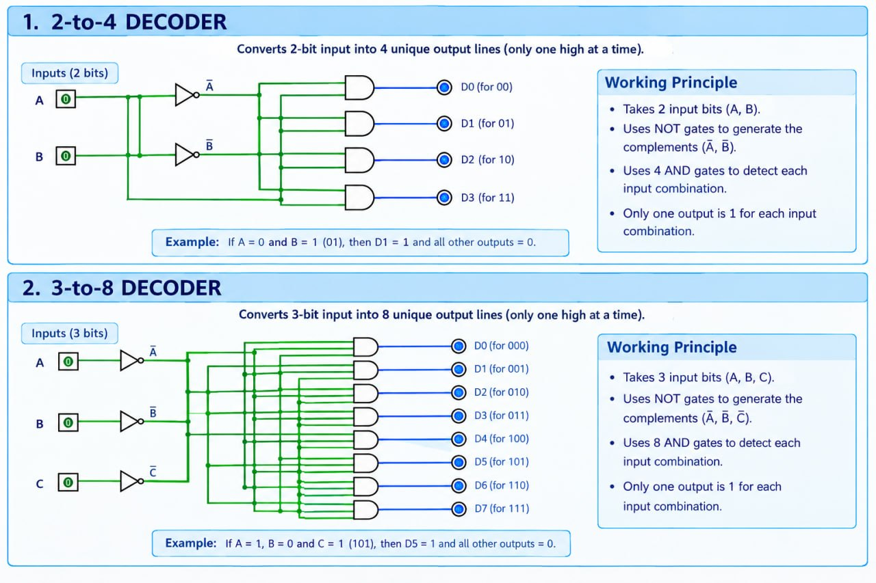
Decoder Circuits: 2-to-4 & 3-to-8

Slide 11
THANK YOU
Your turn: Which output activates for input 10?
Take a guess — then revisit the decoder diagram.
REVISIT DECODER DIAGRAM ↗
Questions, thoughts, or a real-world example? We’d love to hear it.

