Slide 1
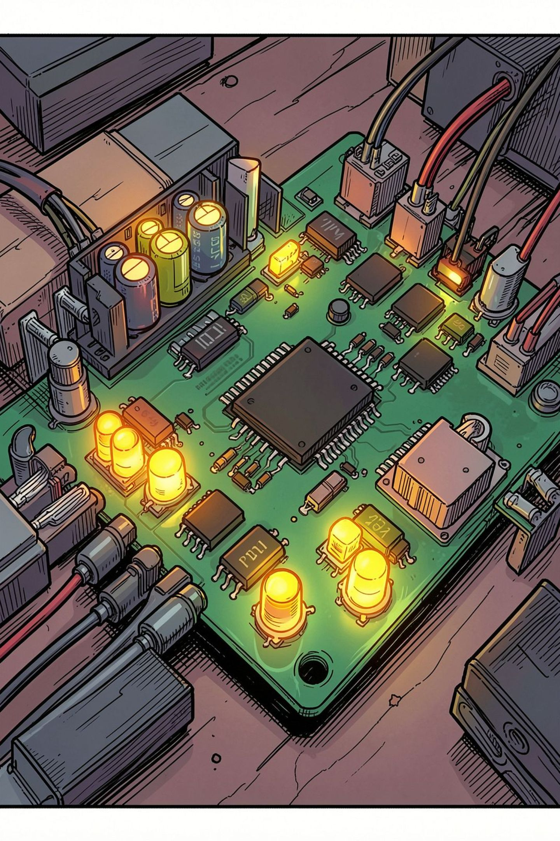
Working Principle of Timers & Splitters
How hardware counts time, generates events, and captures snapshots — with a practical VHDL stopwatch example.
Group Members :
HARISH - 2620080071
NEERAJ - 2620080074
SNEHA- 2620080080
SANTHOSHI - 2620080081
TANUSH - 26200800120

Slide 2
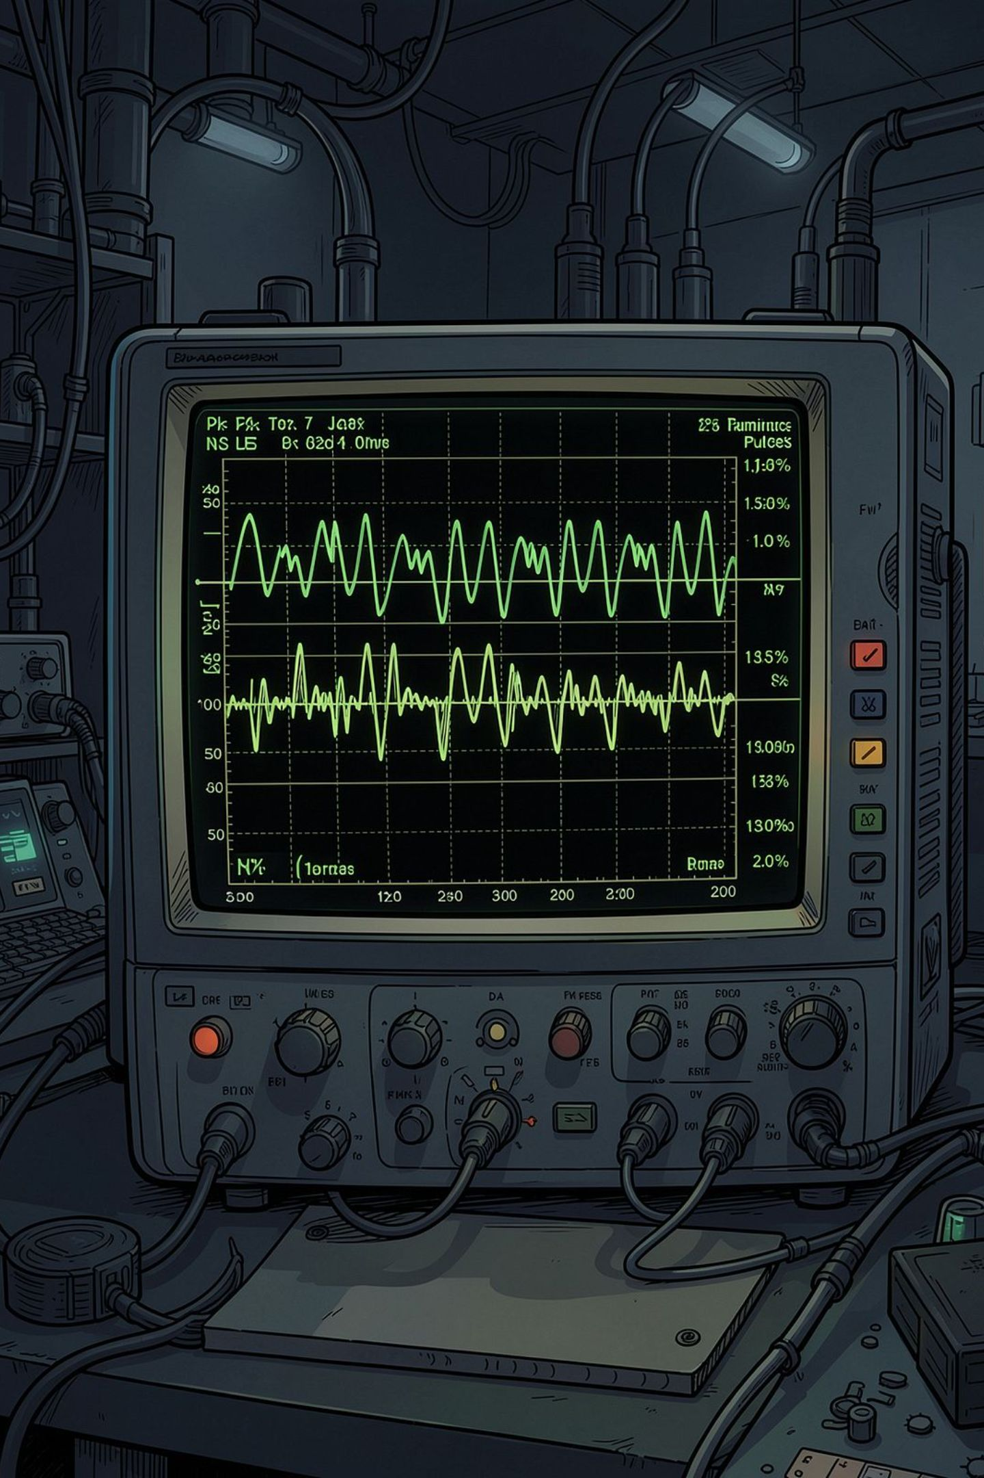
Why Timers Exist: Software Delays Aren't Time
Software loops are unreliable for measuring time — interrupts and CPU load introduce unpredictable delays. A hardware timer is a dedicated counter driven by a stable clock, so you know precisely when a fixed interval has elapsed, regardless of what the CPU is doing.
Software Delay
Unreliable under interrupts or heavy CPU load
Hardware Timer
Dedicated counter, independent of CPU activity

Slide 3
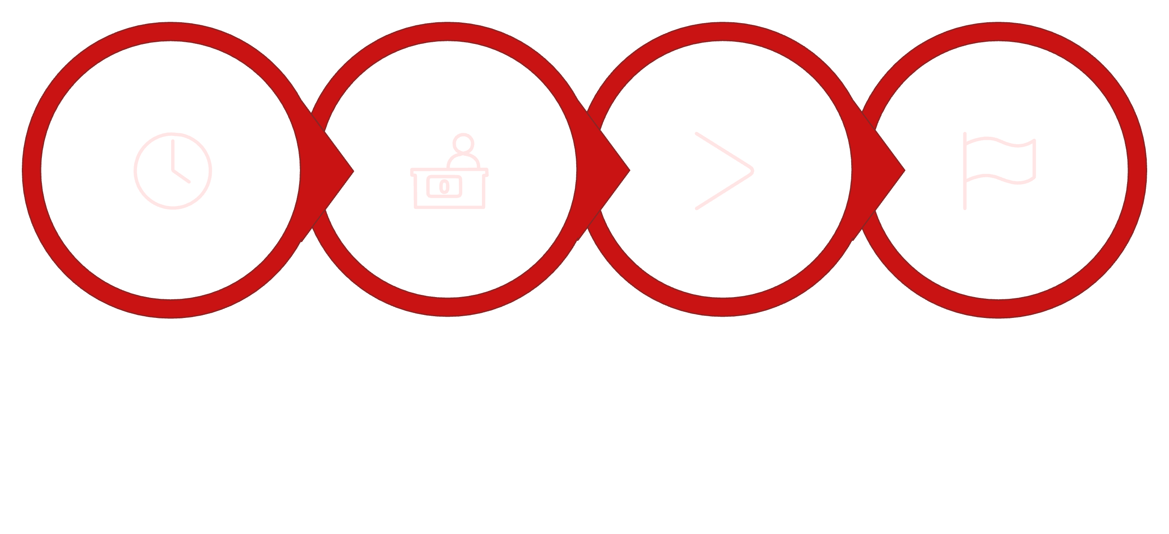
The Core Loop: Clock → Count → Compare → Event
Clock
Counter
Compare
Event
The timer accumulates ticks from a chosen clock source. When the count reaches a preset threshold — or overflows — hardware raises an event flag, allowing your program to respond precisely. Designers trade resolution against range by selecting the clock frequency and prescaler.

Slide 4
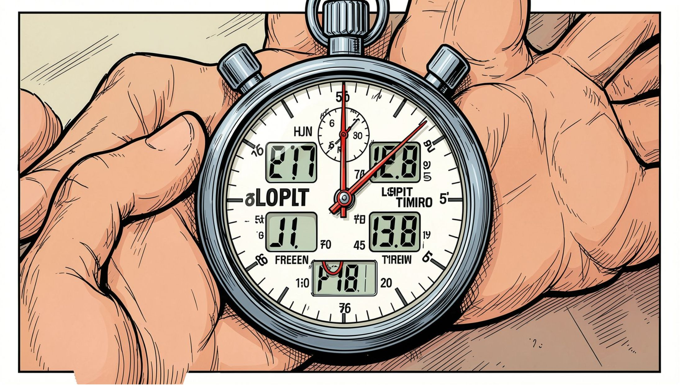
SPLITTER CONCEPT
One Time Source, Multiple Views
A splitter lets you freeze a displayed value while the internal time generator keeps counting. Conceptually:
time_gen
diload (split toggle)
Continuously updates counter value N
When low, DI stops loading new values — display freezes

Slide 5
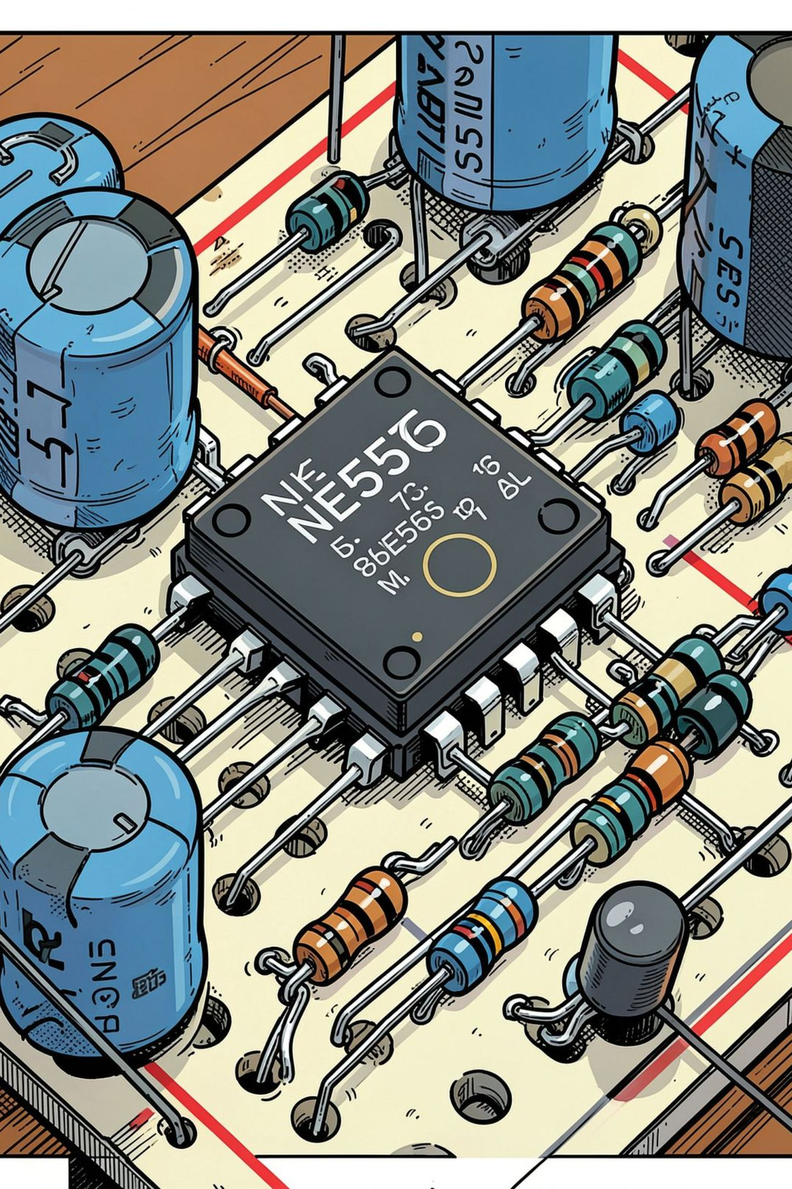
The 555 Timer: Time from Charge & Discharge
The classic 555 timer IC produces precise timing intervals using an external capacitor and resistors. Internal comparators monitor the capacitor voltage, and an RS flip-flop switches the output state when thresholds are crossed.
Charge Phase
Capacitor voltage rises through R until it hits ⅔ VCC (upper threshold)
Discharge Phase
Flip-flop toggles; capacitor discharges until it hits ⅓ VCC (lower threshold)
Output Switch
RS flip-flop drives output HIGH or LOW based on comparator states

Slide 6
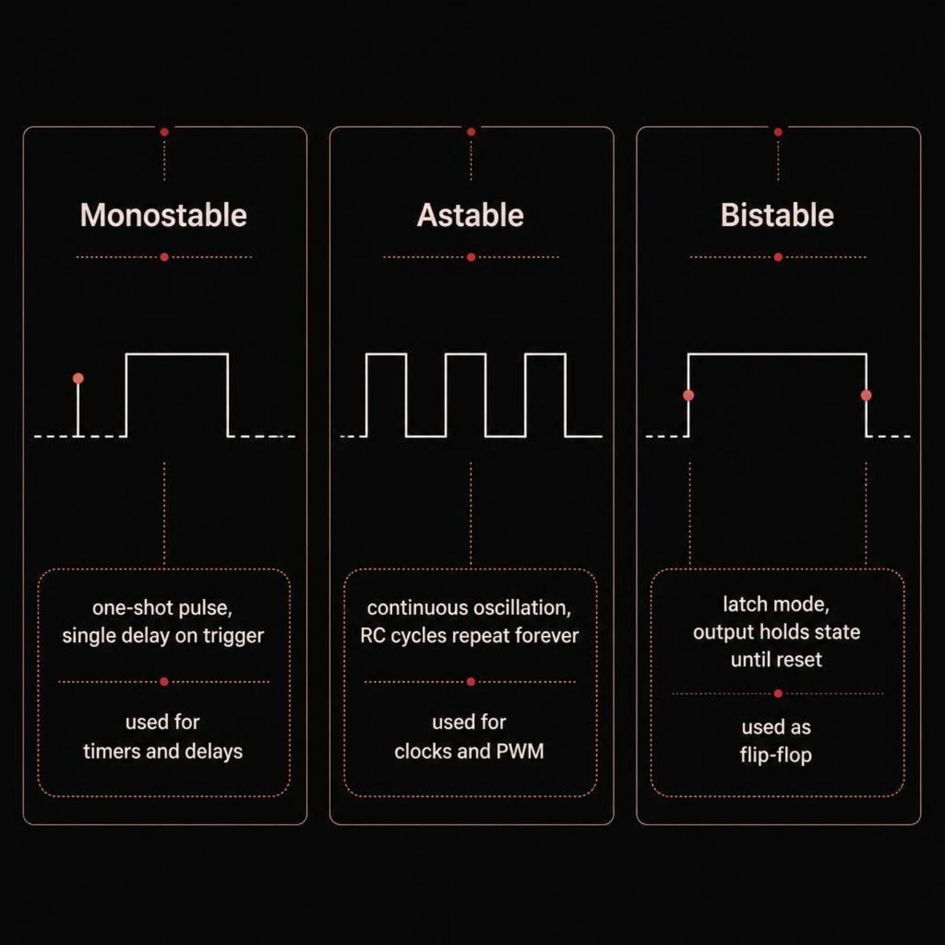
555 Modes: Direct Mapping to Timer Behaviours
Each mode maps to a distinct timer behaviour:
1
Monostable
Single pulse on trigger — ideal for one-shot delays
2
Astable
Continuous oscillation — RC cycles repeat indefinitely
3
Bistable
Latch behaviour — output holds until reset

Slide 7
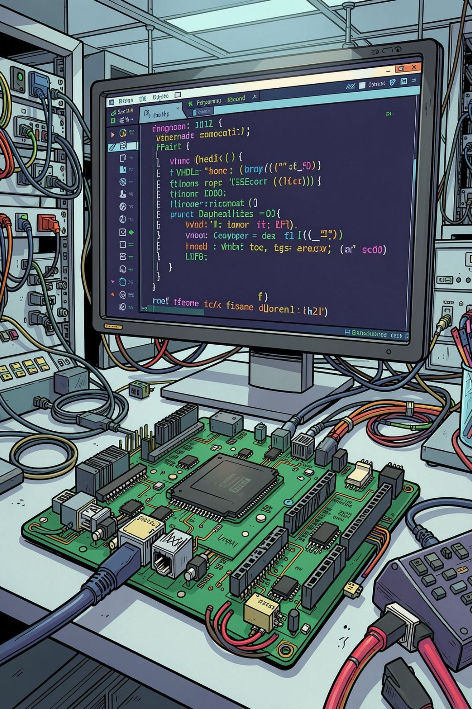




Practical Example: VHDL Stopwatch with Split
A VHDL stopwatch demonstrates both principles working together — a running time generator and a display latch for split timing.
time_gen
Counters generate elapsed time digits continuously from clkin
BTN(1) — Pause
Toggles clkin to pause time_gen internally
BTN(2) — Split
Drives diload low; DI stops loading, freezing the display
Result
Visible split captured while time keeps running — timer + splitter in action

Slide 8
Key Takeaways
✓
Timers Control WHEN
Splitters Control WHERE
Together They Enable Control
They manage precise timing and trigger actions at exact moments
They distribute signals to multiple destinations simultaneously
Combined, they create synchronized multi-output systems for real-world applications
CONCLUSION
Understanding timers and splitters is fundamental to modern electronic control systems and automation.
TIMERS & SPLITTERS
9

Slide 9
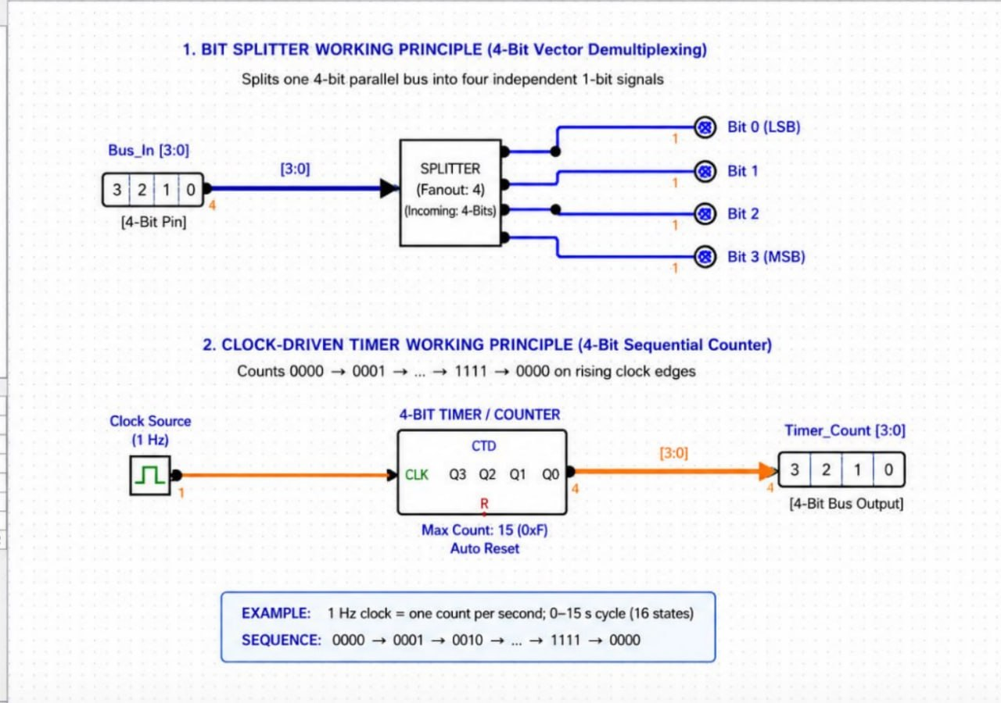
Working Principle: Bit Splitter & Timer/Counter

Slide 10
THANK YOU

