Slide 1

Communication-6. Log-Periodic Antenna for Wireless Communication
Group ID:C6
Reg No | Student Name
21BEC1141 | Shreya Jaiswal
21BEC1271 | Blessy Abraham
21BEC1644 | Tamanna
Project Guide: Dr Richards Joe Stanislaus Associate Professor - SENSE
Email: richards.stanislaus@vit.ac.in

Slide 2
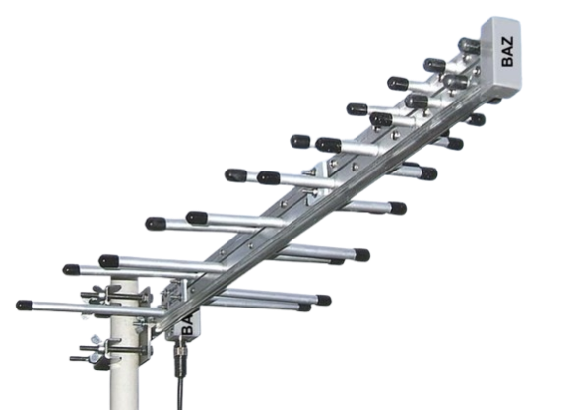
What is a Log-Periodic Antenna?
Log-Periodic Antenna (LPDA): A directional, wideband antenna.
Structure: Multiple dipole elements in logarithmic progression for consistent impedance and gain.
Applications: High-frequency, multi-band uses like broadcasting, spectrum research, and signal monitoring.

Slide 3

Importance in Wireless Communication
Requirements: Ultra-high data rates, low latency, and dense IoT/mobile network connectivity.
LPDA Advantages:
High gain and wide frequency coverage for reliable communication.
Compact and efficient design for modern wireless systems.
Relevance: Essential for advancing 6G technology.

Slide 4
Problem Statement
Traditional LPDAs are bulky and unsuitable for compact devices like IoT and smartphones.
It requires smaller, efficient antennas with wideband performance.
The project optimizes LPDA designs to ensure compatibility with next-gen communication systems.

Slide 5
Research Objectives
Develop a compact LPDA design optimized for wireless communication.
Maintain wideband operation, high gain, and low signal reflection (S11 < -10 dB).
Validate the proposed design through simulation, optimization, and performance testing.
Ensure the antenna’s feasibility for real-world applications in IoT, networks, and satellite communication systems.

Slide 6
Proposed System Introduction
The proposed system introduces an innovative LPDA design using Euclidean line elements.
The focus is on achieving size reduction while maintaining essential performance metrics like bandwidth, gain, and return loss.
Simulation-driven design ensures optimal performance across critical frequencies for wireless communication.

Slide 7
Design formulae
No of elements (n) = log(​fmax​/fmin)/log(1/τ​​)​+1
Scaling factor = τ= Ln+1/Ln = Sn+1/Sn =Wn+1/Wn
Spacing factor = σ =sn/2*Ln
Apex angle =tan−1((1−τ)/4*σ​)
Length of largest dipole(Lmax or L1) = c/2fmin [fmin is lowest operating frequency]
Spacing between 1st and 2nd dipoles (S1) =2*L1*σ
Spacing between n+1 & n+2 dipoles (Sn)= τ*Sn
Width of dipole (Wn+1)=τ*Wn
Length of dipole (Ln+1)=τ*Ln
Effective length (Leff)= Ln/(er^(1/2))

Slide 8
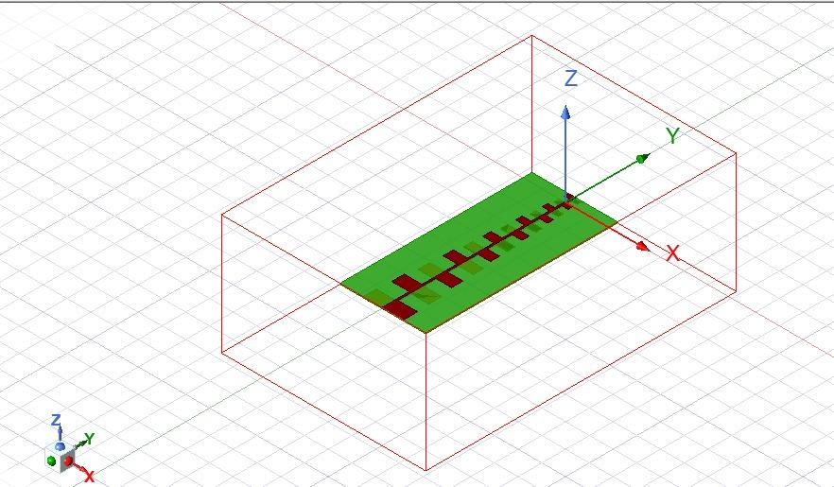
System Diagram
.

Slide 9
Algorithm Overview
Design Process: Iterative approach for optimization of key parameters:
Scaling Factor (τ): Controls dipole element progression for consistent bandwidth.
Spacing Factor (σ): Optimizes spacing to reduce mutual coupling and enhance radiation efficiency.
Maximum Element Length (Lmax): Impacts antenna size and lower frequency limit.
Simulation:
Tool: ANSYS HFSS.
Performance Metrics: Gain, Return Loss (S11), and Bandwidth.
Features used : parametric sweeps ,S11 parameter graphs ,3d polar gain plots

Slide 10
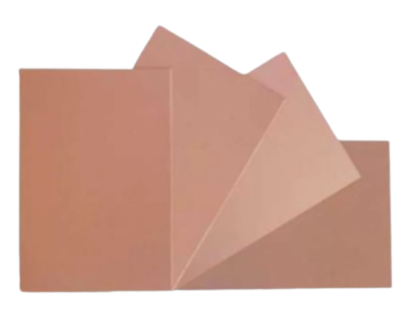
Substrate Selection
Roger RO4003C Substrate:
Excellent dielectric properties with low signal loss.
Provides high radiation efficiency across a wide frequency range.
Chosen for its superior performance in wireless applications.
dielectric constant (εr) ≈ 3.36

Slide 11
Performance Metrics
Return Loss (S11):
Target: Values below -10 dB to ensure minimal signal reflection and maximum power transfer.
Gain:
Maintain consistent gain of 6–10 dB across the 2–7 GHz frequency range.
Bandwidth:
Validate wideband performance for reliable operation across critical bands like 2.4 GHz, 3.5 GHz, and 5.3 GHz.

Slide 12

Implementation
The LPDA design is implemented using simulation tools such as ANSYS HFSS.
Optimization steps include:
Iterative adjustments to scaling (τ) and spacing (σ) factors.
Substrate selection based on performance and cost considerations.
Testing for S11, gain, and radiation efficiency across the target frequency range.

Slide 13
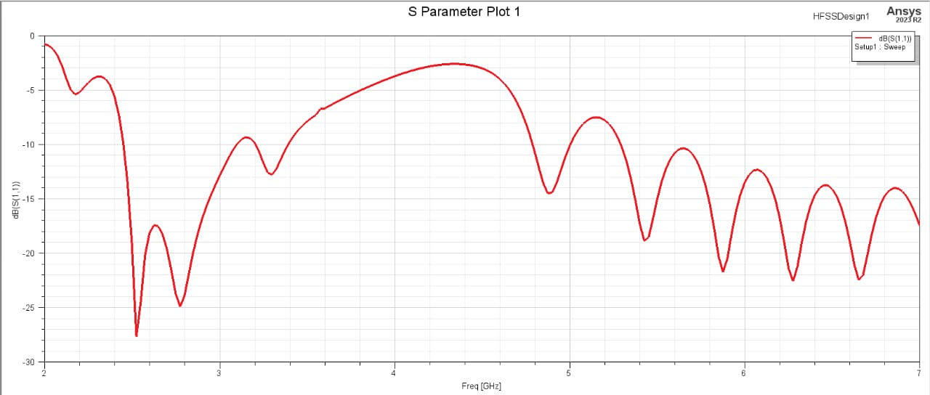
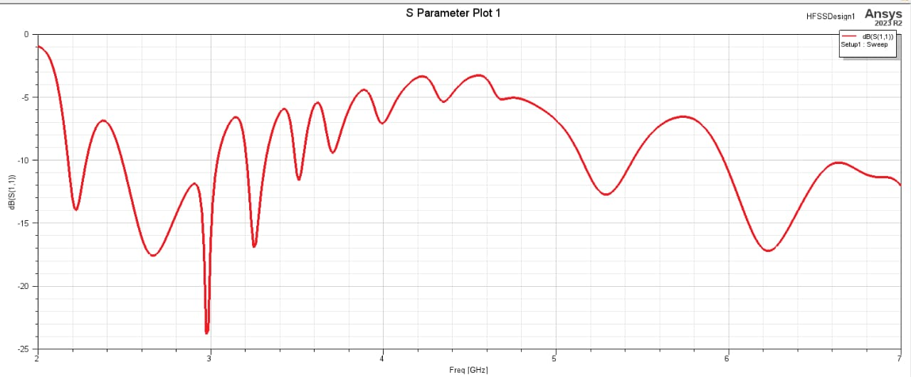
S11 Parameter at Lmax = 70 mm
S11 Parameter at Lmax = 75 mm

Slide 14
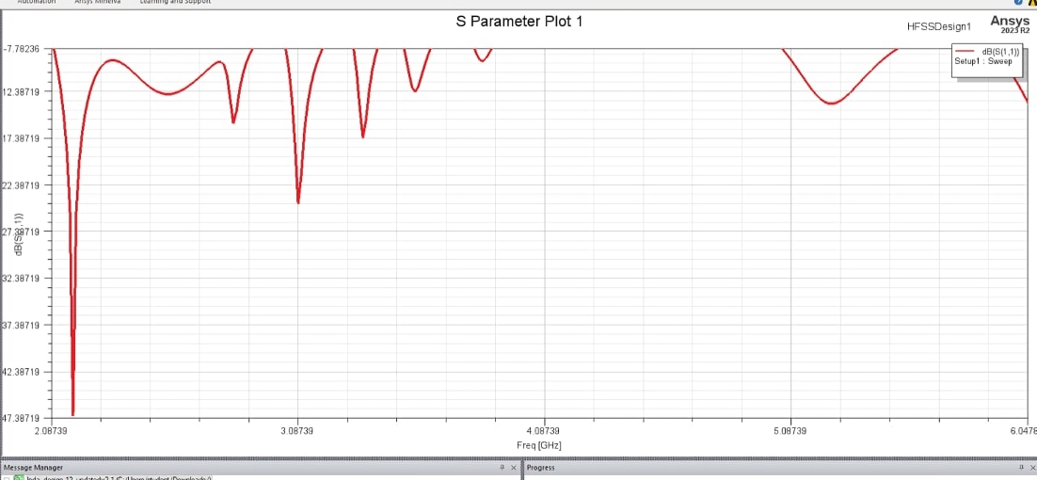
S11 Parameter at Lmax = 70 nm
S11 Parameter at Lmax = 83 mm

Slide 15
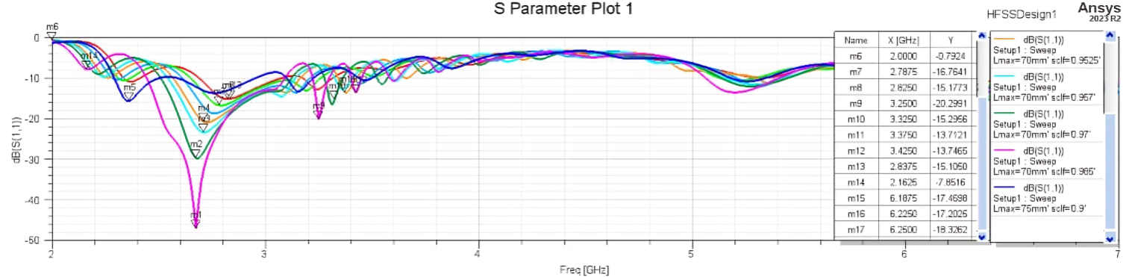
Parametric sweep of scaling factor at Lmax = 70 mm

Slide 16
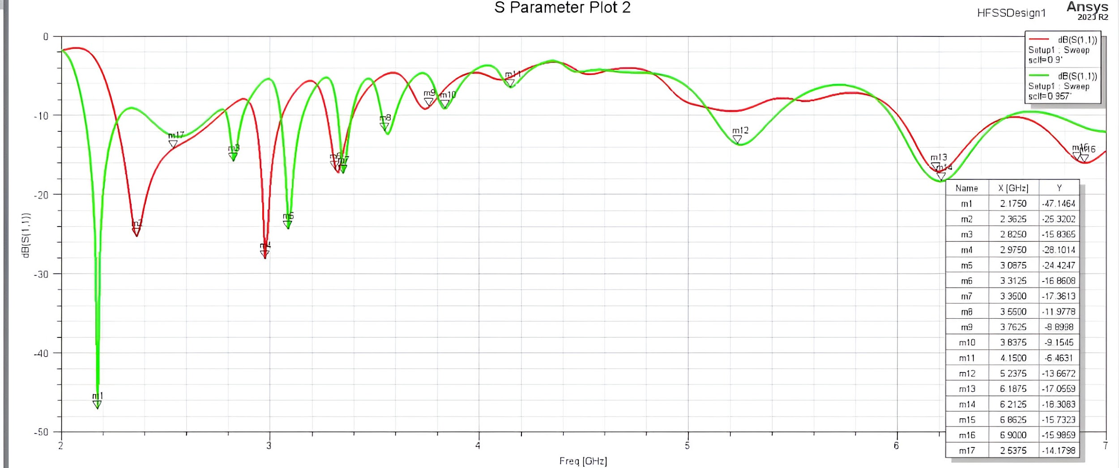
S11 parameter analysis of 0.9 & 0.957 scaling factor

Slide 17
Results
Key Findings:
S11 Values: Below -10 dB for 2.4 GHz, 3.5 GHz, and 5.3 GHz, ensuring effective impedance matching.
Gain: Stable at 6–10 dB across the 2–7 GHz frequency range.
Simulation Tool: ANSYS HFSS used for performance validation.
Optimized Parameters:
Scaling Factor (τ): 0.957
Spacing Factor (σ): 0.16
Substrate: Roger RO4003C

Slide 18

Graphical Analysis
S11 Plot: Shows dips below -10 dB at critical frequencies (2.4 GHz, 3.5 GHz, 5.3 GHz).
Gain Plot: Consistent directional gain of 6–10 dB across the range.
Results validate wideband performance for wireless communication applications.

Slide 19
Interpretation
Performance: Broad frequency coverage with stable gain and low signal reflection.
Compact Design: Suitable for IoT devices, smartphones, and satellite systems.
Comparison: Outperforms Yagi-Uda antennas in bandwidth and impedance matching.

Slide 20

Future Scope
Miniaturization:
Research on advanced materials like metamaterials for further size reduction.
Explore 3D printing for cost-effective manufacturing.
Applications:
Integration into autonomous vehicles, smart cities, and industrial IoT systems.
Use in military and aerospace systems requiring robust, reliable communication.

Slide 21
Conclusion
The proposed LPDA design meets the demands of modern wireless communication systems.
Its compact size, wideband operation, and high gain make it suitable for the applications.
Future enhancements will expand its applicability to various fields, ensuring its role in next-generation technologies.

Slide 22
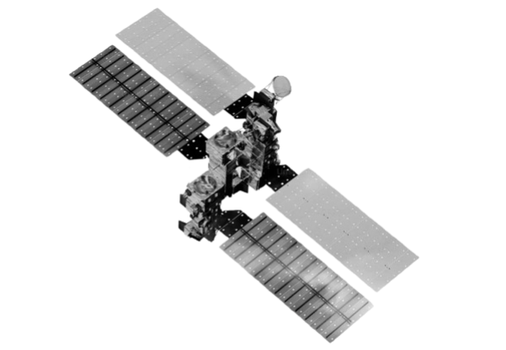
Outcome of the project
Validated Design: Compact LPDA optimized for wireless communication with S11 < -10 dB and stable gain across 2–7 GHz.
Performance Metrics:
Key Frequencies: 2.4 GHz, 3.5 GHz, 5.3 GHz.
Gain: 6–10 dB, ensuring directional radiation.
Practical Use: Suitable for IoT, satellites, 6G networks, and military communication.
Feasibility: Proven through ANSYS HFSS simulations for real-world applications.

Slide 23
References
[1] E. M. K. Reddy and R. Bhaskar, “Design of novel free space log periodic array antenna to enhance the gain at the frequency range of 35 MHz to 60 MHz and compared with the dipole antenna,” AIP Conference Proceedings, vol. 3150, p. 030002, Jan. 2024, doi: 10.1063/5.0228627.
[2] A. A. Gheethan, D. E. Anagnostou, and ECE Department, South Dakota School of Mines & Technology, Rapid City, SD, 57701, “Reduced size Planar Log-Periodic Dipole Arrays (LPDAs) using rectangular meander line elements,” journal-article, 2008.
[3] “The Evolution of Antenna Technology: Yagi–Uda, helix, and log-periodic antennas.,” IEEE Journals & Magazine | IEEE Xplore, Oct. 01, 2024. https://ieeexplore.ieee.org/abstract/document/10623293
[4] “The Evolution of Antenna Technology: Yagi–Uda, helix, and log-periodic antennas.,” IEEE Journals & Magazine | IEEE Xplore, Oct. 01, 2024. https://ieeexplore.ieee.org/abstract/document/10623293
[5] S. S. Gültekin and M. Yerlikaya, “Enhanced Gain Dual-Port Compact Printed Meandered Log-Periodic Monopole Array Antenna Design with Octagonal-Ring Shaped FSS for Broadband 28 GHz Applications,” Arabian Journal for Science and Engineering, Jun. 2024, doi: 10.1007/s13369-024-09256-3. [6] “volume | PIER Journals.” https://www.jpier.org/PIERC/pier.php?paper=23042004
[7] V. Sorathiya et al., “Graphene-Based Log-Periodic Dipole Antenna-Shaped MIMO antenna structure for the terahertz frequency spectrum,” Arabian Journal for Science and Engineering, vol. 49, no. 5, pp. 6391–6404, Sep. 2023, doi: 10.1007/s13369-023-08235-4.

Slide 24
[8] C. Im, S. Youn, T. H. Lim, and H. Choo, “Design of a compact log periodic dipole array antenna for broadband and High-Power beam synthesis using superposition,” Journal of Electromagnetic Engineering and Science, vol. 24, no. 3, pp. 234–242, May 2024, doi: 10.26866/jees.2024.3.r.224.
[9] “Miniature Planar Log Periodic Dipole Array antenna for IEMI Detection Application,” IEEE Journals & Magazine | IEEE Xplore, Oct. 01, 2024. https://ieeexplore.ieee.org/abstract/document/10605071
[10] “An ultrawideband H-Plane monopulse Log-Periodic antenna for jamming signal finding,” IEEE Journals & Magazine | IEEE Xplore, Sep. 01, 2024. https://ieeexplore.ieee.org/abstract/document/10577594 [11] “The design of Log-Periodic Dipole Array (LPDA) antenna for 5G application using SIW technology,” IEEE Conference Publication | IEEE Xplore, May 12, 2024. https://ieeexplore.ieee.org/abstract/document/10576329 [12] “High gain arrow shaped Log-Periodic Dipole Array antenna for 5G applications,” IEEE Conference Publication | IEEE Xplore, Jul. 12, 2024. https://ieeexplore.ieee.org/abstract/document/10692165
[13] “RF circuit analysis of UWB Planar Log Periodic antenna for 5G communications using theory of characteristic modes,” IEEE Journals & Magazine | IEEE Xplore, Aug. 01, 2024. https://ieeexplore.ieee.org/abstract/document/10525207
[14] M. A. Saeed and A. O. Nwajana, “A review of beamforming microstrip patch antenna array for future 5G/6G networks,” Frontiers in Mechanical Engineering, vol. 9, Feb. 2024, doi: 10.3389/fmech.2023.1288171.
[15] “Ultrawideband Transmit-Reflect-Array antenna for 6G communication,” IEEE Journals & Magazine | IEEE Xplore. https://ieeexplore.ieee.org/abstract/document/10584263

