Slide 1

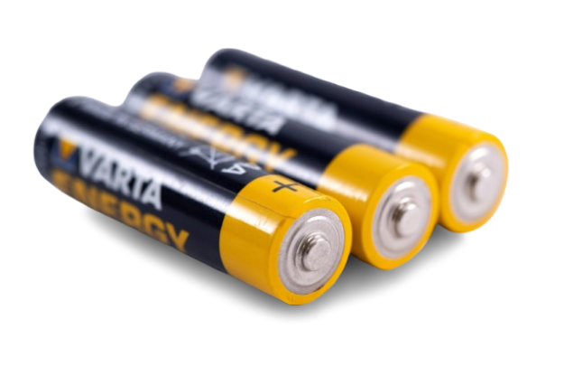

Estimation & characterisation of battery degradation using equivalent circuit modelling for Li -ion cylindrical cell
TEAM MEMBERS:
Shreya Jaiswal 21BEC1141
Blessy Abraham 21BEC1271
Tamanna 21BEC1644
PROJECT GUIDE:
Florence Gnana Poovathy J

Slide 2

Introduction
What is Battery Degradation?
Over time, Li-ion batteries lose capacity due to continuous charge-discharge cycles.
Why it Matters?
Battery health is critical for EVs, smartphones, renewable energy storage, etc.
Our Approach:
Use Machine Learning + Circuit Modeling to estimate battery degradation accurate.

Slide 3


Problem Statement
The Problem:
Existing methods to monitor battery degradation are complex and expensive.
Real-time accurate estimation of State of Charge (SoC) and State of Health (SoH) is challenging.
Key Questions:
How can we estimate SoC and SoH efficiently using an equivalent circuit model?
Can we create a cost-effective and optimized algorithm?

Slide 4

Objectives
Accurately estimate battery SoC and SoH using Machine Learning.
Characterize degradation behavior using Equivalent Circuit Modeling (ECM).
Develop a hybrid algorithm combining:
Machine Learning (Neural Networks)
Kalman Filter for real-time error correction
Genetic Algorithm for optimization
Build a cost-effective Python-based system with minimal resource requirements.

Slide 5

Proposed System
Data Collection:
Use publicly available datasets (NASA Battery Data)
Machine Learning:
Train a Neural Network to predict SoC and SoH
Kalman Filter Integration:
Real-time correction of ML predictions using actual measurements.
Optimization:
Fine-tune the model using Genetic Algorithms.
Output:
Accurate SoC and SoH values with minimal error.

Slide 6



Tools Required
Programming Language: Python
IDE: Visual Studio Code
Libraries:
TensorFlow/Keras (Machine Learning)
NumPy, Pandas (Data Handling)
Matplotlib (Visualization)
FilterPy (Kalman Filter)
DEAP/scipy.optimize (Genetic Algorithm)
Datasets: NASA Battery Dataset

Slide 7

Impact of the Project:
Provides a cost-effective solution for accurate battery health estimation.
Useful for industries like EV manufacturing, renewable energy, and consumer electronics.
Future Scope:
Integration with IoT devices for real-time monitoring.
End Goal:
To deliver an optimized, lightweight hybrid model that is efficient and innovative.

Slide 8
"Innovating for a more sustainable and efficient future."

Slide 9
Thank
You

