Slide 1
STUDENTS’ MATH PERFORMANCE ANALYSIS
By Egeni Tamuno

Slide 2
Introduction
The math performance of any student at the senior High school is of paramount importance in every educational system. Meanwhile, numerous factors influence the math performance of students' and have been researched.
Search terms employed in this study include, importance of meals in math performance, parental educational level, ethnicity, test preparation, e.t.c
(Fan, William and Wolters, 2012) found race/ethnic difference among Asians, Black, White, and Latino children in the effects that parental advice, and communication with children’s school had on their children's school motivation

Slide 3
Also a large body of research provides evidence that better nourished children perform better in school ( Glewwe et al., 2001),Winicki and Jemison, 2003), (Alderman et al., 2006) and (Victoria et al., 2008)
Many students' who take math placement exams may not have used the full range of the skills they have been exposed to in a long while, so re-familiarizing with test preparations may be beneficial. ( Scott- Claytonm 2012)

Slide 4
Problem Statement
Students' performance in math has always been observed to be lower relative to other subjects.
This project seeks to determine the extent to which factors like writing score, reading score, parents’ educational level, ethnicity, test preparation and taking standard lunch impact students'’ scores in math.

Slide 5
Project Aim
To investigate the factors that affects students'’ performance in math.
To determine the extent to which these factors impact students’ math score.
To minimize the negative effects of the factors affecting students’ math performance

Slide 6
Project Objectives
To investigate the relationship between:
Parental level of education and students' math scores
Ethnicity and students' math scores
Reading and math score
Writing and math score
Lunch type and students' math scores

Slide 7
Research Questions
Is there a relationship between parental level of education and students' math score?
How does ethnicity affect students' performance in math?
Is having a high score in reading related to math score?
How does writing score impact math score?
Is there a relationship between lunch type and students' math score

Slide 8
Scope Of The Project
Gather data online
Analyze the data
Get insights
Give recommendations based on insights from the data

Slide 9
METHODOLOGY
The research was conducted on a sample of 1000 High school students' in Texas, United States of America in 2019.
Descriptive analysis was carried out on the data. One- way ANOVA test and Pearson’s Correlations Test and T- test were performed to determine the statistical significance of the findings.

Slide 10
Skill Demonstrated
Data Cleaning and manipulation
Data analysis using python
Data Visualization using Seaborn and Matplotlib
Critical thinking.
Communication
Presentation
Project management

Slide 11
Tools
Python Jupyter notebook
Mircosoft excel
Powerpoint
Internet

Slide 12
Data Source
The data is a secondary data that contains 1000 rows and 8 columns from 2019 to 2021
race/ethnicity– group A- White(British), B-White(Irish), C- mixed(white & black African), D- mixed(white and black caribbean), E- mixed(white & black African), F– mixed(any other background)
parental level of education– high school, some high school, some college, associate’s degree, bachelor's degree, masters degree
Lunch – standard, reduced and free which is a direct correlation to income of parents
Test preparation course– none and completed

Slide 13
Data Transformation & Cleaning
I ensured the following while transforming and cleaning the data:
Imported the dataset
checked for null values. There were no missing values in the data set.
Checked for and removed duplicate values
Checked for data completeness
Check for consistency of all the fields

Slide 14
Data Analysis And Visualization

Slide 15
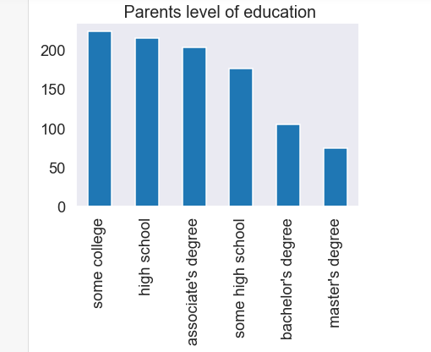
Parents Education Distribution Plot

Slide 16
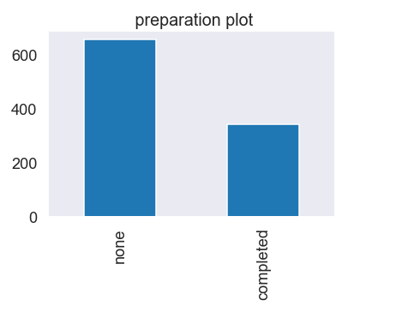
Test Preparation Distribution Plot

Slide 17
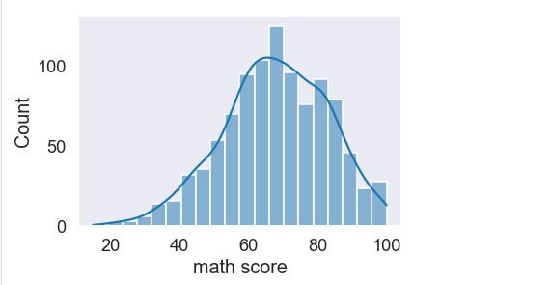
Math Score Distribution Plot

Slide 18
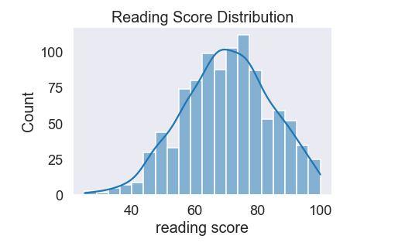
Reading Score Distribution Plot

Slide 19
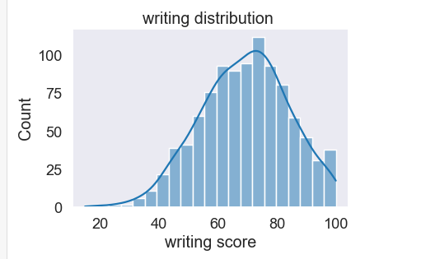
Writing Score Distribution Plot

Slide 20
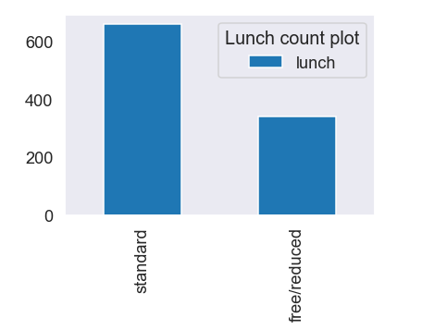
Lunch TypeDistribution Plot

Slide 21
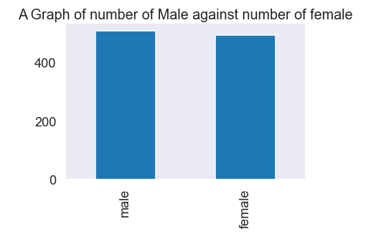
Gender Distribution Plot

Slide 22
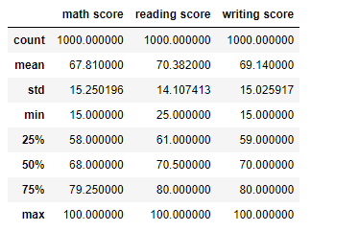
Descripitive Statistics of math, reading and writing score

Slide 23
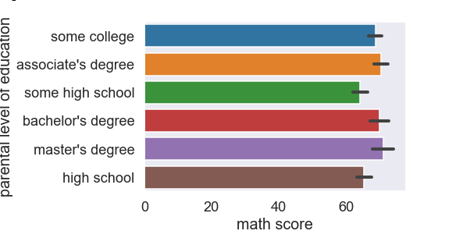
Lets investigate how students' parental level of education affects their math score?

Slide 24
One- way ANOVA test for parents’ level of education and math score
Does parental level of education affect students'’ score in math?
H0: there is no significant effect of parents’ level of education on students' math score.
H1: there is a significant effect of parents level of education on students' math score.
Since p- value(5.16e-05) is less than the critical value(0.05), we reject the H0. Therefore the effect of parents level of education on students' math score is statistically significant
F- value | P- value | Critical value
5.51 | 5.16e-05 | 0.05

Slide 25
INSIGHT
We discover that students’ whose parents with at least some higher college, bachelor’s degree and Master degree have higher math scores
From the test results we discover that there is a significant effect of parent’s level of education on math score,

Slide 26
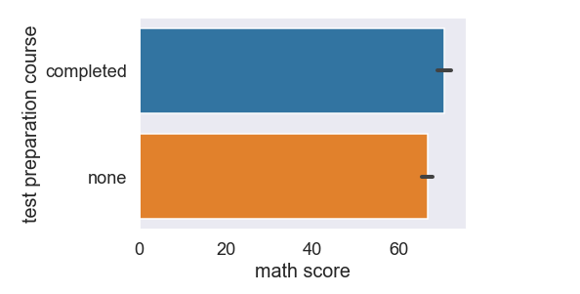
Lets find out if there is an effect of taking the test preparation course on math score.

Slide 27
T- TEST for the effect of taking the test preparation course on Math score.
Does taking a test preparation course have an effect on students' math score?
H0: there is no significance effect of taking preparation course on math score.
H1: there is a significance effect of taking test preparation course on math score.
Since p- value(0.00014) is less than the critical value(0.05), we reject the H0 . Therefore the of taking test preparation course on students' math score is statistically significant
T- Value | P- value | Critical value
3.81 | 0.00014 | 0.05

Slide 28
INSIGHT
We can deduce that students' who completed a test preparation course have higher scores in math
After the test we discover that there is a significance effect of taking a preparational course on math score,

Slide 29
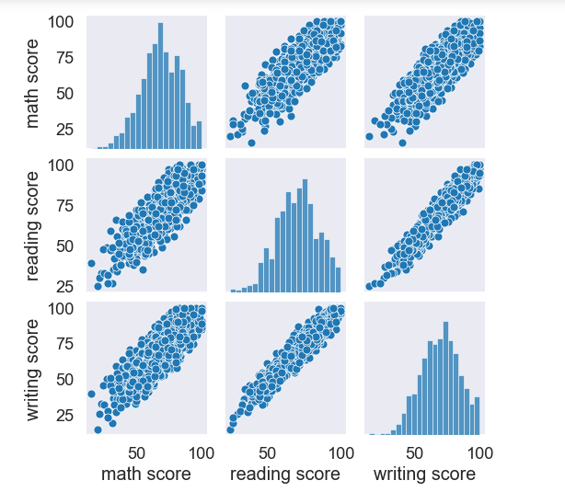
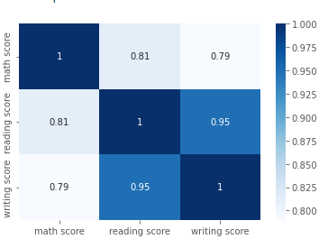
What kind of relationship exists between Reading, Writing and Math scores?

Slide 30
Pearson’s correlation test on Math and Reading.
Do students' with higher reading score have a higher score in math?
H0: there is no statistical significance in the correlation between math score and reading score.
H1: there is a statistical significance in the correlation between math score and reading score.
Since p- value(2.28e-235) is less than the critical value(0.05), we reject the H0 and the correlation between math score and reading score
Correlation Coefficient | P- value | Critical value
0.81 | 2.28e-235 | 0.05

Slide 31
Pearson’s correlation test on Math score and Writing score.
Do students' with higher writing score have a higher score in math?
H0: there is no statistical significance in the correlation between math score and writing score.
H1: there is a statistical significance in the correlation between math score and writing score.
Since p- value(2.60e-214) is less than the critical value(0.05), we reject the H0 and the correlation between math score and writing score
Correlation Coefficient | P- value | Critical value
0.79 | 2.60e-214 | 0.05

Slide 32
INSIGHT
We discover that the higher the reading score, the higher the math score
The higher the writing score , the higher the math score
After the test we discover that there is a statistical significance between reading and math score, and writing and math score

Slide 33
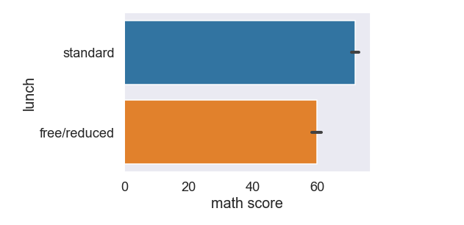
lets find out if there is a relationship between lunch type taking and math score

Slide 34
T- test of Significance of lunch type on Math score.
Do students' who eat standard/free reduced lunch have a higher score in math?
H0: there is no statistical significance in the correlation between standard/free reduced lunch and math score.
H1: there is a statistical significance in the correlation between standard/free reduced lunch and math score.
Since p- value(2.90e-34) is less than the critical value(0.05), we reject the H0 and the correlation between standard/free reduced lunch and reading score.
T- Value | P- value | Critical value
12.68 | 2.90e-34 | 0.05

Slide 35
INSIGHT
Lunch type have an effect on math score.
From the test we discover that there is a significance effect of lunch type on math score.

Slide 36
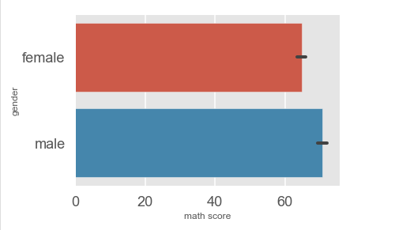
lets find out if there is a relationship between Gender and math score

Slide 37
T- test of Significance of Gender on Math score.
Does gender have an effect on students' math score?
H0: there is no significance effect of gender on math score.
H1: there is a significance effect of gender on math score.
Since p- value(-6.31) is less than the critical value(0.05), we reject the H0 . Therefore the gender on students' math score is statistically significant
Correlation Coefficient | P- value | Critical value
-6.31 | 4.08e-10 | 0.05

Slide 38
INSIGHT
Male students' math score is higher than female math score
There is a significance effect of gender on math score,

Slide 39
Conclusion
Arising from our analysis, we can conclude that parental level of education, lunch type, students' ethnicity and completing test preparational courses are factors that affect students' math scores. The analysis also show that reading scores and writing scores have a strong impact on math score.

Slide 40
Recommendation
Delivery of basic educational classes to increase students' performance in reading and writing will invariably improve their math score.
Government can also have flexible special education classes for parents without degrees since parents’ level of education impacts students’ math score.
Government should improve the standard of free lunch in the school feeding programs as this affect the performance of students’ math score.

Slide 41
References
(Fan, William and Wolters, 2012). Race/ethnicity and early mathematics skills: Relations between home, classroom, and mathematics achievement.
www.kaggle.com
(Suresh, 2012). Impact of parents’ socioeconomic status on parental involvement at home for high academic achievement of student.
Brew, E.A., Nketiah, B. and Koranteng, R. (2021) A Literature Review of Academic Performance, an Insight into Factors and their Influences on Academic Outcomes of Students at Senior High Schools. Open Access Library Journal, 8, 1-14.

Slide 42
Fan, W., Williams, C. M., & Wolters, C. A. (2012). Parental involvement in predicting school motivation: Similar and differential effects across ethnic groups. The Journal of Educational Research, 105(1), 21–35
( Glewwe et al., 2001,Winicki and Jemison, 2003, Alderman et al., 2006, victoria et al., 2008). Early Childhood Nutrition and Academic Achievement: A Longitudinal Analysis February 2001Journal of Public Economics 81(3):345-368
https://schoolnutrition.org/

Slide 43
THANK YOU FOR LISTENING

