Slide 1
Contact Manager

Slide 2
Functional Requirements
1. The system shall display a list of contact names, group names, and blocked contact names.
1.1 The system's default page shall display all contact’s names vertically, starting in alphabetical order.
1.2 The system shall allow the user to change views of lists type by clicking a tab corresponding to the list’s name
1.3 The user shall be able to scroll up and down the list to see more contact names.
1.4 The system shall not allow the user to scroll past the end of the list.
1.5 The system shall not allow the user to scroll past the top of the list.

Slide 3
Functional Requirements
2. The User shall be able to click on any contact or group in the lists to open an options menu with possible actions for the selected item.
2.1 For contacts, the system shall display a small window with options to view profile, call, send SMS, or delete the contact that was clicked.
2.2 For groups, the system shall display a small window with options to view group profile or delete group profile.
2.2 The user shall be able to exit the options menu by clicking anywhere outside the window.

Slide 4
Functional Requirements
3. The system shall launch the default phone calling application and call the selected contact’s phone number.
3.1 The system shall only start the call once the user clicks “Call” in the contact’s profile page or in the selected contact’s option menu.
3.2 The system shall minimize the Contact Management App while the user's default phone calling app runs over it.
4. The system shall launch the Default SMS app with the selected phone number as the recipient.
4.1 The system shall only launch the SMS app once the user clicks “SEND SMS” in the contact’s profile page or in the selected contact’s option menu.
4.2 The system shall minimize the Contact Management App while the user’s default SMS message app runs over it.

Slide 5
Functional Requirements
5. The user shall be able to view a selected contact’s profile page
5.1 The system shall open a new window when the user selects “view profile” from a contact’s option menu.
5.2 The system shall display a contact’s name, picture, groups and phone numbers.
6. The user shall be able to view a selected group’s profile page.
6.1 The system shall open a new window when the user selects “view group info” from a group’s option menu.
6.2 The system shall display contacts related to the group and their phone numbers.

Slide 6
Functional Requirements
7. The user shall be able to edit a contact's phone number, name, group, or picture in its profile page.
7.1 The system shall open a window with editable fields once the user clicks “edit”.
7.2 The user shall be able to input a new string by clicking an existing name or phone number.
7.3 The user shall be able to change a profile picture by clicking the existing image.
7.4 The system shall open a window with a gallery of the user’s images and allow a user to select a new picture to replace an existing picture.
7.5 The user shall be able to save or discard edited fields by clicking a "Save" or “Cancel” button respectively.

Slide 7
Functional Requirements
8. The user shall be able to edit members in a group’s profile page.
8.1 The user shall be able to add contacts to a group using the “add” button in the profile.
8.2 The user shall be able to remove contacts in a group using the “remove” button in the profile.
9. The user shall be able to delete an existing contact or group from their respective list using the selected item’s option menu.
9.1 The system shall prompt the user if they are sure they would like to delete the item with a "Yes" or "No" button.
9.2 If user clicks "Yes", the system shall delete the item from the database and return to the contact list.
9.3 If user clicks "No", the system shall return to the selected contact’s option menu.

Slide 8
Functional Requirements
10. The user shall be able to add a contact to the contact list
10.1 The user shall be able to add a contact by clicking the "Add" button while in the home page’s contact list tab.
10.2 The system shall open a new window and prompt the user for a required name & phone number of the new contact.
10.3 The system shall allow the user to optionally attach a picture to the contact.
10.4 The system shall allow the user to optionally enter multiple phone numbers for the contact.
10.5 The user shall be able to discard the contact and return to the default home page by clicking "Cancel"

Slide 9
Functional Requirements
11. The user shall be able to add a new group to the group list.
11.1 The user shall be able to add a new group by clicking the "Add" button while in the home page’s group list tab.
11.2 The system shall open a new window and prompt the user for a required group name.
11.3 The user shall be able to save or discard the group by clicking the "Save" or “Cancel” button respectively.
12. The system shall allow the user to sort through the lists.
12.1 The user shall be to select to sort the list while in list view.
12.2 The user shall be able to sort the list in ascending order.
12.3 The user shall be able to sort the list in descending order.

Slide 10
Functional Requirements
13. The user shall be allowed to filter through their contacts using the search function.
13.1 The system shall contain a search field on top of the list view.
13.2 The system shall allow the user to input numbers, letters, Or symbols into the search bar.
13.3 The system shall display the contacts or groups whose name contain the Searched keyword while still being in alphabetical order.
13.4 The system shall display “no matches found” if no results were returned.
14. The system shall have a Black List that allows the user to choose which contacts to not receive their calls or texts.
14.1 The system will allow the user to add or remove contacts.
14.2 Blacklist will communicate with the phone and SMS apps to ensure notifications are redirected.

Slide 11
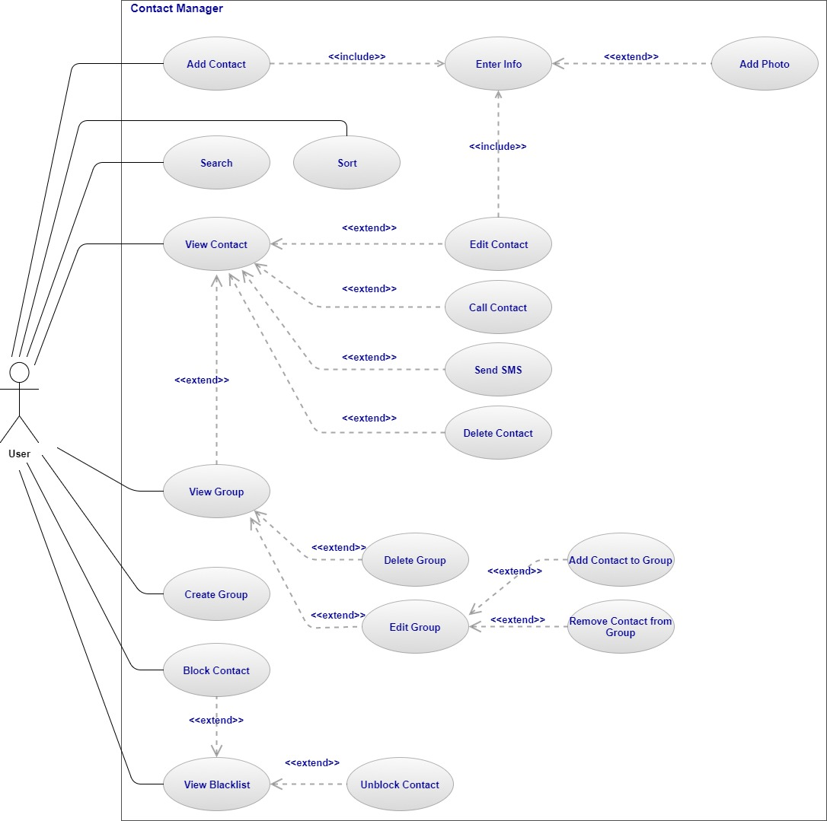
Use Case Diagram

Slide 12
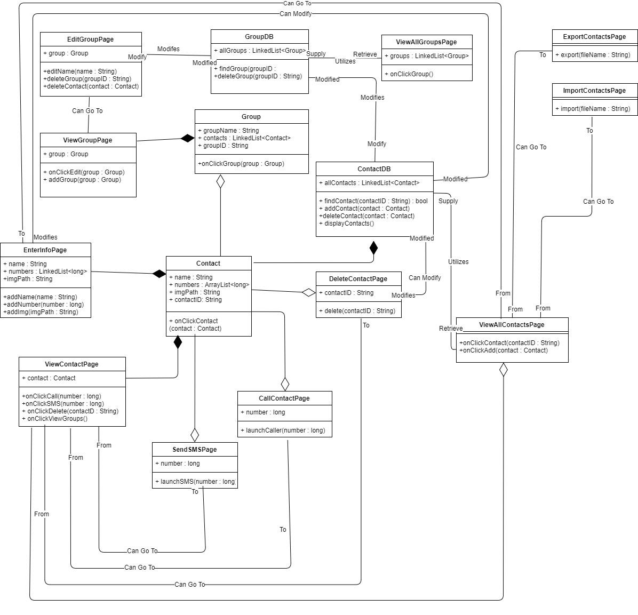
Class Diagram

