Slide 1
Data Storage

Slide 2
Topic
Async Storage
SQLite

Slide 3
URI
Github : https://github.com/tamnuwat/DataStorage
Navigation : https://reactnavigation.org/docs/en/api-reference.html
Asyncstorage : https://facebook.github.io/react-native/docs/asyncstorage
SQLite : https://docs.expo.io/versions/v35.0.0/sdk/sqlite/

Slide 4
AsyncStorage
Unencrypted, asynchronous, persistent
Key-value storage system
Global to the app
Used instead of local storag

Slide 5
Preparation
URL : https://docs.expo.io/versions/latest/react-native/asyncstorage/

Slide 6
AsyncStorage
setItem
getItem
removeItem
multiGet
multiset
multiRemove

Slide 7
SQLite
SQLite is a software library
Provides a relational database management system
Lite in SQLite means light weight in terms of setup

Slide 8
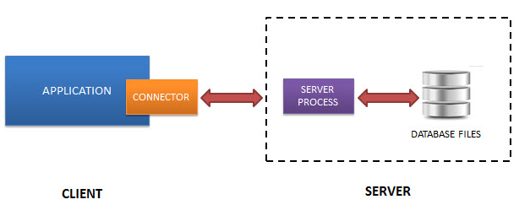
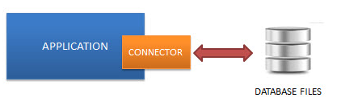
SQLite
RDBMS
SQLite

Slide 9
Preparation
Expo url : https://docs.expo.io/versions/latest/sdk/sqlite/
Installation command : expo install expo-sqlite

Slide 10
expo-sqlite method
db.transaction(callback, error, success)
tx.executeSql(sqlStatement, arguments, success, error)

Slide 11
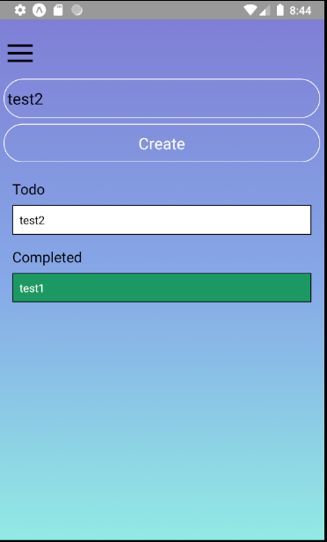
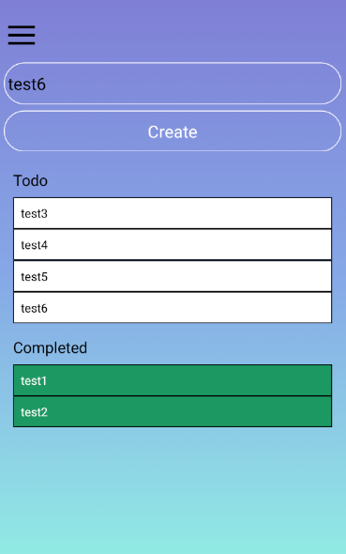
ToDo Application

Slide 12
Database
The app allows adding todo items, marking them as done, and deleting done items. SQLite features used include creating and opening databases, creating tables, inserting items, querying and displaying results, using prepared statements.
Items | Text
Done | Integer

Slide 13


Insert to do list with GUI

Slide 14
React-native life cycle
componentWillMount
render
Constructor
componentDidMount

Slide 15
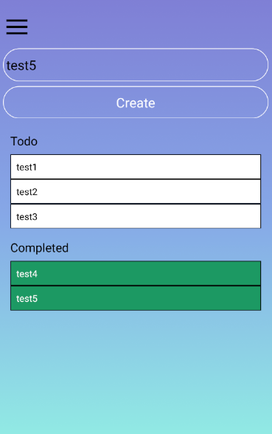

Update with GUI

Slide 16
Pass parameter
Method Page2
Main Page1
(extends React.Component)
Ack
Method Page2
(extends React.Component)
Main Page1
(extends React.Component)
Ack

Slide 17
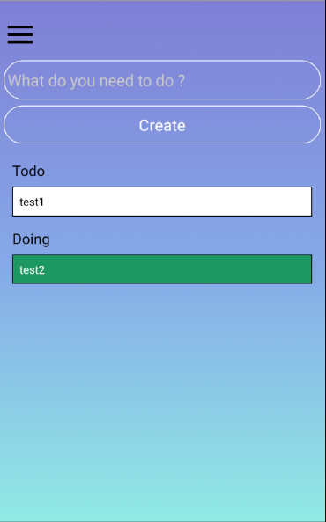

Task

