Slide 1
Figma Tool

Slide 2
Topic
Wireframe
Mockup design
Figma

Slide 3
Wireframe
Wireframes are the skeleton
A way to design a application at the structure level
Commonly used to layout content and functionality
Used early in the development before visual design and content adding

Slide 4
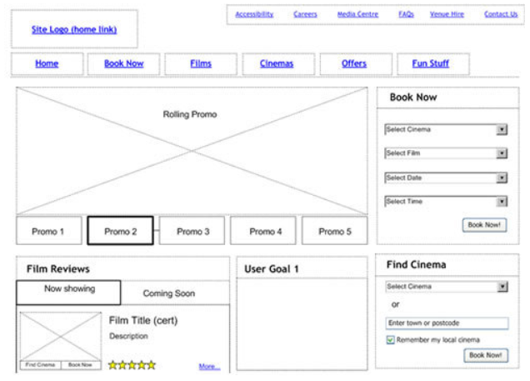
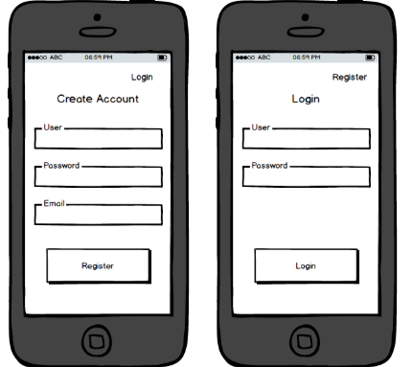
Example

Slide 5
Mockup Design
Mockups are the skin
Create user interfaces that
Show the end user what the software will look like.
Without having to build the software

Slide 6
Mockup Design
Mockups are the skin
Create user interfaces that
Show the end user what the software will look like.
Without having to build the software

Slide 7
Figma
Figma is an interface design application that runs in the browser.
Design : Fast and powerful.
Prototyping : Design and prototype in tandem
Share a link to your design files or prototypes

Slide 8
Figma Design
Example : https://www.figma.com/file/Zzs6zc1g2RHBBVGCKzHrHm/Mobile-App-Example?node-id=51%3A3

Slide 9
Preparation
Figma Account : https://www.figma.com
Example : https://www.figma.com/file/BrSacXZ9L1qOvQ4rWsbjGU/example?node-id=0%3A1

Slide 10
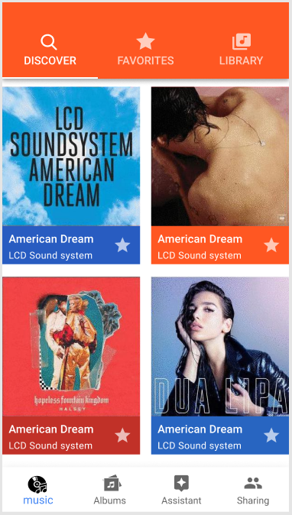
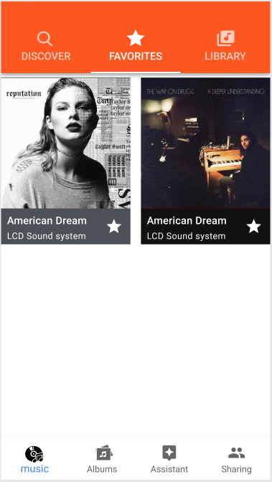
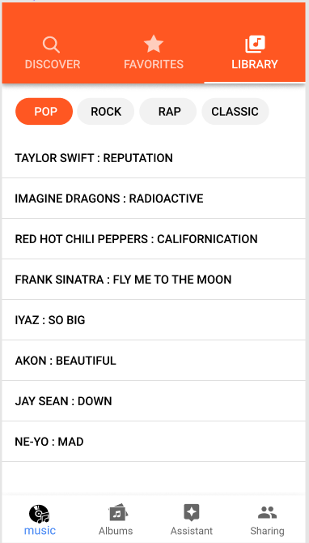
Task

Slide 11
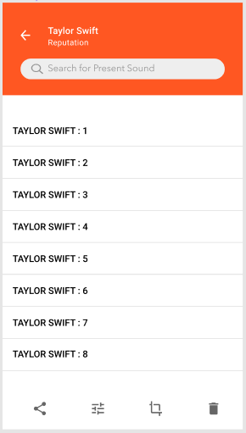
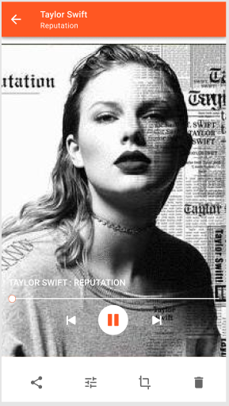
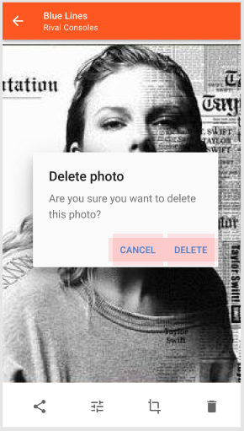
Task

