Slide 1
JSX
Java Script eXtend

Slide 2
Topic
Syntax
Datatype
Number, Method and Operators
String and Method and Operators
Object
State and Event
Example in GUI

Slide 3
What is JSX
JSX is a statically-typed, object-oriented programming language compiling to standalone JavaScript. The reason why JSX was developed is our need for a more robust programming language than JavaScript. JSX is, however, fairly close to JavaScript especially in its statements and expressions.

Slide 4
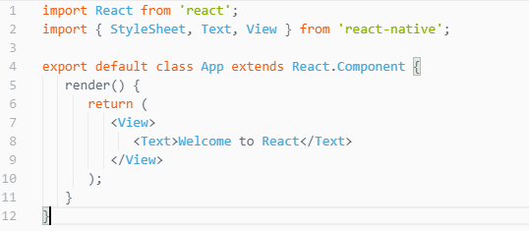
Structure of React Native

Slide 5
JavaScript Data Types
Number
String
Object
Boolean
https://github.com/tamnuwat/JSX/blob/master/variable.js

Slide 6
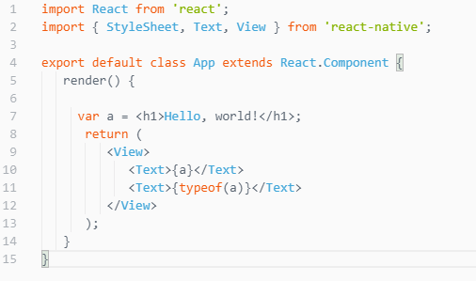
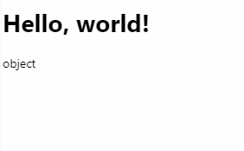
What about this?
https://www.w3schools.com/js

Slide 7


Number
JavaScript has only one type of number. Numbers can be written with or without decimals.
Scientific :

Slide 8
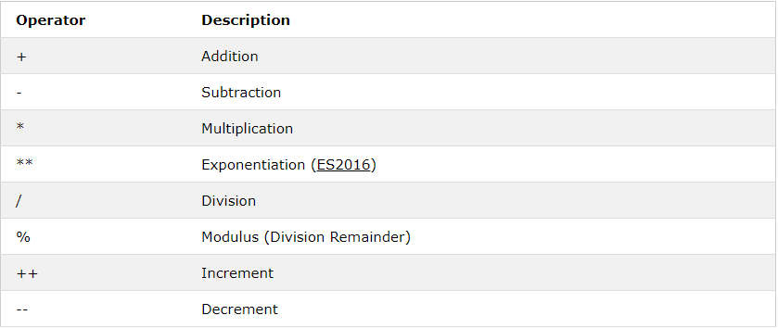
Operators

Slide 9
JavaScript Number Methods
toString() -> Convert number to string
toExponential -> Find exponential notation
toPrecision() -> Set precision of floating point number and return with string
Number() -> parseInt()
Math -> Mathematic functions

Slide 10


String
JavaScript strings are used for storing and manipulating text.

Slide 11
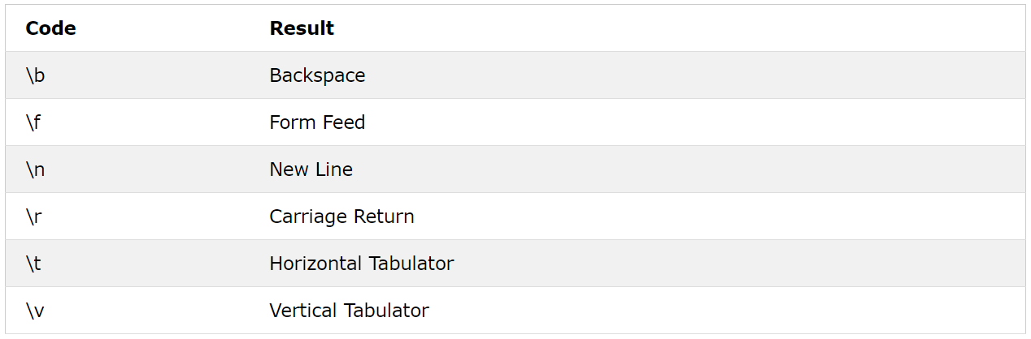
Special Characters

Slide 12
JavaScript String Methods
Length -> find length of a string
indexOf() -> find index of (the position of) the first occurrence of a specified text in a string
slice() - > Extracts a part of a string and returns the extracted part in a new string

Slide 13
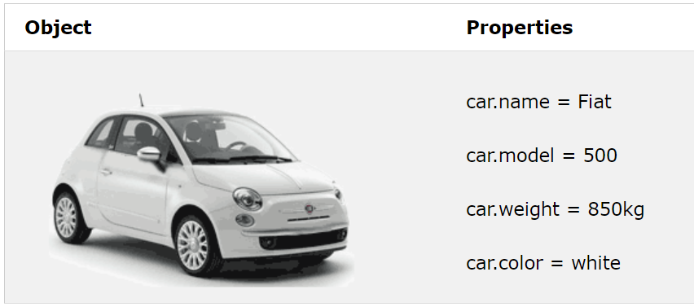
Object

Slide 14
Array
JavaScript arrays are used to store multiple values in a single variable.

Slide 15
JavaScript Array Methods
pop() -> Return the value that was "popped out"
push() -> Adds a new element to an array
length -> Find length of Array
sort() -> Sorts an array alphabetically

Slide 16

State and Event
Button
Event
Text
Init State
Update State

Slide 17
State and Event
Create constructor
Initial state
Create event function
Update state in event function
Call event function

Slide 18
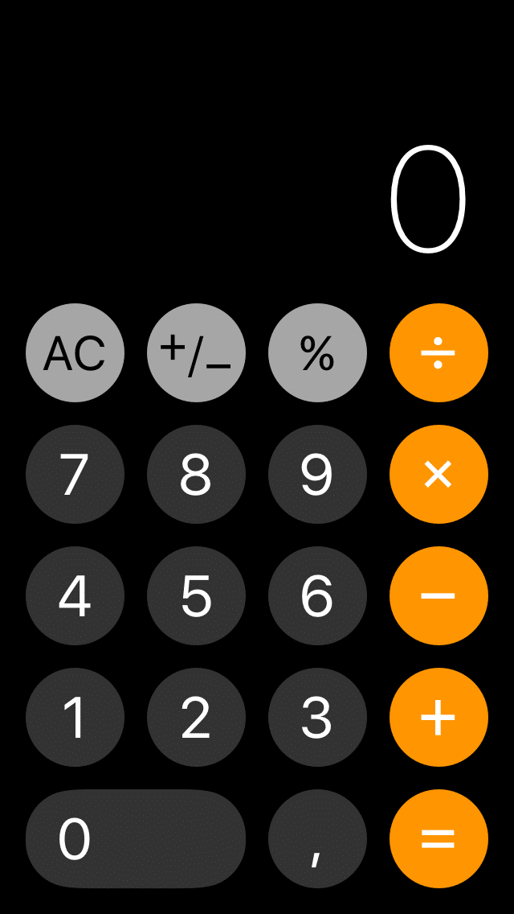
ให้นิสิตสร้าง App เครื่องคิดเลขให้แล้วเสร็จ

Slide 19
JavaScript Syntax eXtension
(Next Week)

