Slide 1
Firebase

Slide 2
Topic
Cloud Firestore
Authentication
Cloud Storage
ML Kit

Slide 3
URI
Firebase : https://firebase.google.com/docs/database
Github :
Expo :
Navigation :

Slide 4
Firesbase
Firebase is Google’s mobile application development platform that helps you build, improve, and grow your app.

Slide 5
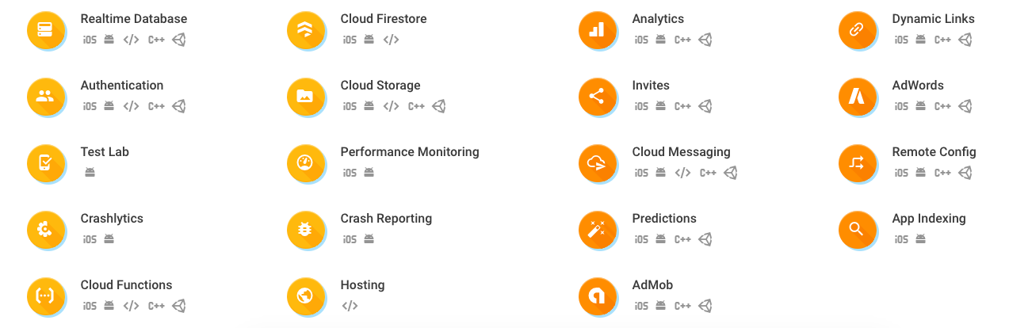
Firesbase

Slide 6
Cloud Firestore
Store and sync data between users and devices
Using a cloud-hosted, NoSQL database
Synchronization and offline support
Integration with other Firebase products
Server less apps.

Slide 7
Cloud Storage
Store and share user-generated content.
Images, audio, and video.
Cost-effective object storage built for Google scale.
Add Google security to file uploads and downloads.
Regardless of network quality.

Slide 8
Authentication
Manage your users in a simple and secure way.
Offers multiple methods to authenticate.
Including email, password, Phone or confirm email
Third-party providers like Google, Facebook, Twitter, GitHub, Yahoo
Build your own interface and fully customizable UI.

Slide 9
ML Kit
Bring powerful machine learning features to your mobile app.
Get started easily by using our ready-to-use APIs
Import your own custom models can be hosted by Firebase.
ML Kit APIs can run on-device or in the cloud

Slide 10
Preparation
Gmail Account
Firebase
Installation node package -> npm install --save firebase

Slide 11
Cloud Firestore
Insert Data
Update
Delete
View
Real time listening

Slide 12
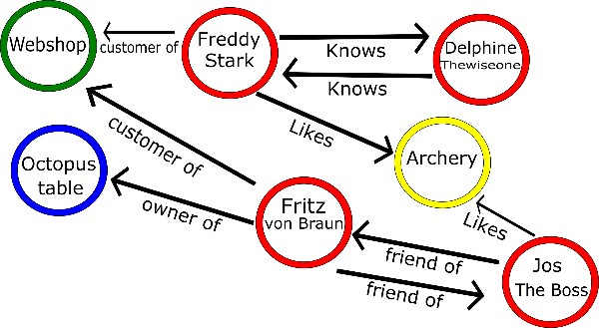
Structure
Collection
Document
Key-Value
Graph database

Slide 13
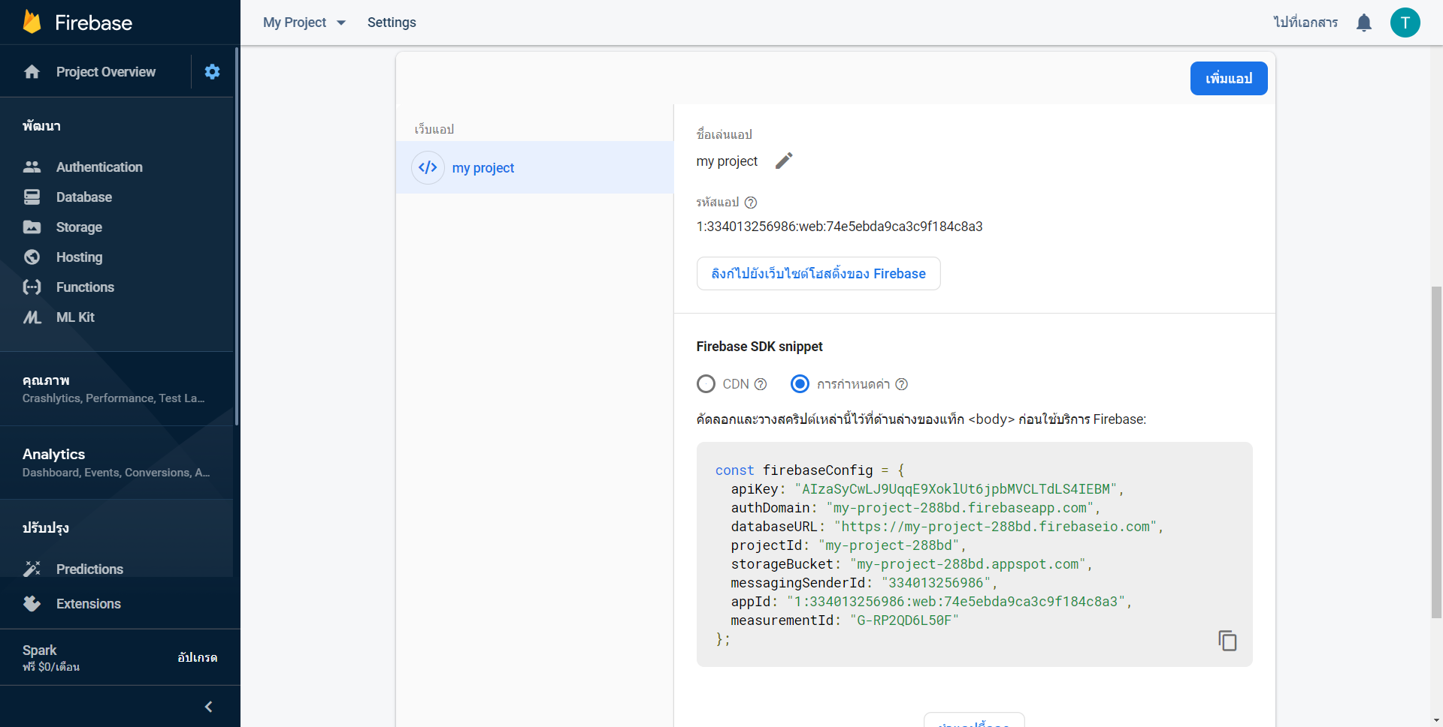
Configuration

Slide 14
Insert Data
Create Collection in Cloud Firestore
Add Configuration in Database class
Create Insert method
Call insert method from main class
Call Insert(parameters, success callback function, Fail callback function)
Main function
- Success function(ID)
- Fail function
Insert Method
(Database Class)
Do success callback function(ID) or Do fail callback function

Slide 15
Read Data(Get data once)
Get All
return Snapshot (multiple document)
Ex. db.collection('cities').get();
Get by ID
return a document
Ex. db.collection('cities').doc('SF').get();
Get by filter
return Snapshot(multiple document)
Ex. db.collection('cities').where('capital', '==', true).get()

Slide 16
Read Data
Create Read method
Call Read method from main class
Call Read(parameters, success callback function, Fail callback function)
Main function
- Success function(Snapshot)
- Fail function
Read Method
(Database Class)
Do success callback function(Snapshot) or Do fail callback function

Slide 17
Read Data(Real-time)
Create Read method
Call Read method from main class
Normal
db.collection('cities').doc('SF').get
Real-Time
db.collection('cities').doc('SF').onSnapshot
Call Read(parameters, success callback function, Fail callback function)
Main function
- Success function(Snapshot)
- Fail function
Read Method
(Database Class)
Do success callback function(Snapshot) or Do fail callback function

Slide 18
Update
Create Update method
Updata by ID
Update All
Call update method from main class
Call Read(parameters, success callback function, Fail callback function)
Main function
- Success function
- Fail function
Read Method
(Database Class)
Do success callback function or Do fail callback function

Slide 19
Delete
Create Delete method
Delete by ID
Delete All
Call Delete method from main class
Call delete(parameters, success callback function, Fail callback function)
Main function
- Success function
- Fail function
Delete Method
(Database Class)
Do success callback function or Do fail callback function

Slide 20
Homework
ให้นิสิตจับคู่
ให้นิสิตสร้างระบบแชทแบบ Real time โดยสร้าง Collection ชื่อ Message เพื่อเก็บข้อมูล
ผลลัพธ์ที่ได้จะเหมือนดังภาพตัวอย่าง

Slide 21
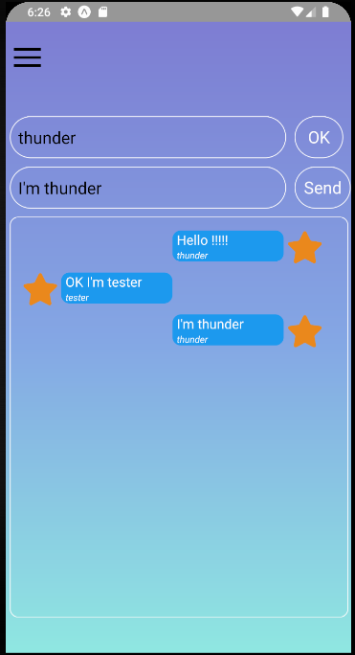
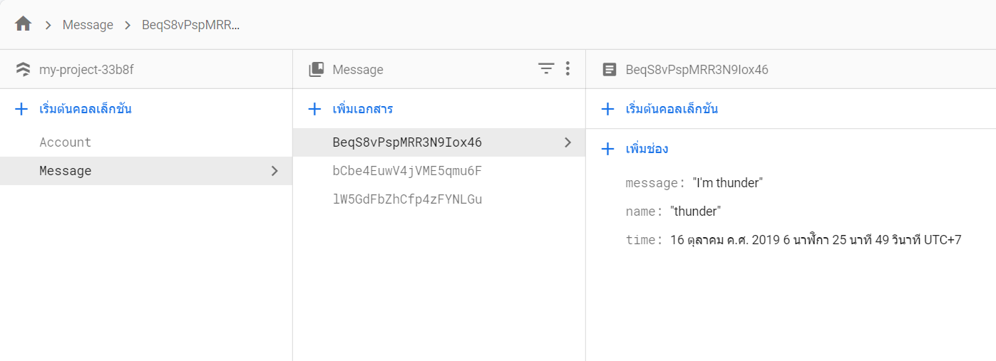
HomeWork

Slide 22
Authentication
Registration
Checking

Slide 23
Workflow
Create Aut
Success
Create Account
Success
Create Aut
(Authentication)
Create Account
(Cloud Fire store)
Create Aut
Fail
Create Account
Fail

Slide 24
Registration(Email-Password)
Create Registration method
Call Registration method from main class
Parameter
UserName(Email)
Password
Call registration(parameters, success callback function, Fail callback function)
Main function
- Success function(user,id)
- Fail function
Registration Method
(Database Class)
Do success callback function(user,id) or Do fail callback function

Slide 25
Checking(Email-Password)
Create Checking method
Call Checking method from main class
Parameter
UserName(Email)
Password
Call registration(parameters, success callback function, Fail callback function)
Main function
- Success function
- Fail function
Registration Method
(Database Class)
Do success callback function or Do fail callback function

Slide 26
Cloud Storage
Upload
Download
View

Slide 27
Cloud Storage(Upload)
Create Blob stream data
Push stream
Status
Uploading
Error
Success
Call upload(uri, success callback function, Fail callback function, uploading function)
Main function
- Success function(uri)
- Uploading function(Progress)
- Fail function(Error)
Registration Method
(Database Class)
Do success callback function(uri), Do fail callback function, uploading function(Progress)

Slide 28
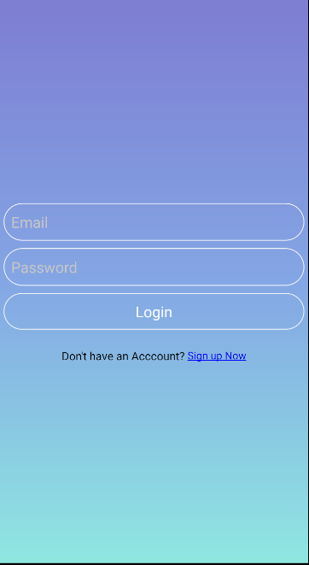
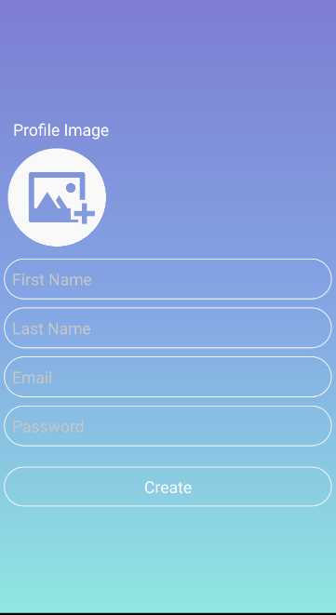
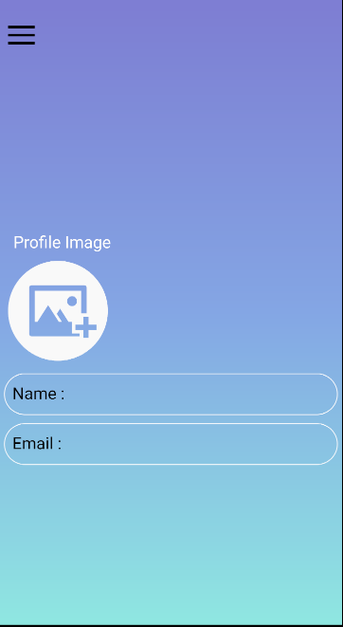
Task

