Slide 1
Sensor and Device

Slide 2
Topic
Sensors API
BarCodeScanner
Battery
Camera
DeviceMotion

Slide 3
Preparation
Github -> https://github.com/tamnuwat/sensor

Slide 4
Sensors API
Accelerometer
Barometer
Gyroscope
Magnetometer
Magnetometer Uncalibrated
Pedometer

Slide 5
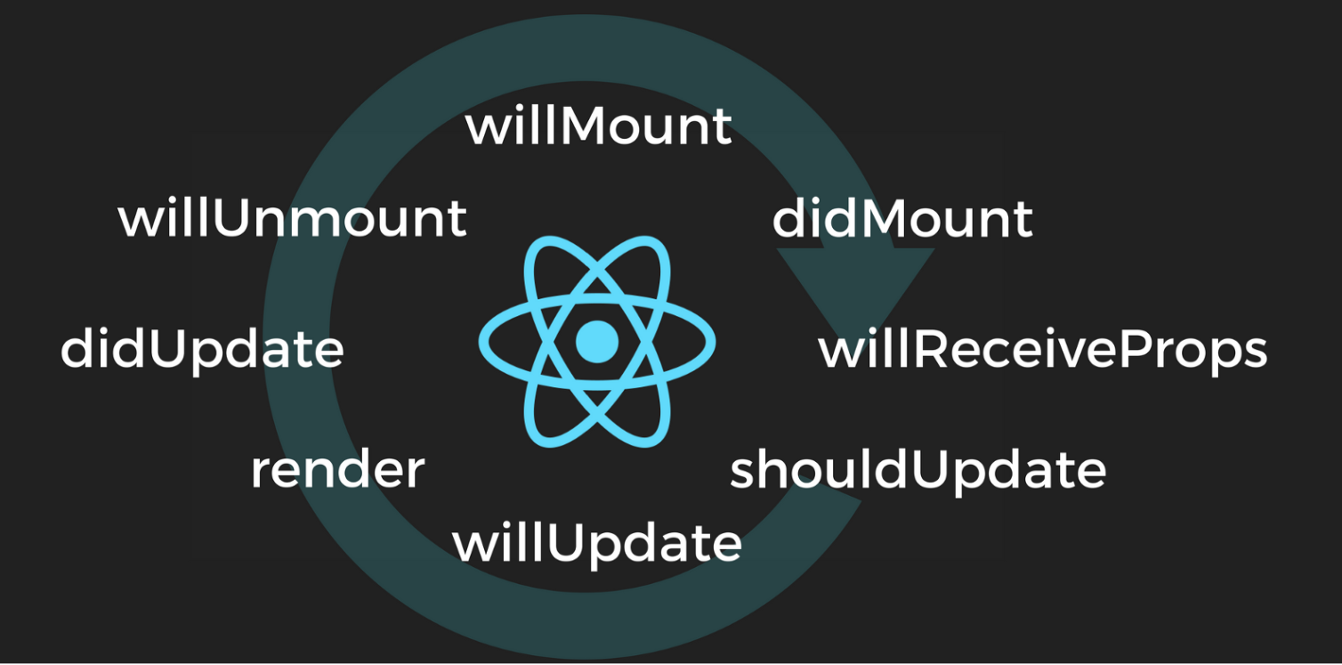
React lifecycle

Slide 6
First Time Render
Constructor
ComponentWillMount
Render
ComponentDidMount

Slide 7
Re-render prop change
Re-render State change
componentWillReceiveProps
ShouldComponentUpdate
shouldComponentUpdate
componentWillUpdate
componentViewUpdate
render
render
componentDidUpdate
componentDidUpdate

