Slide 1

Higher Educational Management System
Graduation Project
2023-2024
Egyptian E-Learning University

Slide 2
Prepared by:
Menna Walid Fadel 2000435
Walaa Ashraf Hafez 1900984
Fatma Ahmed Mohamed 2000821
Ahmed Salah Anter 2001722
Mina Magdy Helmy 2001929
Hossam Ahmed Ahmed 2002047
Ahmed Tamer Fathi 2001955
Supervised by:
Dr. Mahmoud Ashour TA. Zahraa Abdel Sattar

Slide 3
Introduction
Introducing a new Education Management System that uses technology to make learning better for students and teachers.
Our system offers clear feedback and custom tips to help everyone understand how they're doing in unversity.
We're improving learning by solving problems with the old system and making classes more interesting and helpful.

Slide 4
Motivation
The COVID-19 pandemic accelerated the shift to online education, revealing technical challenges, unequal access to resources, and significant disparities in learning environments.
The absence of in-person interactions and home distractions compromised the quality of education and student engagement, exacerbating mental health concerns.
Collaborative efforts are essential to develop a resilient and adaptive education system capable of addressing these challenges and supporting students through crises.

Slide 5
Motivation
- We're updating the Education Management System to give students a clear, detailed view of their grades on quizzes, assignments, and projects.
- Our project helps students see exactly where they're doing well and where they need to work harder.
- We're also tracking the skills students learn, giving them a better understanding of their academic progress.

Slide 6
Objectives
Our project transforms the Education Management System to give students detailed insights into their grades, not just an overall score.
It allows students to pinpoint their weak spots and strengths for each quiz, assignment, and project.
This detailed approach will help students understand their academic performance and the skills they've gained.

Slide 7
Implementation
1. Methodology
Agile Development Methodology:
- The project employed Agile methodology, promoting iterative progress, flexibility, and stakeholder feedback. This facilitated rapid responses to changes and continuous improvement.
Sprint-based Development with Collaborative Tools:
- Development occurred in two-week sprints, with specific goals and deliverables, enabling regular reassessment of project direction. Team collaboration was central, utilizing tools such as Git for version control, and daily stand-up meetings for effective communication and alignment..

Slide 8
Implementation
2. Planning and Analysis
Requirement Gathering: Initial stages involved through discussions with professor to define system requirements accurately.
3. Design
System Design: The design phase involved creating detailed architecture diagrams and adopting design patterns, notably MVVM for the Flutter-based mobile app.

Slide 9
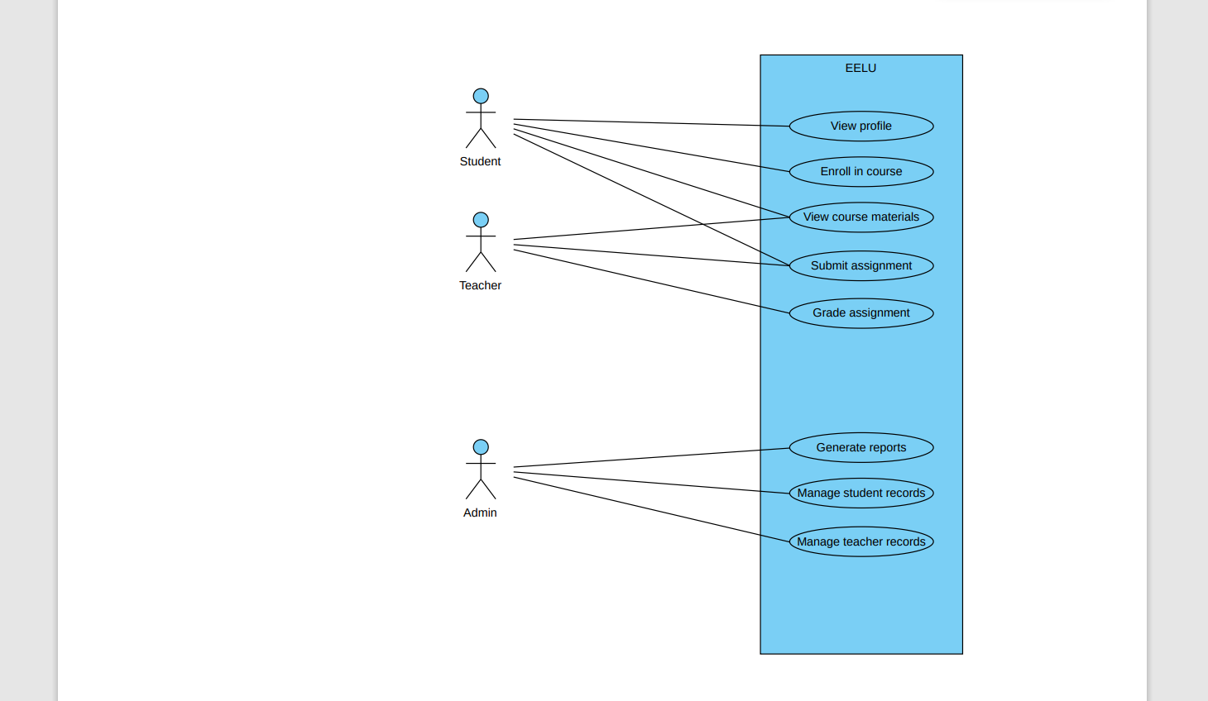
Use case Diagram

Slide 10
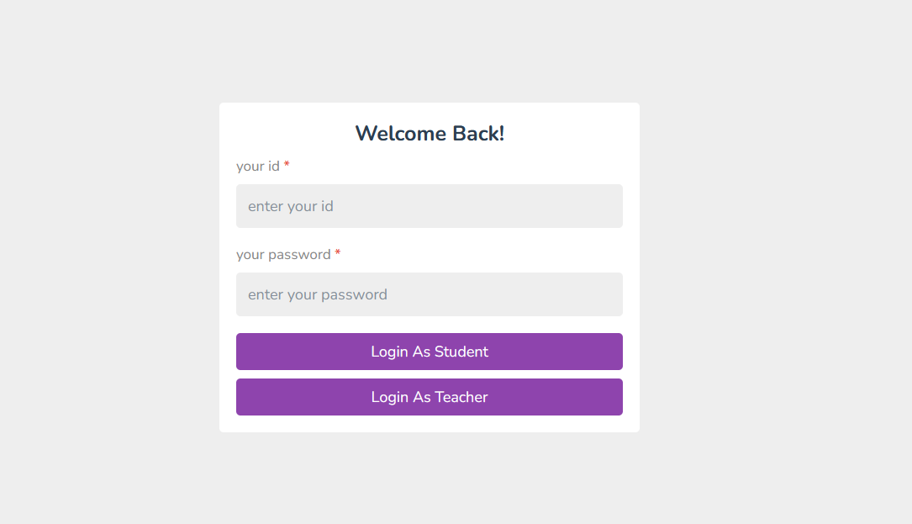
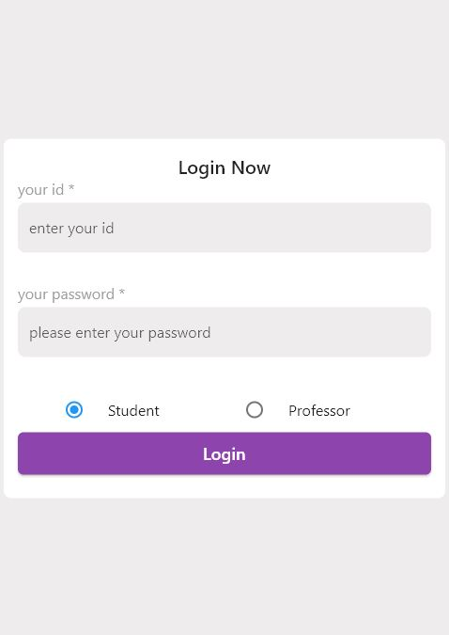
Login Page
Web Login Page
Mobile Login Page

Slide 11
Login Page Description
Key Features:
User Authentication: Securely verify user identity through a combination of unique ID and password.
Role Selection: Choose between 'Student' or 'Professor' via radio button to customize the system experience.
Accessibility: User-friendly design for a seamless and intuitive login process.

Slide 12
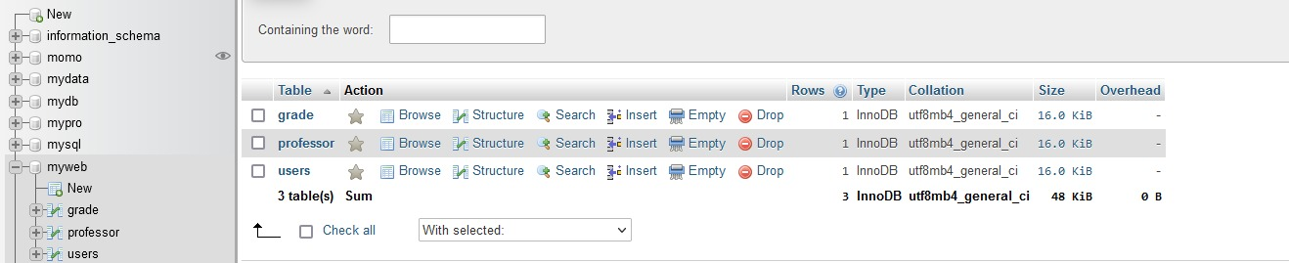
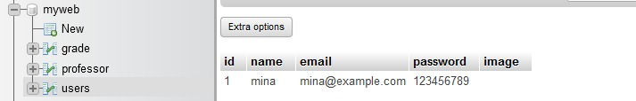
Database of the Login Page
Implemented Student Database with XAMPP :
Developed a student database using XAMPP, containing crucial details like ID, name, email, password, and images.
Ensured secure login access, enabling students to authenticate and access personalized pages tailored to individual profiles.

Slide 13
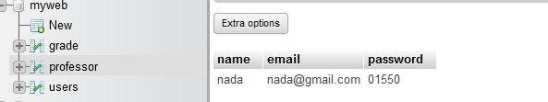
Database of the Login Page
Established Professor Database :
Established a database specifically for professors, capturing essential details like ID, email, and passwords.
Implemented robust security measures, ensuring protected access, and facilitating professors to effortlessly log in and explore personalized pages.

Slide 14
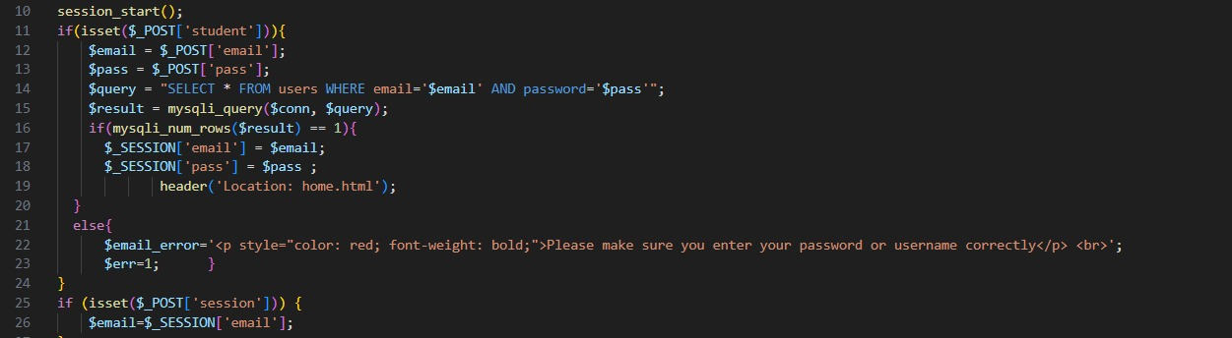
Login Page Code

Slide 15
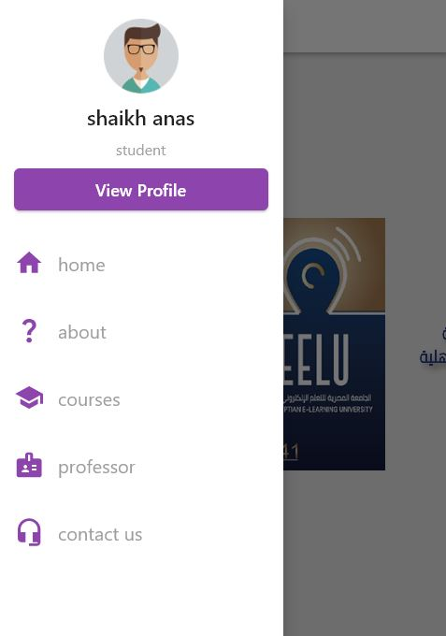
Home Page : Student UI

Slide 16
Home page description: Student UI
Key Features:
Drawer Navigation: A responsive and intuitive Drawer component allowing students to access different sections of the system effortlessly.
Page Options: The Drawer menu includes options such as 'Home', providing an overview; 'About', offering system details; 'Courses', displaying available courses; 'Professors', showcasing teaching staff; and 'Contact Us', facilitating communication.
Efficient Navigation: Students can click on any desired option in the Drawer to swiftly navigate to the chosen page.

Slide 17
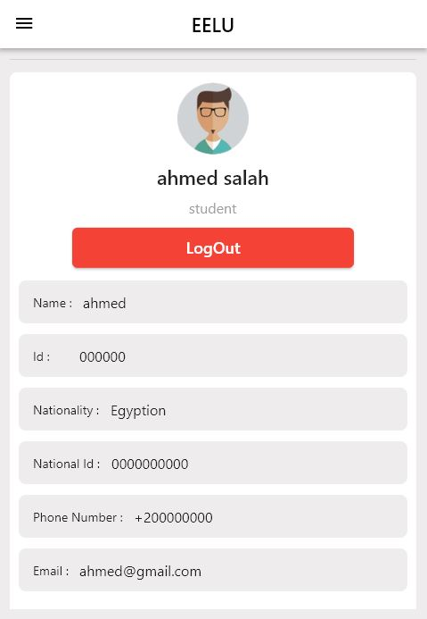
Student Profile: Student UI

Slide 18
Student profile description
Key Features:
Personal Information Display: Provides a user-friendly display of essential details, including ID, email, national ID, and phone number.
Logout Functionality: Enables users to log out seamlessly, promoting secure and convenient access control.
Clean and Intuitive Design: Organizes information in a visually appealing and easily digestible format for an enhanced user experience.
Accessibility: Ensures users can quickly access and review their personal details.

Slide 19
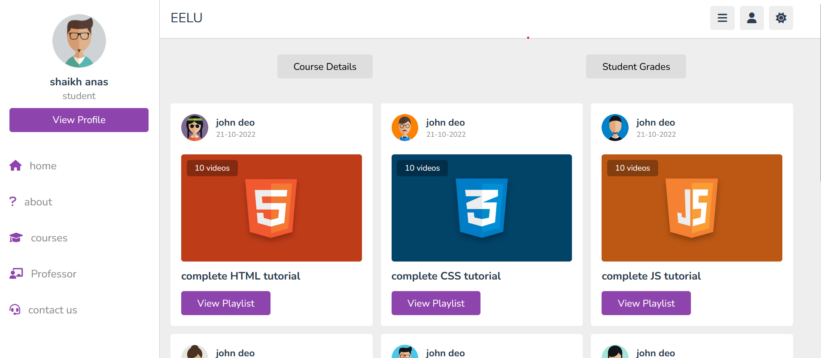
Courses Section: Student UI

Slide 20
Course page description
Key Features:
Main Course Overview: Presents a concise overview of the main courses available within the university, showcasing essential details.
"View Playlist" Button: A prominent button that allows users to navigate to a dedicated page with a comprehensive list of all courses.
Efficient Navigation: Streamlines the exploration process by providing quick access to specific course details.
User-Friendly Interface: Designed with clarity and simplicity, ensuring an intuitive experience for users

Slide 21
Courses page
-In courses page: this screen allows the doctor to add grades for the student, then transfer them to Database, and then display the grade to the student

Slide 22
- in this part the student finishes the quiz and submit it, then the doctor sees the result of the quiz in database

Slide 23
-Here we make it possible that the doctor evaluates the student’s quiz based on the student’s solution and divides it into four needs. The doctor evaluates it: Coding Validation 25% , Layout/Design 25% , Cascading Style Sheet 20% , Graphics 15% , Each of these items is divided into Excellent 20 pts, Good 15 pts, fair 10 pts, poor 1 pts, The doctor let the student knows the reason for having this grade.

Slide 24
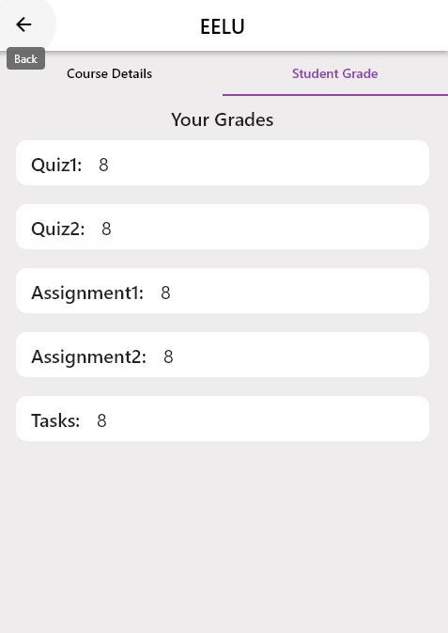
Student course Grades

Slide 25
Each Course Grade description
Key Features:
Consolidated View: Presents a consolidated and organized display of grades in quizzes, assignments, and other relevant tasks for the selected course.
Detailed Breakdown: Provides a detailed breakdown of individual assessments, allowing students to understand their performance in specific areas.
Progress Monitoring: Facilitates ongoing monitoring of academic progress, enabling students to track their achievements and identify areas for improvement.
User-Friendly Interface: Incorporates a user-friendly design within the tab bar navigation, ensuring easy access to essential academic information.

Slide 26
Course Details
The Course Detail Page provides students with in-depth information about a specific course, offering a comprehensive overview of the curriculum and assessment structure. Students can explore the topics covered in the course, as well as gain insights into the various
components such as quizzes, assignments, mid-term exams, finals, and projects. Additionally, the page outlines the percentage distribution of each component, allowing students to understand the weightage of assessments within the course. This detailed presentation empowers students to make informed decisions and approach their studies strategically.

Slide 27
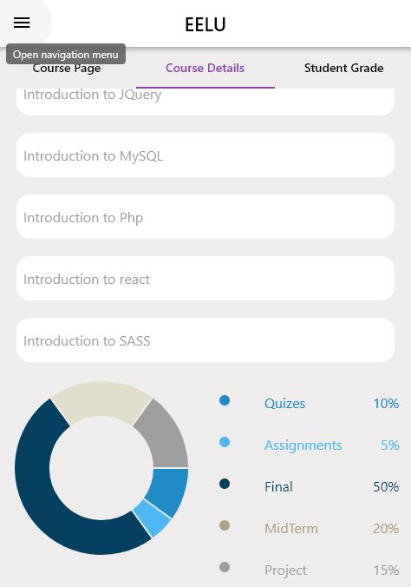
Course Details: Student UI

Slide 28
Course Details Description
Key Features:
Curriculum Overview: Delivers a detailed breakdown of the topics and subjects covered in the course.
Assessment Components: Specifies the different assessment components, including quizzes, assignments, mid-term exams, finals, and projects.
Percentage Distribution: Outlines the percentage weightage of each assessment component, aiding students in understanding the contribution of each to the overall grade.
Clear Presentation: Presents information in a clear and organized manner, enhancing readability and comprehension.

Slide 29
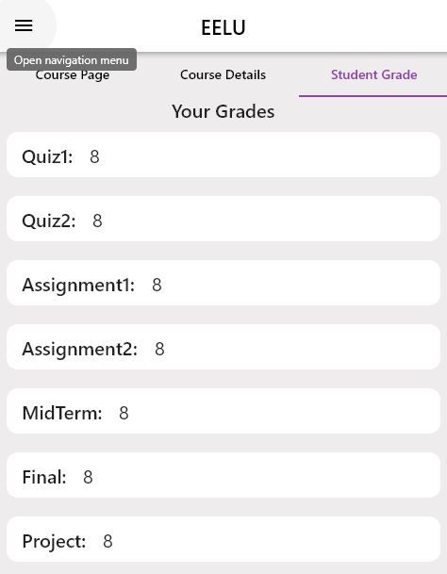
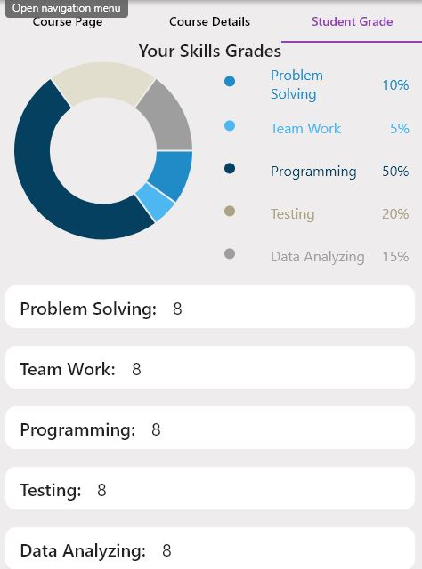
Student Grade : mobile

Slide 30
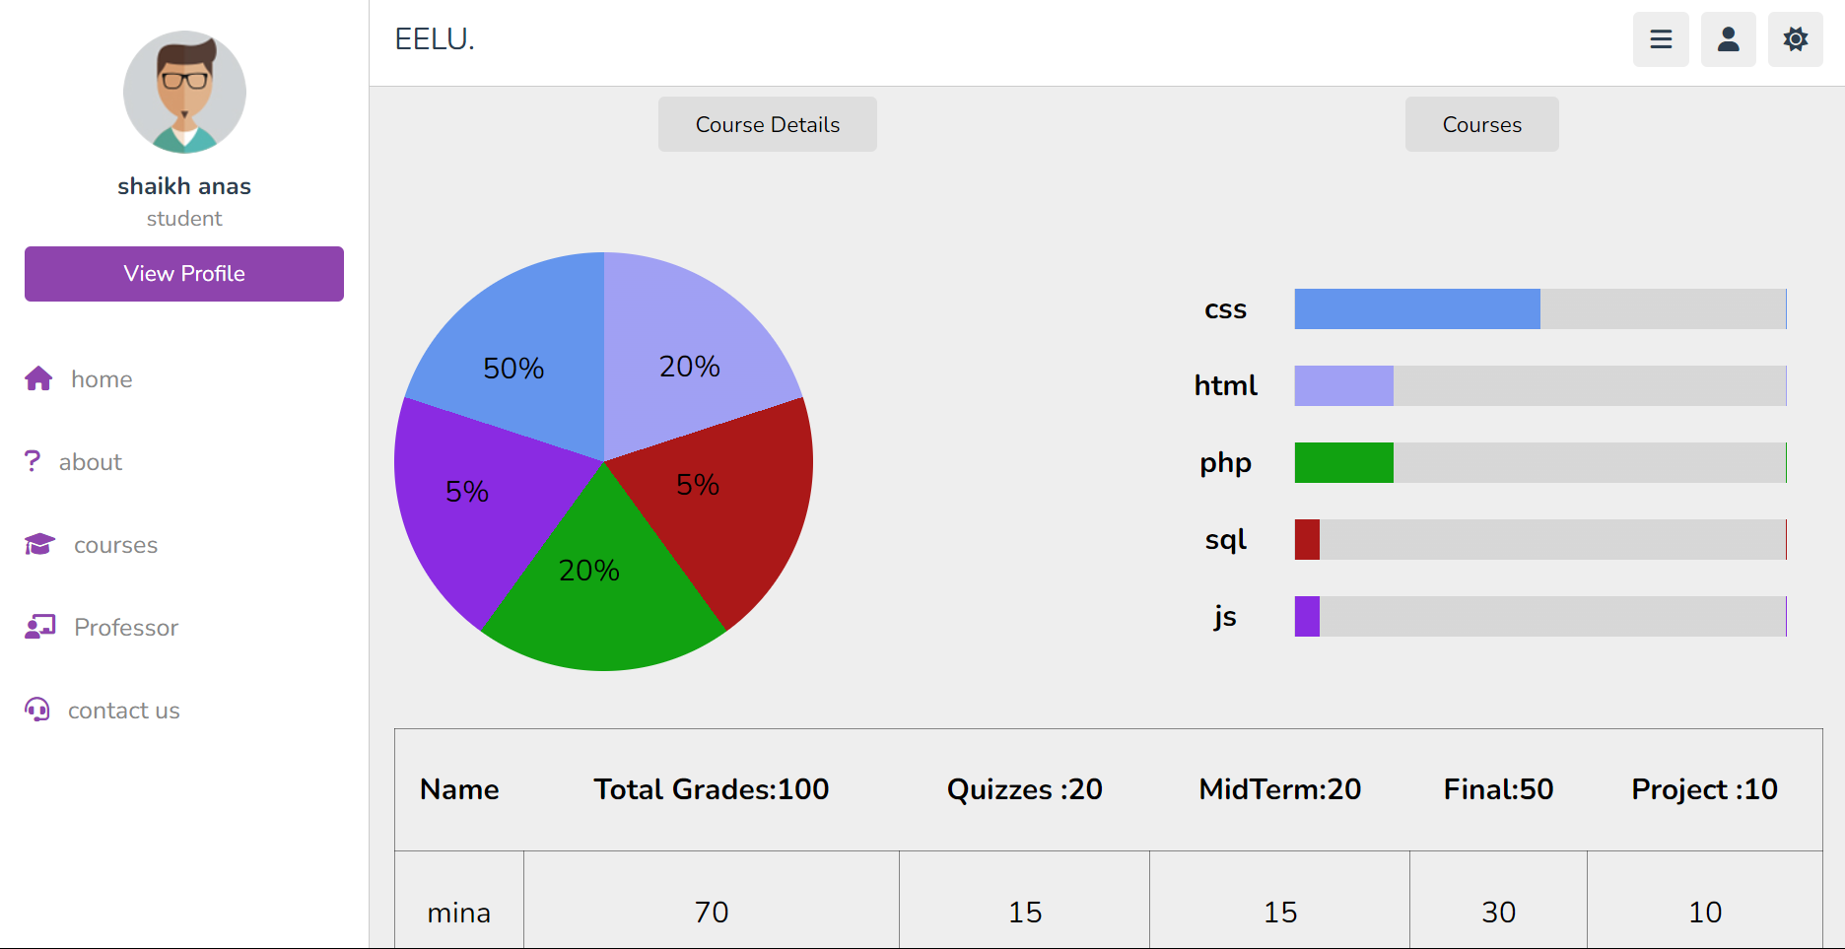
Student Grades Page: web

Slide 31
Chart code

Slide 32
Student Grade Description
Key Features:
Grade Display: Presents a breakdown of grades in quizzes, assignments, finals, mid-term exams, and projects, giving students a clear understanding of their academic performance.
Skills Assessment: Introduces a new feature that evaluates skills in programming, testing, teamwork, data analyzing, and problem-solving.
Visual Feedback: Utilizes visual elements such as charts or graphs to present grades and skills in an easily digestible format.
Actionable Insights: Identifies areas for improvement in skills, empowering students to focus on specific areas for growth.

Slide 33
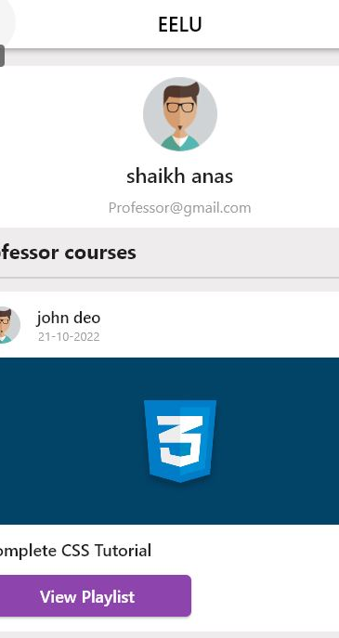
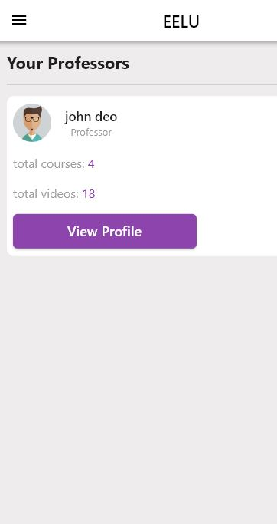
Professor Page: Student UI

Slide 34
Student Grades:

Slide 35
Professor Page
Key Features:
Professor Directory: Presents a directory of all professors affiliated with the institution.
Individual Profiles: Allows students to click on each professor to view detailed profiles, providing information about academic background, expertise, and contact details.
Course Listings: Displays a list of courses associated with each professor, facilitating course selection and enrollment.
User-Friendly Navigation: Incorporates an intuitive interface, enabling students to easily explore and access information about professors and their courses

Slide 36
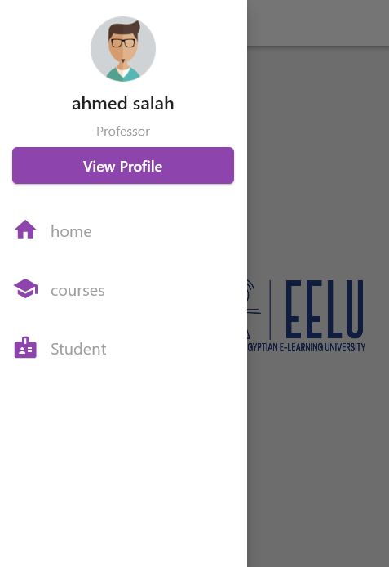
Home Page: Professor UI

Slide 37
Home page description
Key Features:
Navigation Drawer: Features a drawer accessible from the home page, offering quick links to essential sections of the application.
Home Section: Allows professors to return to the home page for a centralized view of information.
Courses Section: Navigates professors to a dedicated page for managing and overseeing their courses.
Students Section: Provides access to information about enrolled students, facilitating communication and academic management.
Profile Section: Allows professors to view and update their personal profiles, ensuring accurate and up-to-date information.

Slide 38
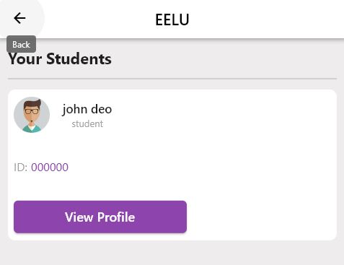
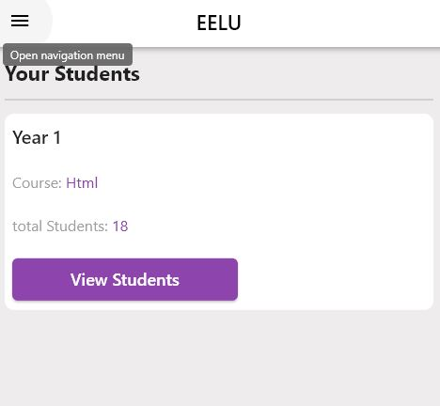
Students Page: Professor UI

Slide 39
Students page description
Key Features:
Class Listing: Displays a list of classes taught by the professor, providing an organized view of course assignments.
Student Categorization: Categorizes students within each class based on their academic year, facilitating targeted communication.
Detailed Student Information: Allows professors to click on specific academic years to view detailed information about all students within that year.
User-Friendly Interface: Offers an intuitive interface for seamless navigation and efficient student management.

Slide 40
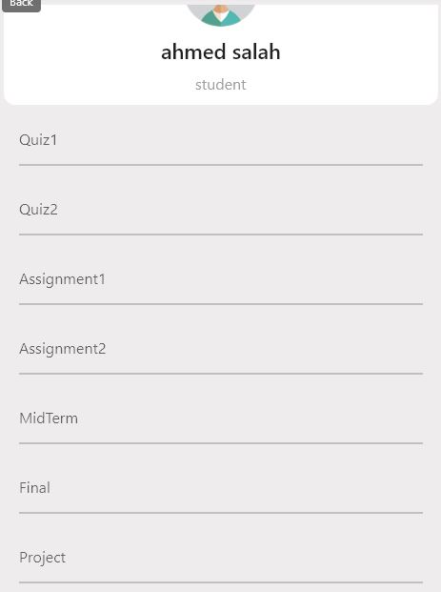
Student Grades: Professor UI

Slide 41
Professor Grading Students
Key Features:
Grade Entry: Enables professors to input and update grades for quizzes, assignments, finals, midterms, and projects.
Student-Specific Grades: Allows professors to assign grades individually for each student in the class.
Transparent Feedback: Fosters transparency by providing students with access to their grades for self-assessment.
User-Friendly Interface: Offers an intuitive interface for efficient grade management and communication.

Slide 42

What is next??

Slide 43
In closing, we thank everyone for their support and belief in our project. We are excited to continue enhancing this Education Management System, aiming to revolutionize the educational landscape for teachers and students alike.

