Slide 1
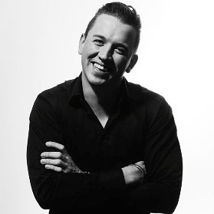
Impactful experimentation
is a leadership challenge
Olli-Pekka Saksa
Business director, consultant, odd-job man
Tampere Goes Agile 5.11.2016
Notes:
O-P, Business director, consultant, odd-job man
Futurice - European digital agency, two-time gptw Europe winner, 300+ consultants, designers, developers

Slide 2
Experiment-driven
(business, organisation, product) development
Notes:
This is my point of view in the presentation
Starting with what and why, going to current issues and leadership & culture considerations

Slide 3
“An experiment is a procedure carried out to support, refute, or validate a hypothesis”
-WIKIPEDIA
Notes:
Just to agree on definition, what I mean by experimentation
From hypothesis to fact by real-world testing rather than intuitive opinion
We have probably read our lean startups and running leans & the lot - that type of environment

Slide 4
In case someone hasn’t yet seen this :)
“The average lifespan of a company on the S&P 500 has decreased from 90 years in 1935 to 18 years today.
75% of S&P 500 will be replaced by 2027”
-INNOSIGHT 2012
Notes:
Maybe one of the most quoted arguments for “new rules” and “creative destruction” - “create, operate and trade”
1) running operations effectively
2) creating new businesses which meet customer needs, and
3) shedding business that once might have been core but now no longer meet company standards for growth and return

Slide 5
Experiments
Disrupt / transform
Build new
Maintain & improve
Notes:
Not all change and renewal is tackled by “experimentation”, different horizons
Part of maintain & improve is driven by already-known facts / legislation, part needs experimentation to accommodate for changing world
Experimentation is often key & core for building new
Part of disruption / transforming can be experiment-driven, part requires a VC-type of operation mode / acquire / invest for already proven & working models or larger-scale disruption

Slide 6
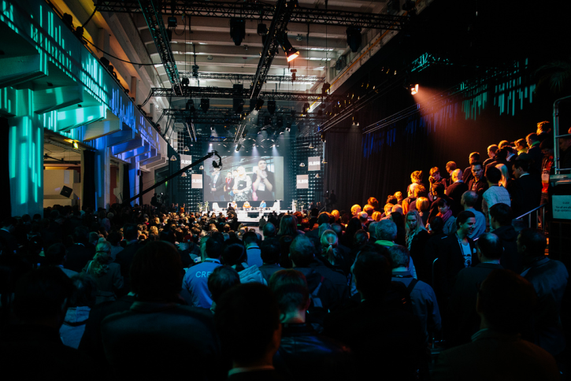
Notes:
Complex world, uncertainty is given, speed is required > new approaches needed
At Futurice we work a lot with how to get a bit more startup skillset to established companies (but not “make big companies like startups”, that doesn’t make sense, big companies have their own advantages: scale, customer access, war chest, marketing people & salesforce…)

Slide 7
Who agrees?
Experiments and validated learning are
must-have concepts.
Enterprises today
experiment enough.
Notes:
How many of you believe the following?
We are believers - for a real, impactful change, non-believers should become believers, different thinking between two camps

Slide 8
What’s the problem then?
Notes:
Ok, we’ve gone the what and why - now the key point, what’s the problem then?

Slide 9
Unreliable prediction of customers & ROI
Notes:
-product is open: what to sell, what’s the cost
-market is open: who to sell, how much they pay
-what’s the payback

Slide 10
Unreliable prediction of customers & ROI
Small new things might risk old big things
Notes:
-e.g. brand impact, cannibalisation risk, or simply how to get focus for 100k annual revenues vs. 100M annual revenues
-sometimes mitigated with separate brands, “labs”, accelerators

Slide 11
Unreliable prediction of customers & ROI
Small new things might risk old big things
Too many people have an opinion
Notes:
-steering groups & leadership teams messing up focus & bogging speed down with must-have comments to irrelevant stuff, “I want this feature to work like this”, “I need this titlebar to be higher with another version of the logo”, “My wife think this looks ugly”
-opinions are like a-holes - everyone’s got one (according to folklore a CEO of one relatively large global company in Tre loved this quote)

Slide 12
Unreliable prediction of customers & ROI
Small new things might risk old big things
Too many people have an opinion
Inertia, lack of focus
Notes:
Budgeting cycles, consulting various siloed departments in an organisations, especially doing things in addition to other duties
Large enterprises have money but no time, it’s like a traffic jam full of porsches - potentially fast, but slowed down because of all the stuff around you

Slide 13
Unreliable prediction of customers & ROI
Small new things might risk old big things
Too many people have an opinion
Inertia, lack of focus
Process & legal considerations
Notes:
- Aligning with IT, with brand & marketing comms, especially with legal -> take it to the lawyers and after 6 months you get a NO in the form of a 10 page document :)

Slide 14
Unreliable prediction of customers & ROI
Small new things might risk old big things
Too many people have an opinion
Inertia, lack of focus
Process & legal considerations
Unreliability is stressful
Notes:
-Organisations consist of humans, for many, unreliability is simply stressful and you have easier and more predictable ways of earning your salary

Slide 15
Unreliable prediction of customers & ROI
Small new things might risk old big things
Too many people have an opinion
Inertia, lack of focus
Process & legal considerations
Unreliability is stressful
Predictability and incrementalism is valued
Notes:
-In general leadership & KPIs value predictability & incrementalism disproportionately to risk-taking - people are paid for results, 0xresult = you get fired, 10xresult = you might get promoted and 20% pay bump, not 10x pay

Slide 16
Notes:
In my experience, in large, established enterprises, outside of top management, it often takes courageous mavericks to take risky new things forward - guys and gals who rather ask for forgiveness than permission

Slide 17
Process change is not enough
Impact comes with Leadership & Culture change
Notes:
Ok, we’ve gone the what, the why, some of the challenges - now to leadership & culture part with suggestions plus tales from the corporate corridors

Slide 18
Changing approach to experimentation, learning, failure
Getting out of culture of fear
Notes:
Start to value learning in early stage initiatives instead of monetary returns
Fail fast is overused term, but it’s still quite hard in practice especially with conflicting performance metrics. If I get 1M investment for a new business and fail with 100k, did I waste 100k or save 900k?
Will you get rewarded or punished for that?

Slide 19
“If we succeed, we will have many new friends. If we fail, there will be explaining to do”
-ANONYMOUS CLIENT

Slide 20
Courage to start
Courage to kill
Courage to go BIG
Notes:
-starting now means starting to learn now, you don’t need all the answers, but you need to start learning
-killing is a lot harder than starting. Sometimes there are valid reasons for this (e.g. customers are dependant on it) but often it’s simply “let’s try a bit more still”. Good example: rocket internet
-world is full of *everything*, more often than not it’s not enough to be good enough, courage to go BIG

Slide 21
Chasm
Chasm
Product
start
Experimenting
Concepting
Idea
Notes:
Organisations are typically full of ideas, ideas as such are cheap if they never make it to reality
First chasm - e.g. in one customer organisation they had been playing with an idea for two years (!) - what it took to proceed was a new person from the outside & new vendor with systematic process for experiment-driven business & concept development (form the outside), i.e. fresh blood
another chasm - typical problem is ownership and investment - how to quickly & smoothly build the new product organisation and get investment for the validated concept - this happens a lot even if enterprises have started to systematically develop “experiment culture” forward. Often needs the risk-takers & mavericks

Slide 22
“I fought so long against windmills that I nearly gave up on the whole thing”
-ANONYMOUS CLIENT
Notes:
Second chasm

Slide 23
“We tried an experiment-driven approach, but it was put on hold because of our organisation. Can you help us with cultural change?”
-ANONYMOUS CLIENT
Notes:
Second chasm

Slide 24
From prediction and vanity calculations to validation and learning - we don’t have the answers yet but we will have them

Slide 25
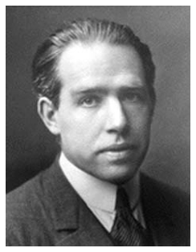
“Prediction is very difficult, especially if it's about the future.”
-NIELS BOHR
Notes:
Scientists have known this stuff :)

Slide 26
“We got the features we wanted but not what we needed. Basic IT model - surgery was successful but the patient died”
-ANONYMOUS CLIENT

Slide 27
Continuous renewal by experimentation
Staying open & hungry
Notes:
When times are good, no sense of urgency for renewal
When times are bad, no resources or attention for real renewal (often optimisation)

Slide 28
“Nothing can save a successful business”
-ANONYMOUS CLIENT

Slide 29
If failure is not an option,
neither is real success
Notes:
Relates to going BIG

Slide 30
“For us, it’s clear that releasing hit [video] games means having to take risks. And by definition, taking risks means that you’ll fail more often than you’ll succeed”
-SUPERCELL

Slide 31
Ownership, autonomy

Slide 32
“Personally I am proud to work at a company so crazy that you can get into a shouting match with the CEO about taking 50 people to Spain on company money, and not get fired but get told go ahead but to deal with the shit storm"
-ANONYMOUS FUTURICE EMPLOYEE
Notes:
Example from own organisation - culture and experiments: case Las Palmas

Slide 33
Enabling and amplifying change
Notes:
What I believe we do right @ Futurice

Slide 34
Tinkerers, day dreamers, non-conformists
Builders, innovators, change agents
Notes:
Culture, values always give the context for evaluating what is good and what is not
In one organisation person can be seen as
We’d like to see them as

Slide 35
Thank you!
olli-pekka.saksa@futurice.com
https://www.linkedin.com/in/saksa
@opsaksa
Notes:
That's all.
Thank you!

