Slide 1

Experimenting with Agile 1975 - 2016
Tampere Goes Agile 2016
Notes:
Hei
Nykypäivän johtajilta vaaditaan kykyä jatkuvasti sopeutua markkinavoimien luomiin uusiin haasteisiin.
Scrum Allianssin tuoreen raportin mukaan yrityskulttuuri on ketterän maailman kuningas.
Menestyäkseen organisaatioiden on luotava kulttuuri, joka rohkaisee yhteistyöhön ja itseohjautuvuuteen asiakaslisäarvon tuottamiseksi.
Tule kuulemaan, mitä uutta johtamisrintamalla on tapahtumassa.
Ilmoittaudu heti. Webinaari keskiviikkona 6.11 kello 9.00 - 9.45 tai keskiviikkona 6.11 kello 13.00 - 13.45.
Lisätietoa osallistumisesta Lync-webinaariin.
Intoa puhkuen
Pentti

Slide 2
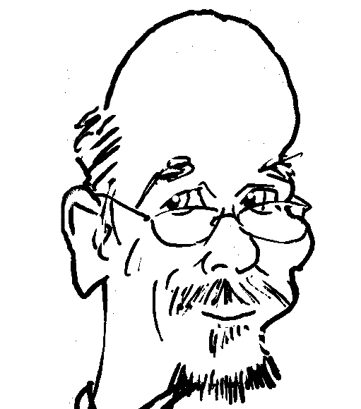

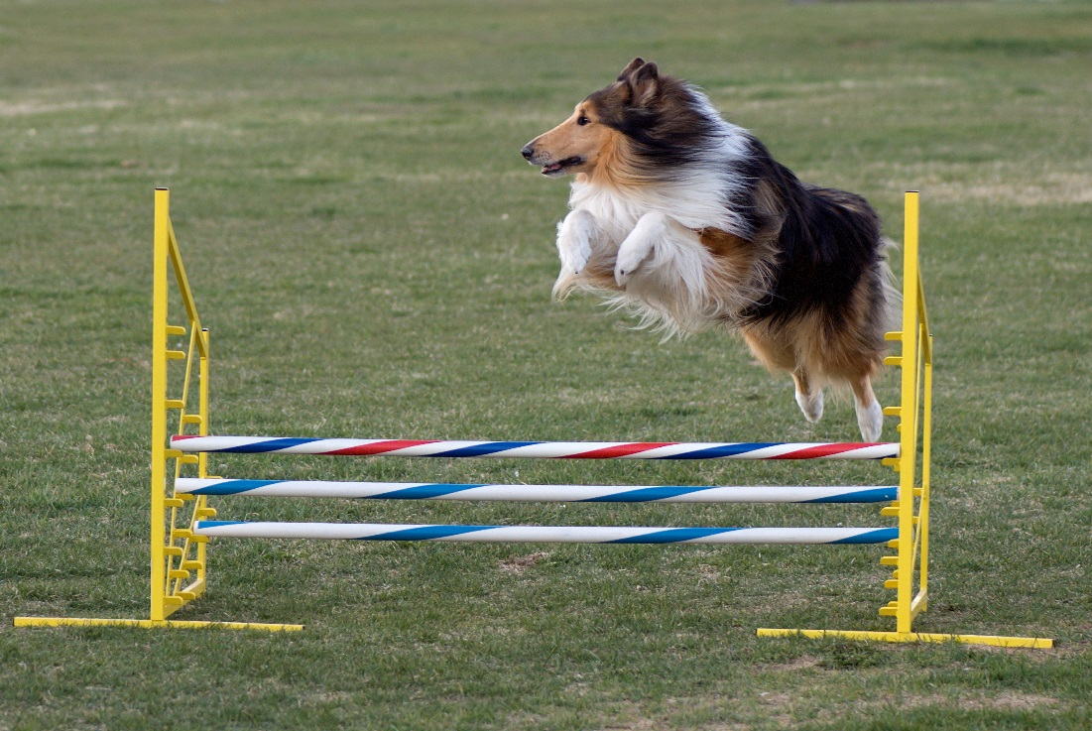
Pentti, Tieturi and agenda
Agile training house with long traditions
Management Institute of Finland, MIF
Tieturi, JTO, Infor, FINTRA
Soprano Oyj
Agenda
Ph.D.
IT-pro over 30 years
VTKK, Tietotehdas
Stonesoft,Tieturi
Certified Scrum Trainer
youtube: Pentti Virtanen
Google: lean developer

Slide 3
Myth of Agile Transformation
Deep waterfall
Real agile
Theory not fully followed
Situational Leadership and others
Team members close to each other
Onsite customer
Teams not tightly functional
Prototypes, piloting
User centric software development
Active change management
Surveys: Theory not fully followed
Just marketing
Only part of the organization is agile
Hierarchical organizations
Project managers and steering groups
Fixed price, fixed content
Technical practices slip a lot

Slide 4
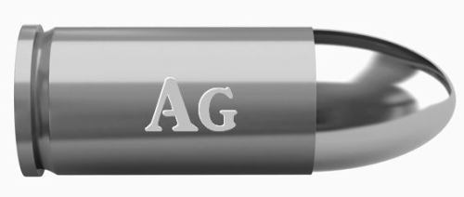
1975 Brooks and Mythical Man Month
Essential complexity is caused by the problem to be solved, and nothing can remove it;
Brooks argues that "there is no single development, in either technology or management technique, which by itself promises even one order of magnitude [tenfold] improvement within a decade in productivity, in reliability, in simplicity.“
From idea to deployment still slow
Punch cards:
code-compile-test cycle one day
Online compiler: cycle few minutes
XP: unit tests under a second

Slide 5
Leadership
Manager behaving like a Scrum Master in 80s
Situational Leadership
Team building strong in 90s
Hiring programmers difficult
Taylorism: Specialized roles
Outsourcing
Bonuses and options came at Y2K
Pair programming in early 80s
Team rooms in 80s and 90s
Working with customers
Coach
Customer
Team

Slide 6
Scrum practices without Scrum
Daily Scrums
1981: 8:45 at coffee room
Death march project at the end of 80s
Building a house 1989
Review meetings (80s and 90s)
Not just paper but deliveries
Paper based quality not very successful
Project and steering groups and changes
Was it sprint planning or following a plan?
What makes continuous improvement so hard?

Slide 7

Deliveries
Monthly delivery in a “waterfall”
Transparency
Changes earlier
Acceptance test driven development in 1995
Error-free code
Test automation was technically challenging
Quality was low: QA practices emerged first
Testing the UI
Maintaining the tests
Extreme Programming as an enabler of Scrum
DevOps

Slide 8
Genuine Agile
Scrum 1995, Manifesto 2001
Certified Scrum Master as key innovation
20 000 CSMs in Finland
Scrum Alliance has nearly 500 000 members
Adoption seen difficult, fallbacks
Coordination chaos with multiple teams
Utilization rate dominates
Why?
What has changed the world of work in last 40 years?
World of supply to world of demand
Financial sector dominates

Slide 9

Conclusions
Change is more gradual than what theory tells
Global drivers in the world of work
Poverty disappearing – prosperous mankind
Meaning of work for the people is changing
New threats & surprises
More software – scarcity of programmers may continue

